Slide 1




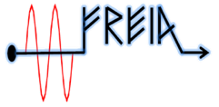

Status of In-Kind work and deliveries
Christine Darve
Deputy WP leader of external WP04 and WP05
Technical Advisory Committee, TAC#19
10-12 April 2019

Slide 2
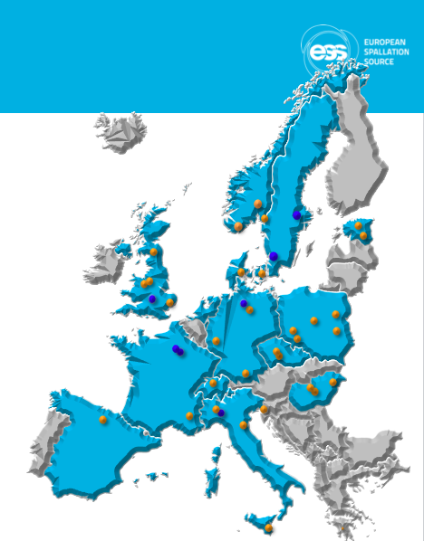
Outline
A Collaborative Project for cavities and cryomodules
Spoke Status
Elliptical Status

Slide 3
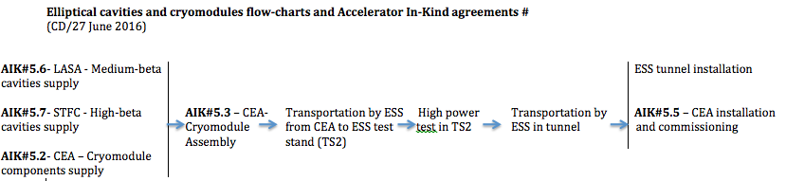
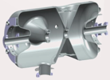





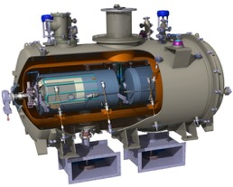
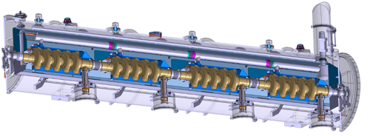


Superconducting Linac – A Collaborative Project
WP03
WP04
WP05
M-β
WP05
H-β
NC FE
Elliptical
Series
Spoke
Prototypes
 | Spoke | Medium-β | High-β
# Cavities | 26 | 36 | 84
In-Kind production | IPNO | LASA | STFC
# Cryomodules | 13 | 9 | 21
Components & Assembling | IPNO | CEA | CEA
Cryomodule Tests | UU | ESS | ESS
3x
6x
5x
1x
2x
352.21 MHz
704.42 MHz
2.4 m
4.6 m
3.8 m
39 m
56 m
77 m
179 m
Target
Source
LEBT
RFQ
MEBT
DTL
Spokes
Medium β
High β
HEBT & Contingency
75 keV
3.6 MeV
90 MeV
216 MeV
571 MeV
2000 MeV

Slide 4
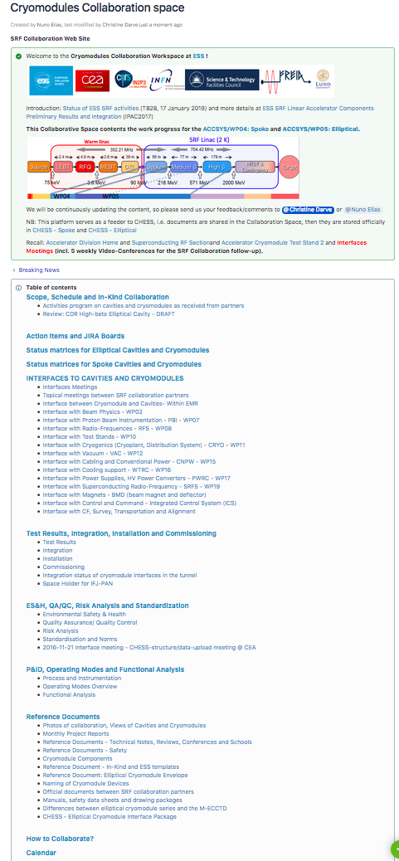
SC Linac – A Collaborative Project
Cryomodule Collaboration Space
https://confluence.esss.lu.se/display/CRYOM
➔ Monthly reports by In-Kind partners
➔ Weekly video-conferences:
  Interface Uppsala – Mondays
  Interface CEA/Saclay – Tuesdays
  Interface IPNO and UU – Wednesdays (bi)
  Interface SRF Collaboration (CEA/LASA/STFC) – Fridays
  Overall Planning – All - Fridays (bi)
➔ Every 3-5 months: SRF Collaboration Meetings
Daily activities coordination with In-Kind partners and ESS other Work Packages
Collaborative progress tracked via Milestones, Project Reviews
Notes:
Daily phone calls

Slide 5

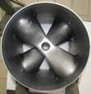
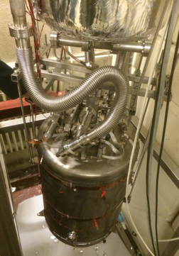
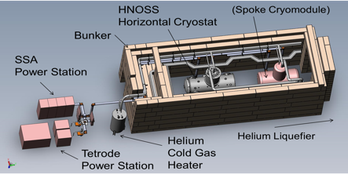
Prototype: Double-Spoke cavities
Step 1: Spoke cavity
@ IPNO
@ UU - HNOSS
Double spoke cavity, 352.2 MHz, β=0.50
Goal: Eacc = 9 MV/m [Bp= 62 mT; Ep = 39 MV/m]
Lorentz detuning coeff.: ~-5.5Hz/(MV/m)²
Tuning sensitivity Δf/Δz = 130 kHz/mm

Slide 6
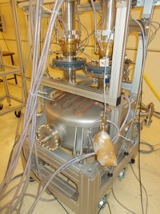
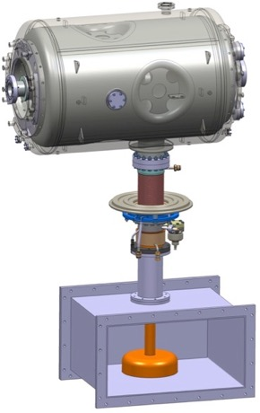
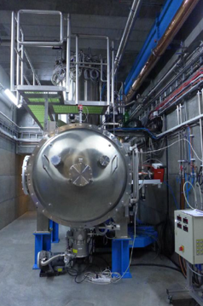
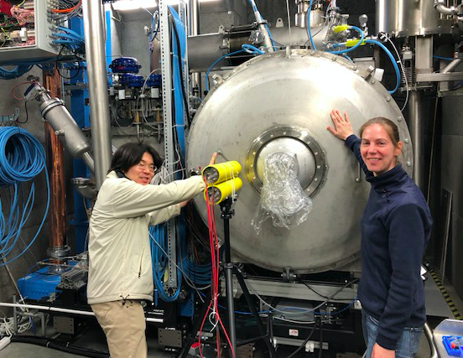
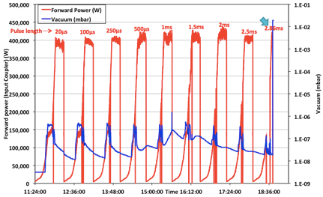
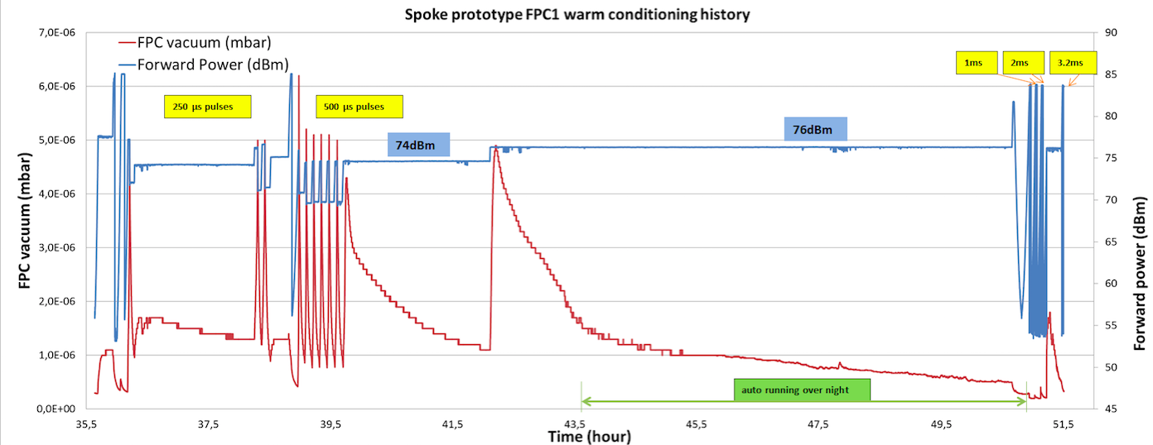
Prototype: Spoke Cryomodule
Step 2: Spoke cavity packages
@ IPNO
@ UU - HNOSS
RF conditioning of power- coupler
Step 3: Cryomodule at high power
@ UU - FREIA
Courtesy: Guillaume Olry
See talk by Roger Ruber
Courtesy: Han Li

Slide 7
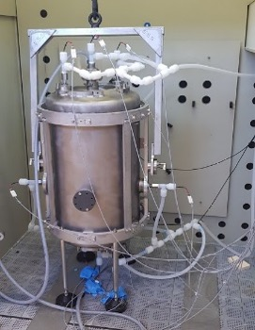
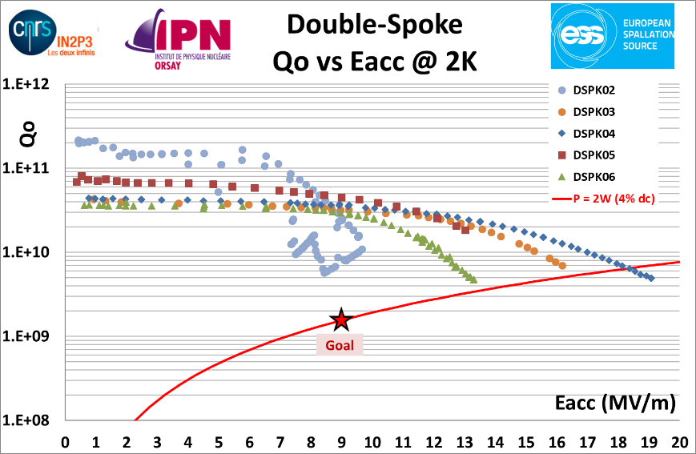
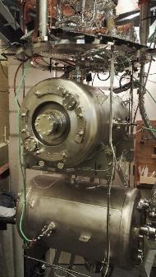
Series: Double-Spoke cavities and cryomodules
Cavities Matrix readiness
Status on April 4
Notes:
@IPNO
10 cavities delivered
1 validated
3 with good RF performances but out of frequency
1 with strong field emission
2 are ready for testing in th vertical cryostat
@ZANON
Delivery rate of 2 cav / month
2 cavities (DSPK10 & 16) will be delivered tomorrow morning.

Slide 8

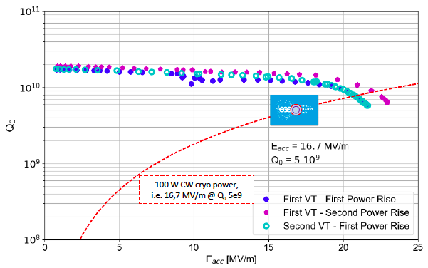
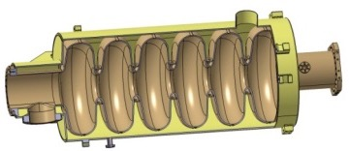
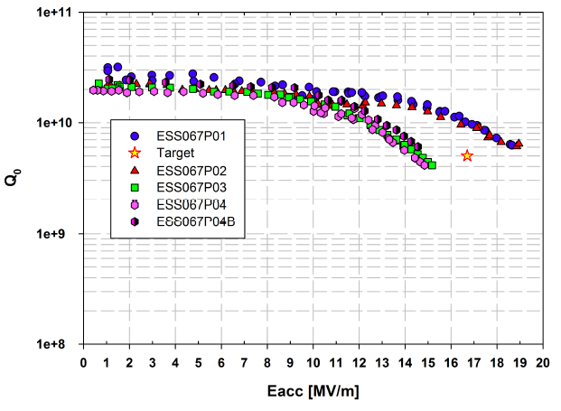
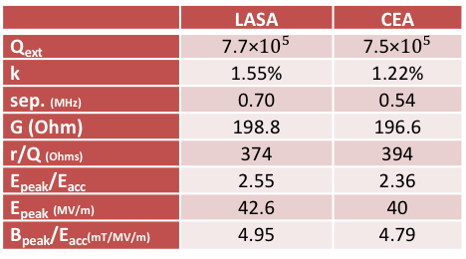
Prototype: Medium-β cavities
Step 1: Elliptical cavities
Medium-beta
@ Saclay
@ LASA
Vertical test of Mb prototype cavity with tank (CW, 2K)
 | LASA | CEA
Q_{ext} | 7.7×${10}^{5}$ | 7.5×${10}^{5}$
k | 1.55% | 1.22%
sep. (MHz) | 0.70 | 0.54
G (Ohm) | 198.8 | 196.6
r/Q (Ohms) | 374 | 394
E_{peak}/E_{acc} | 2.55 | 2.36
E_{peak} (MV/m) | 42.6 | 40
B_{peak}/E_{acc}(mT/MV/m) | 4.95 | 4.79
Cavity | Rs (nΩ) | Q0 at 1MV/m@2K
MP01 | 3.14 | 3.2x10¹⁰
MP02 | 6.09 | 2.2x10¹⁰
MP03 | 6.06 | 2.1x10¹⁰
MP04 | 7.09 | 1.9x10¹⁰
MP04 (b) | 4.85 | 2.5x10¹⁰
Notes:
Qo exceeding results
Integrate the industrialisation study, thanks to LASA and EZ process.

Slide 9
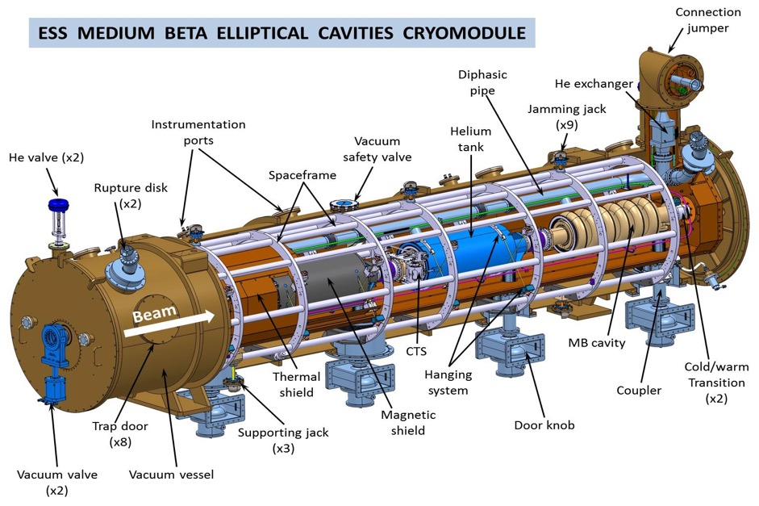
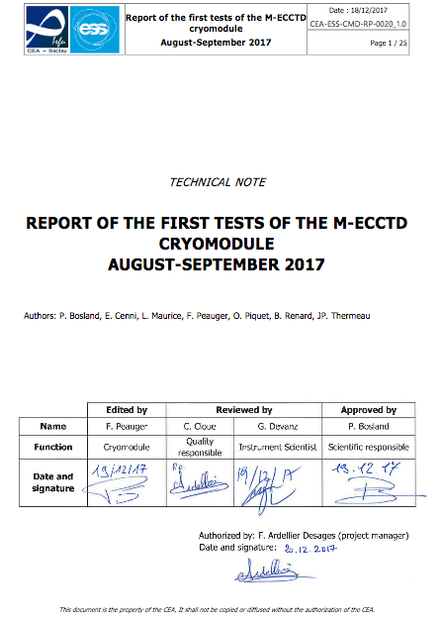
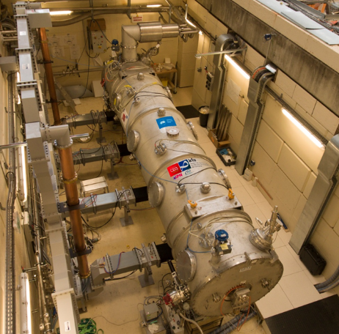
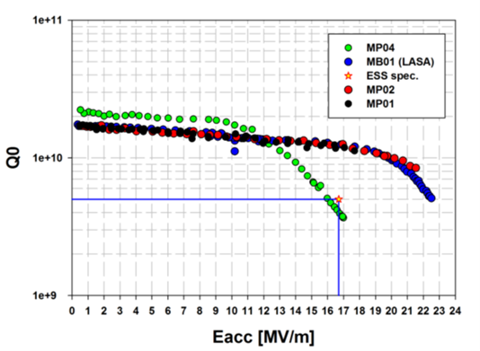
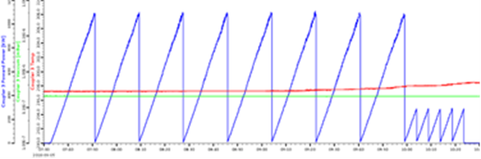
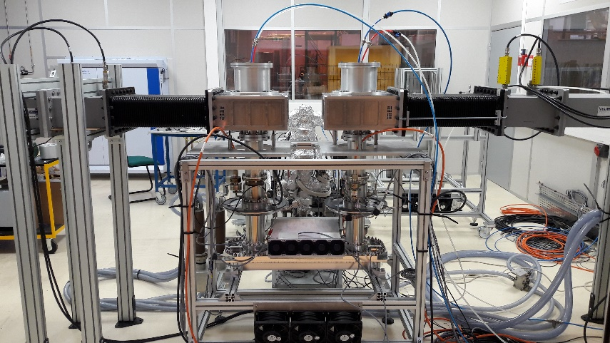
Prototype: Elliptical cryomodules
Step 2: Cryomodule M-ECCTD
M-ECCTD = 3 CEA cavities + 1 LASA cavity
@ Saclay
See Cecilia and other TS2 talks
@ Lund – TS2
4 power couplers conditioned at high power before assembly (P_{max} = 1,2MW transmitted and reflected power)

Slide 10
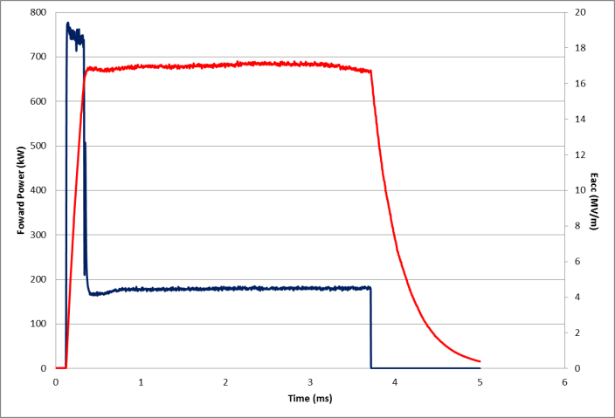
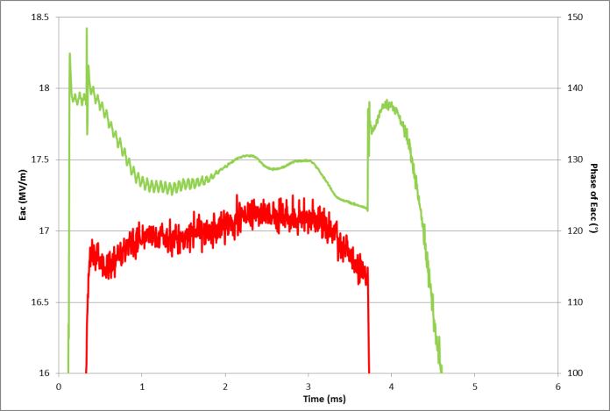
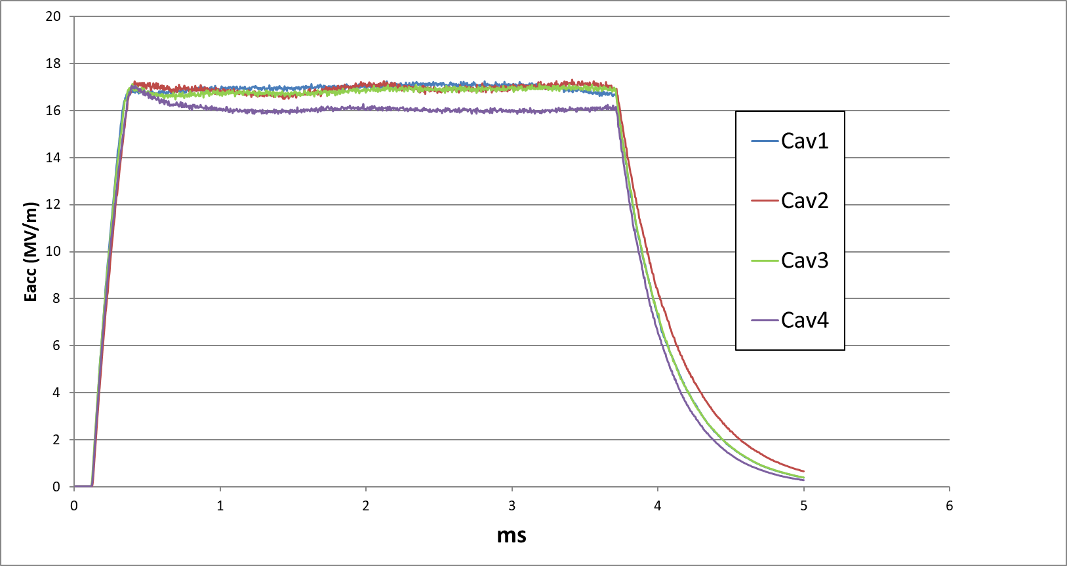
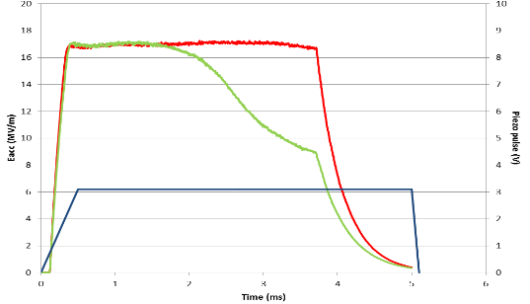
Prototype: Elliptical cryomodules
RF power tests at CEA Saclay: technology validation
Cavity package: cavity + coupler + piezo tuner
Cryostat: assembly, cryogenic behavior, static and dynamic heat loads, alignment, instrumentation, …
Forward power (kW)
Eacc (MV/m)
Main specifications (Medium beta cryomodules):
  E_{acc} = 16,7MV/m
  P = 1,1MW
  Pulses RF: 3.6ms à 14Hz
Blue trace: klystron output pulse profile for flat top cavity field generation (4P/P)
2,86 ms
Eacc (MV/m)
Phase of Eacc (º)
Eacc (MV/m)
Piezo pulse (V)
Green= without piezo compensation
Red= with static pre-tuning and piezo compensation
Blue = Piezo driver pulse
The 4 cavity fields reached with piezo compensation

Slide 11
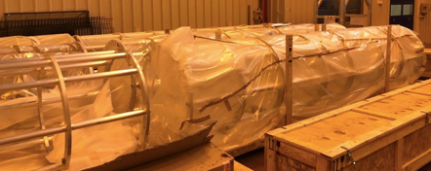
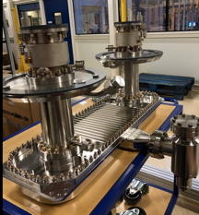
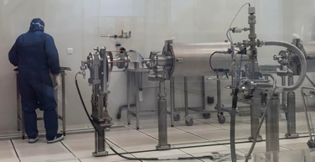
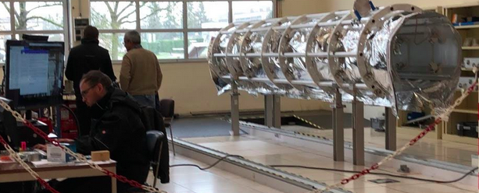
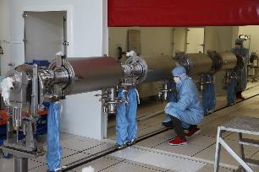
Series: Elliptical cryomodules
Vacuum vessels | Contract awarded to ACPP. The first unit is delivered.
Power couplers | Contract awarded to PMB, the 6 couplers of the pre-series are delivered.
Coupling boxes for coupler conditioning | Contract awarded to SDMS, all units delivered.
Thermal shieldings | Contract awarded to SDMS, 7 first units delivered
Spaceframe | Contract awarded to SDMS, 7 first units delivered
Cold Tuning Systems (mechanical part) | Contract awarded to YVON BOYER. 6 first pre series delivered
Motors for cold tuning systems | Contract awarded to TSA (PHYTRON), 112 motors received
Cryogenic heat exchanger | Contract awarded to SDMS, two first units of the pre-series delivered.
Magnetic shielding | Contract awarded to MECA MAGNETIC, first 3 shieldings delivered.
MLI | Contract awarded to SODITECH, kick off meeting done
Internal instrumentation | Contract awarded to SODITECH, first 6 delivered.
Intercavity bellows, cold-warm transitions | Contract awarded to SDMS, kick-off meeting done.
Cavity supporting systems (tie rods) | Contract awarded to SPG. Kick off meeting done.
Cryogenic circuits, diphasic tubes, tubes for rupture disks, coupler bells | Cryogenic circuits awarded to CRYODIFFUSION fabrication on going Di-phasic tubes awarded to SDMS, fabrication on going Ti bellows: fabrication on going
Cryogenic valves CV01 and CV02 | Contract awarded to VELAN. 9 first units delivered
Level sensors | Contract awarded to CRYOFORUM, all the components received
Temperature sensors | Contract awarded to CRYOFORUM, several batches already delivered
Safety valves | Contract awarded to LESER. Kick off meeting done.
Controlled safety valves | Contract awarded to Velan. Kick off meeting done.
Rupture disks | Contract awarded to BS&S. Kick off meeting done.
RF cables | Contract awarded to HABIA. First batch for 10 CM received.
RF feedthroughs | Contract awarded to MDC Vacuum. All the components are received (2x32 feedthrough)
Pressure transmitters | Contract close to be signed
Screws for clean room assembly | Several contracts awarded
Vacuum components | All item ordered HV90 purge valves: contract awarded to VAT. Standard pumps and gauges awarded to Pfeiffer RGA and baratron gauges: awarded to MKS. Delivery scheduled end of January
Vacuum pumping groups | Contract awarded to 40-30. A first pumping group is delivered.
Cryomodule assembly | Contract awarded to B&S. The work starts with the assembly of CM01.

Slide 12
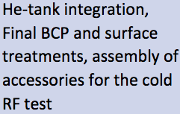
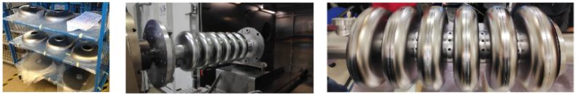

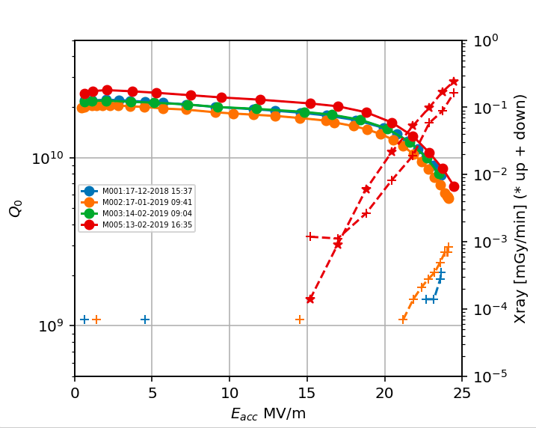



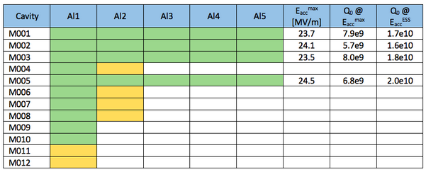
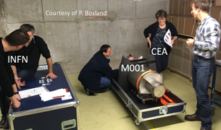
Series: Medium-β cavities
Status on March 21

Slide 13
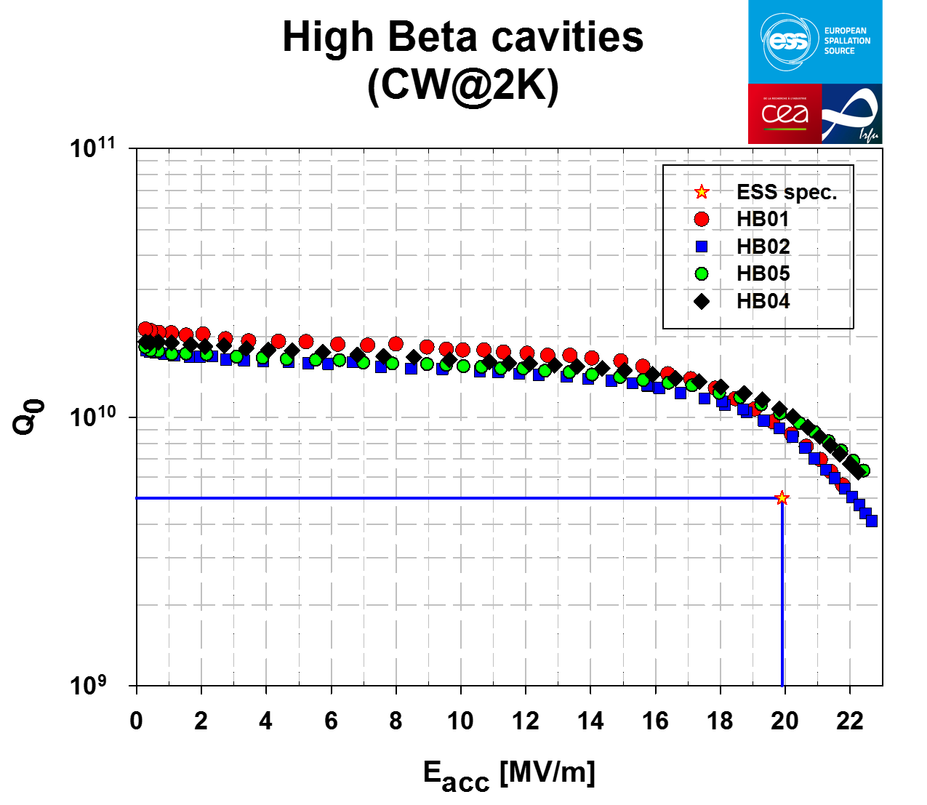
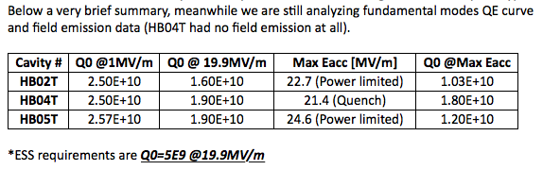

Prototype: High-β cavities
High-β prototype cavities sent to RI for weld of helium tank.
Then sent to ZANON for final flash BCP and HPR rinsing before mounting of the antennas.
HB02, HB04, HB05 tested in vertical cryostat, Qo=1e10 at nominal field, ~ 22 MV/m
Like for the Medium-β, those cavities will be assembled in the High-β Cavity Cryomodule Technology Demonstrator, H-ECCTD, in order to validate the Elliptical cryomodule performance
Notes:
Integration of ” industrialisation study”, thanks to RI and EZ (flash BCP) process.

Slide 14
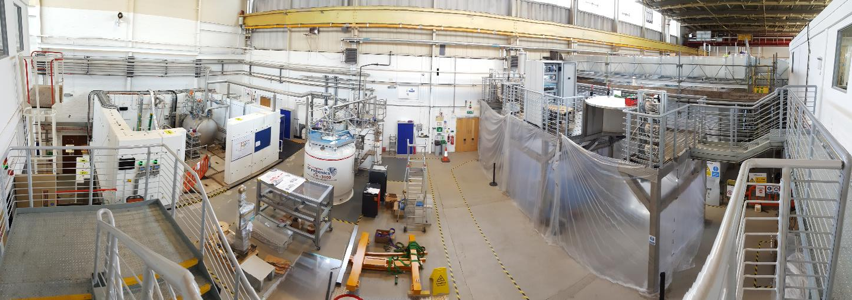
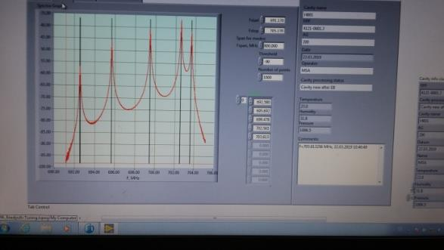
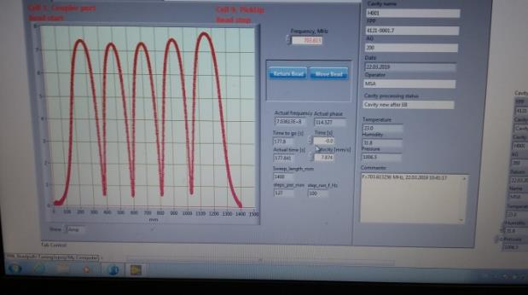
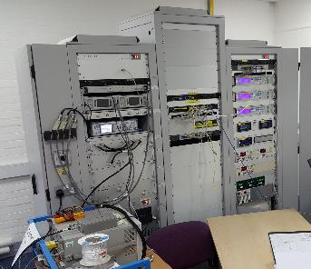
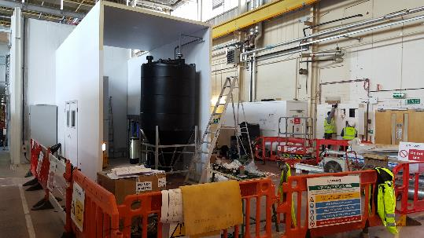
Series: High-β Vertical Test Facility Preparations
Cavities: First cold test result expected June 2019
  “Pre-series” of first 4 cavities H001-H004: industrialization validation
Independent system commissioning: Successfully completed
  All key systems (LLRF, Vac, Cryo, Cryoplant) validated independently by Jan 2019
  LLRF validated with coaxial resonator, Q~5x10⁶ at 7.5K
  Final integration of all subsystems completed in Feb 2019
Integrated system commissioning: March-May 2019
  Validate and qualify key integrated VTF system operation and functionality using CEA 2015 prototype cavity
  On schedule, many technical objectives for this phase already successfully completed
  Elliptical cavity P02 (early CEA prototype) being used, frequency in agreement with CEA measurements
  Observations and data from this phase will be used to optimise subsequent plans and schedules
Final validation: Q4/2019 - Q1/2020
  Multiple production cavities (pre-series) to re-check and qualify VTF operations for ESS cavities
Qualification testing of cavities for series Cryomodules
  Start planned Q1 2020; first 6 cavities required by ESS / CEA 1 June 2020
Notes:
Cavity status:
Procurement and tendering phase now fully complete
All contracts signed; all Niobium and most ancillary components received
“Pre-series” of first 4 cavities H001-H004:
Validate industrial treatment processes since other IKC prototypes treated at IKC labs
First test without helium jacket; retest after integration of helium jacket for final qualification ready for cryomodule installation
Sequential release of each cavity to final assembly and treatment
H001 finished equator welding 21 March 2019
Warm RF measurements immediately after welding:
f(pi) = 703.61MHz (~200kHz < nominal target) before tuning
field flatness = 94% before tuning
First cold test result expected June 2019
H005- onward (series cavities) production:
Components and sub-assemblies started manufacturing already
Release of semi-finished parts in Sept/Oct 2019 for cavity delivery Jan 2020
Infrastructure: Optimisation and benchmarking: June 2019 - Q4/2019
Operations processes to be tuned and optimised using early prototype cavities
Develop automations for process control as required
Benchmark comparison of reference cavity tested externally

Slide 15
EXTRA

Slide 16



Series: Double-Spoke cavities and cryomodules
Qualification of complete cavity lifecycle
Notes:
@IPNO
10 cavities delivered
1 validated
3 with good RF performances but out of frequency
1 with strong field emission
2 are ready for testing in th vertical cryostat
@ZANON
Delivery rate of 2 cav / month
2 cavities (DSPK10 & 16) will be delivered tomorrow morning.

Slide 17

Serie: Spoke cryomodules planning
Risk: Procurement of bellows and door-knobs inducing at least 2 months of delay in delivering the 1st cryomodule to Uppsala
Notes:
→ additional test in Freia

Slide 18

Prototype: Elliptical cryomodules
F. Ardellier, presented at Annual Review, 2018, Dec 18

Slide 19

Series: Medium-β cavities
P. Michelato, presented at the Annual Review, 2018, Dec 18
Notes:
Cavities in preparation:
M004 The weld of one of the equators has been repaired. Based on XFEL experience, the cavity is going to be tested naked at DESY in March. This will allow having the cavity integrated in He-tank ready for VT in April 2019.
M006 The spots present in the cavity have been grinded and the cavity is being prepared for a vertical test in naked configuration at LASA in March. Based on the result of this test, it will be decided how to proceed.
M007 Welded. Start treatment
M008 Welded. Start treatment
M009 Welded
M010 Welded
M011 Composition given. Waiting for weld
M012 Composition given. Waiting for weld
Concerning the subcomponents, the third lot has been started and we expect to have HCs information early March for deciding on DB compositions.

Slide 20

Prototype: Elliptical cryomodules
F. Ardellier, presented at Annual Review, 2018, Dec 18

Slide 21

Series: Medium-β cavities
P. Michelato, presented at the Annual Review, 2018, Dec 18

Slide 22


Series: High-β cavities
Procurement and tendering phase now fully complete
  All contracts signed; all Niobium and most ancillary components received
“Pre-series” of first 4 cavities H001-H004:
  Validate industrial treatment processes since other IKC prototypes treated at IKC labs
  First test without helium jacket; retest after integration of helium jacket for final qualification ready for cryomodule installation
  Sequential release of each cavity to final assembly and treatment
H001 finished equator welding 21 March 2019
  Warm RF measurements immediately after welding:
    f(pi) = 703.61MHz (~200kHz < nominal target) before tuning
    field flatness = 94% before tuning
  First cold test result expected June 2019
H005- onward (series cavities) production:
  Components and sub-assemblies started manufacturing already
  Release of semi-finished parts in Sept/Oct 2019 for cavity delivery Jan 2020
Infrastructure: Optimisation and benchmarking: June 2019 - Q4/2019
  Operations processes to be tuned and optimised using early prototype cavities
  Develop automations for process control as required
  Benchmark comparison of reference cavity tested externally
Nov 2018: Half cell parts at RI after manufacture
March 2019: H001 assembled

Slide 23


Series: High-β cavities
P. McIntosch, presented at the Annual Review, 2018, Dec 18
2K cooldown of VT with CEA
cavity on-going
Pre-series cavity fabricated and to be testing at DESY in May 2019

Slide 24

Serie: Elliptical cryomodules planning
Risk: No spare: any component failure during the fabrication sequence implies a direct delay

