Slide 1
Elliptical cryomodules reception and preparation to tests
Michal Sienkiewicz
Institute of Nuclear Physics PAN, Krakow
IKC to the ESS
11 April, 2019

Slide 2
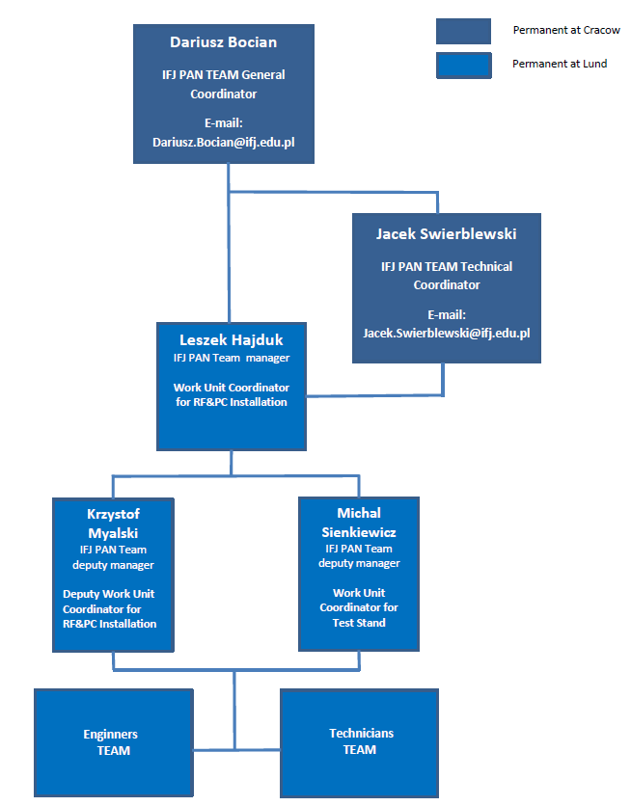
Institute of Nuclear Physics Polish Academy of Sciences
IFJ PAN Team at Lund
IFJ PAN in-kind contribution:
RF components installation
Klystron, Modulators installation
Cryomodule tests
Currently at Lund :
8 engineers
10 technicians

Slide 3
Cryomodule Flow
Assembly
TEST
Installation
IFJ PAN
CEA
ESS
Scope of the work (2017-2022):
IFJ PAN engineers dedicated to CM:
Preparation
Commissioning (Test Stand)
Testing phase 1 ( 9 Medium Beta Cryomodules)
Testing phase 2 ( 21 High Beta Cryomodules)
W. Gaj ( Cryogenics)
P. Halczynski ( Mechanics)
M. Sienkiewicz (Vacuum)

Slide 4
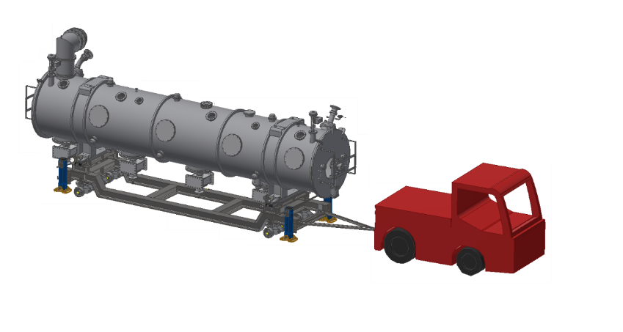
Description of work – flow diagram
Medium Beta and High Beta cryomodules test main flow diagram:
Reception
Preparation for the test bench
Installation on the test bench
Warm up
Cold Test (ESS)
Cool down
Disconnection
Preparation for tunnel

Slide 5
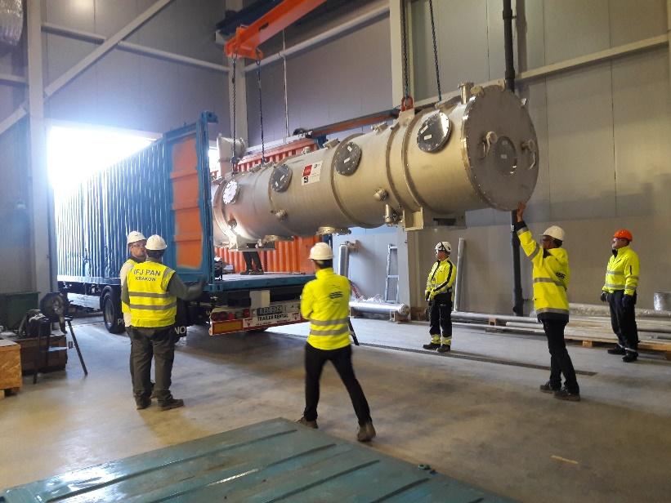
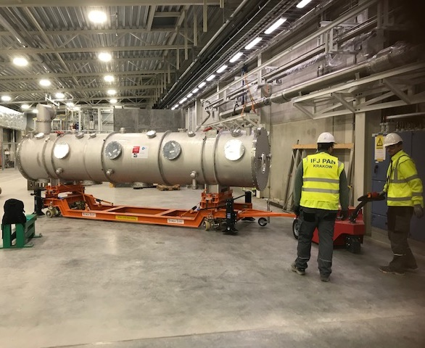
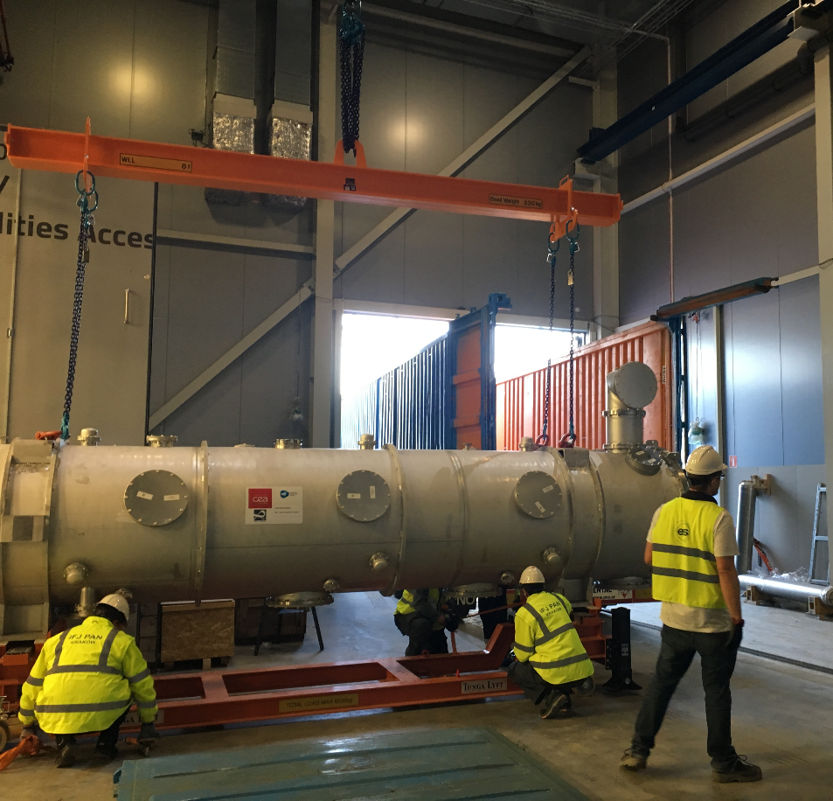
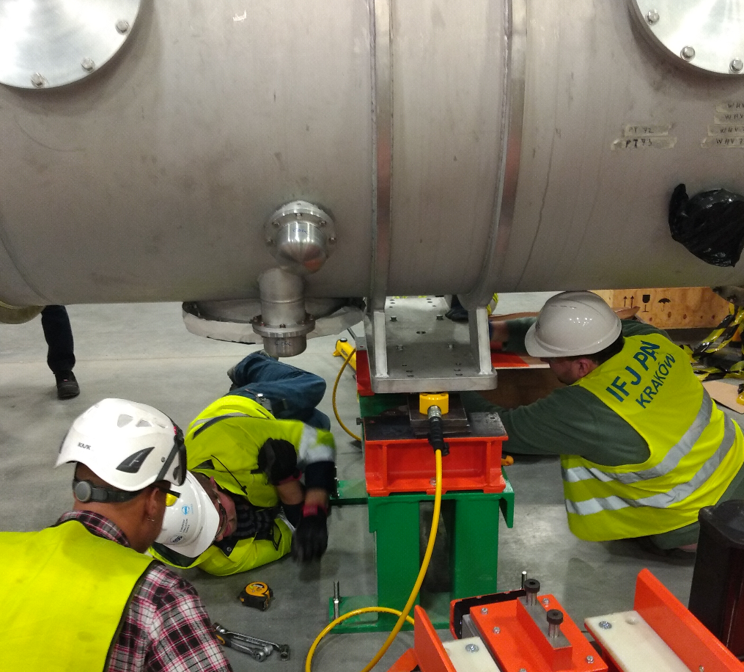
Reception
Check if module was properly fixed in the container during the transport
Check of a equipment box content
Read-out of shock loggers
Unloading (ESS)
Transport and placing on the support
Read-out of beam vacuum
Visual inspection (damages)
Reception Report

Slide 6
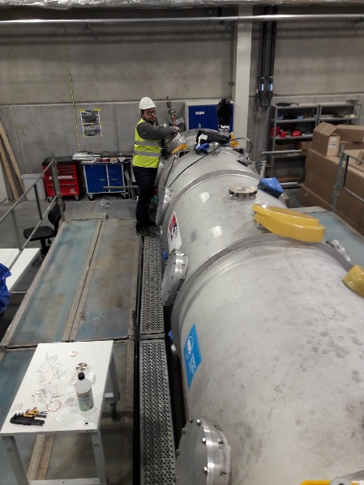
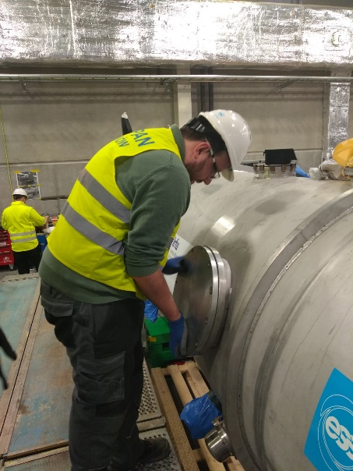
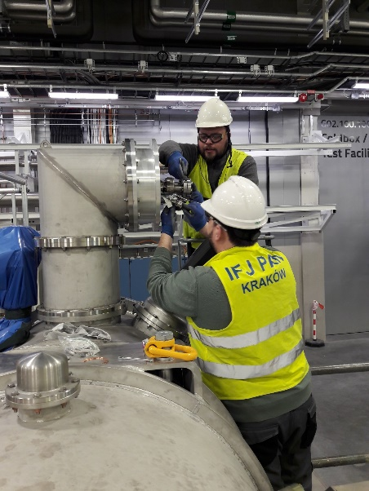
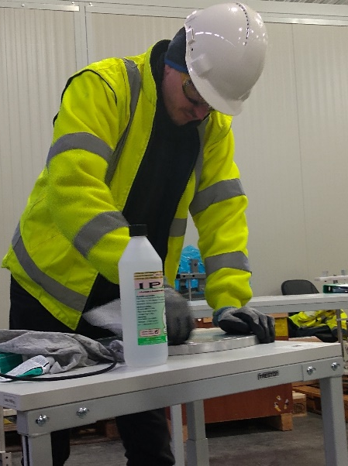
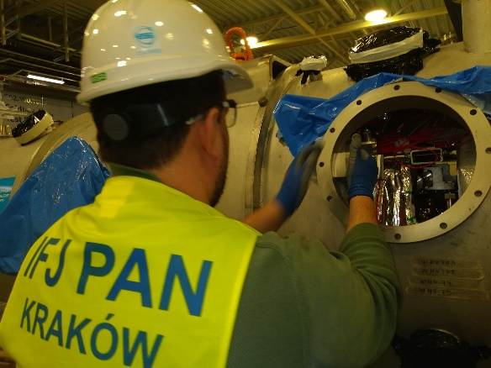
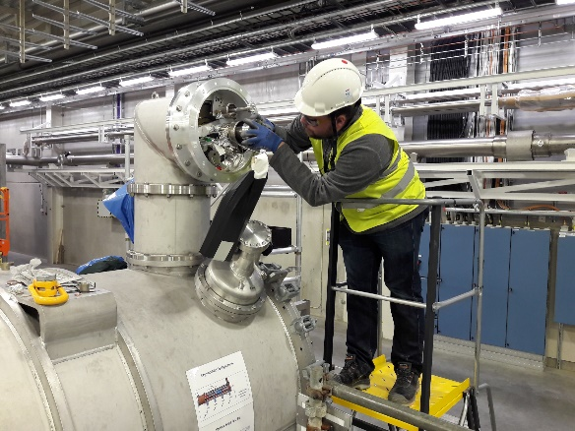
Preparation outside of the test stand
Mechanical inspection (e.g. torque check)
Mounting of door knobs (ESS)
Mounting and dismounting of parts
  Cavities transportation fixing system
  Valve actuators
Alignment check (ESS)
Leak check of insulation vacuum
Electrical checks
  continuity
  resistance values of temperature sensors
  step motors
Transport to the test stand

Slide 7
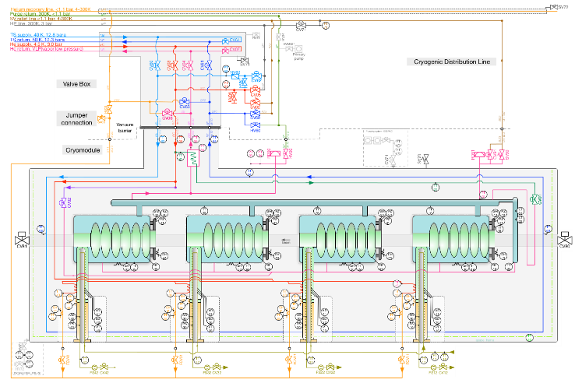
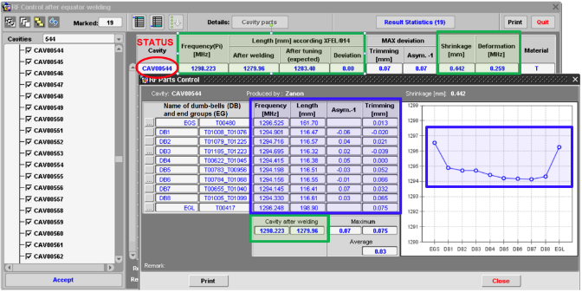
Preparation at the test stand
Cryomodule installation on stands (alignment with respect to the waveguides and jumper cryolines)
Dismounting of cavities supporting bars
Connection of the beam vacuum pump station (clean room)
Actuator installation and test of the gate valve
Making of all interconnections
  Waveguides
  Cryolines
  Cooling water pipes
  Instrumentation
  Compressed air
Connection of the insulation vacuum pump station
Leak check of jumper connection (insulation vacuum)
Leak check of cryogenic circuits
Coupler conditioning (ESS)
Initial RF measurements (ESS)
Incoming Inspection/Warm Test Report
Cecilia Maiano

Slide 8
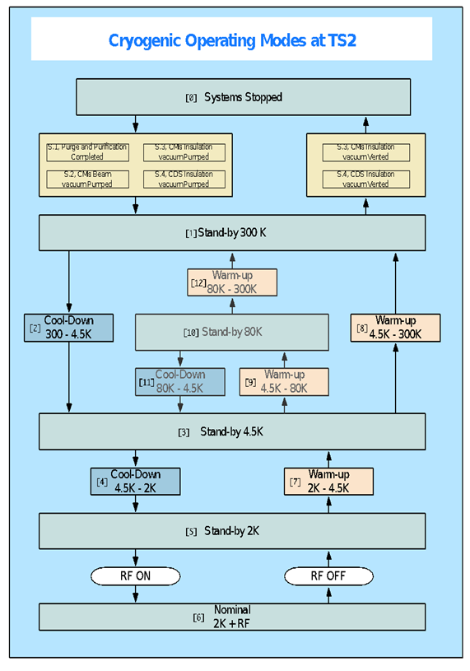
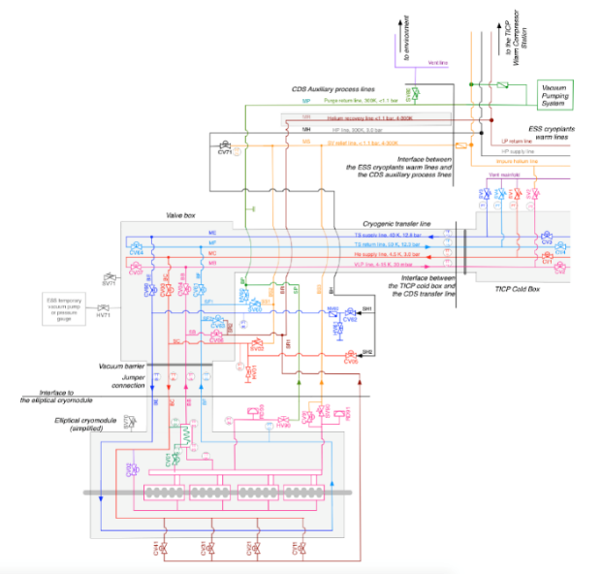
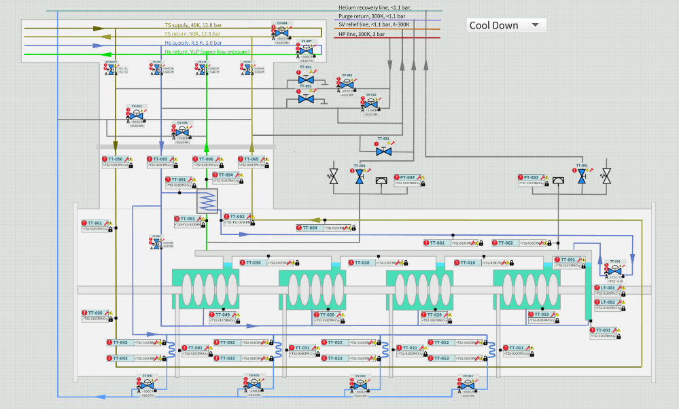
Cool down, cold tests, warm up
Cool down
  Pump and purge of cryolines
  Cool down to 4.5 K
  Cool down to 2 K
  Complete thermal stabilization
Cold tests (ESS)
  LLRF, SRF, …
  Heat Load (IFJ PAN)
Warm up
  Warm up to room temperature
  Venting ISO-VAC to atmospheric pressure
Final / Cold Test Report(ESS)

Slide 9
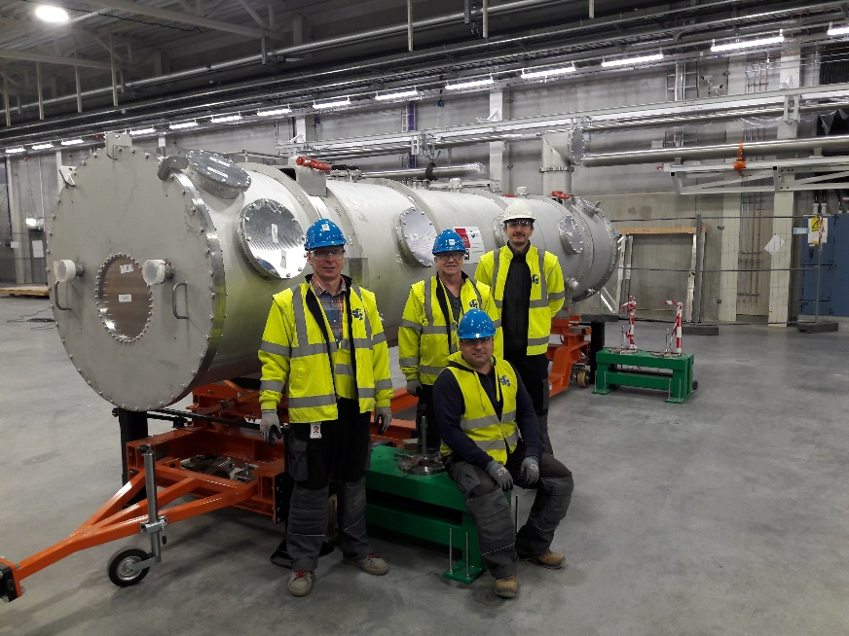
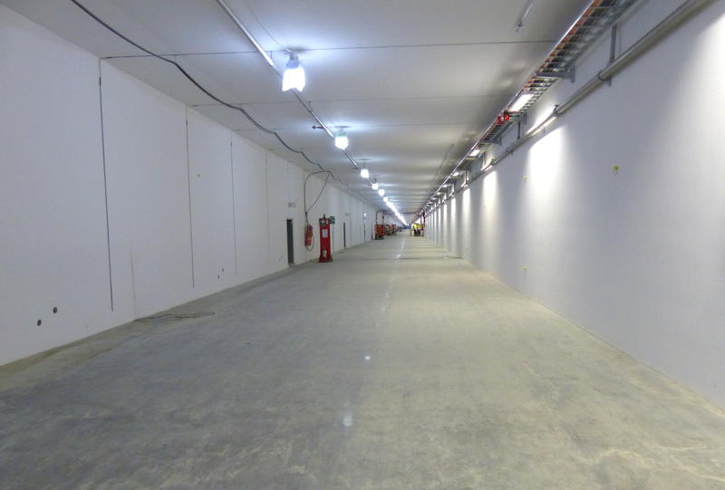
Disconnection and final preparation for installation in the accelerator tunnel
Disconnection of interconnections
  Waveguides
  Cryolines
  Cooling water pipes
  Instrumentation
  Compressed air
Disconnection of vacuum pumps
  Beamline ( cleanroom)
  Insulation vacuum
Moving Cryomodule out of the bunker
Check frequencies
Cutting off cryogenic flanges
Installation of blank flanges
Outgoing report

Slide 10
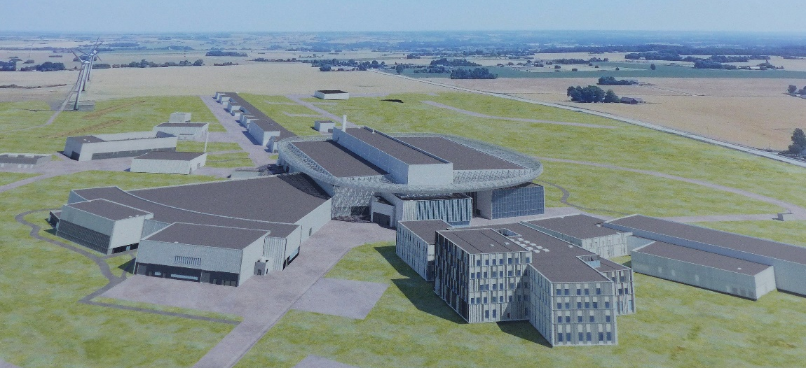
Summary
All medium (9) and high beta (21) cryomodules will be tested before installation in the accelerator tunnel.
RF performance, leak tightness, heat loads of cryomodule will be checked.
Based on our experience (more than 100 cryomodule tests for E-XFEL) IFJ PAN will perform some of those test and prepare ESS cryomodules for cold SRF test.

