Slide 1
High level ESS SRF test plan
Cecilia Maiano
TAC 2019 Apr 10th - 12th

Slide 2
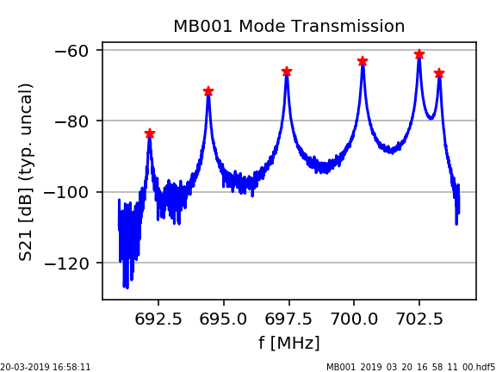
Elliptical Cavity Measurement Data at ESS
Measurements taken @ assembly, testing, commissioning and operation of cavities.
Data taken at IK and ESS are stored into the Measurement & Calibration DB from ICS @ESS
(owncloud service, based on datafiles in HDF5 format).
Gathering of the IK data and the development of the local measurement and handling tools are in the scope and responsibility of the SRF Section of the Accelerator Division.
Let’s have a look at the present system and at its main features

Slide 3
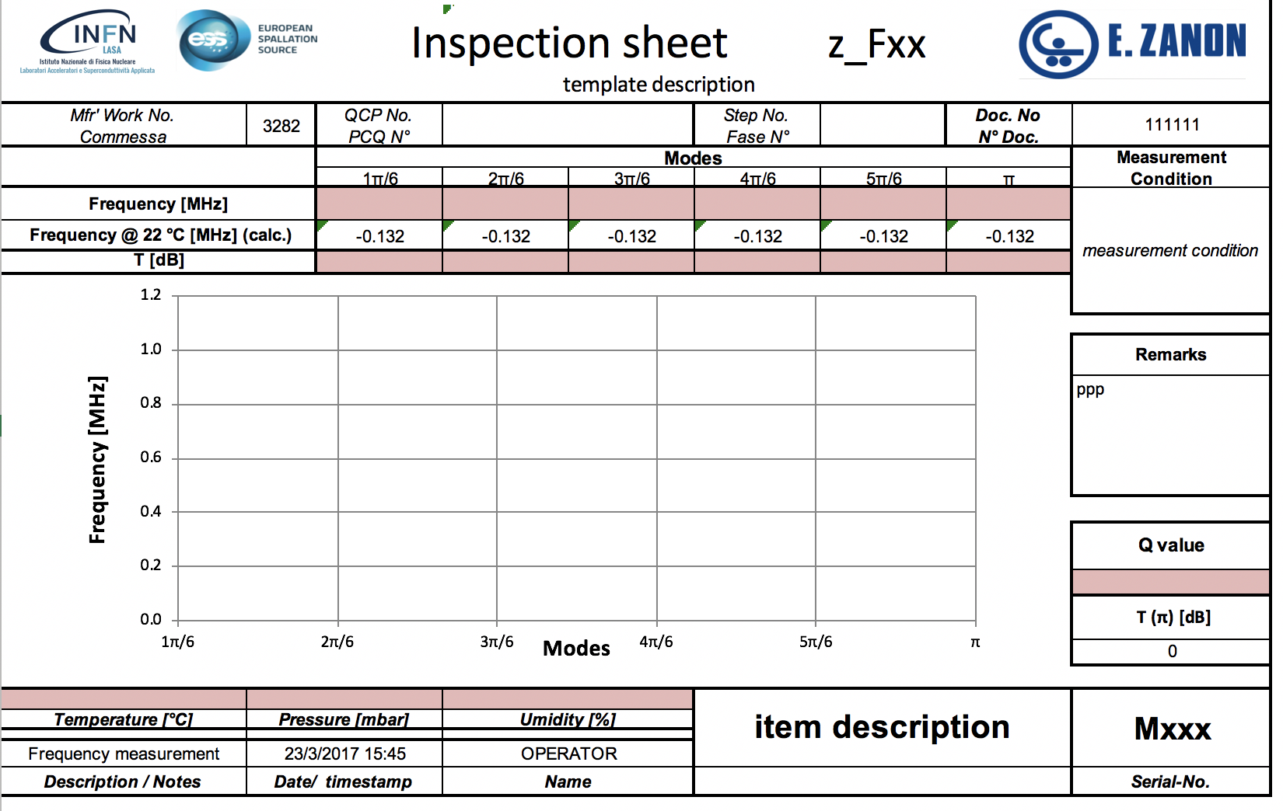
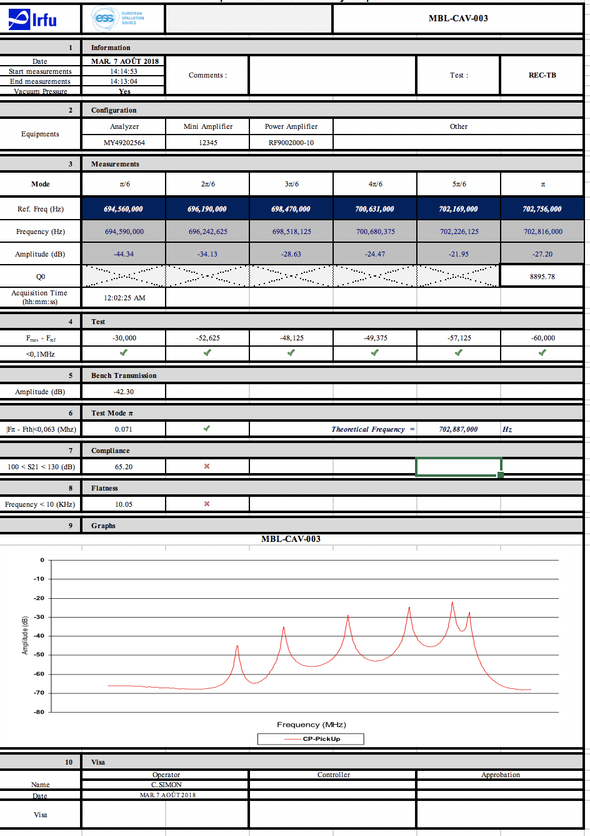
Frequency data at ESS
Following requirements for long term maintenance plan of facility
ESS Scope
MEASUREMENTS @ IKC
After fabrication
Intermediate handover
Outgoing
Measurement&Calibration DB
(ownCloud service)
ESS Asset Management
ID Installation Structure
https://meas01.esss.lu.se/owncloud/index.php/login
Live Staging Area
(typ. text files or xls)
Transfer
Tagging (in metadata)
Script
Save
https://gitlab.esss.lu.se/SRF_Section
Normalized Data
(HDF files, metadata)
APPLICATIONS
Browse
Compare
Assess
MEASUREMENTS @ ESS
Incoming
Preparation TS2/Linac
Script

Slide 4
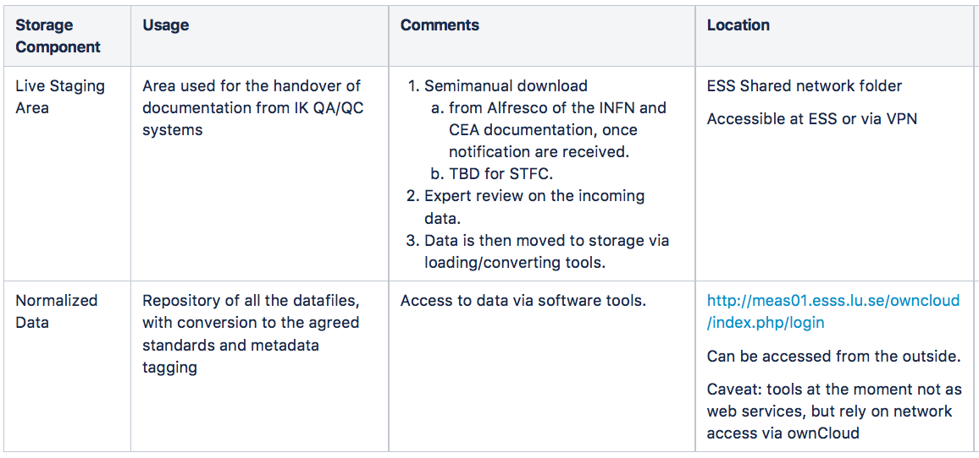
Present Architecture for data storage

Slide 5
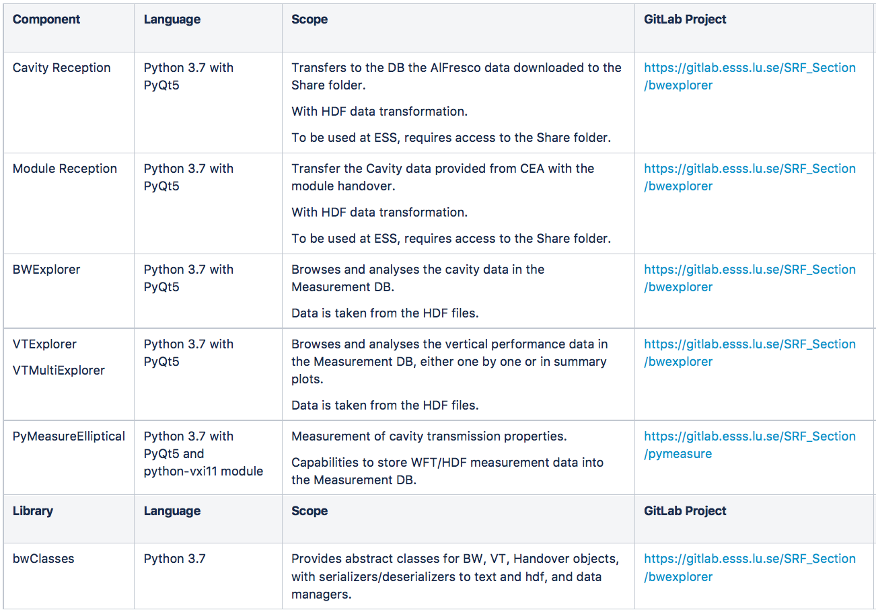
Existing SW tools (all on ESS Gitlab)
Transfer from IK/normalize
Browse/Analyze
Measure
Classes for abstraction/serialization

Slide 6
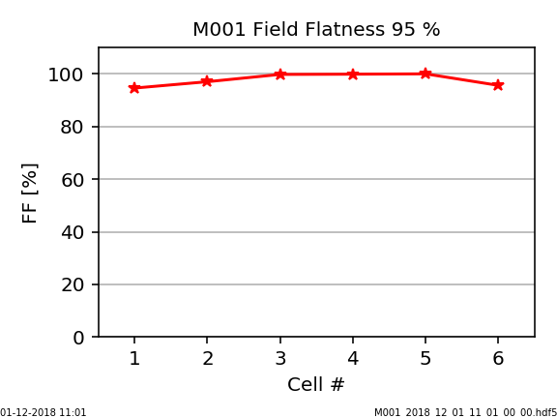
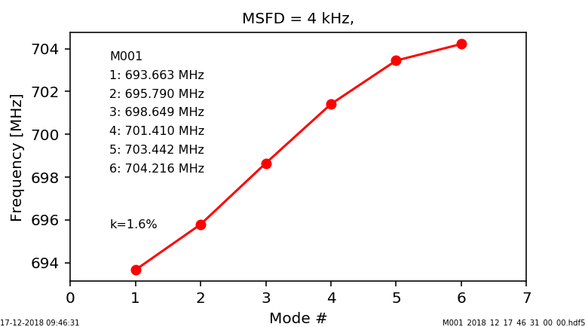
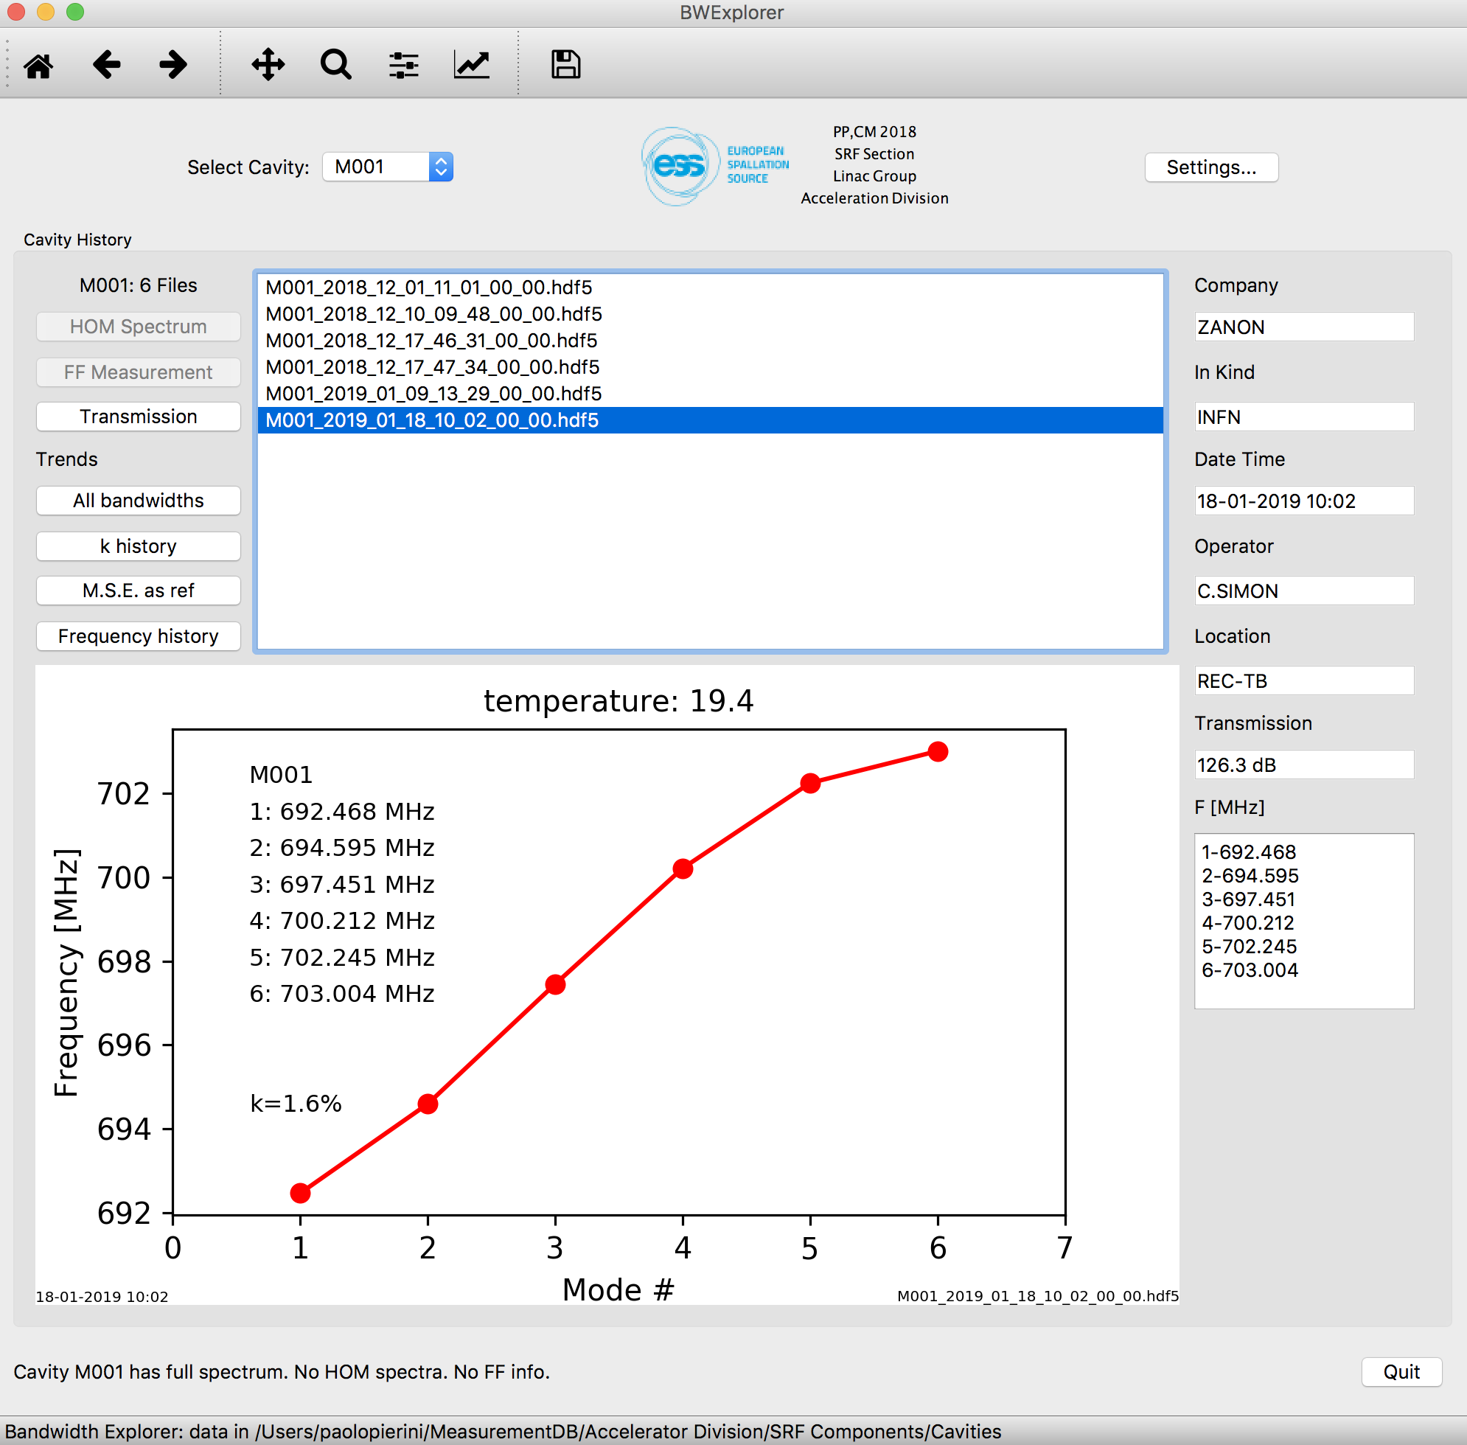
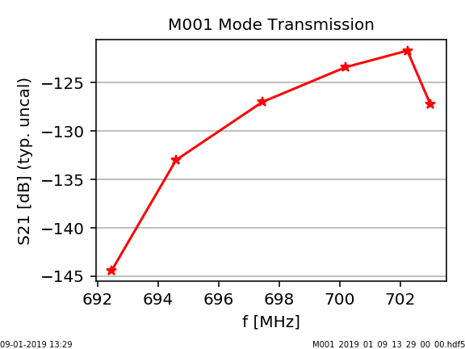
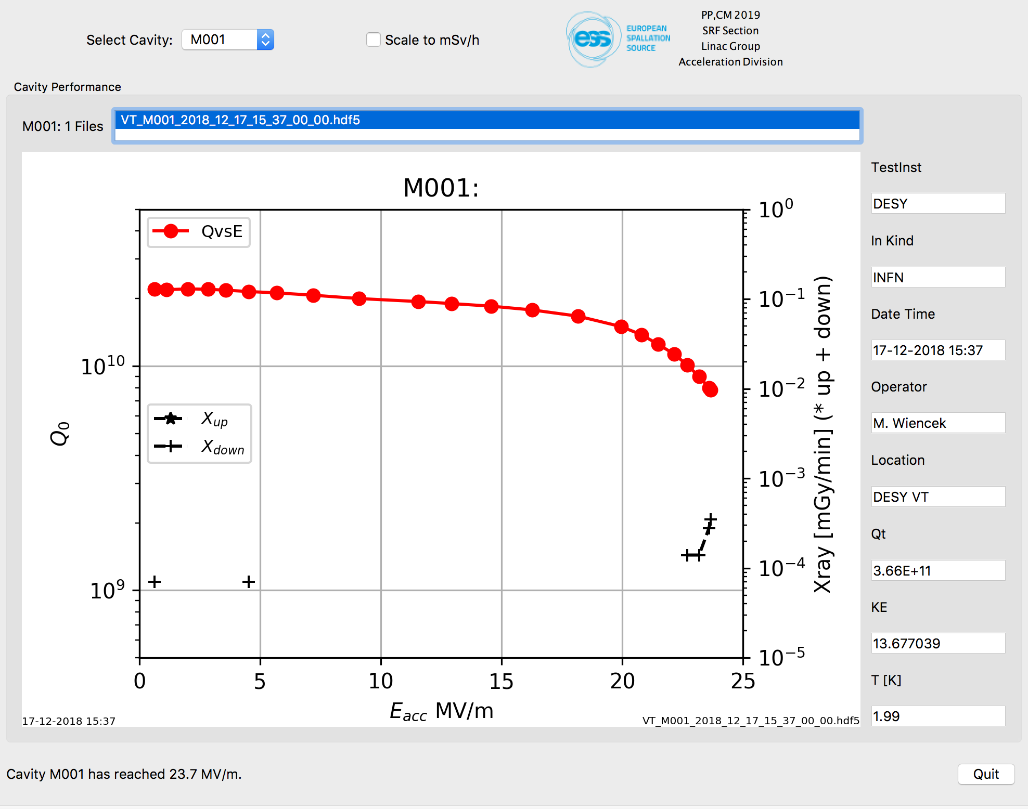
Data explorers: Measured bandwidths & VT
Show fullfillment of specifications or handling the handover conditions
The tool allows to browse, display & analyze the cavity measurements data (warm/cold!)
Field flatness measurement
Cold spectrum
M001 from FAB to CEA
Transmission monitoring
Cold Test and RF calibration
Data taken on cavities at INFN/DESY from INFN DMS (D. Sertore), migrated in ESS DB

Slide 7
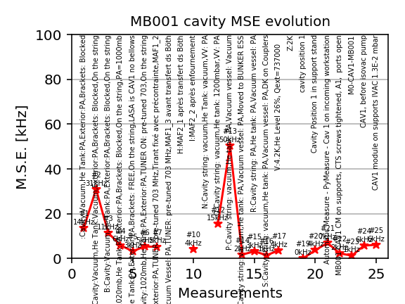
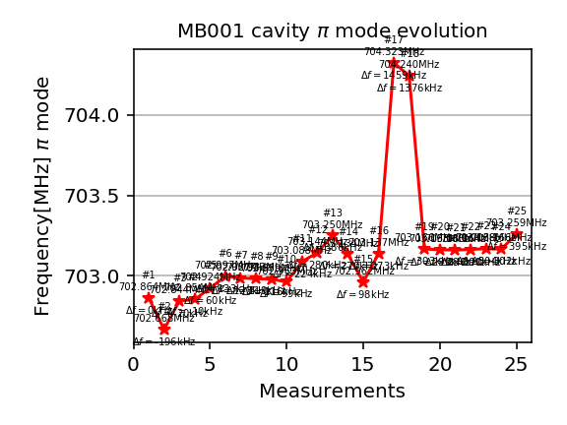
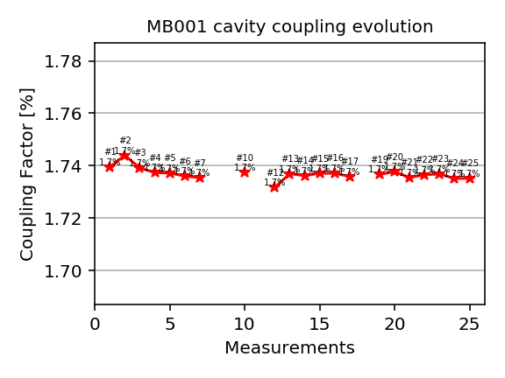
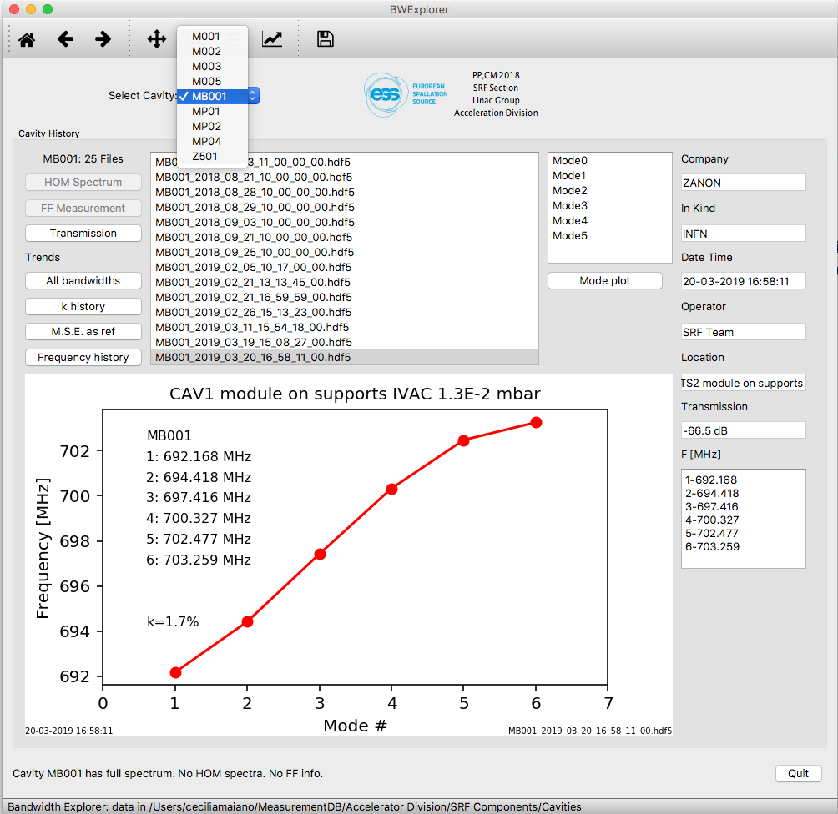
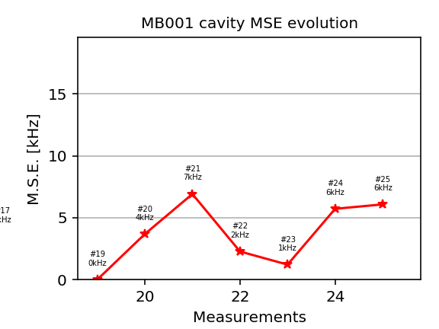
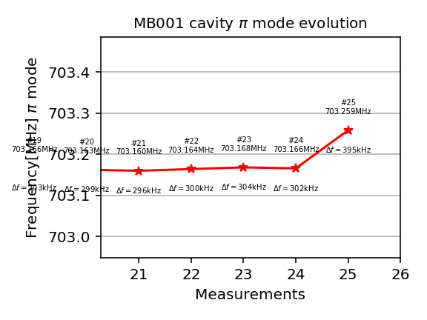
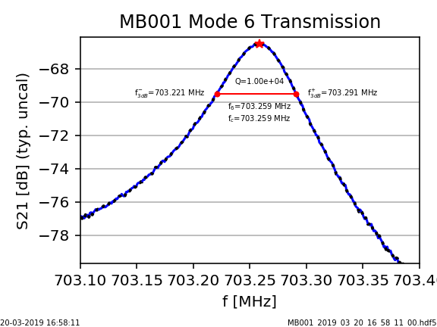
Data explorer: Data trends
During module lifecycle, below M-ECCTD
The tool allows to browse, display & analyze the cavity measurements data (warm/cold!)
MSE: Mean Spectrum Error
pi-mode
coupling
(…)
Q values
MB001 in M-ECCTD
Data taken during MECCTD testing at CEA (E. Cenni),
migrated in ESS DB

Slide 8
M-ECCTD analysis
From demonstrator retrieve data of expected behavior of series in TS2
Parameter, all data kHz | CAV1 M001 | CAV2 MP04 | CAV3 MP01 | CAV4 MP02 | <AVE> SPREAD
Effect of Brackets (also, hysteresis due to mechanical slack) | 70 | 165 | 107 | 112 | 114±48
From string in vacuum, VV&tank PA, to 4.2 K | 1186 | 1181 | 1169 | 1150 | 1172±18
From string in vacuum, VV&tank PA, to 2K | 1103 | 1107 | 1091 | 1080 | 1095±14
4.2K to 2K, col, (Pressure sensitivity 1 bar to 30 mbar ) | -83 | -74 | -78 | -70 | -76±7
String from air to vacuum (tuner, tank & vv air, RT) | 174 | 177 | 190 | 195 | 184±11
Vessel from air to vacuum (tuner, string vacuum, tank air, RT) | 111 | 105 | 107 | 75 | 99±18
Data to be used during TS2/Tunnel preparation phases
T data not available for all measurements (approx. 5 kHz/C around RT)

Slide 9
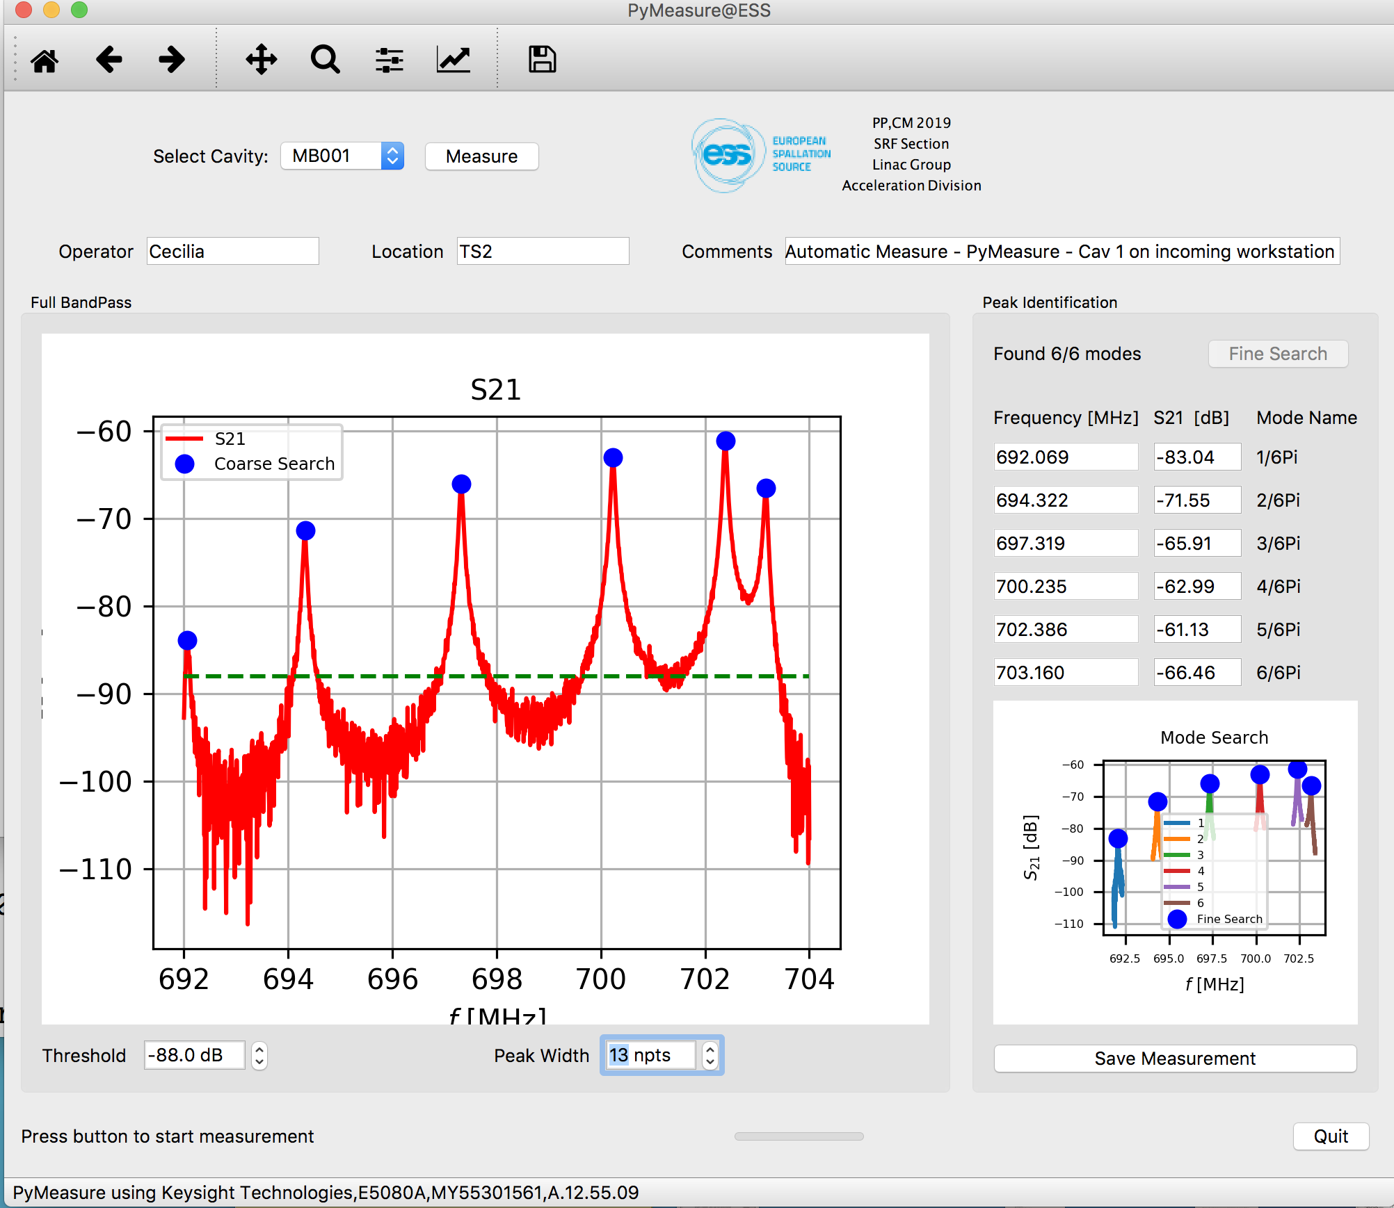
Measurement tools at ESS
It allows to measure cavities (S21, with VNA) and store data automatically in the Cavity DB
Used for all measurements of M-ECCTD, after reception
Bandwidth (coarse & fine search)
Transmission
HOM spectrum
E.g. proof of
no HOM close to n=5 beam
Harmonics at cold in VT!

Slide 10
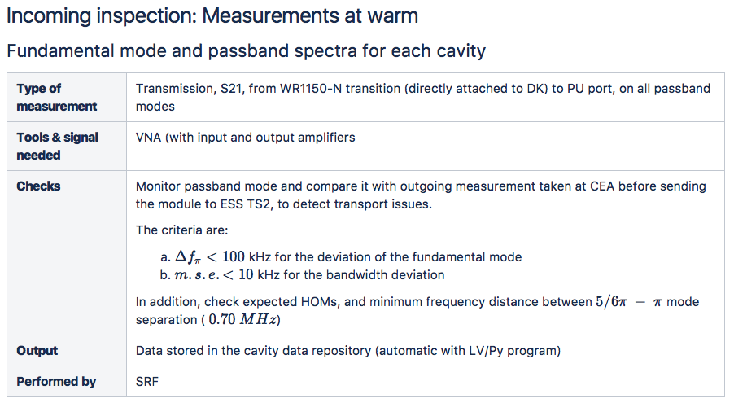
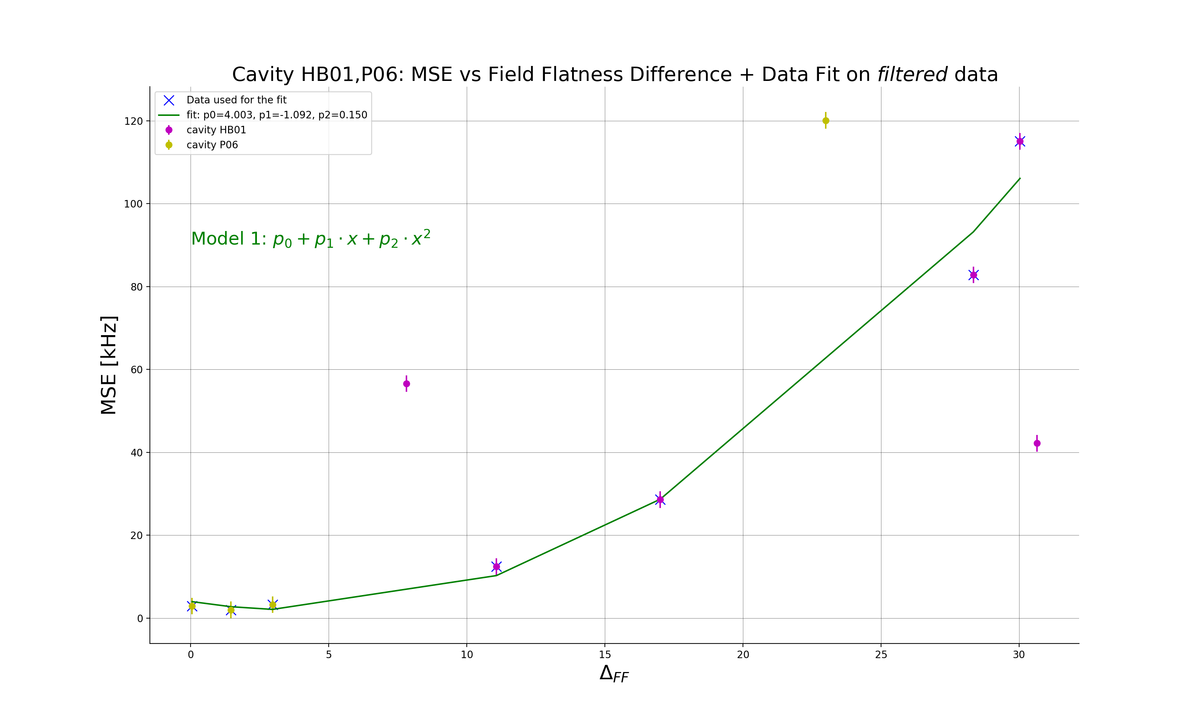
Cavities & Module measurements workflow
Incoming test before connection
Fundamental mode and passband spectra for each cavity at warm
Extimation of Q_{ext} at warm
Verification of inner cabling & components
Check of the Cold Tuning System CTS (after continuity checks)
Slow tuning system check
Piezo check
Detailed measurements
list on our intranet
10 % change in fundamental
Field amplitude

Slide 11
Calibration, Conditioning and Measurements at TS2
Checklist, low power verification
Before Cooldown
Warm Cable & Component Calibration availability
Warm Input RF Couplers Conditioning
After cooldown no HP RF
4K cavities passband measurement
After reaching stable conditions @2K no HP RF
Cold cable calibration
2K cavities passband measurements, before tuning
Cavities slow Tuners Test and Cavities Tuning
2K cavities passband measurements, after tuning

Slide 12
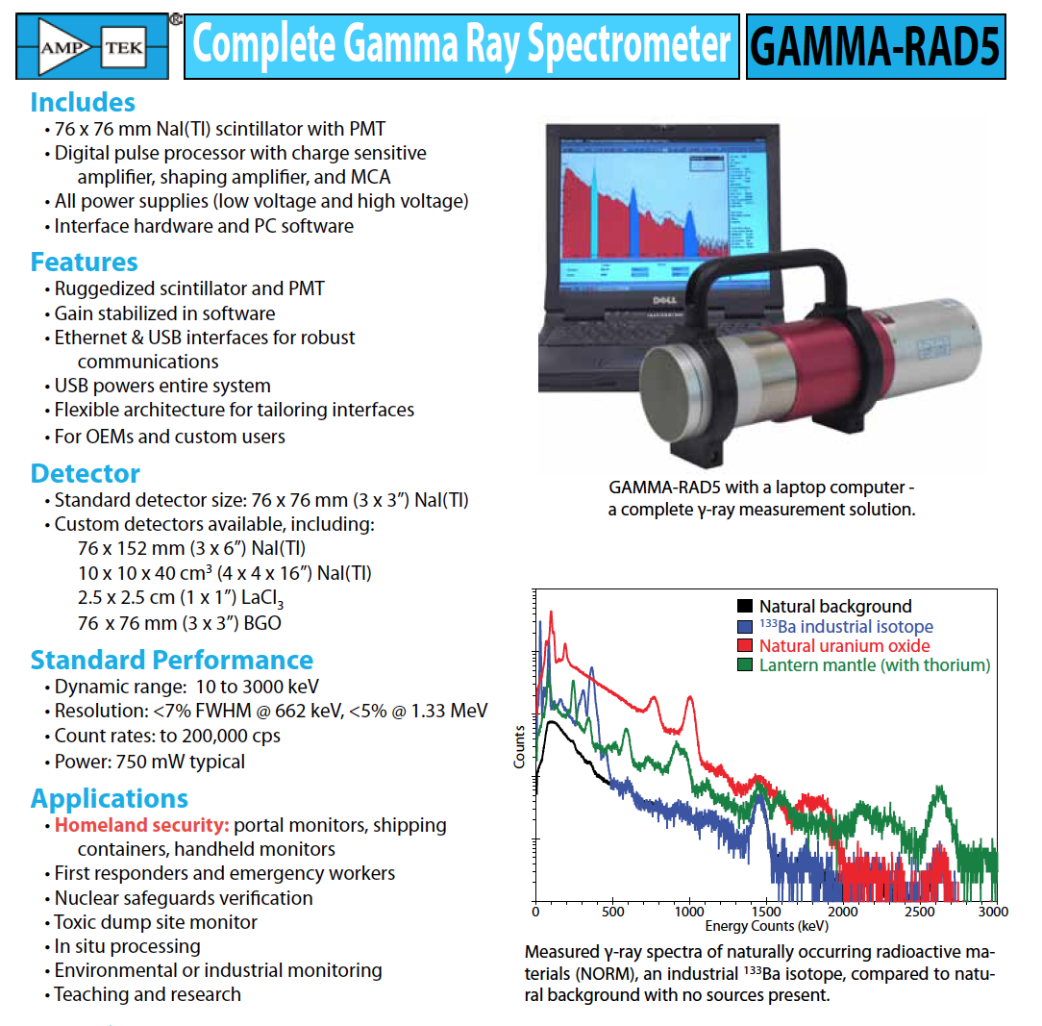
Calibration, Conditioning and Measurements at TS2 (2)
High power measurements
After reaching stable conditions @2K starting HP RF
Cold coupler conditioning (off-resonance)
Start open loop operation at low forward power
Fine tuning with Pt
Calibration
Power ramp up (cavities on resonance)
Field emission measurements (dose & energy spectrum)
Test goals
Performance assessment (specs fulfilled?)
Limiting mechanisms (quench, FE, Power limitations)
Comparison/correlation wrt VT results (and cryomodule results, where possible)
Store data for future Linac operations (degradation, perf. recovery)

Slide 13
Thank you for your attention!

Slide 14
Backup slides

Slide 15
Frequency data at ESS (2)
Present system
Mechanisms for transferring the relevant subset of important measurements performed at the IK partners during production and at the handover phases (construction, testing, assembling, shipping between partners of the SRF collaboration,...)
Measurements taken at ESS use the same live data area and final repository
Data is uniquely associated at each accelerating cavity/module and will later be associated with the proper tags (including the EAM asset ids)
The SRF Section has the responsibility to develop all the tools to load, browse, compare and access the data.
Data and tools should be, as much and as early as possible, shared with the project IK partner for proper followup after delivery of the components to ESS

Slide 16
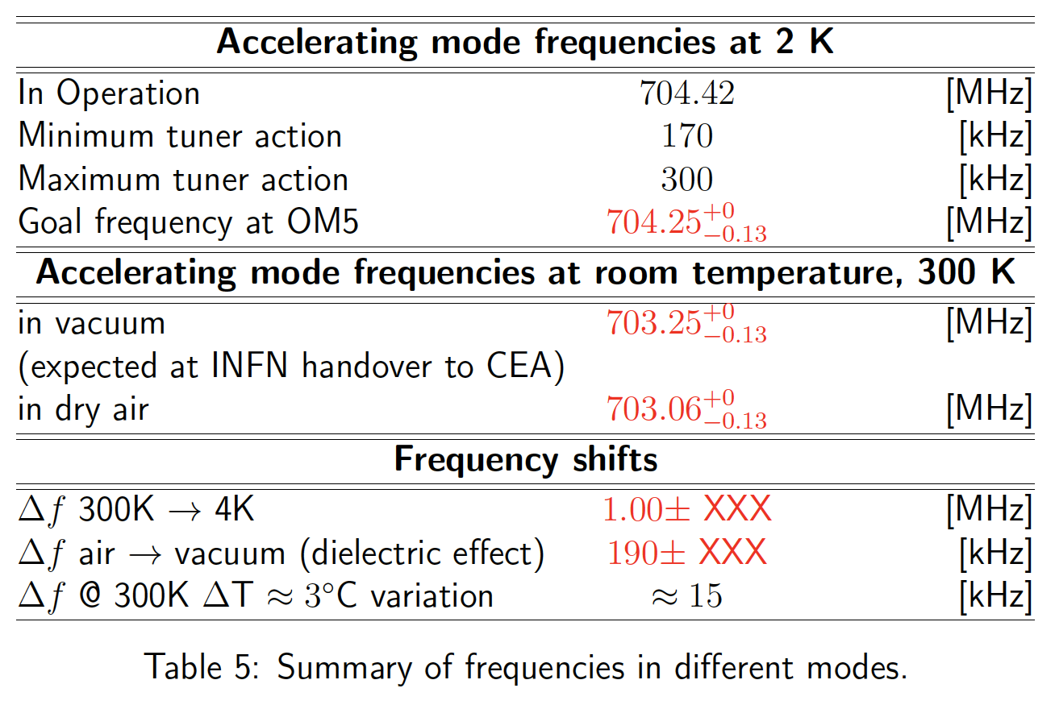
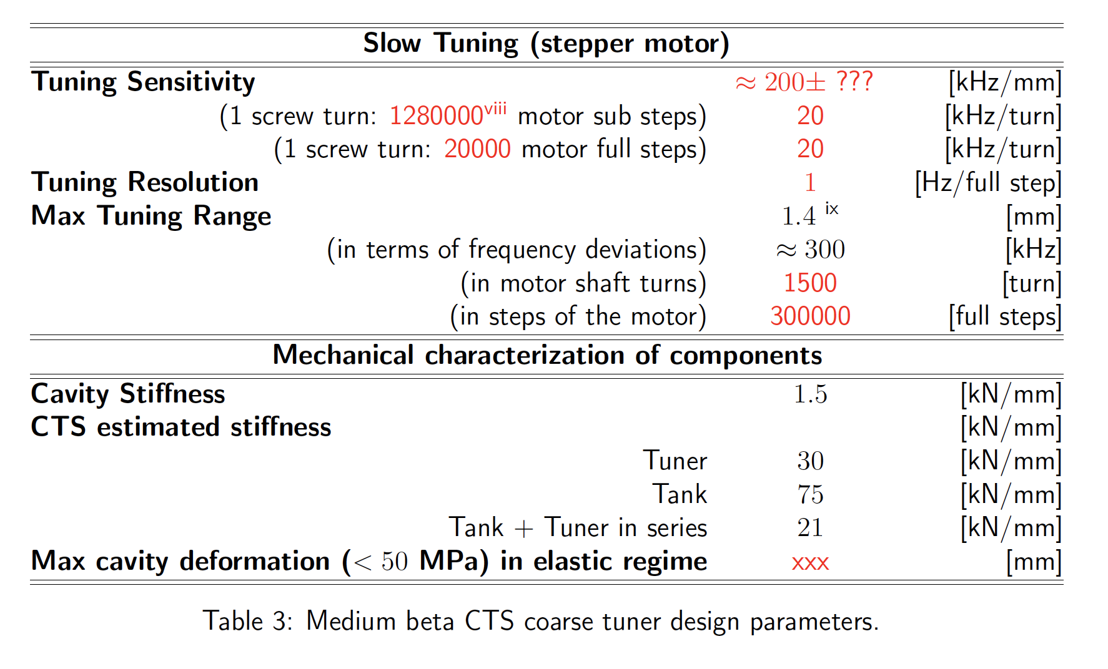
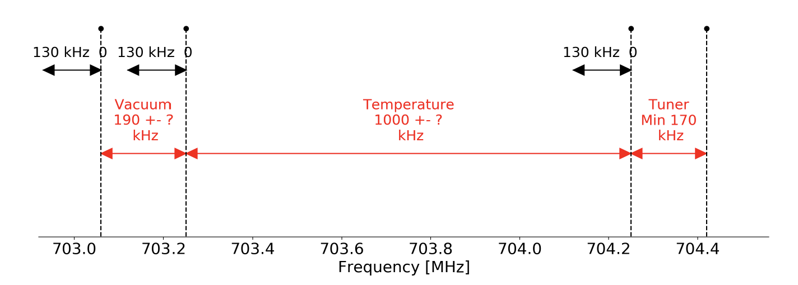
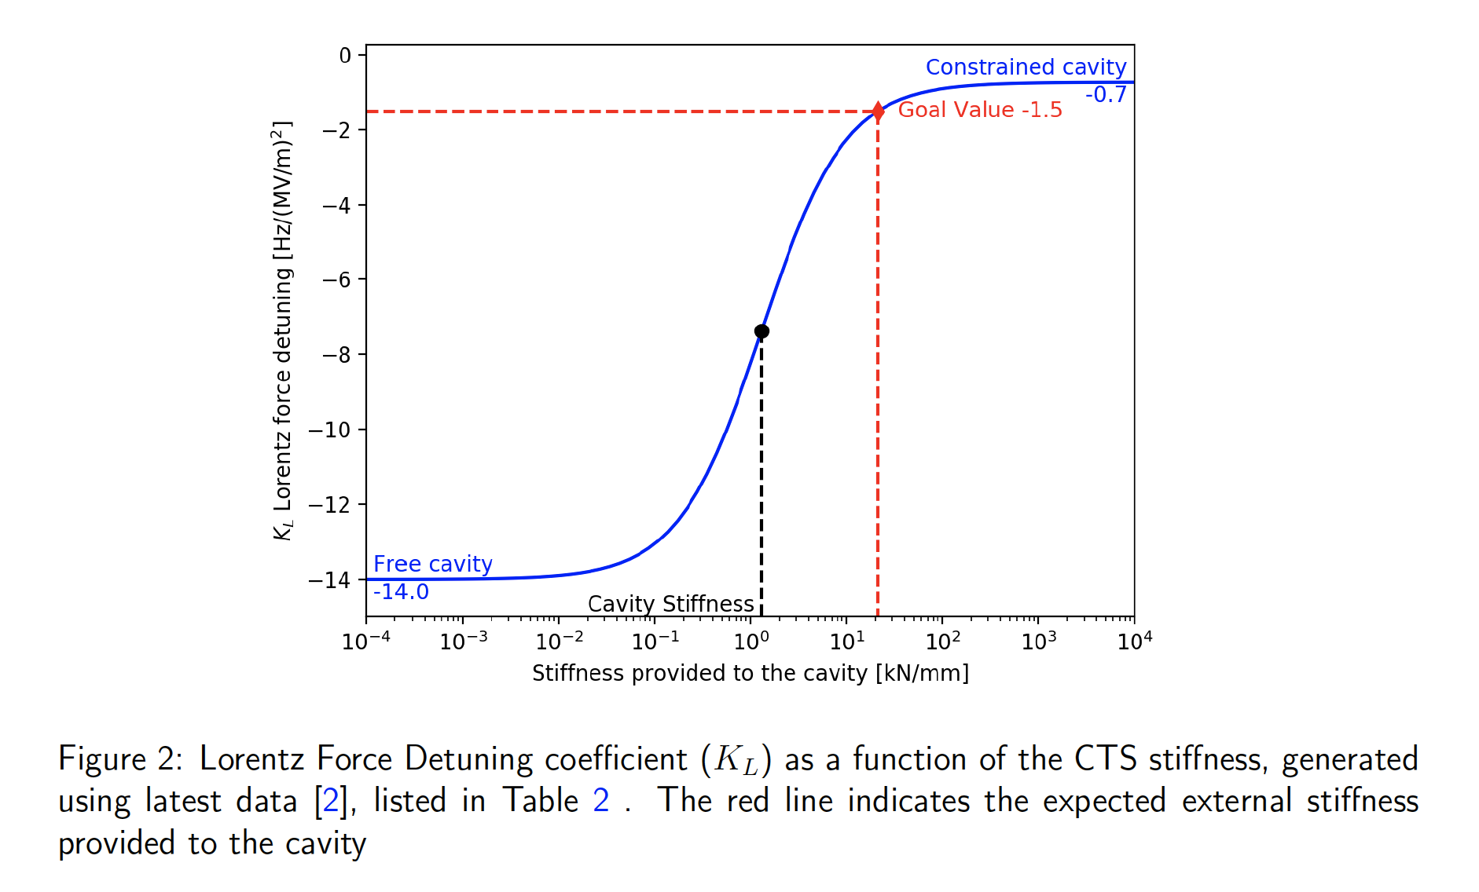
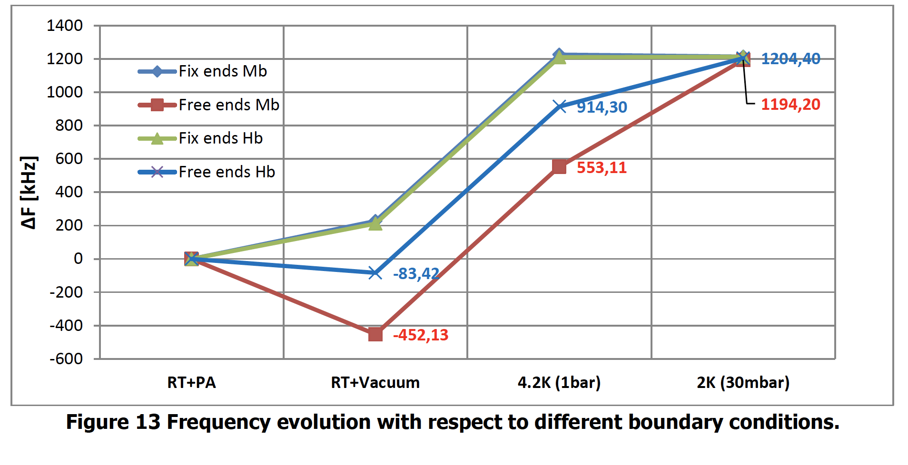
Documentation, from IK and at ESS
ESS-”SRF manual” and CEA technical notes

Slide 17
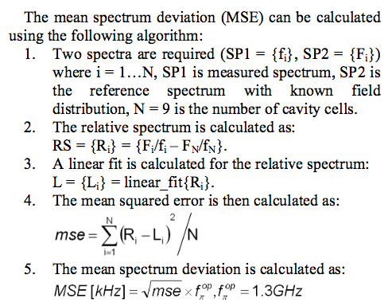
Use of standard methods in SRF community
E.g. MSE analysis
XFEL experience

