Slide 1
ESS Project Status
Roland Garoby
Technical Director
10 April 2019

Slide 2
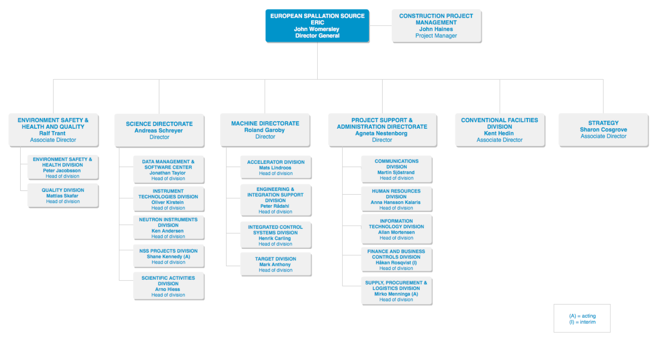


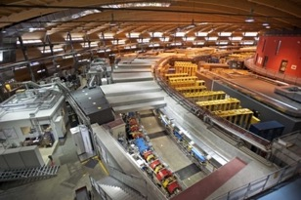
Organisation and People
481
Employees
53
Citizenships
~ 100
Collaborating Institutions
146
Consultants
Notes:
Updated September 2017

Slide 3
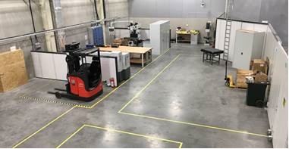
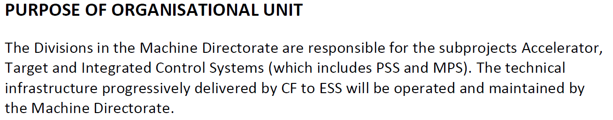
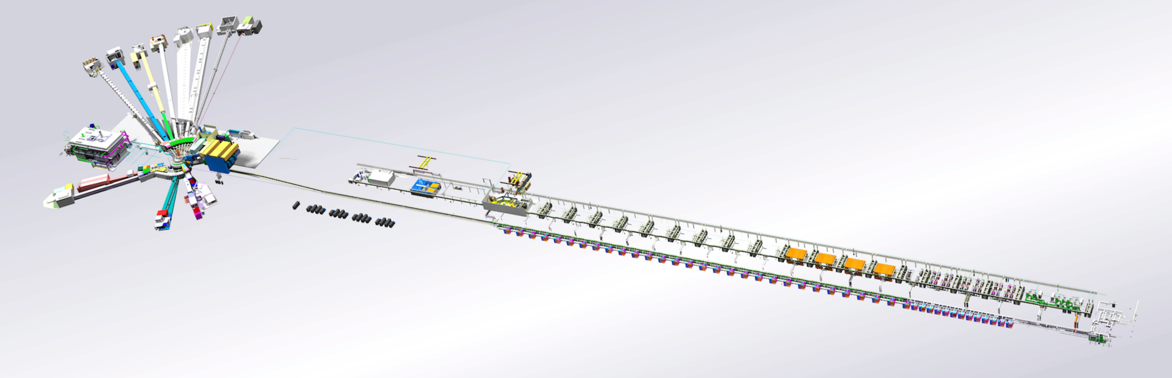
Machine Directorate organization
also provides engineering/technical support to the whole of ESS
Technical Director
Deputy Technical Director
Target
Accelerator
Integrated Control Systems (ICS)
Engineering and Integration Support (EIS)
In charge for all of ESS of:
Vacuum
Cryogenics
In charge for all of ESS of:
Controls
Machine Protection Systems
Personal Safety Systems
In charge for all of ESS of:
Design & Engineering services
Survey & Alignment
Mechanical workshop
Spatial Integration
Providing support to all of ESS for:
Engineering and PLM tools
Installation
Technical Infrastructure

Slide 4
Recent additional roles
Installation Manager (reporting to the ESS Project Manager) – Michael Jakobsson
  Responsible of coordinating installation work for the whole ESS project with authority to prioritize as well as start/stop tasks.
  In charge of “ Way of Working” to install the facility.
  Leading the team of Installation Coordinators of subprojects.
Operations Manager (Deputy Technical Director) – Carlo Bocchetta
  Responsible for coordinating commissioning and operation of the neutron source and its technical infrastructure.
  In charge of “ Way of Working” to operate the facility.
  Leading the “Operation Coordination Team” (OCT) – Matrixed organization composed of representatives from all units concerned with Operations.
Engineering Manager (EIS Division Leader) – Peter Radahl
  Responsible for making sure that the facility is integrated and that the baseline configuration is properly documented, fulfills the ESS requirements and that changes follow a well-defined configuration control process.
  In charge of “Way of Working” to “Manage Configuration” and “Develop and Maintain the Facility”.
  Leading the Engineering Board - Matrixed organization composed of representatives from all units concerned with construction and/or operation/maintenance/upgrade of the facility.

Slide 5
Baseline schedule (revised mid-2018)
2018
2019
2020
2021
2022
2023
2024
2025
BOT
ES
SOUP
EOC
Warm LINAC Commissioning Steps
1.3 GeV Capability Installed
Accelerator + ICS
Hi-Beta Install
Beam on Dump
(570 MeV)
Accel RBOT
Start of Neutron Source
Accelerator Schedule Float
CF + Target + NSS (Bunker+TBL) + ICS
Bunker and Test Beam Line RBOT
Access for Monolith Installation
Target RBOT
15th Instrument Complete (Ready for hot commissioning)
NSS Instruments + ICS
BOT - Beam on Target
ES - Early Science
SOUP - Start of User Programme
EOC - End of Construction project
RXXX - Ready for XXX
Instrument Hall Access for Start of Installation
Start beam commissioning for 1st Instruments

Slide 6
Transition to Operations for Early Science is outlined
Updated description of “Early Operations of the ESS Neutron Instruments and first scientific results” (ESS-0420218) distinguishing successive stages.
(NSS requirement: 2.86 ms beam pulses on a 14 Hz time grid)
Up to Beam on Target (-July 2022)
  570 MeV Beam on Dump after “Accelerator Ready for Beam On Target” (mid-2021)
  Beam commissioning at increasing energy interlaced with installation of High Beta cryomodules
ESS initial stages (July 2022-December 2023)
  Early Days: BOT to (BOT + 3 months) (July – September 2022). Req.: 1x8 h /week with > 100 kW
  Consolidation Days: The next 3 months: (BOT + 3 months) to (BOT + 6 months) (October – December 2022). Req.: 6x8 h/week with >100 kW.
  Performance Assessment days: (BOT + 6 months) to (BOT + 9 months) (January – March 2023). Req.: 12x8 h/week with >100 kW.
  First Performance Demonstration Days: (BOT + 9 months) to (BOT + 12 months) (April – June 2023). Req.: 33x8 h/2 weeks with >300 kW.
  Ramp up and Early Science: (BOT + 12 months) to (BOT + 18 months) (July – December 2023). Req.: 33x8 h/2 weeks with up to 500 kW.
Start of the ESS User programme SOUP (2024-2027)
500 kW beam power with 80 % availability.

Slide 7
ESS Project 58% complete
Project execution is on track with new schedule
  Based on “Early Finish” dates
  Beam on Target (BOT) in mid-2022, Start of User Programme (SOUP) at end of 2023
Full 2019 budget request approved by Council
Ramping down building design work, ramping up installation
Safety Readiness Review SRR1 completed - permission to start trial operation of ion source granted
Ion source/LEBT and helium cryo-plants are being brought on-line
Campus construction started for the future laboratory and office complex
Preparation for permit to run normal conducting linac on track for submission on July 15.

Slide 8
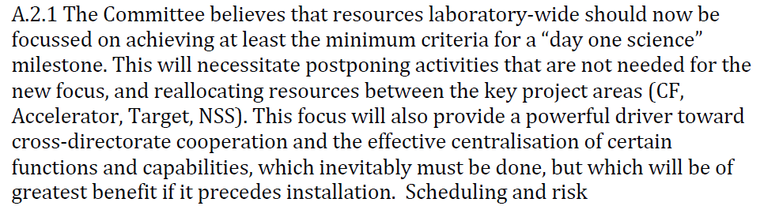
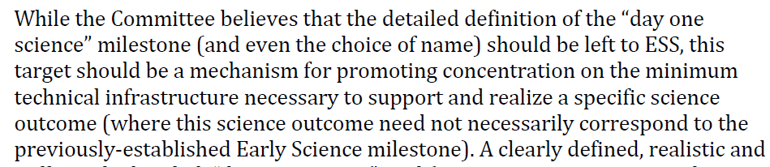
Main outcome of Annual Review 2018
(1/2)
Re-organization
under study
…
New definition
under study
…

Slide 9
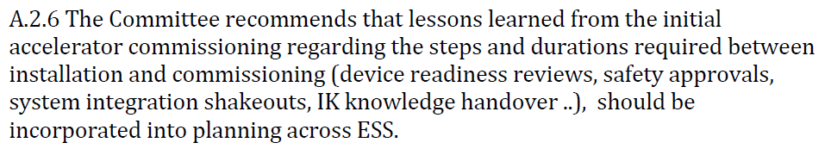
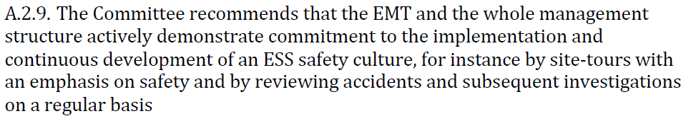
Main outcome of Annual Review 2018
(2/2)
Being done
…
New measures
implemented
…

Slide 10
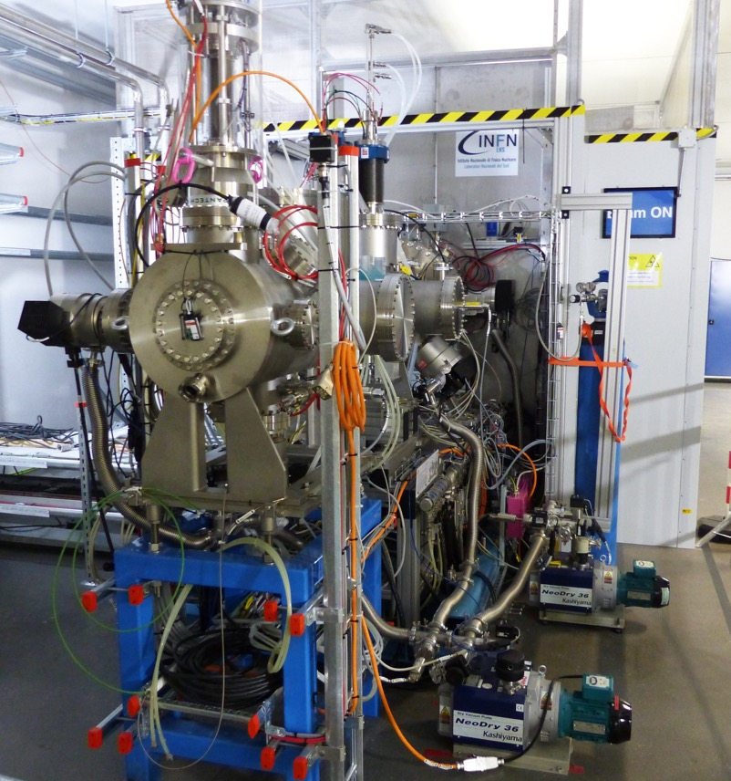
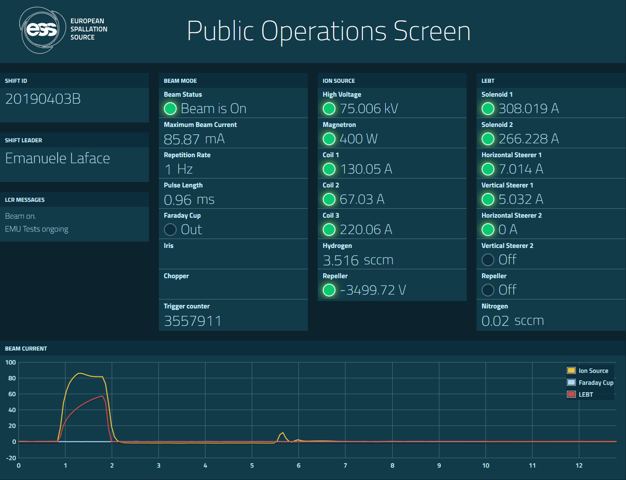
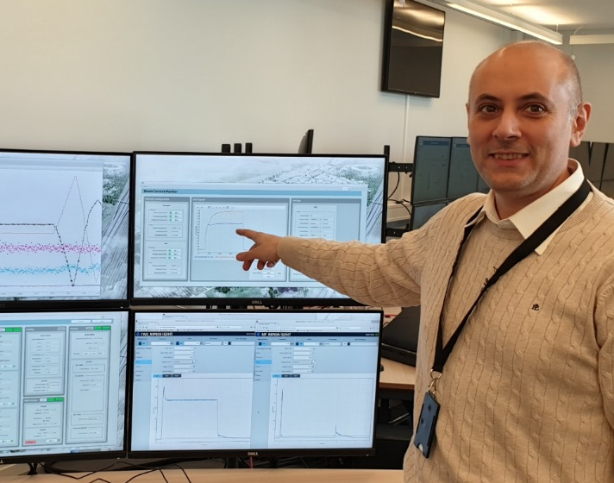
Ion source & LEBT are being commissioned
(Accelerator subproject is 54 % complete)
65 mA in LEBT
on April 3, 2019

Slide 11
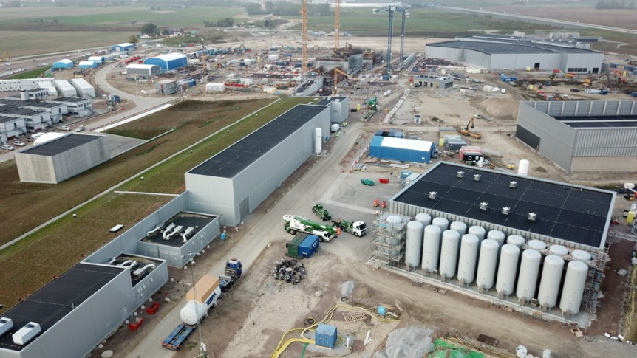
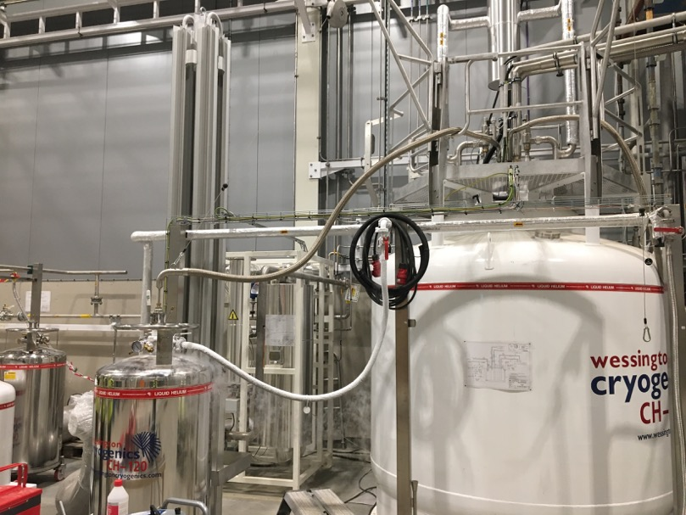
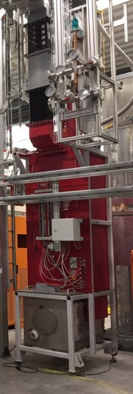
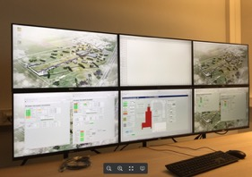
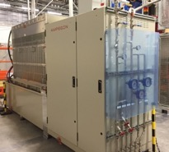
Infrastructure installation is in progress
Cryogenics plants installed and partly operational:
All large components of all cryoplants are on site.
Successful acceptance tests of liquefaction, refrigeration, internal purifier and Process Vacuum Pumps System. Final acceptance of plant completed.
Filling of liquid helium into mobile Dewars
TMCP cold box
delivered
All 19 PHS tanks ready and filled with helium
High power RF available in Test stand 2 (elliptical cavities cryomodule):
Modulator and klystron running
Bunker built
Licensing in preparation for cryomodule test
Accelerator Infrastructure project in progress:
10 496 meters of pipes, ~6000 welds, ~5000 valves
3000 m cable trays, > 700 km cables, 24 902 cables
6 central UPS-units
~800 control racks and 100-120 cooling units.

Slide 12
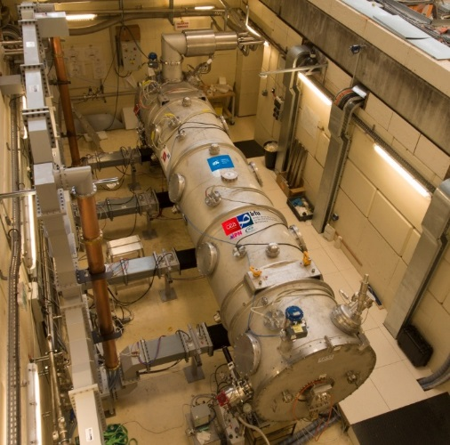
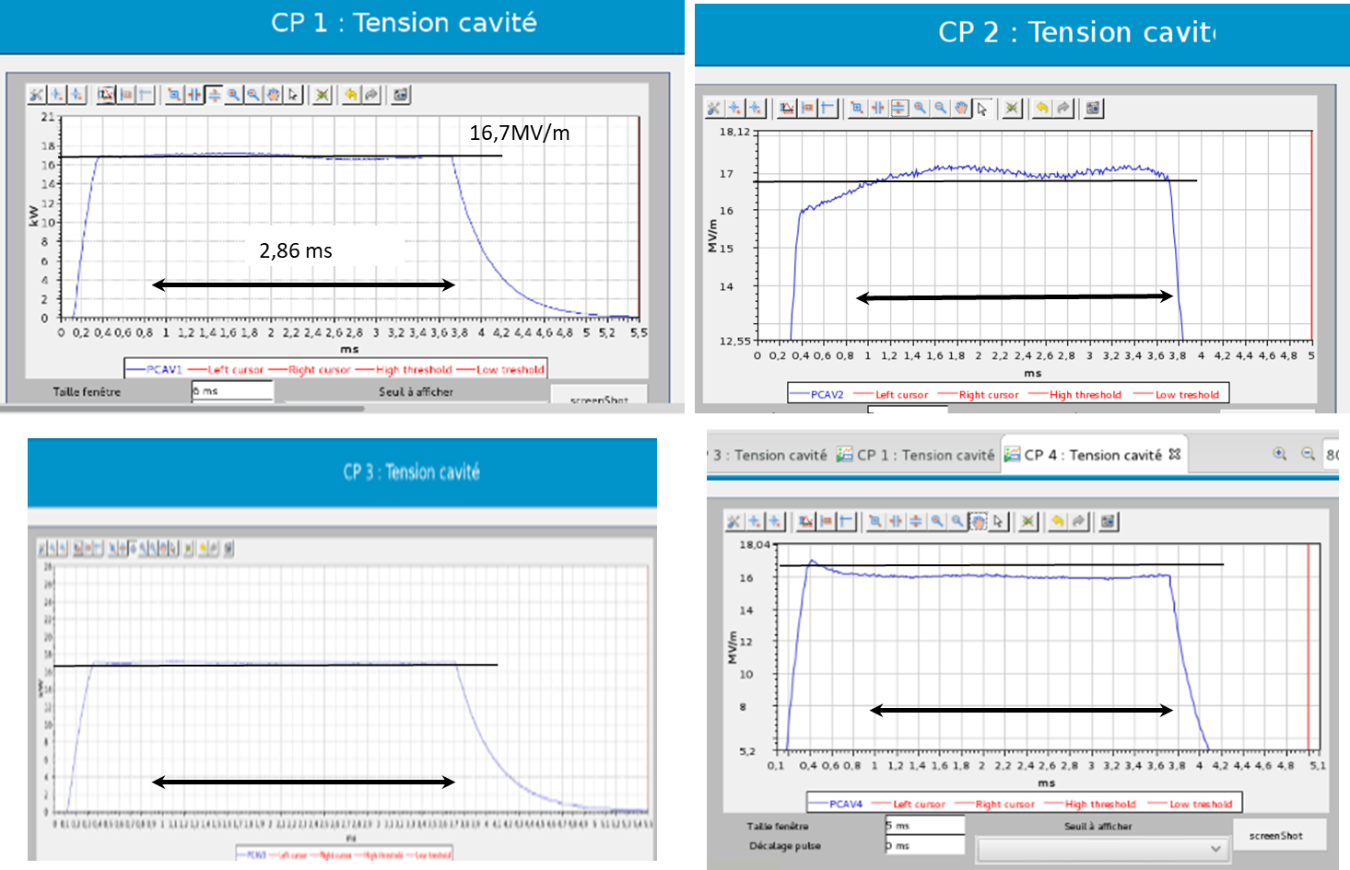
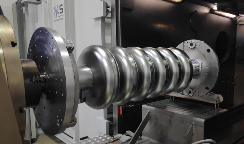
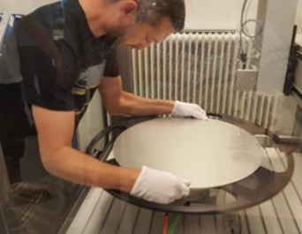
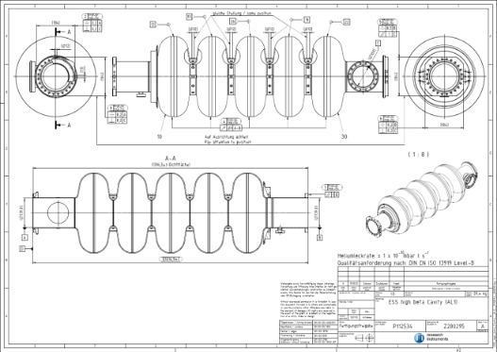
Work progresses actively at in-kind partners (1/2)
Cryomodules and elliptical cavities
  Development phase : Medium-β Cryomodules demonstrator tested, nominal gradient obtained in cavities (CEA-Saclay)
  Medium Beta cavities production (INFN- LASA)
    3 cavities welded
    2 cavities bulk BCP surface treatment done and annealing
RF voltage in
cavities 1-4
(Open loop &
Trapezoid pulse
on piezo tuner)
Prototype cryomodule
with elliptical cavities
is now at Lund
for testing…
- High Beta cavities production (STFC – Daresbury)
  Niobium Material - Contract awarded in Oct17
  Final Nb batch delivery expected in Dec18
  Cavity Manufacture - Contract awarded in Jul18
Mail from P. Michelato (INFN) on 21/12/2018:
“…The first INFN-LASA medium beta cavity… reached
23.7 MV/m with a Q₀ of 7.9e9. At the ESS field of 16.7 MV/m,
the Q₀ is 1.7e10, well over the ESS requirements of 5e9.
The frequency at cold is 704.221 MHz with a Q_{t} of 3.6e11…”

Slide 13
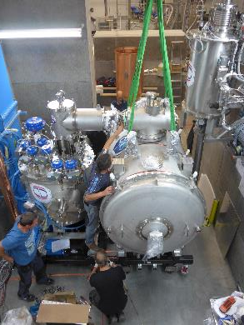
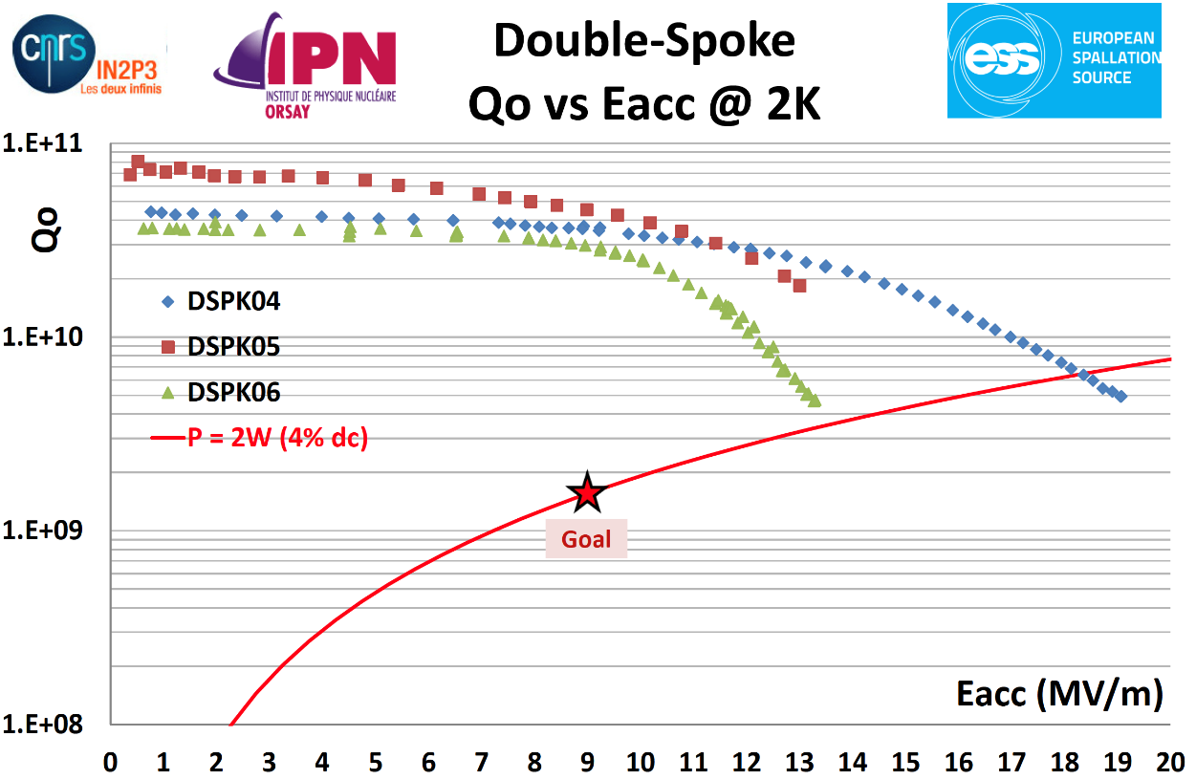
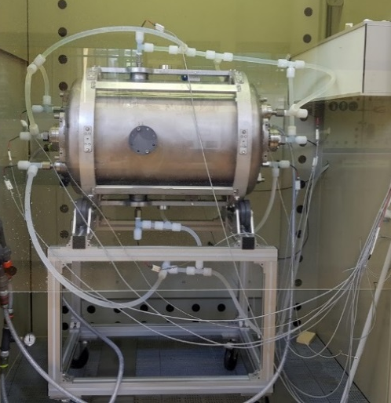
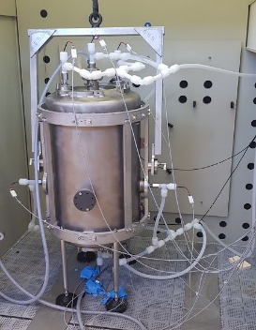
Work progresses actively at in-kind partners (2/2)
Cryomodules and spoke cavities
Prototype cryomodule delivered
at FREIA (Uppsala)
RF tests in April 2019
Assembly of the 1st series cryomodule will begin mid –March
Delivery at FREIA mid-May
3 series spoke cavities have been tested and exceed requirements

Slide 14
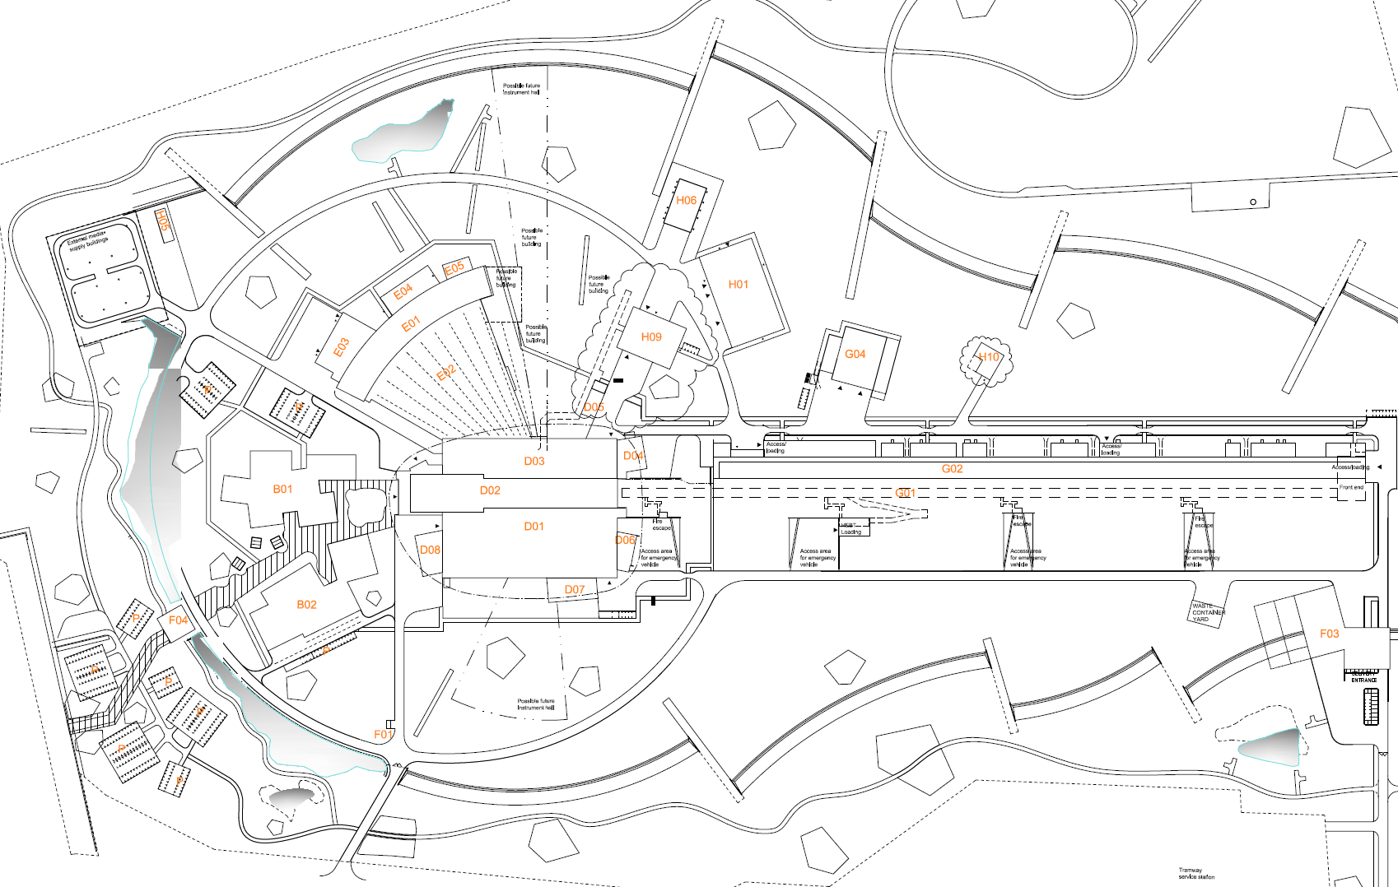
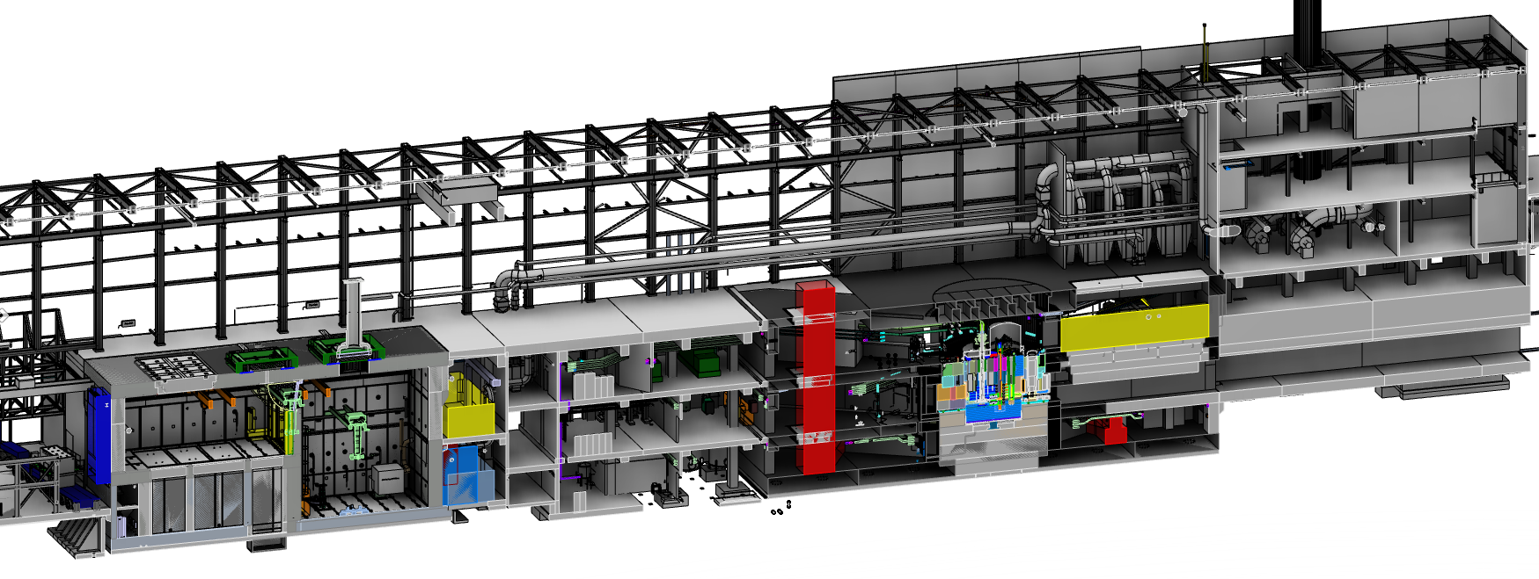
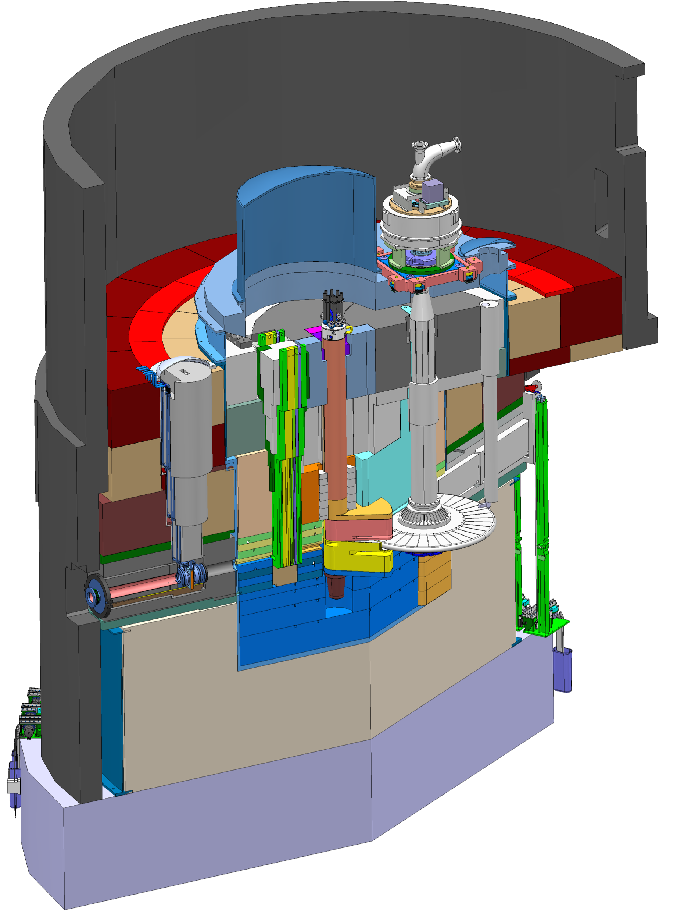
ESS Target and Target building
(Target subproject is 43% complete – Main contracts signed)
Target Building
Utilities and cooling plant
Remote handling systems
High bay
22 m
130 m
Transport hall
37 m
Target Building
Moderator and reflector
proton beam instrumentation plug
monolith vessel
neutron beam extraction port
Target
monolith
Active cells
Utilities block
Beam expander hall
proton
beam
target wheel
target monitoring plug
Target Monolith
Rotating solid tungsten target (11 t, 23.3 rpm)
Moderators (LH₂ – 17 K and H₂O – 300 K)
Helium gas cooling of target (11 bar, 3 Kg/s)
Target Safety System
Diagnostics and instrumentation
proton
beam window

Slide 15
All Target Work Packages are allocated
Target Sub-Project has 22
in-kind work elements
  TA or CA signed for 10
  work elements
  Partner selected for another 4 work elements
  Completed 2
  Self Performing 6 work elements
78.2M€ total Inkind achieved, this represents 37% of Target Scope

Slide 16
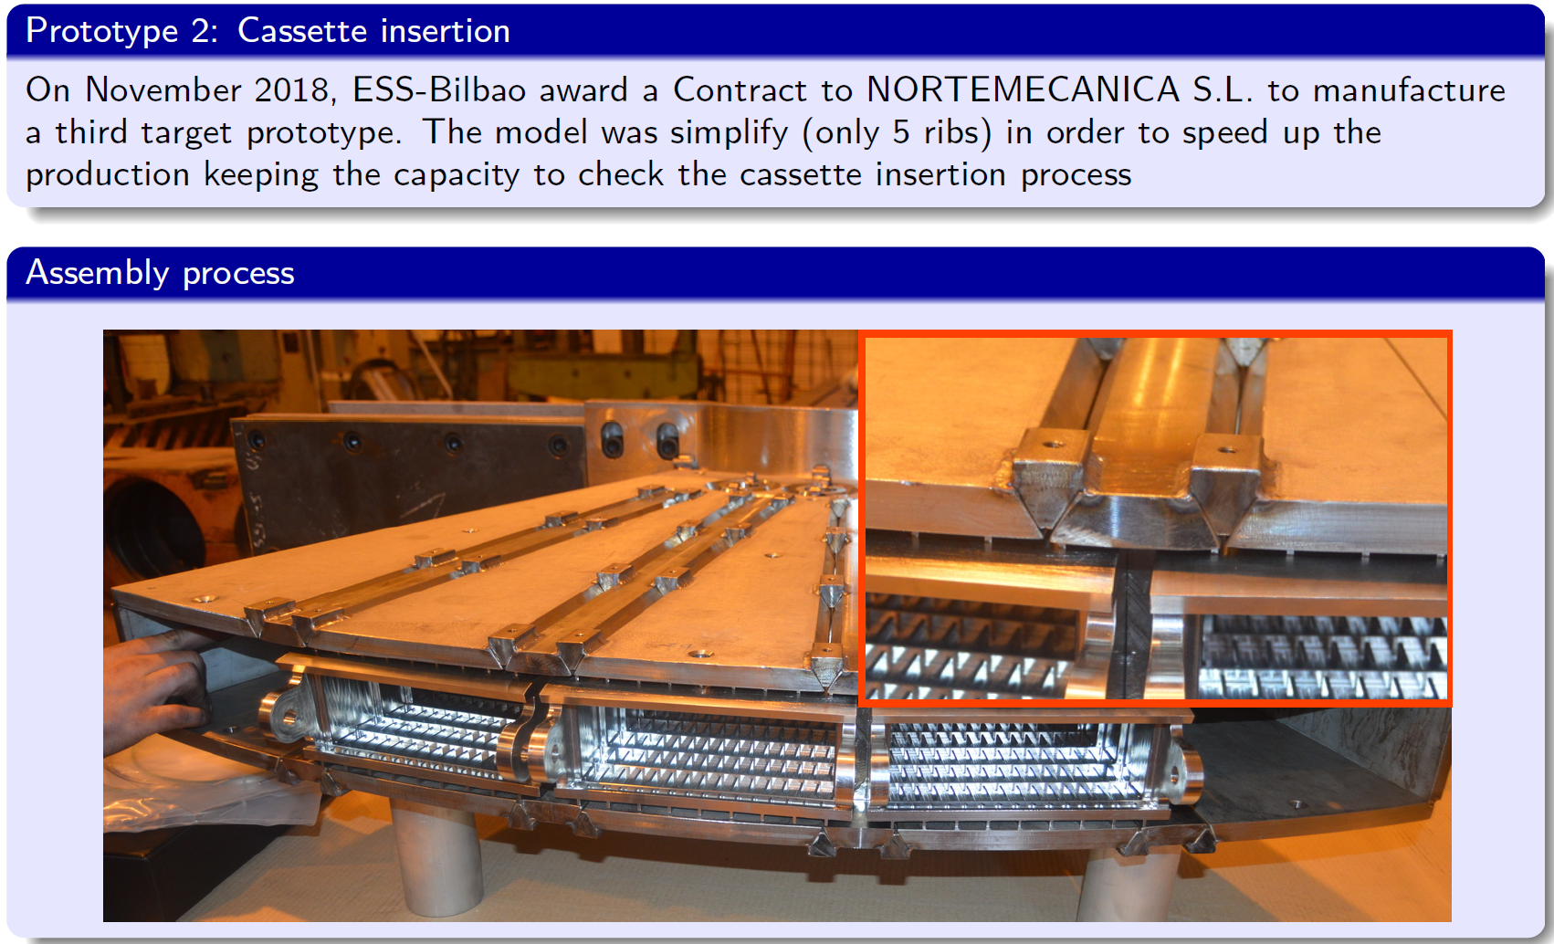
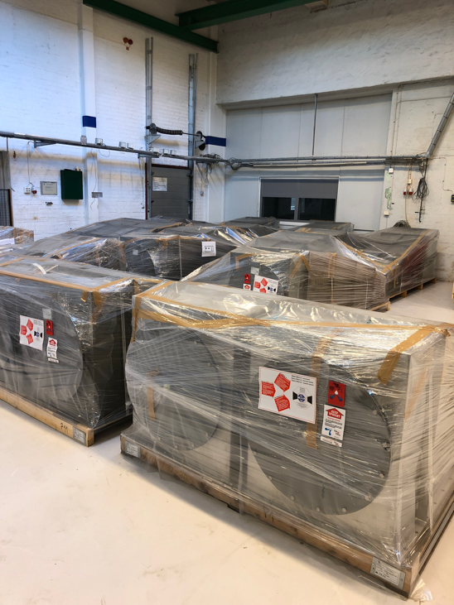
Good progress of target work packages at partners
Target wheel prototype
Vacuum chamber and cold moderator
Acceptance test of Be reflector
Twister shaft ready milled
HVAC delivered at Lund

Slide 17
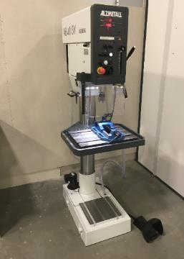
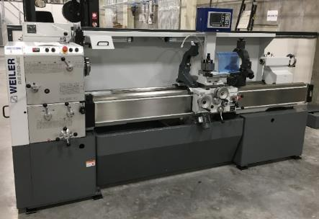
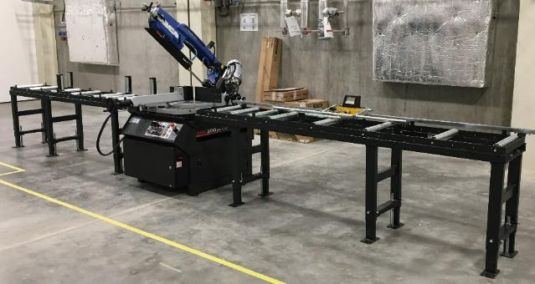
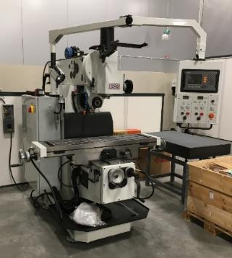
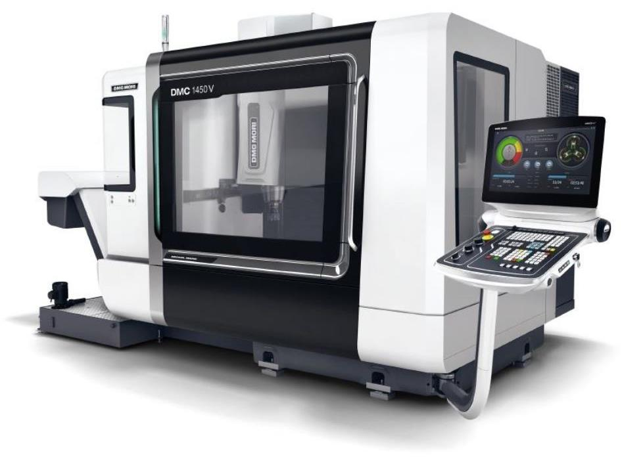
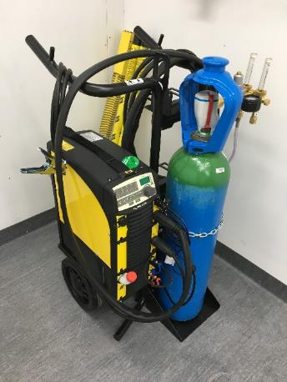
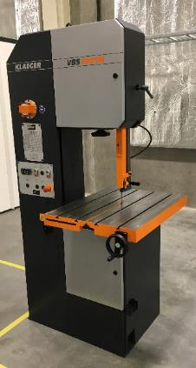
The Temporary Technical Centre (TTC) is operational
(Preliminary version of ESS central workshop located in G02 building)
Column drill
Throat depth 300mm
Up to Ø50mm/M30 drilling capacity in steel
Manual milling machine
Horizontal and vertical spindles
Max. travel 850x300x500mm, 300kg
Manual lathe
Max. workpiece Ø530x2000mm, 500kg
Horizontal band saw
Double mitering, max. Ø300x6000mm
CNC milling machine ordered
Arrival of CNC milling machine
3 axis simultaneous machining
1450x700x550mm XYZ
Up to 2t on table
20 000rpm spindle
Operative lease arrangement
Vertical band saw
Max. workpiece height 400mm
Fitted with moving table
Additionally:
Precision measuring equipment
Hardness tester
Precision assembly equipment including bearing installation
Removal/extraction/repair tooling
Numerous hand tools
Manual and magnetic base drills
Bar stock bender
Grinding and linishing
Aluminium circular saw
Hydraulic press – 40T & arbor press - 8T
MMA, MIG & TIG welding
Steel and aluminium
No certified welding under ISO3834 yet

Slide 18
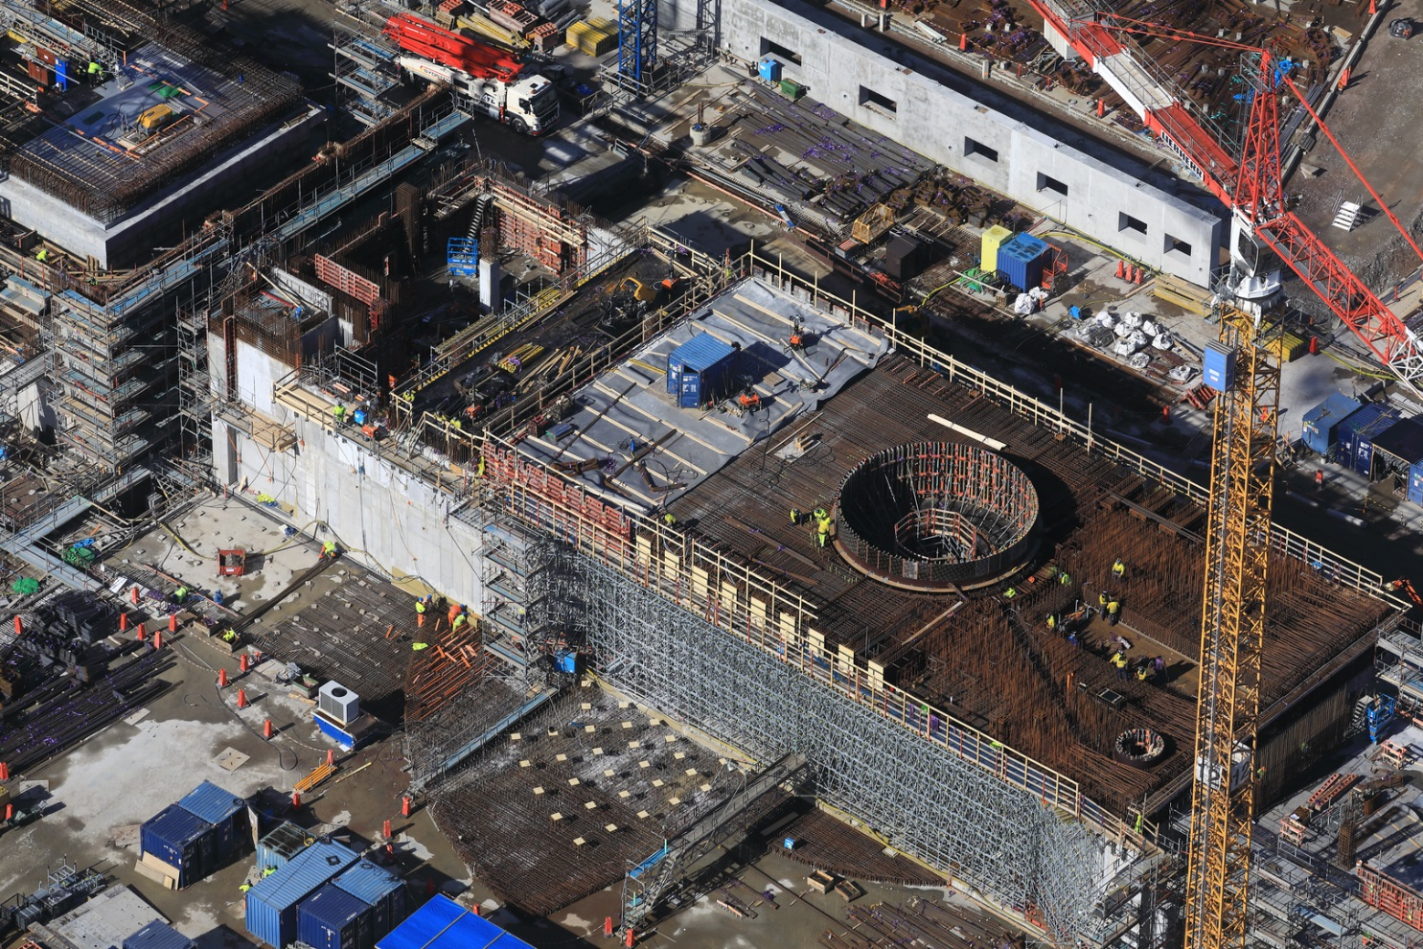
High bay slab will soon be cast
(CF is 69 % complete)

Slide 19
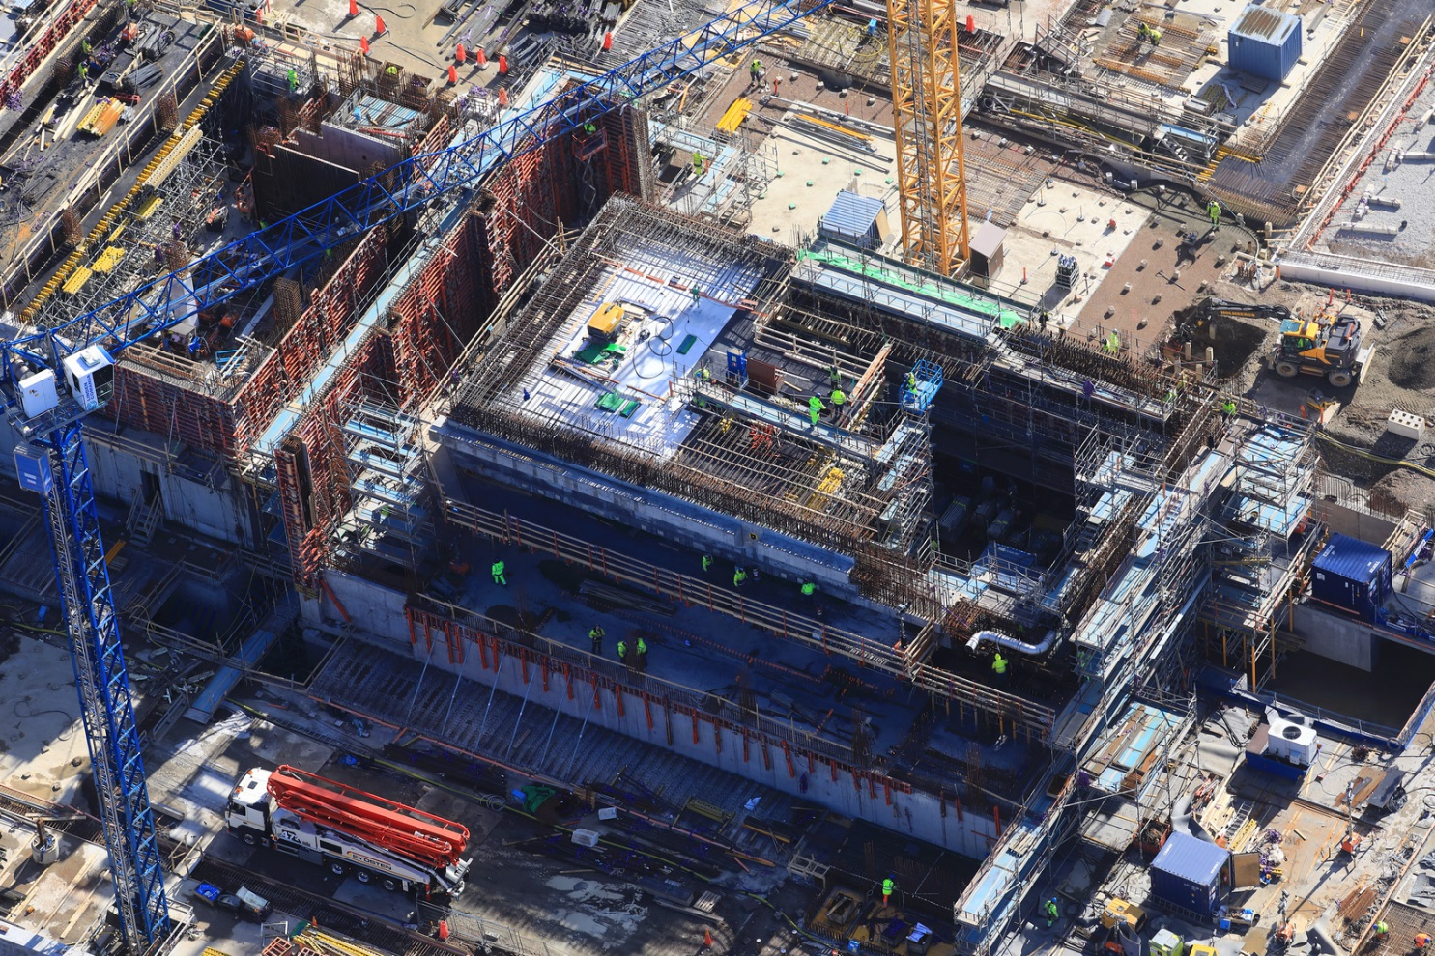
Construction of Active Cells is advancing as planned

Slide 20
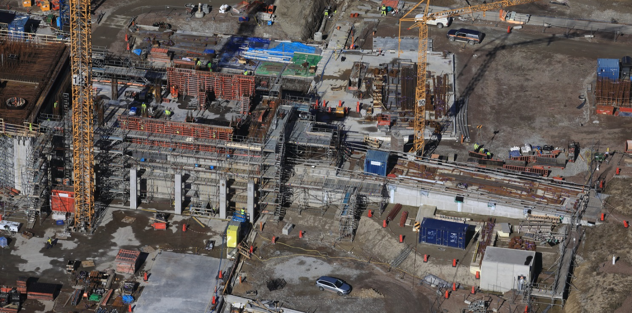
Casting of A2T roof is soon finished

Slide 21
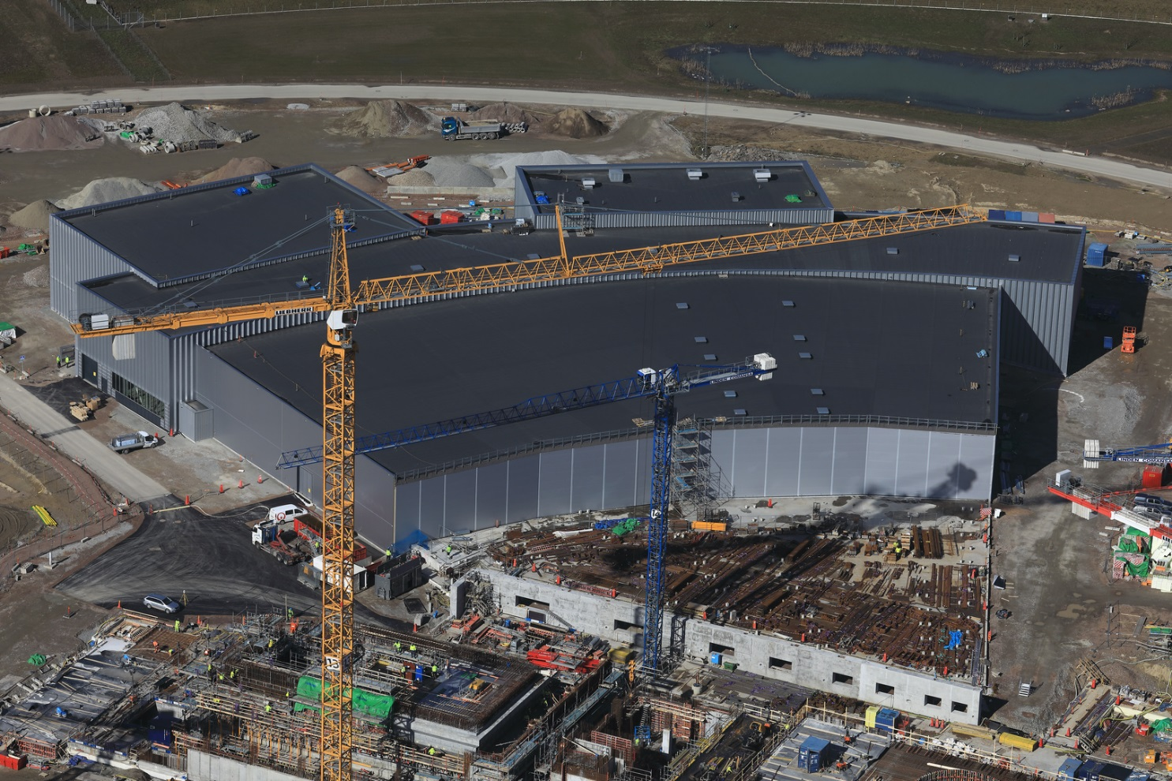
Construction of experimental hall E01 is well advanced
(NSS is 27 % complete)

Slide 22
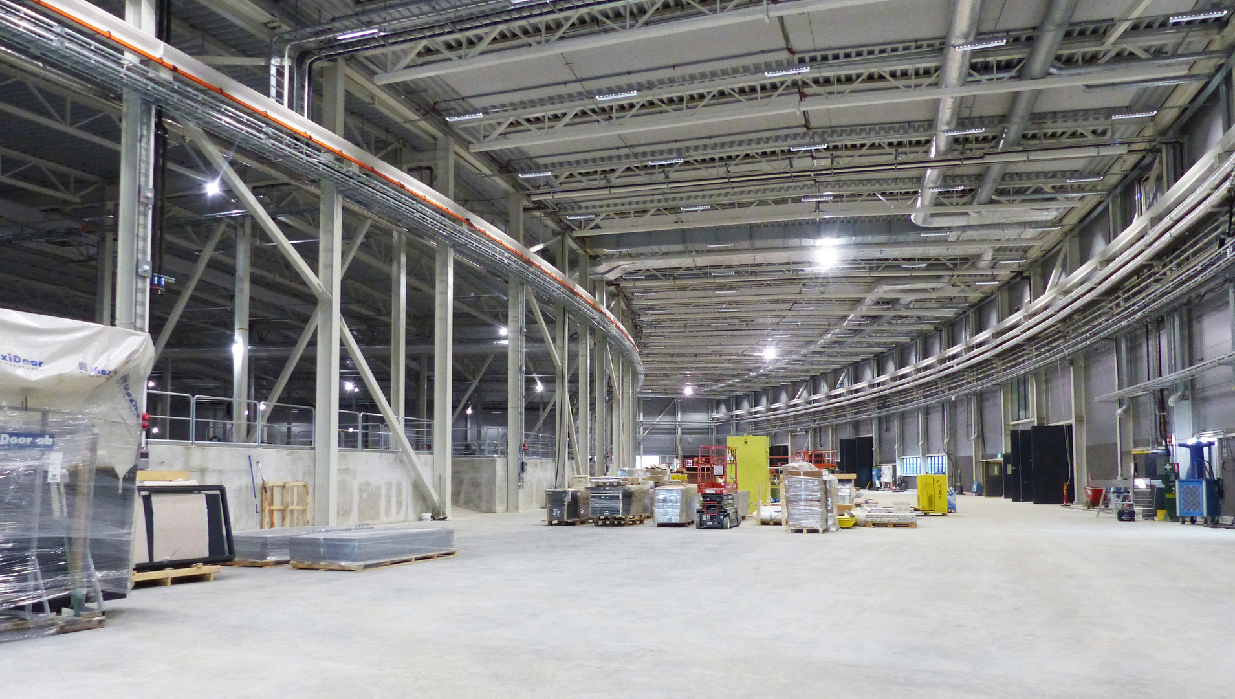
Installation of Instruments in E01 will start this Summer

Slide 23
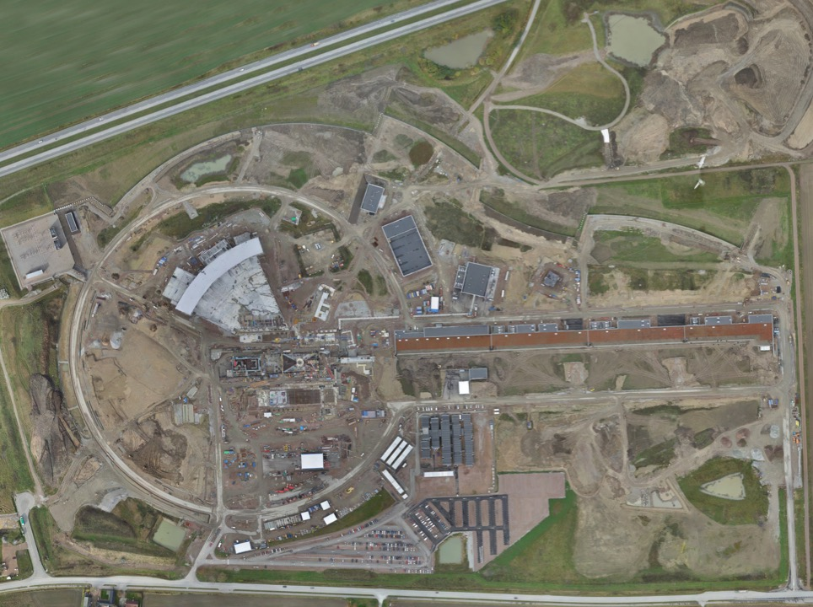
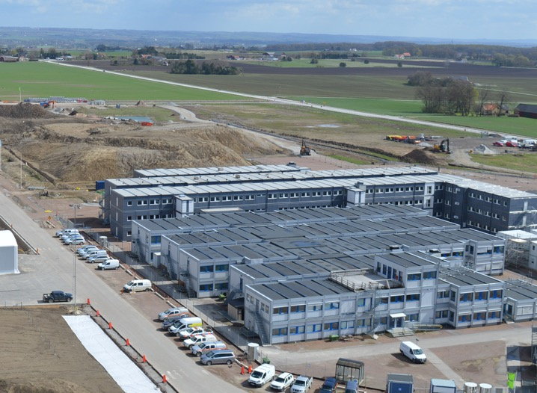
Moved to site in summer 2018 -
Moving to permanent office and lab buildings in 2021
Permanent
Office Campus
2021
New 2018 ESS offices for all staff
PermanentEntrance
Bus 20
Lund Tramway Depot

Slide 24
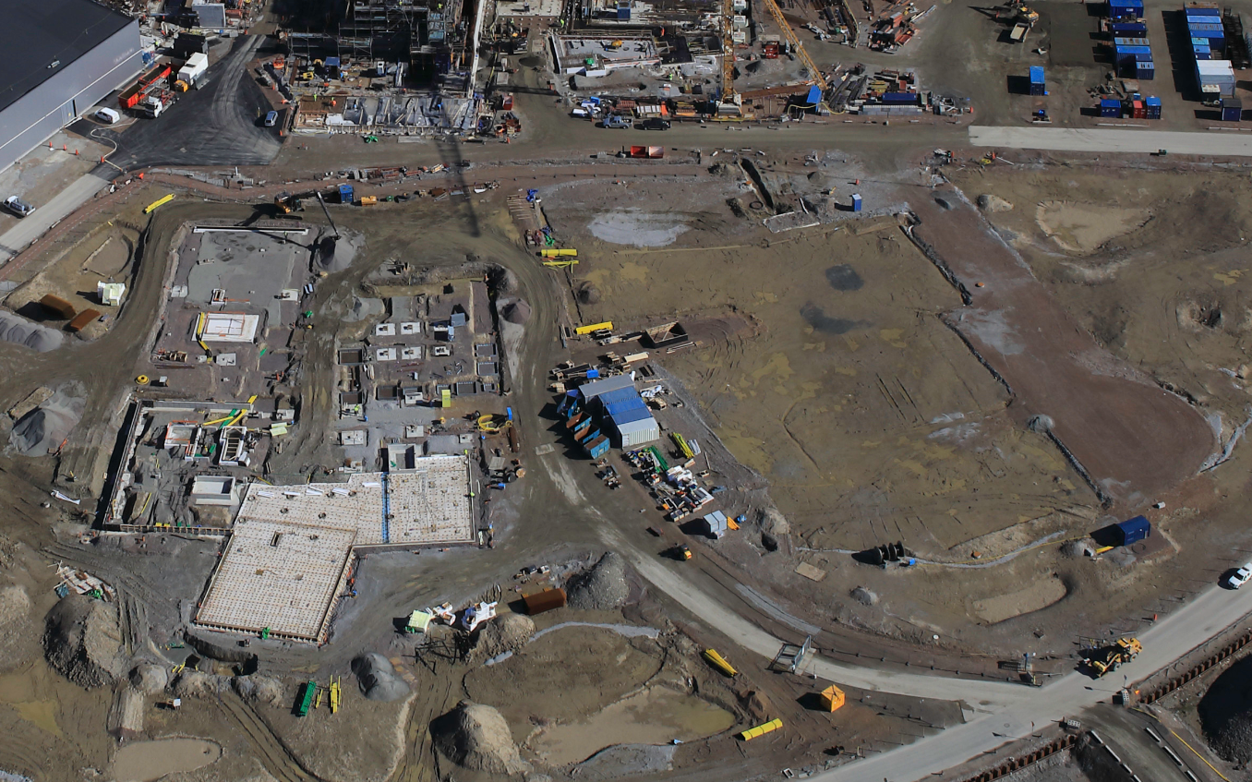
Status of Office and Laboratory Campus
Ground breaking
In December 2018
Campus will consist of 3 buildings, 450 workspaces, 16 labs and workshops

Slide 25
Key activities in 2019
Start of series cryomodules testing in TS-2 (G02 - Lund) and FREIA (Uppsala)
Installation of cryolines in Accelerator tunnel (G01)
Installation of servers in Server Room (H01) for ICS, DMSC and IT
Infrastructure installation in klystron gallery (G02)
Permit application for normal conducting linac
Start of assembly of DTLs
Installation and start conditioning of RFQ and DTL1
Target Building (D02) access granted for start of technical (Target) equipment installation
Start of Instruments installation in long beamline Experimental Hall (E01)
Construction of Campus and Lab. Buildings
…

Slide 26
Summary
The ESS facility is >58% complete. Important progress has been accomplished during the past year both at ESS and at the in-kind partners.
Project execution is on track with the new schedule established by mid-2018. Focus is on day-1 science.
The ESS organization is evolving to adapt from construction to installation, commissioning and operations.
Plans are being made for the transition to operations for early Science.
Budget and activity are peaking in 2019. It will visibly materialize with the delivery and installation of a large amount of equipment for Accelerator and Target.

Slide 27

Thank you for your help!

