Slide 1
Charge and Agenda
of the 19th TAC meeting
10-12 April 2019, Lund
Roland Garoby
https://indico.esss.lu.se/event/1188/

Slide 2
TAC #19 – ESS context
Accelerator, Target and ICS subprojects are now respectively 54, 43 and 54% complete, contributing to the 58% level nowadays attained by the whole ESS construction project. It materializes highly visibly at Lund with the delivery of numerous equipment (waveguides, klystrons, Target HVAC system…) and the progress of construction (bunker for Test Stand 2, assembly room for DTL tanks, progress with infrastructure installation in G02…)…
Progress is also taking place at the partners’ locations like for example with the test of the prototype spoke cryo module in Uppsala, the finalization of moderator and reflector in Julich, the realization of 3rd version prototypes of Target wheel and proton beam window in Bilbao etc. Copper plating of the DTL tanks (work package of INFN Legnaro) is now advancing as scheduled. Series manufacturing of all types of superconducting cavities is taking place (spoke, medium beta and high beta elliptical cavities). Teams are ready for assembling cryomodules.
New large procurement contracts have been signed by ESS and partners (klystrons for high beta section of the linac, inner and outer target shielding, NBEX manufacturing, …)…
Overall advancement is basically in line with the new baseline schedule, although some specific work packages still deserve attention and may require mitigation (e.g. delivery of 352 MHz waveguides by ESS-Bilbao, RFQ by CEA, RF amplifiers for spoke cavities by Elettra, …).

Slide 3
Questions to the TAC for its 19th meeting - Accelerator -
a1) Please comment on the experience so far from the ion source and LEBT commissioning and operations. Does this experience and the lessons learned bode well for future linac operations?
a2) Do you have proposal for late changes to the suite of beam instrumentation at ESS and/or do you think the planning and staffing is correct for the proposed work? Do you have proposal for priorities for the beam instrumentation if we can’t complete all systems in time?
a3) Work on SRF for ESS will increasingly transfer to the ESS site and the ESS test stands in Uppsala and Lund. Please give your view on the presented plans, we especially need your comments on the schedule and the staffing of this work.
a4) Do you have comments on the operation planning for the ESS accelerator? Is the operations section staffing and training adequate to support the near-term (few years) commissioning needs?
a5) Accelerator and ICS work closely together and will have to work even more closely in the future for the testing and commissioning phase. Please comment on the methods for priorities and resource allocation. Are there other ways to organize this work which we should consider?
a6) Have we missed anything?

Slide 4
Questions to the TAC for its 19th meeting - Target -
t1) Concerning “Target wheel design and manufacturing challenges, includes the seal and drive unit”:
Will the presented technical solution, for the Target Wheel be a reasonable compromise to conflicting and challenging requirements?
Are the schedule risks sufficiently managed to prevent impact on RBOT?
t2) Concerning “NBOA and Port Insert, design, tolerances, interface with NSS”:
Will the presented technical solution, for the NBEX system be a reasonable compromise to conflicting and challenging requirements?
Are the schedule risks sufficiently managed to prevent impact on BOT?
t3) Concerning “Update on the plant areas (water cooling plant, filter areas, etc.) and the active handling”:
Will the pursued technical solutions for water cooling and waste management of filters and contaminated water assure safe, efficient and reliable maintenance work within the Target Station? Proper ALARA?
t4) Concerning “Follow up on the inner shielding, including the selected design and progress, Team will see the mockup at RATS”:
Will the presented technical solution to water cooled inner shielding be acceptable to minimize the risk of leakage?

Slide 5
Questions to the TAC for its 19th meeting - ICS -
c1) Is the updated control system integration strategy appropriate and adequate? Suggestion for improvement are welcome.
c2) Do you see any improvements that can be made using recent learnt lessons?
c3) Is the way forward for controls development and integration of instruments feasible?
c4) Is the safety classification work for basic process control systems appropriate and adequate?
c5) Is the integration of machine protection strategies into operations likely to be successful?

Slide 6
Questions to the TAC for its 19th meeting - EIS -
e1) Is the proposed approach for interacting with the in-kind partners going to lead to delivered documentation of the proper quality and usability? Additional suggestions are welcome.
e2) Is the level of Configuration Management and Change Control, provided by Spatial Integration, on the right level to fulfil ESS requirements on Facility Documentation?
e3) Is the strategy for centralized support of mechanical design convincingly fulfilling requirements and needs for production, installation and future operations?

Slide 7
TAC #19 – Additional information
The Committee is encouraged to provide also suggestions/comments and recommendations on any other subject it would find relevant. Feedback on the follow-up of former TAC recommendations is welcome.
A preliminary version of the TAC report is expected during the closeout session in the afternoon of Friday 12, April. The final report is expected before the end of October. The Chairman will orally present the TAC#19 report to the ESS Council on June 4-5.

Slide 8
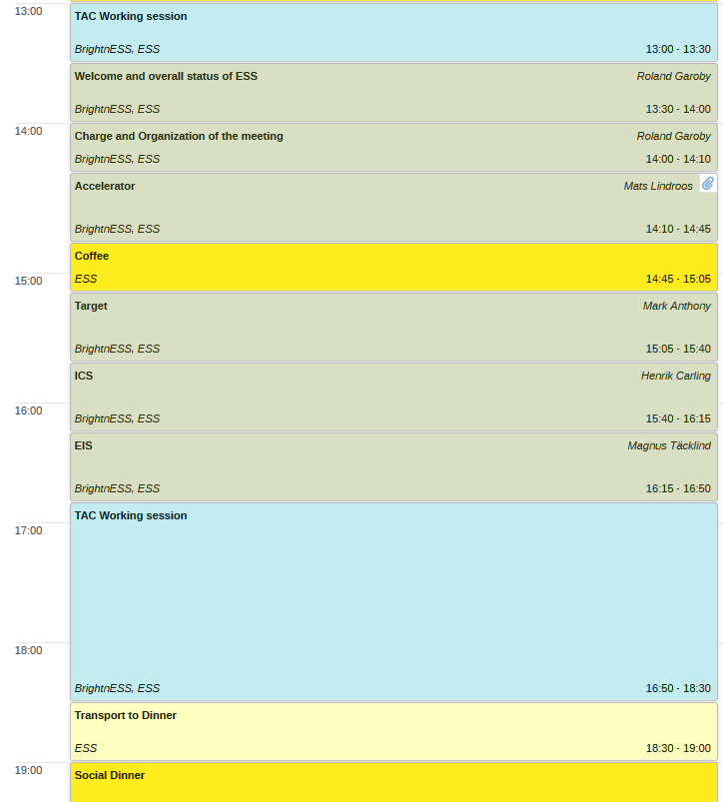
Agenda TAC#19 Wednesday 10 April 2019
TAC initial session
Plenary session
TAC session
Dinner

Slide 9
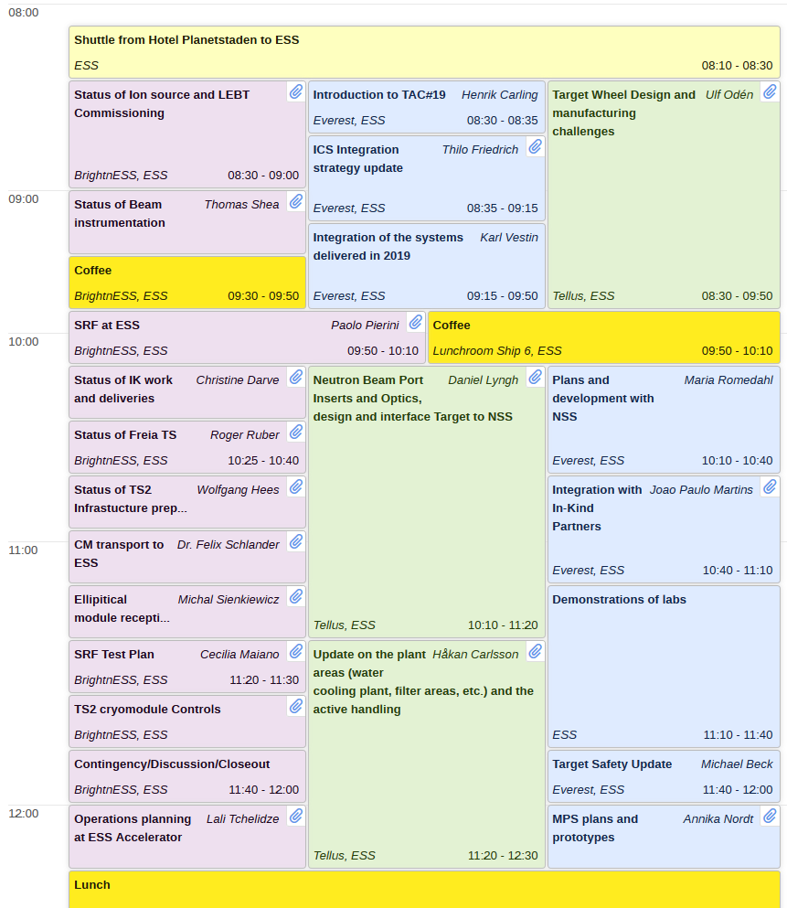
Agenda TAC#19 Thursday 11 April 2019 (am)
Parallel sessions

Slide 10
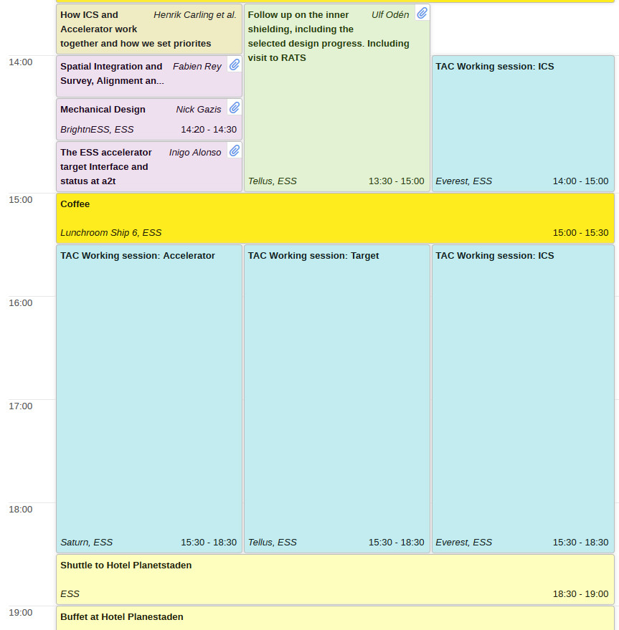
Agenda TAC#19 Thursday 11 April 2019 (pm)
aTAC-tTAC joint session
Parallel sessions
TAC sessions

Slide 11
Agenda TAC#19 Friday 12 April 2019
TAC sessions
Public close-out
Site tour

Slide 12
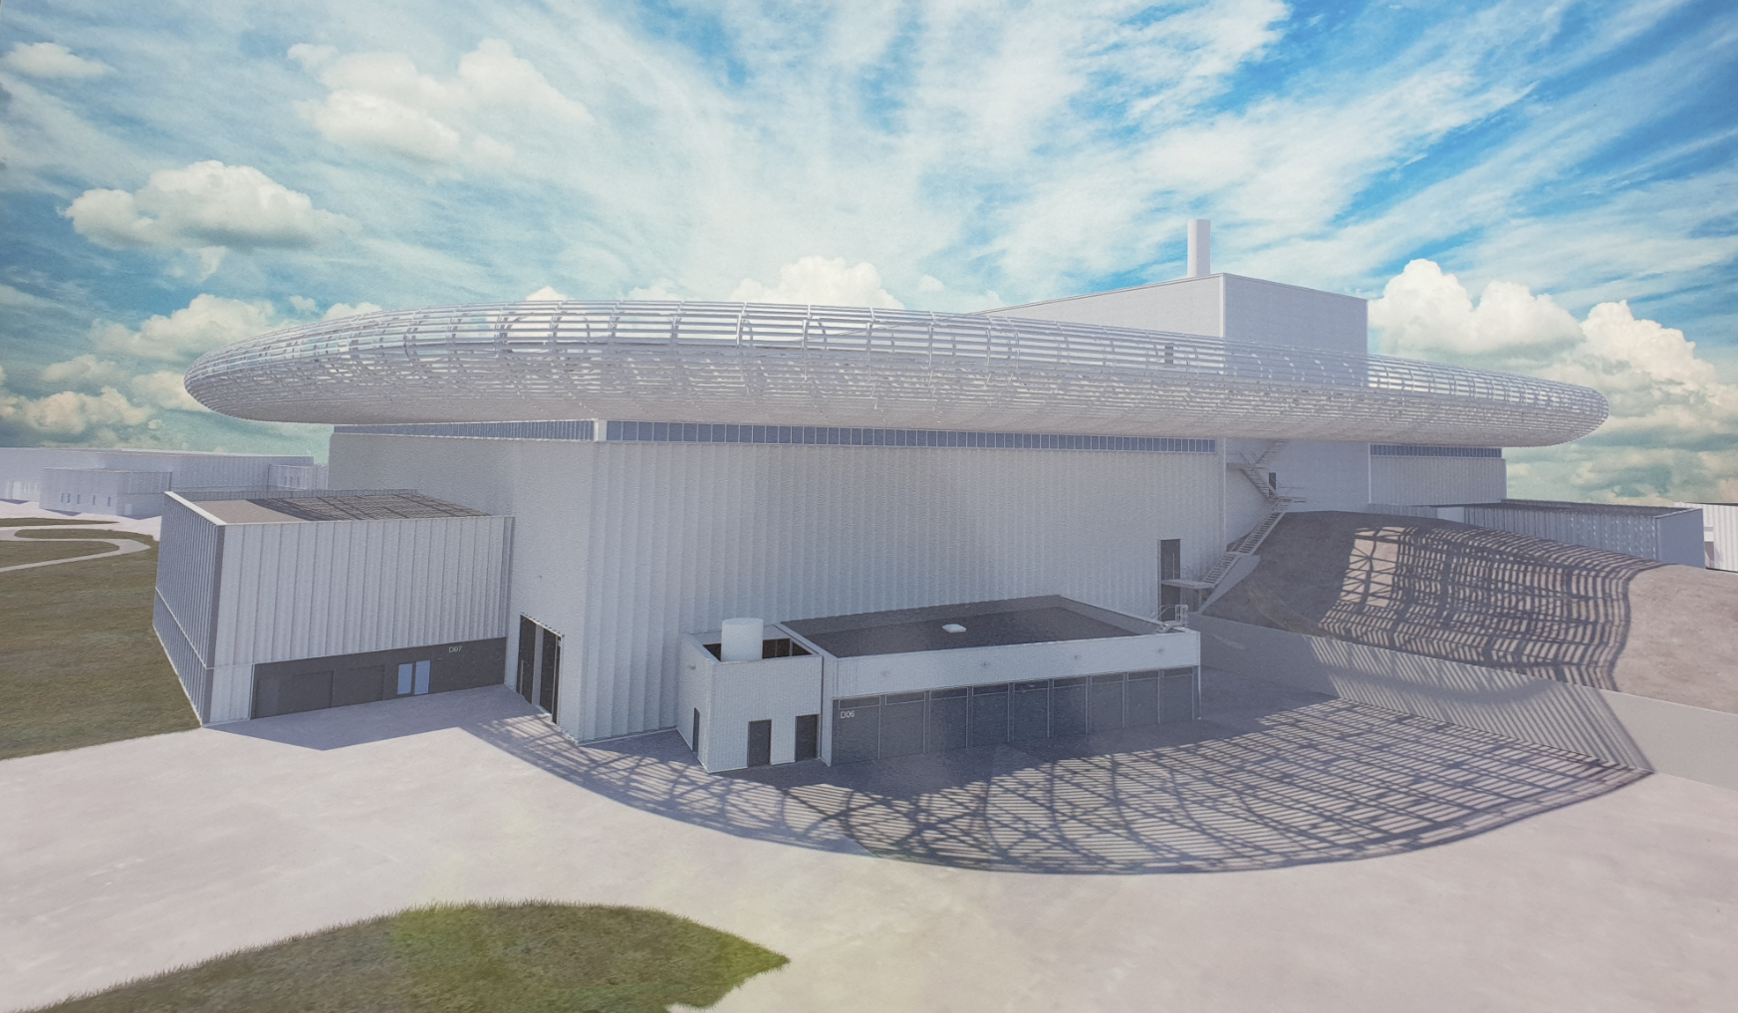
Thank you for being here.
We look forward to your advice!

