Slide 1
TAC 10-12 April 2019
ACCSYS (Accelerator) sub-project
Mats Lindroos
Head of Accelerator Division and ACCSYS sub-project
European Spallation Source ERIC

Slide 2
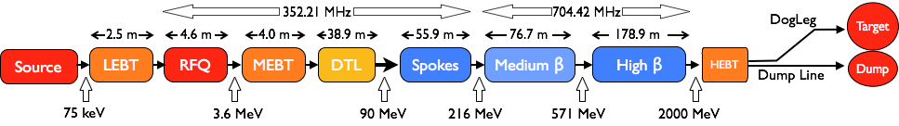
Accelerator – Scope
Accelerator Technical performances
Key parameters:
    -2.86 ms pulses
    -2 GeV
    -62.5 mA peak
    -14 Hz
    -Protons (H+)
    -Low losses
    -Minimize energy use
    -Flexible design for mitigation and future upgrades
Design Drivers:
High Average Beam Power
5 MW
High Peak Beam Power
125 MW
High Availability
95%
18 IK partners in 8 countries and 5 collaboration partners
1.3 GeV capacity with 2 MW on target for 2025 with remaining RF sources (40) to be installed after 2026

Slide 3







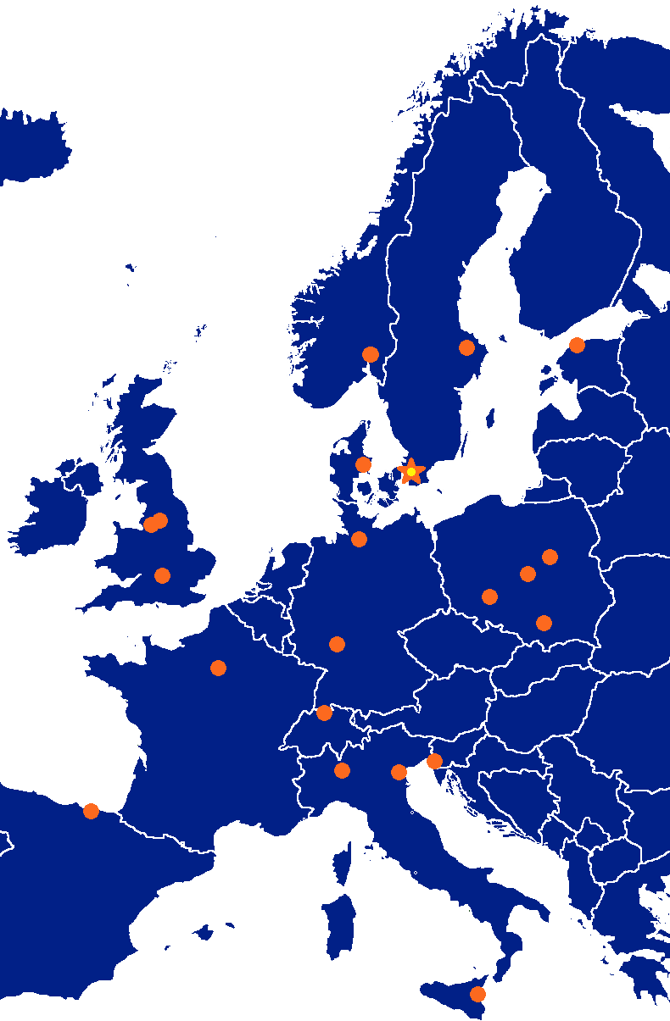

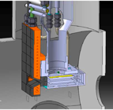


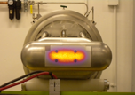
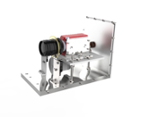





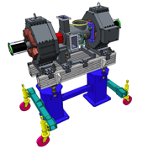









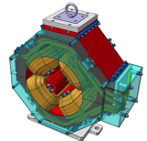

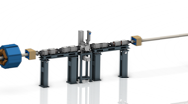



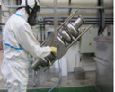












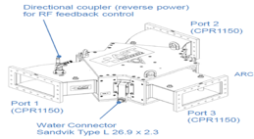
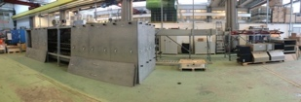
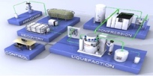







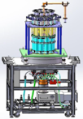
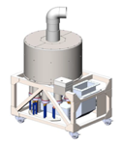






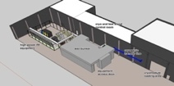
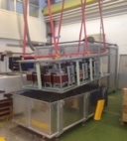

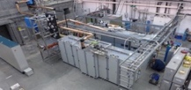
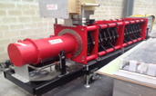
Accelerator Collaboration
3

Slide 4
High level accomplishments
Ion source and LEBT commissioning under way
RFQ machining progressing with first 3 segments brazed
MEBT assembly completed in Bilbao and SAR passed
M-ECCTD tested at CEA-IRFU and shipped to Lund
DTL machining of all parts started with at least 4 sections out of 20 copper plated
All contracts signed for all sub-elements for the Elliptical CM series and manufacturing in progress
Spoke prototype CM under testing, all parts for series contracted and under manufacturing
>10 series klystrons delivered
Final design of modulator, test of all sub-systems and assembly started of 1 series modulator
LLRF assembly started and reference line installation in tunnel close to complete
Test stand 2 construction close to completion and DTL workshop at ESS ready
RF wave guide, circulator and load installation in gallery and stubs started
Instrument cryoplant is operational, Accelerator and Target moderator plant being installed and commissioned.
Cryodistribution lines under manufacturing with IRR passed and installation starting after easter
And more as we are in the middle of construction, assembly and installation

Slide 5
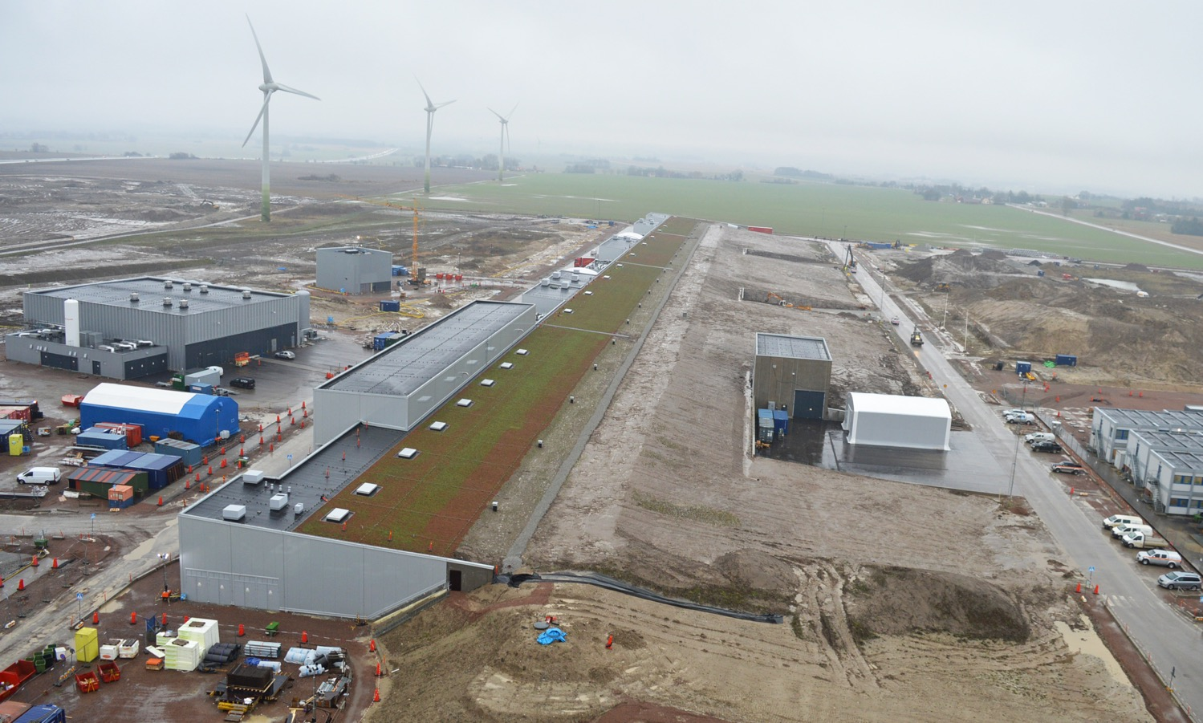
Accelerator & Klystron Gallery
Thanks to Anders Ingels

Slide 6
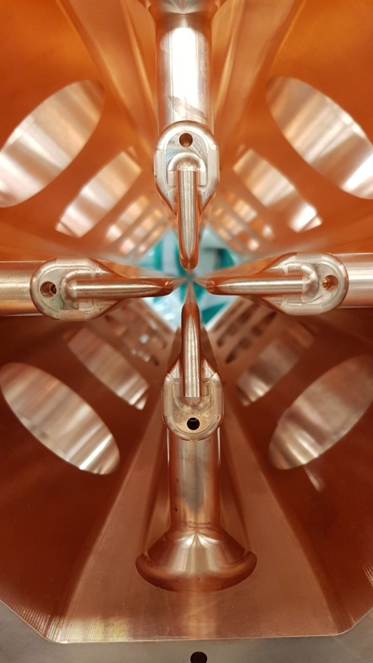
NC Accelerator

Slide 7
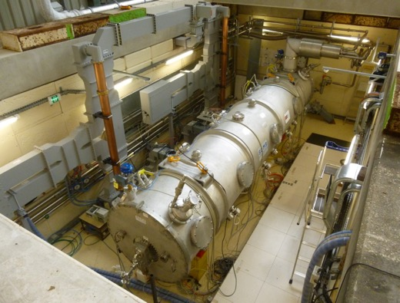
MEBT, RF systems and cryomodule

Slide 8
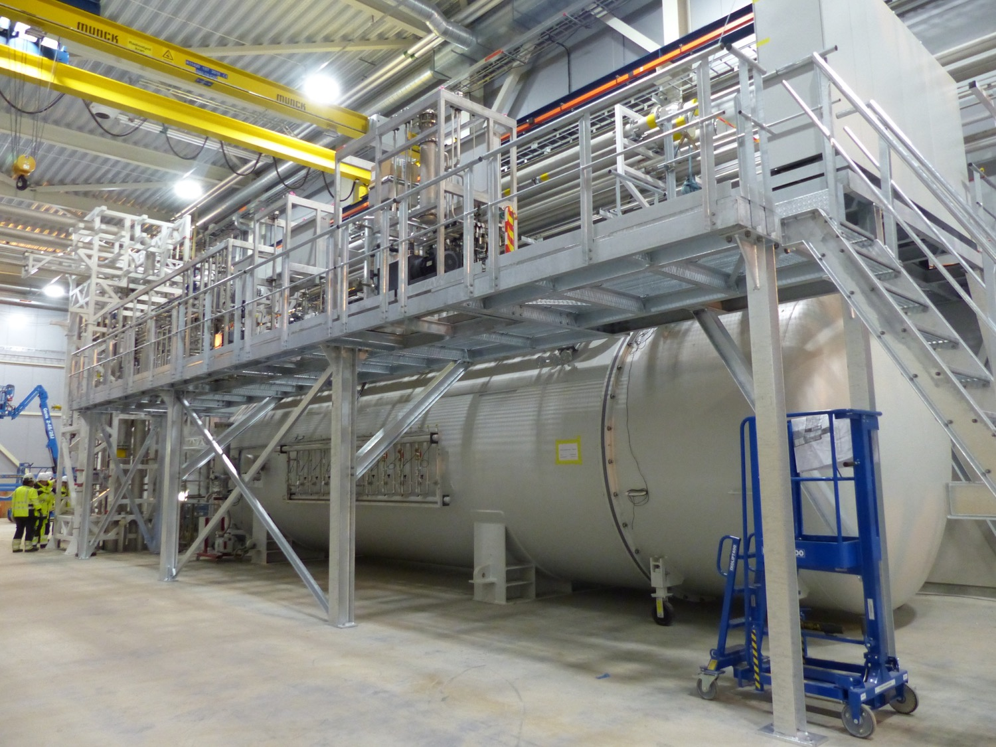
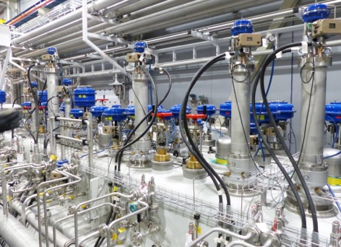
Cryogenics

Slide 9
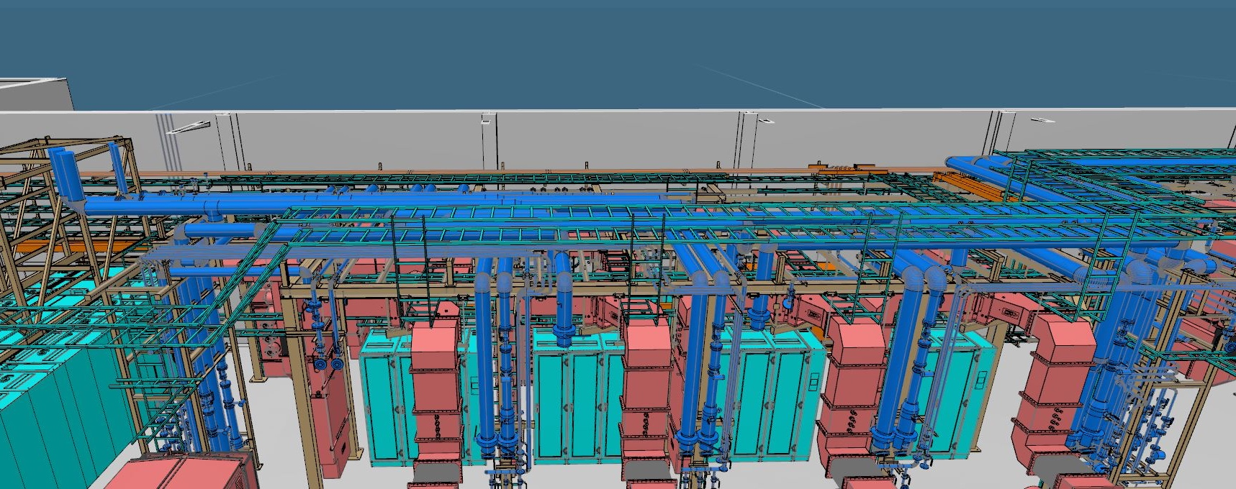
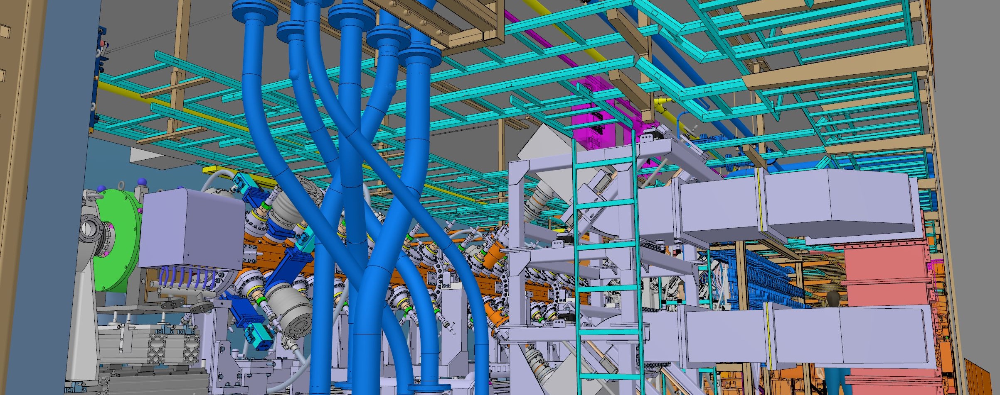
Infrastructure

Slide 10
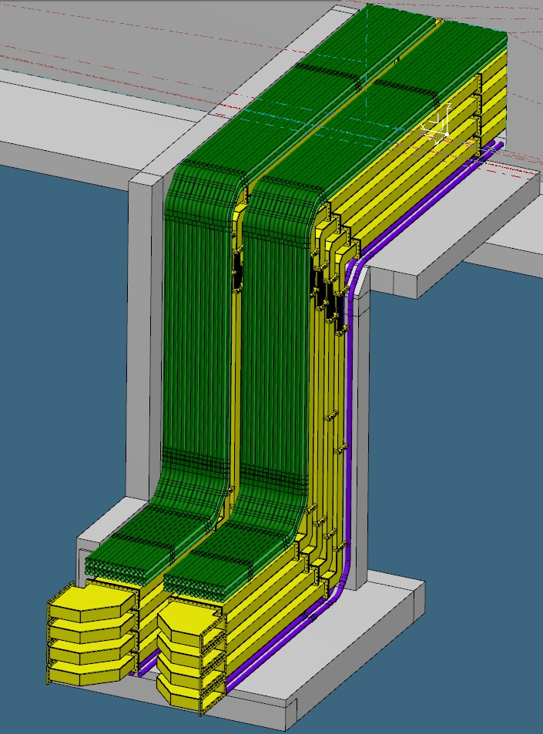
Infrastructure

Slide 11
Installation principles packages for infrastructure sub-project
Infrastructure installations
    Cooling water to RF systems (G02) and manifolds (G01)
    Instrument air manifolds
    Cable raceways; including ICS
    Cabling
    Power distribution (G02)
    Grounding
    Rack installation and population
    Shielding
    Mechanical supports and stands
Component installation
    Marking and drilling
    Alignment
    Installation (moving, lifting, bolting, etc.)
    Support systems installations; e.g., vacuum, cryo, BI

Slide 12
Infra project status
First 100 m
Primary supports NC Gallery installed
Rack secondary steel supports – installations in progress
Piping installations in progress (NC & Spok)
Raceways installations in progress (NC & Spok), including northern and southern wall
Cable routing in progress for RFQ/MEBT/DTL sections
Procurement cable and connector started TS2 and Normal conducting
Remaining sections
Design started for MBL/HBL cell 170A & B piping and cable raceway
Instrument air (IAR) TS2 TS3 ongoing - Design in review
PRL gas pipes – Design in review
nBLM gas pipes – Design in review

Slide 13
High level message for infrastructure sub-project
The PDU design is critical to support rack power distribution, manufacturing start of PDU
Preparation and implementation of minor installation Pipe supports/cable trays over components/conduits for PSS/wather manifolds and couplings to components/ in the tunnel under prep. And to be finalized before the RFQ installation
Cross functional systems require extra resources and focus to be synchronised with the overall AD project;
  Cryo. distribution system, need accelerated design and installation efforts
  Phase ref line, need interim solution for testing, will be achieved in two phases.

Slide 14
Prioritizations and work forward
Infra project targets for 2019
Infra project targets, in order to allow for testing of RF systems
  Cooling, IAR, raceways, and cables installed and terminated in NCL G01
  Cooling systems for SPK, MBL, and HBL in G02 installed and ready for connection to components
  Cable raceway systems for SPK, MBL, and HBL in G02 installed
  Piping and cable raceways for SPK, MBL, and HBL in G02 grounded
  Power distribution systems for NCG, SPK and MBL installed
  Racks and PDUs for NCG, SPK and MBL installed
Infra project design targets, in order to meet NSS infra scope
  All cooling system, and IAR design issued for construction
  All cable raceway design issued for construction
  Plan for cable routing design defined
Infra project targets for 2020
  Power distribution systems for HBL installed
  Racks and PDUs for HBL installed

Slide 15
Major Installations
ISrc to Beam Dump (BOD)
2/7/2021
ISrc to DTL1
ISrc to DTL4
RBOT
Today
17/2/2020
5/10/2020
14/10/2021
2019
2020
2021
2022
ISrc to DTL1 Beam Commissioning
13 wks
ISrc to DTL4 Beam Commissioning
13 wks
ISrc to DMPL Beam Commissioning
13 wks
NCL Installation (RFQ/MEBT/DTL1)
NCL Installation (DTLs)
NCL RF System Installation
SPK CDS Installation
SPK CM Installation
SPK LWU Installation
SPK RF System Installation
Elliptical CDS Installation
MBL CM Installation
MBL LWU Installation
MBL RF System Installation
HBL CM Installation
HBL RF System Installation
HEBT/A2T LWU Installation
Infrastructure

Slide 16
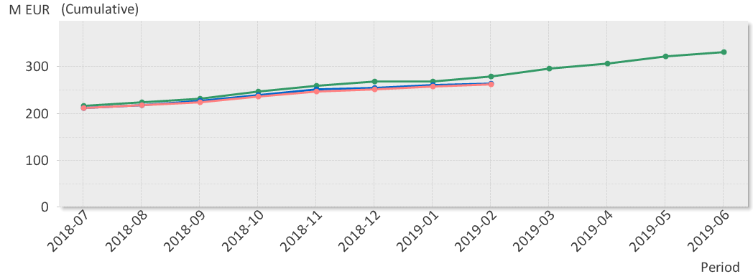
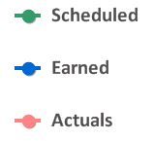
EV Graph
(* No InKind included)
Current Status
Cost Variance is by end of Jan 2.8 M€.
  Main reason for the positive CV is need of additional re-planning to reflect actual cost.
Schedule variance is by end of Feb -12.9 M€.
  Main contributors to the SV are NCFE: Delay in copper plating for the DTL tank sections. DTL schedule have been re-planned in P6. Beam Diagnostics: re-planning in progress. RF Systems: delay in ESS Bilbao, Atomki IK activities.

Slide 17
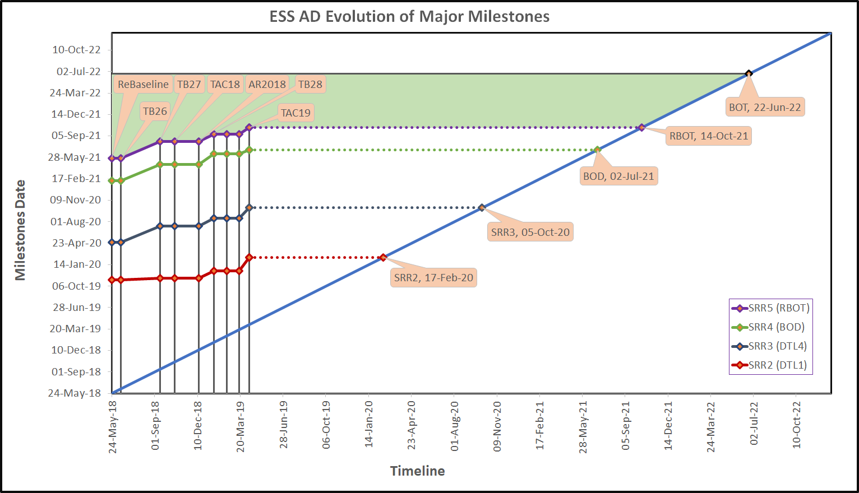
Evolution of Accelerator Major Milestones

Slide 18
Accelerator Division– organigram for line org (in white) and contractors/visitors for the sub-project + In-kinds
Head Count: 136 (2019-04-08)
97 employees
29 from EIS, Visitors, Consultants, Students, Planners, Controller
13 In-kind
Mats Lindroos – Head of Division
Håkan Danared – Deputy Head of Division
John Weisend II – Deputy (sub) Project Leader
Administration
Caroline Prabert
Inga Tejedor
WeiYing Li
Planning and Project Control
Lena Gunnarsson
Eldar Safarov
Diana Bergenholtz
IN-KIND from IFJ PAN Poland
Leszek Hajduk
Krzysztof Myalski
Michal Sienkiewicz
Tadeusz Ostrowicz
Edward Gornicki
Wawrzyniec Gaj
Marek Skiba
Karol Kasprzak
Pawel Halczynski
Artur Krawczyk (2019-05-02)
Agnieszka Zwozniak (2019-05-02)
IN-KIND from Norway
Greyson Christoforo, Oslo
IN-KIND from Warsaw University of Technology
Krystian Bec
Beam Physics, Operations & Beam Diagnostics
Andreas Jansson - GL
Testing and Comissioning
Ciprian Plostinar
IKC Coordination
Håkan Danared
Ebbe Malmstedt (C)
Beam Physics
Mamad Eshraqi – SL
Renato de Prisco
Ryoichi Miyamoto
Yngve Levinsen
Natalia Milas
Björn Gålnander
Emelie Nilsson
YuanShuai Qin (S)
Benjamin Bolling (S)
Linac
Håkan Danared- GL
Cecilia Maiano
Iñigo Alonso
Radio Frequency Systems
Anders Sunesson- GL
Specialized Technical Services
John Weisend II – GL
Gunilla Jacobsson
Accelerator Utilities group
Peo Gustavsson – GL
Olle Lagerblad
Kristofer Falkland (C)
Björn Rundcrantz (C)
Ila Sjöholm (C)
Mats Pålsson (C)
Christer Sjöblom (C)
Nicolas Eke (C)
Fredrik Håkansson (C)
Patrik Weiler (C)
Lars Jalmarson (C)
Front End & Magnets
Edgar Sargsyan – SL
Georg Hulla
Janet Schmidt
Richard Bebb
Alejandro Garcia Sosa
Emmanouil Trachanas
Jim Stovall (C 20%)
Power Converters
Carlos Martins – SL
Göran Göransson
Marko Kalafatic
Rutambhara Yogi
Petro Pohorilo
Dana McKenzie
Matthew Bergstrom
Manish Kumar
Anders Andersson (C)
Yury Loayza (C)
Cryogenics
Philipp Arnold – SL
Jaroslaw Fydrych
Xilong Wang
Xiaotao Su
Johnny Råström
Mattias Olsson
Per Nilsson
Romain Goncalves
Piotr Tereszkowski (C)
Ole Øystein Bakke (C)
Frans Rödström (C)
Jianqin Zhang (2019-05-15)
Beam Diagnostic
Tom Shea– SL
Cyrille Thomas
Hooman Hassanzadegan
Hinko Kocevar
Irena Dolenc Kittelmann
Rafael Baron
Edvard Bergman
Clement Derrez
Slava Grishin
Dmitri Gudkov (at CERN)
Elena Donegani
Kaj Rosengren
Roxana Tarkeshian
Thomas Grandsaert (EIS)
Johan Norin (C)
Mehdi Mohammadnezhad (C)
Utilities and Test Stand
Wolfgang Hees - SL
Anton Lundmark
Frithiof Jensen
Emilio Asensi
Owen Buchan
Steven McGlasson
Lars Rosberg
Antonio Muras Montejo
Nour Akel
Jörgen Jönsson (EIS)
Weiming Yue (V)
Superconducting RF
Paolo Pierini – SL
Christine Darve
Felix Schlander
Saeid Pirani
Luca Sagliano (2019-05-02)
Nuno Elias (EIS)
RF Sources
Morten Jensen – SL
Rihua Zeng
Rafael Montano
Bruno Lagoguez
Chiara Marrelli
Staffan Ekström
Stevo Calic
Iñigo de la Fuente
Anders Svensson
Christian Amstutz
Walther Borg
Anirban Krishna Bhattachanyya
Linus Ternelius Svensson
Slavisa Micic
Nils Öst
Vacuum
Marcelo Juni Ferreira – SL
Hilko Spoelstra
Fabio Ravelli
Kristell Barthélemy
Ralf Huber
Laurence Page
Fredrik Svensson
Henric Gunnarsson
Grant Wallace
David Bigelow (2019-04-28)
Peter Ladd (C 50%)
Operations
Lali Tchelidze – SL
Marc Munoz

Slide 19
Accelerator Systems (sub-) Project (ACCSYS) – organization
TITLE | LEADER | EXT. WP | DEPUTY WP LEADER for EXTERNAL WPS | PCC | OCC
WP 1 - ACCSYS MANAGEMENT | M. LINDROOS J.G. WEISEND II | NO |  | 110100001 & 110100002 | 8301001 & 8301002
WP 2 - ACCELERATOR PHYSICS | M. ESHRAQI | NO |  | 110200001 | 8301101
WP 3 - NORMAL CONDUCTING FRONT END | S. GAMMINO | YES | E. SARGSYAN/ J SCHMIDT | 110300001 | 8301301/4-5
WP 4 - SPOKE CRYOMODULES | G. OLRY | YES | C. DARVE | 110400001 | 8301302
WP 5 - ELLIPTICAL CRYOMODULES | P. BOSLAND | YES | C. DARVE | 110500001 | 8301303
WP 6 - BEAM DELIVERY SYSTEMS | S. MØLLER | YES | I. ALONSO | 110600001 | 8301304
WP 7 - BEAM DIAGNOSTICS | T. SHEA | MIX |  | 110700001 | 8301102
WP 8 - RF SYSTEMS | M. JENSEN | MIX |  | 110800001/3--9 | 8301401-8
TEST STANDS & UTILITIES | W. HEES | MIX | Moved to Infra-structure sub-project | 111000001 250601000
WP 11 - CRYOGENICS | P. ARNOLD | MIX |  | 111100001 | 8301202
WP 12 - VACUUM | M. JUNI-FERREIRA | MIX |  | 111200001/4 | 8301203/1
WP 13 - SAFETY & OPS OPERATIONS | L. TCHELIDZE | NO | Now in operations only | 111300001 | 8311301
WP 14 - LINAC | H. DANARED | NO |  | 111400001 | 8301305
ELECTRICAL SUPPORT | F. JENSEN | NO | Moved to Infra-structure sub-project | 111500001 250602000
COOLING SUPPORT | A. LUNDMARK | NO | Moved to Infra-structure sub-project | 111600001 250602000
WP 17 - POWER CONVERTERS | C. MARTINS | MIX |  | 111700001 | 8301409
ENGINEERING RESOURCES | obselete | NO |  | 119900000
WP 19 - SUPERCONDUCTING RF | P. PIERINI | NO |  | 111900001 | 8301302/3/6
GENERAL INSTALLATION SUPPORT | PO GUSTAFSSON | NO | Moved to Infra-structure sub-project | 119800001 250000000
INSTALLATION GO1, G02, RF | PO GUSTAFSSON | NO | Moved to Infra-structure sub-project | 119800002—4 250000000
Accelerator Collaboration Board (ACB) – meets twice annually:
Reps from each IKC & collaborating institute (one elected as chair)
ESS Technical Director
ACCSYS Sub-Project leader
Accelerator Technical Board (ATB) – meets quarterly:
AccMT & all WP leaders and deputies
Reps of all contracted institutes if not already a WP leader
ESS Machine Management Team members invited
Accelerator (Project) Management Team (AccMT) – meets weekly:
Mats Lindroos: Project Leader
Caroline Prabert: Administration
John Weisend II: Dep. Proj Leader (WP 1) & STS (WPs 11,12,15,16)
Lena Gunnarsson, Eldar Safarov: Project Planners
Diana Bergenholtz: Controller
Lali Tchelidze: Section leader Operations
Peo Gustafsson: Installation coordinator and infrastructure sub-project leader (sub-project 25)
Håkan Danared: Linac systems leader (WPs 3,4,5,6,14,19) and IKC coordination manager
Andreas Jansson: Beam Physics, Diagnostics, Init ops planning mgr (WPs 2,7)
Anders Sunesson: RF power systems leader (WPs 8,17)
Note: Section Leaders (AD line) can be called to participate in AccMT meetings
IKC coordination, IKC liaisons & BrightNESS IKC ‘field coordination’:
Håkan Danared: IKC coord mgr Ebbe Malmstedt (C): assists overall IKC coord and risk manager at AD
Georg Hulla: for WP 3 IKC Felix Schlander: for WP 4 & WP 5
Nuno Elias: for WP 4 & WP 5 IKC
Fredrik Håkansson (C): for WP 4 & 5

Slide 20
ACCSYS Major In-kind Collaborations
Item | Value (M€) | Partner | Date of final equipment delivery | Agreement Status: Planned /Agreed | Status of Execution (R, Y, G)
MEBT | 4.5 | ESS Bilbao | February 2019 | Agreed
RFQ | 8.7 | CEA-IRFU | March 2019 | Agreed
DTL | 16.8 | INFN-LNS | March 2020 | Agreed
Spoke CMs | 17.4 | CNRS-IPN | May 2020 (To UU) | Agreed
Spoke linac cryodistribution | 2.4 | CNRS-IPN | August 2019 | Agreed
Elliptical Medium beta cavities | 11.2 | INFN-LASA | February 2020 | Agreed
Medium beta CMs | 17.4 | CEA-IRFU delayed by medium beta cavities being late | September 2020 | Agreed
Elliptical high beta cavities (11 CMs) | 25.2 | STFC | February 2021 | Agreed
High beta CMs (11 CMs) | 40.6 | CEA-IRFU | September 2021 | Agreed
Elliptical linac cryodistribution | 6.6 | WUST | June 2019 | Agreed
Spoke RF sources | 19.4 | ELETTRA-INFN | December 2020 | Agreed
NC linac RF systems | 7.3 | ESS Bilbao | February 2020 | Agreed
Linac warm units | 10.4 | STFC | August 2020 | Agreed
Linac magnets with power supplies | 9.4 | ELETTRA-INFN | November 2019 | Agreed
Installation services | 12.6 | IF-JPAN | December 2020 | Agreed
LLRF systems | 4.5 | PEG | December 2021 | Agreed
RF distribution systems | 19.0 | STFC | August 2019 | Agreed
Target imaging system | 2.0 | Oslo University | December 2019 | Agreed | 2013 schedule
There are over 150 IK deliveries
Some IK have issues with prolonging contracts and keeping staff as the project is delayed compared to the 2013 baseline
Being on the critical path doesn’t necessarily mean an IK partner is late, they can be delayed by others including ESS

Slide 21
ACCSYS major collaboration agreements
Item | Value (M€) | Partner | Date of final equipment delivery | Agreement Status: Planned /Agreed | Status of Execution (R, Y, G)
Testing (Spoke CM, Modulator, Cavity proto,…) | 12.9 | Uppsala University | Not applicable | Agreed
Rastering system and beam diagnostics | 3.1 | Aarhus university |  | Agreed | 2013 schedule
LLRF and modulator design and prototype | 3.3 | Lund university | Not applicable | Agreed

Slide 22
ACC – Top 5 Risk Mitigation Status (data from Exonaut)
Value of cost risk = 3.90 M€ (8.74 M€ last month)
Latest risk workshop: CEA & ESS WP4 & WP5, May 17, 2018 ; Next workshop: TDB 2019
Risk ID | Event |  | Potential Impact C – Cost S – Schedule Q – Quality and Function | Proba-bility | Mitigation Measures | Due Date
241 | CE marking has to be implemented |  | C: 1.3 M€ S: 0-3 M Q: (3) Several req. | 4 | Define ESS ambition level Inform all partners, institutions & stakeholders Discuss, agree and implement | 181231 181231 191231
240 | Insufficient ICS Resources for Accelerator |  | C: - S: 4-6 M Q: (3) Several req. | 4 | Develop strategy (Treated) Regular ACC-ICS Workshops and meetings on WP level to review progress and needs | 180131 191231
2 | In-kind contributors do not meet scope and schedule requirements |  | C: 91 k€ S: 7-9 M Q: (2) One low-level req. | 3 | ESS single point Partner contact. Reporting progress to IKC. IKC provides a written monthly report on progress Yearly formal WP audits, led by experts IKC WP milestones are tracked as P6 schedule | 191231 191231 191231
18 | Potential misfits/conflicts in interfaces if ICS support does not meet ACCSYS schedule |  | C: 17 k€ S: 4-6 M Q: (2) One low-level req. | 3 | Explicit links between ICS and ACCSYS in P6 and close communication at the working level between projects | 191231
242 | Lack of spares when needed |  | C: 472 k€ S: 4-6 M Q: - | 3 | Identify and quantify amount per system, find funding. Secure funding | 191231 191231
Mitigation actions performed since last report |  | RACSXXX: Exonaut analysis made with two major differences compared with last month: Analysis period: Remaining part of project time (Nov. 2013-Dec. 2021) Estimated residuals for the 20 highest risks from last month was used as input values for this updated analysis. As expected, risk exposure drops when analysing the remaining period of the project (compared with the whole project period. While chosing residuals of correct and effective treatment actions as input, the risk exposure also drops, as expected.

Slide 23
Major activities for 2019
Installation of the RFQ, MEBT and first DTL tanks in tunnel
Installation of infrastructure for tunnel and RF gallery
Commissioning of cryoplants completed and installation of cryo-distribution system completed
Test stand 2 in Lund in operation
2 medium beta cryomodules assembled and 8 spoke cryomodules assembled
NC , spoke and Medium beta RF systems installation ongoing with system operational for NC linac commissioning
HEBT installation completed with magnets and beam pipe

Slide 24
ACCSYS Summary
All essential components for Ready for Beam on Target (RBOT), except the RF Power Stations for Spokes, are under construction, assembly and testing.
The Ion Source and LEBT is under commissioning with the commissioning and operations team in charge of the work The cryoplants are under testing or final stages of installation
The new infrastructure sub-project handles infrastructure and component installation for accelerator
A new organization for testing and commissioning for AD and associated ICS activities has been put in place
The present prediction is that RBOT will be delayed with 4 months mainly due to issues with Spoke Rf sources, copperplating, DTL tanks, RFQ manufacturing and some delays for elliptical cavity fabrication.
The large majority of IK partners can deliver to the agreed Ready-for-Installation dates in the May 2018 re-baseline review
The very good results from testing of e.g. series spoke cavities, elliptical cavities and prototype modulators gives confidence that the high performance goals for the SC linac can be reached

Slide 25
Back-up slides
The following slides are kept in the presentation as back-up

Slide 26
Replies to ATAC 18 1
Recommendation:
Streamline the effort spent on planning to free resources for installation and
commissioning. Find pragmatic compromises between detailed planning and the tracking of
critical milestones, which have impact on interfaces between activities. Detailed planning
should be left to the equipment responsible and installation managers. Where possible,
reduce formal procedures and documentation to a reasonable level to free resources.
Reply: The planning for accelerator is now in a much better position with two full time planners doing all follow-up, reporting and updating of the P6 schedule. They are supported by a planning manager which provides the high-level schedule and helps with details for the technology. The new Testing and commissioning manager which just been hired will have the overall responsibility for accelerator and related ICS systems during testing and commissioning. The commissioning coordinator work with the testing and commissioning manager and provides the detailed commissioning planning and also performs commissioning with the support of the operations team from the control room.

Slide 27
Replies to ATAC 18 2
Recommendation:
Installations & infrastructure readiness must have first priority.
Reply: The plan for infra follow the strategy and time plane as outlined. The needed priorities have been done e.g. move of cabinets, and priority on mechanical installation in parallel with definition and routing of cables. When entering in to the spoke installation phase, the infra installation should be more or less ahead of the components and causing less issues and overall delays.
There are two areas which need special attention since they cut through the entire accelerator.
The Phase ref line, need an interim/temporary solution and this will be created I two phases.
The cryo distribution line need mechanical installation to be moved up for secondary steel and cable trays above cabinets.

Slide 28
Replies to ATAC 18 3
Recommendation:
We support the installation of the HV cables for all couplers and purchase a limited number of HV supplies. For the spoke couplers we recommend to pursue the biased version with the same approach as for the medium beta couplers.
Reply: The CDB contains HV cables for all couplers, and the installation is in the infrastructure project scope. IPNO has finalized the design of the bias version of the doorknob and ordered two prototypes, which are in advanced phase of production. Tests will be performed in the following months. The tender for the procurement of the series spoke doorknobs has been launched at IPNO, and is based on the bias-capable design. Bias testing capabilities will be implemented at the test stands, and a limited (~30%) number of power supplies will be initially procured by WP17.

Slide 29
Replies to ATAC 18 4
Recommendation:
Continue using / improving the direct involvement of ESS system owners in the external IK activities to prepare for later successful testing, installation and commissioning. The system owner has the ultimate responsibility to get his systems delivered and has to adapt his follow-up to the different IK partners.
Reply: We fully agree that preparations together with IK partners for testing, installation and commissioning is vital. Tools for this include regular - often weekly - video conferences with the partners, frequent although not regular visits, and, importantly, site acceptance reviews (SARs) and installation readiness reviews (IRRs). An example of a complicated system soon to be installed is the MEBT. Installation will start in the summer, a comprehensive SAR was held in Bilbao in the last week of March, an IRR at ESS will follow, and visits have been made by engineers and technicians from the system owners, representing mechanical design, electrical installations, quality, vacuum, beam instrumentation, controls, RF, survey & alignment, etc. In the ideal case, there were sufficient resources to allow ESS personnel to be posted for longer periods at our in-kind partners, but the staffing situation unfortunately does not allow for this.

Slide 30
Replies to ATAC 18 5
Recommendation:
During commissioning there has to be enough staff to operate and write instructions for operation. One 8 hr shift per day may prove inadequate; 2 shifts can provide an opportunity for catch up on the AD schedule. Means must be provided to facilitate conditioning of RF components for long periods when beam is not present.
Reply: Unfortunately, we didn't get a permission to hire staff (control room operators/shift leaders) for the beam commissioning stage of Ion Source and LEBT. Therefore, we still haven't written good set of instructions for operation. We have moved to extended shifts (8 am to 9 pm) in the period between March 18 and April 26 to try to help for catching up on the schedule. We are currently hiring 2 shift leaders/operators, which will help with writing the operating instructions as well as be present in the next stages of commissioning, including RF conditioning. However, this number is not enough to allow 24/7 for longer periods of time. We are considering either bringing additional staff. At the same time, we are exploring with HR and the unions, the possibilities we have with existing personnel.

Slide 31
Replies to ATAC 18 6
Recommendation:
Finalise use cases and probable fault modes. Work with the
science/instrument specialists and those knowledgeable of target damage scenarios.
Reply: Both Inigo Alonso and Lali Tchelidze will address this recommendation in their presentations at the next TAC meeting.
Lali’s response: the operation of the neutron source (accelerator and target) and related technical infrastructure will occur from the main control room. Integrated approach was taken, and the control room team will be trained and responsible for operating the neutron source.

Slide 32
Replies to ATAC 18 7
Recommendation:
In the readiness reviews make sure that the process documents focus on the readiness of infrastructure and controls. The new HOTC and the installation and commissioning managers must be strongly involved in the preparation for these reviews, and be confident that rapid turn-on will be achieved.
Reply: A distinction needs to be made here between Installation Readiness Reviews (IRRs) and Safety Readiness Reviews (SRRs). While both infrastructure and controls are discussed at the IRRs it is not a requirement that these systems be complete prior to the start of installation. Doing so would add an add unnecessary delay to the project. For example, we will start the 6 month long installation of the cryogenic distribution system in April 2019 well before either the instrumentation cables are pulled or all the control software is developed. Waiting for these activities to be completed would add 4 – 6 months to the schedule. The IRR does check that start of component installation does not preclude later installation of controls or infrastructure.
In the case of the SRR, the situation is different. It is the expectation that the system can move into operations immediately after the SRR. ESS will ensure that controls and infrastructure are ready prior to the SRR. The HOTC and installation mangers will contribute to making sure that rapid turn-on is achieved.

Slide 33
Replies to ATAC 18

Slide 34
Replies to ATAC 18

Slide 35
Replies to ATAC 18

Slide 36
Accelerator: staff categories through time
ESS employees evolving according to the approved accelerator staff plan.
In-kind personnel working abroad: calculated as 30% of the yearly “planned & agreed” in-kind contributions (P6), divided by the average rate per person (60€/hour x 1800 hours/year)
Total = 114 employees in 2026 and onwards→ consistent with
Steady State Operations’ approved numbers
 | 2014 | 2015 | 2016 | 2017 | 2018 | 2019 | 2020 | 2021 | 2022 | 2023 | 2024 | 2025
ACCELERATOR STAFF | 51 | 62 | 68 | 92,5 | 103,5 | 107,5 | 107,5 | 107,5 | 113,5 | 114,5 | 114,5 | 113,5
ESS STAFF-NON ACCELERATOR (planners, EIS staff, controller) | 4 | 4 | 5 | 5 | 6 | 6 | 6 | 6 | 6 | 6 | 6 | 6
CONSULTANTS | 4 | 6 | 14 | 23 | 47 | 47 | 20 | 5 | 0 | 0 | 0 | 0
LONG TERM IN-KIND/PhD's/TEMP CONTRACTS/STUDENTS/VISITORS | 0 | 2 | 6 | 11 | 18 | 20 | 17 | 15 | 15 | 5 | 5 | 5
Number of IN-KIND personnel WORKING ABROAD for the AD (*) | 7 | 24 | 69 | 106 | 187 | 148 | 65 | 20 | 11 | 0 | 0 | 0

