Slide 1
The ESS Accelerator/Target interface and status of the A2T
Iñigo Alonso
Lead Engineer, Linac Group
European Spallation Source ERIC
2019/04/11

Slide 2
Outline
Table of contents
Context
Accelerator systems
Accelerator/Target interfaces
Integrated operations
Installation schedule

Slide 3
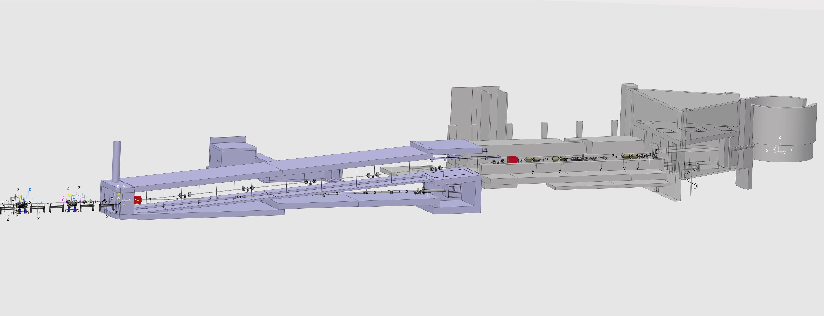
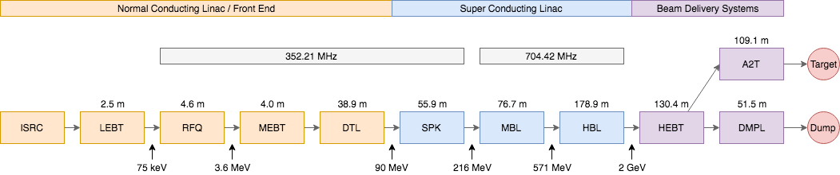
Context
Accelerator sections
A2T
NSW
Dogleg
HEBT: High Energy Beam Transport
DmpL: Dump Line
A2T: Accelerator to Target
TBD: Tuning Beam Dump
NSW: Neutron Shield Wall
PBDR: Proton Beam Drift Room
Target
HEBT
DmpL
TBD
PBDR
Notes:
HEBT+A2T ~40% of the 601m linac
+DmpL ~45%of total beam line

Slide 4
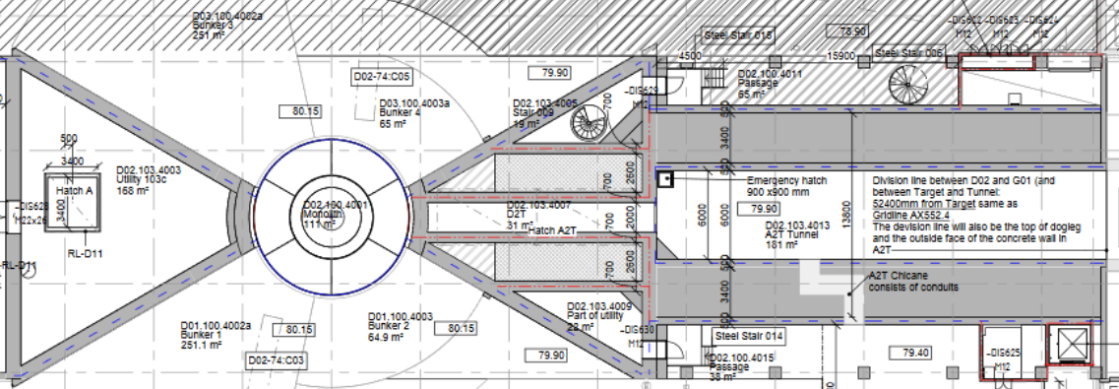
Context
Top view
A2T tunnel
Target
Proton Beam Drift Room
Gallery Support Area (GSA)

Slide 5
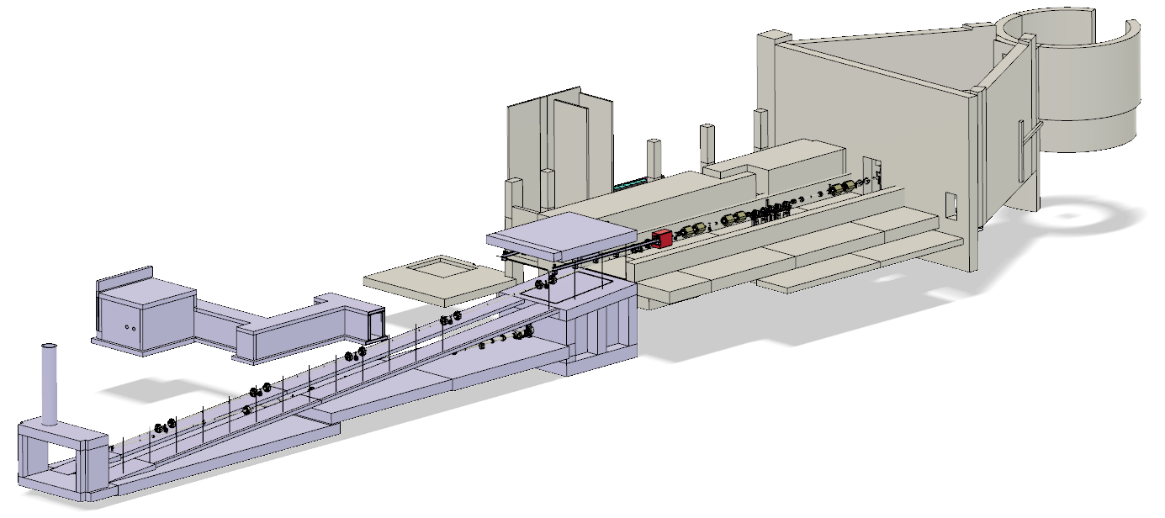
Accelerator systems
Systems in the DmpL and A2T sections of the Linac
Target
A2T
Emergency exit
Raster magnets
Gamma Blockers
Beam Instrumentation
Phase Reference Line
Vacuum
Magnets: quads, correctors, dipoles
Magnets Power Supplies
MPS & PSS
Tuning Beam Dump
Electrical support
Cooling support
Instrument air
WP 6 Beam Deliver Systems
WP 6 Beam Delivery Systems
WP 7 Beam Diagnostics
WP 8 RF Systems
WP 12 Vacuum
WP 14 Linac
WP17 Power Converters
Integrated Control System
Target
Infrastructure Project (former WP15)
Infrastructure Project (former WP16)
Infrastructure Project (former WP16)
DmpL
HEBT

Slide 6
Accelerator systems
Magnets
Q6 Quads
Q7 Quads
C6 Correctors
Raster
Q8 Quads
C8 Correctors
D1 Dipole
6

Slide 7
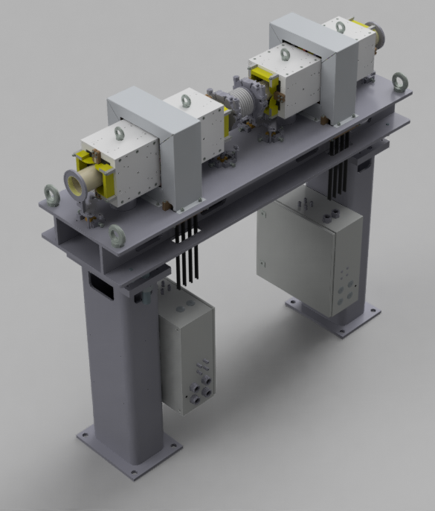
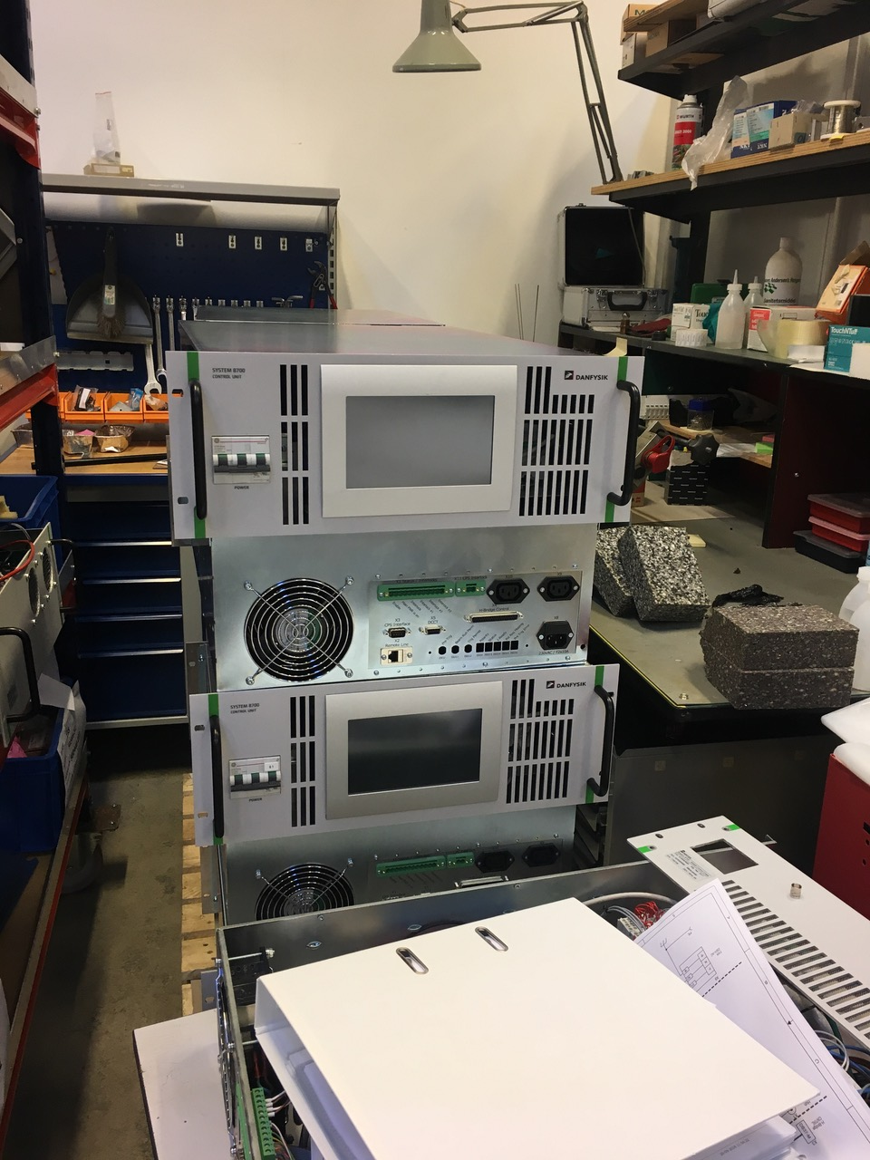
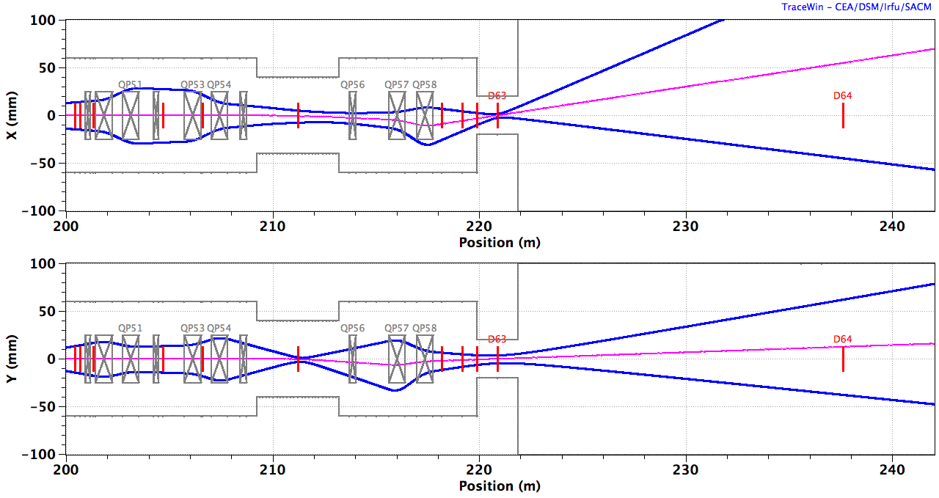
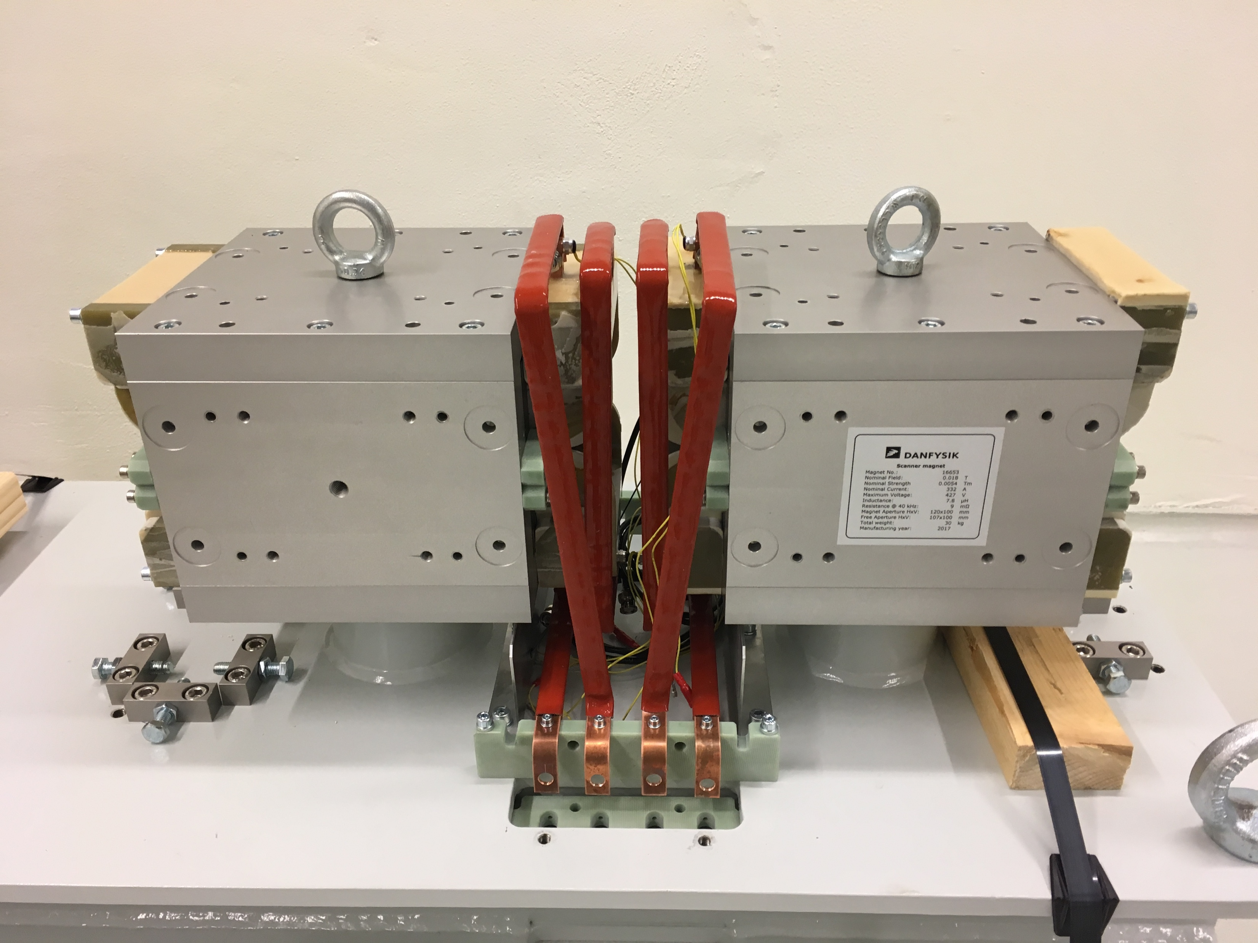
Accelerator systems
Raster magnets and beam optics
Danish contribution by Aarhus University
Beam optics by Heine Dølrath Thomsen, in collaboration with the ESS Beam Physics section
Raster magnets and power supplies produced by Danfysik, expected delivery in May 2019
BEW
QP1-4
RMs
QP5,6
PBW
Centroid
10 x RMS beamlet
B_{y} B_{y} B_{x} B_{x} | B_{x} B_{x} B_{y} B_{y}
AP
CO
2.0 GeV: B_{x} = ±1.96 mT.m, B_{y} = ±2.28 mT.m, ±5 mT.m
Courtesy Heine Dølrath Thomsen, ISA, Aarhus University

Slide 8
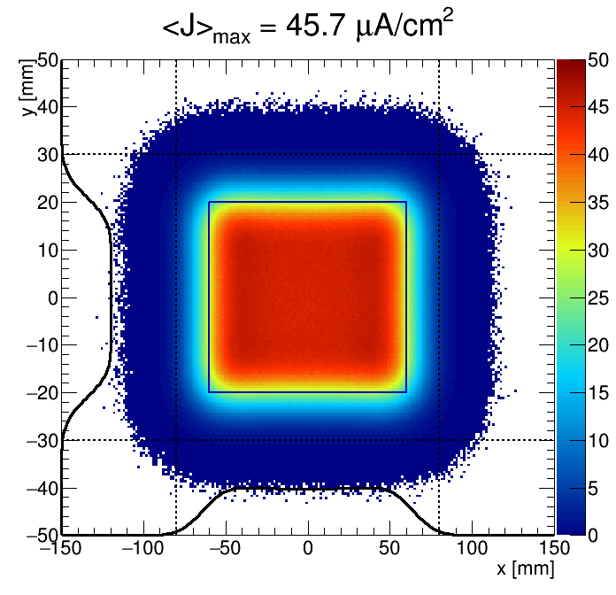
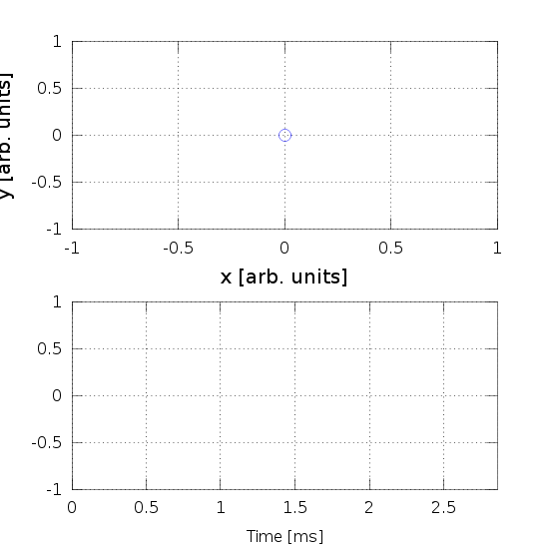
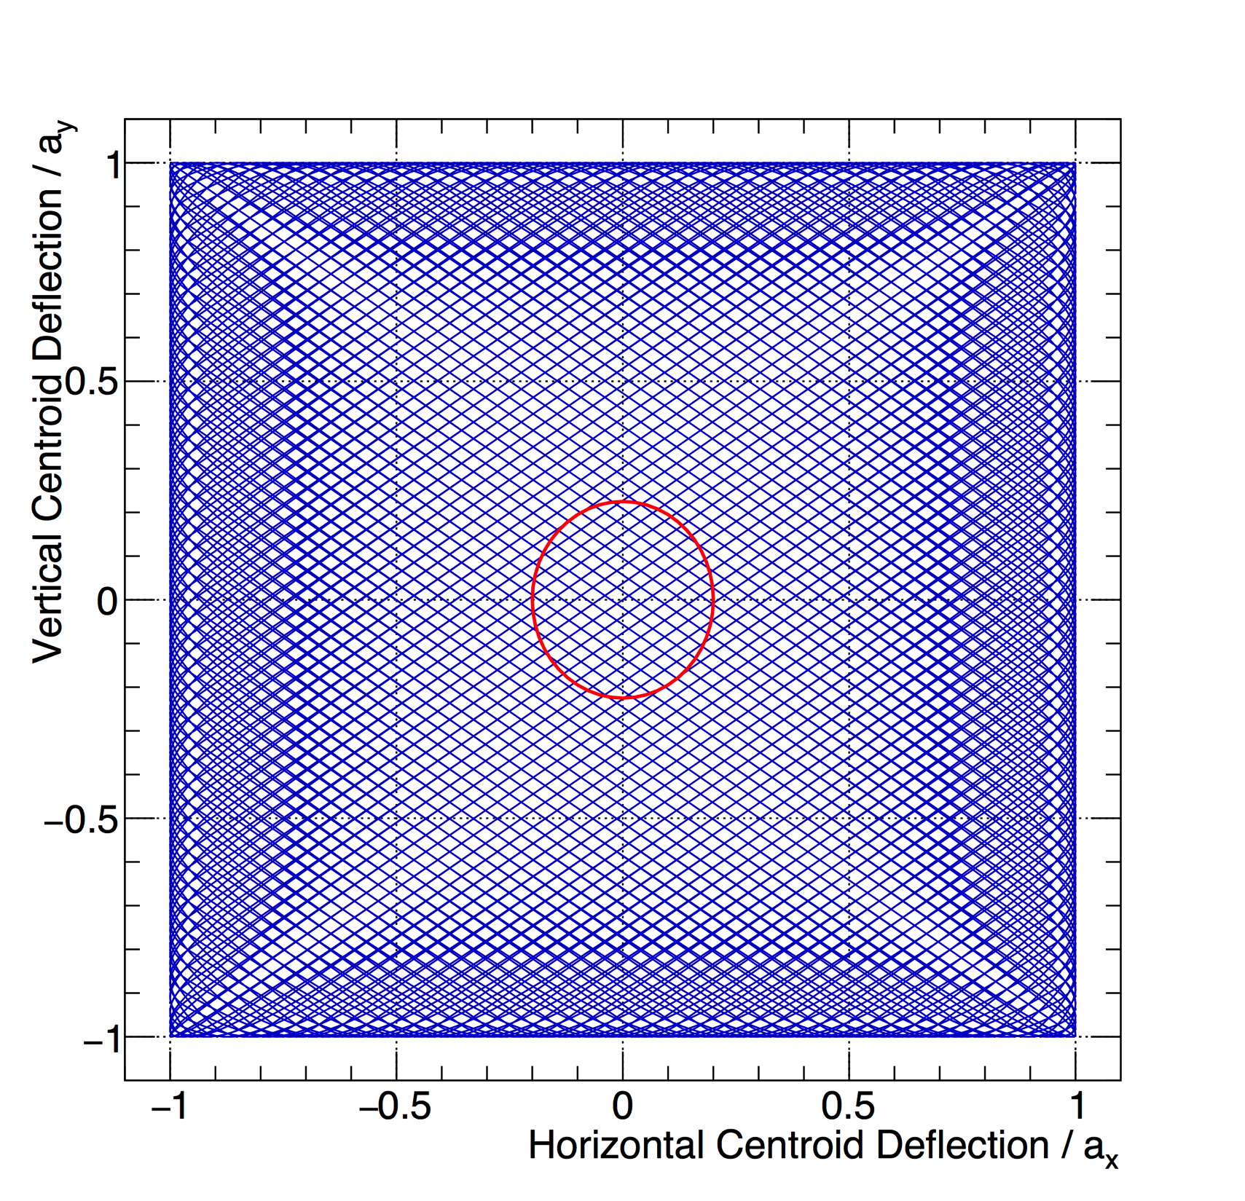
Accelerator systems
Raster magnets and beam optics
Closed pattern (f_{x}/f_{y}, ϕ_{xy}, a_{x}, a_{y}) within a beam pulse:
T₀ = 2.86 ms = (350 Hz)⁻¹ f_{x} = n_{x} / T₀, f_{y} = n_{y} / T₀
Triangle waveforms => No lingering near edges, crosshatch
f_{x} / f_{y} ~ 1 => A single (magnet + supply) design
f_{x} = 39.6 kHz
f_{y} = 29.1 kHz
5/4 pattern
(a_{x}, a_{y}, σ_{x}, σ_{y}) = (60, 20, 12, 4.5) mm
113/83 pattern (200 kHz filter)
Hor / Ver wfm
Beamlet RMS
Courtesy Heine Dølrath Thomsen, ISA, Aarhus University

Slide 9
Accelerator systems
Vacuum
NEG Pumps
Sector Gate Valves
Turbo Molecular Pumps
Primary Dry Pumps
Target Isolation Valve
9
Pirani, cold-cathode and thermo couple gauges also present

Slide 10
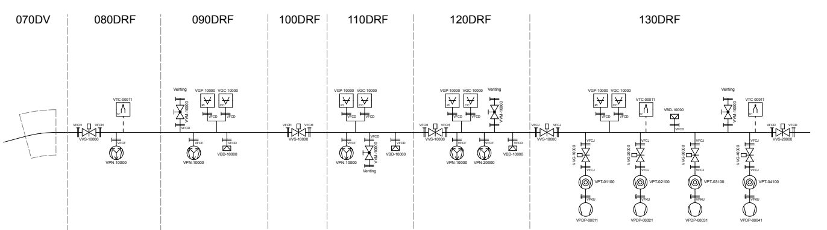
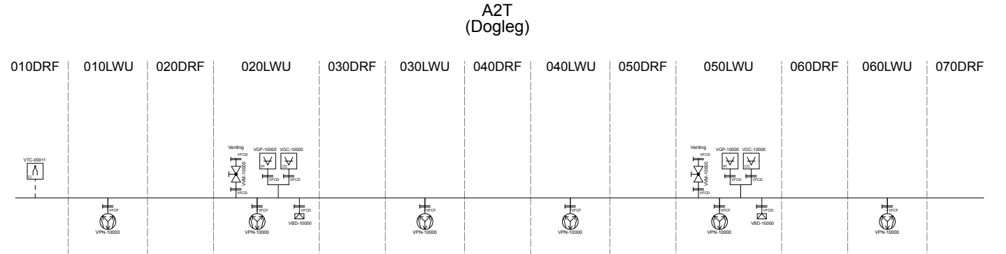
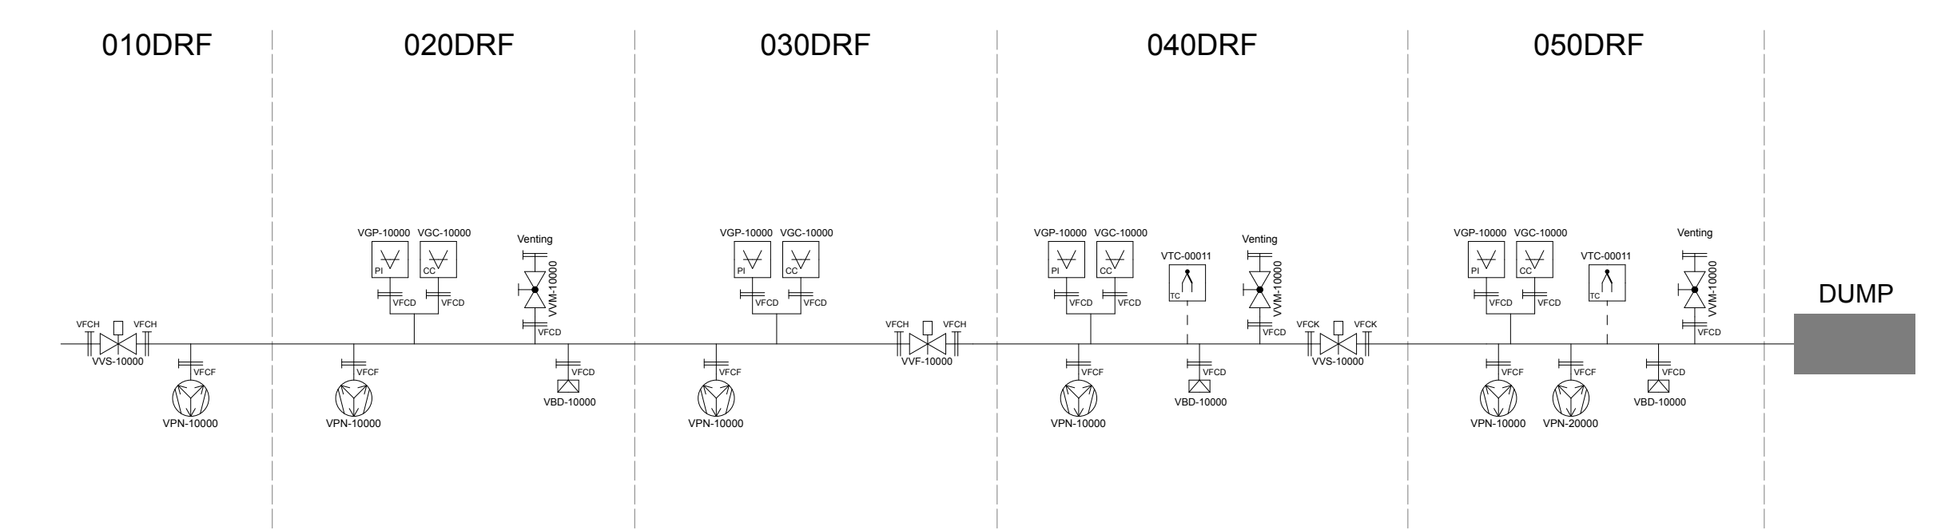
Accelerator systems
Vacuum
https://confluence.esss.lu.se/display/VG/Vacuum+Section

Slide 11
Accelerator systems
Beam Instrumentation
BPM
BCM
BIF (NPM)
WS
APTM
APTM
IMS
GRID
IMG
IMG
11

Slide 12

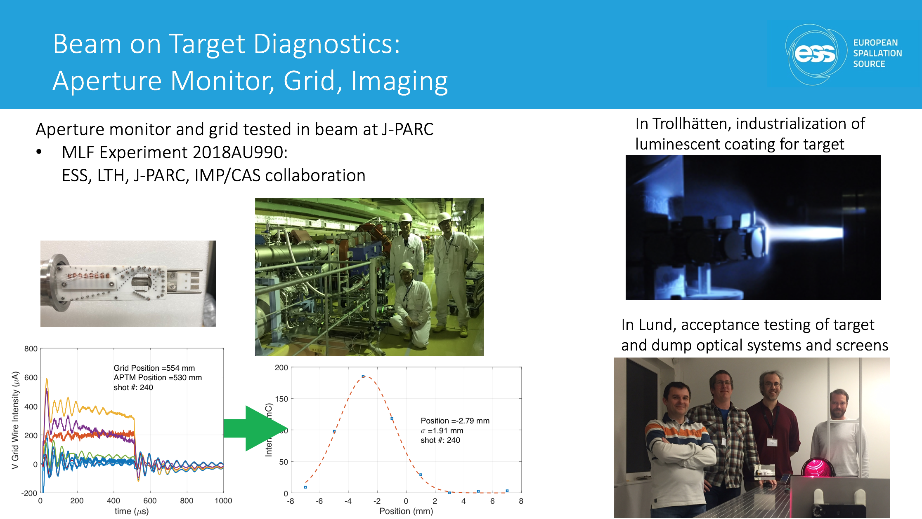
Accelerator systems
Lattice synoptic view
See talk by Tom Shea
https://confluence.esss.lu.se/display/ALSV/Accelerator+Lattice+Synoptic+Viewer
Notes:
Refer to Tom Shea’s presentation

Slide 13
Accelerator systems
Other systems
Crane
A2T Gamma Blocker
Phase Reference Line
Dump Line Gamma Blocker
13

Slide 14
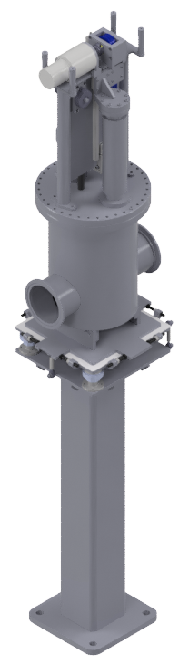
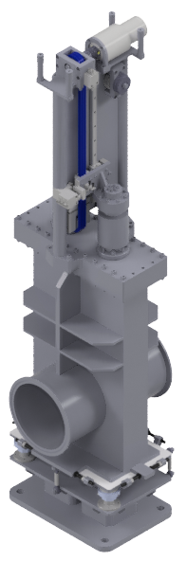
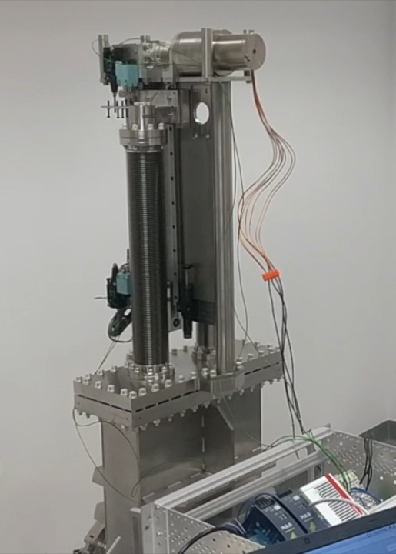
Accelerator systems
Gamma Blockers
Vacuum chamber with a sliding steel core inside, tasked with blocking the line of sight to the target wheel/dump while maintenance happens in the accelerator tunnel, to shield workers against gammas from those highly activated components.
Interface switches to MPS and PSS
Core sizes:
  A2T: 20cm * Ø20cm
  DmpL: 5cm * Ø37.5cm
In-kind contribution from NCBJ, Poland
Delivery expected mid April 2019
A2T
DmpL

Slide 15
Accelerator/Target interfaces
High level ESS System Requirements
ESS.SyR-192 | Target Station shall receive proton beam from accelerator.
ESS.SyR-312 | Target Station shall limit its backscattering of particles to the accelerator.
ESS.SyR-313 | Target Station shall protect the accelerator from contamination by its by-products.
ESS.SyR-314 | The Target Station monolith atmosphere shall be prevented from entering into the accelerator beam pipe so that the accelerator vacuum is preserved.
ESS.SyR-410 | At the completion of the milestone ‘5MW’ of the ESS Construction Phase, the accelerator shall be designed and constructed to be capable of delivering to the Target Station a time averaged proton beam power of 5 mega-Watts.
ESS.SyR-420 | At the completion of the milestone ‘First protons to target’ of the ESS Construction Phase, the accelerator shall be designed and constructed to be capable of delivering to the Target Station a time averaged proton beam power of 1 mega-Watts
ESS.SyR-430 | The nominal operational repetition rate of accelerator acceleration cycles shall be 14 Hertz.
ESS.SyR-450 | The nominal operational beam pulse length shall be 2.86 milli-Seconds.
ESS.SyR-460 | The nominal peak beam power delivered to Target Station averaged over a period of 200 micro-Seconds shall not vary more than 5 percent from the peak beam power delivered to Target Station averaged over the nominal macro pulse length.
ESS.SyR-463 | The time averaged beam power delivered to the Target Station shall not vary more than 5 percent pulse to pulse.
ESS.SyR-465 | The time averaged beam power delivered to the Target Station shall be able to be varied in steps to its nominal value of 5 mega-Watts with a maximum step size of 500 kilo-Watts and with a precision of 125 kilo-Watts.
ESS Systems Architecture Specification, ESS-0005699

Slide 16
Accelerator/Target interfaces
Beam on Target Requirements
Parameter | Value at PBW | Value at BEW
Maximum beam footprint enclosing 99% beam fraction (mm²) | 140 H × 52 V | 160 H × 60 V
Maximum beam footprint enclosing 99.9% beam fraction (mm²) | 160 H × 56 V | 180 H × 64 V
Nominal time-averaged peak current density (µA/cm²) | 89 | 56
Maximum time-averaged peak current density (µA/cm²) | 112 | 71
Maximum displacement of footprint from nominal position (mm) | ±4 (horizontal) | ±5 (horizontal)
 | ±3 (vertical) | ±3 (vertical)
Minimum s_{x}s_{y} for rastered Gaussian beam (mm²) |  | 50
Minimum horizontal raster frequency (kHz) |  | 35
Proton beam current density spatial distribution at the PBW (left), and the BEW (right) at 5 MW beam power. The blue rectangle illustrates the outline of the raster pattern

Slide 17
Accelerator/Target interfaces
Interface Control Documentation
Interface Control Document Target Systems- Accelerator Systems, ESS-0022919
Target Station
  Beam on Target Requirements, ESS-0003310
Beam Instrumentation
  ICD-R: Proton Beam Instrumentation Plug - Proton Beam Instrumentation, ESS-0060563 (Preliminary)
  ICD-R: Proton Beam Window - Proton Beam Instrumentation, ESS-0060561 (Rev.2 Preliminary)
  ICD-R Monolith Systems – Proton Beam Instrumentation, ESS-0032631
  ICD-R Inner Shielding - Proton Beam Instrumentation, ESS-0084051
  ICD-R Outer Shielding - Proton Beam Instrumentation, ESS-0084052
  ICD-R Covers, Penetrations and Monolith Vessel 1067 - Proton Beam Instrumentation A117, ESS-0078254 (Preliminary)
Target Safety System
  ICD-R Target Safety System - Accelerator, ESS-0030068
Tuning Beam Dump
  ICD-R Tuning Beam Dump and Shielding, Target – Accelerator, ESS-0034025
  ICD-R: CWS02 Water Cooling System - Tuning Beam Dump Shielding, ESS-0104429
Vacuum
  Monolith Systems
  Moderator vacuum insulation
Cryogenics
  TMCP
  Target cryogenic systems
Notes:
Old ICD: ESS-0005734 (Obsolete)

Slide 18
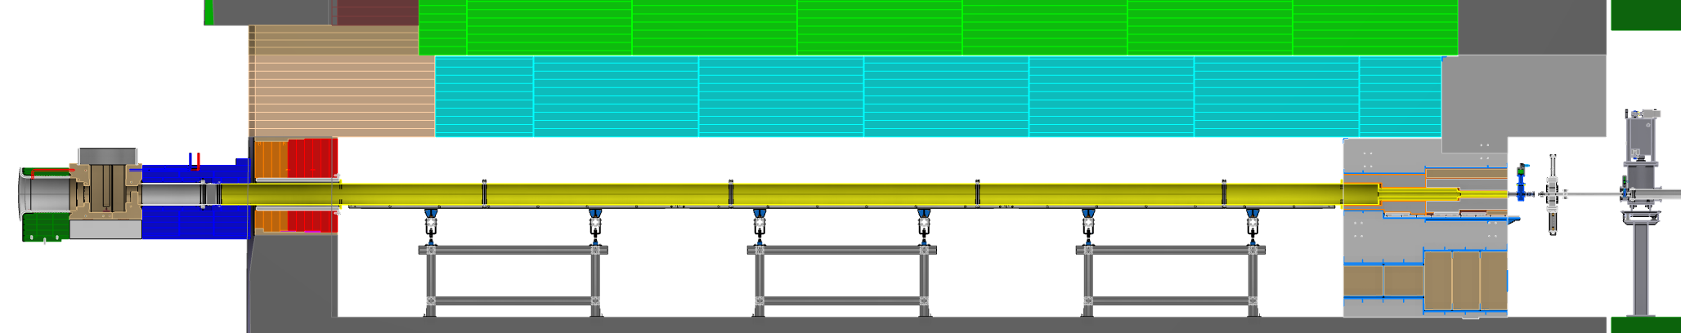
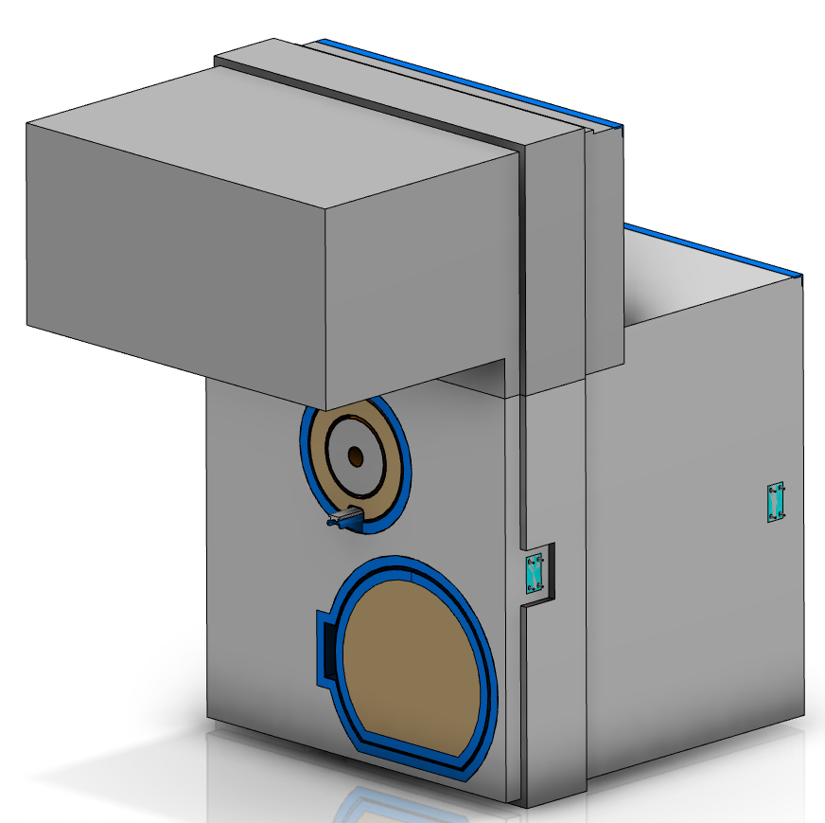
Accelerator/Target interfaces
Neutron Shield Wall
Heavy Concrete
Normal Concrete
Courtesy Alexander Hermansson
Vacuum Pipe penetration
Manhole
Notes:
CDR 12 March 2019

Slide 19
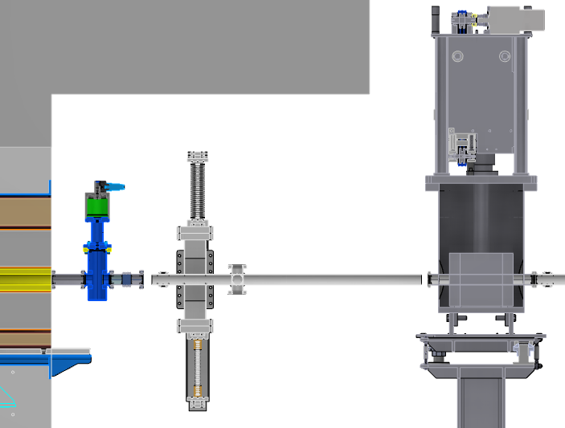
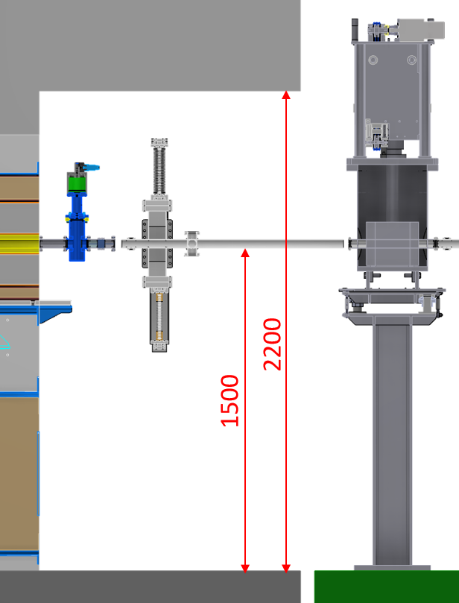
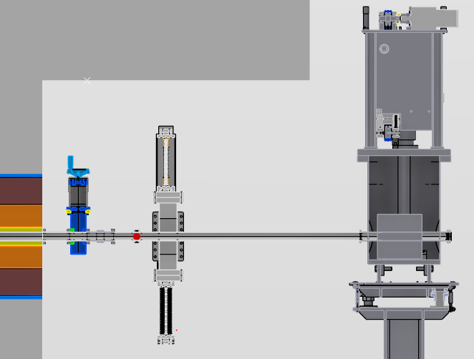
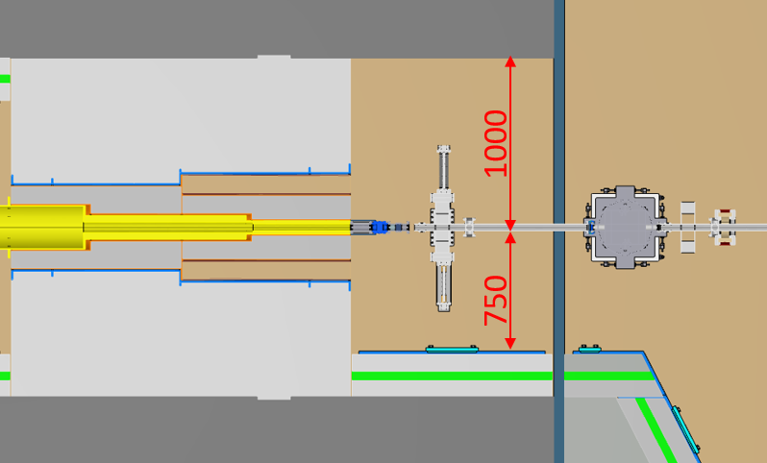
Accelerator/Target interfaces
Physical interface near the NSW
Interface point
Proton Beam Direction
PBDR Pipe
VAT Isolation Valve
Bellow DN40
Beam Position Monitor (BPM)
Aperture Monitor (APTM)
Gamma Blocker (GB)
5
6
1
2
3
4
Courtesy Alexander Hermansson

Slide 20
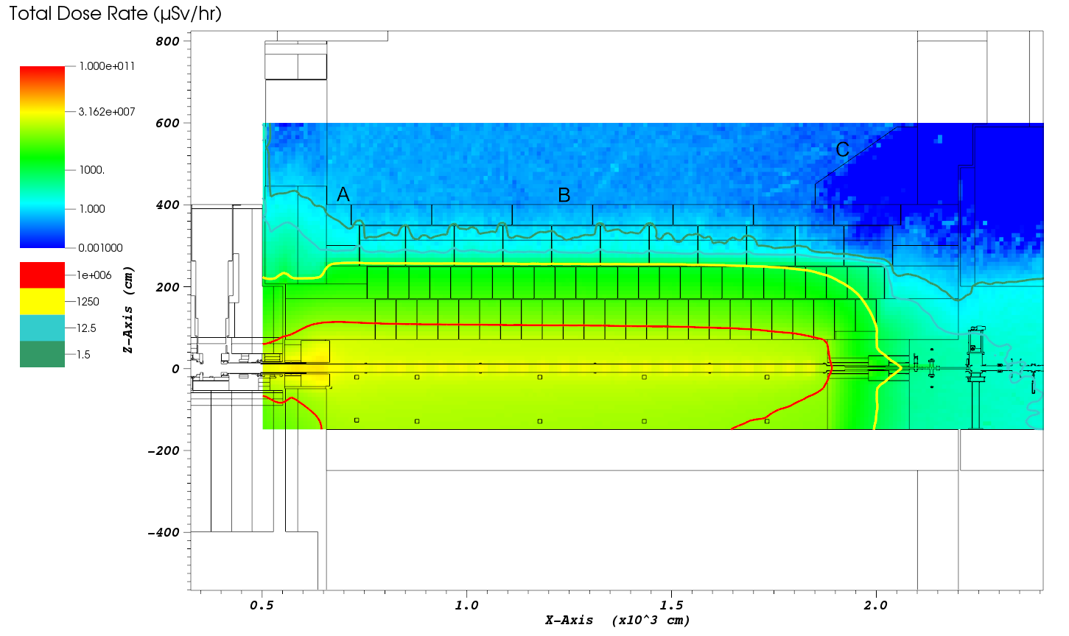
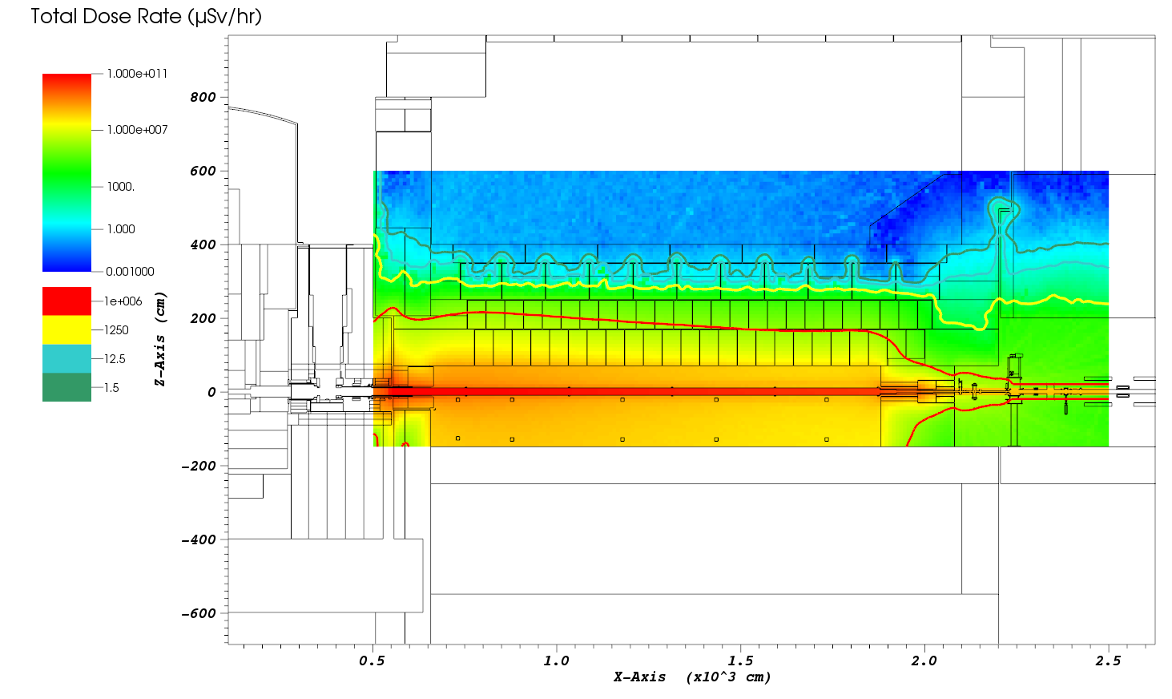
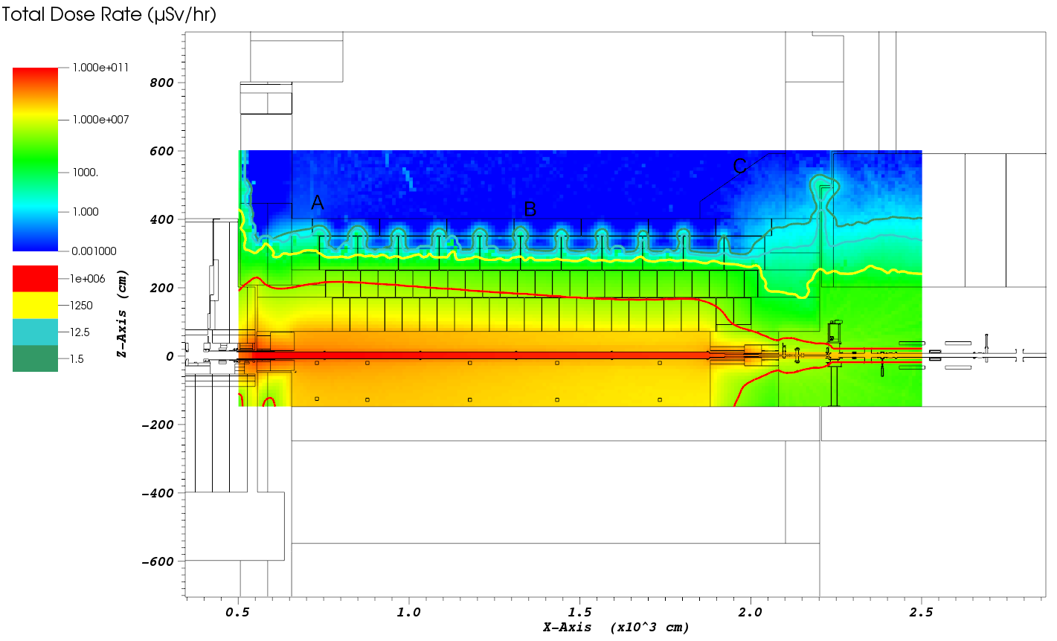
Accelerator/Target interfaces
Prompt dose rates
Beam losses
Combined dose rate
Backscattering
ESS-0322246 - ESS Proton Drift Tube; UKAEA Prompt Radiation Transport Calculations for the ESS Proton Drift Tube Room

Slide 21
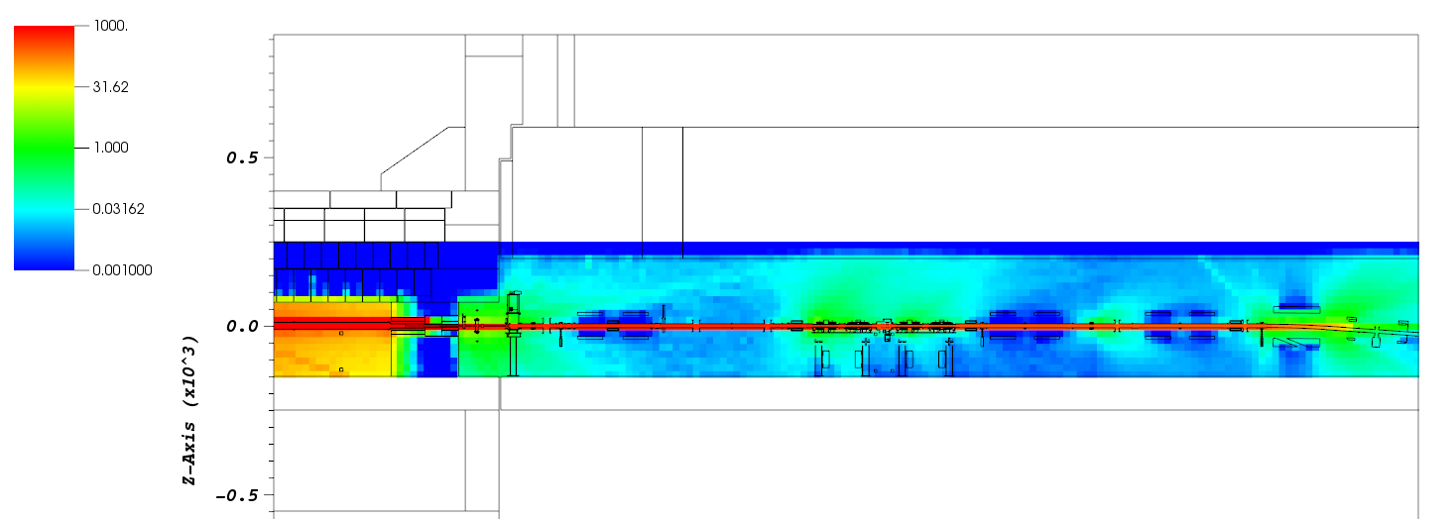
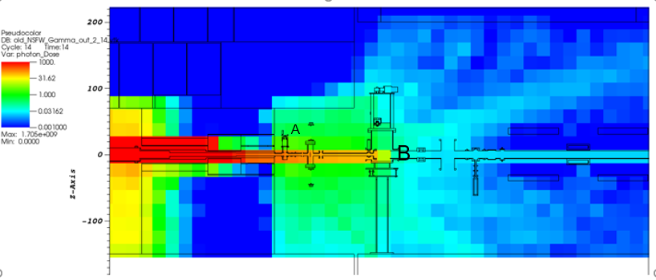
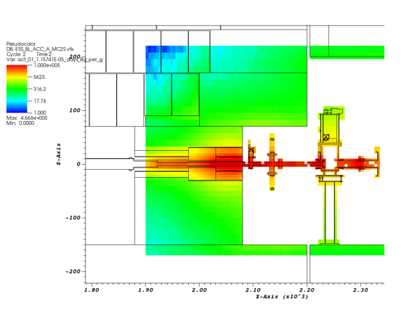
Accelerator/Target interfaces
Activation and shutdown dose rates
2 µSv/hr
0.8 µSv/hr
Shutdown dose rate in µSv/hr
Shutdown dose rate in µSv/hr from the target wheel source
ESS-0679987 - ESS Proton Drift Tube; UKAEA Shutdown Dose Rate Calculations for the ESS Proton Drift Tube and Accelerator to Tunnel Rooms
Activation of components in Bq/g for T= 0

Slide 22
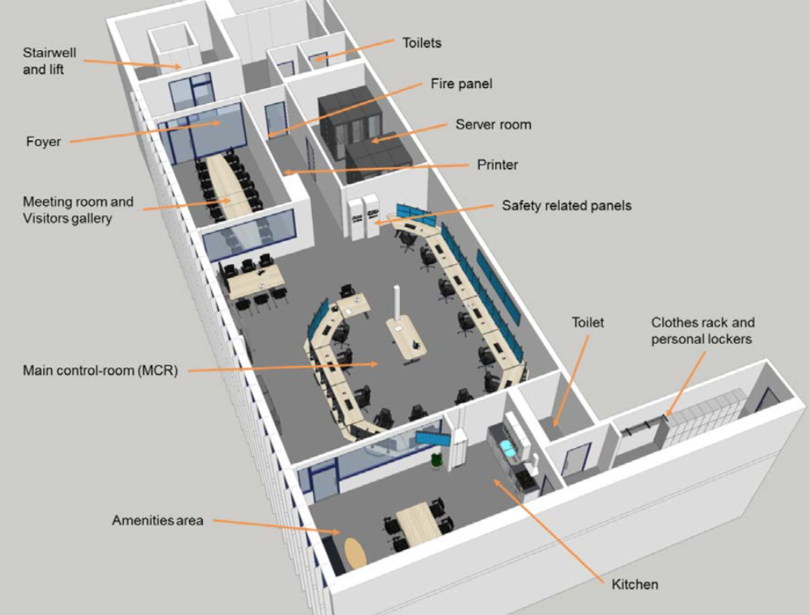
Integrated operation of Accelerator and Target
The normal operation of the Neutron Source (linac + target) will be performed from the Main Control Room
  See talk by Lali Tchelidze
Communication between accelerator and target developed by the Integrated Control System division:
  EPICS
  Timing System
TSS
More high level coordination is needed
Notes:
higher-level coordination should be strengthen to avoid surprises later on
AA2 - Accident Analysis Report - Proton Beam events on Target and Proton Beam Window, ESS-0063901 https://chess.esss.lu.se/enovia/link/ESS-0063901/21308.51166.46337.1618/valid
AA13 - Accident Analysis Report - Public: High power beam on Beam Dump, ESS-0057359 https://chess.esss.lu.se/enovia/link/ESS-0057359/21308.51166.16384.7257/valid

Slide 23
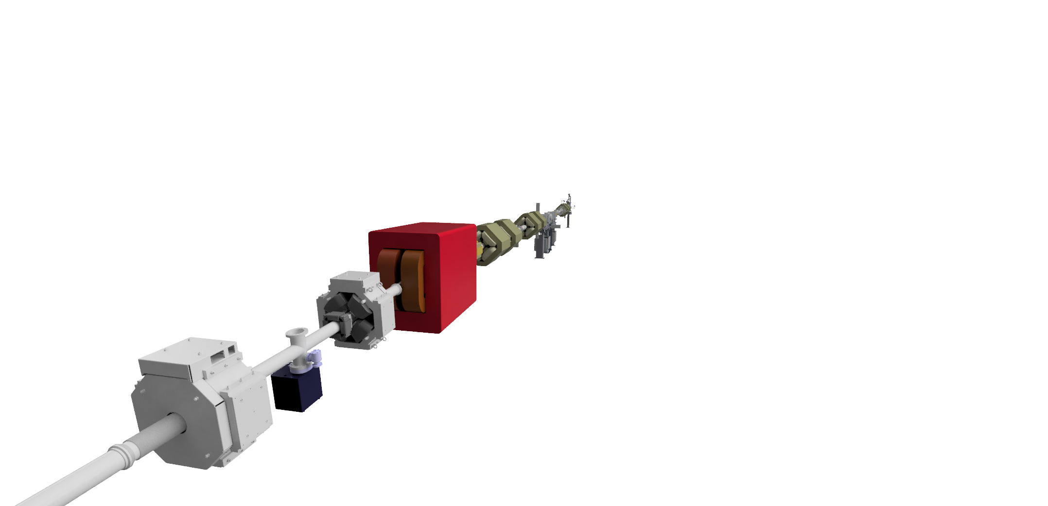
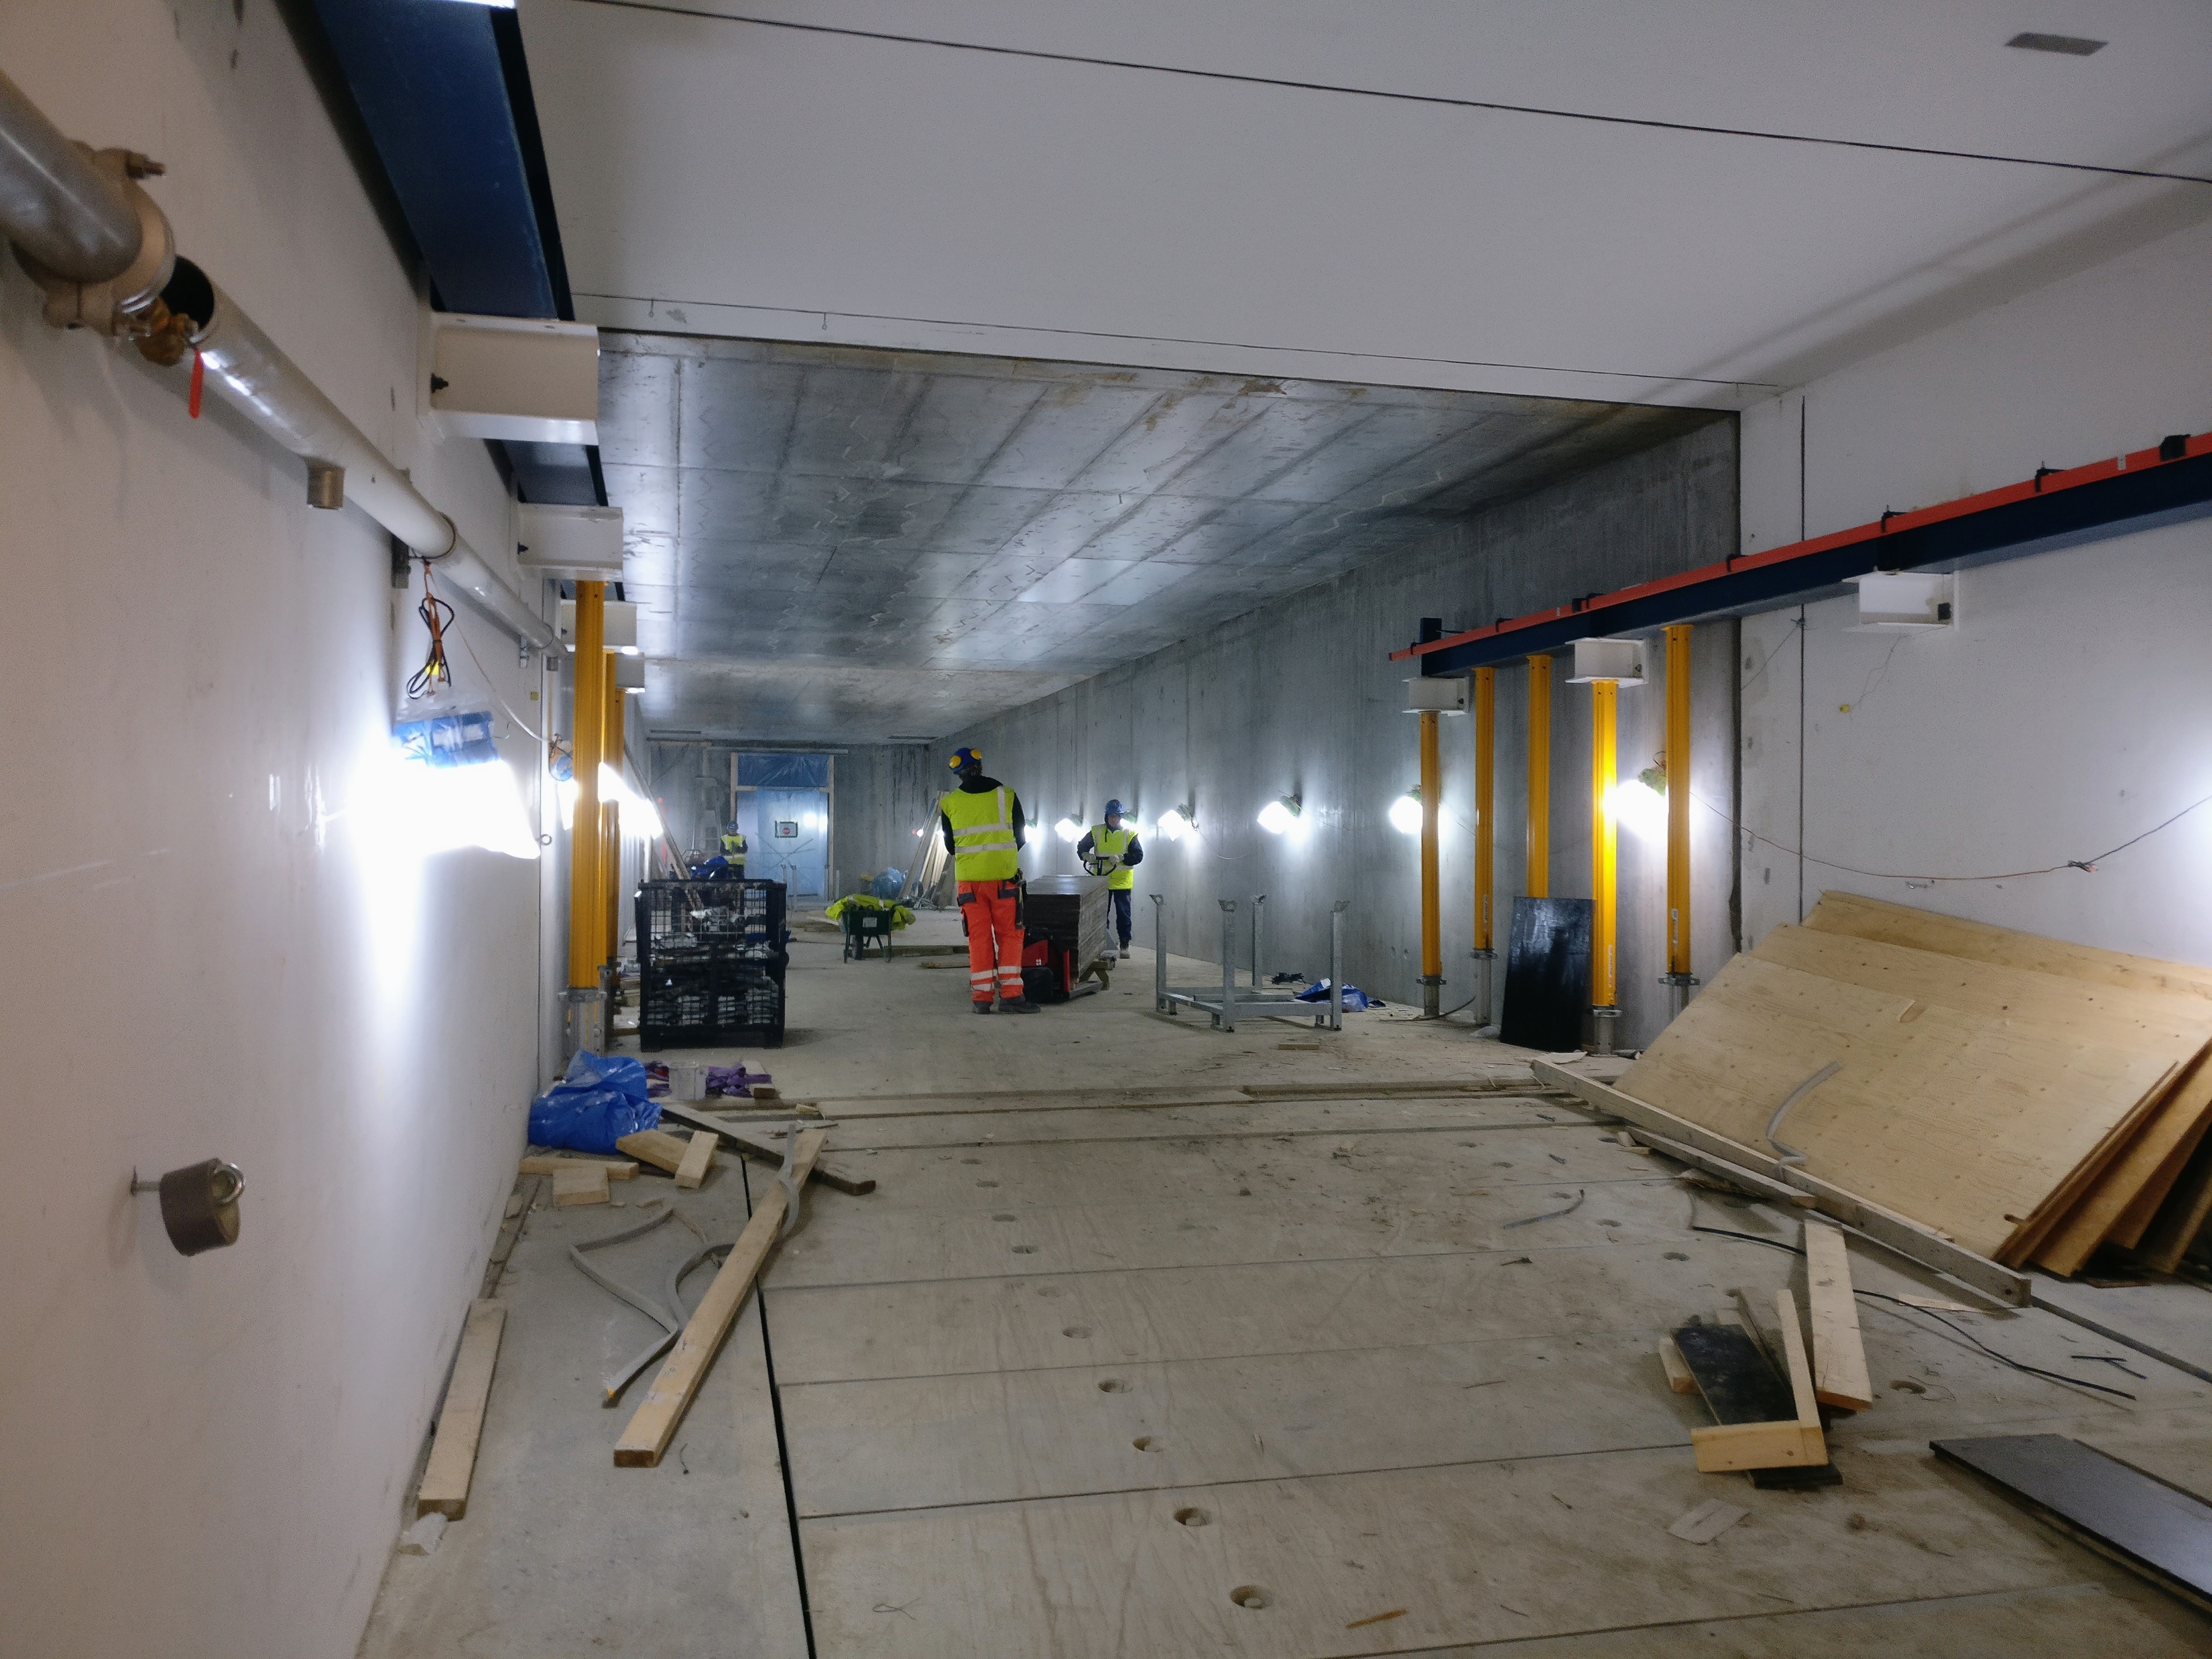
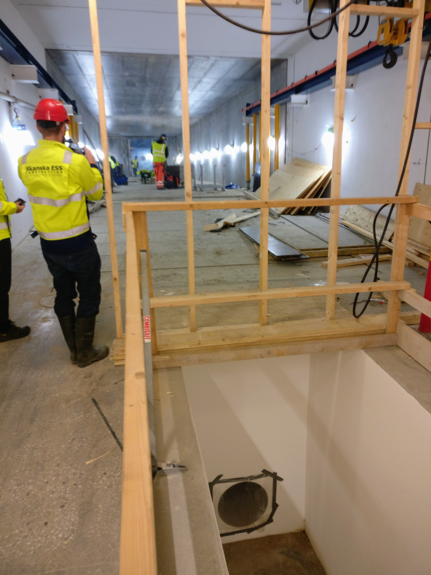
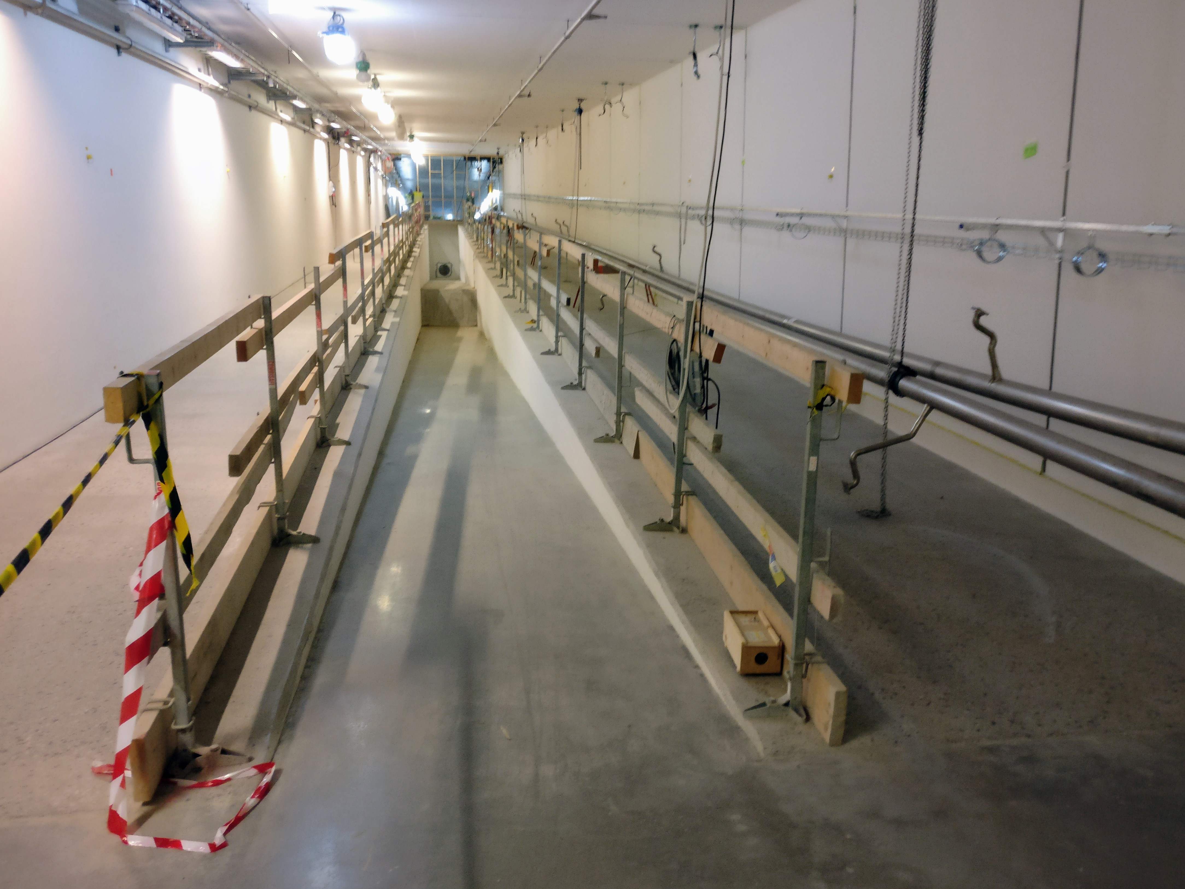
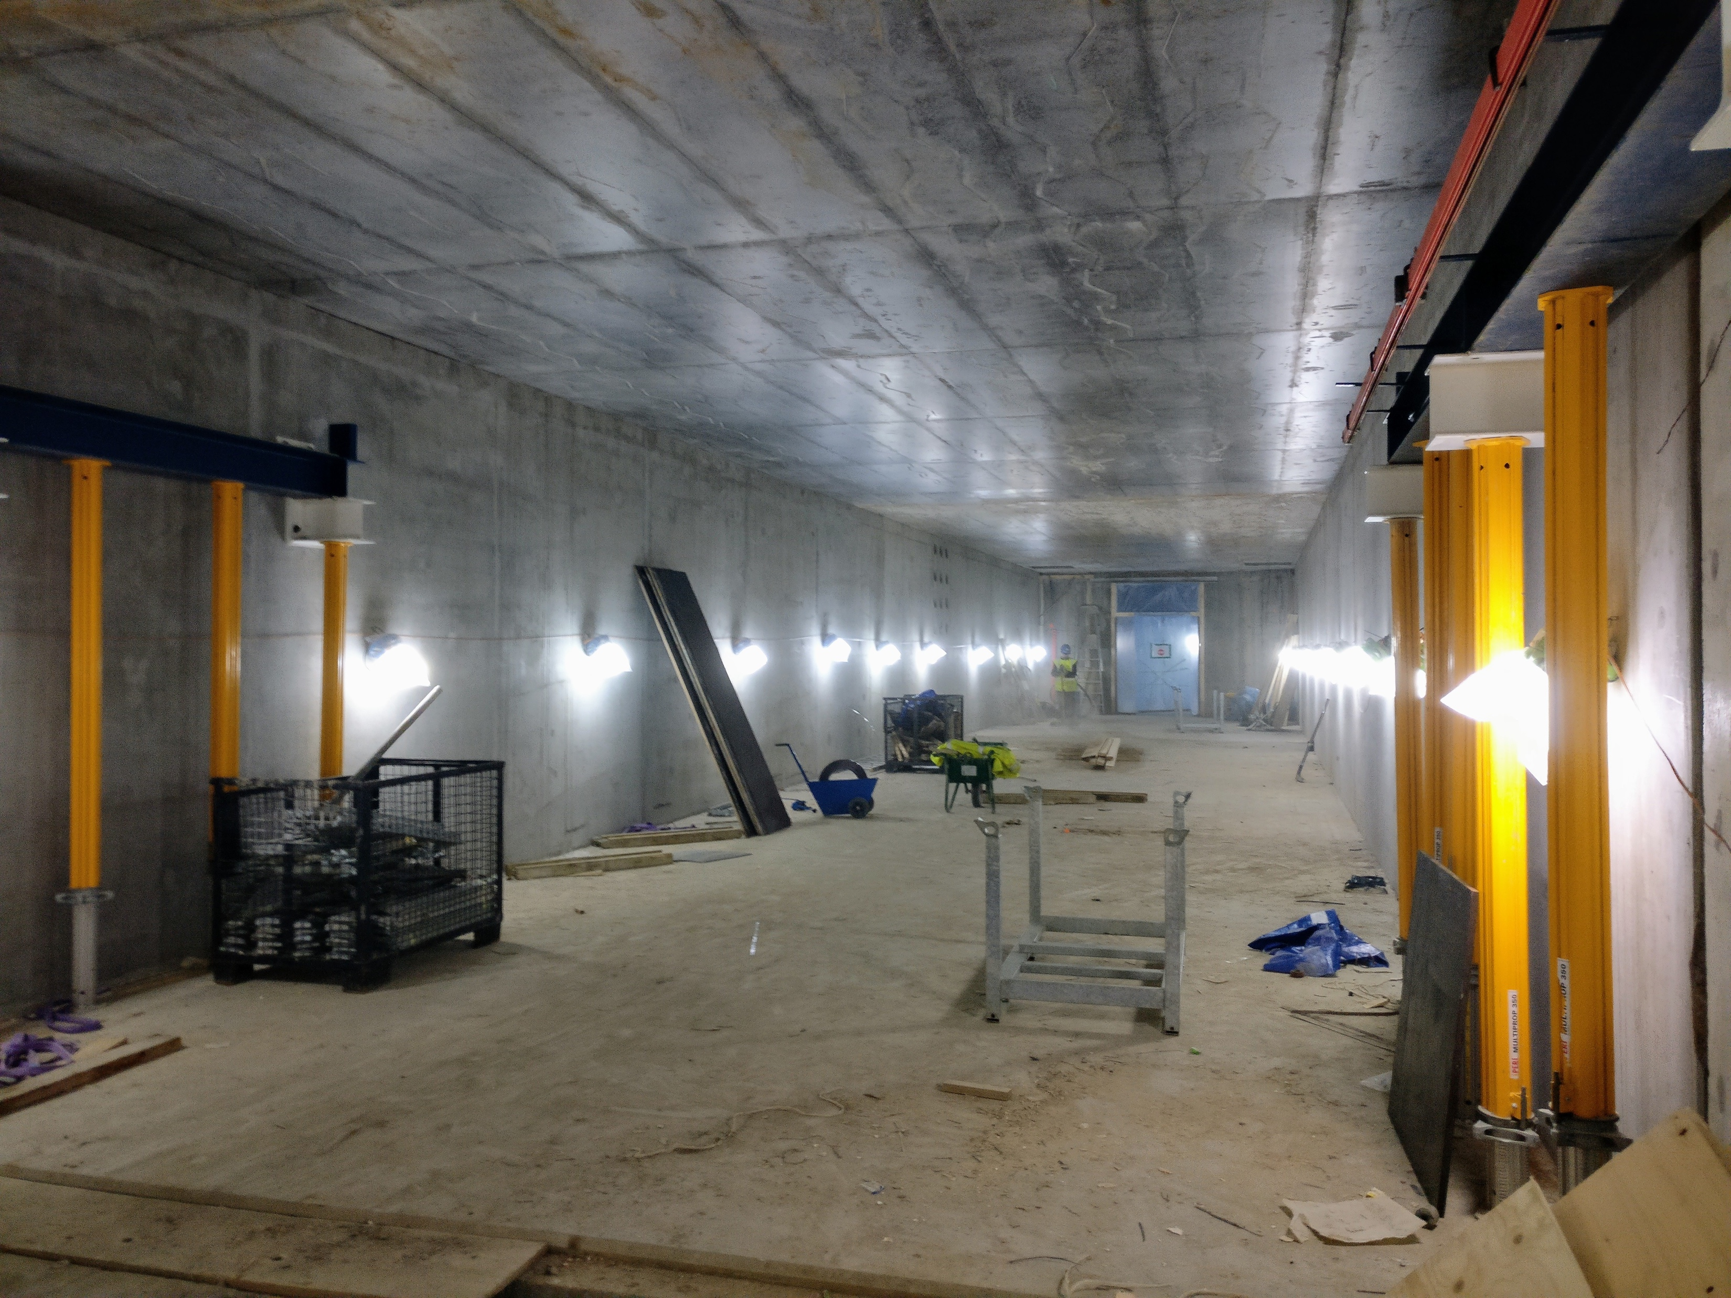
Installation schedule
Current status of the buildings

Slide 24
Installation schedule
2018
2019
2020
2021
2022
2023
2024
2025
BOT
ES
SOUP
EOC
Warm LINAC Commissioning Steps
1.3 GeV Capability Installed
Accelerator + ICS
Hi-Beta Install
Beam on Dump
(570 MeV)
Accel RBOT
Accelerator Schedule Float
Notes:
HEBT 2019
TBD Q4 2019
NSW Q4 2019
PBDR Q1 2020
Dump Line
Dogleg
A2T, access 2020/01/20
GSA, access ~2021
RBOT 2021/09/13

Slide 25
Installation schedule
2019
2020
2021
2022
HEBT
TBD
DmpL
A2T
DgLg
GSA
RBOT
BOT
NSW
PBDR
Notes:
HEBT 2019
TBD Q4 2019
NSW Q4 2019
PBDR Q1 2020
Dump Line
Dogleg
A2T, access 2020/01/20
GSA, access ~2021
RBOT 2021/09/13

Slide 26
Thank you for your attention
Questions?

Slide 27
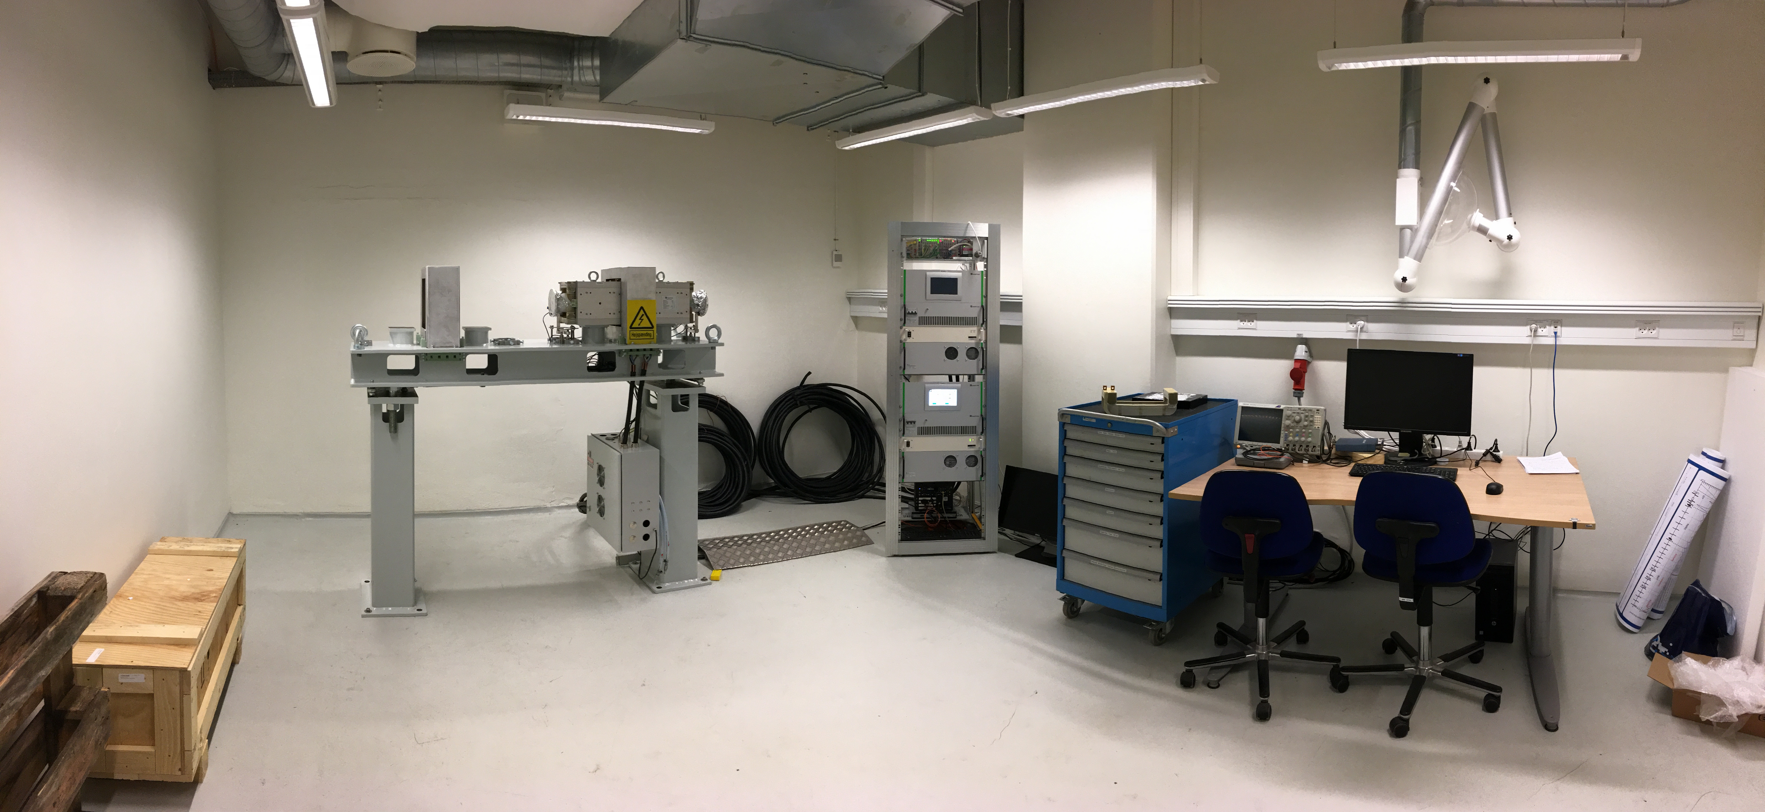
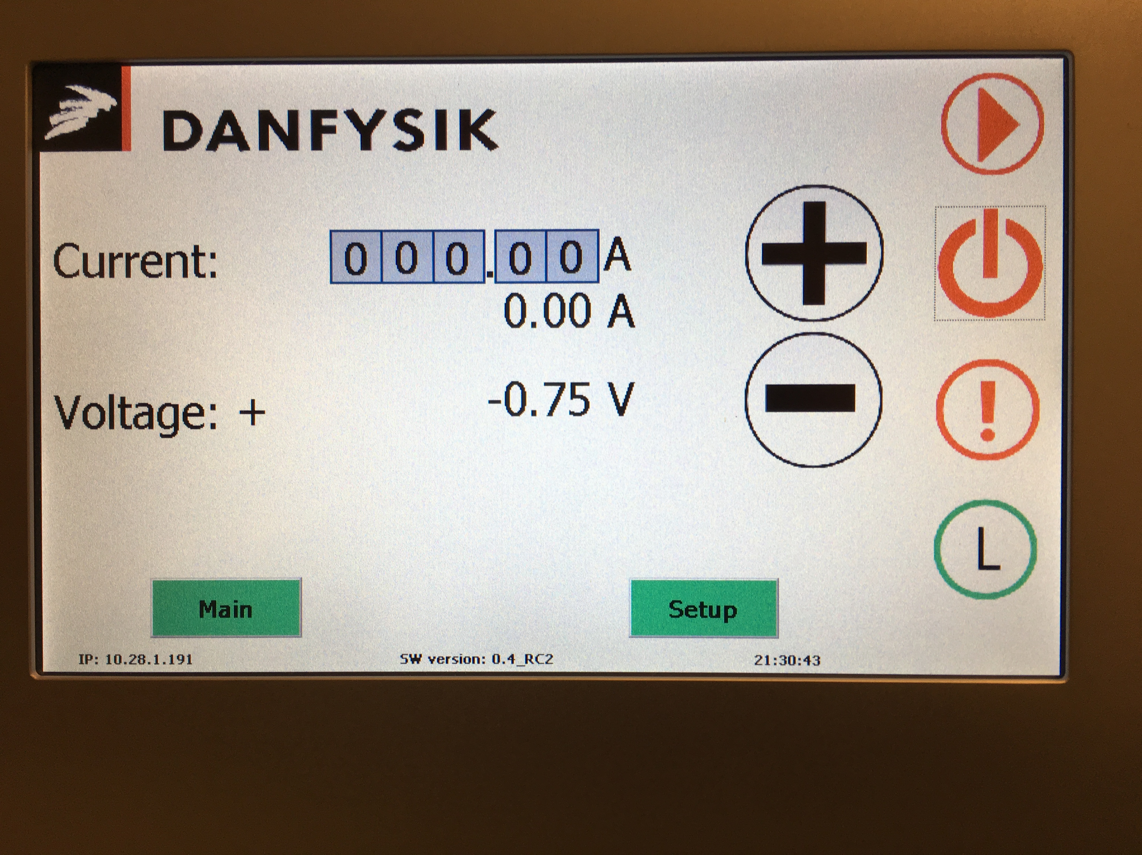
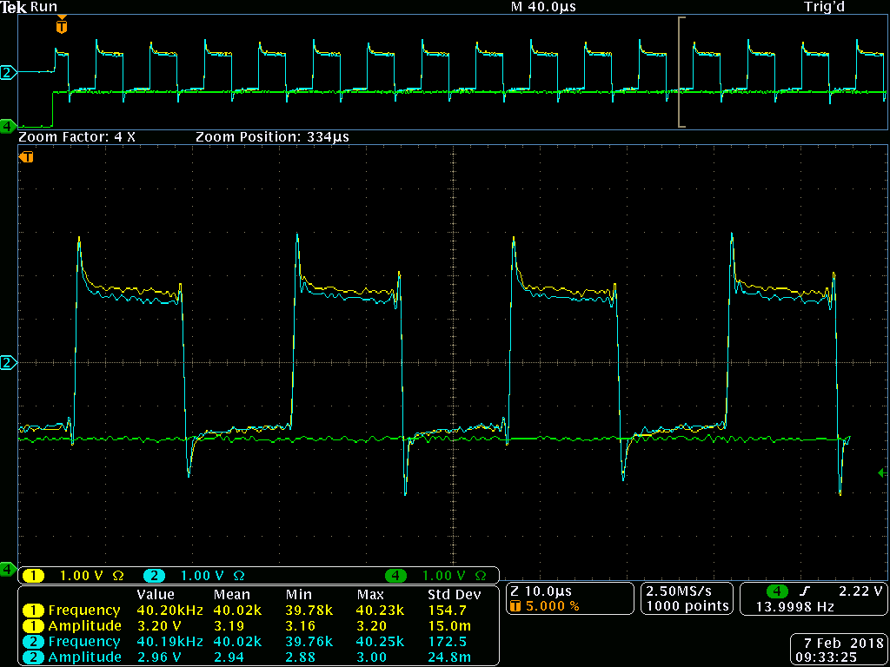
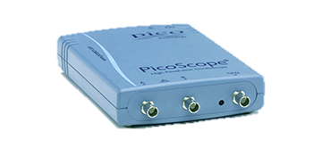
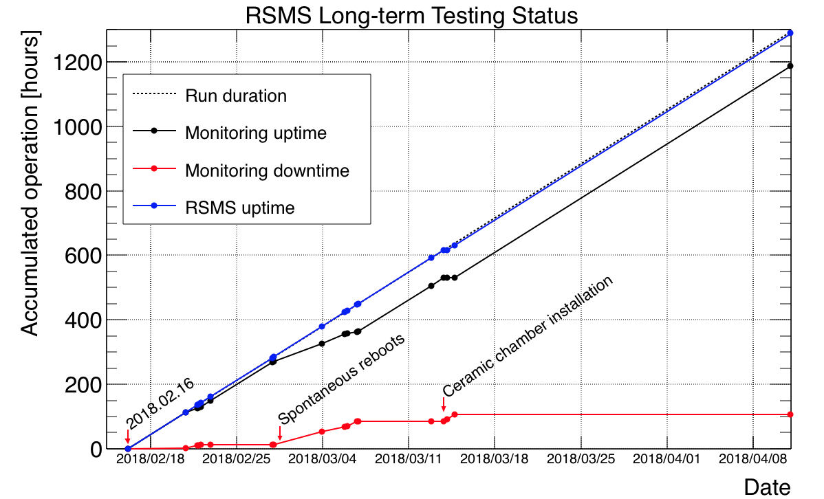
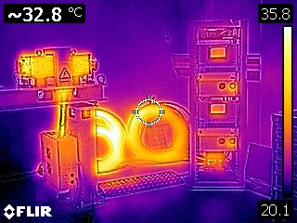
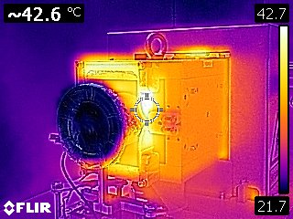
Raster Scanning Magnets System
Pre-series testing at Aarhus University
PLC
RSM2 RSM1
PicoScope
Power cables
RSM2 RSM1
Girder
EVR
Termination box
Bdot, Interlock
Local PC
Courtesy Heine Dølrath Thomsen, ISA, Aarhus University

Slide 28
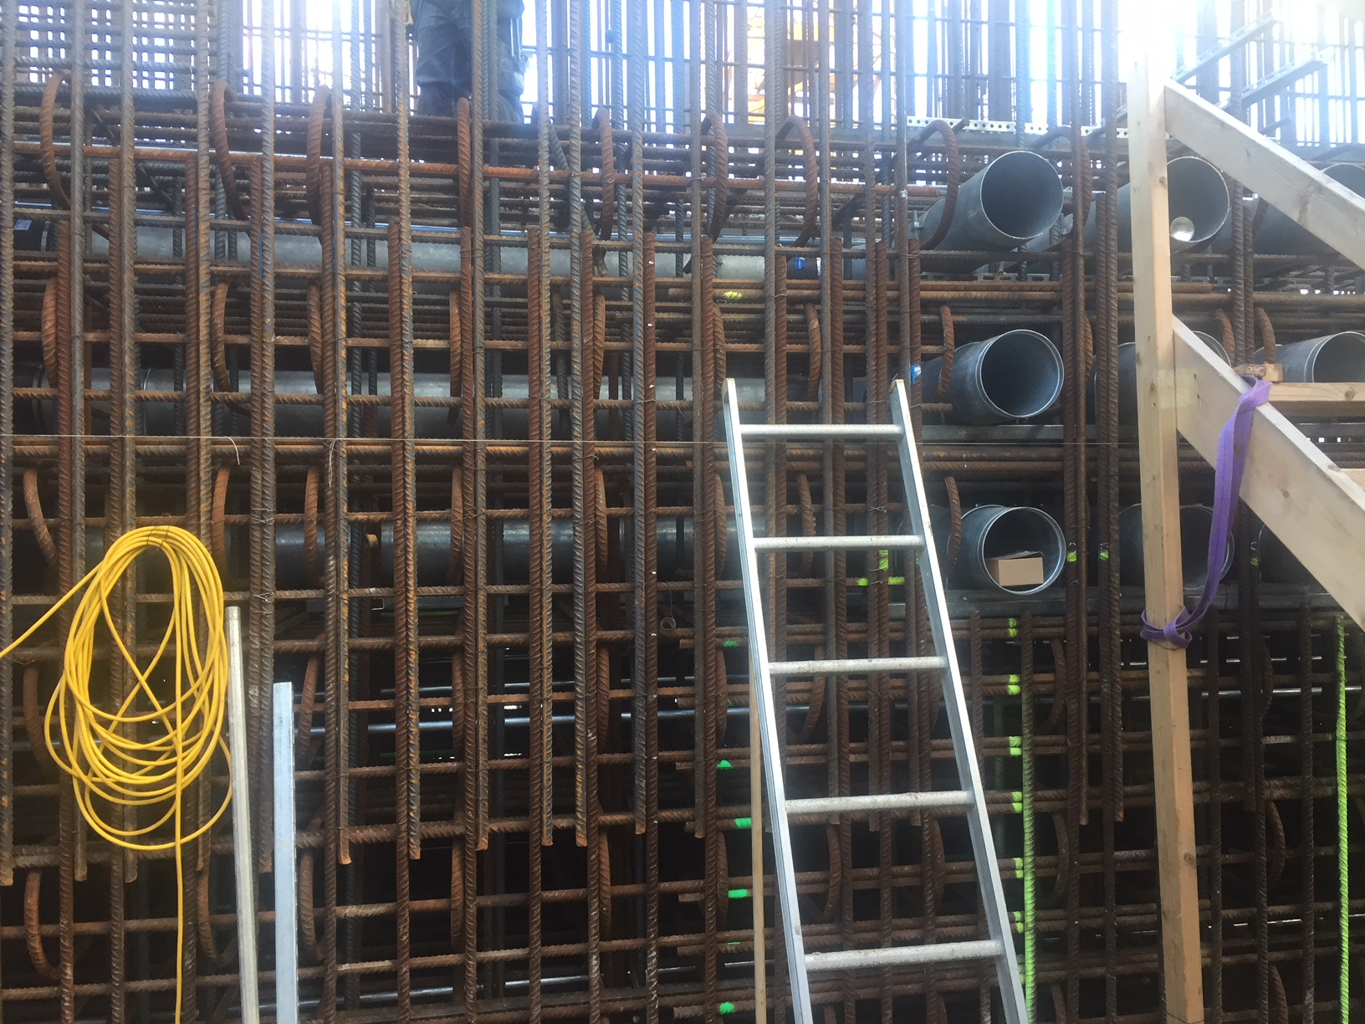
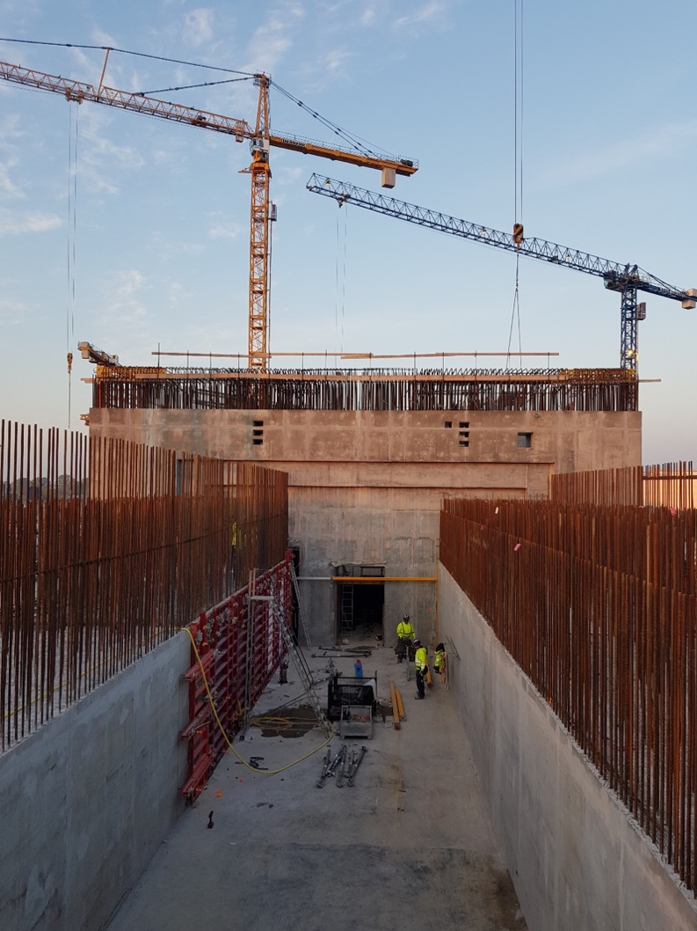
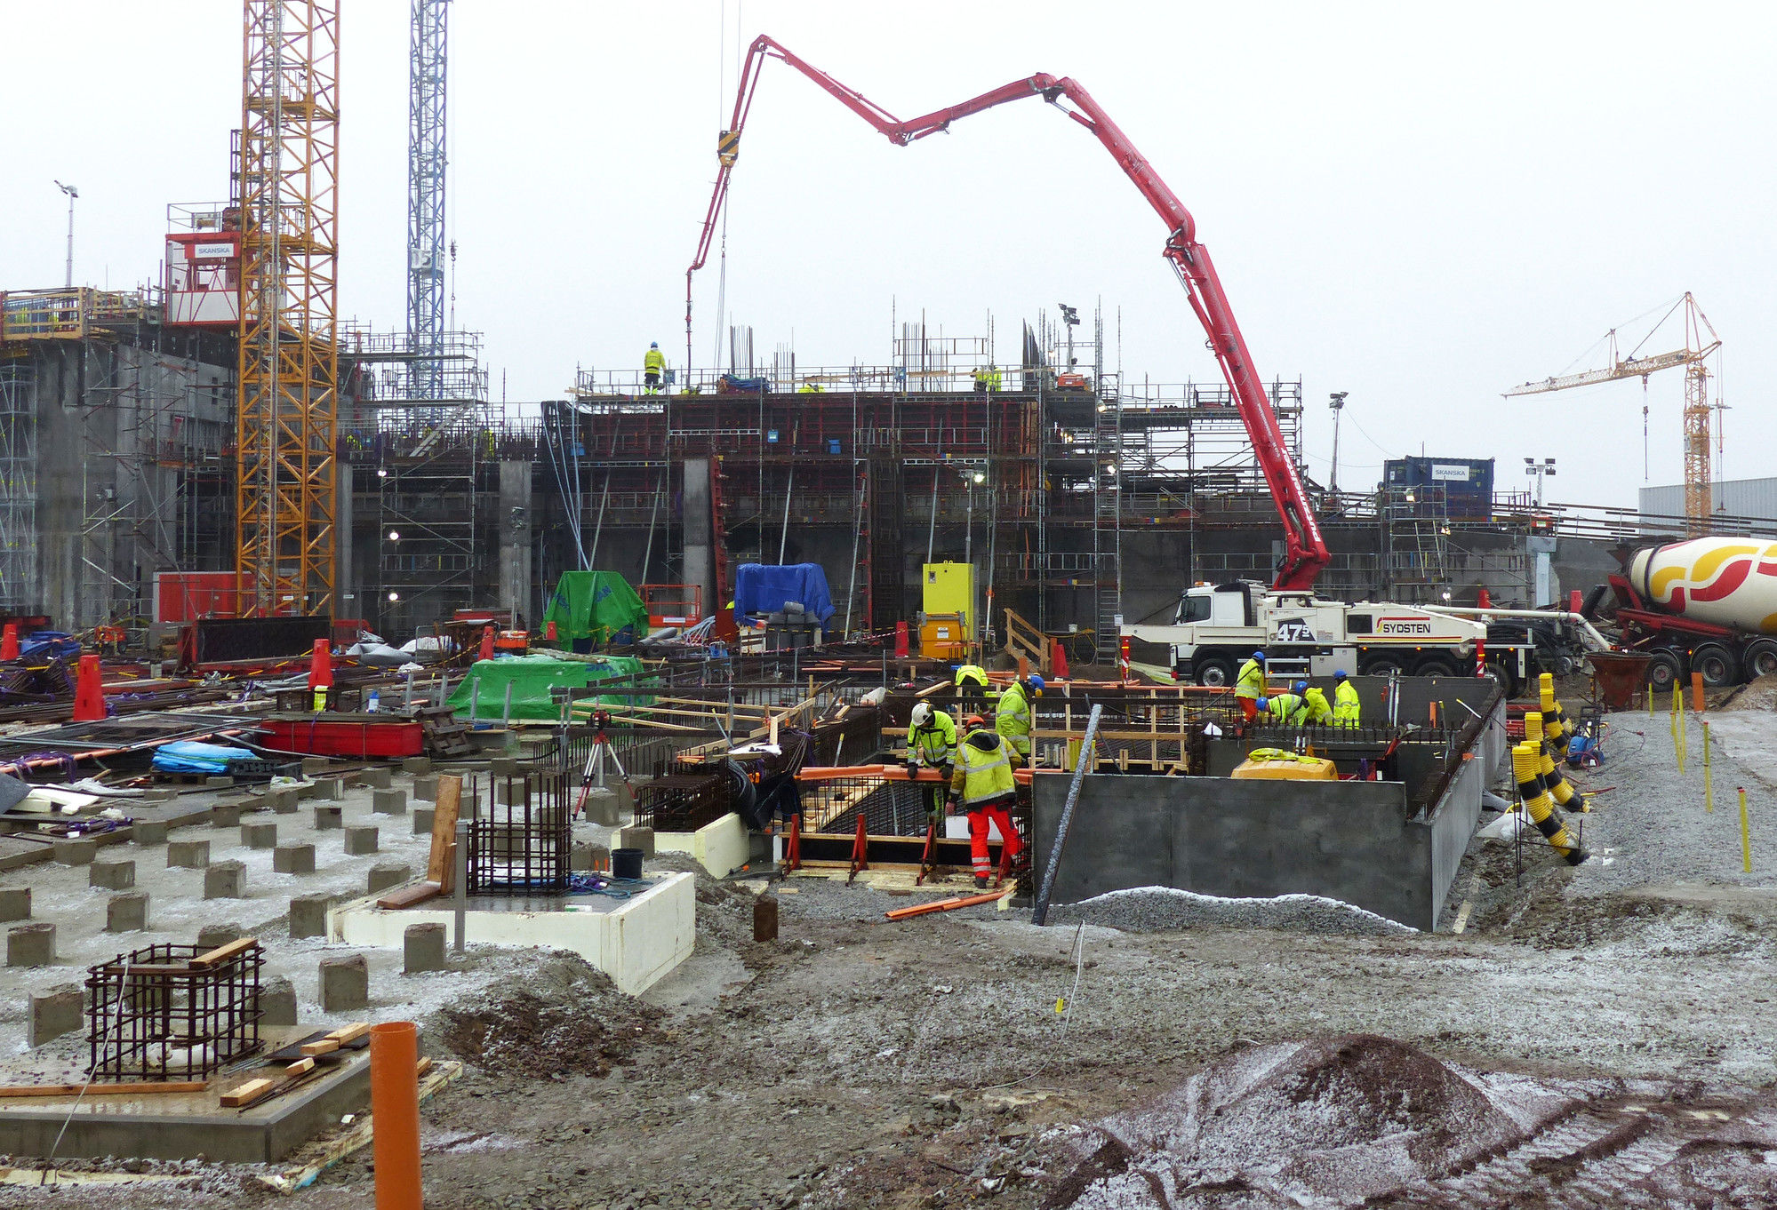
Other pictures
Civil construction
GSA chicane conduits (2018)
GSA (Feb 2019)
A2T walls 1st level (2018)

Slide 29
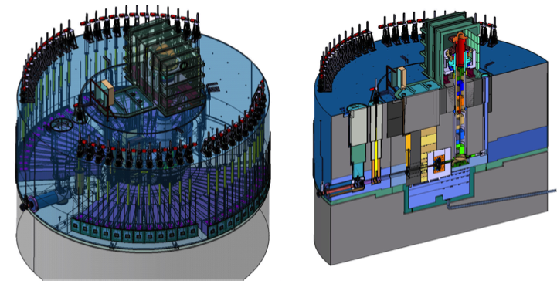
Accelerator/Target interfaces
Monolith general layout
Side view along the vertical plane of the incident proton beam
3D perspective view

Slide 30
Accelerator tunnel
Main dimensions
A
60900
TCS
52400
22222
A
4°
TCS: Target Coordinate System
Section A-A:
3500
2850
1500
3150
6000
30

