Slide 1
PSS verification and validation
TS2 PSS Preliminary Design Review
Paulina Skog
On behalf of Protection Systems Group
ESS/ICS/PS
2019-02-11

Slide 2
Agenda
Verification and validation goal
Introduction to the V&V Plan for TS2
Verification Strategies
Traceability
Overview of the tests

Slide 3
Verification and validation goal
Prior to any operation or energization of the systems interlocked by PSS, the PSS shall be verified and validated.

Slide 4
V&V Plan for TS2
It will not describe the test activities in detail, giving all complete approved test specifications and test reports.
Provides an overview of standards, required tests, reviews and assessments
  When (sequence), where, who and how!
  Inputs, outputs, entry criteria, acceptance criteria and roles for all:
    Reviews
    Tests
      Tools
      Methods
    Functional Safety Assessments
It shall be used as an input when designing the test specifications and test reports.

Slide 5
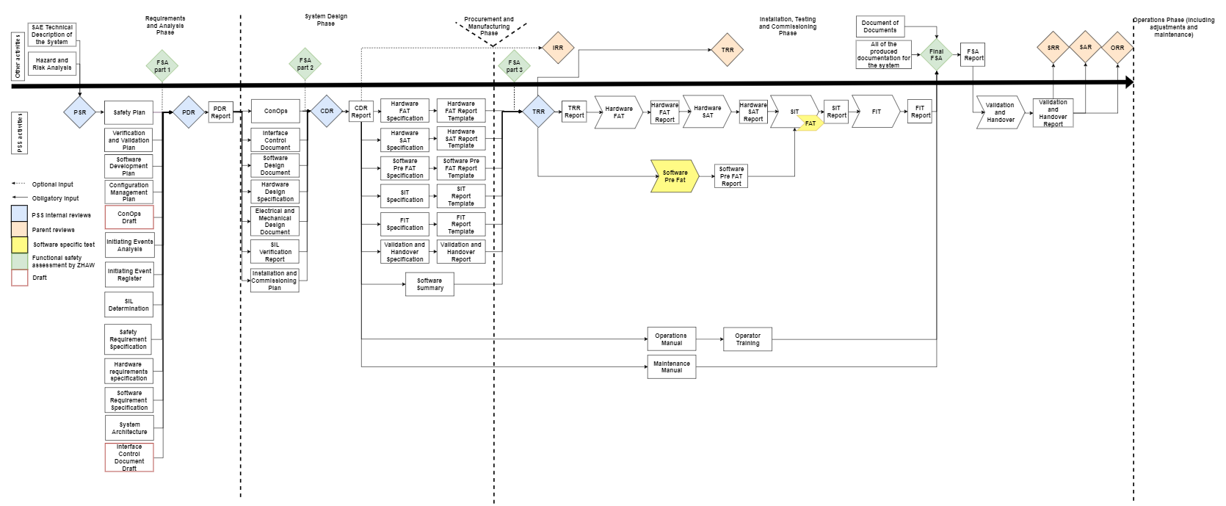
V&V FLOW
Notes:
PSR: The PSR verifies that enough information is available to start working on the PSS system.
PDR: The PDR verifies that the conceptual design and the planned technical approach shall meet the requirements
CDR: The CDR verifies that the specified requirements are met by the detailed, or critical design and demonstrates that maturity of the design is appropriate to proceed into implementation and installation.
TRR: The TRR verifies that the product, its test equipment, support personnel, and test procedures are ready for verification and validation.
Functional Safety assessment (FSA): Zurich University of Applied Sciences (ZHAW). The shortcomings of the items under assessment shall be specified and recommendations on modifications shall be proposed by Zurich University of Applied Sciences (ZHAW).

Slide 6
Verification strategy
HW and SW component tests, system integration tests, the tests planning, and documentation shall be carried out according to:
  Functional safety – Safety instrumented systems for the process industry sector (IEC 61511), 2016.
  Automation systems in the process industry – Factory acceptance test (FAT), site acceptance test (SAT), and site integration test (SIT) (SS-EN 62381), 2012.

Slide 7
Verification strategy
All documents shall be reviewed and approved by appropriate reviewers
  NORA
    Notified
    Owner
    Reviewer
    Approver
Reviews (PSR, PDR, CDR, TRR)
Functional Safety Assessment
The software shall have documented code reviews
Traceability

Slide 8
Traceability for TS2
The Initiating Event Analysis document the Overall Safety Requirements.
  Documented in the TRM tool (Traceable Requirement Management)
The Requirement Specification(s) (SRS)
  The safety requirements for each SIF.
  It includes specifications of both the functional and safety integrity requirements for the system.
Each test and validation report template and report shall have a traceability matrix

Slide 9
Hardware FAT
Verifies that the as-built hardware system meets the specified design.
Includes component test
Performed by the vendor, but it should be designed and accepted by ESS.
Note:
This HWFAT is not the same as the FAT defined in IEC61511 standard. The FAT from IEC 61511 standard is part of the SIT.
The HWFAT follows the ESS guideline for FAT.
Notes:
Methods: Inspection and test, checks insultation resistance, disruptive discharge, residual voltage etc
Tools: Multimeter, Insulation tester, Loop calibrator, Windows laptop with a PLC programming tool to force and monitor signals to PLC modules

Slide 10
Hardware SAT
Verifies that the hardware system is installed as specified in its operational environment (On site).
HWSAT include the same tests as the HWFAT and some additional field device tests and a loop check.
Note: This HWSAT does not follow the IEC61511 standard definition of SAT. The SAT according to the standard is included in the validation described in the validation section of this document.

Slide 11
Software verification
The Software FAT follows the recommendations from IEC 61511 standard and has two stages:
Software Pre FAT - preparation for software FAT, where the software developer tests the code in test environment, mainly through simulation.
Software FAT (included in PSS SIT and FIT)

Slide 12
Software Pre FAT
It includes the software code review
  shall include a confirmation from independent software code review that software is ready for SIT.

Slide 13
Site Integration Test (SIT)
The SIT verifies that installed hardware and software work together properly.
For software (A.12.5.3 in IEC 61511-2):
  Performance tests
  Integration-level structural tests
  System-level integration tests
Tools:
  Windows laptop with PLC programming tool
  Multimeter for continuity tests
  PSS PLCs
  PSS HMI-s
Note: To reduce the risk of damaging the SAE due to repeated tests, the SAE shall be disconnected from PSS during PSS SIT.

Slide 14
Final Integration Test (FIT)
The FIT is a repetition of SIT whilst SAE is operational and connected to PSS.
Stakeholder associated equipment (SAE)
  Equipment in TS2 that TS2PSS interlocks in order to mitigate risk associated with them.

Slide 15
System demonstration and handover
The demo covers the real system and the positive tests from the FIT
To prove that PSS meets the safety and operational requirements
Presented to all identified stakeholders
  The stakeholders shall have access to all PSS documentation before the handover and demonstration.

Slide 16

Questions?
Thank you for your attention!

Slide 17
Verification Methods
The following standard methods are used according to the INCOSE System Engineering Handbook:
Analysis: Critical and careful evaluation of a situation or problem that shows the theoretical compliance, e.g. by use of simulation or analytical data.
Test: Program or procedure that is designed to verify that a system conforms to its requirements.
Inspection: Visual examination of a system and associated descriptive documentation.
Demonstration: Verification by witnessing an actual operation in the expected1 or simulated environment, without need for measurement data, additional test equipment or post demonstration analysis.
Review: A formal assessment or evaluation of documentation, procedures, decisions or design, with the intention of ensuring that specific requirements are fulfilled. The different reviews are specified further in the next section.

Slide 18
Pre Start Review (PSR)
The PSR verifies that enough information is available to start working on the PSS system.
Input | Output | Acceptance criteria | Responsible
SAE technical description Hazard and Risk Analysis | An approval from the committee to start the detailed analysis phase and drafting system architecture. | The input documents are approved and contain enough information for PSS to start the detailed analysis phase and creating the draft of system architecture. | A committee containing at least representatives from: Environment Safety and Health (ES&H) Stakeholder Associated Equipment (SAE) PSS

Slide 19
Preliminary Design Review (PDR)
The PDR verifies that the conceptual design and the planned technical approach shall meet the requirements according to the ESS Handbook for System Verification .

Slide 20
Preliminary Design Review (PDR)
Input | Output | Acceptance criteria | Responsible
Approved documents: Safety Plan Verification and Validation Plan Software Development Plan Configuration Management Plan Initiating Event Analysis Initiating Events Register SIL Determination Safety Requirement Specification Software Requirement Specification Hardware Requirement Specification System architecture (can also be part of the ConOps) | Approved PDR Report An approval from the committee to start the engineering and design phase. | The input documents are approved and contain enough information for PSS to start the engineering and design phase. | A committee containing at least representatives from: ES&H SAE PSS
Drafted documents: Concept of Operations (ConOps) draft Interface Control Document Draft

Slide 21
Pre Start Review (PSR)
The following verification activities should be performed for the personnel safety systems before validation.
Input | Output | Acceptance criteria | Responsible
SAE technical description Hazard and Risk Analysis | An approval from the committee to start the detailed analysis phase and drafting system architecture. | The input documents are approved and contain enough information for PSS to start the detailed analysis phase and creating the draft of system architecture. | A committee containing at least representatives from: Environment Safety and Health (ES&H) Stakeholder Associated Equipment (SAE) PSS

Slide 22
Critical Design Review (CDR)
The CDR verifies that the specified requirements are met by the detailed, or critical design according to the ESS Handbook for System Verification [7]. A CDR demonstrates that the maturity of the design is appropriate to proceed into implementation and installation.

Slide 23
Critical Design Review (CDR)
Input | Output | Acceptance criteria | Responsible
Concept of Operations Interface Control Document Software Design Document Hardware Design Specification Electrical and Mechanical Design Document SIL Verification Report Installation and Commissioning Plan | Approved CDR Report An approval from the committee to start the installation and test development. | The input documents are approved and contain enough information to start the installation and test development. | A committee containing at least representatives from: ES&H SAE PSS

Slide 24
Test Readiness Review (TRR)
The TRR verifies that the product, its test equipment, support personnel, and test procedures are ready for verification and validation.

Slide 25
Test Readiness Review (TRR)
Input | Output | Acceptance criteria | Responsible
Installation and Commissioning Plan Software Summary HWFAT Specification Hardware SAT Specification Software Pre-SAT Specification SIT Specification FIT Specification Validation and Handover Specification HWFAT Report Template Hardware SAT Report Template Software Pre-SAT Report template SIT Report Template FIT Report Template Validation and Handover Report Template | TRR Report An approval from the committee to start the commissioning phase. | The input documents are approved and contain enough information for verification and validation of the system and to start the commissioning phase. | A committee containing at least representatives from: ES&H SAE PSS

Slide 26
Functional Safety assessment (FSA)
All of the documents produced for PSS until that point in time shall be reviewed internally at ESS and externally by an independent team from Zurich University of Applied Sciences (ZHAW).
The shortcomings of the items under assessment shall be specified and recommendations on modifications shall be proposed.

Slide 27
Functional Safety assessment (FSA)
Input | Output | Acceptance criteria | Responsible
All the produced documents, see Figure 1 for detailed flow. Document of Documents | An FSA Report | An FSA Report with approval from ZHAW | ZHAW

Slide 28
Responsibilities and roles
HWFAT
 | Role
Manager | Work package manager
Designer | Hardware designer
Verifier | Hardware verifier
HWSAT
 | Role
Manager | Work package manager
Designer | Installation coordinator
Verifier | Hardware verifier
SIT
 | Role
Manager | Work package manager
Designer | Software developer
Verifier | Software verifier
SIT & FIT
 | Role
Manager | Work package manager
Designer | Software developer
Verifier | Integration coordinator
Handover and demonstration
 | Role
Manager | Work package manager
Designer | Integration coordinator
Validator | External Validator (External meaning not from PSS)

Slide 29
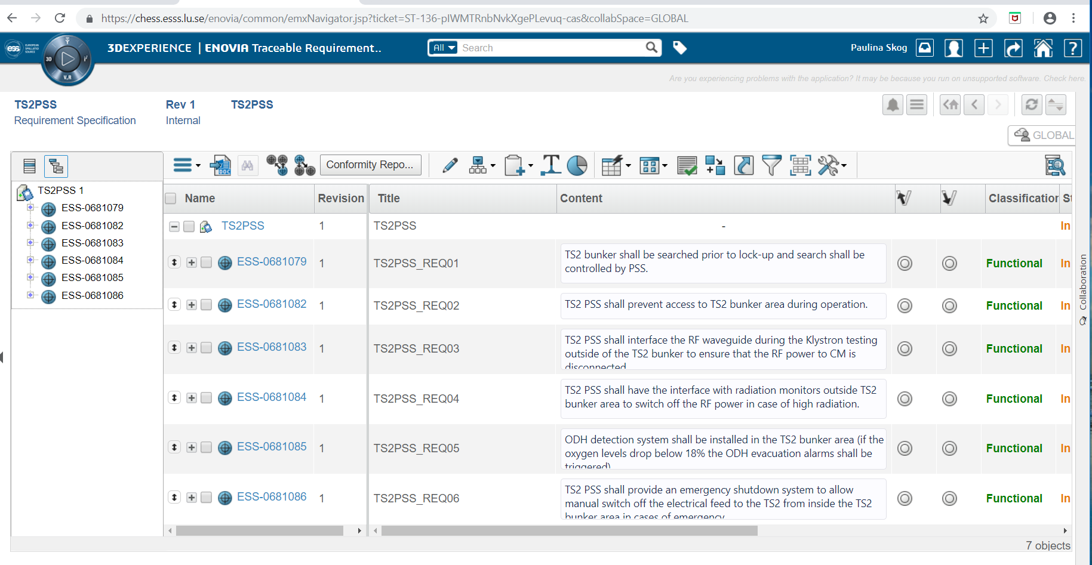
TRM

Slide 30
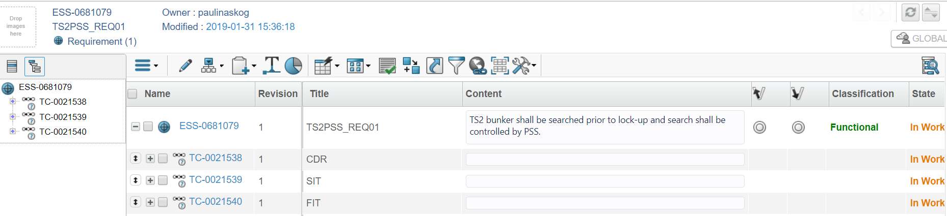
TRM

Slide 31
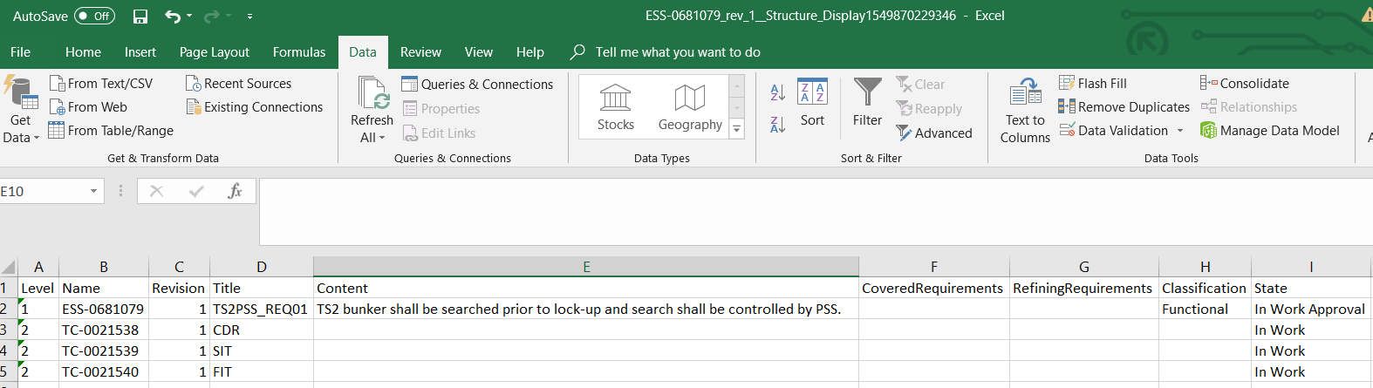
TRM

Slide 32
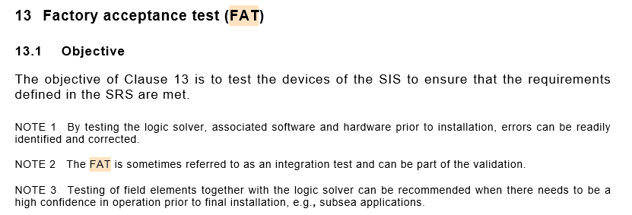
FAT

Slide 33
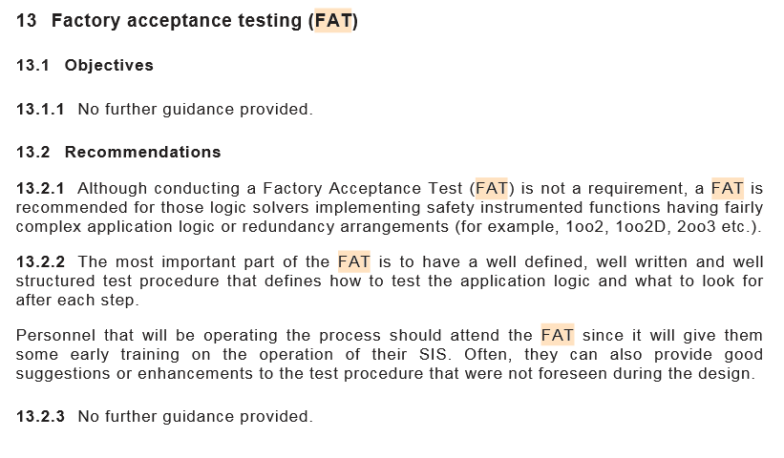
FAT

Slide 34
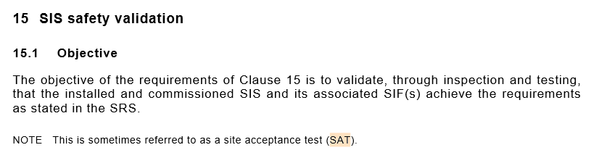
SAT

