Slide 1
Configuration Management
TS2 PSS Preliminary Design Review
Meike Rönn
Technical Documentation Specialist
ESS/ICS/PS
2019-02-11

Slide 2
Contents
Chronicle
Introduction
Purpose
Configuration Item and CIDL
Roles
CM activities
  Identification
  Configuration control
Status accounting and audits
Notes:
Mayer add a background here.

Slide 3
Chronicle
Configuration Management (CM) Plan for PSS released
Development of ESS facility-wide CM, within WoW Area Manage Configuration
Working group
Now
Problem: not integrated with the rest of ESS facility
Integrate with comparable systems, develop high-level CM Plan for HW/SW for safety critical systems → PSS & TSS
CM plan for safety critical systems integrated into development of facility-wide CM

Slide 4

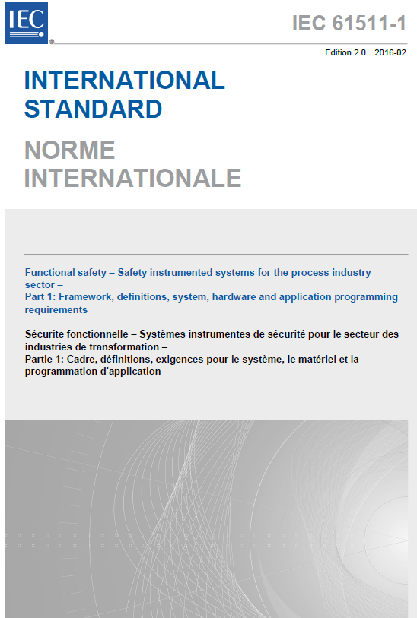

Introduction
ESS facility CM
development
IEC 61511
Configuration Management for Safety Critical Systems
Personnel Safety Systems (PSS)
Target Safety Systems (TSS)

Slide 5
Purpose
HW and SW to be under CM → identified & documented
All items under CM named & versioned → unique identifier
CM relevant information for these items → identified and controlled
Changes to items and baselines → controlled and evaluated
Only approved changes are implemented
The status of all items can be tracked
The Safety Critical System maintains safety integrity, despite of any changes made to them

Slide 6
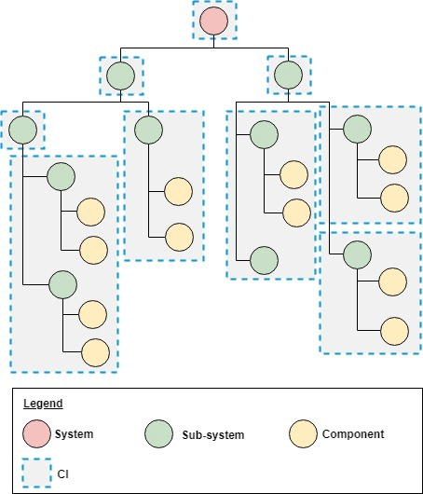
Configuration Item (CI)
CIDL
CI: collection of HW and SW systems & components
Grouping: criteria such as functionality, physical systems, safety risk, interfaces,...
Follow FBS structure
Each CI: Configuration Item Documentation List
  All information related to the CIs
CIDL
CIDL
CIDL
CIDL
CIDL
CIDL
CIDL
CIDL

Slide 7
Configuration Item Documentation List (CIDL)
Listing information related to CI (directly or through reference to a document)
Change log (change requests)
CIDL template
Uploaded to CHESS, related to the CI’s FBS node
parent CIDLs and sub-CIDLs
documentation, reports, HW components and SW
Models and data for HW and SW authoring tools, uploaded to CHESS
Version numbers
Toolboxes, libraries, compilers, firmware
Checksum for safety program for each PLC
Which software and version installed on each PLC
Safety related settings
Safety program parameters

Slide 8
Roles and Responsibilities
CI owner
CIDLs
Establish, review, approve
Create new sub-CIDLs
Updating
Maintaining information
Ensuring change control is carried out properly
Accountable for CIDLs being accurate and up-to-date
SCCB
Configuration control board for safety critical systems
Making decisions on proposed changes in the safety critical system configuration
FCCB
ESS facility-wide configuration control board
Involved in decision making within change control for safety-critical systems
Managing baselines

Slide 9
Configuration Management Activities
Configuration Identification
  Identifying and organising HW and SW items to be under CM → CIs
  Determining which information related to these needs to be controlled
Configuration Control
  Planning, creating and changing baselines
    Procedure to control changes

Slide 10
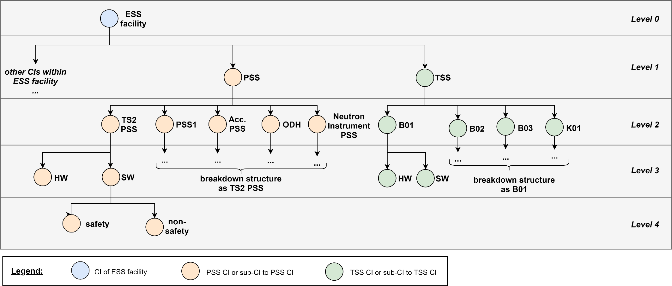
Configuration Identification
PSS CI breakdown: PSS system, hardware / software, safety-related
Note: CI owner can create sub-CIs

Slide 11
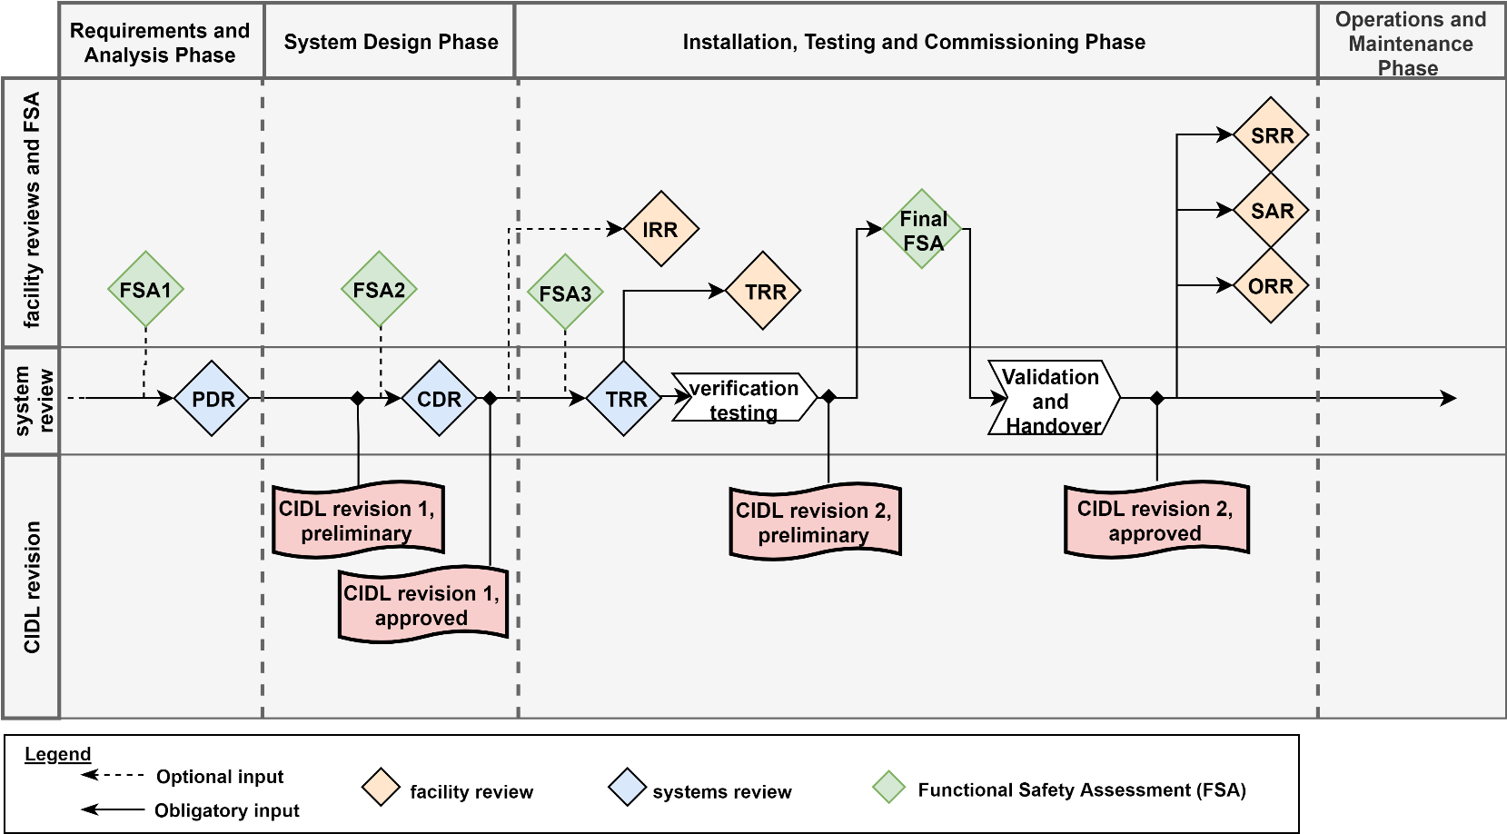
Configuration Identification
Each CI added to a configuration baseline → Configuration baselines: ESS facility-level
Update baseline: CI owner sends CIDL(s) to FCCB
CIDLs during TS2 PSS development updated as follows:

Slide 12
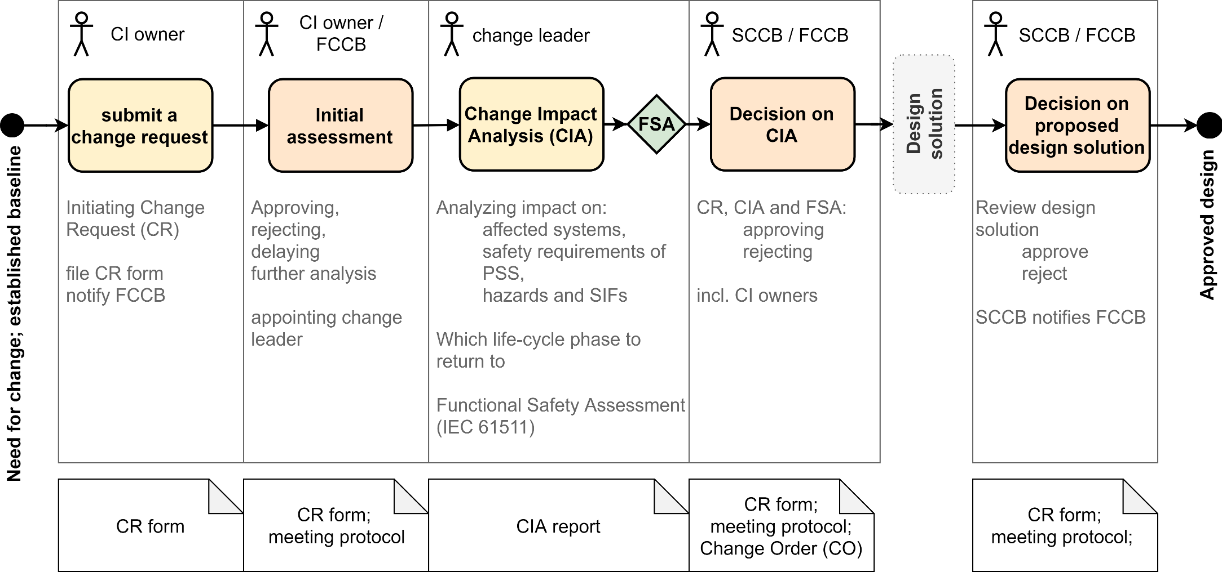
Change Control Procedure
CR and design solution approved → CIDL(s) to be updated
CIDL forwarded to FCCB for baseline update

Slide 13
Status Accounting and Audits
Status accounting:
  Sources: CIDLs, Configuration Baseline Plan (ESS facility), change logs, CR forms, CCB meeting protocols
Functional configuration audits
  In conjunction with system reviews
  Examining functional characteristics of the CI, verifying it meets the specified requirements
Physical configuration audits
  Formal examination verifying CI has achieved the physical characteristics specified in its configuration information

Slide 14

Questions?
Thank you for your attention!

