Slide 1
Target Collaboration Board Project Update
Mark Anthony
Head of Target Division
www.europeanspallationsource.se
8 February 2019

Slide 2
Target Project is 40% complete
Current budget at completion for the ESS Target Sub-project is 208.1M€
Earned value as of December 2018 is 80.6M€
Cumulated Schedule Performance Index is 0.93
Actual cost spent as of September is 86.8M€, Cost performance index 0.90
Preliminary Design Phase is 94% completed, 3 remaining
42 CDRs have been conducted in total. 17 during 2018 whereof 6 of those were conducted in December.

Slide 3
Highlights
Deliveries, Installation, and commissioning
The civil works continues in all parts of the D02 target station building, Concrete casting for ACF level 2 complete, at crane shelf level, and A2T at vault level roof 1st cast of 3 completed, 1st high bay floor cast scheduled in feb.
Ground Shielding delivered to ESS ERIC as well as several HVAC shipments and is placed in storage.
Cryogenic Hydrogen System and Helium Cryoplant equipment delivered and installed, commissioning ongoing. TMCP impeller fixed, redesigned start logic at power cabinet
CMS: Technical specification document for CTL&HTL has been finished. And it started the review process. (reviewed by Jarek and Philipp in ESS. Additionally, Jülich Prof. Hans and Yannick are asked to review/check it as well.)
Components
Monolith water cooled Inner Shielding prototype design finalized, manufactured, inspected and tested SAT. Proving design is acceptable.
TSS CDR 1 of 3 completed successfully, supports hardware selections (CDR 2 and 3 moved 10 weeks)
A hydrostatic pressure test on one of the PBW prototypes was successfully carried out. No pores, no leakages and no breakage occurred with pressure up to 15 bar (design pressure is 5 bar)
Welding of cold and thermal moderators has been completed and tested.
Target Monitoring Plug (TMP) instruments (IR and X/Y laser) testing performed at Julich was positive. IR was tested very close to the real temperature.
Conducted PDR of target electrical distribution system
Analysis
Fire analysis of TSS is complete. Results conclude we will be able to cope with a large fire and TSS will still be able to stop the proton beam.
The Functional Spec format and content has been resolved. ICS is preparing for the PDR for the Target cooling process control system
TIK 6.1 for ACF has been signed, presentation to IKRC Jan 31st.

Slide 4
Highlights
Manufacturing contracts awarded for several large in-house & in-kind hardware;
Tuning Beam Dump
Outer Shielding, Part 1 for Inner shielding
Proton Beam Drift Room shielding
NBEX port inserts material
Shaft Cutting Station in ACF
Interbay confinement doors, and floor valves
Port block intermediate shielding and baseplates
Target Monitoring Plug Controls
Contract for Phase 1 of NBEX
Helium Cooling System
Design package for Radiolysis Gas Treatment System

Slide 5
Highlights Recent Accomplishments

Slide 6
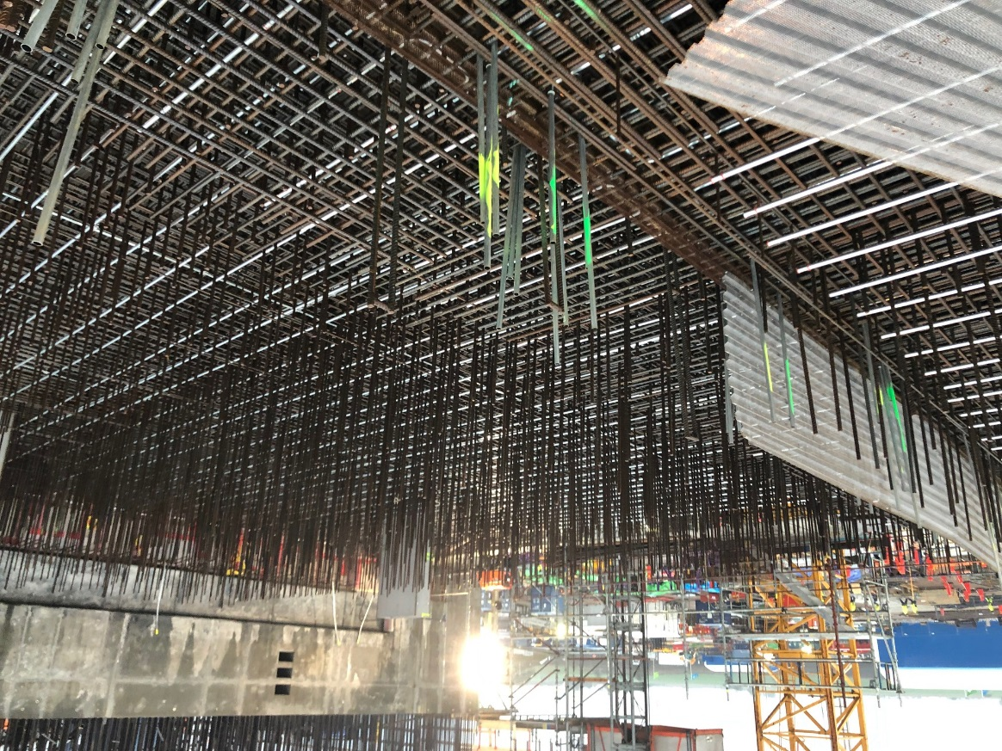
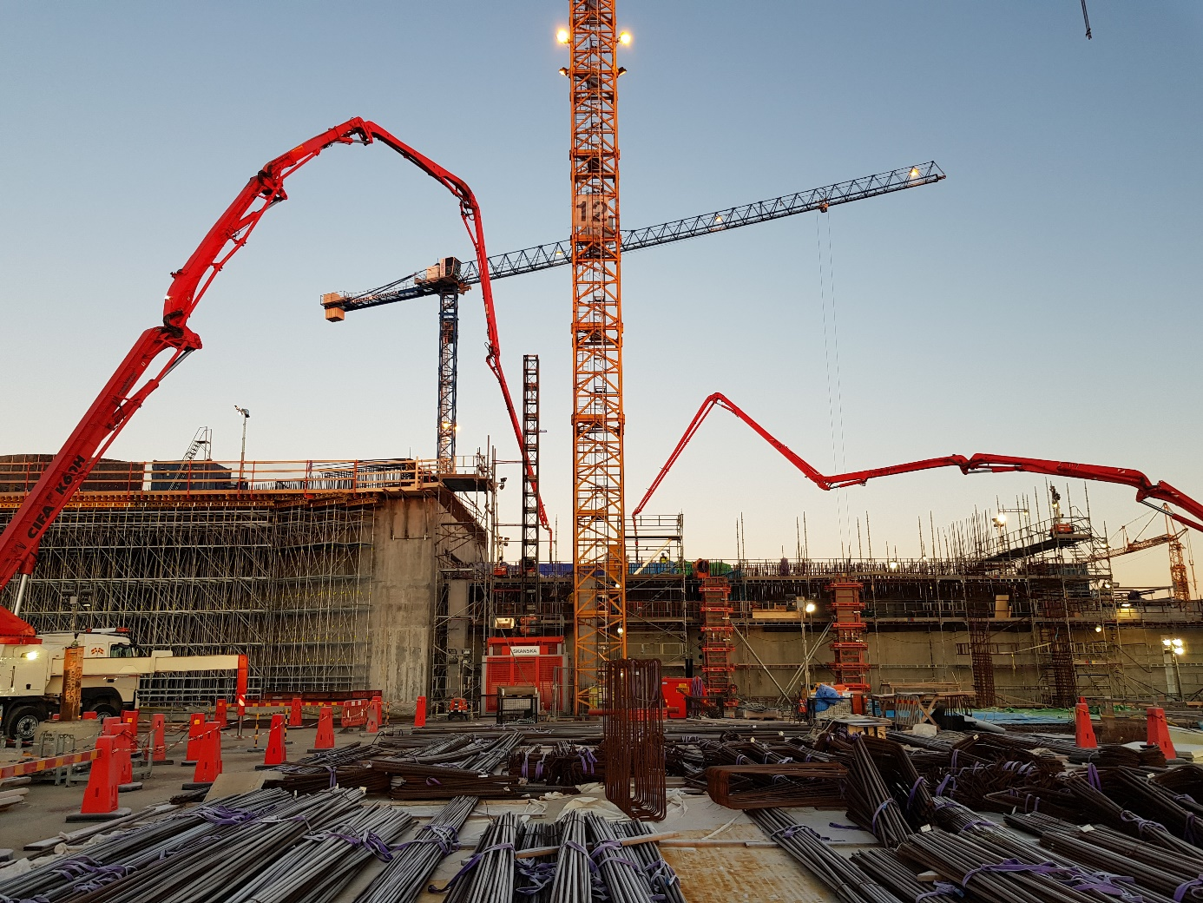
Highlights Recent Accomplishments
Casting of slab above A2T tunnel
Mesh for casting joint in A2T vault.

Slide 7
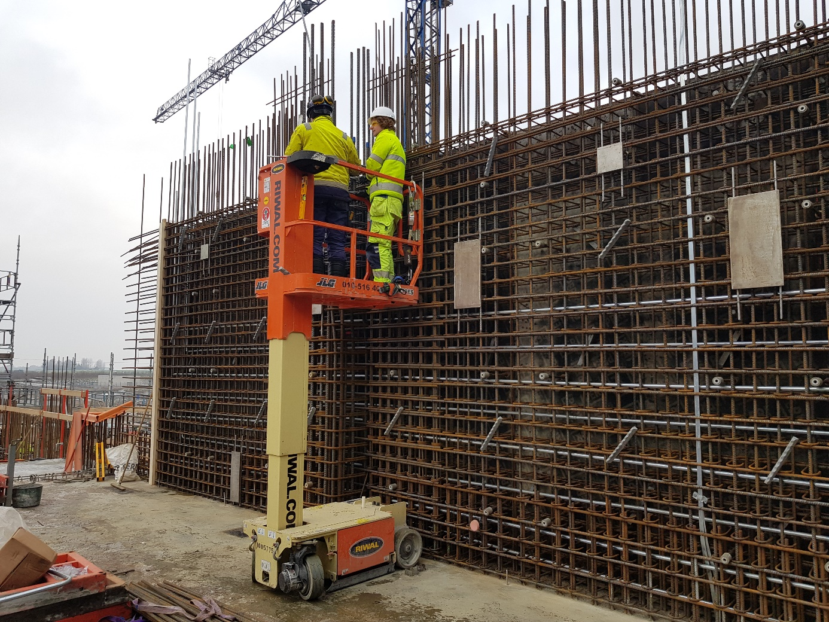
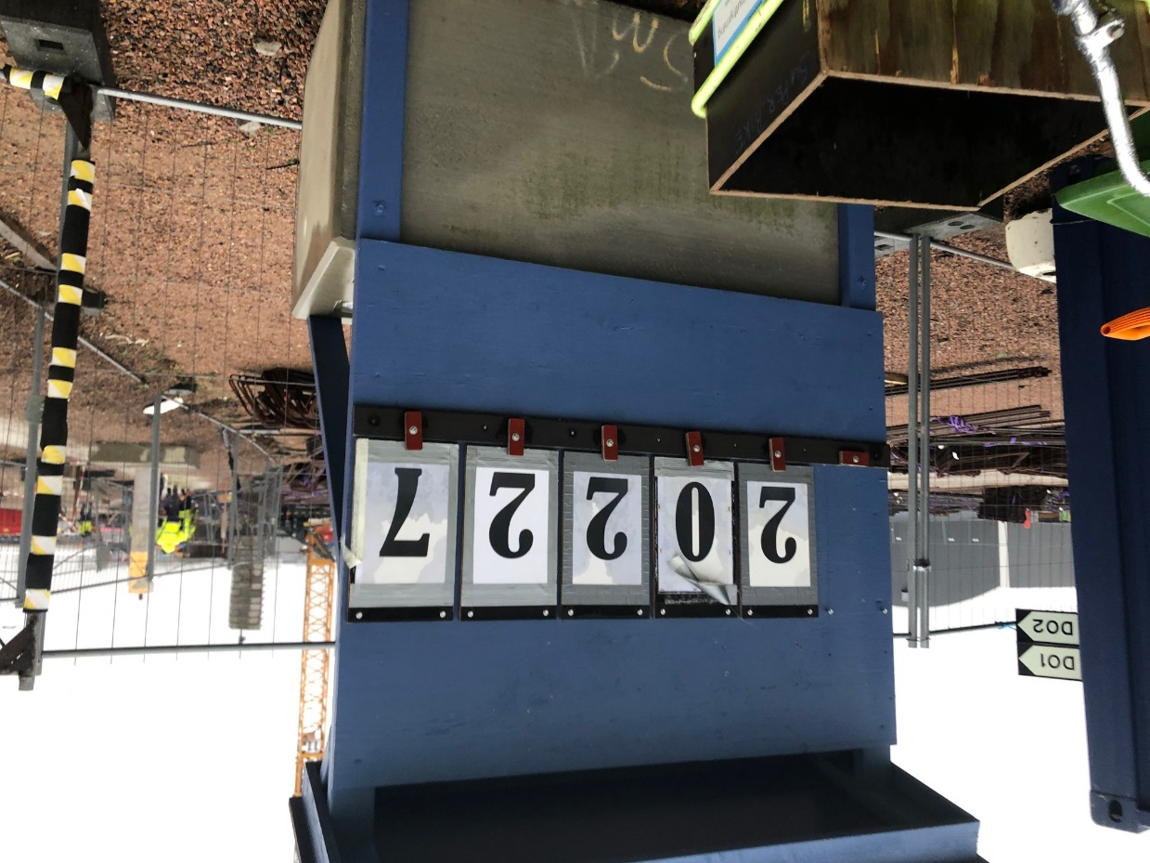
Highlights Recent Accomplishments
Accumulated cubic metres of concrete poured in the D-buildings
Utility building north and south walls are reaching the full height.

Slide 8
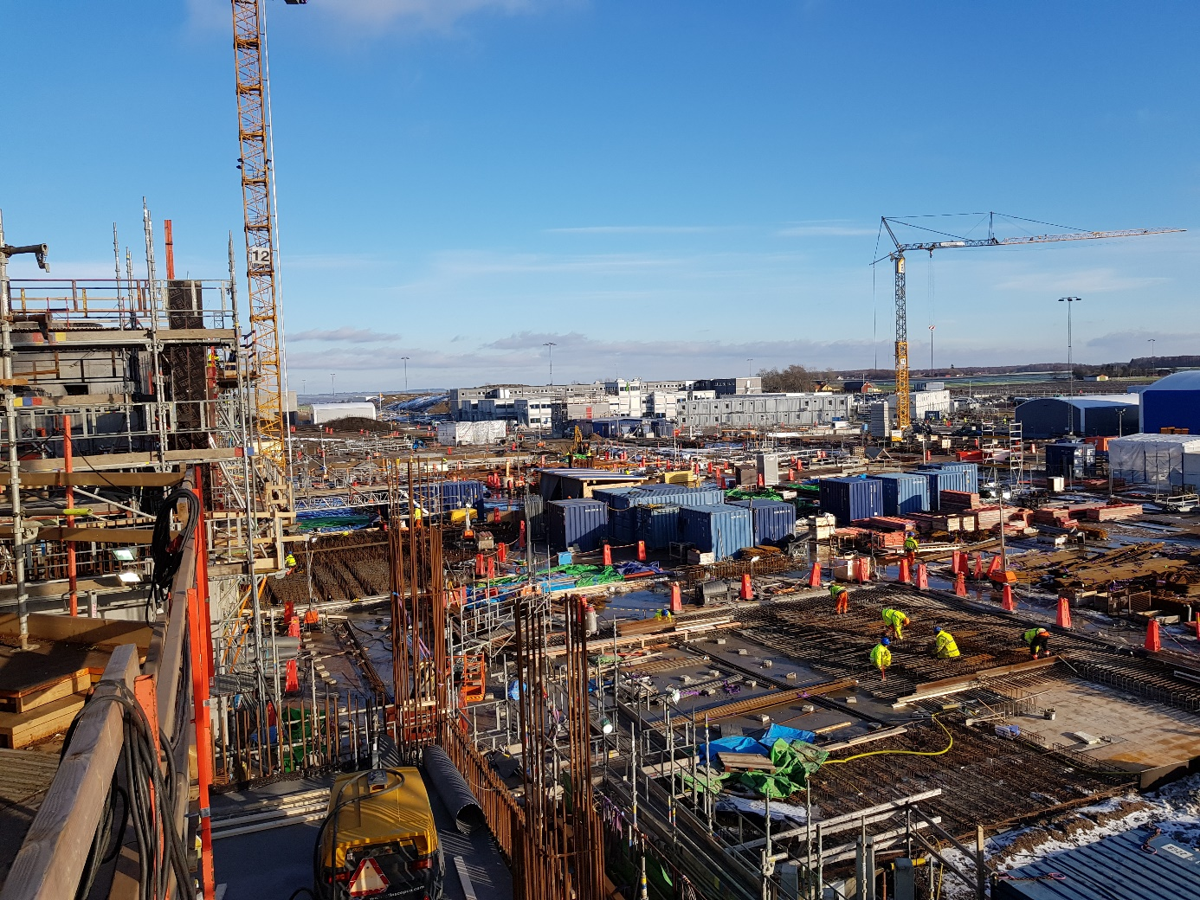
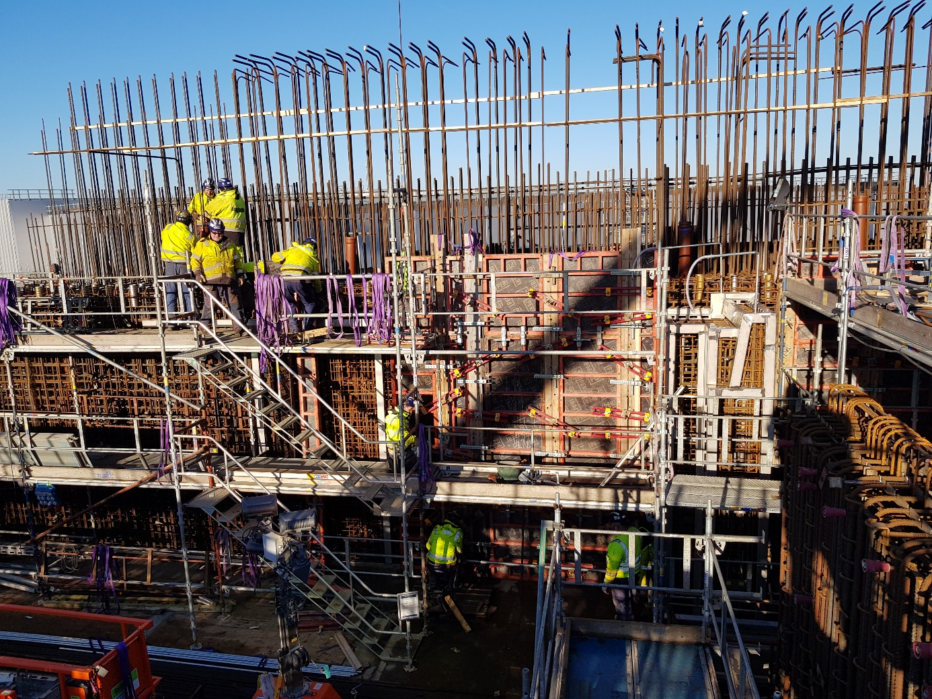
Highlights Recent Accomplishments
Work in progress with the D01 slab outside Target Building
Maintenance cell liner beams and formwork NW wall

Slide 9
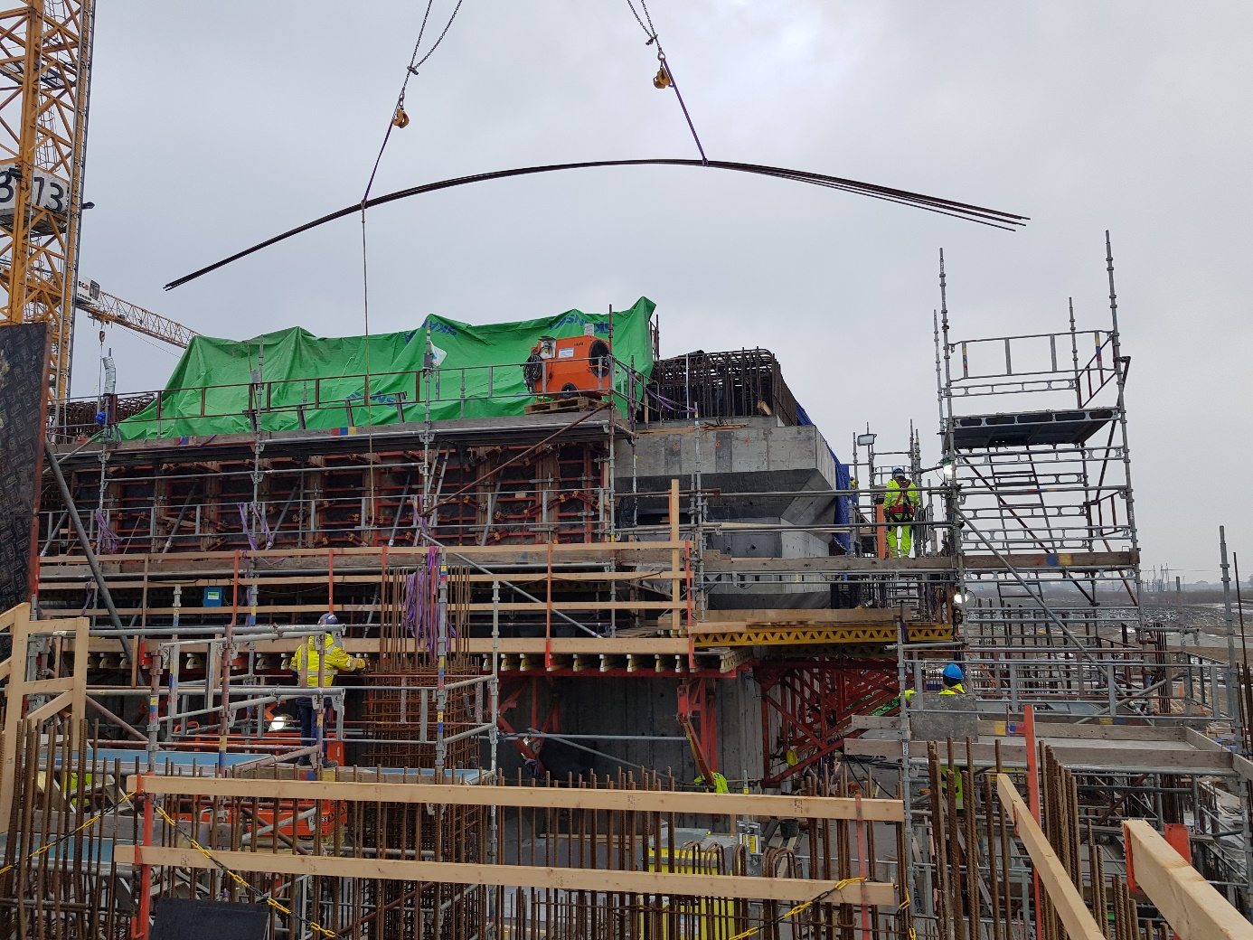
Highlights Recent Accomplishments
Active Cells walls are also beginning to reach their full height. Intense work is also going on with Technical Galleries between UB and AC.

Slide 10
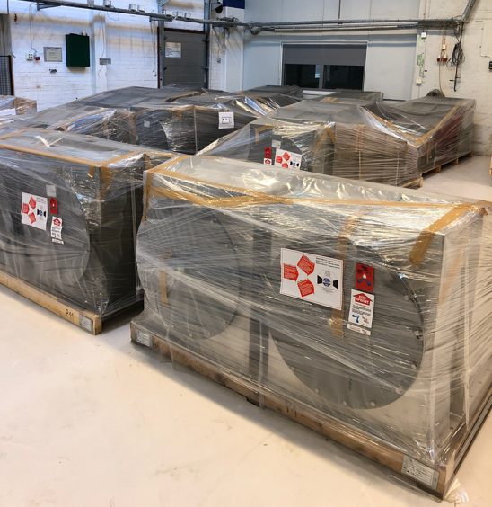
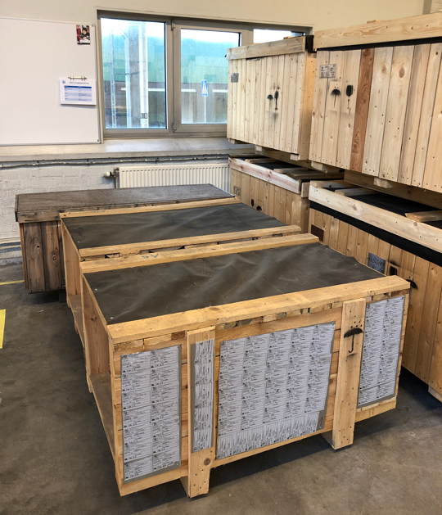
Highlights
HVAC Shipments arriving (Czech Inkind)

Slide 11
IKC package Summary

Slide 12
ESS Target Station Collaborators

Slide 13
Target In-Kind Packages
Target Sub-Project has 22 in-kind work elements
TA or CA signed for 10 work elements
Partner selected for another 4 work elements
Completed 2
Self Performing 6 work elements
78.2M€ total Inkind achieved, this represents 37% of Target Scope

Slide 14
Issues
Welding of the target wheel shroud creates too much distortion, Test of mockup #3 planned mid-Feb, CDR postponed to May 19, slip of 5 months.
It is hard to verify the target monitoring system instruments to be radiation hard for 1 year.
CVR lack progress for some tasks in the Target He Cooling System, loosing float, mtg. on feb 11th
Industeel material delivery schedule is aggressive, WP 2, 3, & 4 working out partial delivery sequencing against schedule need dates. Float to installation dates will be reduced.
Problems finding qualified suppliers and credible offers.
Port Blocks. Invoked article 16 of EU procurement rules to allow direct negotiations with suppliers. Supplier found but resulted in a delay of 4 months.
Tuning Beam Dump material supplier, …just resolved
Ferrofluidic seals for target wheel
Radiolysis Gas Handling System, Ion-exchange columns
Helium Purification System components
Light Shutter automation
Delays of NBOA designs causing NBPI schedule to slip into negative float on installation activities (-45 days). Only 1 design received, LOKI.

Slide 15
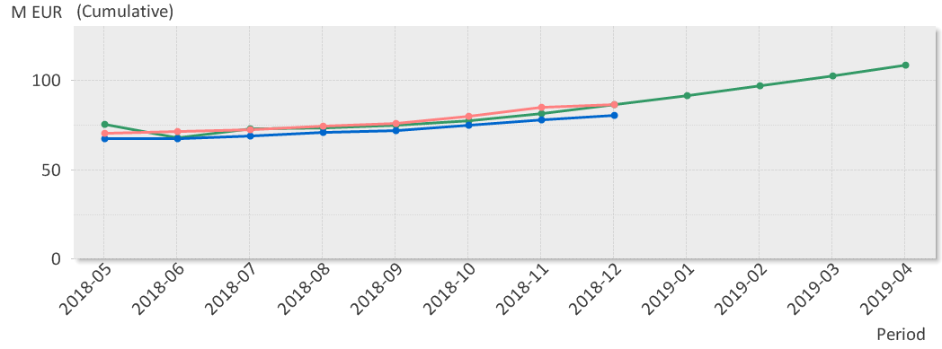
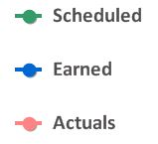
EV Graph
(* No InKind included)
Current Status
SV
Cumulative schedule variance for Target is -6.3 M€;
Since the Rebaseline is -6.2M€
For the period is -2.9M€
CV
Cumulative cost variance for Target is -6.3M€
Since Rebaseline in June is -2.5M€
For the Period is +508K€

Slide 16
Schedule Variance
(Earned – Planned)
Current Status -6.2M since the Rebaseline
-4.2M€ is In-Kind related delays
-1.2M Target He Cooling Circulator and Hx’s
-0.6M Monolith vessel
-0.7M HVAC components
-1.2M Primary & Intermediate water cooling
-2.1M€is Self Perform
-1.5M Julich work on MRP (note Julich treated as self perform)
-0.3M Port Block & NNBar material
-0.2M storage tanks
-0.3M Stainless steel liner material
SV from Inkind partners
Challenging, delays continue to add to the variance, ESS Bilbao will add more SV as those activities are slipping.
SV from self perform
SV will disappear after the January progress window. 1.5M just for the Jülich work and the for activities for which have now moved forward.
Notes:
Earned 0 but scheduled 1.5M, simply missed an update

Slide 17
CV per Cost Type - Cash

Slide 18
Cost Variance
(Earned – Actual)
Total Project CV is – 6,3 m€
Labor -4,4 m€
-4.3M before Rebaseline and is historical because nearly all resources were planned as employees but work was done by contractors.
-0.1M after Rebaseline and is the gap between consultant and ESS staff rates (Small but still occurring in WP2)
Additional Hours for support for ESS Bilbao were needed
Non labor -1,9 m€
This is related to invoice timing and will self correct in the next month report. The major part of this comes from WP 3 and is related to invoices from Jülich (TMP & NBEX).
Expect non labor element will move up and down depending on timing issues.

Slide 19
L1 Milestones
Name | Baseline | Current Forecast | Δ since last month | Total Float | Status (R, Y, G) | Impact/Action
Delivery on Site - Monolith Vessel | 2019-07-09 | 2019-12-17 | -16 | -16 |  | Target CP to RBOT, start of installation Jan 8th.
Delivery On Site - Cold Moderator Assembly | 2019-02-11 | 2019-11-13 | - | 265
Installation Complete - Target Cryoplant (Helium ) | 2018-11-16 | 2019-06-05 | - | 422
Delivery - Complete Target Wheel to ESS Site | 2019-11-08 | 2020-05-21 | - | 94
Tuning Beam Dump Ready for Proton Beam | 2019-07-26 | 2019-09-19 | - | 0 |  | AD needed by Dec 1 2019
Installation - 1st Survey of TCS | 2020-08-19 | 2020-09-15 | - | 0 |  | Target CP
WP3 System Test complete – Cryo + LH2 | 2021-11-02 | 2021-10-20 | - | 6
Target ready for BOT | 2022-03-09 | 2022-03-09 | - | 0 |  | Unchanged

Slide 20
L2 Milestones
Name | Baseline | Current Forecast | Δ since last month | Total Float | Status (R, Y, G) | Impact/Action
Contract Signed - Cryogenic Transfer Line | 2018-06-21 | 2019-02-19 | - | 126 |  | Teamed up with AD
All PDRs completed | 2019-02-05 | 2019-08-19 | -
TSS CDR | 2018-11-23 | 2019-05-19 | 20 | 16 |  | Resources dedicated to licensing
CDR Monolith Port Block Shielding | 2018-10-02 | 2019-02-08 | -
CDR Proton Beam Instr. Plug | 2019-01-22 | 2019-08-05 | - | 115
CDR Target Wheel Vessel | 2018-05-02 | 2019-01-29 | - | 123
CDR – Beam Drift Room | 2019-04-23 | 2019-02-28 | - | 139

Slide 21
EAC remaining after Rebaseline 1 of 3
Item | M€ | Comment
Budget At Completion (BAC) | 208.1
Casks and associated handling devices (A20173220) | 2 | Estimate Based on Market survey from UK. Additional 7.9M is in Risk Register, cost known by end of Feb.
Installation organisation 2019 -22 (A20159190) | 5.14 | Reduced 526k€ by CR0224
Installation infrastructure incl Laydown and Transport (Non-labour) 2019-22 (A20173270) | 1.42 | Reduced 167k€ by CR0224
Monolith and NBEX Installation (A20173260) | 1.8 | Additional technicians for double crews. Reduced 167k€ by CR0224
NBEX HW. (Insert, removal tool, casks except NBOA) (A20177990) | 1.5 | Estimate based on RFIs received. Additional 2.5M is in Risk Register
Monolith Port Blocks – HW (A20173250) | 1.5 | Estimate from in-kind candidate. Bids received, contract award by Jan 30.
Beam Drift Room HW (A20202370) | 1.2 | Isolation valve, higher activation change in shielding
CF - JIRA Item, lifting equipment (A20196640) | 1 | Estimate is for both the cask lifting yoke and the lifting plate for NBEX

Slide 22
EAC remaining after Rebaseline 2 of 3
A202080910
A202080950
A202080960
A202080970
A202080980
A202080990
A202081000
A202081010
A202081020
A202081030
A202081230
A202081240
A202081520
A202081530
A202081540
A202081570
A202081580
A202081800
A202081770
A202081790
A202081860
A202081870
A202081880
A202087620
A202087630
A202087640
A202087650
A202087690
A202087700
A202087710
A202087720
A202087730
A202087660
A202087670
A202087680
Item | M€ | Comment
Active Cells Installation Infrastructure (A20173290) | 0.88 | Manpower paid by RACE, infrastructure by us. Reduced 120k€ by CR0224
Shielding of water pipes in connection cell (Material and installation) (A20172370) | 0.84 | Higher activation
Shielding doors in Target Building (A20177060) | 0.9 | Orphan scope, working with Norwegian and Czech suppliers, preliminary estimate
Travel and service cost 2020-22 (A20202390) | 0.3 | Longer construction period
Increased staffing cost 2020-22 (A20202420) | 9.6 | 5.9 / 3.7 (Employees / Contracted) Note: does not include any initial ops funding transfer
PBW Primary Cooling System (20172980& A20173030) | -0.425 | Less expensive than planned for
Installation savings - A Pool for Installation Support Group and Cable routing (A20173040) | -0.18 | Decided by CCB
He Purification System savings (A999920159170) | -4.0 | Expect CCB review Feb 2019
A202081590
A202081600

Slide 23
EAC remaining after Rebaseline 3 of 3
A202087550
A202087560
A202087570
A202087580
A202087590
A202087600
A202087610
Item | M€ | Comment
Radiolysis Gas Treatment (A202081950) | 0.34 | Estimated need to cover manufacturing and installation
CF – Jira – Civil Works | 1,26 | Shielding, Penetrations, Foundations
ACF schedule delays and as built tolerances out of spec (A202087810) | 0.45 | RFR Solutions delay access, cask pit lids out of tolerance
Total Remaining Forecast | 25.53 | (6.78M in deductions, 2.4M in adds for net reduction of 4.3M)
Estimate At Completion (EAC) | 233.63 | (CR’s 14.8M-4.3M reduction=10.5Mnet)
Notes:
CF – JIRA – Civil Works 1,26 comprised of following:
Penetration Shielding (A202087550) - 0.5
Shielding Blocks Outside Transfer Area (A202087560) - 0.1
Welding Plates, Hilti Rails & Small-Bore Penetrations (A202087570) - 0.09
Target HVAC – Additional Electrical Penetrations (orphan scope) (A202087580) - 0.2
Concrete Foundations for Target Equipment in D02 (A202087590) - 0.17
Drip Plate for Grating and Connection Cell (A202087600) - 0.1
Sealing Between Bunker and Basement (A202087610) - 0.1

Slide 24
Target – Top 5 Risk Mitigation Status Value of cost risk* = min 26 M€, max 38 M€, expected 32M€ (46 M€)
Risk ID | Event | Potential Impact C – Cost S – Schedule Q – Quality and Function | Proba-bility | Mitigation measures | Due date
66 | Staffing level is too low for the workload | C: 5M€ S: 4-6 months Q: Several req. | 3 (35%) | Impact identified in Forecast Move work to initial ops Secure funding for 2019 Staff plan review | Treated 190228 Treated 190228
74 | Target critical path is delayed because of a delay in manufacturing the port blocks. The monolith vessel installation sequence is interrupted. | C: 500k€ S: 0-3 months Q: Several req. | 5 (90%) | Combined procurement with Vessel (treatment failed) Interface with multiple manufacturers Sequence material delivery between WP’s | Treated 190115
65 | Installation of target components in parallel with CF/Skanska installations impacts productivity in the Target Building, or is not in time for the Target Project to meet the "Ready for Beam on Target" milestone date. | C: 3M€ S: 4-6 months Q: 1 low level req. | 4 (65%) | Work with CF to develop an integrated CF construction/Target installation schedule with acceptable "early access" dates. Work with site installation manager Mikael Jacobsson to clearly define installation priorities and decision making. | - 191231
84 | Change of civil design CF, JIRA items | C: 500k€ S: 4-6 months Q: Several req. | 5 (90%) | Routine interface meetings with CF, all issues tracked in JIRA. High level definition of roles and responsibilities. Acknowledgement of Target ICD-Rs. 1,6M€ has been added in EAC.
96- 105, 114 | In-kind partners do not deliver full scope or on time. Cost exceeds cost book. (eg. ACF 9.5M€) | C: 16M€ S: 7-9 months Q: Several req. | 5 (90%) | Hand off Design work to InKind, CDRs complete Leverage In-kind review committee support Oversight and engagement, face-to-face | 180601 191231 181231
*Data from Exonaut – sorted Cost & Schedule, remaining part of project time

Slide 25
Concluding Remarks
Since the Rebaseline CF has held the site early access dates; however, we have seen slips with Inkind deliveries. (adding 4.2M in SV)
Most all Target WP installations are with < 40 days float to Critical Path.
Target has entered installation phase, mainly for ACF, the Vessel installation activities begin in December 2019.
No Inkind interest was secured for several large work packages which required organizational changes at ESS to support inhouse design and procurements.
Due to ongoing difficulties finding equipment suppliers, a major schedule risk remains with manufacturing and equipment deliveries.
Target Ready for Beam milestone is March 2022

Slide 26
Backup

Slide 27
CF – JIRA Detail
CF – JIRA – Civil Works 1,26 comprised of following:
Penetration Shielding (A202087550) - 0.5
Shielding Blocks Outside Transfer Area (A202087560) - 0.1
Welding Plates, Hilti Rails & Small-Bore Penetrations (A202087570) - 0.09
Target HVAC – Additional Electrical Penetrations (orphan scope) (A202087580) - 0.2
Concrete Foundations for Target Equipment in D02 (A202087590) - 0.17
Drip Plate for Grating and Connection Cell (A202087600) - 0.1
Sealing Between Bunker and Basement (A202087610) - 0.1

