Slide 1
Target Collaboration Board
Status of ESS Bilbao IKCs
Mario Pérez, ESS-Bilbao
Copenhagen, 8 February 2019

Slide 2



In-Kind Contribution to ESS
Spanish In-Kind contribution to ESS ERIC ~ 47 M€
(ACCYS, Target, ICS and NSS)

Slide 3
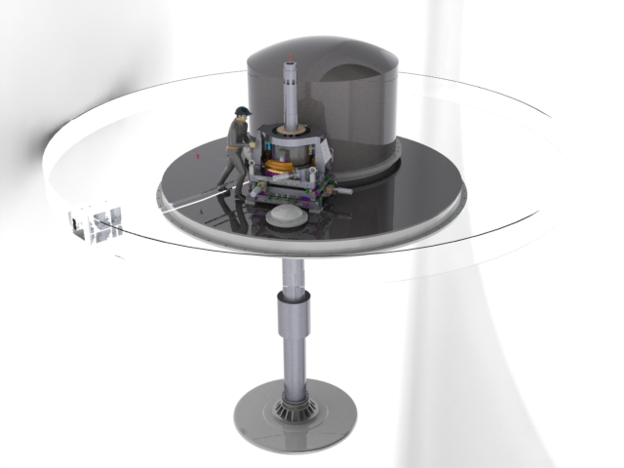
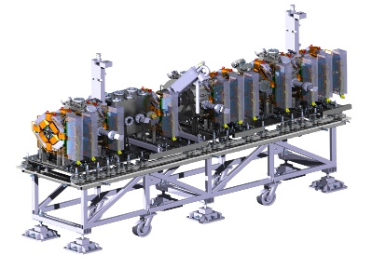
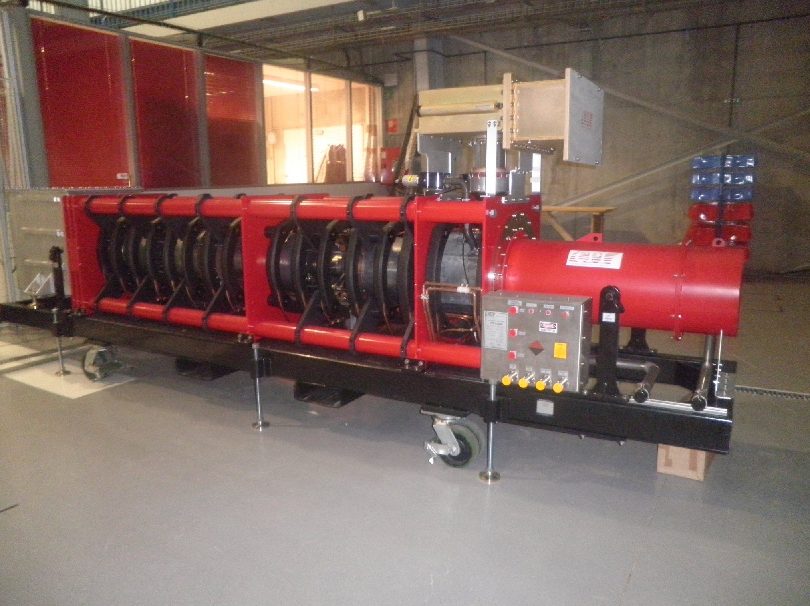
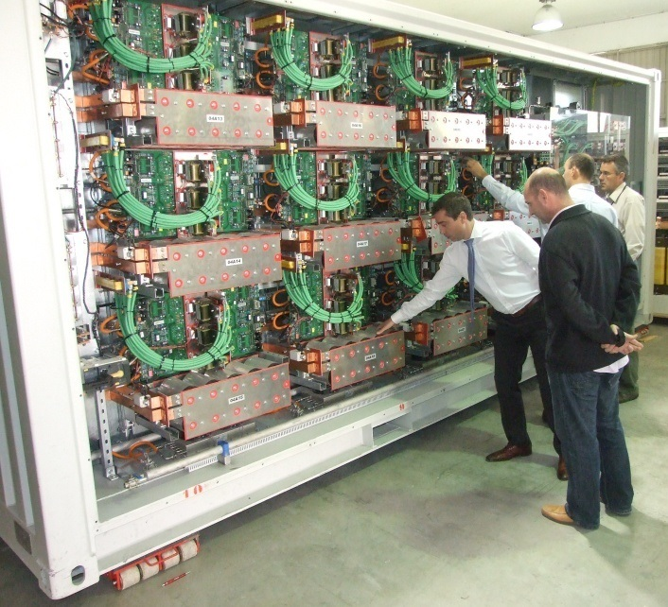
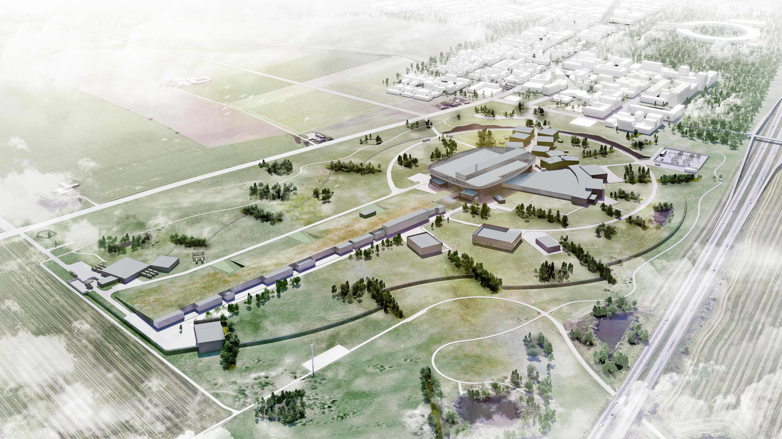
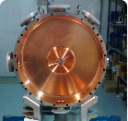
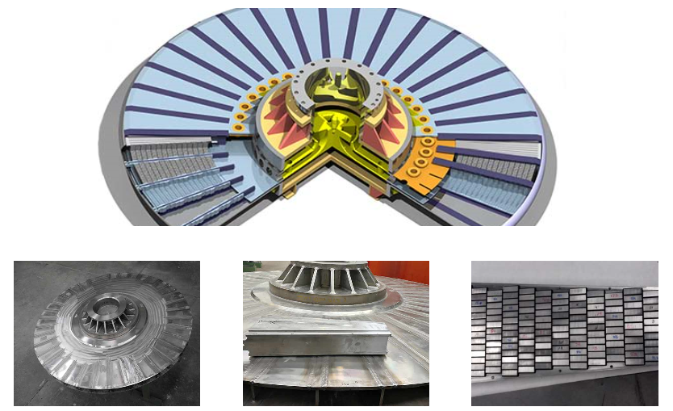
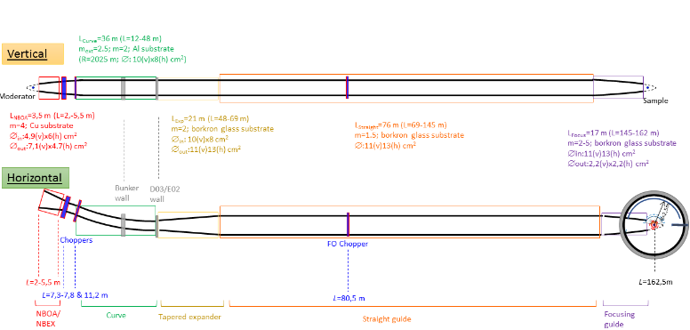
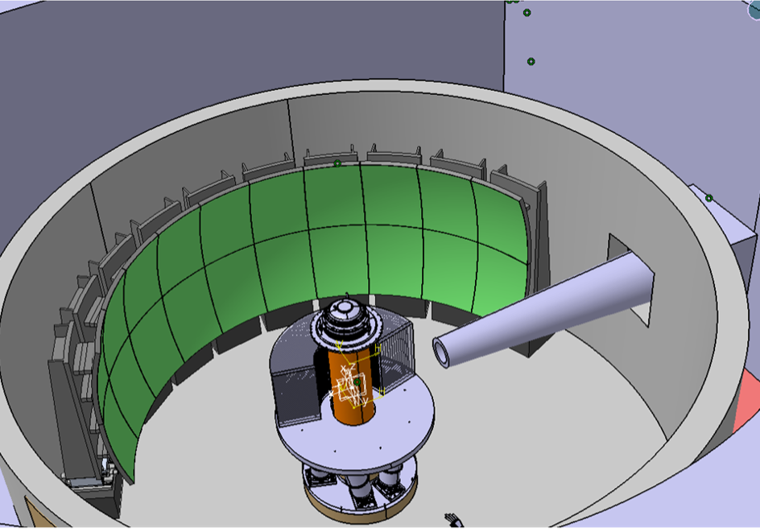


In-Kind Contributions to ESS
TARGET
MEBT
RF Systems
RF chains: 1 for RFQ and 5 for DTL. Composed by klystrons, modulators, loads, waveguides, interlocks and LLRF
Accelerating element: complete subsystem that goes after the RFQ and integrates: design, manufacturing, diagnostics, control, assembly and testing.
4
5
The spallation process takes place when the accelerated proton beam hits the Tungsten bricks of the 11-tonne / 2 m diameter target wheel. This will produce neutron brightness for scientific experiments across multiple disciplines.
3
MIRACLES INSTRUMENT
Time-of-Flight backscattering instrument for polymer science, energy materials, and magnetism studies.
Prime contractors: design, manufacturing, assembly &cold commissioning

Slide 4
In-Kind Contributions to ESS
TARGET
4
The spallation process takes place when the accelerated proton beam hits the Tungsten bricks of the 11-tonne / 2 m diameter target wheel. This will produce neutron brightness for scientific experiments across multiple disciplines.

Slide 5
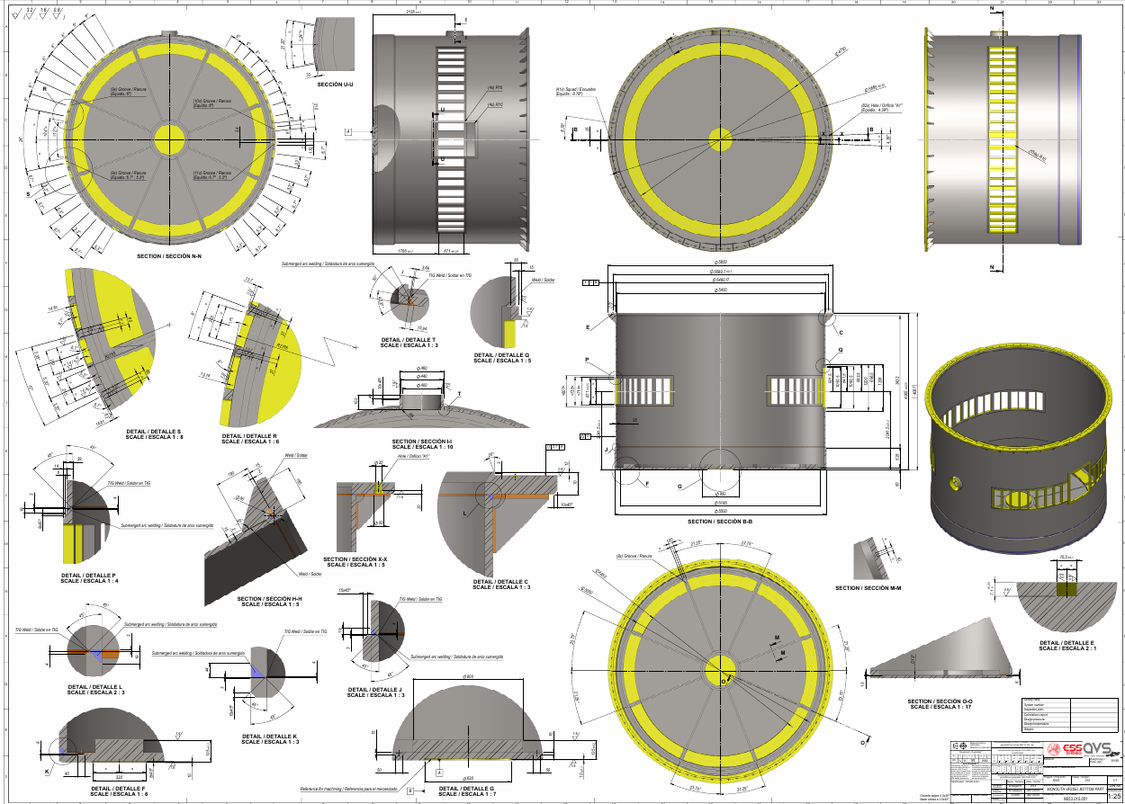
In-Kind Contribution – Target
MONOLITH VESSEL
Contract awarded in June 2018 to AVS/Cadinox
Design reviewed for manufacturing (incl. design change to eliminate the concern to maintaining ovality) and agreed with ESS ERIC
Interface with neutron ports agreed on January 15th, 2019
Raw material specs. approved by AIB. Procurement launched
Critical path of ESS ERIC – delivery Nov 2019 agressive but feasible

Slide 6
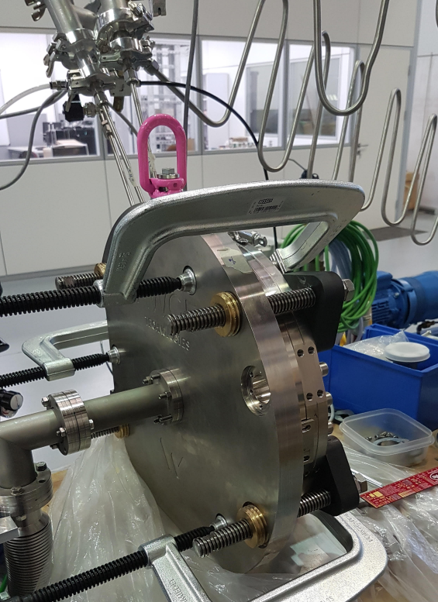
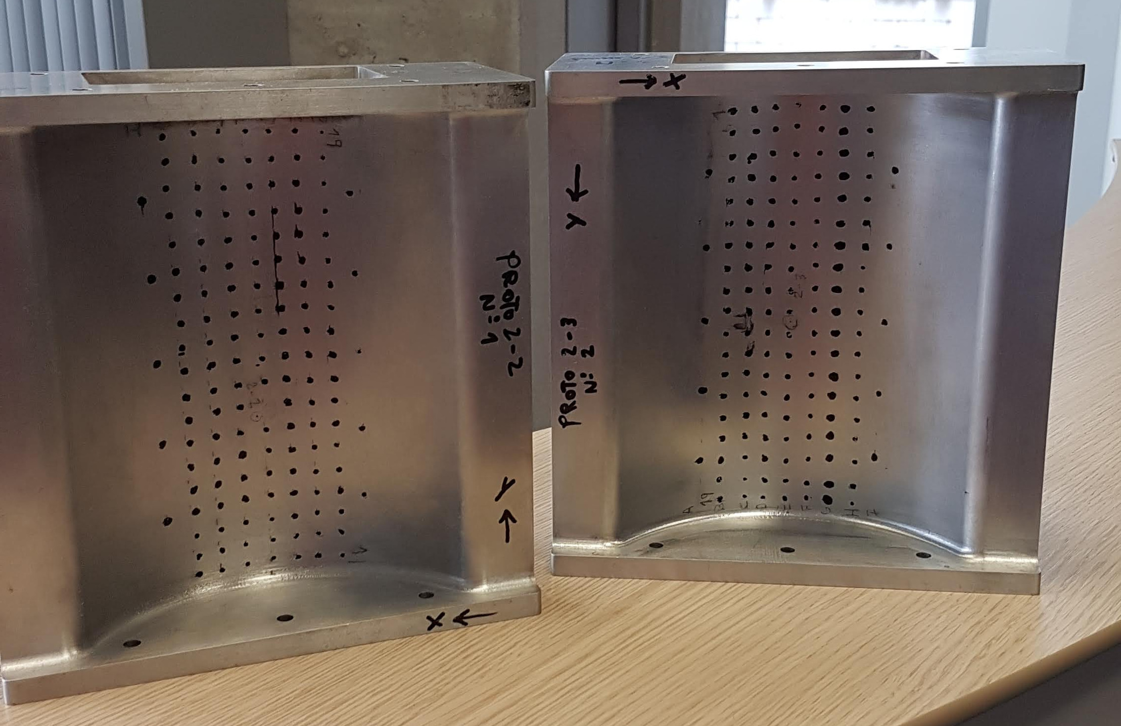
In-Kind Contribution – Target
PROTON BEAM WINDOW (PBW)
PBW manufacturing: Several prototypes manufactured and tested. Some unexpected failures reported. Failure source detected and under correction (EDM leaves small holes caused by uncontroled sparks in thin walls).
Alternative manufacturing techniques, as drilling wider holes, combined with design changes, are investigated.
PBW Seal. 2 prototypes built and tested. Sealing of the cavity and general functionality has been proven; however desired leak rates haven´t been reached
Evaluation of current design to improve leak rates is being undertaken
Prototyping tasks for the EBW between PWB and frame in Al6061 being carried out. Simulations finished and testing will start Feb-19
CDR will take place Q2 2019

Slide 7
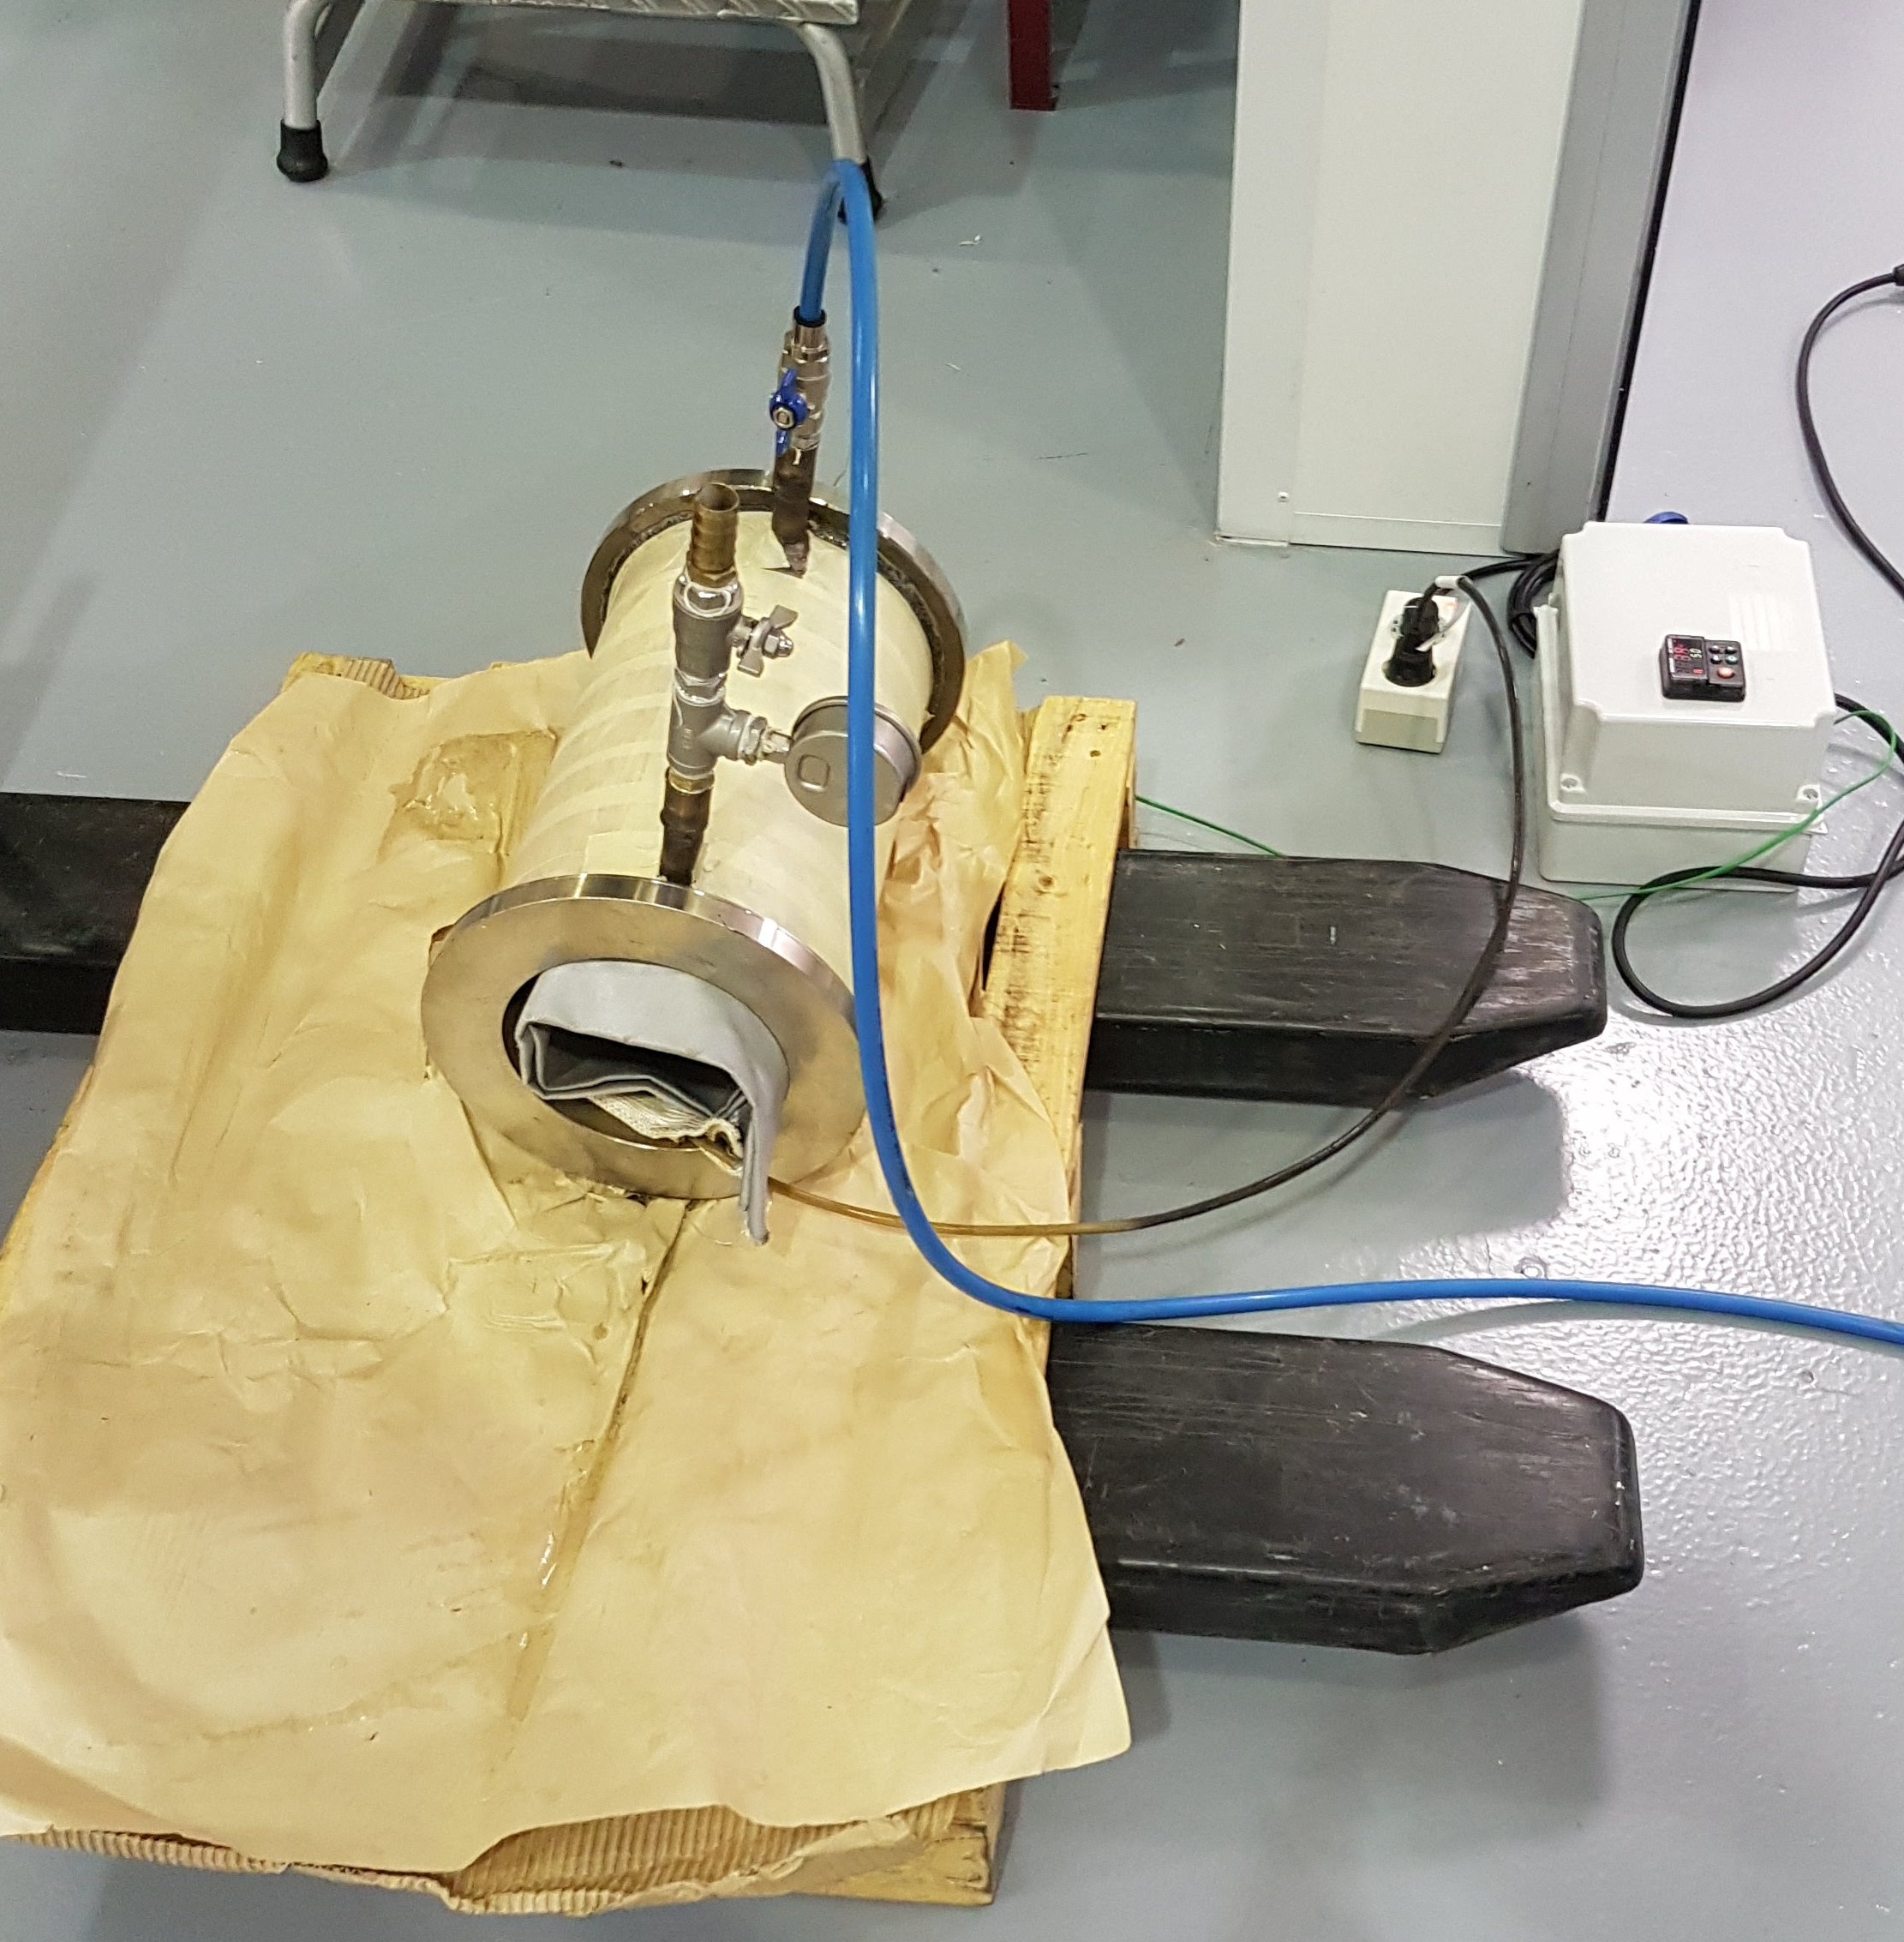
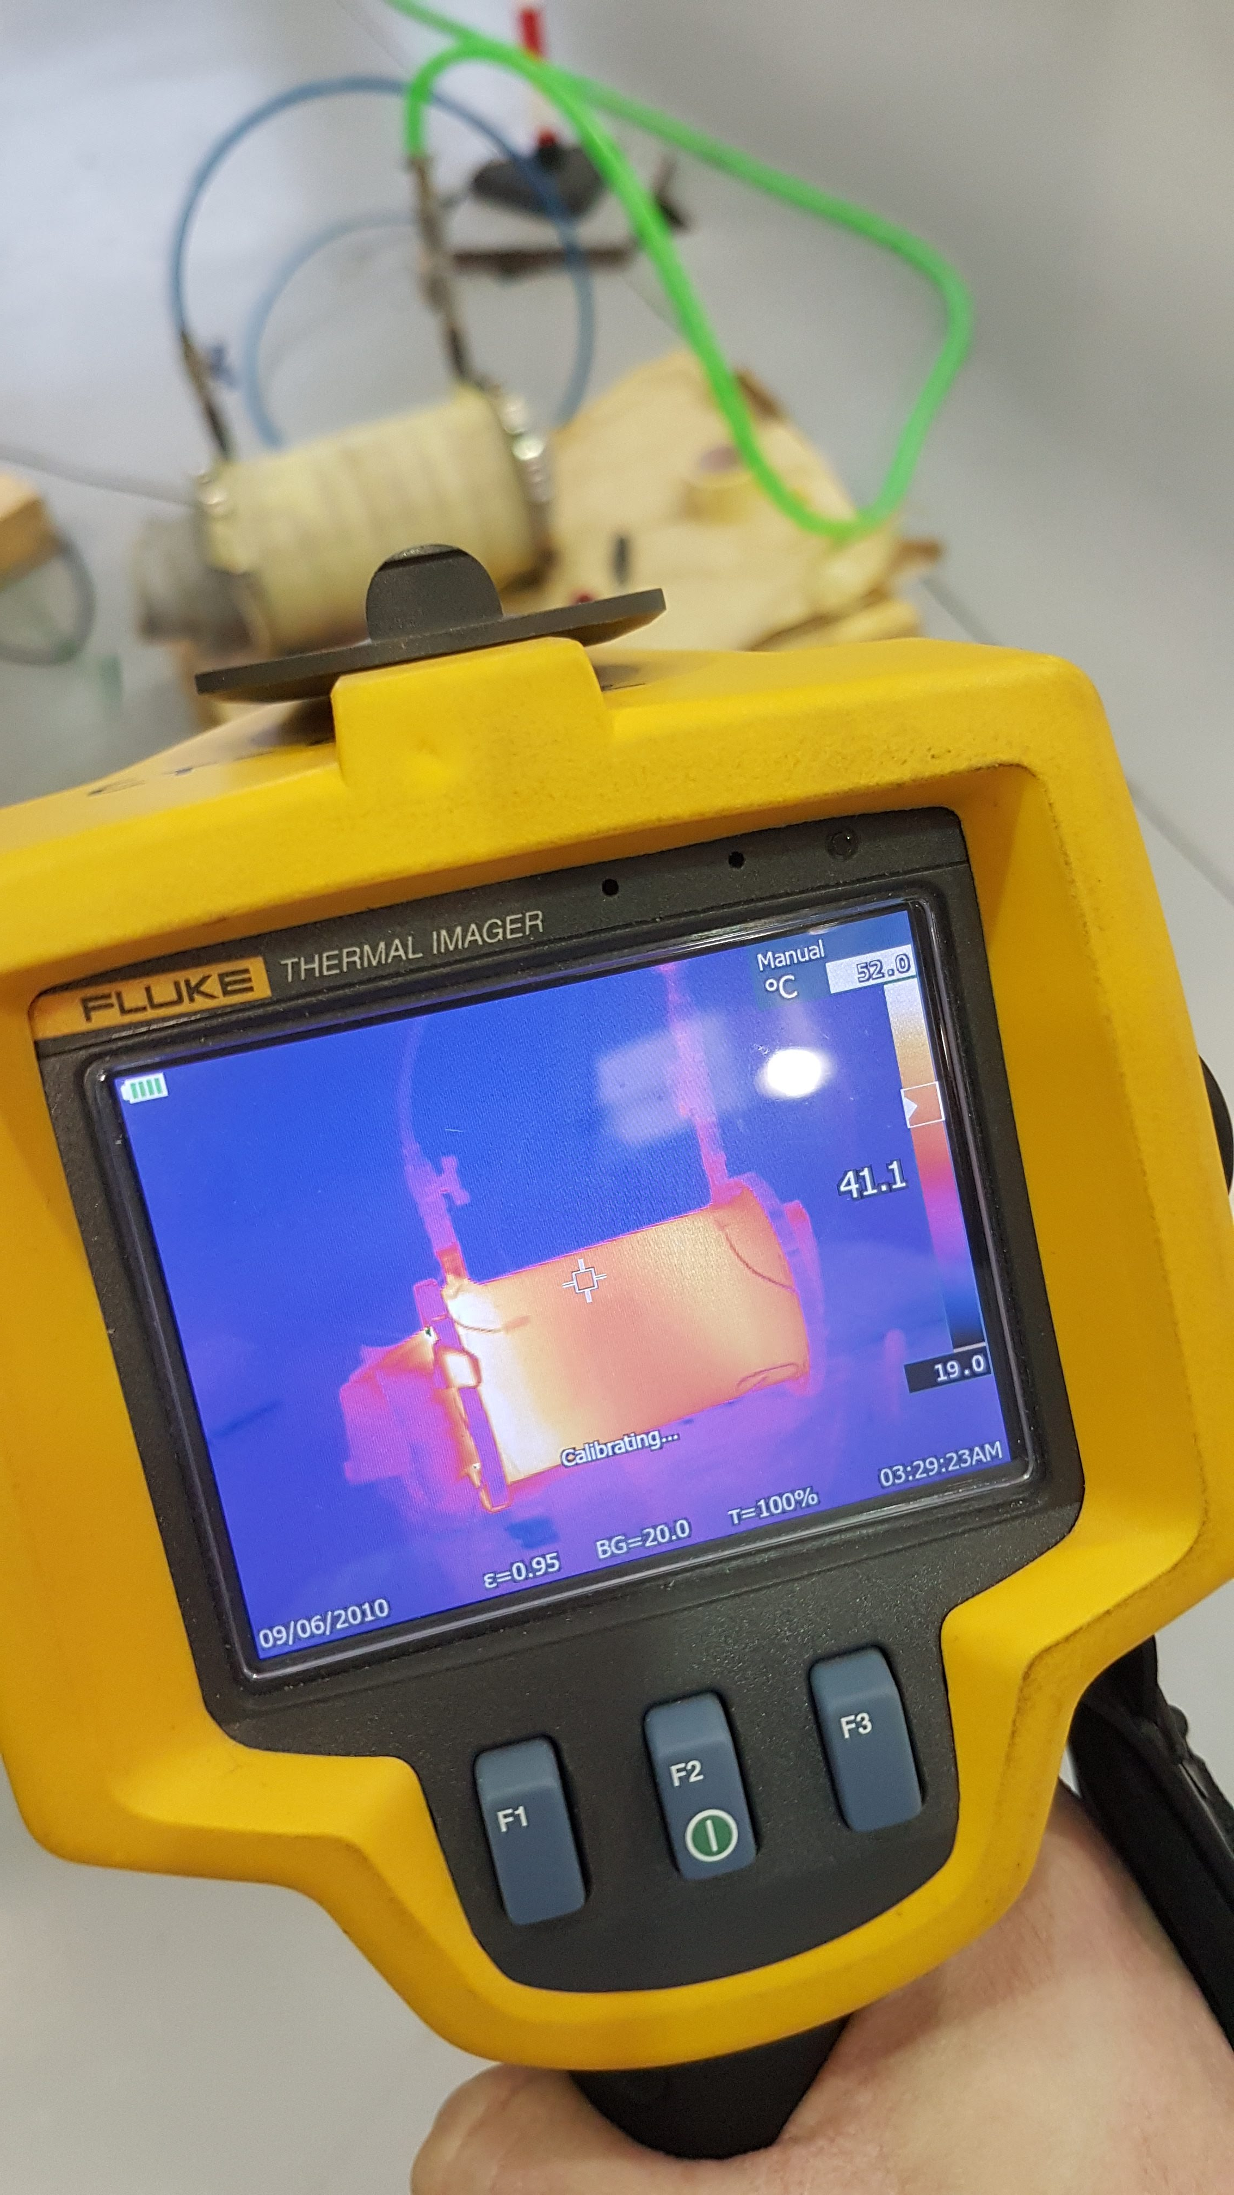
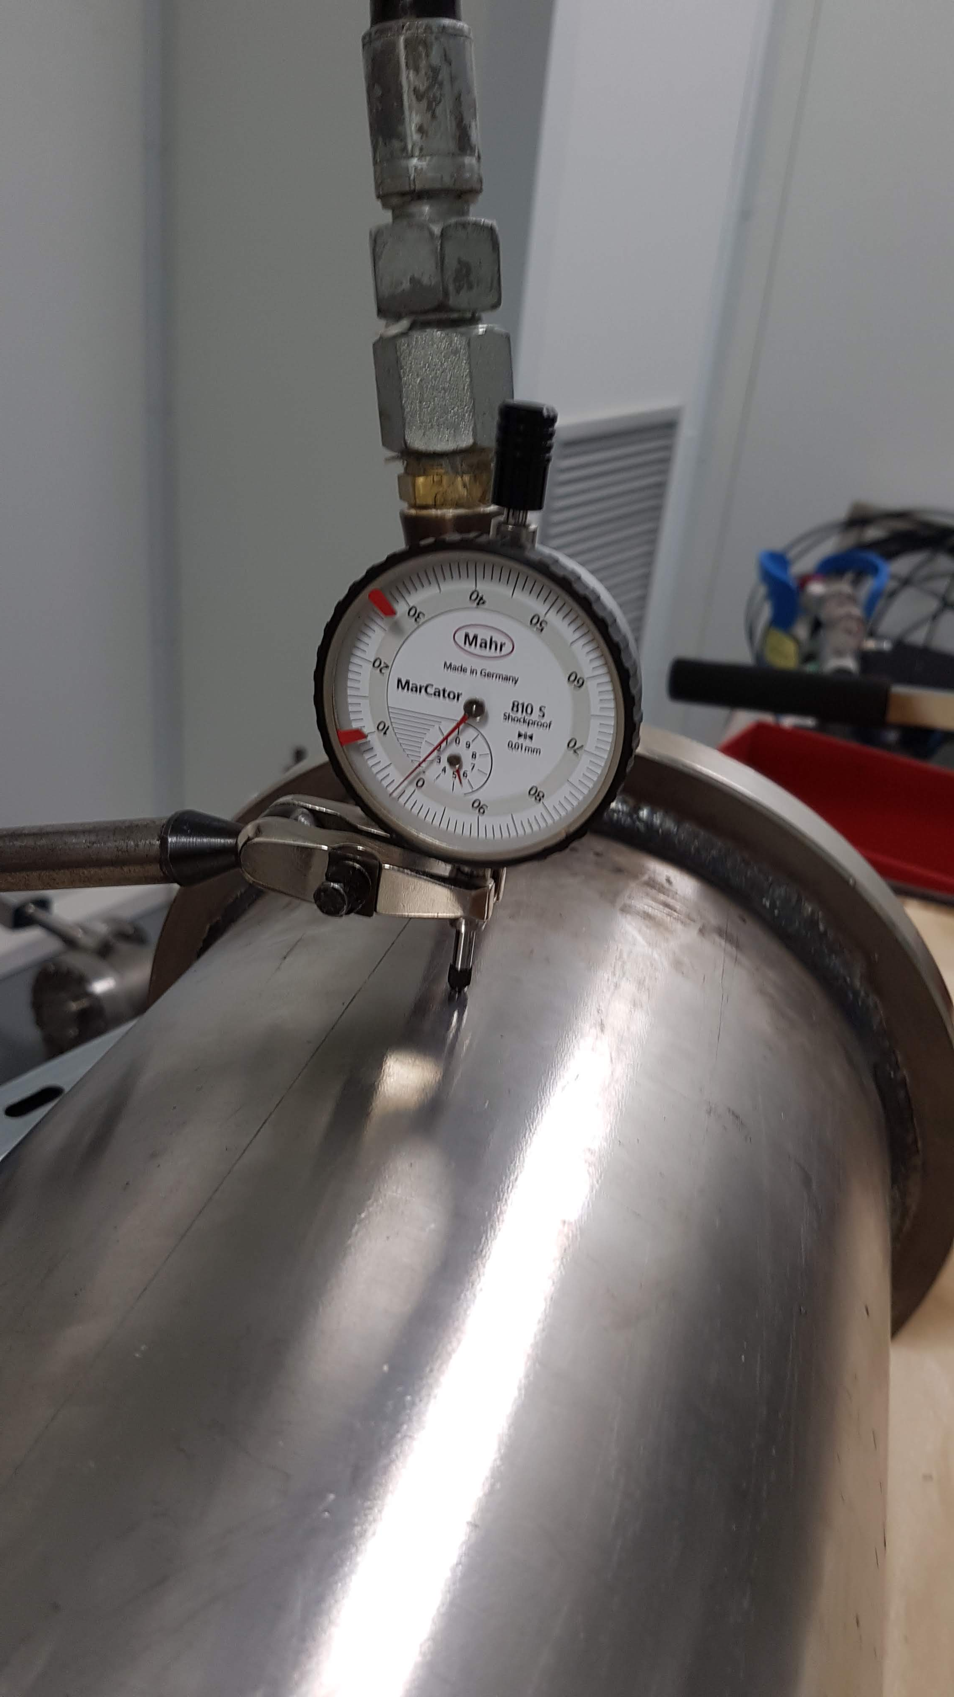
In-Kind Contribution – Target
PBW Port Block & Vessel
Design Review conducted in Q3 2018. Design changes have been implemented. Manufacturing plan is under review
Final design review/validation of the component outsourced to Empresarios Agrupados.
Problems regarding inspections in service forced to separate engineering of the connecting pipe between Port Block and Monolith Vessel
Prototype already manufactured and tested (pressurized to 15 bar – design pressure 5 bar)
Open Call for Tender has been published, contract planned to be awarded by March -19
CDR will take place Q1 2019
Delivery date planned by end of 2019

Slide 8
In-Kind Contribution – Target
PBIP (Proton Beam Instrumenation Plug)
Re-desing of the aligment system has been implemented in the model.
Independent exchanging system of each slice is already prepared
Review of the interface with the ACF is in progress
PBIP CDR will take place by Q3 2019
Optical system (IMG) will be tested at ESS Bilbao facilities prior to final delivery to Lund
Delivery date is planned by Q2 2020

Slide 9
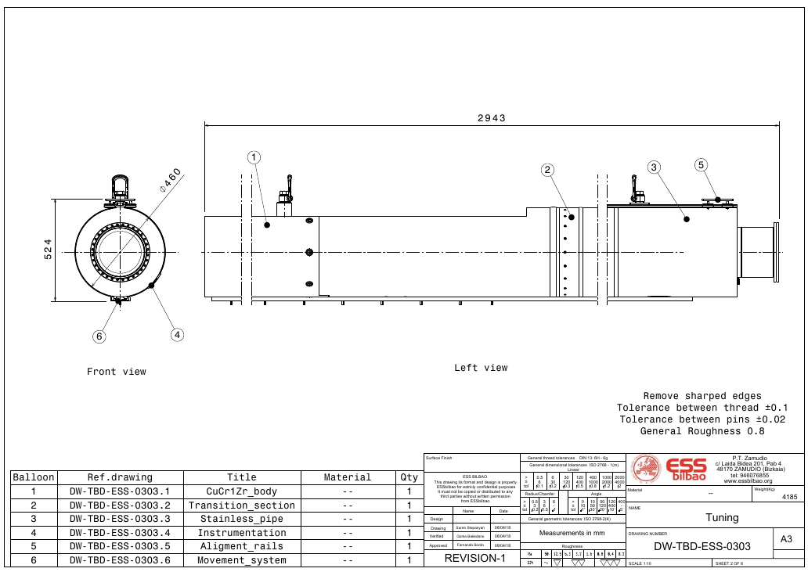
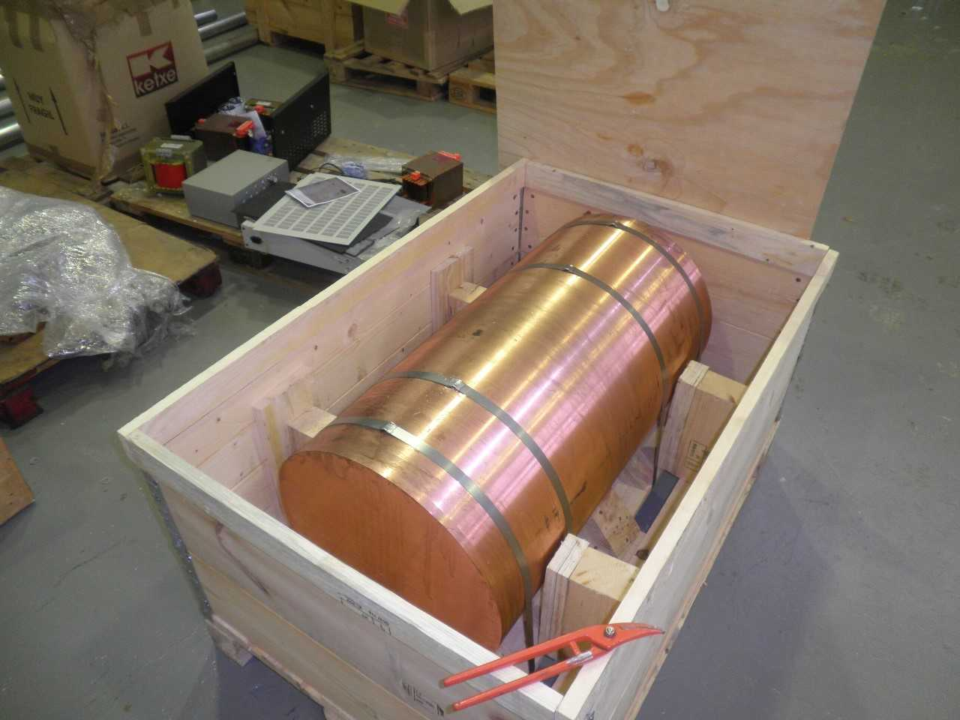
In-Kind Contribution – Target
TUNING BEAM DUMP
Design completed (CDR OK for all subsystems)
Raw material already delivered to ESS Bilbao premises
Contracts for manufacturing awarded to Nortemecanica and Thuneureka are under execution
Delivery planned by July-2019 (delayed from April-2019)

Slide 10
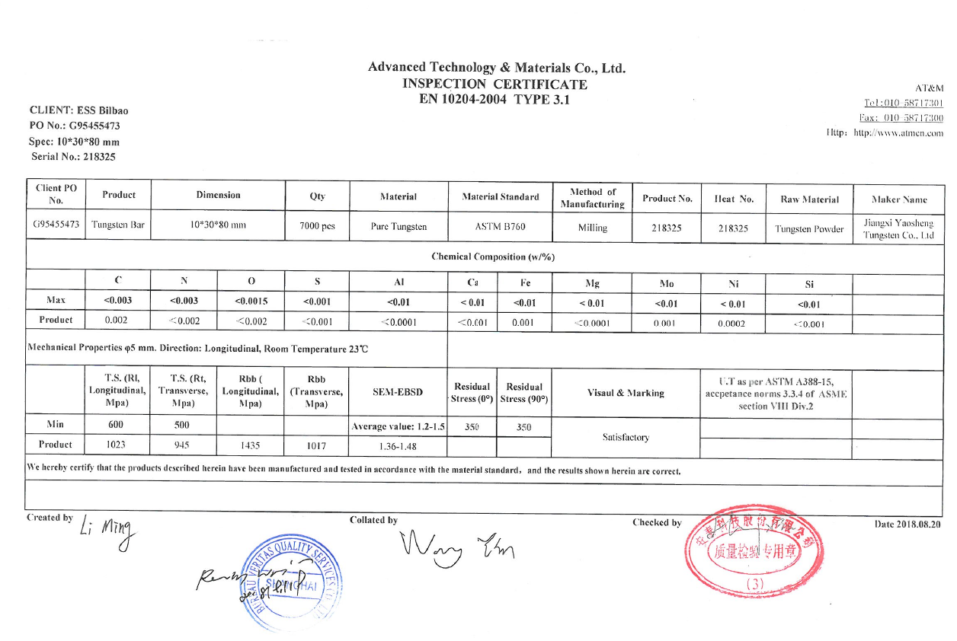
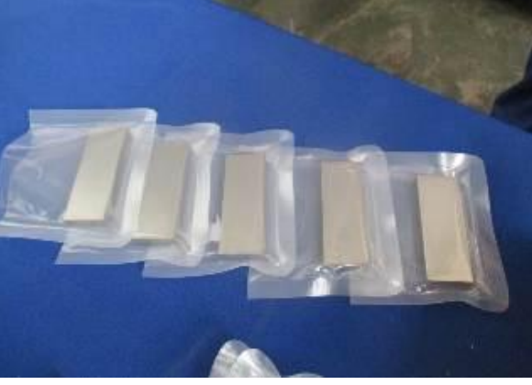
In-Kind Contribution – Target
TARGET WHEEL AND SHAFT: SPALLATION MATERIAL
W production is completed
Final QA analysis on-going at CEIT Research Center
Preliminary tests showed an excellent agreement with CDR requirements

Slide 11
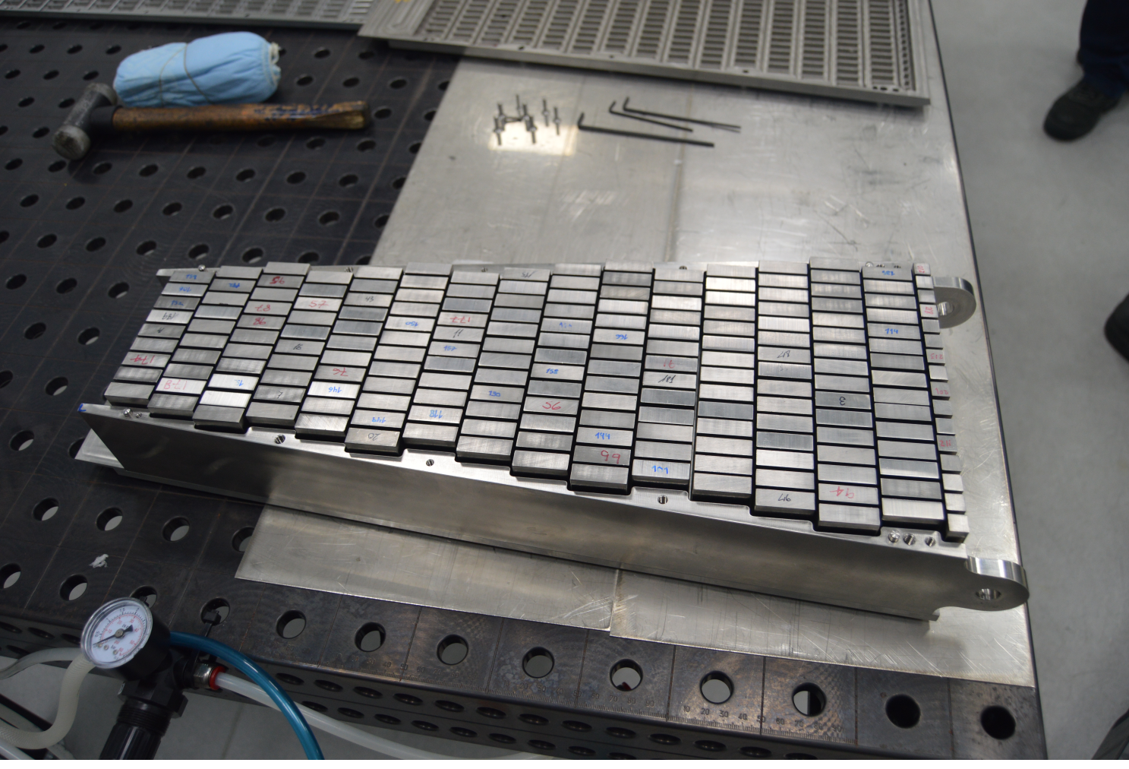
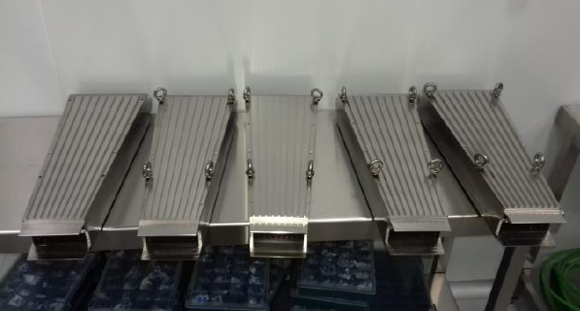
In-Kind Contribution – Target
TARGET WHEEL AND SHAFT: CASETTES
Casette production completed (37 units)
Components recieved and accepted by ESS Bilbao
Storage process certified by Bureau Veritas according to RCC-Mrx
Assembly about to start

Slide 12
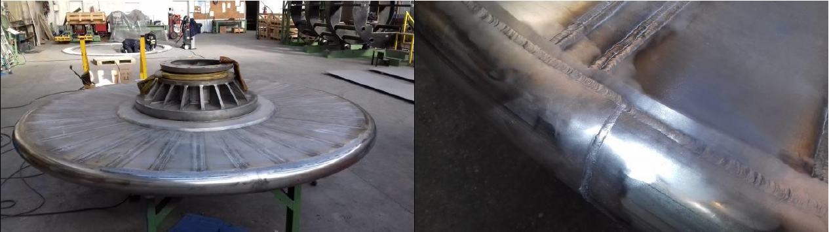
In-Kind Contribution – Target
TARGET WHEEL AND SHAFT: TARGET VESSEL
1st full scale protoype was manufactured by ENWESA.
The tests showed significant deformations (welding) not compatilble with casette insertion
However, NDT inspection were sucessful

Slide 13
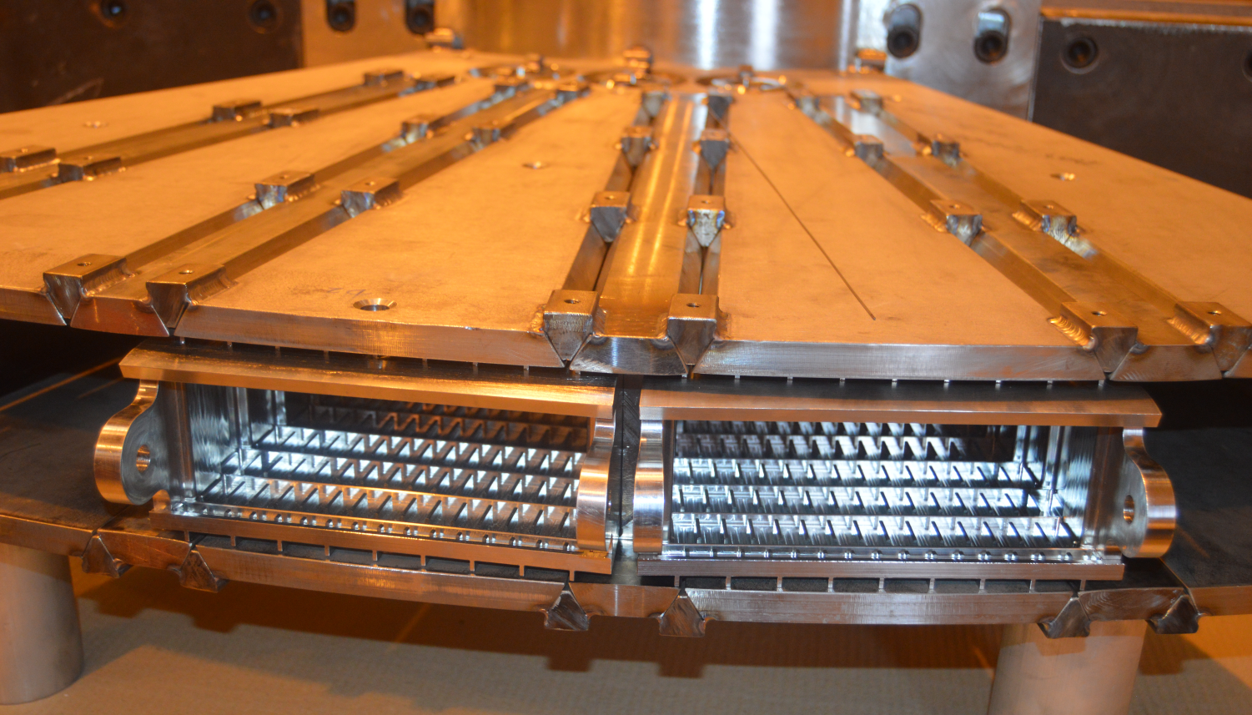
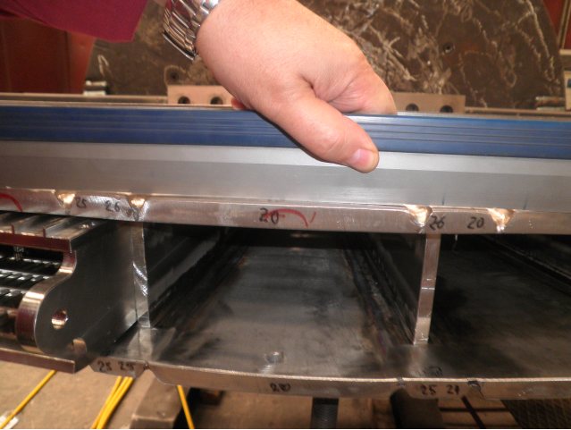
In-Kind Contribution – Target
TARGET WHEEL AND SHAFT: TARGET VESSEL
A 2nd target vessel welding prototype was manufactured by Nortemecanica.
The prototype aimed at minimazing deformations during welding.
The prototype and tests were completed in September 2018. Still the process showed the need to further minimize the welding volume

Slide 14
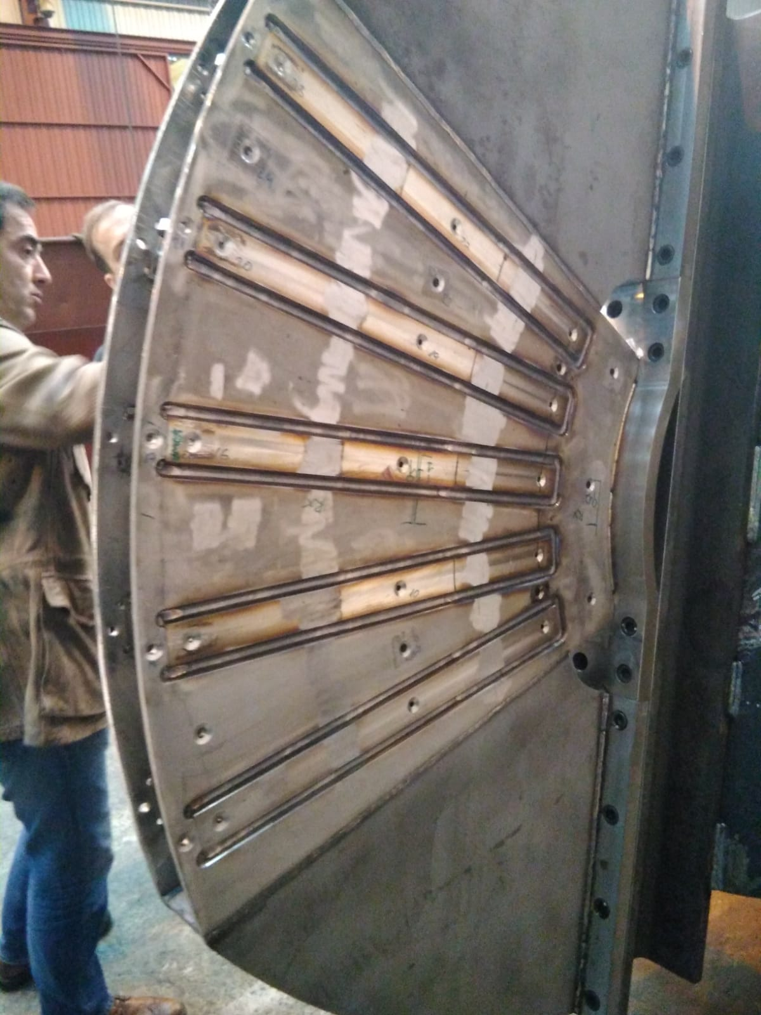
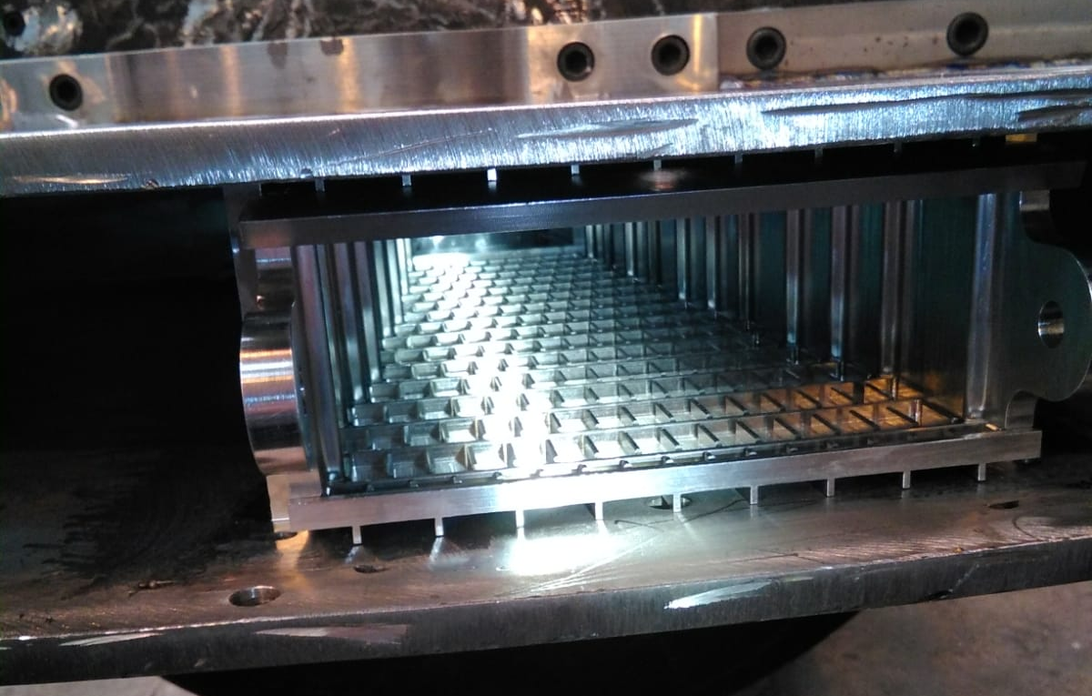
In-Kind Contribution – Target
TARGET WHEEL AND SHAFT: TARGET VESSEL
A 3rd target vessel welding prototype is under manufacturing by Nortemecanica.
A new welding configuration (20 times lower welding volume) has been tested.
Results has shown feasibility of the new configuration – Review to be held before goign ahead with final manufacturing.
The Target Wheel is accumulating significant delays (CDR postponed by 5 months) not uncommon when facing prototyping of a first-of-a-kind component. Still on time as per latest installation plans

Slide 15
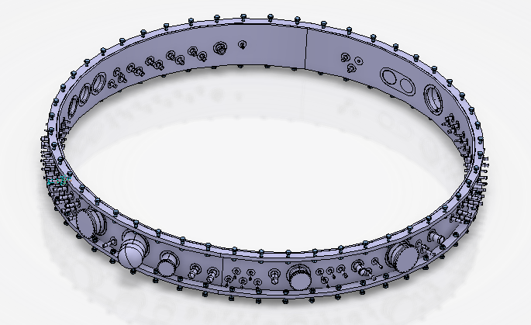
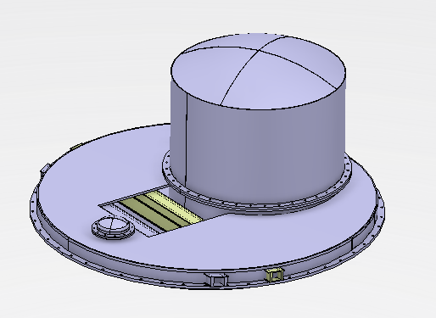
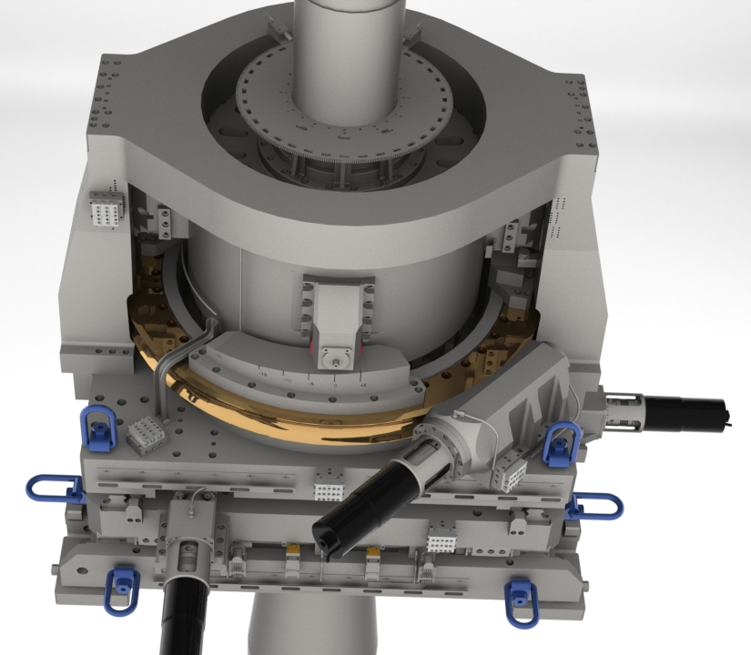
In-Kind Contribution – Target
OTHERS
DRIVE UNIT “turn-key” to AVS, being executed according to plan
CDR CONNECTINON RING passed in Dec. 2018. CDRs ROTATING SEAL / SHAFT beginning 2019
HEAD OF THE VESSEL AND COVER– to be tendered as a “Turn Key”

Slide 16
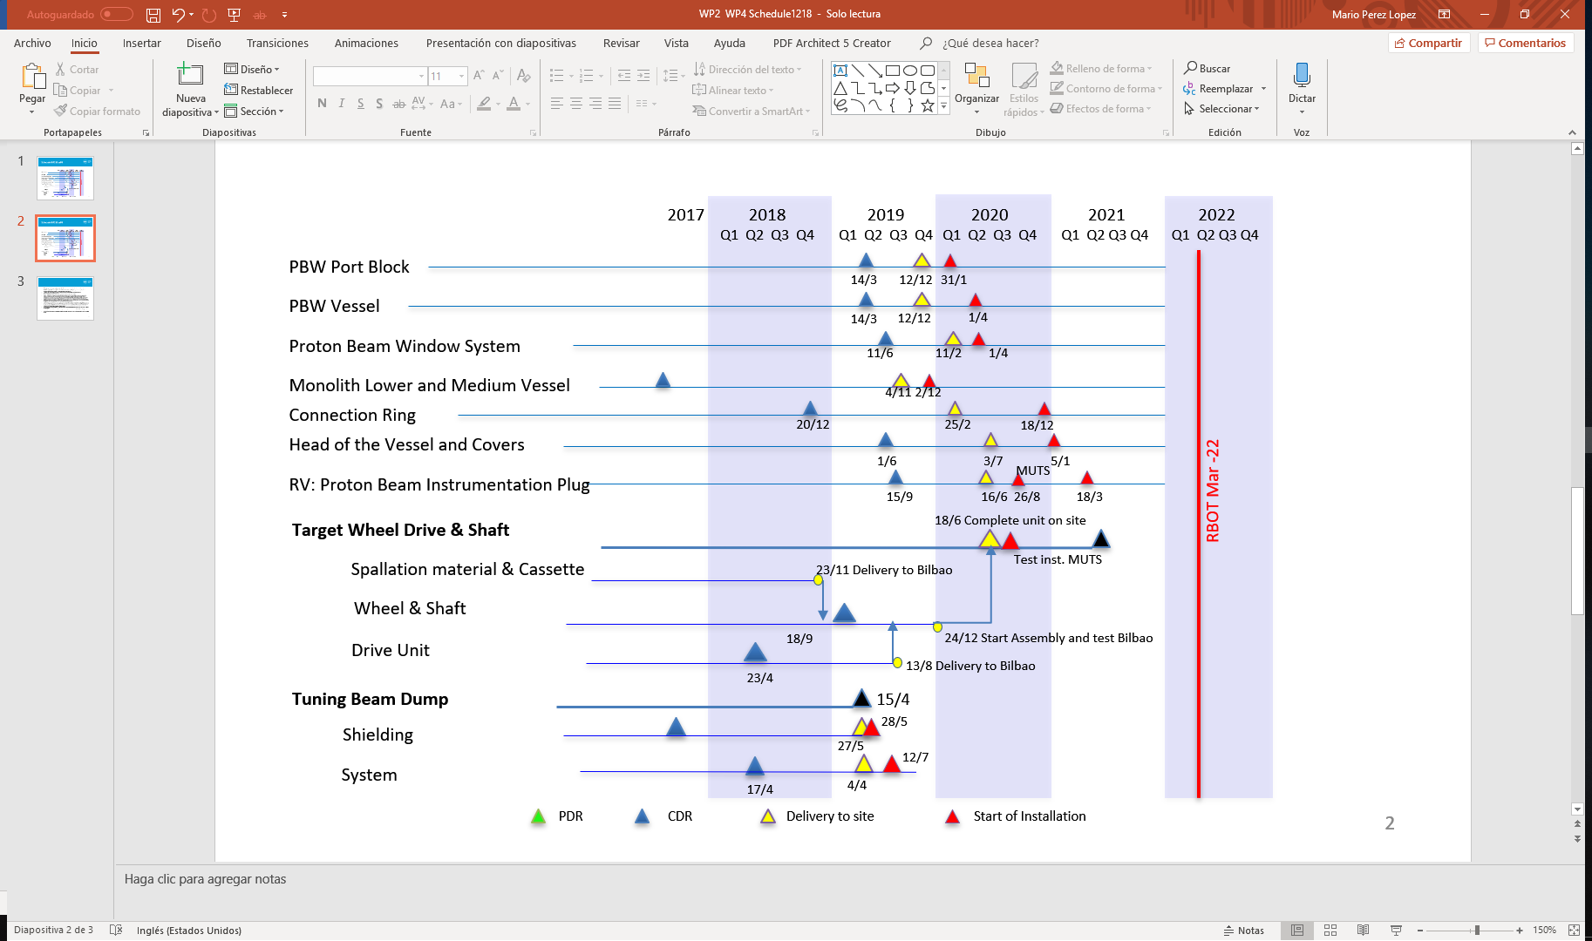
16
In-Kind Contribution – Target
Target Deliveries in or near Critical Path

Slide 17


IKRC#17
Partner Presentation -
Status of ESS Bilbao IKCs
Mario Pérez, ESS-Bilbao
Lund, 31 January 2019

