Slide 1
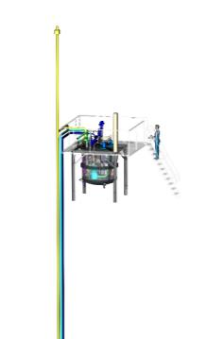
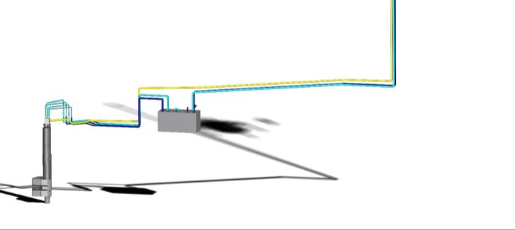

Target collaboration Board Meeting
8th Meeting / February / Copenhagen
2019.02.08 I M. Butzek

Slide 2
OUTLINE
Brief technical status
  Moderator & Reflector Plug -TIK3.1 status
  Cryogenic Moderator System -TIK3.2 status
  Additional small ESS projects
  Target Monitoring Plug -TIK4.1
  Neutron beam extraction system
Contractual issues

Slide 3
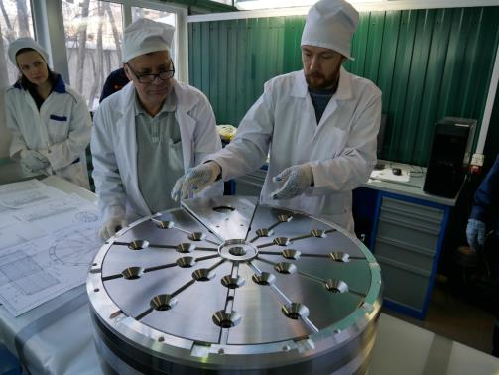
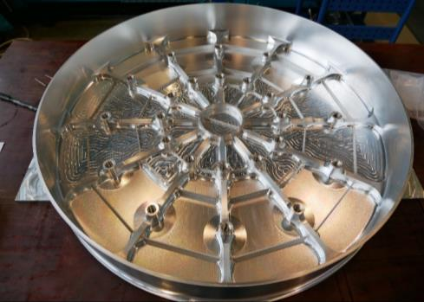
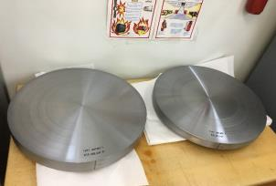
MRS TIK3.1
Yannick / FZJ
Beryllium Reflector
Beryllium Reflector manufacturing
Beryllium acceptance test (Moscow)
Welding Reflector Feb. 19 (ZEA-1)
FAT Feb. / Mar. 18
Beryllium acceptance (Moscow)
Pre machined Beryllium disc 2 and 3
Reflector Vessel (FZJ)
Pre machined Beryllium disc 1

Slide 4
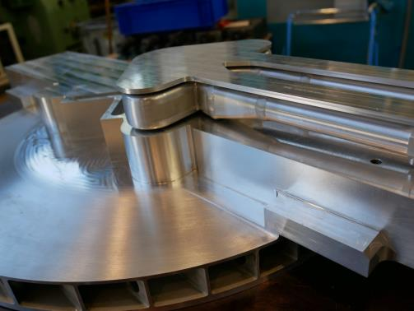
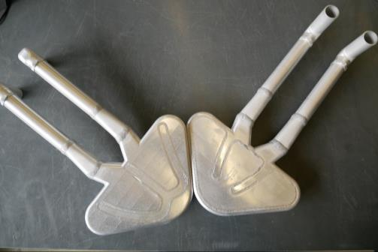
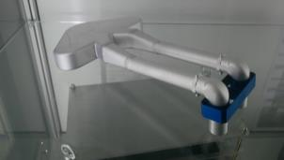
MRS TIK3.1
Cold Moderators
Cold Moderator manufacturing
FAT (cold Moderator)
Cold Moderators with
thermal Moderator (intermediate stage)
Final cold Moderators

Slide 5
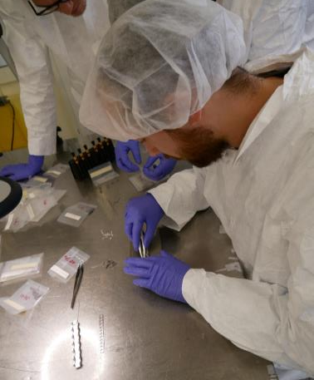
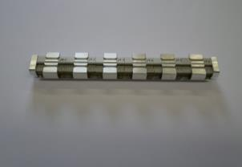
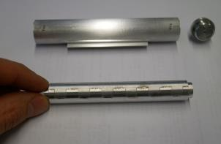
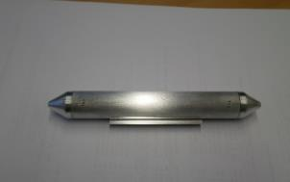
MRS TIK3.4
Irradiation Module (extra project
Cooperation with Uni Roma / R. Senesi)
Inner holder with
96 samples…
Assembly of Irradiation Module
Welded inner
holder
Irradiation Module manufacturing
FAT
Final Irradiation Module

Slide 6
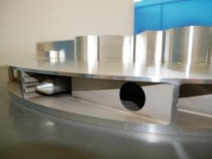
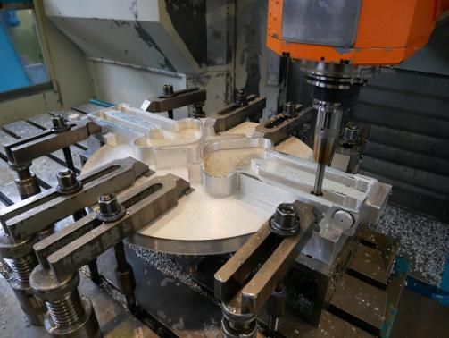
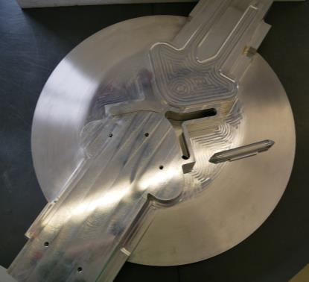
MRS TIK3.1
Thermal Moderator
Thermal Moderator manufacturing
Integration irradiation Module
Integration cold Moderator Feb. 19
FAT Feb./Mar. 19
thM with Irradiation Module
Thermal Moderator final milling
Thermal moderator intermediate stage

Slide 7
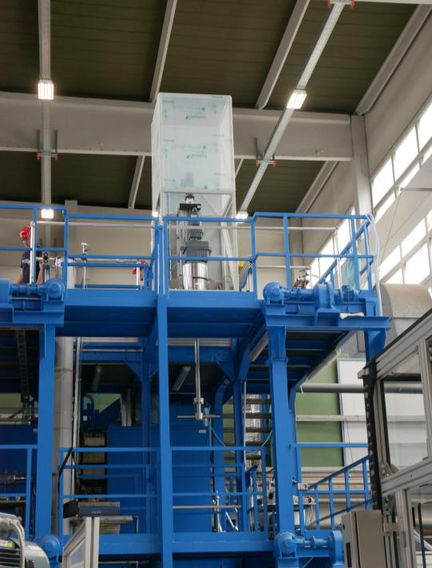
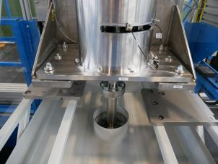
MRS TIK3.1
Final assembly of Rotation Unit at ZEA-1
Rotation Unit
Rotation Unit manufacturing
FAT
Detail view of rotation mechanism

Slide 8
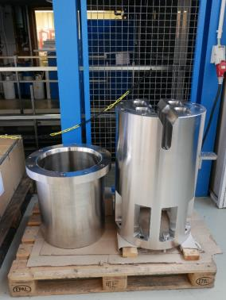
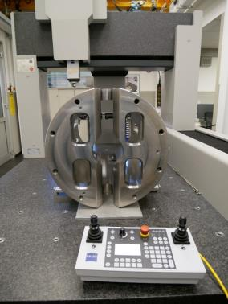
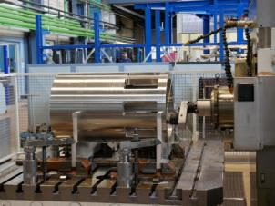
MRS
Bucket (extra project) and Crown (TIK3.1)
Crown and bucket manufacturing
FAT
Final Crown and Bucket
3D dimension check of Crown
Milling of crown

Slide 9
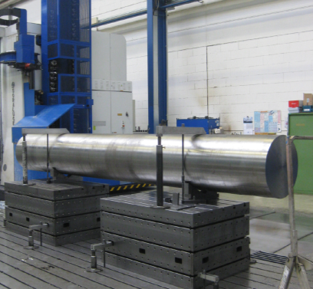
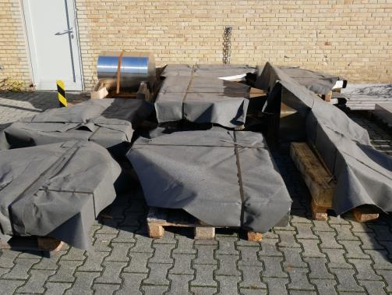
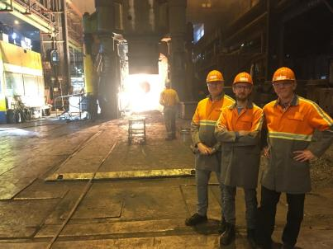
MRS TIK3.1
Twister
Shaft manufacturing
Frist welding March 19
Radial bearing manufacturing April 19
Axial bearing manufacturing April 19
Frame manufacturing Mai 19
Second welding June 19
FAT August 19
→More Highlight TTB……
Twister shaft manufacturing
Yannick and Marc
Pre cutted twister frame parts
forge of the Twister shaft

Slide 10
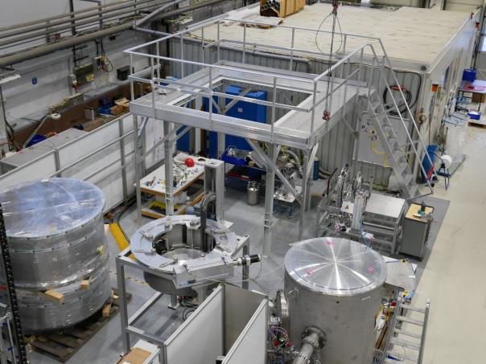
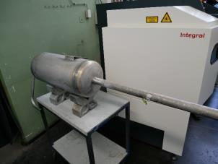
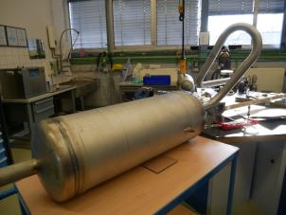
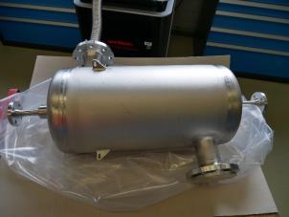
CMS TIK3.2
Cryostat
Manufacturing cryostat 80%
Pressure vessel FAT
Welding June 19
FAT Aug. 19
Vacuum chamber, platform and stand of CMS
O-p- converter
Pressure control buffer
HX2

Slide 11
additional “small” projects
LH2 Pump cooling
→ initial budget insufficient
CMS Cabinet
→ delivery will be June 2019
Retro Reflector Project
→ in preparation
RAMAN view port characterization
→ Master thesis completed

Slide 12
TMP TIK4.1
Task of Target Monitoring Plug (TMP)
Measure the x/y position of the wheel
Measure the z position of the wheel
Measure the helium coolant outlet temperature from each cassette during operation
Measure shaft vibration during operation
Measure helium borne sound in the helium coolant for acoustic diagnostics of the target cooling system and for acoustic diagnostics
Measure the internal cooling system inlet and outlet temperature
Final design phase
name | duration | start | complete
target monitoring plug (TMP) | 528 d | Fr 01.06.18 | Di 09.06.20
final design phase | 177 d | Mi 12.09.18 | Do 16.05.19
Milestone CDR | 2 d | Di 30.04.19 | Mi 01.05.19
making phase | 185 d | Mo 20.05.19 | Fr 31.01.20
test phase | 91 d | Di 04.02.20 | Di 09.06.20
Milestone FAT | 1 d | Mi 29.04.20 | Mi 29.04.20
Milestone Delivery | 4 d | Do 04.06.20 | Di 09.06.20
Source: ESS
Schedule

Slide 13
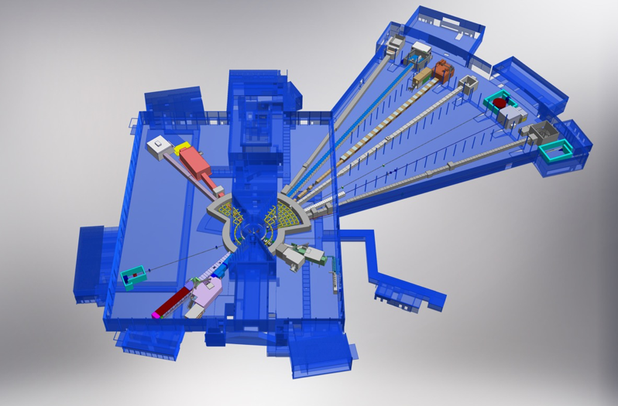
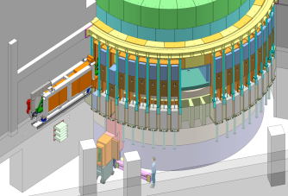
NBEX WBS 12.4.2.4
Phase 1
Phase 1:
Manufacturing acc.
ESS drawings
  Test Stands
  Prototype (NBPI)
Phase 2:
Neutron Beam Port Insert
Neutron Beam Port Plug
Neutron Beam Window
Light Shutter System
42 inserts / plugs are needed
Source: ESS
Source: ESS

Slide 14
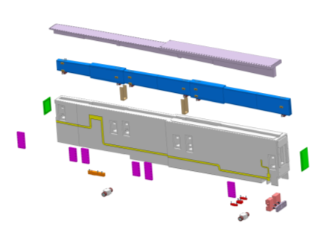
NBEX - NBPI prototype
Scope of phase 1
Redesigning by FZJ designer Feb. 19
NBPI Manufacturing +14 w
Beam window manufacturing March 19
Outer dimensions 3480 x 722 x 270 mm
Weight 4500 kg
Lid
NBOA, Neutron Beam Optic Assembly (NSS responsibility)
Shielding plates
NBPI body, including welded media channel lids (yellow)
Front window, Al 6061
Back window, Al 6061
NBOA alignment lids
Rollers
Media connector
Source: ESS
Alignment features

Slide 15
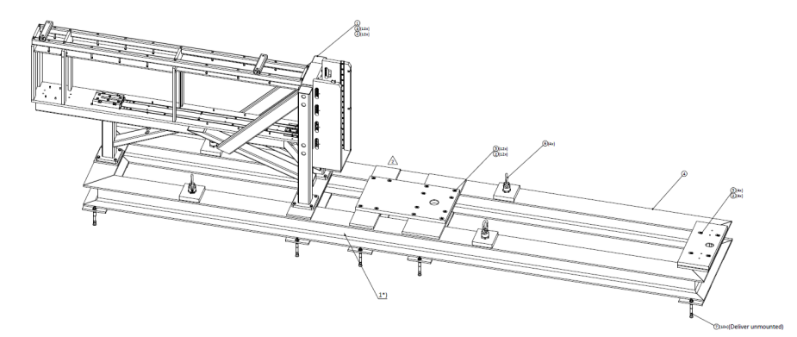
NBEX – Horizontal test stand
Scope of phase 1
Drawings available since January 19 (ESS)
Horizontal test stand manufacturing August 19
Source: ESS

Slide 16
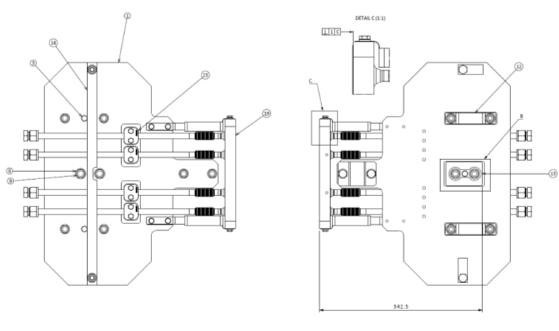
NBEX TIK Media connector test
Scope of phase 1
Media connector manufacturing April 19
Source: ESS

Slide 17
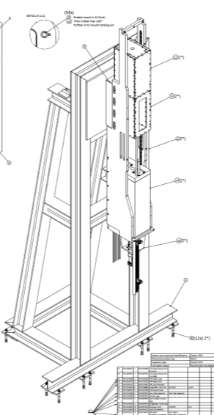
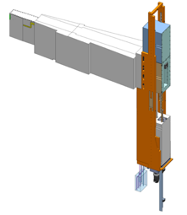
NBEX – light Shutter Test stand
Scope of phase 1
Still no final drawings ESS
Manufacturing +16 w
Source: ESS
Source: ESS

Slide 18
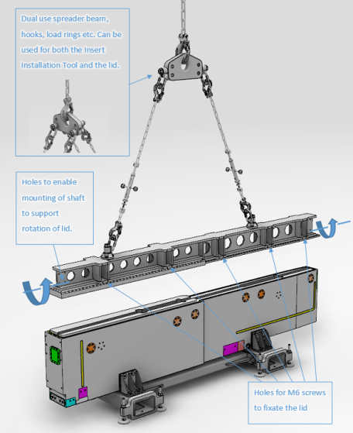
NBEX Lid handling tool
Scope of phase 1
Still no final drawings ESS
Manufacturing +14 w
Source: ESS

Slide 19
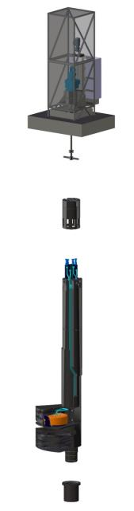
Summery
TIK3.1 & TIK3.2 will be complete around late summer 2019
Small projects will be complete around summer 2019
TIK4.1 will be complete around early summer 2020
NBEX phase 1 will be complete around August? 2019
NBEX phase 2 will be complete around end of 2020???

Slide 20
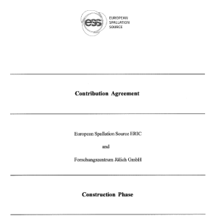
Contractual issues
Contribution Agreement for the Construction Phase between
      ESS ERIC
      and
      Forschungszentrum Jülich GmbH
is finally agreed and in the process of being
signed. Final signature is expected within
the next month.

Slide 21
Contractual issues
  In order to officially contract work under this Contribution Agreement TAs for all work packages have to be written, agreed and signed.
  TAs for TIK3.1 & TIK3.2 exists and are agreed (as of Nov 2018) but still have to be signed by ESS.
  TA for NBEX has to be written, agreed and signed soon.
  TIK4.1 is performed under a bilateral contract, thus no TA is needed.

