Slide 1
Target Technical Board March 13 2019
Mark Anthony
Head of Target Division
www.europeanspallationsource.se
13 March2019

Slide 2
Target Project is 43% complete
Current budget at completion for the ESS Target Sub-project is 211.1M€
Earned value as of Feb 2019 is 90.4M€
Cumulated Schedule Performance Index is 0.97
Actual cost spent as of September is 90.7M€, Cost performance index 0.99
PDR meetings held for 89% of the packages in Target (40 out of 45)
CDR meetings held for 56% of the packages in Target (45 out of 81)

Slide 3
Highlights
Deliveries, Installation, and commissioning
The civil works continues in all parts of the D02 target station building, Concrete casting for ACF level 2 complete, at crane shelf level, and A2T at vault level roof 3 of 3 completed,
Ground Shielding delivered to ESS ERIC as well as several HVAC shipments and is placed in storage.
Cryogenic Hydrogen System and Helium Cryoplant equipment delivered and installed, commissioning ongoing. TMCP impeller fixed, redesigned start logic at power cabinet
CMS: Technical specification document for CTL&HTL has been finished. And it started the review process. (reviewed by Jarek and Philipp in ESS. Additionally, Jülich Prof. Hans and Yannick are asked to review/check it as well.)
Components
Monolith water cooled Inner Shielding prototype design finalized, manufactured, inspected and tested SAT. Proving design is acceptable.
TSS CDR 1 of 3 completed successfully, supports hardware selections (CDR 2 and 3 moved 10 weeks)
A hydrostatic pressure test on one of the PBW prototypes was successfully carried out. No pores, no leakages and no breakage occurred with pressure up to 15 bar (design pressure is 5 bar)
Welding of cold and thermal moderators has been completed and tested.
Analysis
Fire analysis of TSS is complete. Results conclude we will be able to cope with a large fire and TSS will still be able to stop the proton beam.
The Functional Spec format and content has been resolved. ICS is preparing for the PDR for the Target cooling process control system
TIK 6.1 for ACF has been signed, presentation to IKRC Jan 31st.

Slide 4
Highlights
Manufacturing contracts awarded for several large in-house & in-kind hardware;
Tuning Beam Dump
Outer Shielding, Part 1 and 2 for Inner shielding
Proton Beam Drift Room shielding
NBEX port inserts material
Shaft Cutting Station in ACF
Interbay confinement doors, and floor valves
Port Blocks
Target Monitoring Plug Controls
Contract for Phase 1 of NBEX
Helium Cooling System
Design package for Radiolysis Gas Treatment System

Slide 5
Highlights Recent Accomplishments

Slide 6
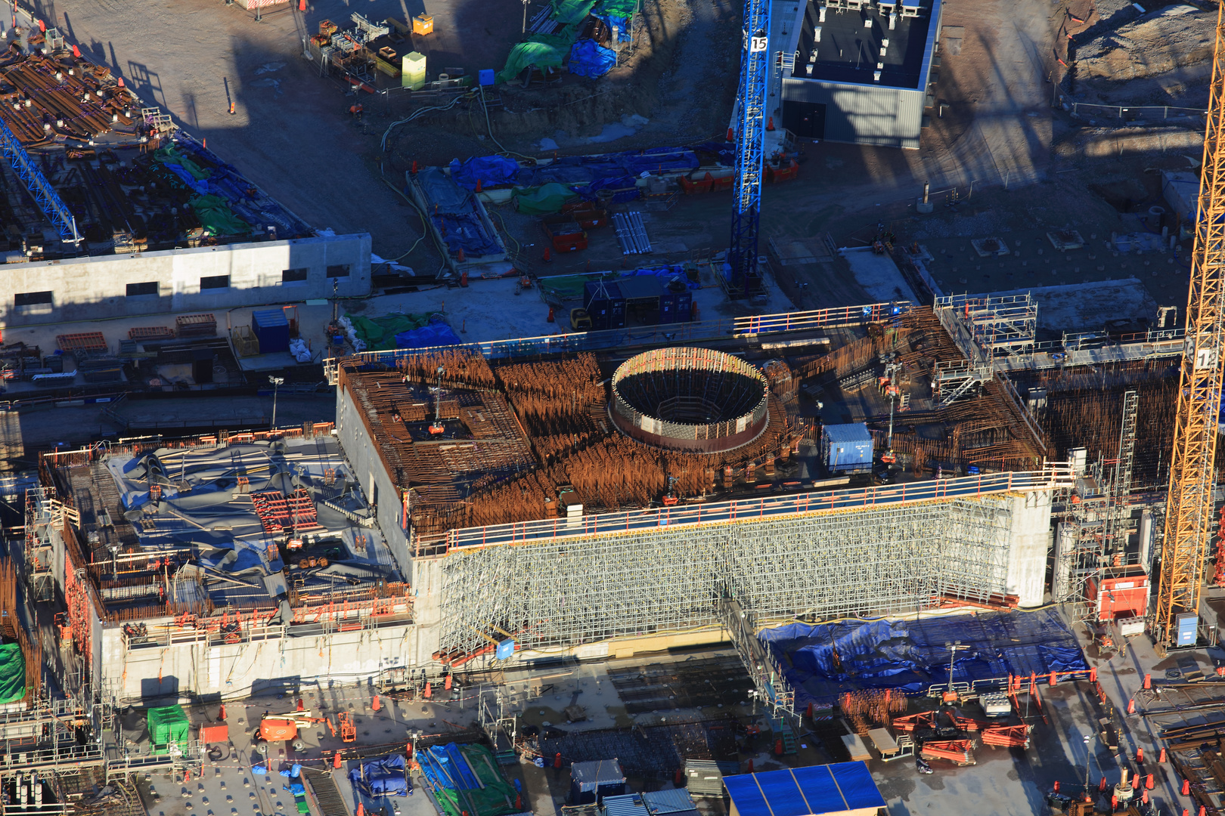
Target Monolith – Highbay vault

Slide 7
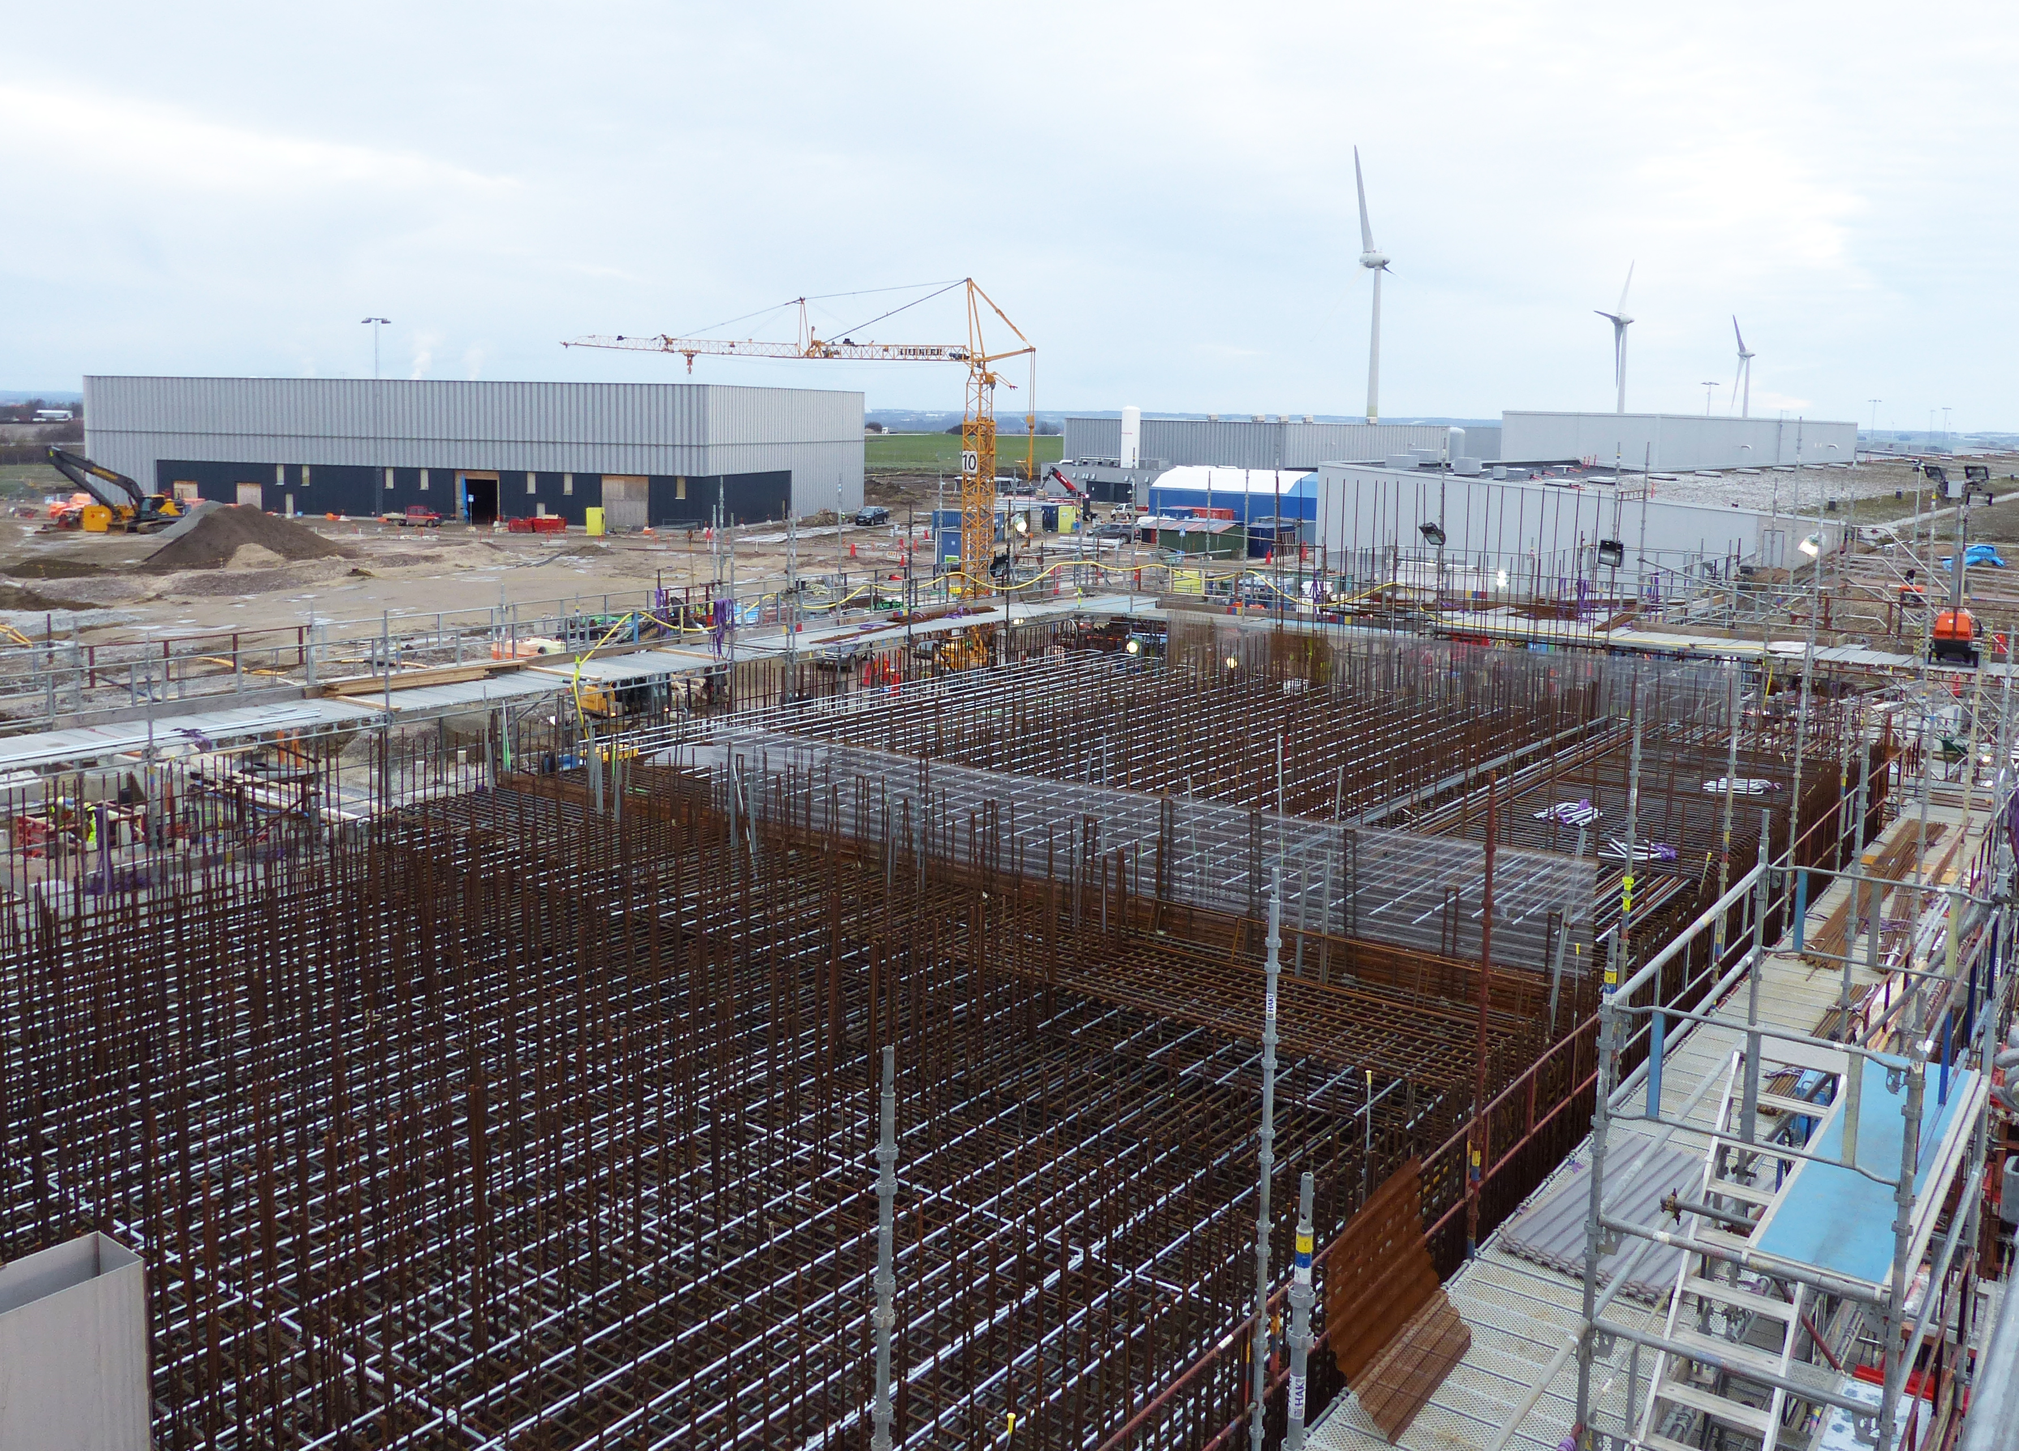
A2T vault

Slide 8
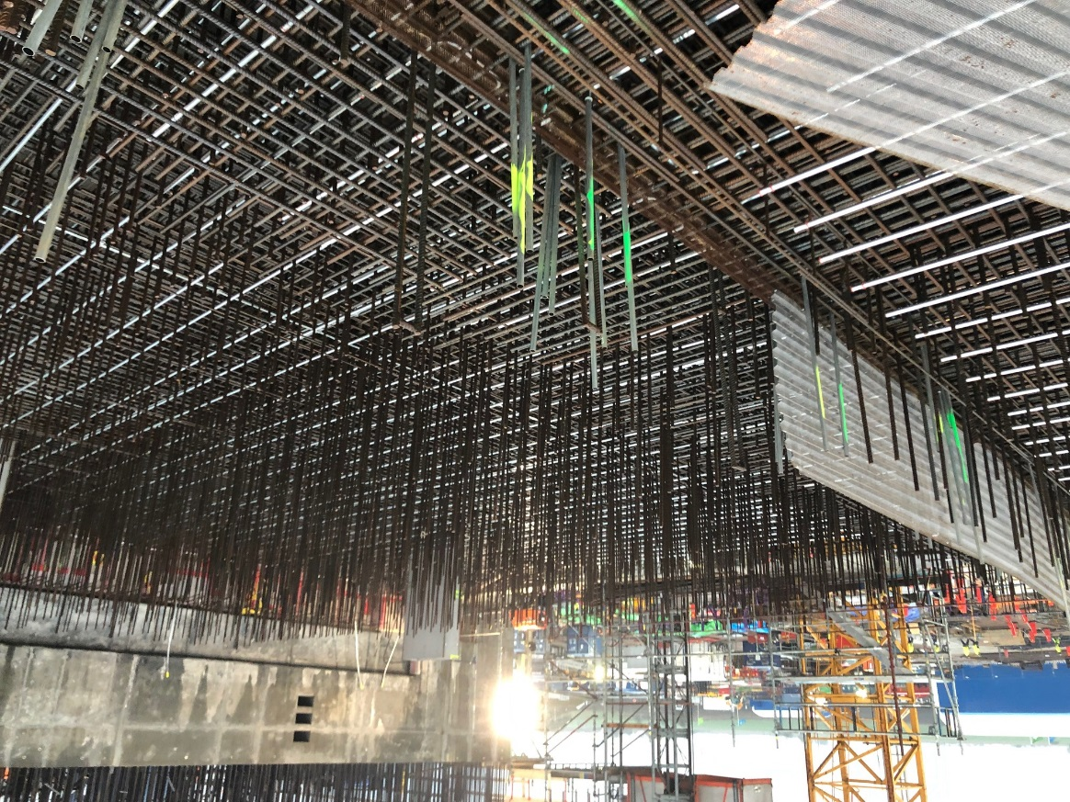
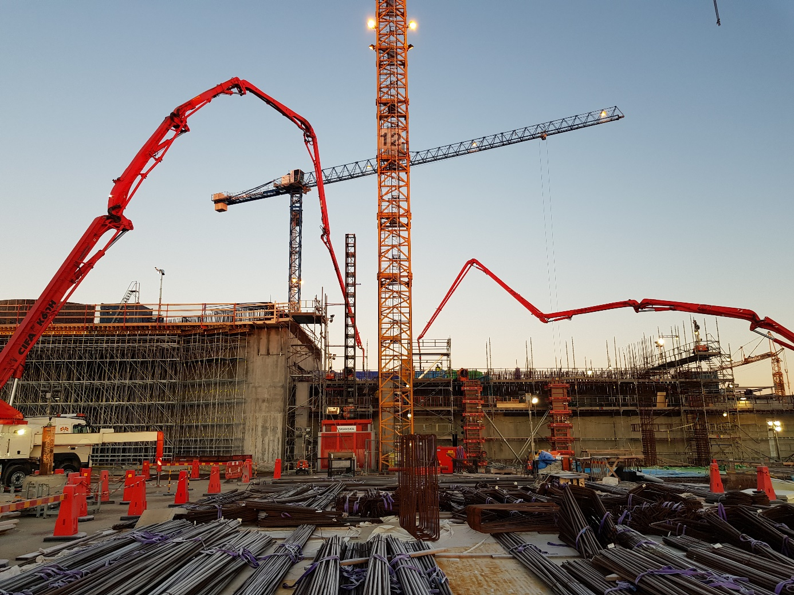
Recent Accomplishments
Casting of slab above A2T tunnel
Mesh for casting joint in A2T vault.

Slide 9
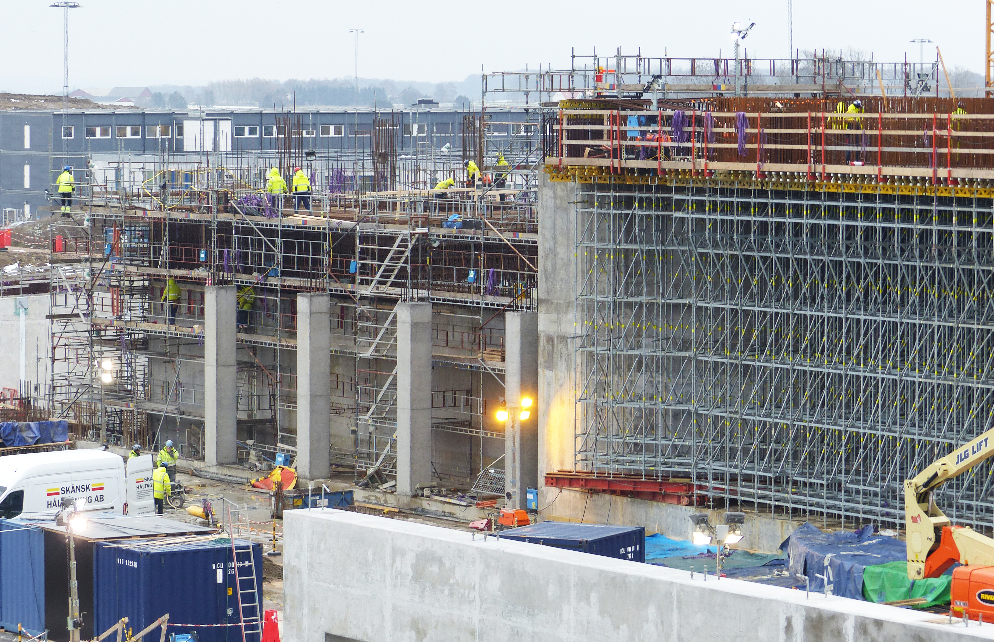
A2T

Slide 10
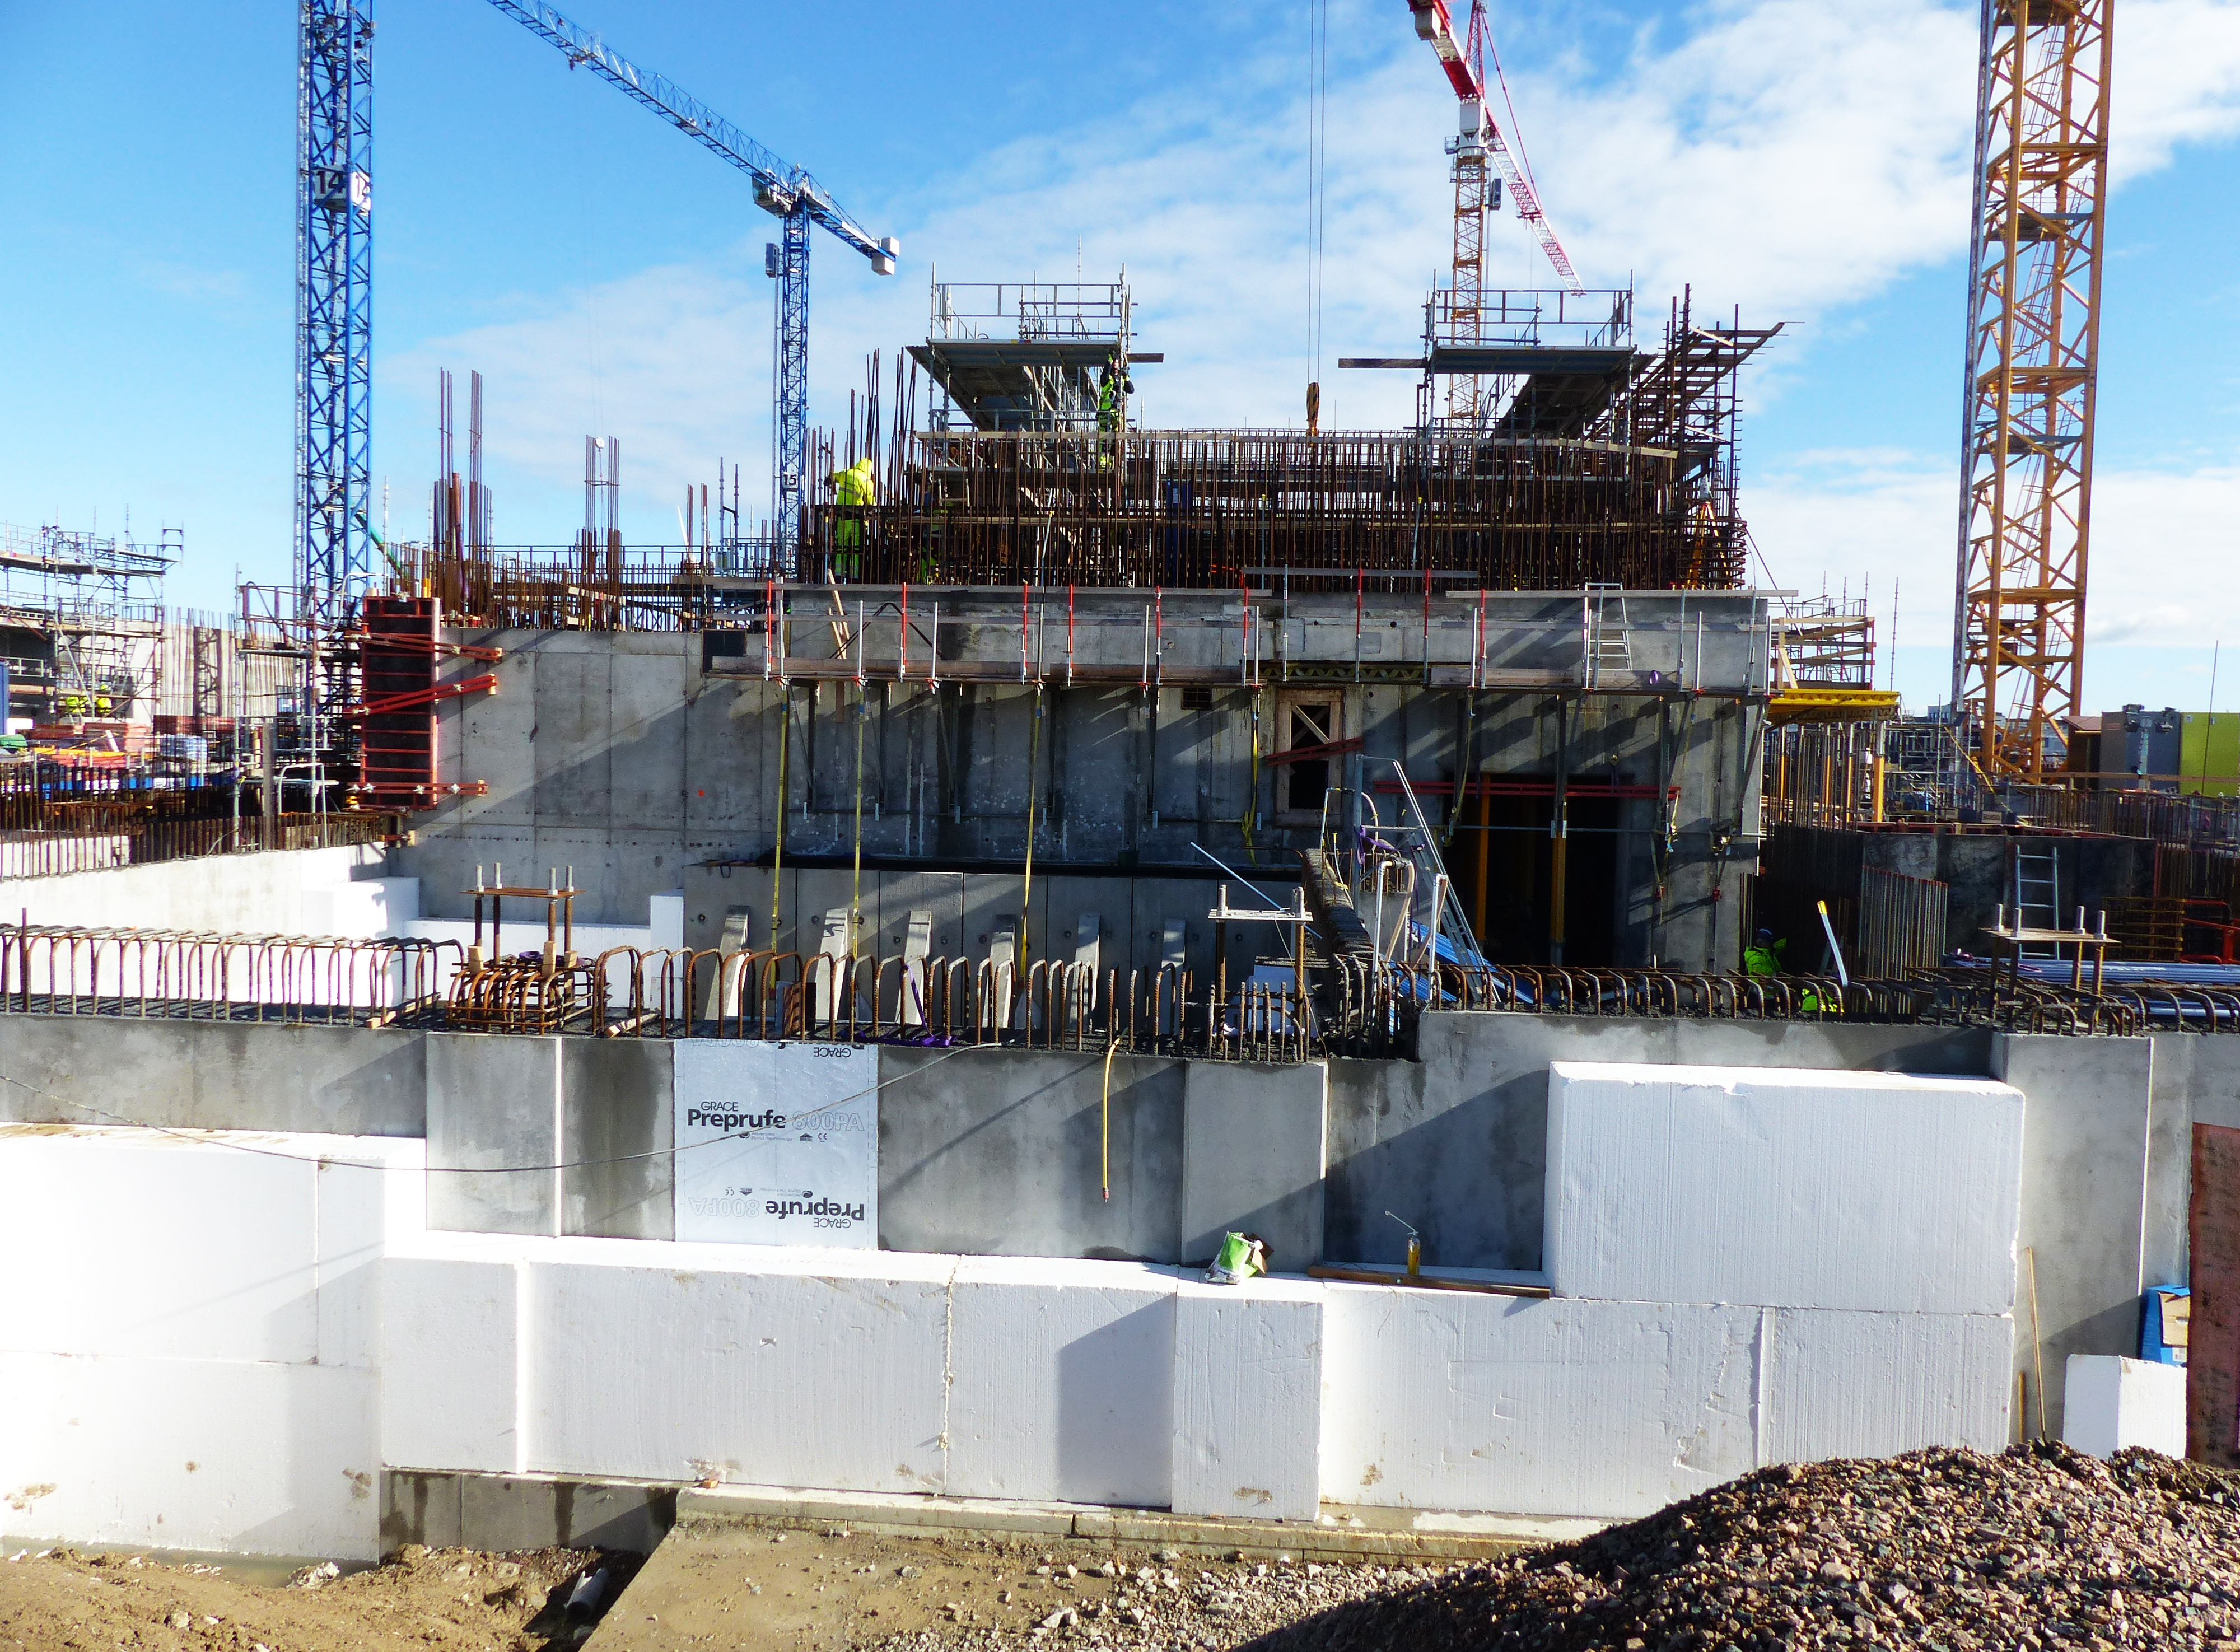
Active Cell

Slide 11
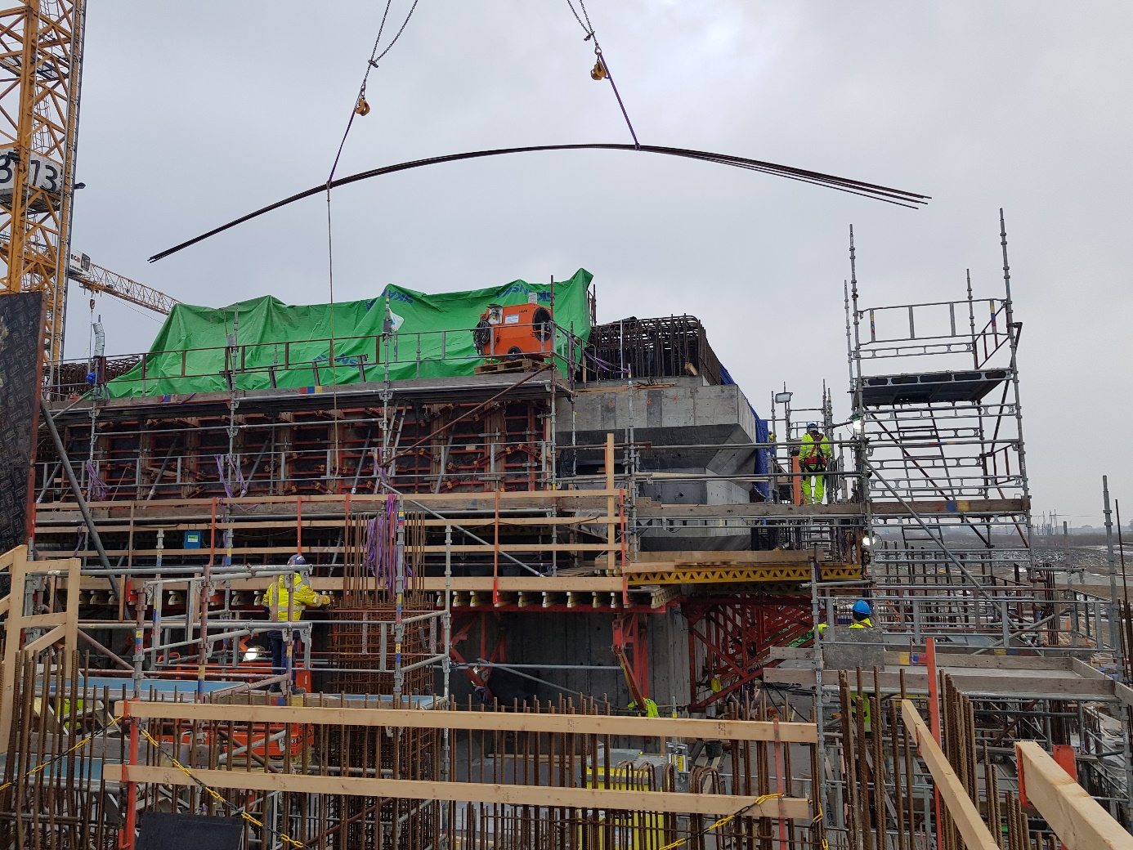
Highlights Recent Accomplishments
Active Cells walls are also beginning to reach their full height. Intense work is also going on with Technical Galleries between UB and AC.

Slide 12
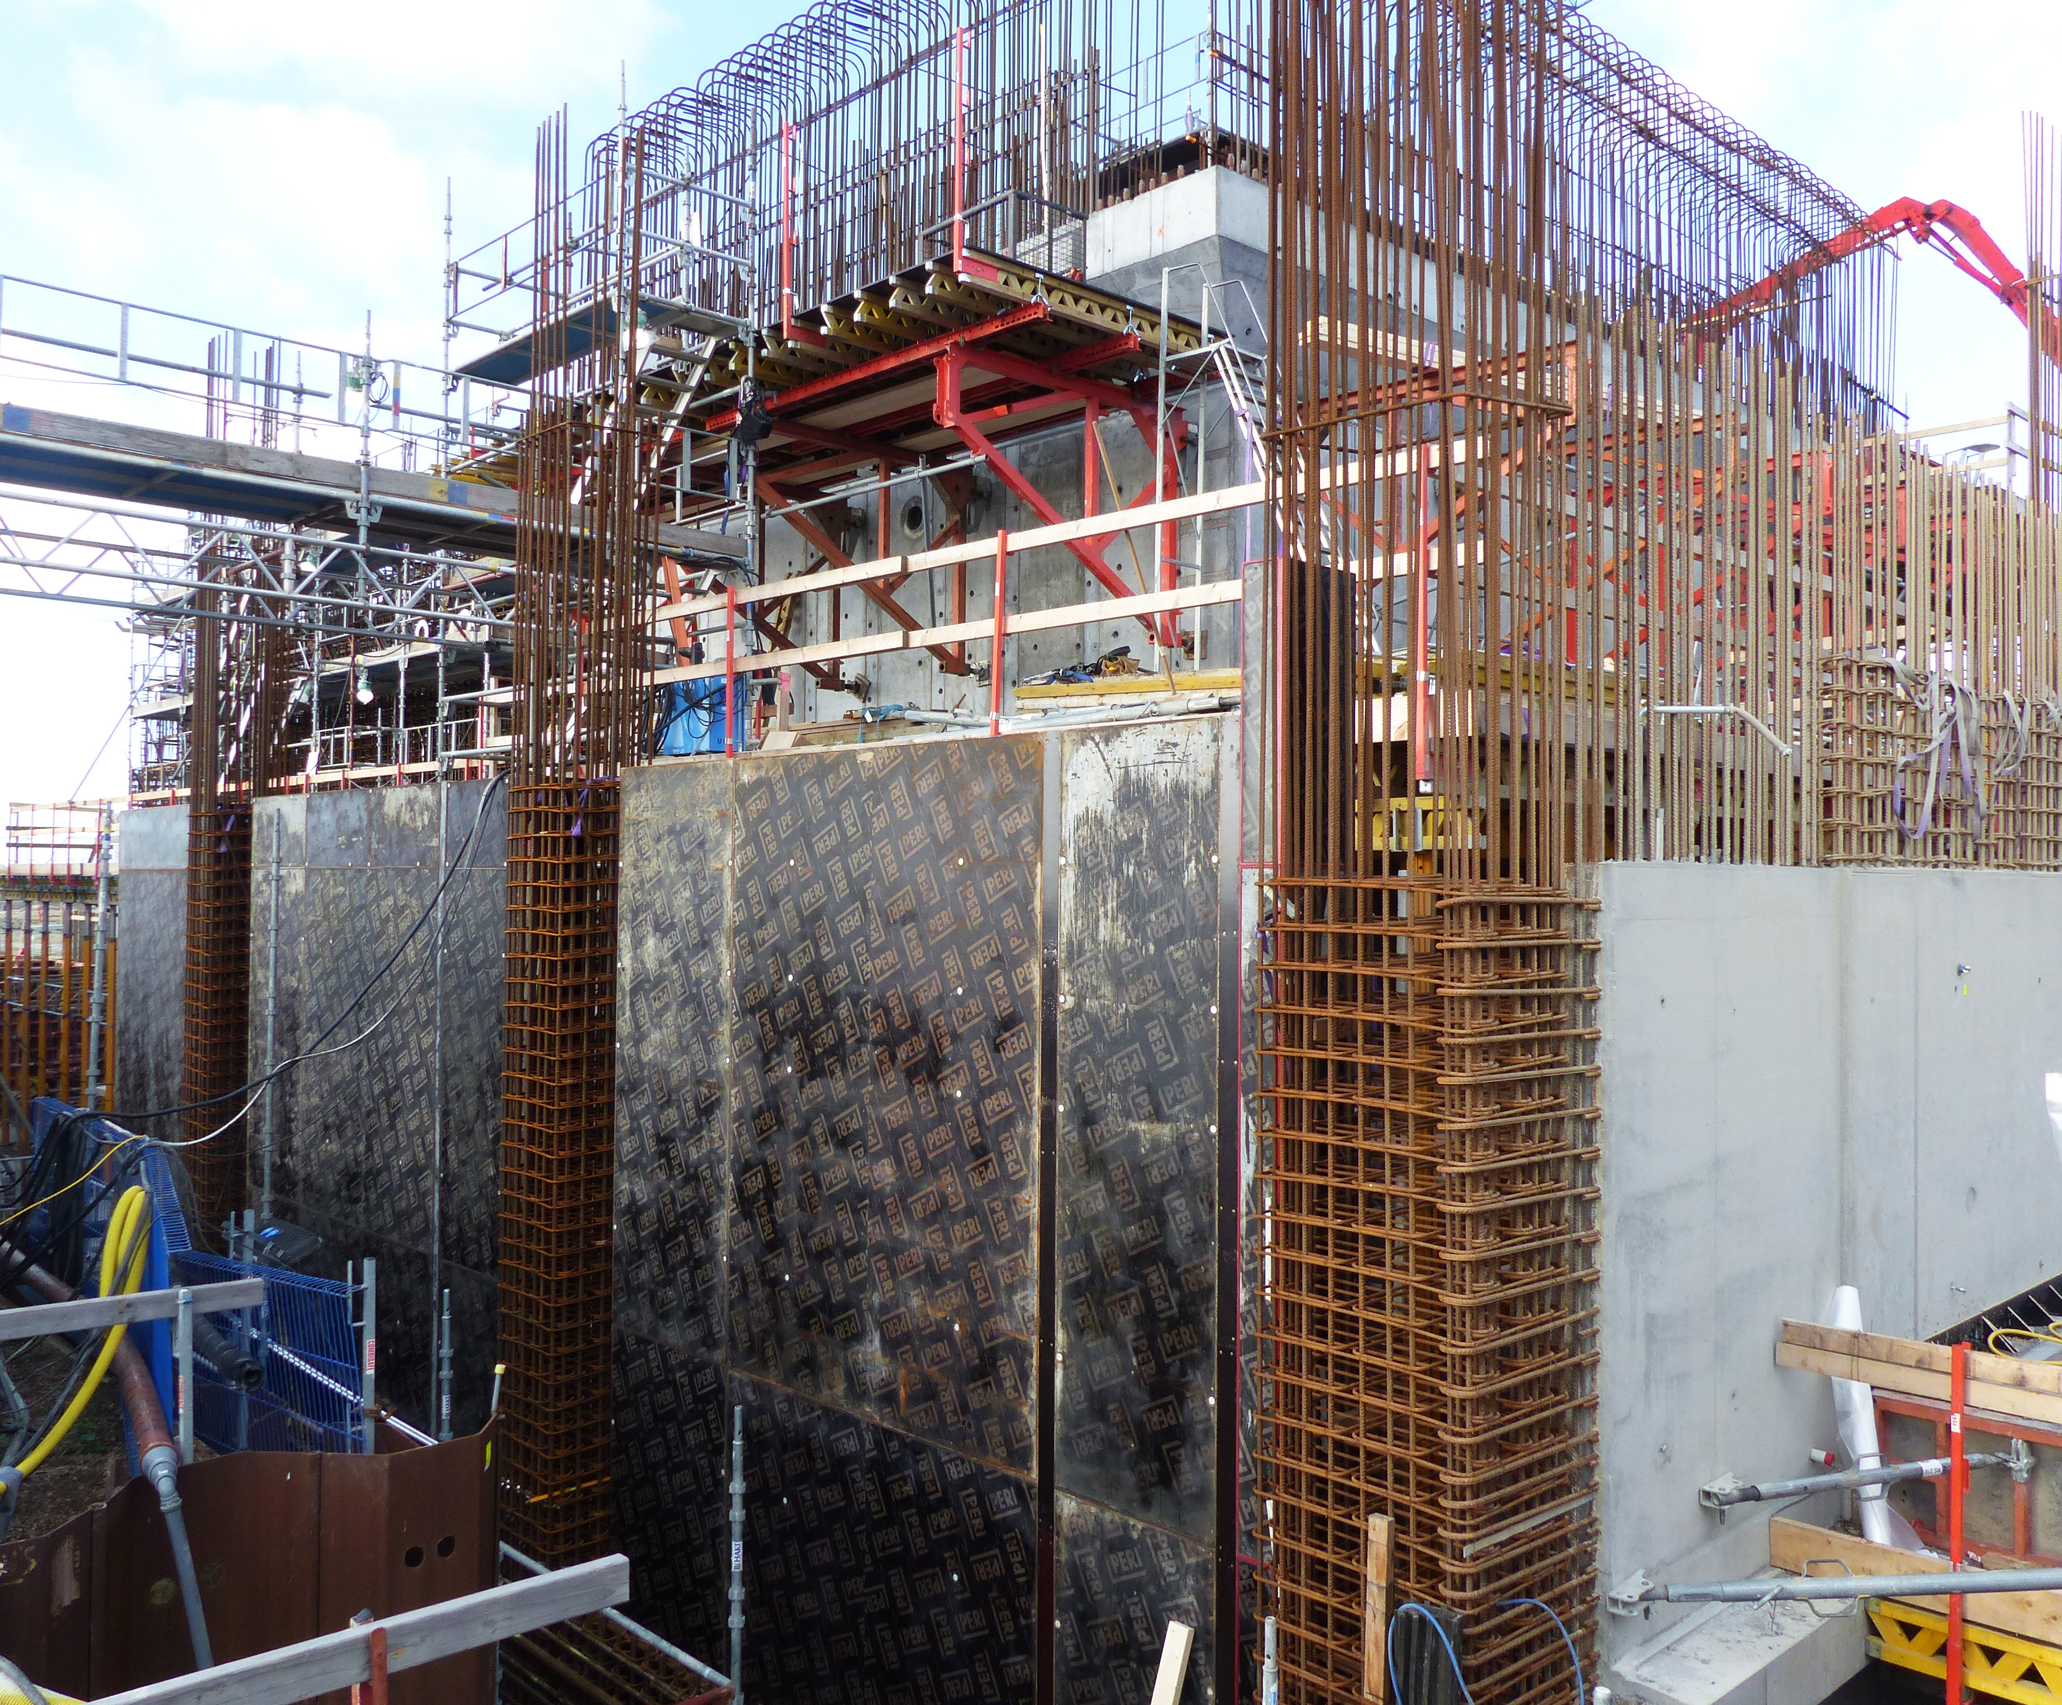
Active Cell – Technical Galleries

Slide 13
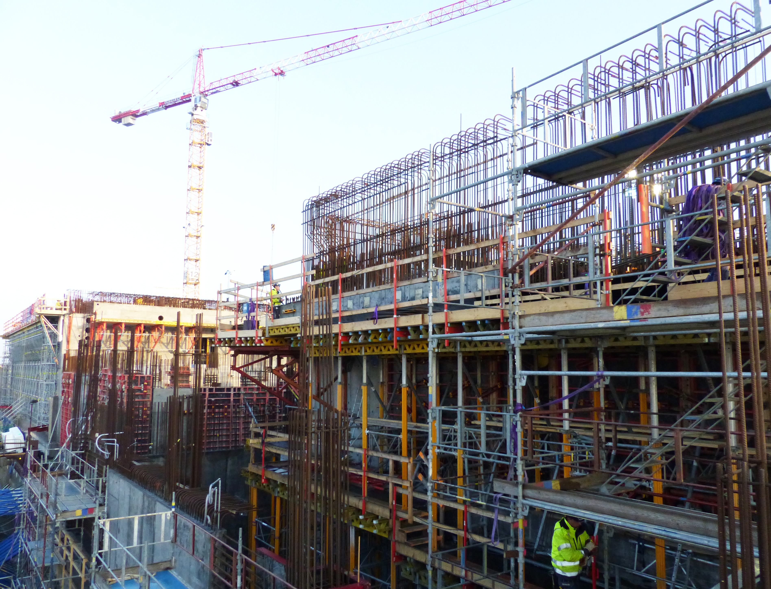
Technical Gallery

Slide 14
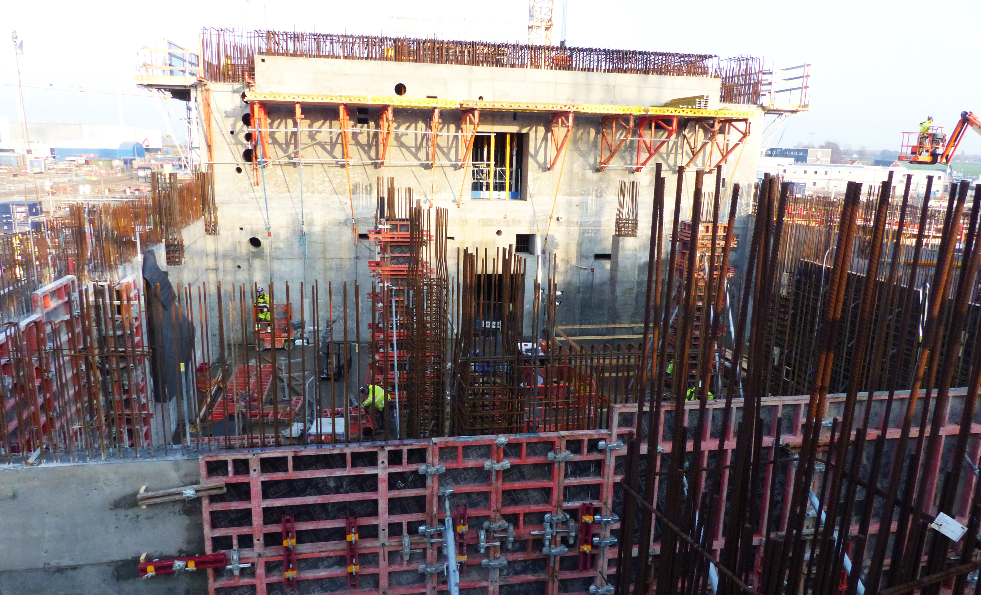
Utility + back of Monolith

Slide 15
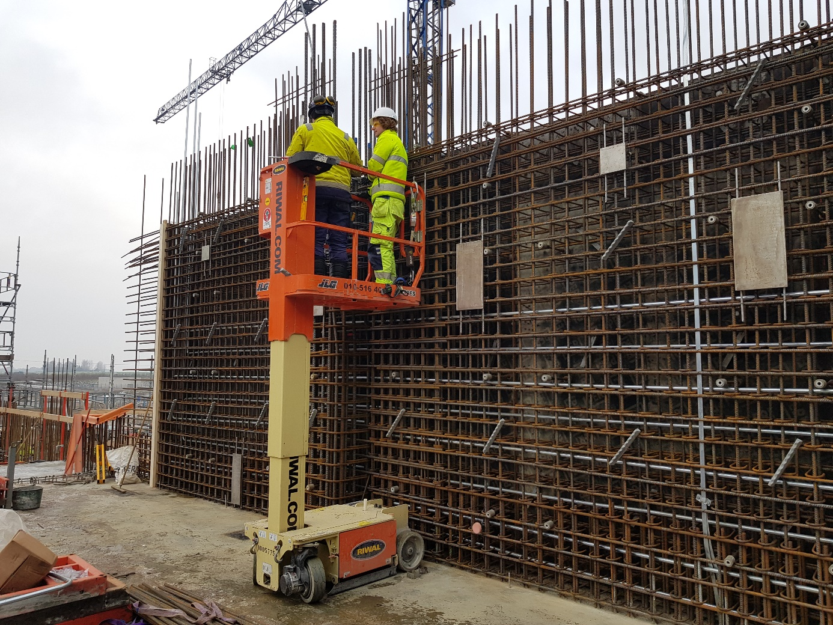
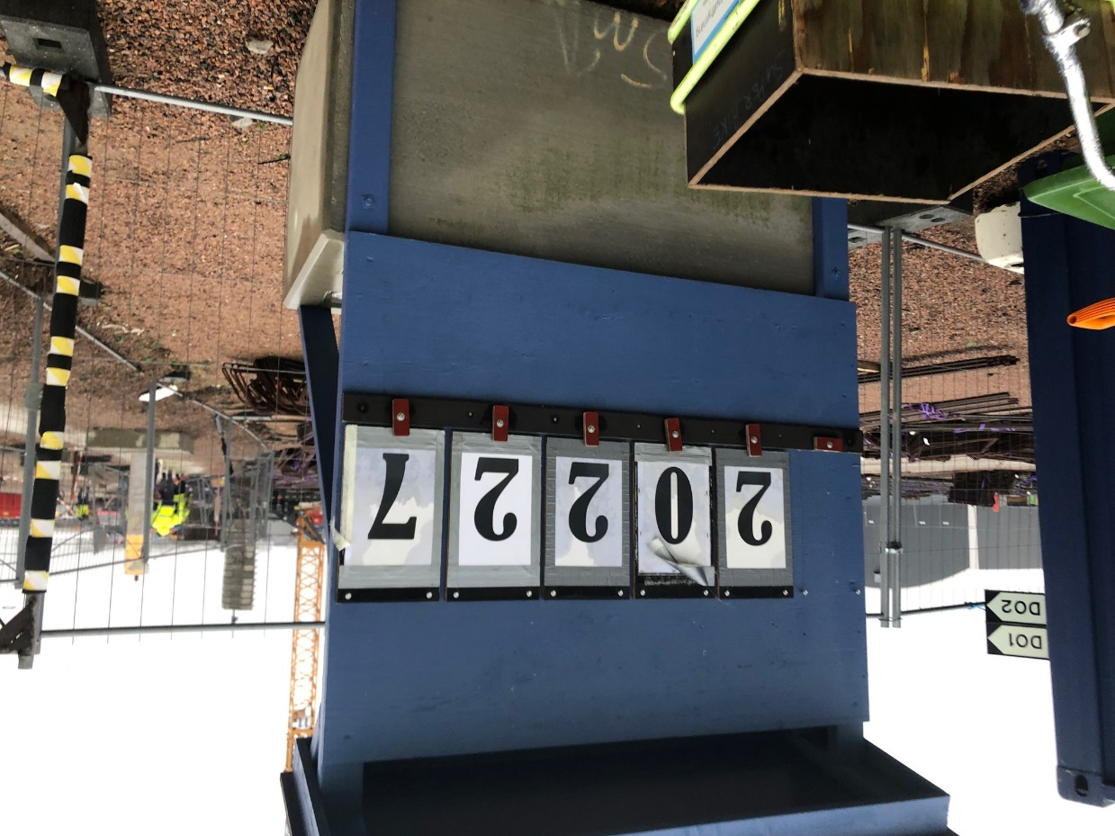
Highlights Recent Accomplishments
Accumulated cubic metres of concrete poured in the D-buildings
Utility building north and south walls are reaching the full height.

Slide 16
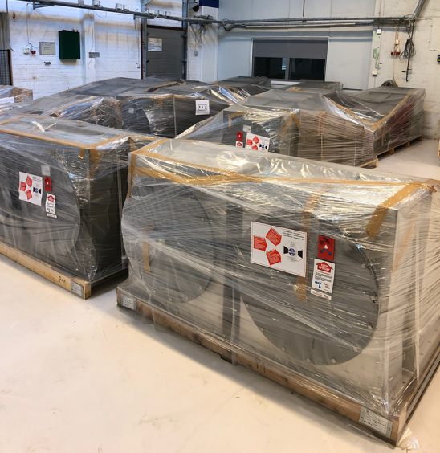
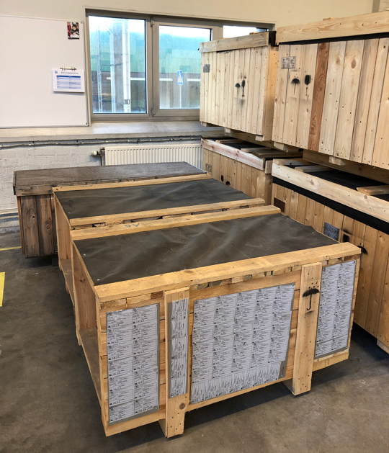
Highlights
HVAC Shipments arriving (Czech Inkind)

Slide 17
IKC package Summary

Slide 18
ESS Target Station Collaborators

Slide 19
Target In-Kind Packages
Target Sub-Project has 22 in-kind work elements
TA or CA signed for 10 work elements
Partner selected for another 4 work elements
Completed 2
Self Performing 6 work elements
78.2M€ total Inkind achieved, this represents 37% of Target Scope

Slide 20
Issues
Welding of the target wheel shroud creates too much distortion, Test of mockup #3 completed, CDR postponed to May 19, slip of 5 months.
CVR lack progress for some tasks in the Target He Cooling System, loosing float, contribute to neg SV
Industeel material delivery schedule is aggressive, WP 2, 3, & 4 working out partial delivery sequencing against schedule need dates. Float to installation dates was reduced.
Problems finding qualified suppliers and credible offers.
Port Blocks. Invoked article 16 of EU procurement rules to allow direct negotiations with suppliers. Supplier found but resulted in a delay of 4 months.
Tuning Beam Dump material supplier, …just resolved
Ferrofluidic seals for target wheel
Radiolysis Gas Handling System, Ion-exchange columns
Helium Purification System components
Light Shutter automation
Delays of NBOA designs causing NBPI schedule to slip into negative float on installation activities (-45 days). Only 2 designs received, LOKI, test beam dump

Slide 21
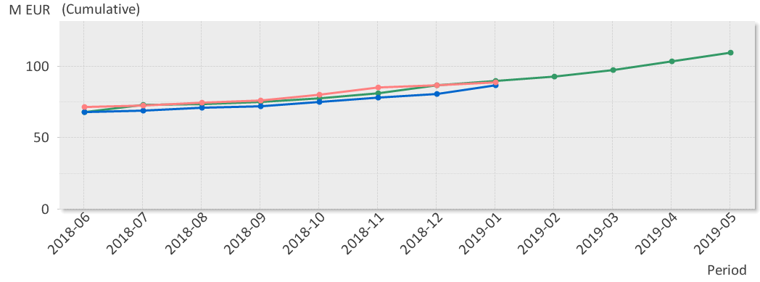
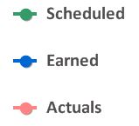
EV Graph
(* No InKind included)
Current Status
Cumulative Cost Variance (CV) for Target for -212K€;
The CV value reported last month has largely been corrected. Further corrections due to invoice timing.
Cumulative Schedule Variance (SV) is -3M€; Fluid Systems and Target System and their in-kind partners stand for -2.8M€ of total SV
Notes:
SV
Cumulative schedule variance for Target is -3.0 M€;
Since the Rebaseline is -2.9M€
For the period is +3.2M€
CV
Cumulative cost variance for Target is -2.1M€
Since Rebaseline in June is +1.7€
For the Period is +4.2M€

Slide 22
L1 Milestones
Name | Baseline | Current Forecast | Δ since last month | Total Float | Status (R, Y, G) | Impact/Action
Delivery on Site - Monolith Vessel | 2019-07-09 | 2019-12-18 | -19 | -19 |  | ESS Bilbao slip, start of installation now Jan 8th.
Delivery On Site - Cold Moderator Assembly | 2019-02-11 | 2019-12-16 | -20 | 240
Installation Complete - Target Cryoplant (Helium ) | 2018-11-16 | 2019-06-12 | - | 416
Delivery - Complete Target Wheel to ESS Site | 2019-11-08 | 2020-07-03 | -30 | 61 |  | Prototype 3 testing I/P
Tuning Beam Dump Ready for Proton Beam | 2019-07-26 | 2019-08-16 | - | 60 |  | AD need date Dec 1 2019
Installation - 1st Survey of TCS | 2020-08-19 | 2021-01-14 | 40 | -79 |  | Driven by Port Blocks
WP3 System Test complete – Cryo + LH2 | 2021-11-02 | 2022-01-27 | -60 | -64 |  | Driven by Port Blocks, pushed connection of final piping in monolith
Target ready for BOT | 2022-03-09 | 2022-03-09 | -79 | 0 |  | Represents 4 month delay, Driven by Port Blocks

Slide 23
L2 Milestones
Name | Baseline | Current Forecast | Δ since last month | Total Float | Status (R, Y, G) | Impact/Action
Contract Signed - Cryogenic Transfer Line | 2018-06-21 | 2019-04-16 | -40 | 84 |  | Managed with AD, Resource just quit, spec not finalized
All PDRs completed | 2019-02-05 | 2019-09-12 | -20 |  |  | In 2018 added 5 new PDRs
TSS CDR | 2018-11-23 | 2019-07-04 | -40 | 16 |  | Slipping - Resources dedicated to licensing
CDR Monolith Port Block Shielding | 2018-10-02 | 2019-06-24 | -40
CDR Proton Beam Instr. Plug | 2019-01-22 | 2019-08-05 | - | 122
CDR Target Wheel Vessel | 2018-05-02 | 2019-03-01 | - | 136
CDR – Beam Drift Room | 2019-04-23 | 2019-02-28 | - | 137
Notes:
Like He atmosphere in NBPI

Slide 24
EAC remaining after Rebaseline 1 of 3
Item | M€ | Comment
Budget At Completion (BAC) | 212.3 (208.1) | Added CR0243 for port blocks
Casks and associated handling devices (A20173220) | 2 | Estimate Based on Market survey from UK. Additional 7.9M is in Risk Register
Installation organisation 2019 -22 (A20159190) | 5.14 | Reduced 526k€ by CR0224
Installation infrastructure incl Laydown and Transport (Non-labour) 2019-22 (A20173270) | 1.42 | Reduced 167k€ by CR0224
Monolith and NBEX Installation (A20173260) | 1.8 | Additional technicians for double crews. Reduced 167k€ by CR0224
NBEX HW. (Insert, removal tool, casks except NBOA) (A20177990) | 1.5 | Estimate based on RFIs received. Additional 2.5M is in Risk Register
Monolith Port Blocks – HW (A20173250) | 0 (1.5) | Estimate from in-kind candidate. Bids received, contract award by Jan 15.
Beam Drift Room HW (A20202370) | 1.2 | Isolation valve, higher activation change in shielding
CF - JIRA Item, lifting equipment (A20196640) | 1 | Estimate is for both the cask lifting yoke and the lifting plate for NBEX
Active Cells Installation Infrastructure (A20173290) | 0.88 | Manpower paid by RACE, infrastructure by us. Reduced 120k€ by CR0224

Slide 25
EAC remaining after Rebaseline 2 of 3
A202080910
A202080950
A202080960
A202080970
A202080980
A202080990
A202081000
A202081010
A202081020
A202081030
A202081230
A202081240
A202081520
A202081530
A202081540
A202081570
A202081580
A202081800
A202081770
A202081790
A202081860
A202081870
A202081880
A202087620
A202087630
A202087640
A202087650
A202087690
A202087700
A202087710
A202087720
A202087730
A202087660
A202087670
A202087680
A202091330
A202091340
A202091380
A202091390
A202091430
A202091410
A202091490
A202091500
A202091450
A202091460
A202091470
A202091480
A202091400
A202091420
A202091440
A202091240
A202091250
A202091260
A202091350
A202091360
A202091370
A202091300
A202091310
A202091320
A202091270
A202091280
A202091290
A202091510
A202091580
A202091590
A202091630
A202091610
A202091620
A202091660
A202091670
A202091680
A202091690
A202091730
A202091740
A202091720
A202091650
A202091710
A202091750
A202091640
A202091700
A202091520
A202091530
A202091540
A202091550
A202091560
A202091570
A202091210
A202091220
A202091230
A202091960
A202092000
A202091980
A202091990
A202091970
A202092010
A202091950
A202091790
A202091830
A202091810
A202091850
A202091860
A202091900
A202091910
A202091890
A202091870
A202091940
A202091920
A202091930
A202091880
A202091760
A202091770
A202091780
A202091800
A202091840
A202091820
A202092050
A202092060
A202092070
A202092270
A202092280
Item | M€ | Comment
Shielding of water pipes in connection cell (Material and installation) (A20172370) | 0.84 | Higher activation
Shielding doors in Target Building (A20177060) | 0.9 | Orphan scope, working with Norwegian and Czech suppliers, preliminary estimate
Travel and service cost 2020-22 (A20202390) | 0.3 | Longer construction period
Increased staffing cost 2020-22 (A20202420) | 9.6 | 5.9 / 3.7 (Employees / Contracted) Note: does not include any initial ops funding transfer
PBW Primary Cooling System (20172980& A20173030) | -0.425 | Less expensive than planned for
Installation savings - A Pool for Installation Support Group and Cable routing (A20173040) | -0.18 | Decided by CCB
He Purification System savings (A999920159170) | -4.0 | Expect CCB review Feb 2019
A202081590
A202081600
A202092200
A202092210
A202092220
A202092260
A202092230
A202092240
A202092250
A202092190
A202092180
A202092110
A202092080
A202092090
A202092100
A202092120
A202092130
A202092150
A202092160
A202092170
A202092140
A202092020
A202092030
A202092040

Slide 26
EAC remaining after Rebaseline 3 of 3
Item | M€ | Comment
Radiolysis Gas Treatment (A202081950) | 0.34 | Estimated need to cover manufacturing and installation
CF – Jira – Civil Works | 1.26 | Shielding, Penetrations, Foundations
ACF schedule delays and as built tolerances out of spec (A202087810) | 0.45 | RFR Solutions, cask pit lids
Total Remaining Forecast | 24.03 (25.53)
Estimate At Completion (EAC) | 236.32 (233.63)
A202087550
A202087560
A202087570
A202087580
A202087590
A202087600
A202087610
Notes:
CF – JIRA – Civil Works 1,26 comprised of following:
Penetration Shielding (A202087550) - 0.5
Shielding Blocks Outside Transfer Area (A202087560) - 0.1
Welding Plates, Hilti Rails & Small-Bore Penetrations (A202087570) - 0.09
Target HVAC – Additional Electrical Penetrations (orphan scope) (A202087580) - 0.2
Concrete Foundations for Target Equipment in D02 (A202087590) - 0.17
Drip Plate for Grating and Connection Cell (A202087600) - 0.1
Sealing Between Bunker and Basement (A202087610) - 0.1

Slide 27
Target – Top 6 Risk Mitigation Status Value of cost risk* = min 24 M€, max 37 M€, expected 31M€ (32M€)
Risk ID | Event | Potential Impact C – Cost S – Schedule Q – Quality and Function | Proba-bility | Mitigation measures | Due date
66 | Staffing level is too low for the workload | C: 5M€ S: 4-6 months Q: Several req. | 3 (35%) | Impact identified in Forecast Move work to initial ops Secure funding for 2019 Staff plan review | Treated 190228 Treated 190228
74 | Target critical path is delayed because of a delay in manufacturing the port blocks. The monolith vessel installation sequence is interrupted. | C: 1M€ S: 4-6 months Q: Several req. | 5 (90%) | Combined procurement with Vessel (treatment failed) Interface with multiple manufacturers Contract incentives Multiple shifts for welding | Treated Treated 190401 190401
65 | Installation of target components in parallel with CF/Skanska installations impacts productivity in the Target Building, or is not in time for the Target Project to meet the "Ready for Beam on Target" milestone date. | C: 3M€ S: 4-6 months Q: 1 low level req. | 4 (65%) | Work with CF to develop an integrated CF construction/Target installation schedule with acceptable "early access" dates. Work with site installation manager Mikael Jacobsson to clearly define installation priorities and decision making. | - 191231
84 | Change of civil design CF, JIRA items | C: 1M€ S: 4-6 months Q: Several req. | 4 (65%) | Routine interface meetings with CF, all issues tracked in JIRA. High level definition of roles and responsibilities. Acknowledgement of Target ICD-Rs. 1,6M€ has been added in EAC.
96- 105, 114 | In-kind partners do not deliver full scope or on time. (eg. UK - ACF 9.5M€) Cost exceeds cost book value | C: 16M€ S: 7-9 months Q: Several req. | 5 (90%) | Hand off Design work to InKind, CDRs complete Leverage In-kind review committee support Oversight and engagement, face-to-face | 180601 191231 181231
110 | Casks and associated handling devices - taken back from InKind, also cost increase due to more deliverables and extended schedule. | C: 7.9M€ S: 0-3 months | 5 (90%) | Commissioning shift Implement Systems Engineering Procurement plan Review functional specifications Transfer scope to init ops
*Data from Exonaut – sorted Cost & Schedule, remaining part of project time

Slide 28
Concluding Remarks
Since the Rebaseline CF has held the site early access dates; however, we have seen slips with Inkind deliveries. (adding 4.2M in SV)
Most all Target WP installations are with < 40 days float to Critical Path.
Target has entered installation phase, mainly for ACF, the Vessel installation activities begin in December 2019.
No Inkind interest was secured for several large work packages which required organizational changes at ESS to support inhouse design and procurements.
Due to ongoing difficulties finding equipment suppliers, a major schedule risk remains with manufacturing and equipment deliveries.
Target Ready for Beam milestone is March 2022

