Slide 1
Target Cooling System
Project status
11th TTB Target Technical Board
Tatiana Adamíková
14. 03. 2019

Slide 2
Heat exchangers
ESS made a review of QA documentation
Expected date of manufacturing start → 18.03.2019
Circulators
Delayed with Inspection plans will be delivered asap
CVR planning visit Offtech → 1th week of April
Gas Bottles – storage of He
Rented from a local company (SE)
Discussed during technical meeting in February 2019
Compressor
In negotiation with two suppliers → Haug and Sera
The purchase will be finalized to the end of March
Delivery time → 24 weeks

Slide 3
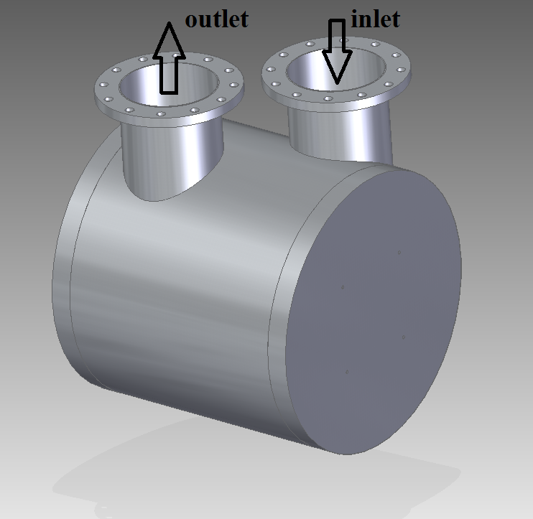
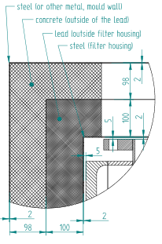
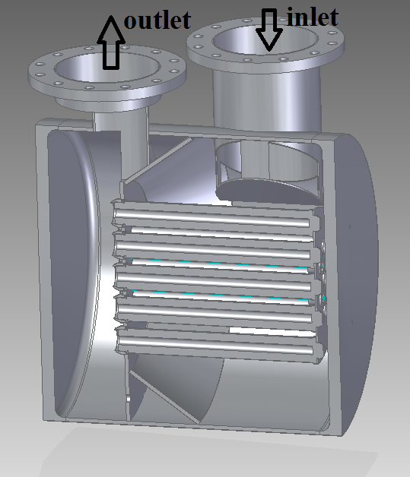
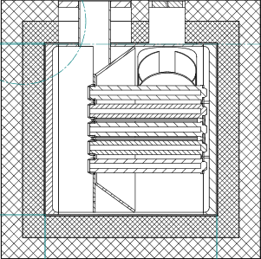
Filter unit
Status:
Pressure drop calculations performed in February with unsatisfactory results → new calculations are ongoing, new results are expected in April.
Meeting with filter inserts supplier
Manufacturing of vessel will take about 1 month

Slide 4
Status of Other components
Valves:
contract signed at 2018,
documentation for approval → 18.03.2019
Gas bottles B-010a – B-010f:
contract signed at March 2019, ongoing
Delivery time → 5 months
Bellows A-001, A-002:
QA documentation approved by ESS
stored in CVR
Instrumentation:
Pressure, temperature → in discussion with potential supplier
Radiation measurement → CVR is waiting for technical details from ESS

Slide 5
Assembly and Installation on site
Task | Duration | Start | End date | Completeness
MS - Installation | 132 dny | 7.1. 20 | 8.7. 20 | 0%
Site preparation | 30 dny | 2.12. 19 | 10.1. 20 | 0%
Component installation | 60 dny | 7.1. 20 | 30.3. 20 | 0%
Heat exchanger installation | 14 dny | 13.1. 20 | 30.1. 20 | 0%
Circulator installation | 14 dny | 20.2. 20 | 10.3. 20 | 0%
Filter installation | 3 dny | 10.3. 20 | 12.3. 20 | 0%
System 1011 installation | 104 dny | 7.1. 20 | 29.5. 20 | 0%
System 1013 installation | 104 dny | 7.1. 20 | 29.5. 20 | 0%
Status:
Technical specification for installation → done
CVR is preparing installation on site from January 2020
Plan:
Transport of all components to Lund → December 2019
CVR Installation works start → January 2020
Handover → July 2020

Slide 6
He cooling loop – time span
2018
design
2019
End of manufacturing
2020
Site installation
2022
ESS -Operation

Slide 7
Thank you for your attention!

