Slide 1
TIK 5.1 Primary water cooling systems
TIK 5.2 Intermediate water cooling systems
TIK 5.3 Target station HVAC
Jan Černý
TTB meeting, Lund 14 March, 2019

Slide 2
Project Schedule
TIK 5.1 Primary Water Cooling System
  Milestone 1 – CDR completed - DONE 31.08.2017

Slide 3
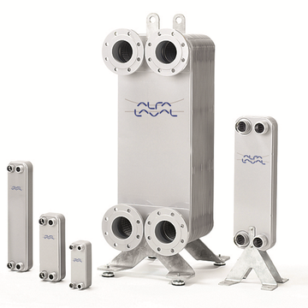
Current status
Welded heat exchangers intended to use were removed from Alfa Laval‘s catalogue.
During last 6 months no alternative supplier was found (no experience with radioactive environment or inability to meet requirements).
After discussion Alfa Laval proposed new solution:
  Alfa Nova
    Fusion-bonded plate heat exchangers
    100% stainless steel

Slide 4
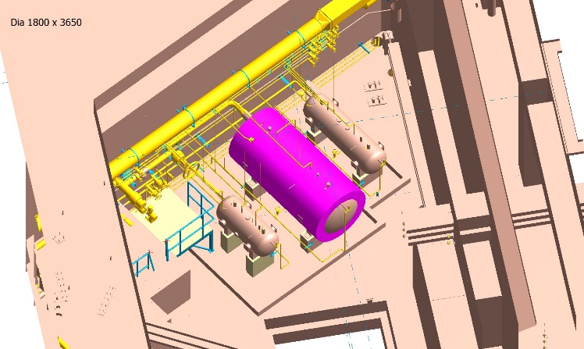
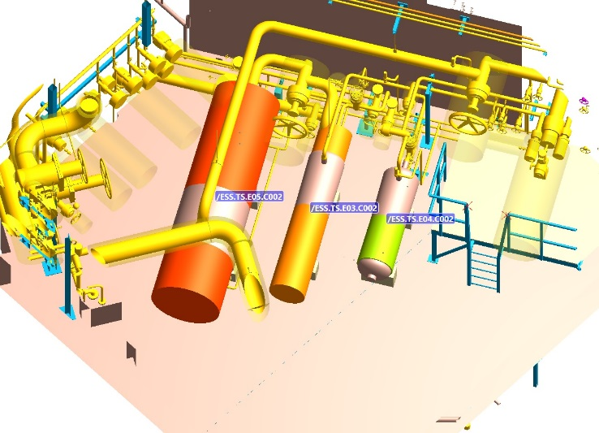
Current status
Discussion about design of tanks is in progress, the volume had to be increased due to increased flow to preserve delay time.

Slide 5
Project Planning
TIK 5.1 Primary Water Cooling System
  Milestone 2 – Manufacturing completed 31.10.2019
  Milestone 3 – Delivery to ESS site completed 31.12.2019
  Milestone 4 – Final report completed 31.01.2020

Slide 6
Project Schedule
TIK 5.2 Intermediate water cooling systems
  Milestone 1 – CDR completed - DONE 30.06.2017 

Slide 7
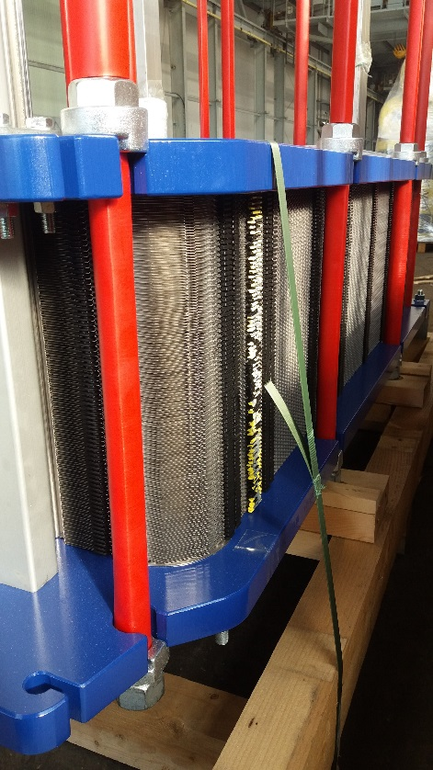
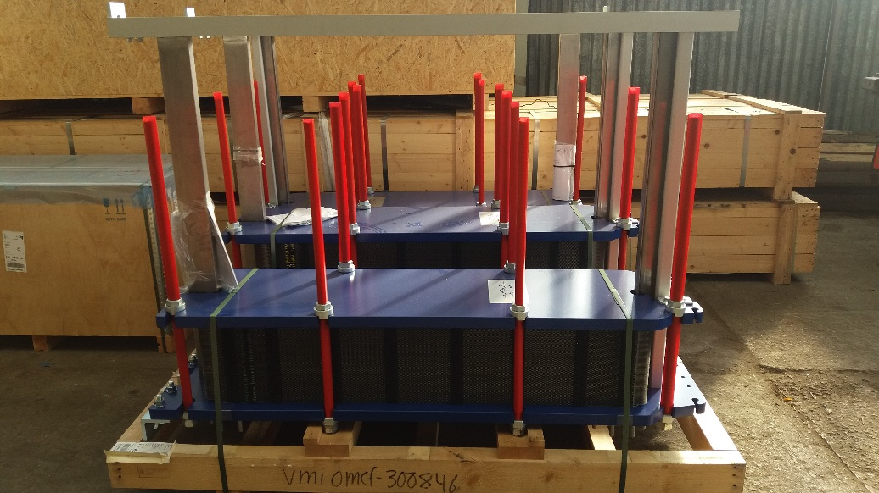
Current status
Heat exchangers
  Ready for transport.

Slide 8
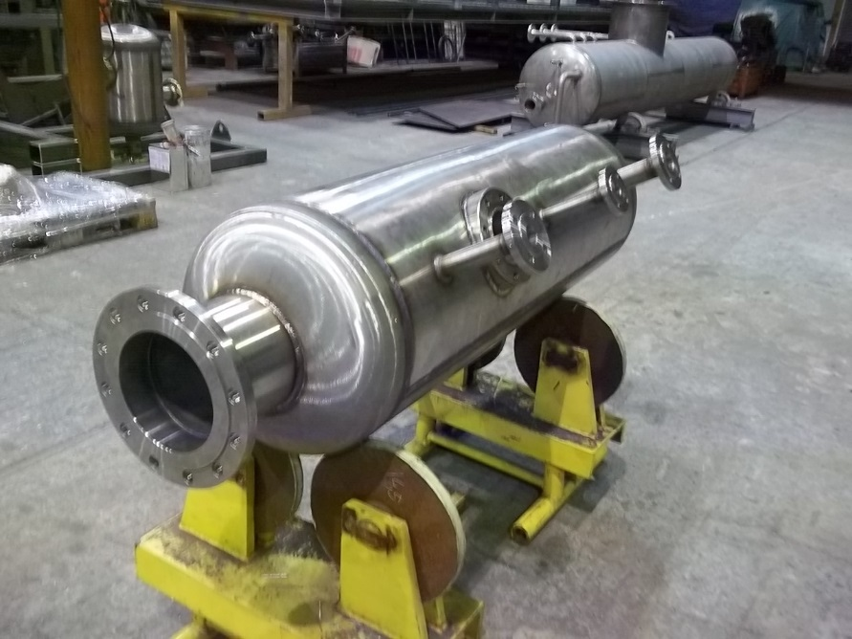
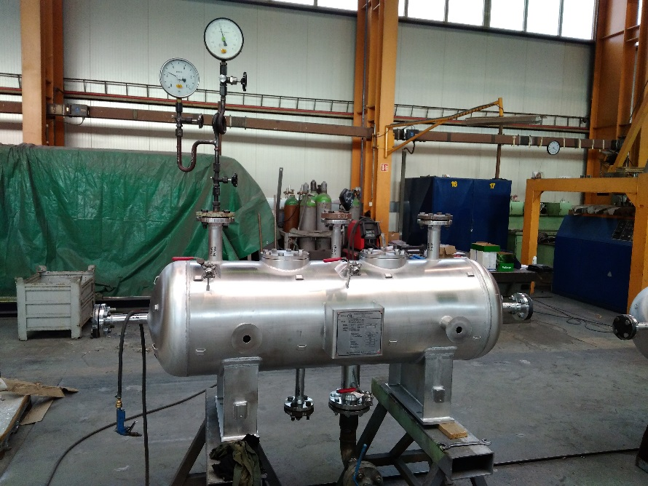
Current status
Tanks
  Pressure tests completed in February, ready for transport.

Slide 9
Current status
Filters
  Manufacturing is in progress, estimated completion in 04/2019.
Piping
  Ready for transport.
Valves
  Ball valves, control valves, check valves, solenoid valves – ready for transport.
  Butterfly valves – approved for order by ESS.
  Safety valves – under discussion with ESS.
Measurement
  Technical specification is under discussion with ESS.

Slide 10
Project Planning
TIK 5.2 Intermediate water cooling systems
  Milestone 2 – Manufacturing completed 30.04.2019
  Milestone 3 – Delivery to ESS site completed 30.09.2019
  Milestone 4 – Installation and commissioning completed 30.06.2020
  Milestone 5 – SAR completed 31.08.2020
  Milestone 6 – Final report completed 30.09.2020

Slide 11
Project Schedule
TIK 5.3 TS HVAC System
  Milestone 1 – CDR completed - DONE 30.08.2017 

Slide 12
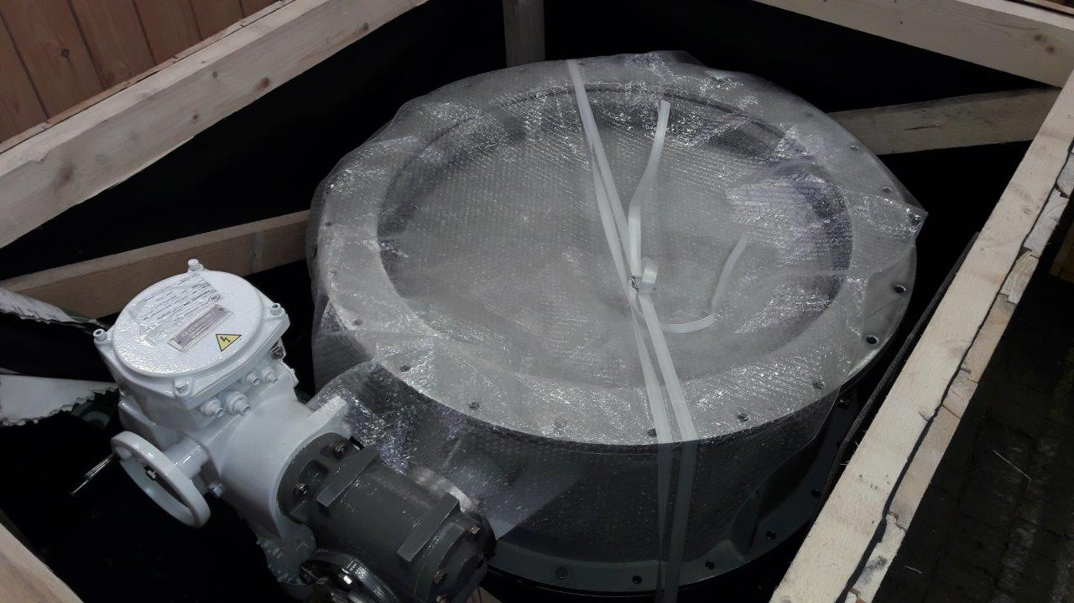
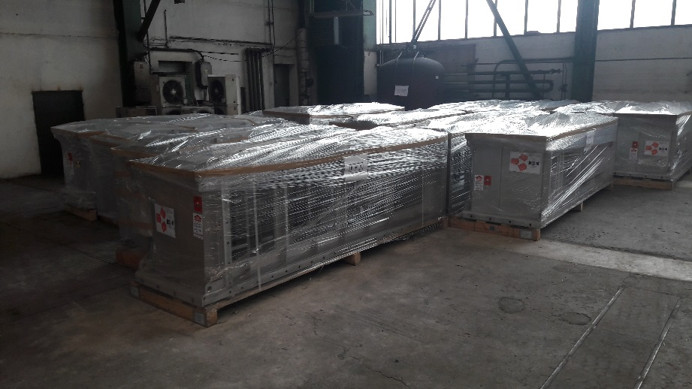
Current status
Equipment delivery to Lund is in progress.
  Delivered equipment – airtight shutters, filter stations, exhaust fans, ducts (part), circular units, constant flow control dampers

Slide 13
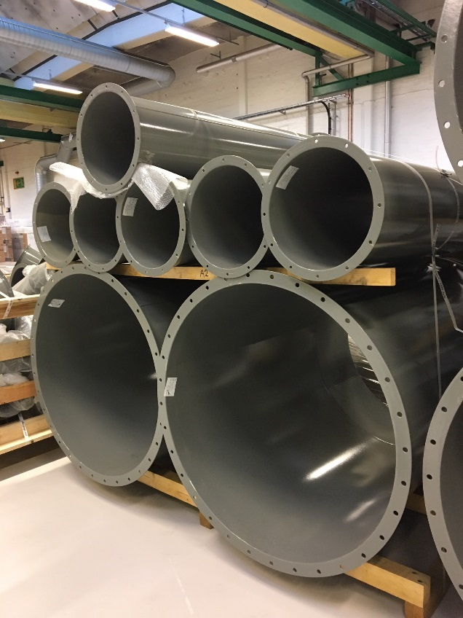
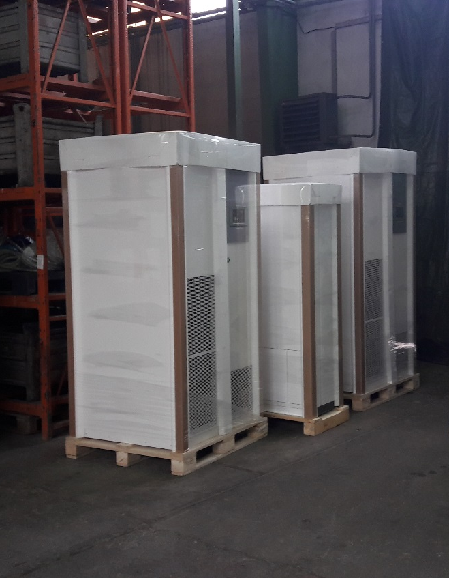
Current status

Slide 14
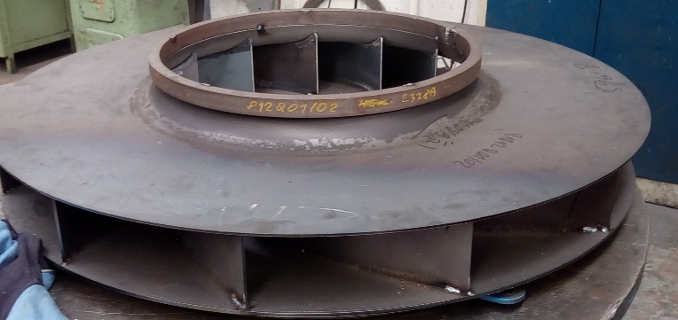
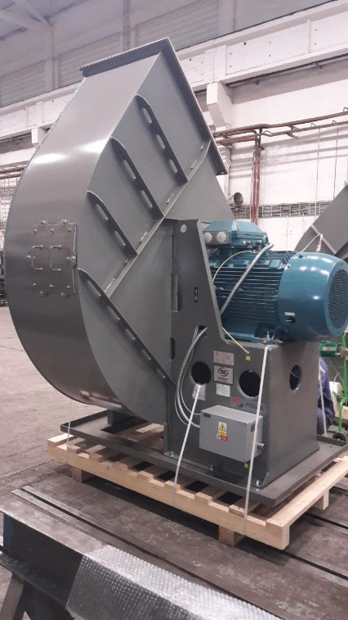
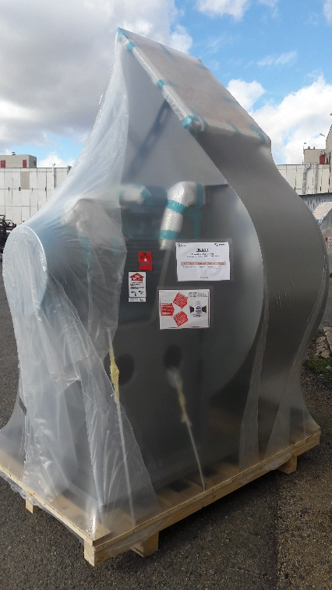
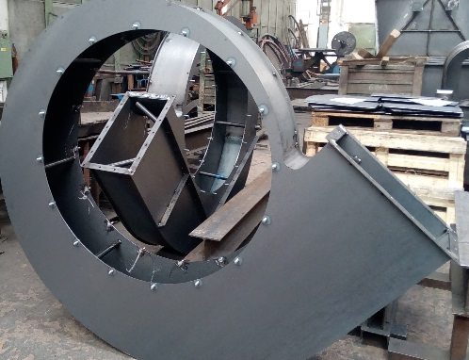
Current status
Exhaust fans

Slide 15
Current status
All other components were approved for procurement or manufacturing.
  Fire dampers, square tight control dampers, air handling units, electric convectors, overpressure flaps
  Most of the equipment will be ready for transport in April 2019.

Slide 16
Project Planning
TIK 5.3 TS HVAC System
  Milestone 2 – Manufacturing completed 31.05.2018
  Milestone 3 – Delivery to ESS site completed 31.07.2018
  Milestone 4 – Final report completed 31.08.2018

Slide 17
Open issues
Electrical and ICS design has no major improvement at the moment, we are waiting for inputs from ESS.
  Inputs shall be available till the end of March.
  Update of the documentation should take 2-3 months.
  Expected finalization of Detail Design documentation – 07/2019.

