Slide 1
Target Station
Test and Commissioning WoW
www.europeanspallationsource.se
14 March, 2019

Slide 2
The Test and Commissioning phases
Functional test, single objects, Cold PLC / MCR Readings, larms, controllers
System test, Cold PLC / MCR Readings, alarms, controllers, start-stop objects.
Integrated system test, Cold MCR Readings, alarms, controllers- dynamic respons, MPS-test, TSS-test
Integrated system test, Hot

Slide 3
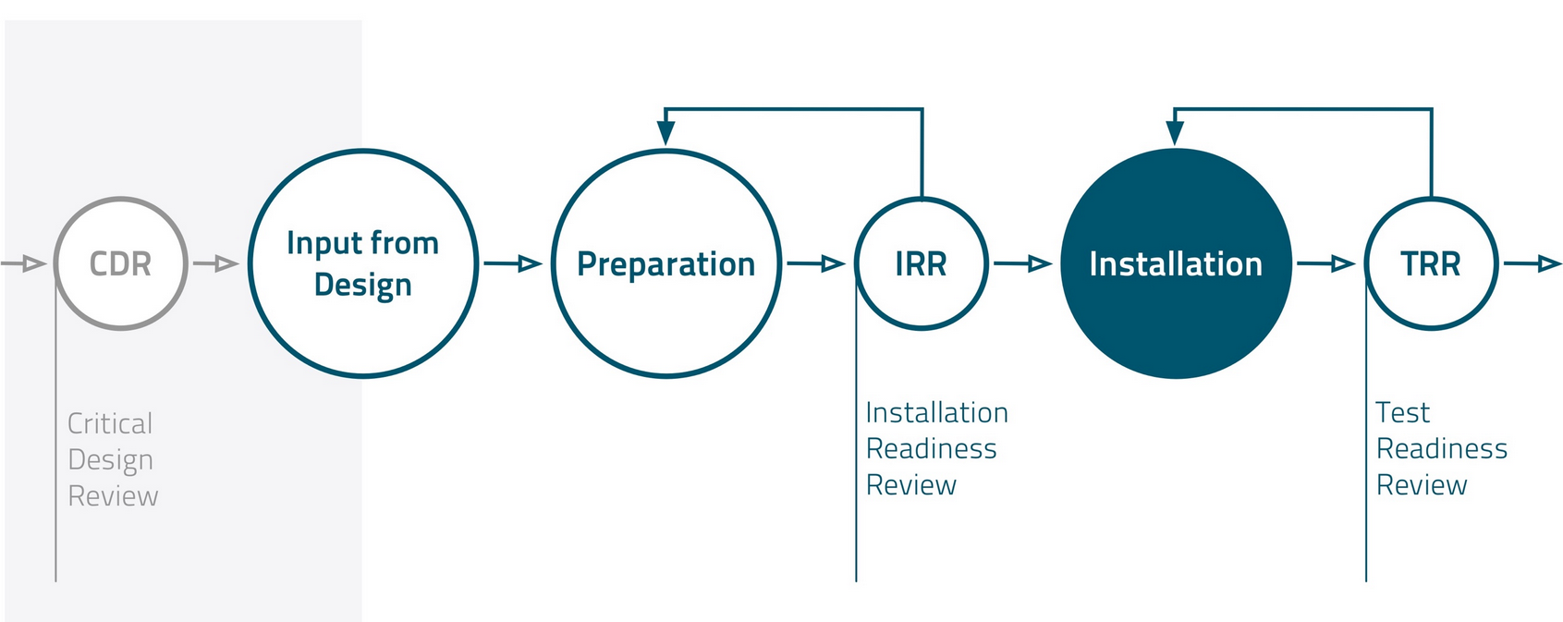
Workflow and milestones Installation

Slide 4
Workflow and Milestones
Installation Phase
Test and Commissioning Phase
Detailed
Design
Input:
Preparing for Test and Commissioning Activities
Perform
Target/ICS
Integrated
Systems Test
Cold
Perform
Target/ICS
Integrated
Systems Test
Hot
ESS Operation
Func.
Spec.
f
Create
Test Doc
Prepare
Perform Target/ICS Single Test
Perform Target/ICS System Test
Test Binders
Gate 1
Gate 2
Hand-over
TOM Template
Finalize Installation
Activities
TRR
SRR
BOT
ORR
SAR
RBOT
Test Readiness Review
System Acceptance Review
Operational
Readiness Review
Safety Readiness Review

Slide 5
Preparation
Division of responsibilities
Time planning:
TOM (with input from WP)=> Installation organization
Info and documentation from In-kind: WP
Templates for Test procedures/checklists : TOM
Definition of tests: WP
Templates for O&M manuals: TOM
Test resources:
Common manpower TOM; specialists WP
Work orders: Test Package Leader, TPL
Test binder: TPL

Slide 6
Test and Commissioning - DOR
TRR: TPL
Single test: TPL
Gate 1. System ready for test: TPL
System test: TPL
Gate 2. Systems ready for integrated test: TPL & TOM
Integrated systems test: TOM
etc

Slide 7
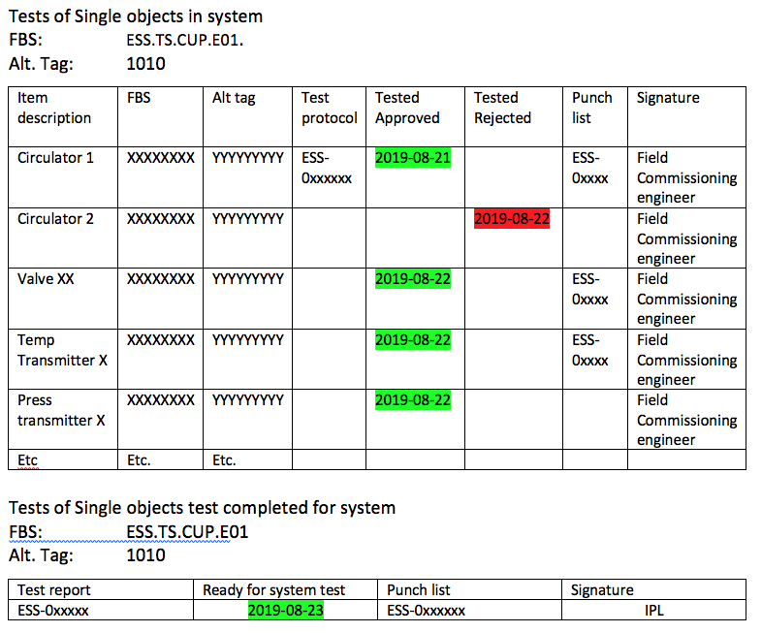
Gate 1. System ready for test
Field engineer signs
single object test
TPL signs the whole
package for the
whole system
WP home office function

Slide 8
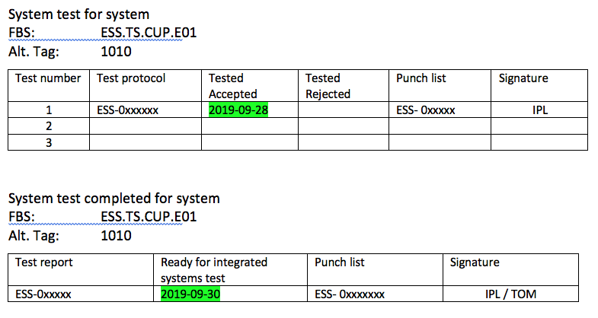
Gate 2. Systems ready for integration test
TPL signs every
system test
TPL & TOM signs the
system acceptance
WP home office function

Slide 9
Test binder (draft contents)
Test binder for system X
  Input from design:
    P&ID
    FS for the actual system
    Data sheets, etc.
  Test, Commissioning & Operation documentation:
    RAMS/ Risk Assessment
    Test protokoll for each single objects
      Transmitters and switches: Pressure/dp, Flow, Level, Temp, position, etc (TOM template/check list)
      Pumps, Motors, Circulators, special valves, Controllers, etc (Templates/check lists to be provided by supplier / WP)
    Test protocol for System test (TOM template)
    Operation manuals incl baseline (initial version, TOM Template)
  Test and Commissioning binder for ”integrated systems tests”
  Integrated systems test # 1
  Integrated systems test # 2, etc
  (document issued by TOM and reviewed by involved system owners)

Slide 10
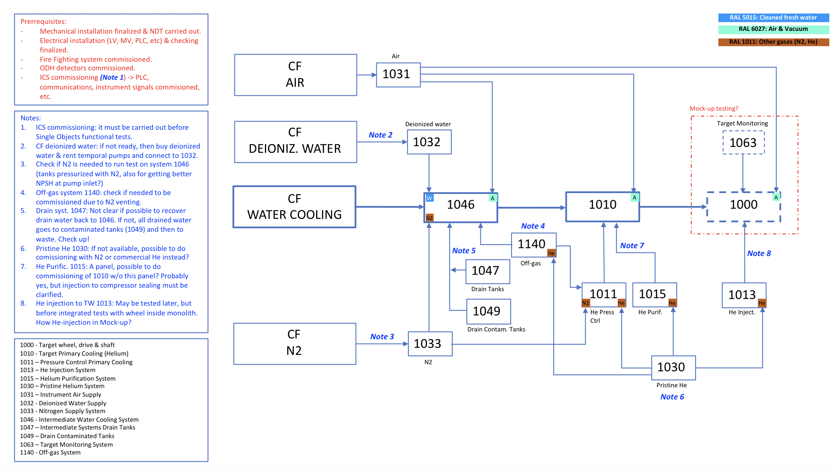
Integrated Systems test (exempel)

Slide 11
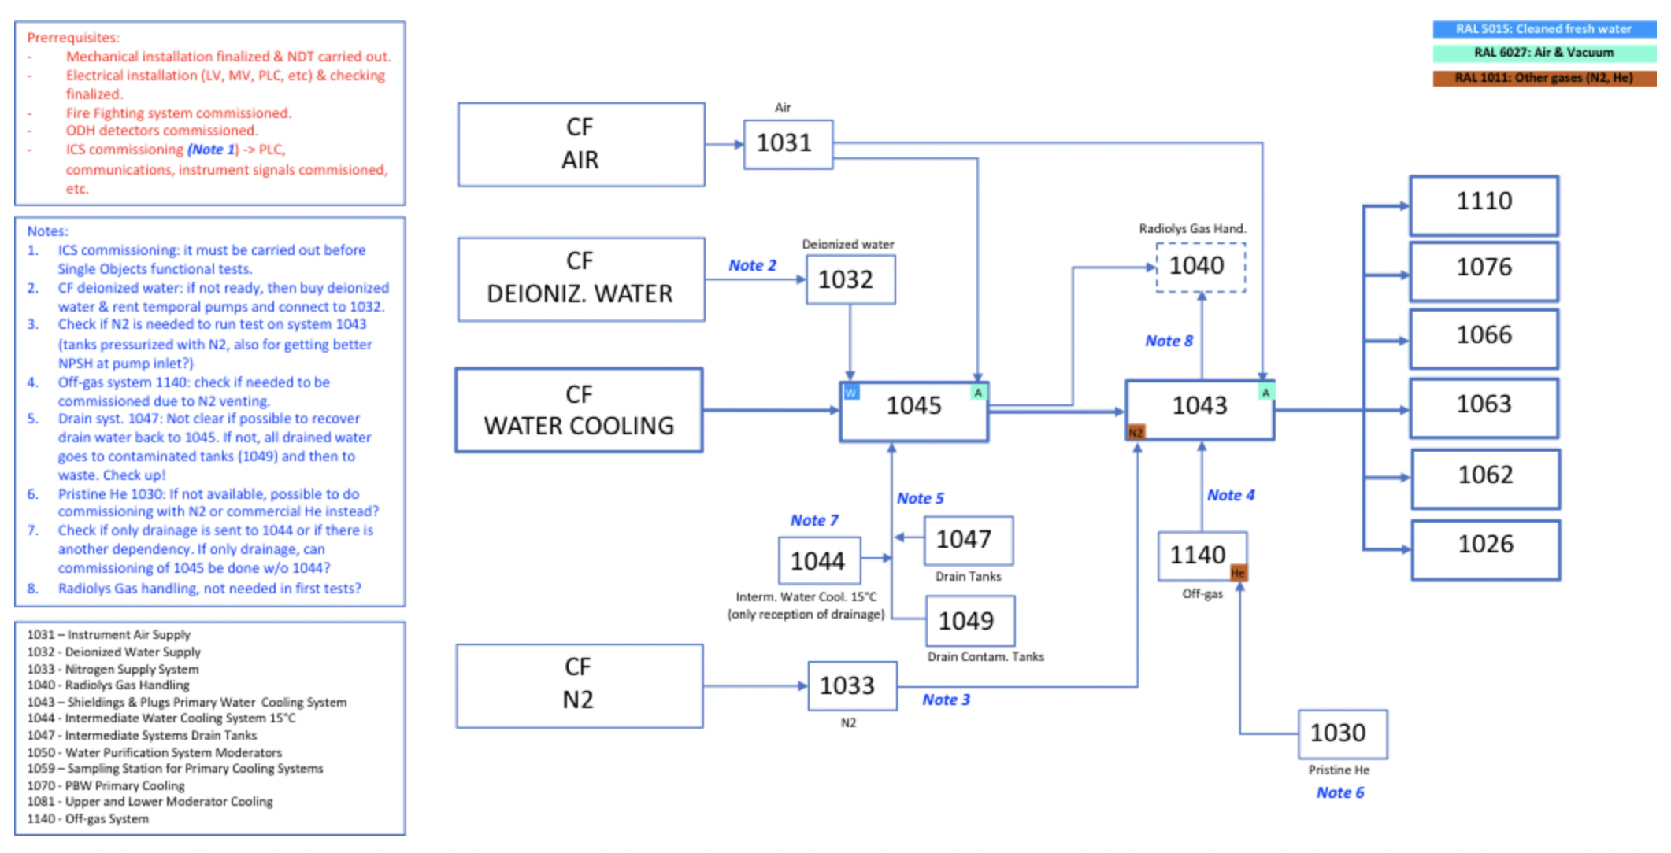
Integrated Systems test (exempel)

Slide 12
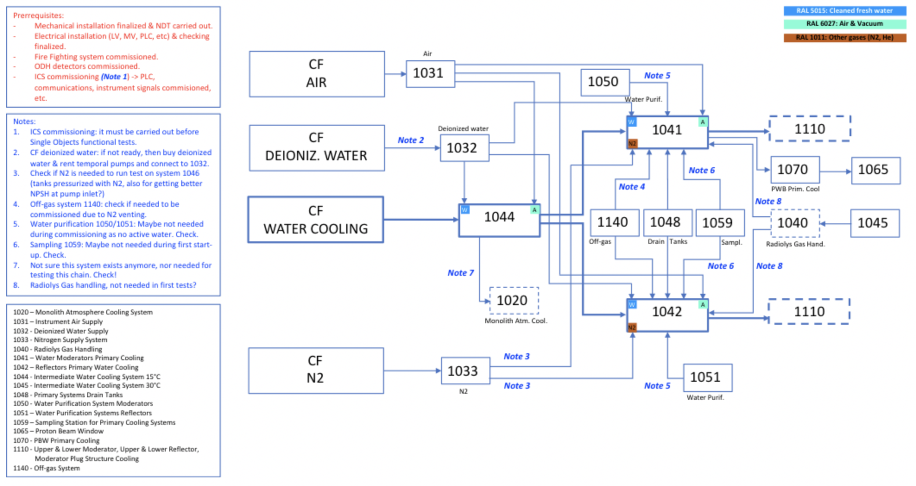
Integrated Systems test (exempel)

