Slide 1


Instrument Projects
Rob Connatser

Slide 2
Instrument Projects
Experiment Halls
Planning Status
Harmonization of Terminology
Realistic Schedule
Resource planning
Ideas for Partner Involvement
Risks

Slide 3
Gather Requirements
Initial gathering of requirements was performed in a haphazard method.
As the Chief Instrument Project Engineer, I took on the responsibility to be the focus point for relaying requirements to CF.
The reverse became true as well, that CF brought questions to me.

Slide 4
Experiment Halls
To organize this process, we started a dialogue via a CF-NSS Cross Functional Working Group.
R. Connatser (co-chair) | Instrument Construction
J. Lundgren (co-chair) | CF Experiment Hall Coordinator
K. Andersen | Neutron Instruments
Hiess | Science Support
F. Bergstedt | CF Target Building Coordinator
P. Bentley | Neutron optics and shielding
M. Jakobsson | Target Systems
I. Sutton | Instrument Operations
E.Segerstedt | CF Technical Buildings Coordinator
M. Strobl | Instrument Scientist
P. Deen | Instrument Scientist
E. Nilsson | Instrument Engineering Support
B. Kildetoft | CF Architect
M. Everett | Science Lab Coordinator

Slide 5
Expanded Focus
Experiment Halls
Technical Spaces
Labs
Offices
Access
Logistics

Slide 6
Experiment Halls
Temperature Stability
Floor Capacity
Floor stability
Future Discussions
  Limiting EM interference
  Grounding/Earthing
  Access

Slide 7
Planning Status
Work to develop processes and methods is ongoing
  Process for Instrument Design and Construction
  CIPE office Project Management Requirements
  Instrument Construction Tollgate 2 Review
  Roles within Instrument Construction
  Instrument Work Package Resources
  PBS, WBS
Continuing development of internal relationships and responsibilities
  Service Level Agreement for clarifying support from the Design Office
Continuing recruitment efforts for instrument engineers
Planning for instrument projects

Slide 8
STC
Approval
Phase 1 – Preliminary Engineering
Design and Baseline
Decision
to move forward
Approved
Baseline
Design,
Cost
and Schedule
Phase 2 – Final Engineering
Design and Installation Plan
Engineering
Review
Phase 3 – Construction
and Installation
Safety Systems
Review
Readiness for
“Hot”
Commissioning
“Hot”
Commissioning
and Operations
Phase 4 – Beam Testing
and cold Commissioning
Notes:
----- Meeting Notes (8/22/13 11:23) -----
stc approval

Slide 9
Definitions
Preliminary Design – adaption of requirements to an initial technical solution.
Final Design – Creation of a model and drawings ready for fabrication of the final technical solution.
Procurement – the formal process for acquiring components, either through purchasing or with agreements with in-kind partners
Fabrication – the process of turning drawings into physical components
Instrument Construction – the building of the physical infrastructure of an instrument, e.g. poured in place concrete, structural elements, piping and electrical power systems, etc. in the experiment hall.
Instrument Installation – placing, aligning and connecting the instrument components in place in or on the physical infrastructure.
Cold Commissioning – testing all the instrument components and infrastructure elements and verifying operational readiness without spallation neutrons.
Hot Commissioning – Using spallation neutrons to verify the instrument and its operational parameters.

Slide 10
Role Definitions
Scientist – Responsible for defining technical requirements of instrument including scientific case. Acts as project manager.
Engineer – MS or BS in an engineering discipline. Does conceptual design work/modeling/FEA/calculations, etc.
Draftsman – responsible for details in models, creates drawings for use in the field and for fabrication.
Technician – has technical schooling, responsible for assembling, building, installing technical components. Very experienced technicians can approach knowledge level of an engineer, but generally approach is from experience “has a feel for how it should work/look”.
Construction Workers– has gone through an apprenticeship, either formal or informal, “works with tools” – carpenter, electrician, iron worker, pipe fitter, crane/forklift operator.
Construction Manager – manages the installation/construction work in the field. Will make integrated (all instruments) and individual instrument construction/installation plans. There will be a team of these people that report to the Chief Engineer’s office.
Notes:
----- Meeting Notes (8/22/13 11:23) -----
add scientist

Slide 11
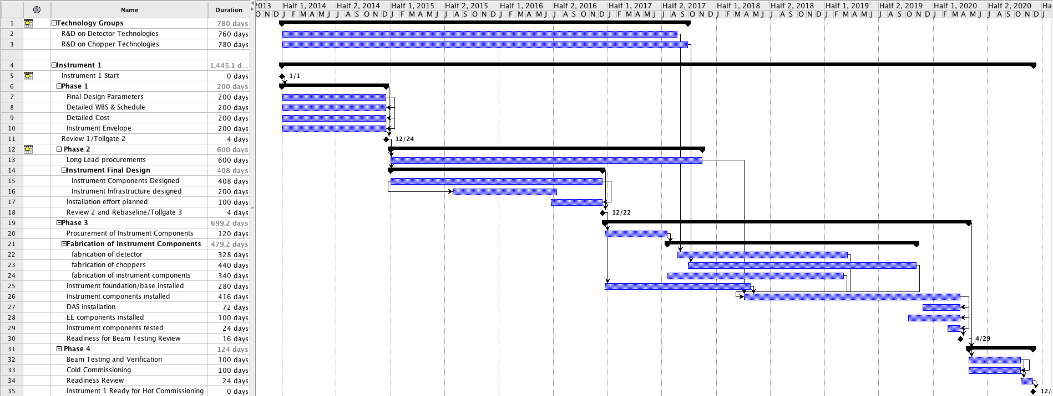
Single Instrument Details
2014 2015 2016 2017 2018 2019 2020
Development Work
Phase 1
Phase 2
Phase 3
Phase 4
Initial Design | Final Design | Procurement & Fabrication | Construction | Installation | Cold Commissioning
Notes:
----- Meeting Notes (8/22/13 11:23) -----
make some milestones of tollgates and make them readable. make some text readable. adjust colors
get rid of detail"
----- Meeting Notes (8/30/13 14:30) -----
benefits of seeing the scientific and technical review.

Slide 12
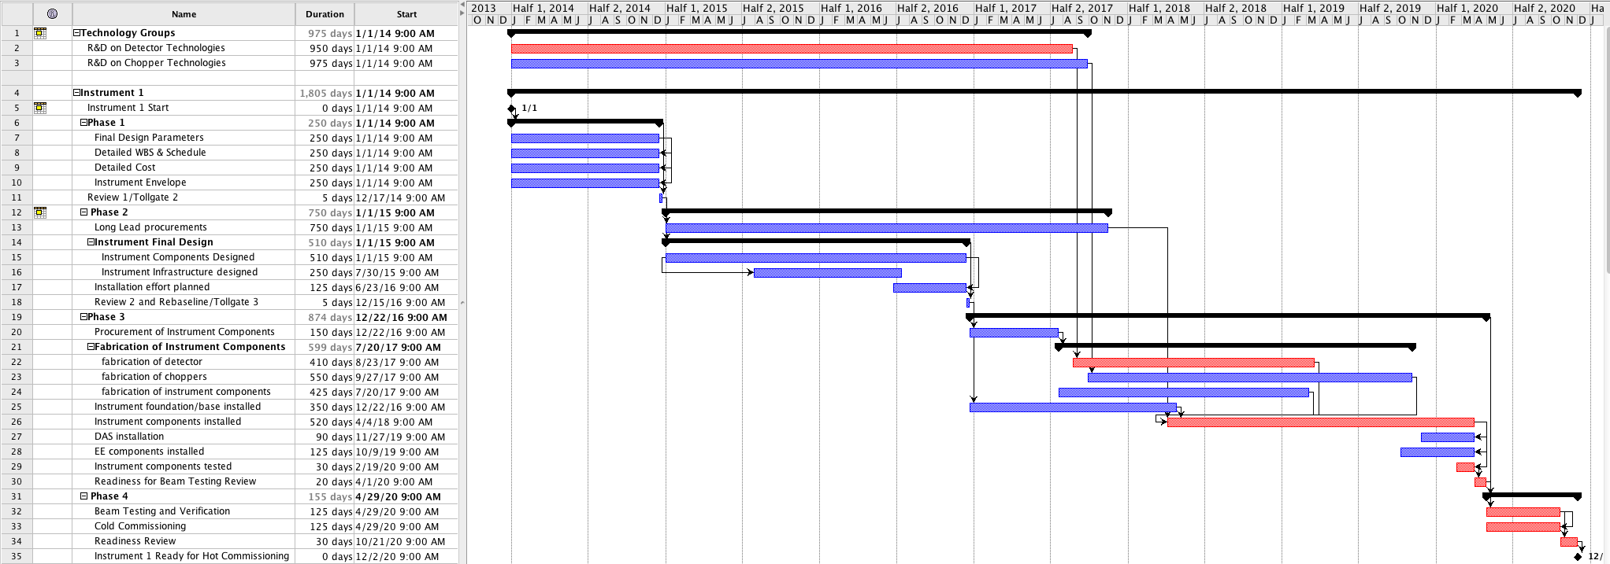
Single Instrument Details
Initial Design | Final Design | Procurement & Fabrication | Construction | Installation | Cold Commissioning
Notes:
----- Meeting Notes (8/22/13 11:23) -----
make some milestones of tollgates and make them readable. make some text readable. adjust colors
get rid of detail"

Slide 13
Instrument Manpower
 | 2014 | 2015 | 2016 | 2017 | 2018 | 2019
LOKI
Lead Scientist | 90% | 90% | 90% | 90% | 90% | 90%
Lead Engineer | 100% | 100% | 100% | 100% | 100% | 100%
Detector Group | 50% | 25% | 25% | 100% | 150% | 150%
Chopper Group | 25% | 25% | 25% | 25% | 75% | 50%
Optics & Shielding | 50% | 50% | 50% | 50% | 50% | 10%
Electrical Eng. | 25% | 25% | 25% | 50% | 100% | 50%
Additional Engineering | 0 | 100% | 250% | 150% | 100% | 50%
General Technicians | 0 | 0 | 0 | 0 | 25% | 100%
Construction Manager | 0 | 0 | 25% | 33% | 33% | 33%
Initial Design | Final Design | Procurement & Fabrication | Construction | Installation | Cold Commissioning
Notes:
----- Meeting Notes (8/22/13 11:23) -----
FTEs

Slide 14
Single Instrument FTEs
 | 2014 | 2015 | 2016 | 2017 | 2018 | 2019
LOKI
Lead Scientist | 0.9 | 0.9 | 0.9 | 0.9 | 0.9 | 0.9
Lead Engineer | 1 | 1 | 1 | 1 | 1 | 1
Detector Group | 0.5 | 0.25 | 0.25 | 1 | 1.5 | 1.5
Chopper Group | 0.25 | 0.25 | 0.25 | 0.25 | 0.75 | 0.5
Optics & Shielding | 0.5 | 0.5 | 0.5 | 0.5 | 0.5 | 0.1
Electrical Eng. | 0.25 | 0.25 | 0.25 | 0.5 | 1 | 0.5
Additional Engineering | 0 | 1 | 2.5 | 1.5 | 1 | 0.5
General Technicians | 0 | 0 | 0 | 0 | 0.25 | 1
Construction Manager | 0 | 0 | 0.25 | 0.33 | 0.33 | 0.33
Initial Design | Final Design | Procurement & Fabrication | Construction | Installation | Cold Commissioning
Notes:
----- Meeting Notes (8/22/13 11:23) -----
FTEs

Slide 15
Instrument Installation
 | 2014 | 2015 | 2016 | 2017 | 2018 | 2019 | 2020 | 2021 | 2022 | 2023 | 2024 | 2025 | 2026 | 2027 | 2028
ODIN
LOKI
NMX
Initial Design | Final Design | Procurement & Fabrication | Construction | Installation | Cold Commissioning

Slide 16
Instrument Installation
 | 2014 | 2015 | 2016 | 2017 | 2018 | 2019 | 2020 | 2021 | 2022 | 2023 | 2024 | 2025 | 2026 | 2027 | 2028
Operations Schedule
ODIN
LOKI
NMX
Initial Design | Final Design | Procurement & Fabrication | Construction | Installation | Cold Commissioning | Hot Commissioning
Notes:
When we take this average and put it on a realistic timescale for the first fourteen instruments, we see that

Slide 17
Instrument Installation
 | 2014 | 2015 | 2016 | 2017 | 2018 | 2019 | 2020 | 2021 | 2022 | 2023 | 2024 | 2025 | 2026 | 2027 | 2028
Operations Schedule
ODIN
LOKI
NMX
#4
#5
#6
#7
#8
#9
#10
#11
#12
#13
#14
Initial Design | Final Design | Procurement & Fabrication | Construction | Installation | Cold Commissioning | Hot Commissioning
Notes:
When we take this average and put it on a realistic timescale for the first fourteen instruments, we see that

Slide 18
Instrument Installation
 | 2014 | 2015 | 2016 | 2017 | 2018 | 2019 | 2020 | 2021 | 2022 | 2023 | 2024 | 2025 | 2026 | 2027 | 2028
Operations Schedule
ODIN
LOKI
NMX
#4
#5
#6
#7
#8
#9
#10
#11
#12
#13
#14
Initial Design | Final Design | Procurement & Fabrication | Construction | Installation | Cold Commissioning | Hot Commissioning
Notes:
When we take this average and put it on a realistic timescale for the first fourteen instruments, we see that

Slide 19
Full Time Equivalents (FTEs)
 | 2014 | 2015 | 2016 | 2017 | 2018 | 2019 | 2020 | 2021 | 2022
Lead Scientist | 2.7 | 5.1 | 7.1 | 8.2 | 7.3 | 8.15 | 6.9 | 4.8 | 2.25
Lead Engineer | 3 | 7 | 11 | 14 | 14 | 14 | 11 | 7 | 3
Detector Group | 1.5 | 2.75 | 3.75 | 6.5 | 10.25 | 15.25 | 15 | 10.5 | 4.5
Chopper Group | 0.75 | 1.75 | 2.75 | 3.5 | 5 | 6.25 | 5.75 | 4.25 | 1.5
Optics & Shielding | 1.5 | 3.5 | 5.5 | 7 | 7 | 5.8 | 3.9 | 1.9 | 0.3
Electrical Eng. | 0.75 | 1.75 | 2.75 | 4.25 | 6.75 | 8.25 | 7.5 | 5 | 1.5
Additional Engineering | 0 | 3 | 11.5 | 18.5 | 22 | 19 | 10.5 | 5 | 1.5
General Technicians | 0 | 0 | 0 | 0 | 0.75 | 4 | 5 | 4.75 | 3
Construction Manager | 0 | 0 | 0.75 | 1.99 | 3.31 | 4.38 | 3.63 | 2.31 | 0.99

Slide 20
Full Time Equivalents (FTEs)
 | 2014 | 2015 | 2016 | 2017 | 2018 | 2019 | 2020 | 2021 | 2022
Lead Scientist | 2.7 | 6.3 | 9.9 | 12.6 | 12.6 | 12.6 | 9.9 | 6.3 | 2.7
Lead Engineer | 3 | 7 | 11 | 14 | 14 | 14 | 11 | 7 | 3
Detector Group | 1.5 | 2.75 | 3.75 | 6.5 | 10.25 | 15.25 | 15 | 10.5 | 4.5
Chopper Group | 0.75 | 1.75 | 2.75 | 3.5 | 5 | 6.25 | 5.75 | 4.25 | 1.5
Optics & Shielding | 1.5 | 3.5 | 5.5 | 7 | 7 | 5.8 | 3.9 | 1.9 | 0.3
Electrical Eng. | 0.75 | 1.75 | 2.75 | 4.25 | 6.75 | 8.25 | 7.5 | 5 | 1.5
Additional Engineering | 0 | 3 | 11.5 | 18.5 | 22 | 19 | 10.5 | 5 | 1.5
General Technicians | 0 | 0 | 0 | 0 | 0.75 | 4 | 5 | 4.75 | 3
Construction Manager | 0 | 0 | 0.75 | 1.99 | 3.31 | 4.38 | 3.63 | 2.31 | 0.99

Slide 21
Full Time Equivalents (FTEs)

Slide 22
Full Time Equivalents (FTEs)

Slide 23
Partner Resources
Manpower – Scientists, Engineers, designers, draftsmen, technicians
Fabrication & Procurement Capability
Testing and Assembly

Slide 24
What do Partners want?
Many want to be more than just a supplier.
Several have the capability to fully design and fabricate one or more instruments.
All want their contribution to the ESS partnership to be meaningful and recognized.

Slide 25
What are some of ESS’s needs?
Phase 1
  Significant fraction of work needs coordination with internal groups, requiring secondment of personnel to Lund.
Phase 2
  Scientist and Engineer need to be co-located.
Phase 3
  Construction effort requires at least 50% presence and 100% communication with lead engineer.
  Installation effort requires 50% presence by scientist, 100% presence by engineer
Phase 4
  Cold commissioning requires 100% presence by scientist and engineer.
Compliance with ESS standards and reporting.
Coordination of instrument spaces with neighborhood.

Slide 26
Partner Manpower Resources
 | 2014 | 2015 | 2016 | 2017 | 2018 | 2019
Partner Instrument
Lead Scientist | 90% | 90% | 90% | 90% | 90% | 90%
Lead Engineer | 100% | 100% | 100% | 100% | 100% | 100%
Detector Group | 50% | 25% | 25% | 100% | 150% | 150%
Chopper Group | 25% | 25% | 25% | 25% | 75% | 50%
Optics & Shielding | 50% | 50% | 50% | 50% | 50% | 10%
Electrical Eng. | 25% | 25% | 25% | 50% | 100% | 50%
Additional Engineering | 0 | 100% | 250% | 150% | 100% | 50%
General Technicians | 0 | 0 | 0 | 0 | 25% | 100%
Construction Manager | 0 | 0 | 25% | 33% | 33% | 33%
Initial Design | Final Design | Procurement & Fabrication | Construction | Installation | Cold Commissioning

Slide 27
Instrument Installation
 | 2014 | 2015 | 2016 | 2017 | 2018 | 2019 | 2020 | 2021 | 2022 | 2023 | 2024 | 2025 | 2026 | 2027 | 2028
Operations Schedule
ODIN
LOKI
NMX
#4
#5
#6
#7
#8
#9
#10
#11
#12
#13
#14
Initial Design | Final Design | Procurement & Fabrication | Construction | Installation | Cold Commissioning | Hot Commissioning

Slide 28
Full Time Equivalents (FTEs)
 | 2014 |  | 2015 |  | 2016 |  | 2017 |  | 2018 |  | 2019 |  | 2020 |  | 2021 |  | 2022
 | ESS | Partners | ESS | Partners | ESS | Partners | ESS | Partners | ESS | Partners | ESS | Partners | ESS | Partners | ESS | Partners | ESS | Partners
Lead Scientist | 2.7 | 0.0 | 3.6 | 2.7 | 4.5 | 5.4 | 6.3 | 6.3 | 6.3 | 6.3 | 6.3 | 6.3 | 3.6 | 6.3 | 2.7 | 3.6 | 1.8 | 0.9
Lead Engineer | 3.0 | 0.0 | 4.0 | 3.0 | 5.0 | 6.0 | 7.0 | 7.0 | 7.0 | 7.0 | 7.0 | 7.0 | 4.0 | 7.0 | 3.0 | 4.0 | 2.0 | 1.0
Detector Group | 1.5 | 0.0 | 2.8 | 0.0 | 3.3 | 0.5 | 5.5 | 1.0 | 7.6 | 2.7 | 10.1 | 5.2 | 8.3 | 6.7 | 6.5 | 4.0 | 3.5 | 1.0
Chopper Group | 0.8 | 0.0 | 1.8 | 0.0 | 2.3 | 0.5 | 2.5 | 1.0 | 3.8 | 1.2 | 4.1 | 2.2 | 3.1 | 2.7 | 2.8 | 1.5 | 1.2 | 0.3
Optics & Shielding | 1.5 | 0.0 | 3.5 | 0.0 | 4.5 | 1.0 | 5.0 | 2.0 | 4.7 | 2.3 | 3.5 | 2.3 | 2.4 | 1.5 | 1.4 | 0.5 | 0.2 | 0.1
Electrical Eng. | 0.8 | 0.0 | 1.8 | 0.0 | 2.3 | 0.5 | 3.3 | 1.0 | 5.1 | 1.7 | 5.1 | 3.2 | 4.2 | 3.3 | 3.3 | 1.7 | 1.2 | 0.3
Additional Engineering | 0.0 | 0.0 | 3.0 | 0.0 | 8.5 | 3.0 | 8.0 | 10.5 | 9.0 | 13.0 | 9.0 | 10.0 | 4.5 | 6.0 | 2.5 | 2.5 | 1.0 | 0.5
General Technicians | 0.0 | 0.0 | 0.0 | 0.0 | 0.0 | 0.0 | 0.0 | 0.0 | 0.8 | 0.0 | 3.5 | 0.5 | 2.5 | 2.5 | 2.6 | 2.2 | 2.3 | 0.7
Construction Manager | 0.0 | 0.0 | 0.0 | 0.0 | 0.8 | 0.0 | 2.0 | 0.0 | 3.3 | 0.0 | 4.4 | 0.0 | 3.6 | 0.0 | 2.3 | 0.0 | 1.0 | 0.0

Slide 29
Full Time Equivalents (FTEs)

Slide 30
Full Time Equivalents (FTEs)

Slide 31
Full Time Equivalents (FTEs)
Programme
Notes:
----- Meeting Notes (8/22/13 11:23) -----
ESS Programme

Slide 32
Full Time Equivalents (FTEs)
Notes:
----- Meeting Notes (8/22/13 11:23) -----
ESS Programme

Slide 33
Full Time Equivalents (FTEs)
Notes:
----- Meeting Notes (8/22/13 11:23) -----
ESS Programme

Slide 34
Exploring How
Work with partner facilities
  Some have the capability for large scale projects.
  Some would be more focused on smaller sections of projects
Find the right interface between what partners can deliver and what ESS needs.
Ensure clarity on responsibilities and authorities in each area.

Slide 35
Exploring How
An example is the ESS Competence Center at FZJ. JCNS and ZEA have expertise and capacity which we need access to and they would like to continue to build instruments.
We will work with other partners to develop this idea and determine if this could be mutually advantageous.
Notes:
----- Meeting Notes (8/22/13 11:29) -----
have a role in developing standards with ESS
make a vision slide of what the competence center encompasses
"tightly integrated"
"as close as possible as being in Lund"
"meet criteria" common tools

Slide 36
Vision for
Competence Centers
A collection point for ESS focused work at the partner facility
  A close connection with partners in Lund
The gateway for accessing these and other resources at the partner facility
Partners in developing the instrument component standards

Slide 37
Vision for
Competence Centers
Required to meet specific criteria
Set up to help reduce the overhead on instrument project work conducted at the partner.
Integrated with the ESS IT technology
Utilize the common planning and engineering tools used by ESS.

Slide 38
Risks
Project
  Manpower
  In-kind contribution approval process
  Internal processes
Operational
  Standardization

