Slide 1
STAP Meeting in April 2019 – Science Support Systems Sample Environment, Scientific Laboratory Services, Scientific Coordination and User Office
Arno Hiess
Head of the Scientific Activities Division
European Spallation Source ERIC
2. April 2019

Slide 2
Meeting of the Scientific and Technical Advisory Panels ‘Sample Environment’ and ‘Samples and Users’
Members STAP ‘Sample Environment’
Elizabeth Blackburn (Chair), Lund University, SE
Andy Church, STFC, UK
Marek Bartkowiak, PSI, CH
Stefan Klotz, Université Paris-Sorbonne CNRS, FR
Andrew Boothroyd, Oxford University, UK
Yamali Hernandez, NIST, US (absent)
Robert Barker, Kent University, UK
Stefan Carlson, MAX IV, SE
Michael Meissner, HZB, DE
Stuart Clark, University Cambridge, UK
Giovanna Fragneto, ILL, FR
Stephen Hall, Lund University, SE
Members STAP ‘Samples and Users
Michelle Everett (Chair), SNS, US
Peter Holden, ANSTO, AU
David Hess, ILL, FR
Kim Lefmann, Copenhagen University, DK
Ron Smith, STFC, UK
Karin Edler, University Bath, UK
Ina Lommatzsch, MLZ, DE
Laura Edwards, SNS, US
Giovanna Cicognani, ILL, FR

Slide 3
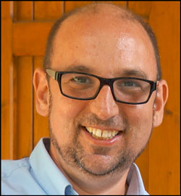
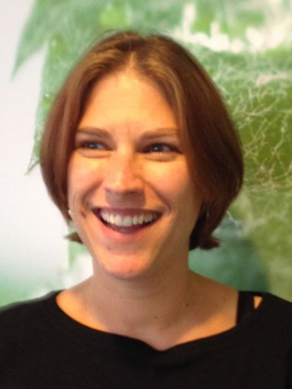
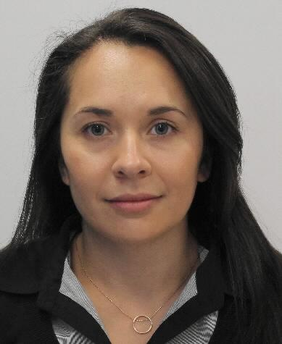
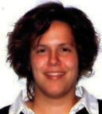
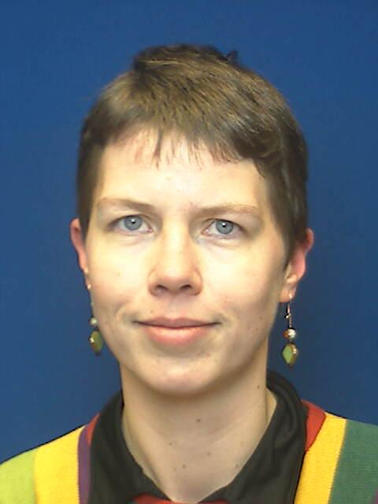
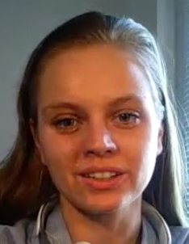
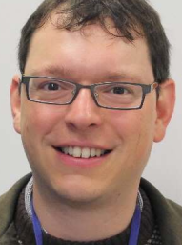
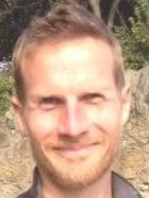
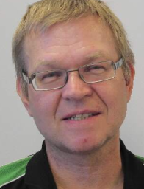
Line Organisation and Project Execution
The Scientific Activities Division delivers Science Support Systems:
Sample Environment, Scientific Laboratory and Sample Services, Scientific Coordination and User Office
for first 8 instruments as part of NSS construction budget
Scientific Activities Division
DEMAX
Deuteration & macromolecular Crystallization Group
(in operation)
SULF
Sample and User Labs Group
(ops in 2020)
SCUO
Scientific Coord. and User Office
(in operation)
SAMPLE ENVIRONMENT GROUP (operation in 2022)
TEFI
Temperatures and Fields
PREMP
High Pressure & Mech. Process.
FLUCO
Fluids incl Gases, Vapor, Compl. Fl.
MESI
Mechatronics & System Integr.

Slide 4
Feedback on STAP report ‘Sample Environment’
Team works increasingly together on projects; always potential for improvement and synergies.
Lack of technicians impacted on PREMP plans; Lauritz started March 1; Recruitment started for FLUCO.
Instrument tollgate reviews increasing,; significant workload; participation in relevant topics only (caves)
Standardisation beneficial for instruments; prototypes for mounts available; testing of scanning set-up.
Safety hazard analysis performed by team itself; consultant to implement framework,
System integration via new beamline control team BCT; ICS resourcing still challenging; several tasks ok.
Mechanical design process in place using in-house resources and sub-contracting successfully.
Line organisation to be implemented for operation; efforts on ‘non-core activities remain significant.
Group leader recruitment by end 2019; integration activities MESI to remain direct report to GL.
SE workshops designed jointly with chem. Labs using partner’s IK supplier incl supplies, electr., networks
Utgård operational but commute to site challenging; hi-p testing facility stalled; network no addressed.
Diffraction magnet design ok but TA pending; spectroscopy magnet not funded; HZB used systems ok.
High pressure systems available, testing pending Utgård facility, collaboration ORNL, U Edinburgh cont.
Low Temperature automation completed; SECoP SINE2020 project concluding & to be implemented.

Slide 5
Feedback on STAP report ‘Samples and Users’
Lab fit-out: plans refined & integration schedule in ESS plans incl. worker cabins; IK & procurement TBD
Chemical safety still challenging requiring work arounds though increased exchange with ESH
Procurement improved with blanket order system and smoother goods pick-up but challenges remain.
SCUO recruitment enabled by Brightness2 and user meeting 2020 planning will start soon.
SULF exchange with instrument teams on labs spaces; part of tollgate review, D04 labs specialised 4 REF.
SULF staff exchange with FLUCO envisaged; inventory system to be implemented
DEMAX well supported by SMT & SAC;
DEMAX call for proposals open using dedicated software; SCUO support pending (access policy)
DEMAX MV secured until 2023; LU agreement to be re-negotiated; sustainability discussed SINE B2 LENS

Slide 6
Charge for the Scientific and Technical Advisory Panels ‘Sample Environment’ and ‘Samples and Users’
Common Topics
enactment on SAD vision / mission considering ESS construction project / start initial ops (first science)
readiness of SAD team to meet challenges of project completion and starting initial operation.
implementation of logistics and procurement support to meet the needs of (initial) operation.
ways-of-working within the ESS safety framework: challenges and solutions for operational safety.
preparation and implementation for on-site installation of laboratories and workshops.
Sample Environment
interactions with instrument team throughout detailed design phase in respect to sample environment operation: sample and sample environment handling, standards and implementation.
progress within each sample environment platform – both in-house achievements as well as in-kind work.
design and installation planning for on-site workshops.
way-of-working with the beam line control team in respect to sample environment integration.
way-of-working with central technical service teams in respect to sample environment design and manufacturing.

Slide 7
Charge for the Scientific and Technical Advisory Panels ‘Sample Environment’ and ‘Samples and Users’
Samples and Users
DEMAX: start initial operation deuteration & crystallisation support service incl. proposal administration & user survey.
DEMAX: closer integration of the three DEMAX support pillars with respect to staffing & projects.
DEMAX: synergies and consolidation of on-site and off-site lab infrastructure; options for future DEMAX location.
DEMAX: scientific collaborations & developmental projects: establish new capability via grants (SINE2020, VR, B^2).
DEMAX: strengthen the DEUNET network as part of LENS initiatives.
DEMAX: own ESS priorities for first science and beyond; 3rd DEMAX chemist position (competence and activities)
DEMAX: commercial collaboration with DEMAX “pay for play” – Should we? How?
SULF: progress of the SULF platform in respect to installation planning and moving to the on-site labs.
SULF: internal projects with accelerator / target; setting-off lab investment by external collaboration.
SULF: way forward with chemical hazard analysis applying and complying with Swedish law for working with chemicals.
SCUO: lessons learned DEMAX; way forward ESS user office software: functionalities, KPIs, DOI, policy implementation
SCUO: next steps towards establishing SCUO; transition functions from DEMAX to SCUO.

