Slide 1
STAP 2019-04-02
Jörgen Larsson
Senior Logistics Officer
www.europeanspallationsource.se

Slide 2
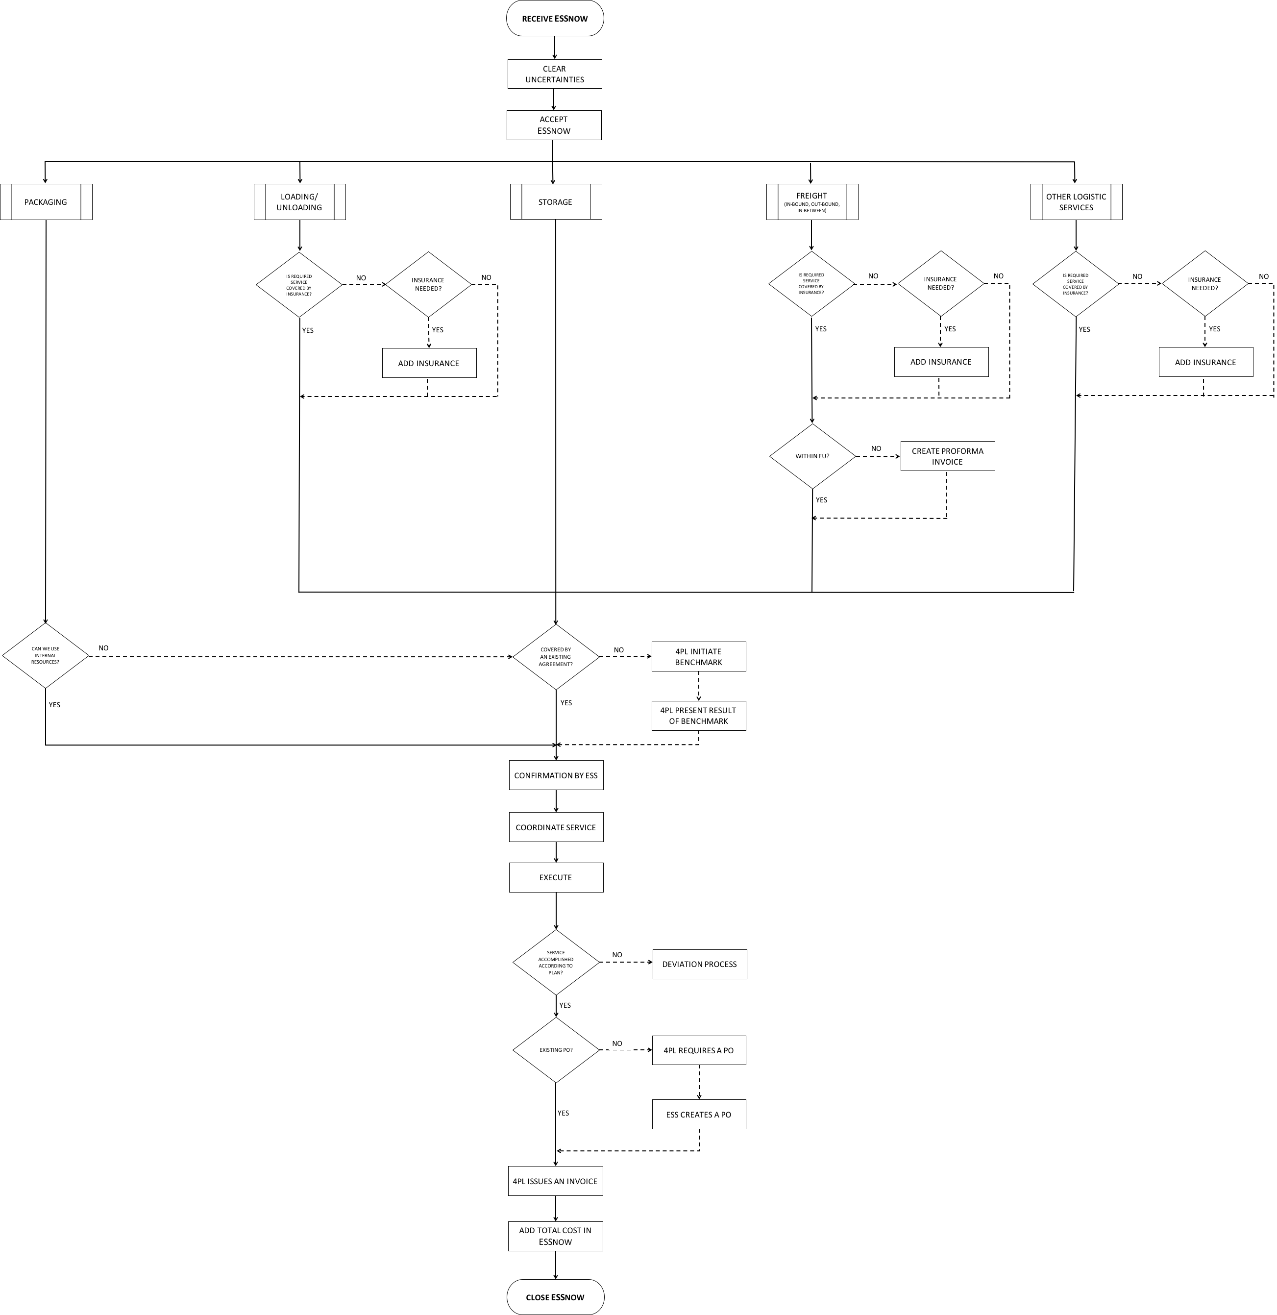
Logistics process–Way of Working (WoW)
SNOW

Slide 3
Logistic services to program clients when utilizing:
DAP, Incoterm 2010 – ESS absorbing the risk/cost
According to stipulated WoW through a SNOW task – benchmark of transportation cost
FCA, Incoterm 2010 – clients absorbing risk/cost utilizing their shipping account
ESS makes the sample ready for shipping – packaging and documentation
  No task in SNOW

Slide 4
Logistics services – ”to be” and initiated WoW:
Zoë Fisher wishes to take training arranged through Lund University by DGM to pack parcels with small amount of hazardous goods, incl. dry ice (UN 1845). Offered every few years (!)
For perishables a ticket in SNOW before 10am will render in pick up before 4pm same day – shipping Monday-Wednesday to secure sample
ESS Logistics sets up a framework agreement with FedEx who accepts the dry ice packaging certificate (future).
Possibility for ESS Logistics service provider (4PLC) to absorb shipping cost and then forward invoice to clients (bypass ESS for invoicing users for S&H). This is for clients that do not have accounts set up with Fedex/DHL etc.

Slide 5
DGR transport
Planned and immediate actions by Logistics
Physical to do;
  Lorry completed with safety equipment - done
  Benchmark with STFC setup - planned
Mental to do
Administrative staff to attend:
  DGR online education DGR 1.3
Drivers to attend:
  ADR förarutbildning, Styckegods – Grundutbildning
  ADR förarutbildning, Klass 1 –Explosiva ämnen och föremål
  ADR förarutbildning, Klass 7 – Radioaktiva ämnen

Slide 6
Questions & Feed back

