Slide 1
PREMP update
Malcolm Guthrie
www.europeanspallationsource.se
1 April, 2019

Slide 2
Overview
Alignment with instruments and refining day 1 priorities (“bubble” meeting summary).
Latest long-term schedule
Recent activities
Future plans

Slide 3
Conclusions: bubble meetings
Discussed with instruments in three meetings:
LSS (Nov 2018 @ ISIS)
IMG and ENG (Dec 2018 @ ESS)
DIFF and SPEC (Jan 2019 @ ESS)
Main conclusions:
High pressure
HP not considered urgent by any instrument teams, most prefer to wait until at least 1 MW before pursuing pressure (Q4 2024)
Only explicit stated need in “Early science” (Q1 2023) is from BIFROST (1.5 GPa clamp cell)
Coupling pressure with low T and High B should be prioritised.
Standard sample sizes should be on smaller side (also to facilitate low T)
SANS not really interested in HP, but this might not represent user community (O. Kirichek mentioned HP SANS studies of skyrmions are very popular)
Notes:
Comments:
Bifrost clamp is off-the-shelf
Above doesn’t not necessarily reflect interest of user community (e.g. no interest amongst SANS instrument scientists, but Oleg Kirichek mentioned massive interest at ISIS

Slide 4
Conclusions: bubble meetings
Discussed with instruments in three meetings:
LSS (Nov 2018 @ ISIS)
IMG and ENG (Dec 2018 @ ESS)
DIFF and SPEC (Jan 2019 @ ESS)
Main conclusions:
Mechanical processing
Stress rig is most urgent, needed end of BEER cold commissioning (22Q4)
decided on basic spec (100kN, vert orientation, fatigue testing,…
will facilitate imaging on ODIN (360° rotation).
Basic EPICS integration already via sine2020
Dilatometer needed mid hot commissioning also involves(23Q1)
Also vertical orientation
Suitable for SANS
Plan commercial solution
Preliminary integration in Munich (NICOS)
Interest in portable stress rig for BEER and SANS
Notes:
Comments:
Bifrost clamp is off-the-shelf
Above doesn’t not necessarily reflect interest of user community (e.g. no interest amongst SANS instrument scientists, but Oleg Kirichek mentioned massive interest at ISIS

Slide 5
Effect of “rebaselining” + bubbles
Change in required “delivery” dates
SYSTEM | Original READY BY | New READY BY | Postponement years | Years to go
stress/strain rig (generic) | 23/Q1 | 23/Q1 | none | 4
stress strain rig | 21/Q1 | 22/Q4 | 1.75 | 3.5
dilatometer | 22/Q1 | 23/Q1 | 1 | 4
Diamond Anvil Cell | 21/Q1 | 24/Q1 | 3 | 5
PE Cell | 21/Q1 | 24/Q1 | 3 | 5
Clamp < 1.5 GPa | 21/Q2 | 22/Q4 | 1.5 | 3.5
Gas < 0.7 GPa | 21/Q2 | 24/Q1 | 2.75 | 5
Most urgent deliverables:
BEER stress-strain rig and
BIFROST clamp cell (spec is “off the shelf”)
Notes:
Raman 41.6k (could de-scope to ruby only) ~ 15k (saving 26k)
Portable laser 100k (could swap for MP SEE).
Corrosive gas already removed. 15k

Slide 6
Revising PREMP schedule
Some experience
SE Mounting project (Phase 2)
Design work: 12 month
Manufacturing: 3 months
Assembly – commissioning: 3 months (and counting)
Alignment cameras
Software integration: 9 months
PE cell
mechanical integration (full project): 11 months
Notes:
Raman 41.6k (could de-scope to ruby only) ~ 15k (saving 26k)
Portable laser 100k (could swap for MP SEE).
Corrosive gas already removed. 15k

Slide 7
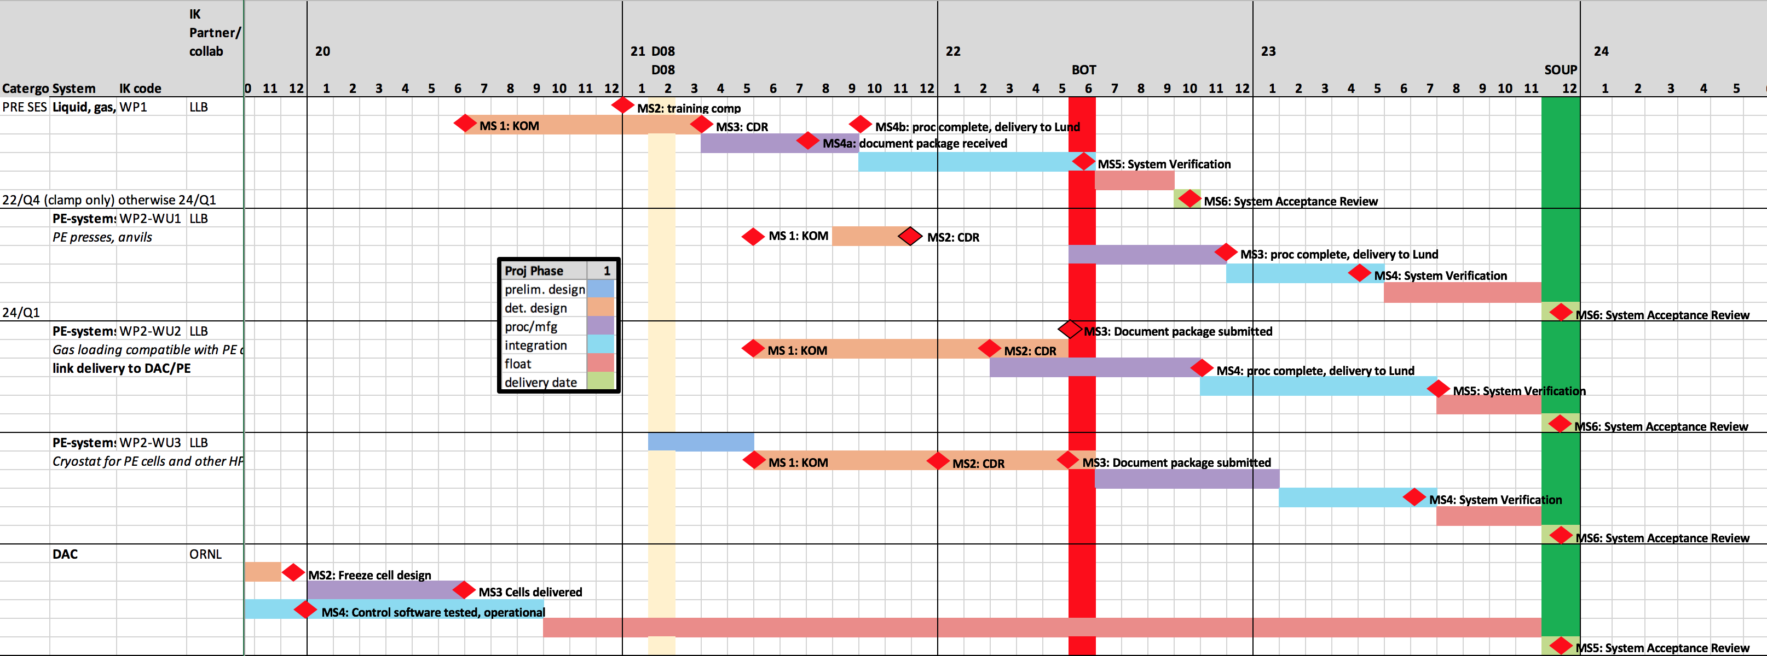
Pressure equipment schedule
Deadline for starting work on clamp cell is mid 2020
Most other projects start in mid 2021
Notes:
Raman 41.6k (could de-scope to ruby only) ~ 15k (saving 26k)
Portable laser 100k (could swap for MP SEE).
Corrosive gas already removed. 15k

Slide 8
MP equipment schedule
Deadline for starting stress-rig project is Dec 2019
Preliminary design is already complete

Slide 9
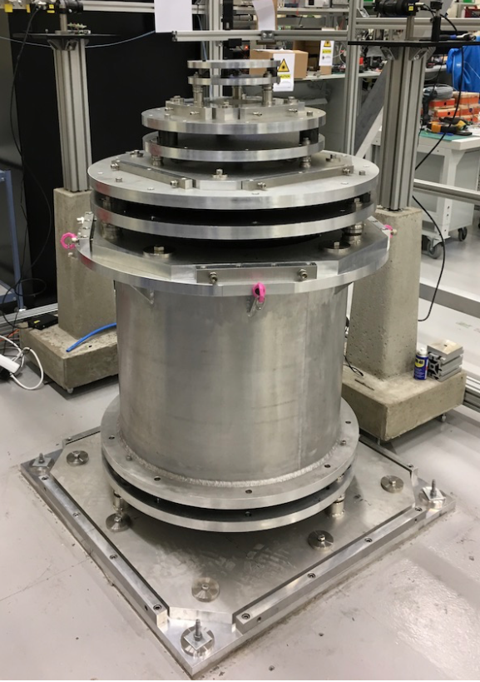
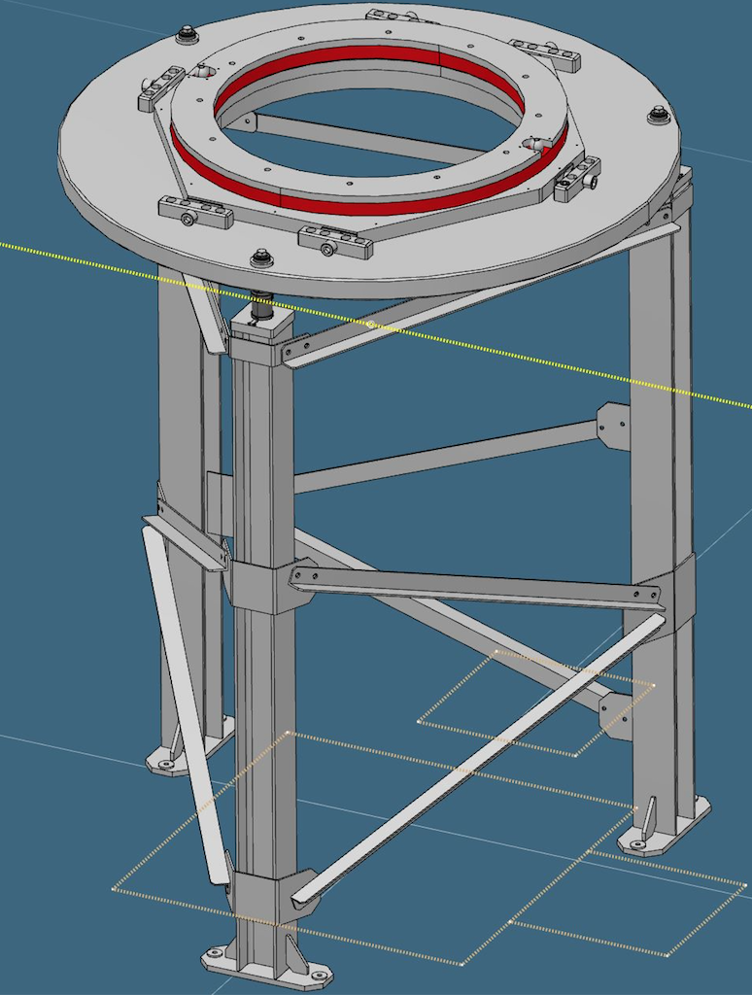
Recent Activities: Mounting
Notes:
V20 scan works as a generic “motion” test bed, also useful for instruments

Slide 10
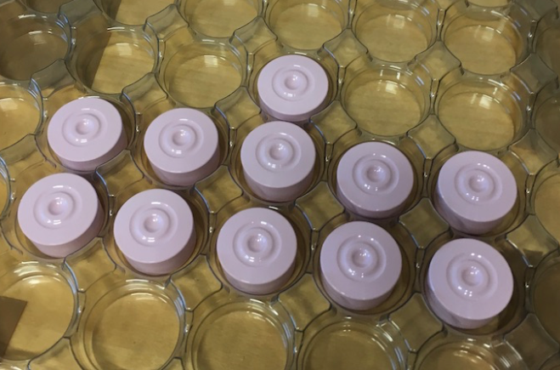
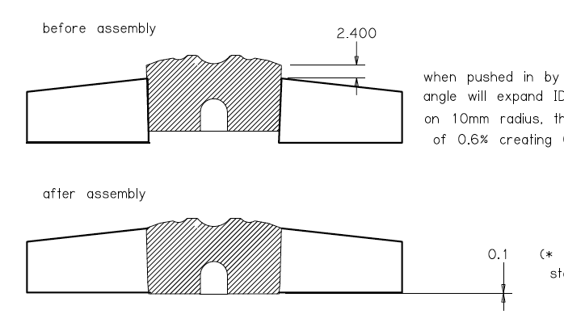
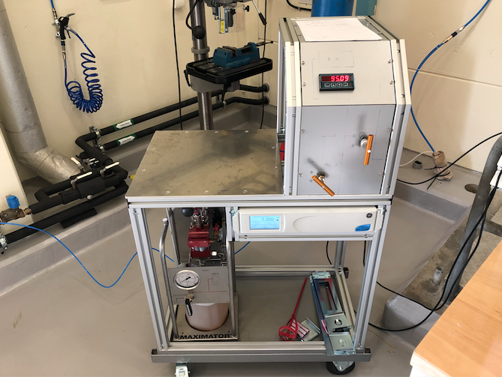
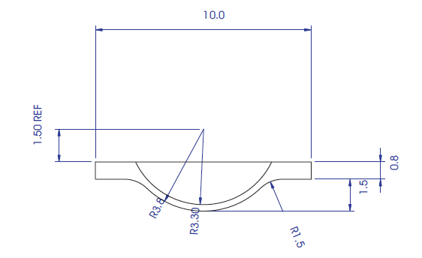
Recent Activities: Pressure
Focus on integrating and operating PE cells
Notes:
V20 scan works as a generic “motion” test bed, also useful for instruments

Slide 11
Recent Activities: Pressure
Through Zvonko, contracted Kinetic to do concept, detailed design and final manufacture
Design ~ €14k manufacture €8k
Initial concept
Detailed design

Slide 12
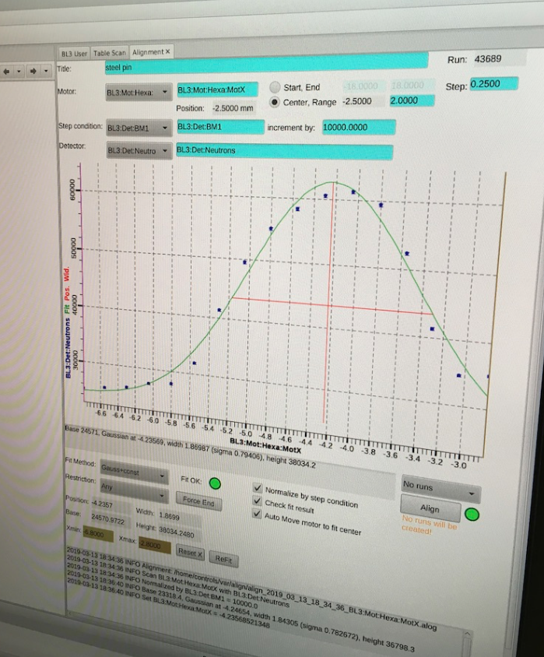
Recent Activities: V20 scanning
Setup:
z-axis
Beam
Detector
x-axis
Notes:
V20 scan works as a generic “motion” test bed, also useful for instruments

Slide 13
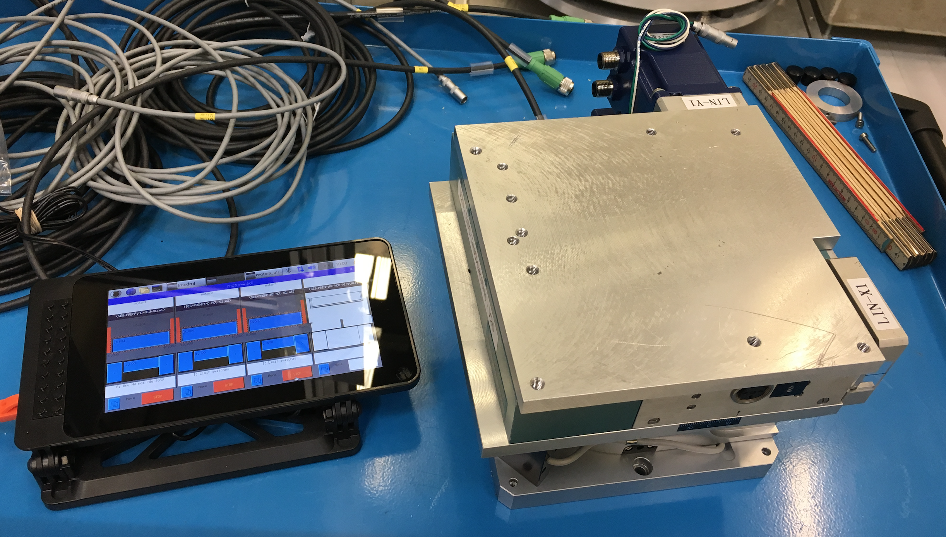
Recent Activities: V20 scanning
Major project!
Choppers
Motion control
Detectors
DMSC
ICS
Nicos
EPICS
Notes:
V20 scan works as a generic “motion” test bed, also useful for instruments

Slide 14
Next 6 months
V20 scanning (test April 8-11)
Finish kinematic mount project and flanges (remainder 2019)
Safety for high pressure (remainder 2019)
Quality
Pressure test facility
Integration of safety into software control systems
Notes:
V20 scan works as a generic “motion” test bed, also useful for instruments

