Slide 1
Temperature and Fields (TEFI)
Alex Holmes
European Spallation Source ERIC
2 April 2019

Slide 2
Outline
Helium recovery
Magnets, suite etc.
In-kind
Highlights
Next steps

Slide 3
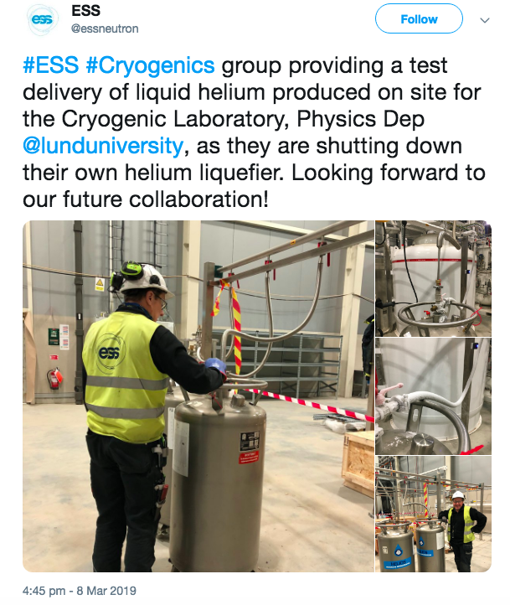
He recovery
Liquiefier Installed and working! First lHe supplied to Lund University!
Responsibilities:
Place requirements: NSS/SAD
Piping requirement: Cryogenics
Design & Implementation: EIS/CF
Budget: Main pipe – ACC
Final hook-ups – Instr./SAD
Plan to use HZB Helium management system
Target date for main pipework end 2020
He dewar boil-off stations

Slide 4
Magnets
System | Instruments OPTIMISED, Suitable, Possible | Cost (€) | Status | Next steps | Available by
8 T diffraction cryomagnet | MAGiC, DREAM, HEIMDAL, BIFROST, CSPEC, TREX | 1M | Draft TA. Waiting for IKA | Finalise TA. Call for tender | Q1/22
15 T HZB | BIFROST, DREAM, MAGiC, HEIMDAL | 1M 200k | Informal agreement from HZB | Consider integration at V20 | Q4/21
2.5 T Warm bore #1 | ESTIA, LOKI, MAGiC, BIFROST, SKADI, HEIMDAL, DREAM | 335k | Planned FR IK. Specs from TOFTOF OK | Confirm mounting interface with ESTIA | Q4/21
14 T Spectroscopy cryomagnet | CSPEC, TREX, MAGiC, DREAM, HEIMDAL, BIFROST | 800k | Specs collected from CSPEC, TREX | Decide on IK scenario, | Q1/22

Slide 5
Magnets contd. & ULT etc.
System | Instruments | Cost | Status
5T warm bore | TBD | 400k | To be defined
2.5T warm bore #2 | Top loading? | 280k | To be defined
11T horizontal | SKADI, ESTIA | 500k | Out of construction scope
System | Instruments | Cost | Status | Next steps | Available by
Dilution #1,2 | Most instruments (requires wet outer/cryomag) | 250k each | Draft TA. Part of FR IK | Conclude TA | Q4/22
He3 Sorption | Pool + CSPEC specific | 150 | Pool part of FR in-kind | Conclude TA | Q1/22
Cryofurnace, wet/dry cryo etc. requirements to be defined in detail later this year
Suite aligned with instrument timelines – see onedrive for details: https://1drv.ms/x/s!AuCQb_HPf3b9g8g2HHqvybpQKix-Lg
Notes:
Bubble meeting outcome:
Not a huge urgency for furnaces – standard cryofurnaces are good to start with.
Spectroscopy magnet big gap – could be filled to start with by lower field 2nd hand.

Slide 6
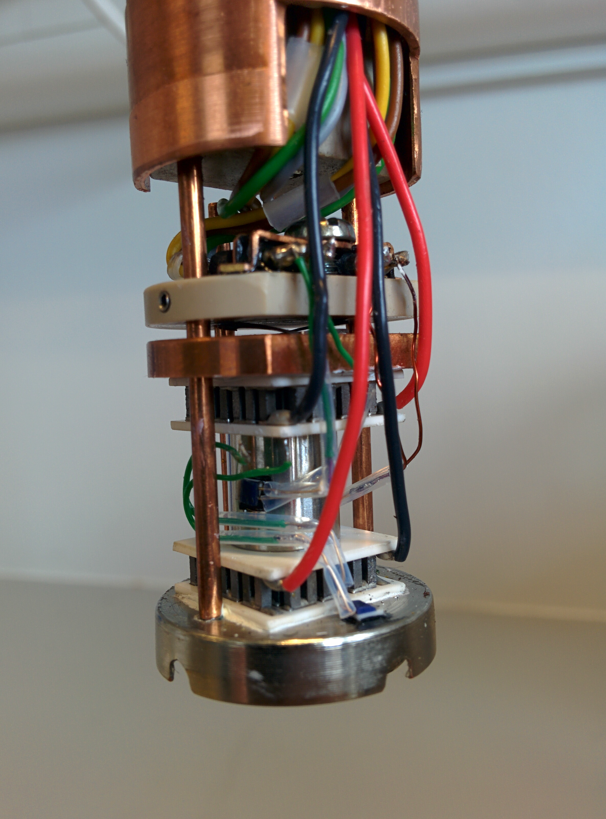
Temperature and Fields – suite for 8 by 2023 incl. infrastructure
 | # | Cost k€ | Ready | Start | In-kind partner
Vertical cryomagnet 8T large opening | 1 | 1000 | 20 Q4 | 19 Q1 | ‘agreed’ (FR)
Vertical cryomagnet 15T (HZB) | 1 | (1000) | 21 Q1 | 17 Q4 | re-used (DE)
Warm bore cryomagnet 2x 2.5T, 1x 5T | 3 | 1000 | 22 Q1 | 19 Q1 | ‘agreed’ FR
Horizontal cryomagnet 11T | 1 | 500 | 22 Q1 | 19 Q1 | not identified
Cryostat incl PTR, wet, flow, cryostream | 4 | 350 | 21 Q1 | 19 Q4 | ‘agreed’ FR
CryoFurnace (4K – 500K) incl. changer | 3 | 500 | 21 Q1 | 19 Q4 | MAGIC, DREAM, CSPEC
Dilution | 2 | 500 | 21 Q1 | 19 Q2 | ‘agreed’ FR
High Temperature Vacuum Furnace | 2 | 80 | 21 Q1 | 20 Q3 | ‘agreed’ FR
Infrared Furnace | 1 | 50 | 21 Q2 | 20 Q3 | ‘agreed’ FR
Sorption stick | 1 | 150 | 21 Q1 | 20 Q1 | ‘agreed’ FR
10kV HV supply | 2 | 50 | 21 Q2 | 22 Q1 | in-house
Peltier subcryostat, | 1 | 125 | -- | complete | DK
in-situ AC suscept. | 1 | 30 | 19 Q3 | 18 Q1 | In-house
LHe vessels / Helium management | IN | 200 | 21 Q1 | 18 Q1 | not identified

Slide 7
French In-Kind (LLB/Xavier Fabrèges)
3 packages:
8T Magnet + ULT inserts – in progress – two stage procurement envisaged
Optimised for single crystal diffraction (aperture vs field vs background), possible to install on top-loading instruments using standard XL flange mount. Advice welcome on acceptance criteria.
Warm bore magnets – 2.5T warm bore next.
Wet/dry cryo + furnaces
Total ~3M€ for temperature and fields
Potential for 2nd hand LLB?

Slide 8
French IK contribution to TEFI
Large aperture magnet
Vertical split pair magnet
8T, (120°x50°) aperture
Low temperature devices
2 x dilution fridges
³He sorption stick
Where are we ?
Magnet:
Specifications set
Preliminary design from Oxford and Cryogenics
LT devices:
High level specifications set
Legal status:
TA is well advanced. Will not be submitted to the April IKRC as LLB focus on instruments.
French IKCA will be signed in April => access to funding
Next steps:
Call for tender documentation to write (June 2019)
Validation by CNRS and ESS (November 2019)
CDR (April 2020)
Delivery (April 2022)

Slide 9
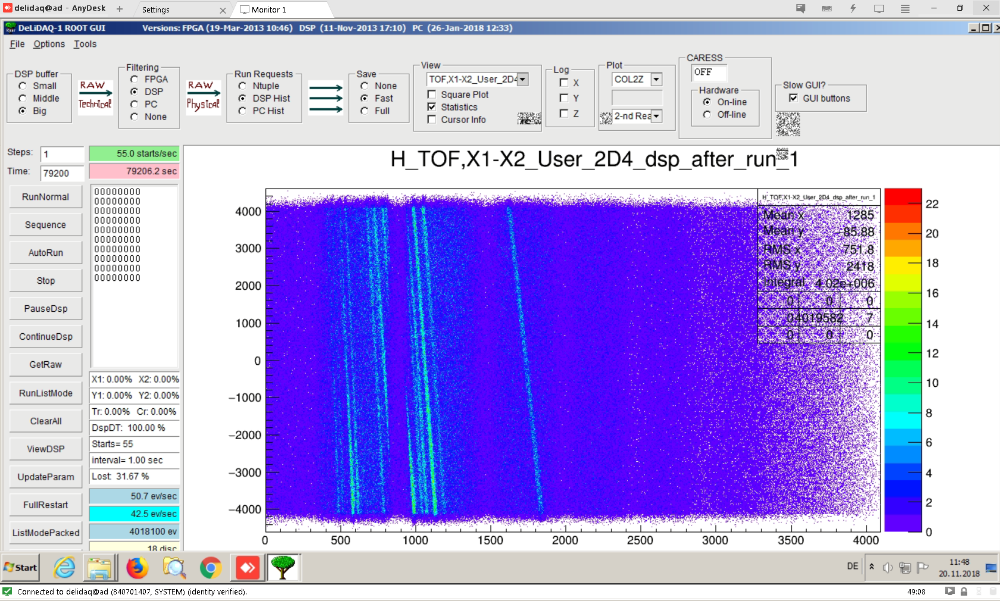
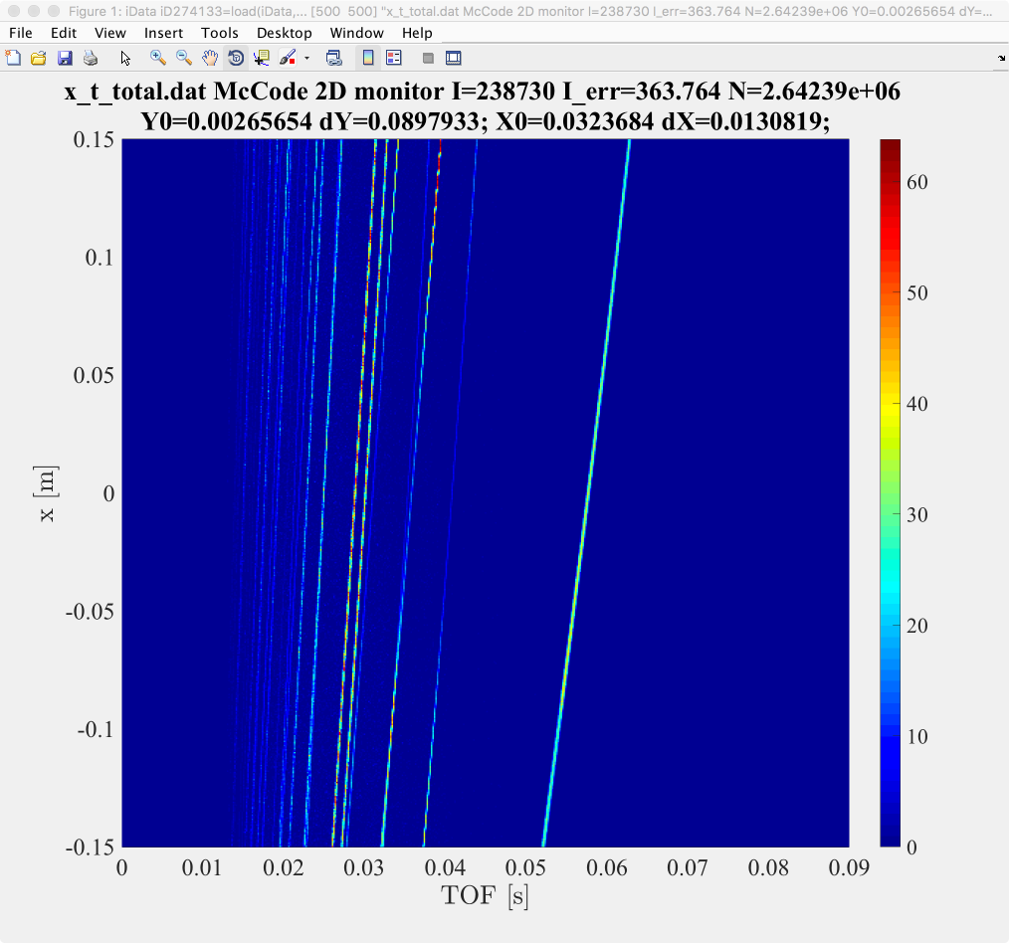
Testing Spurions@HZB
Collaboration with Mads Bertelsen to verify McSTAS Union Components

Slide 10
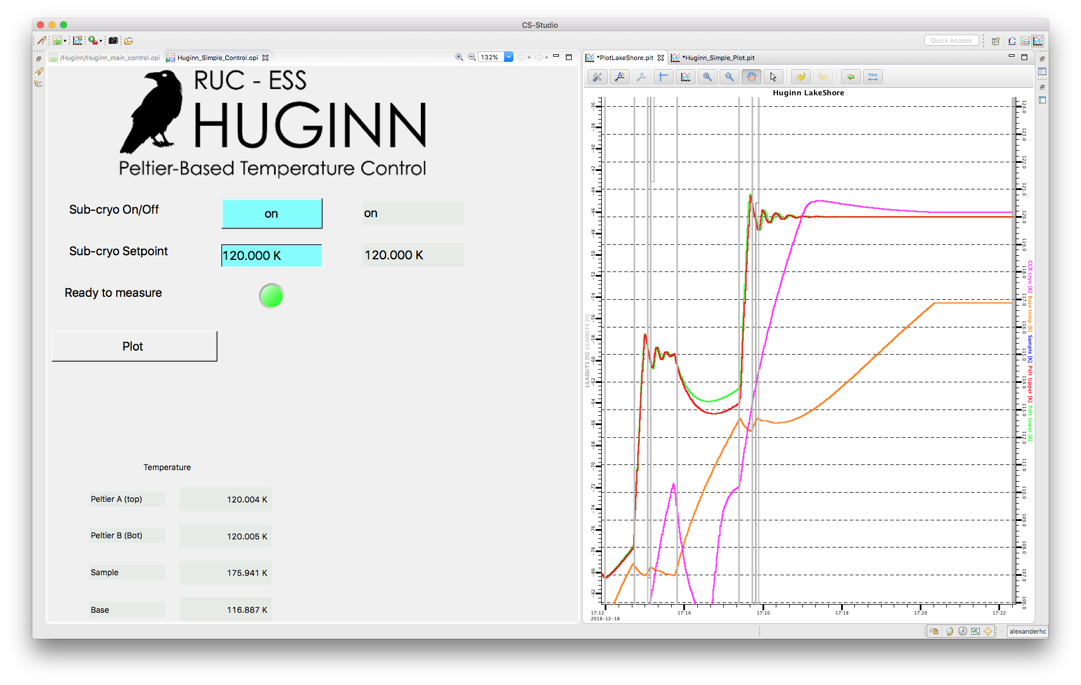
Huginn remote operation Lund-Berlin
New! 2nd Huginn sub-cryo built by Richard

Slide 11
Automatic Flushing Sequence (with Andreas@MESI)
Automates pumping & flushing of sample space
Coordinate with vacuum group on automatic valves & pumps
Proof of concept for ‘intelligent’ Sample Environment System
Test case for risk assessment of 2nd hand items
Remotely controllable
Next step – needle valve control & cold running

Slide 12
Next 6 months
8T magnet finalise & tender launch
Warm bore magnet kick-off
Procure liquid N2 and He equipment & run OC cold with auto needle valve
He recovery connections & flow meter specifications
2nd hand HZB equipment
On-site training – possibilities @FRM2, HZB
E03 (see later talk)

