Slide 1
Sample Environment Workshops
Sample Environment STAP
2 April 2019

Slide 2
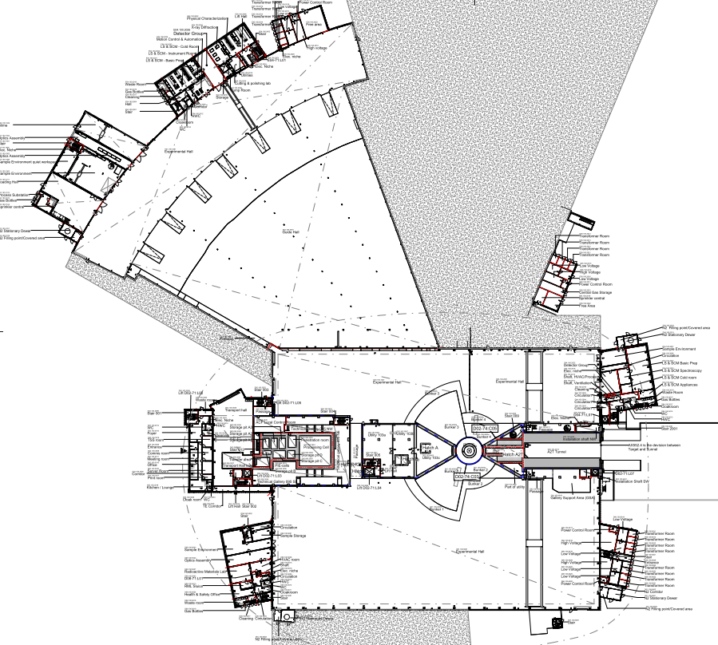
Buildings hand-over (Labs & Workshops)
E buildings (Labs)
E04
E03 | 16/Dec/19
E04 | 02/Dec/19
E03
15.08.2019
Sample environment workshops
10.05.2021
D04
D buildings (Labs)
18.01.2021
D04 | 04-May-20
D07 (Basement) | 15/Aug/19
D08 | 26/Feb/21
D08
03.06.2021
D07

Slide 3

Organisation of Workshops
SAD2CF – CF contact (Monika)
BR – Building Responsible
AR – Area Responsible
SME – Subject Matter Experts
E03 – Alex Holmes
D04 – Harald Schneider
D08 – Malcolm Guthrie

Slide 4
E03

Slide 5
Questions for STAP
Layout reasonable?
Utility supplies, enough?
Cranes
  Beam vs XY, investment priorities

Slide 6
Use cases E03 100
Sample environment system preparation
Cryomagnet testing (requires non-magnetic area)
Cryogen filling
Furnace testing and maintenance
Alignment
Pumping and leak checking
Wiring and soldering
Welding and brazing

Slide 7
Non-magnetic floor + 2 columns

Slide 8
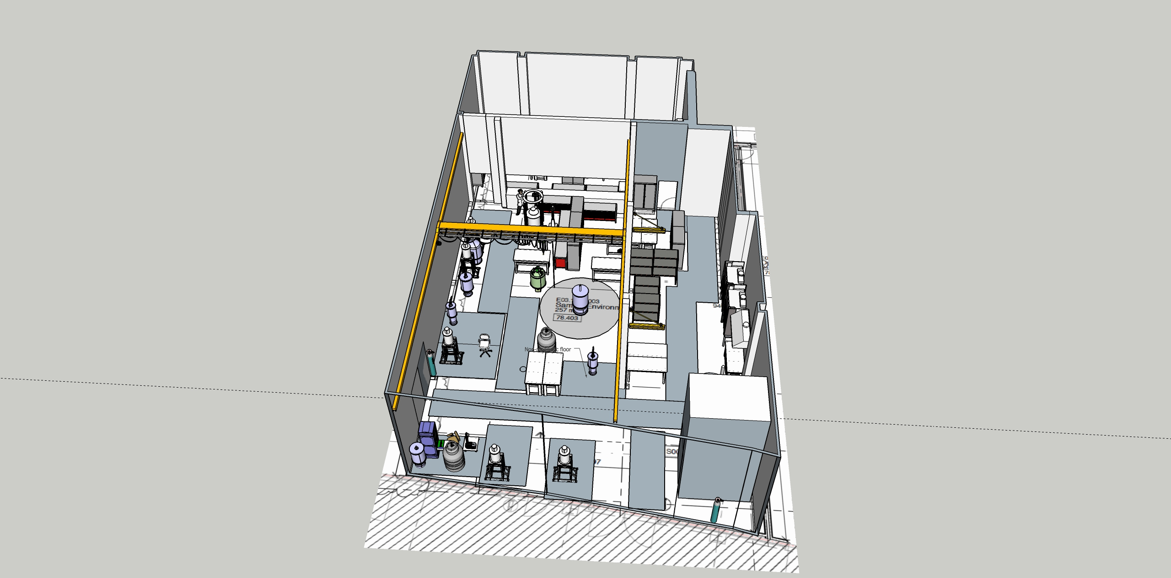
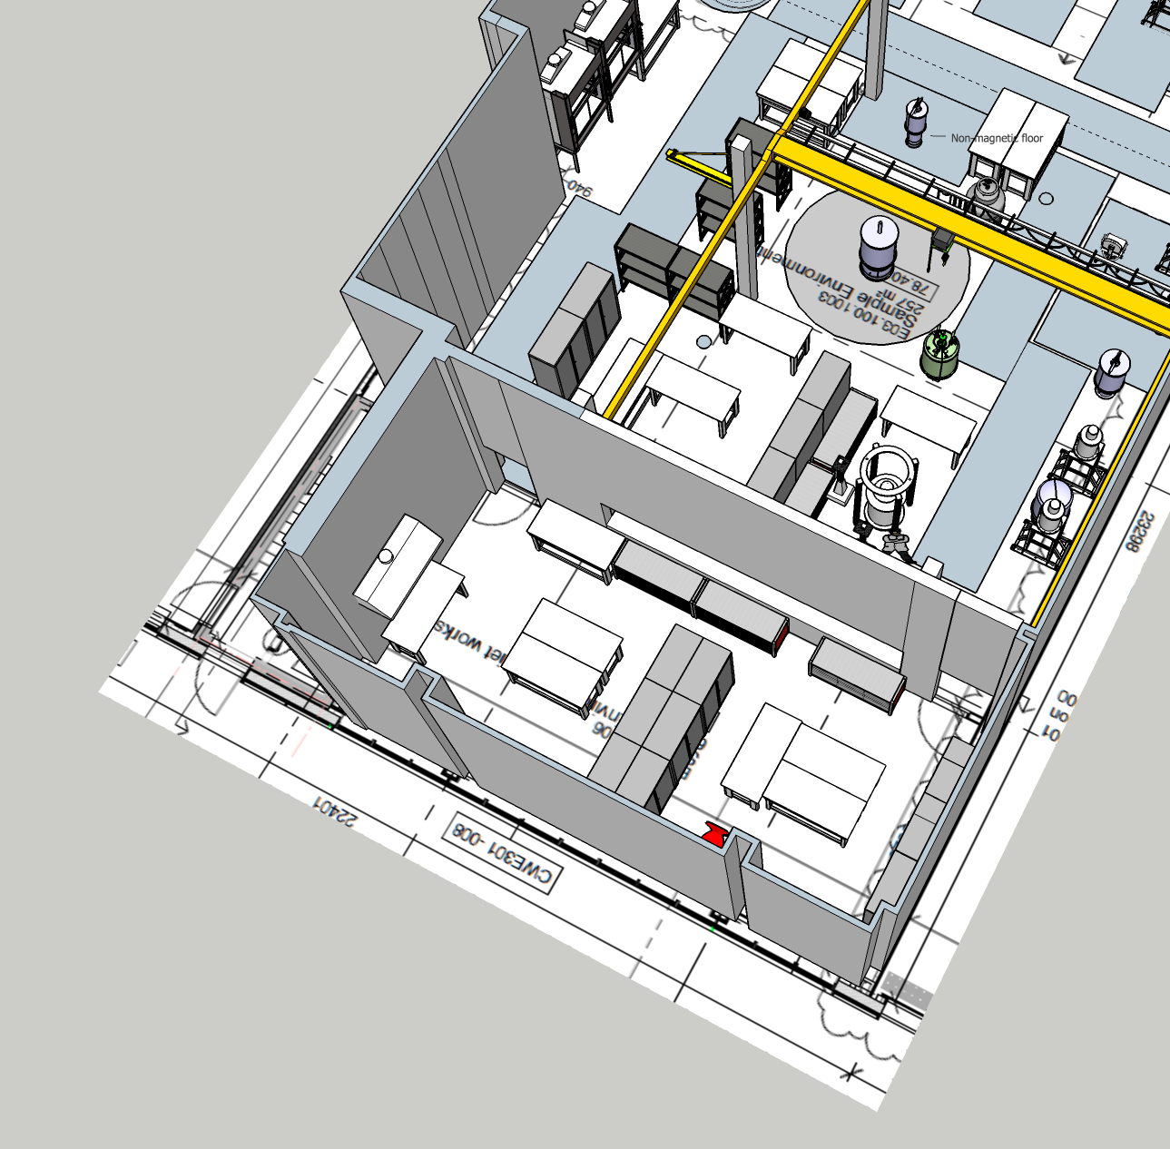
2 cranes installed

Slide 9
Use cases E03 110
Mechatronics development
Soldering (hot work)
Pressure assembly & testing
Storage
Destructive testing
Mechanical workshop

Slide 10
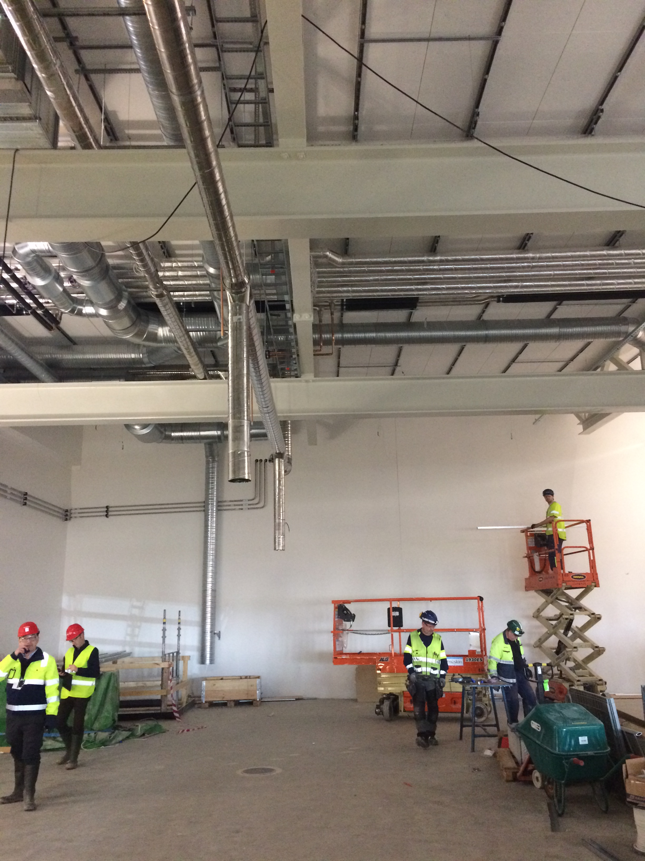

Slide 11
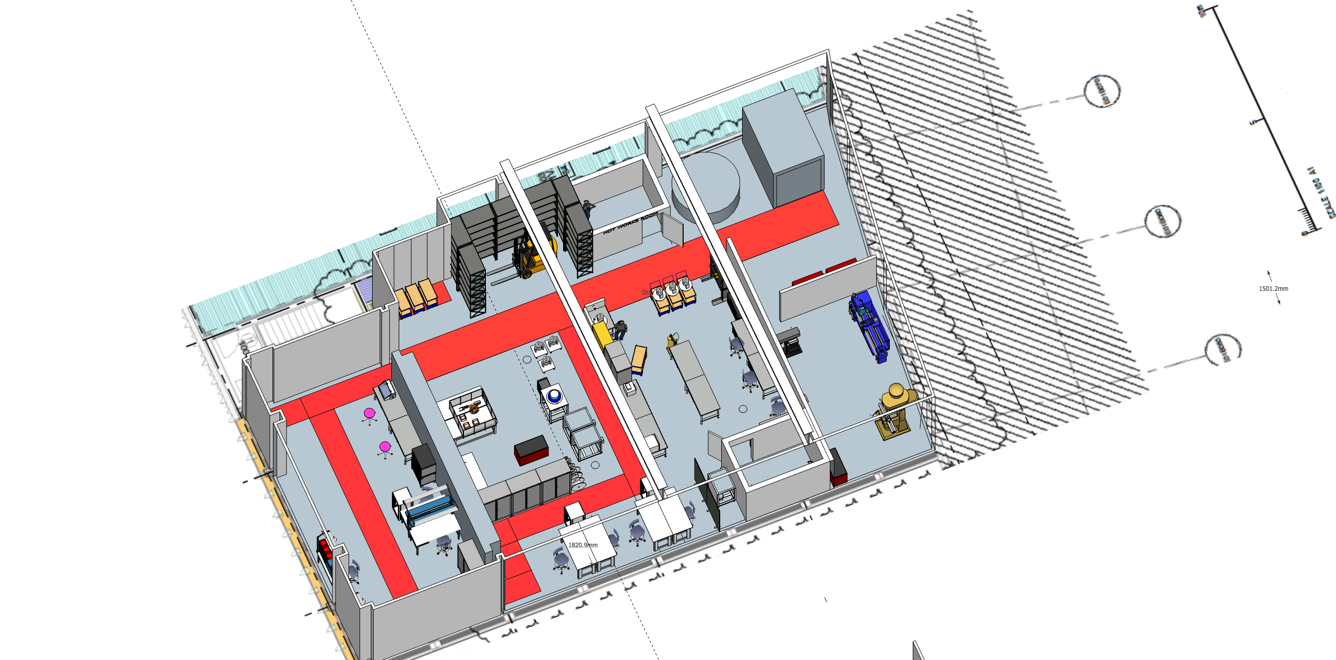

Slide 12
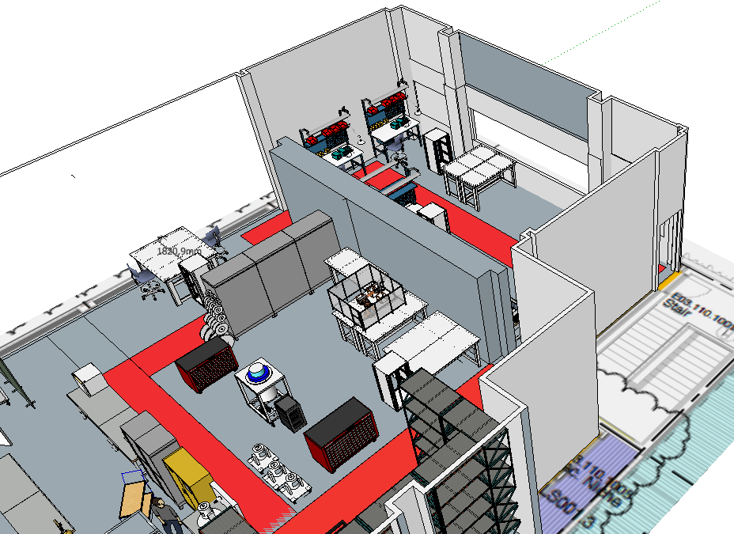
E03 - MESI

Slide 13
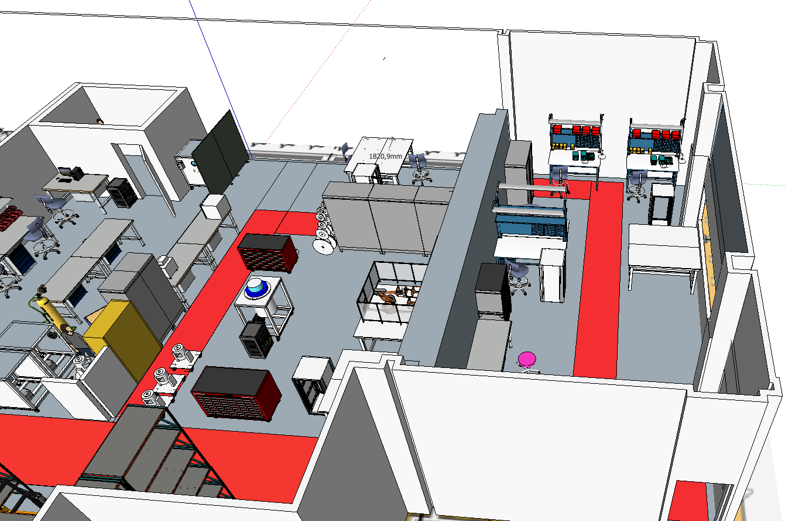
E03 - MESI

Slide 14
D04
Harald Schneider

Slide 15
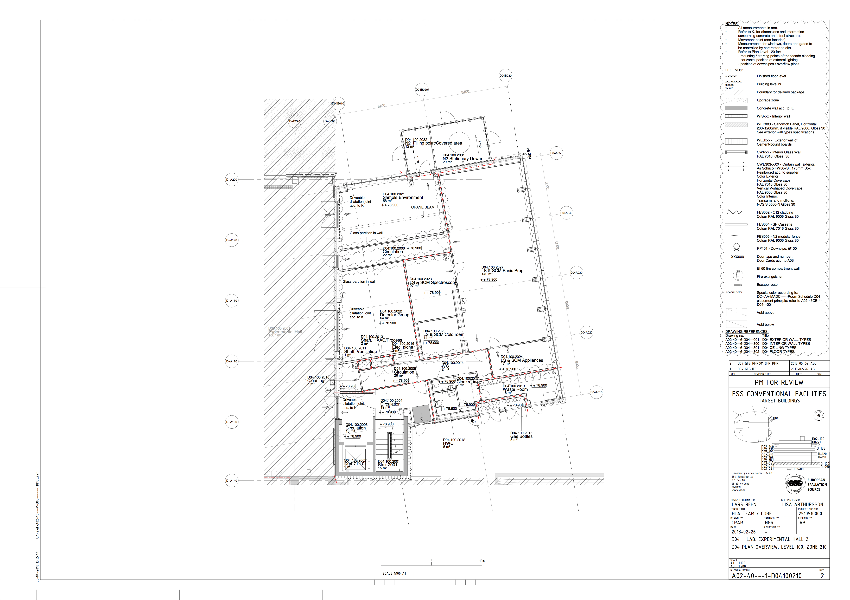
The FLUCO habitat
Outside LN2 tank with filling station for dewars
D04.100.2021 SE lab
58 m²
Main entrance
Crane beam

Slide 16
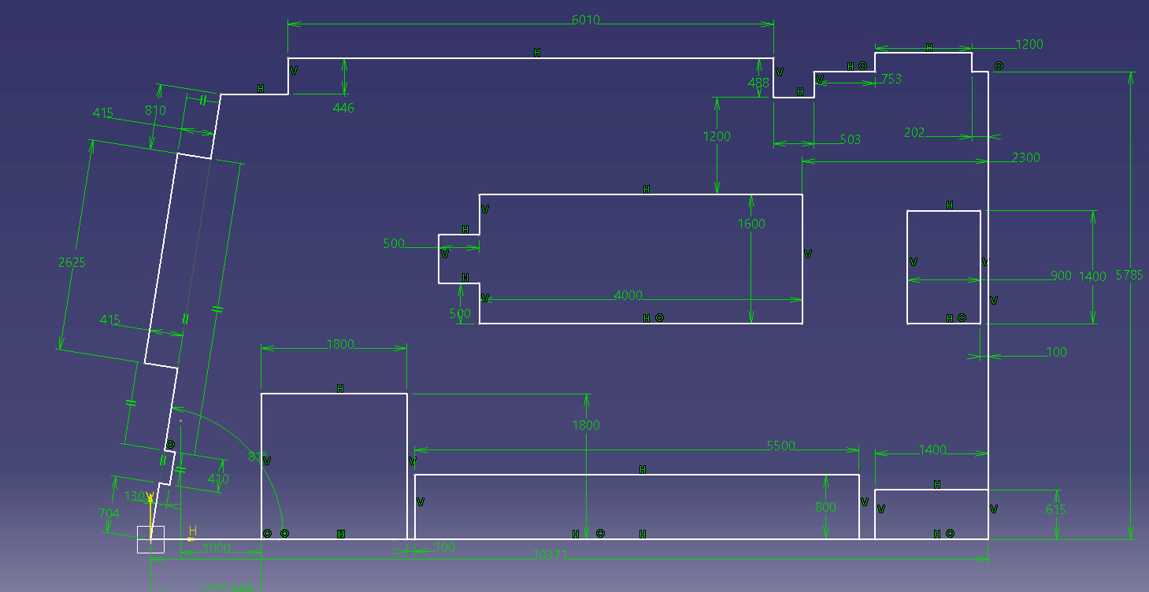
Window front/bench,heater elements
“Island” bench for “standing”work, w. furnaces,spin coater,
Electro chem. Testcells,balances,temporary. setups. Height 900mm
Lost space, due to
LN2 transport
Fume hood cabinet,
e.g. Exploris type
Crane beam
Gas cylinder
Storage 3,4 cyl.
Test area with laser protection curtain, class 3a/3b
3 workplaces : 2 w. chemical benches , 1 for office work

Slide 17
Media supply column from top [A]
Media supply bench top [B], both sides
from media supply column [A]
Main electrical supply box
To extraction
To mobile extraction
Protected corners
For 10l gas cyl.
Temporary sp. gases
2 x Media supply,[D]
Office/IT
To mobile extraction
Media supply,[E]
3 workplaces : 2 w. chemical benches , 1 for office work
With bench top media supply [C]2x
Sink,tap water cold/warm, drain
Media supply,[F]

Slide 18
Use cases:
Electrochemistry measurements, Island
Calibration measurements with moveable test rack
Cell development, tests. Island & workbenches
Prototyping & mounting of Liquid-Solid/Liquid-Liquid/user cells. Island
Ashering of old samples , Muffel oven. Island
Troughs/Longmuir troughs development, tests. Island
Standard setup for SANS, Euro-palette – tests/calibration/development – Laser curtain test area
Preparation/calibration/of gas handling systems and gas manifolds. Island
Preparation of gas stream devices. Island
Testing and risc analysis of user devices and cells/chambers. Island
Development/test of ortho-para-generator – Laser curtain test area
Method development DLS/SLS/DWS/WLS/RAMAN/FIR… - Laser curtain area
Characterizing updating LPP. Laser curtain area
Installing, testing, calibrating, prototyping of modules for SANS mag. Laser curtain area
Preparing special sample cells with desktop laser. Moveable desk
Various measurements/devices-balance/ovens/stirrer/spin coater/autoclaves/HPLC..Island
………

Slide 19
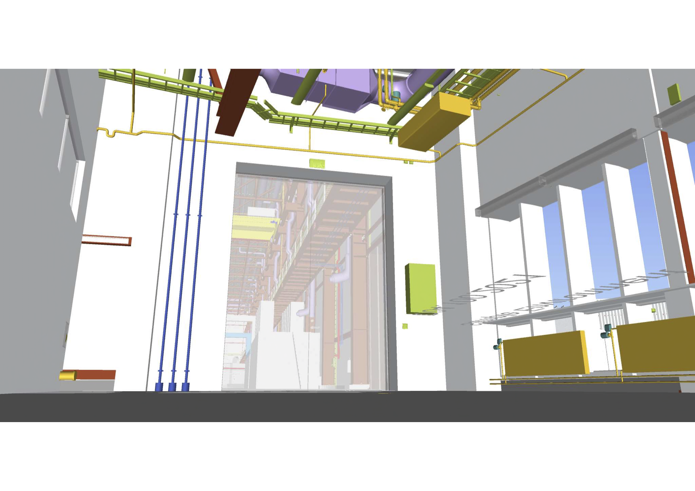
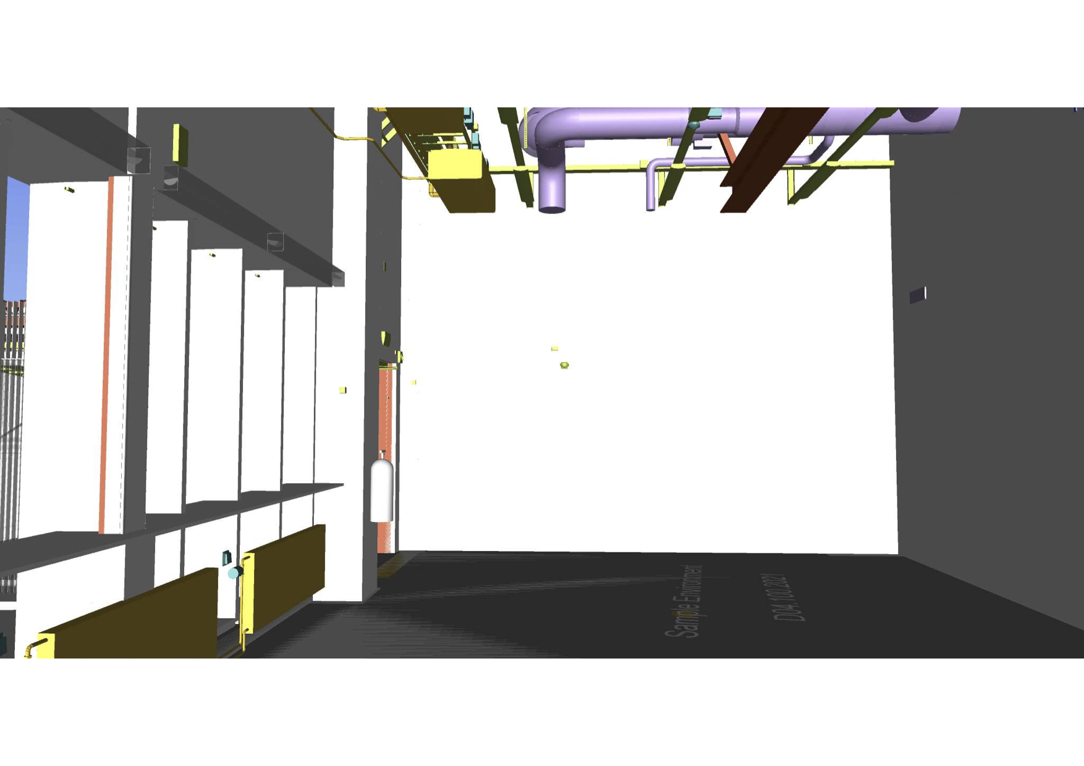
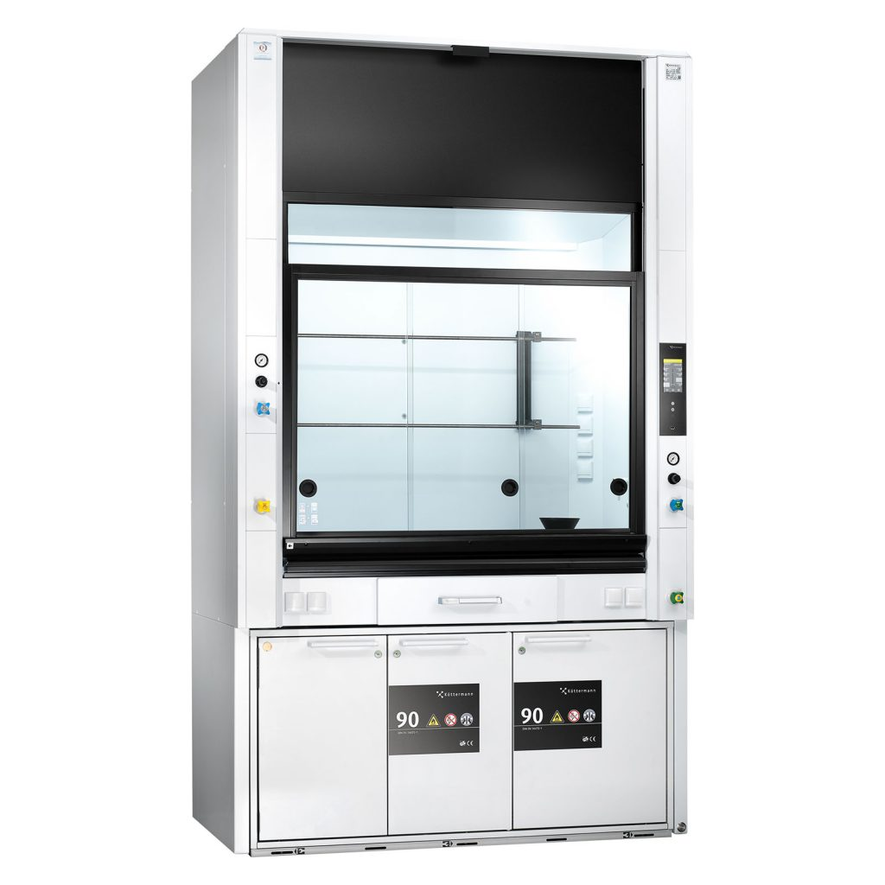
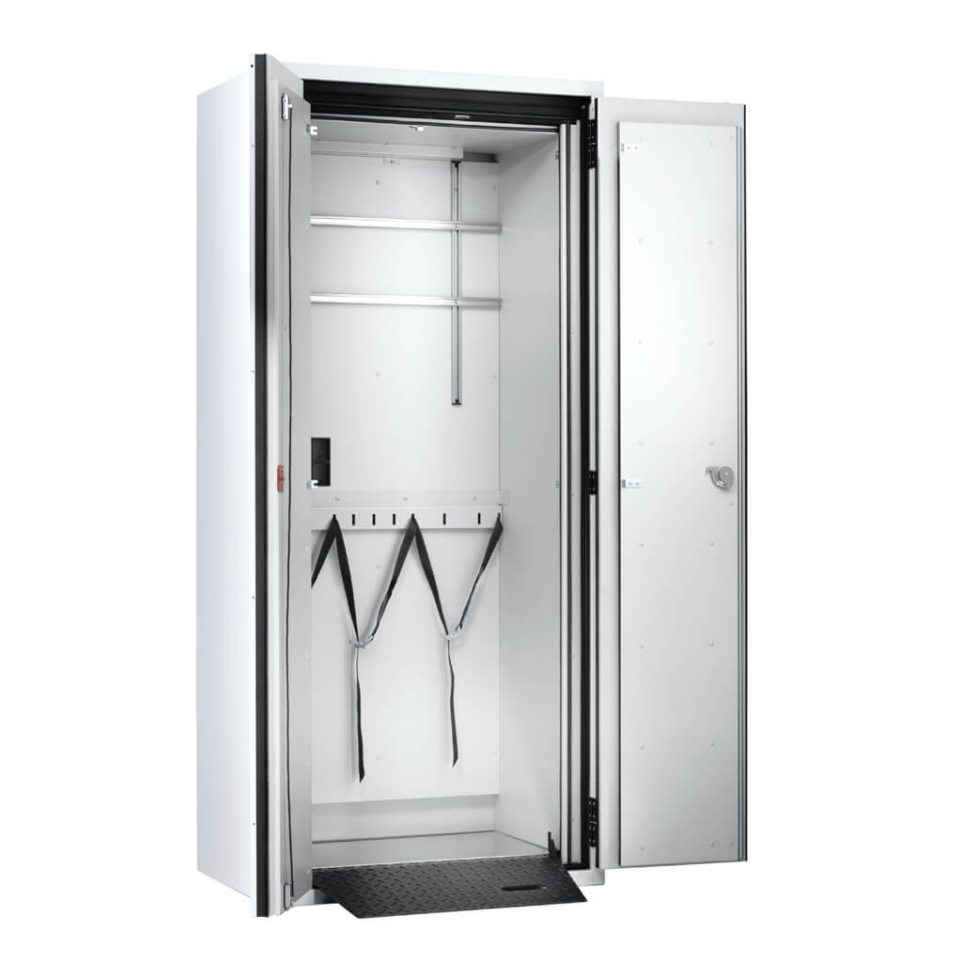
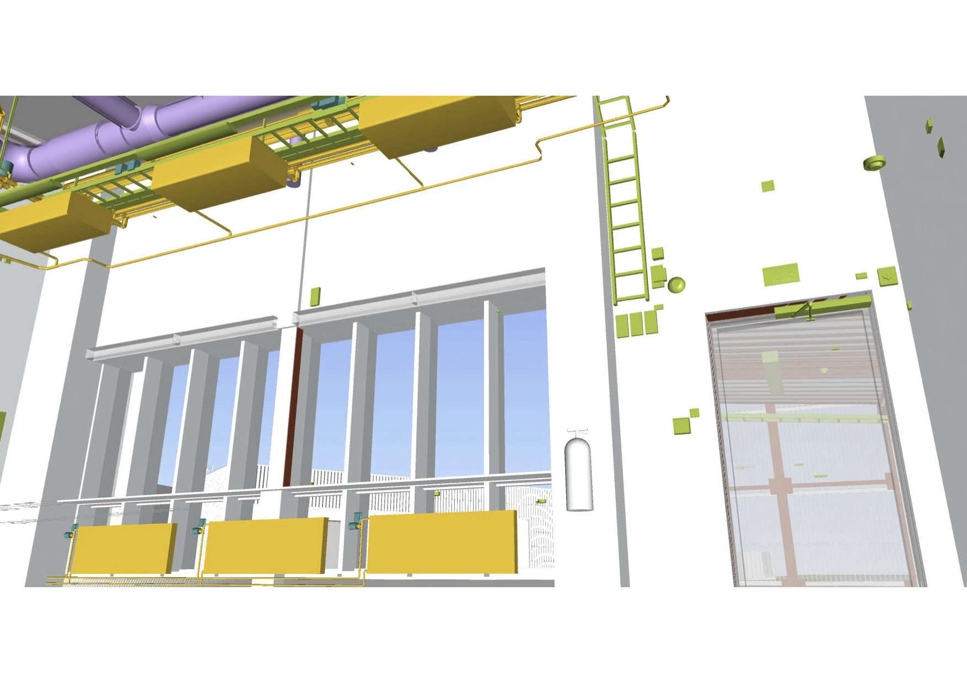
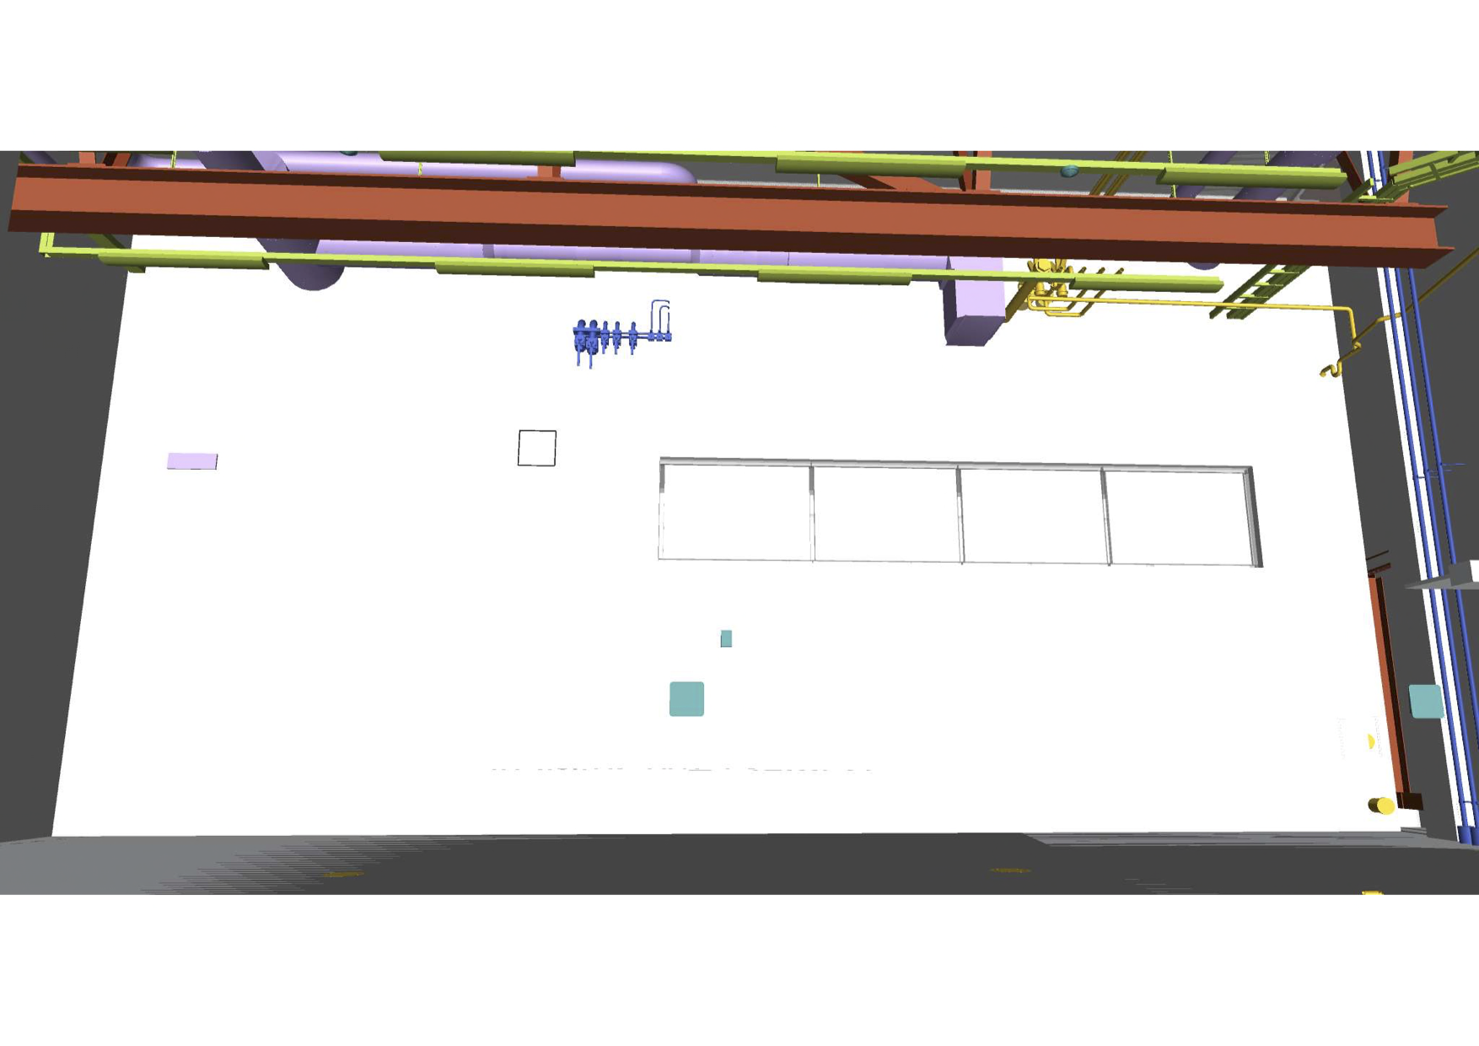
Mains el.
supply
Sink/tap water
Test field with laser
Protection curtain
Three workplaces

Slide 20
B02
Anders Pettersson

Slide 21
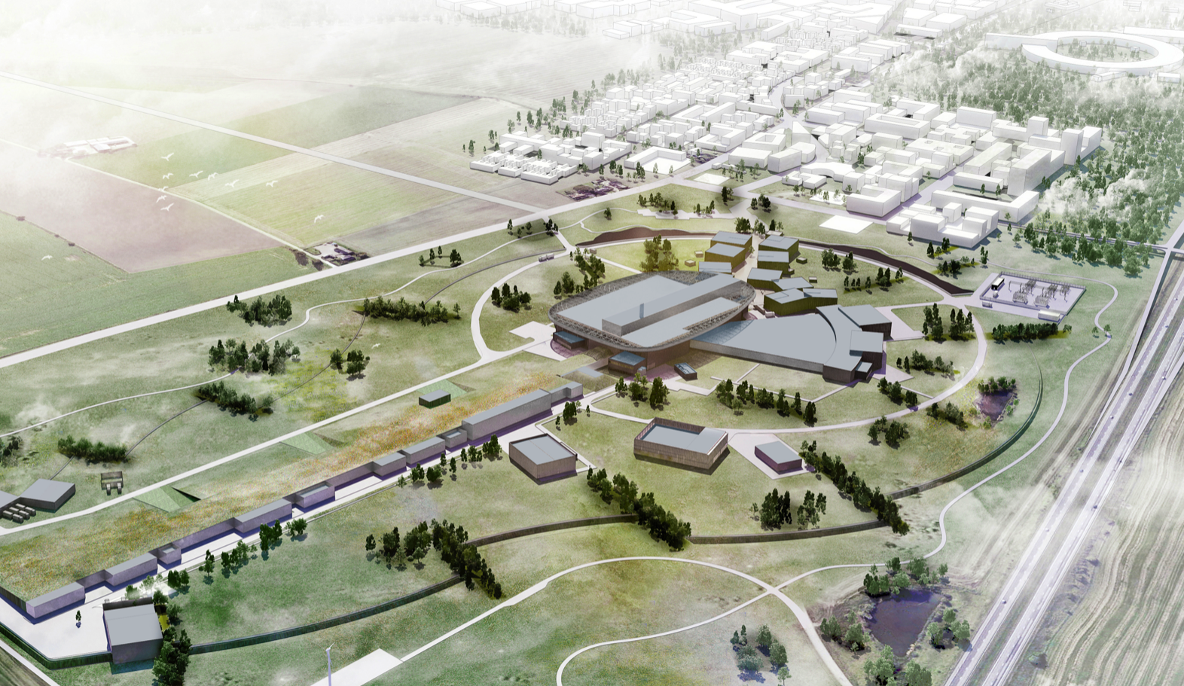
B02 building. SE Workshop.
B02, SAD-SE 170sqm

Slide 22
B02 SE workshop
Additional SE workshop area
Mainly intended for development and long term testing
Includes a non-magnetic area
Close to main workshop
170 sqm
Estimated access in Q1 2021

Slide 23
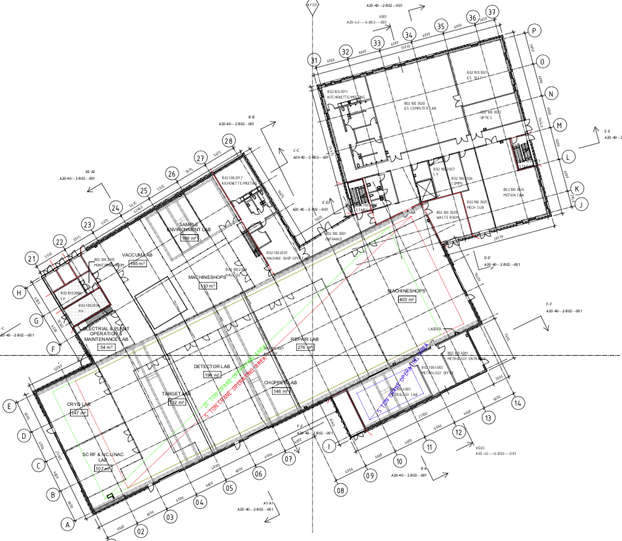
B02 building overview

Slide 24
