Slide 1
SULF activities -ONE chemistry lab for ESS
Monika Hartl , Katrin Michel, Melissa Sharp
European Spallation Source ERIC
Date

Slide 2
SULF = one chemistry lab for ESS
REASONS to have one chemistry lab for all ESS instead of several small scale labs in each division:
The expertise is and will be in SULF as shown by various involvements, nationally and internationally.
Having to go to an outside lab is expensive and takes longer.
Activated materials cannot easily be sent outside.
We have the expertise and the experience
Neutron scattering and working at chemistry labs of neutron sources (with involvement of chemistry work for accelerator and target)
Internal and external collaborations/projects
Very close collaborations with sample environment and materials group will benefit both sides.
External collaborations , grants, projects
Will help us build up a user base in Sweden by educating local users on neutron scattering and assisting with their beamtime preparation –> SULF benefit: equipment, “advertisement” and gaining expertise
Will and is assisting us in buying equipmen

Slide 3
We are the in-house experts
Ortho/parahydrogen online diagnostics for TD
Synthesis and characterization of luminescence screen materials for target (AD)
Advisor for TD on water chemistry and diagnostics (pH, conductivity, AAS…)
Small tasks for SD, TD, AD: cleaning, analysis, guidance/assistance for small laboratory tasks…, debris from the ion source,…
We are currently establishing ourselves and are becoming “known” in ESS. This is a step in the direction that we want to go:
Well-working chemistry laboratories at user facilities offer more than just a place with glassware and instrumentation (see STFC ISIS labs), they offer assistance and knowledge. Other well equipped labs (also at an European User Facility) have little use as the users are left to fend for themselves.
We cannot offer extensive service to every user, but we can do a lot to enhance and sometimes to “save” experiments.

Slide 4
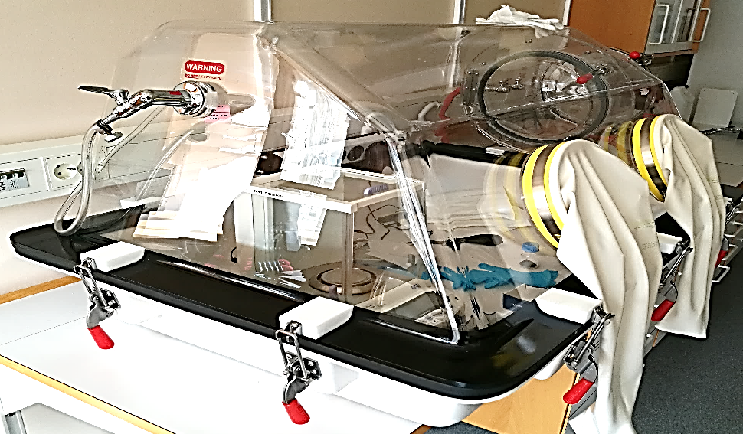
ESS-Internal Collaborations
Internal collaborations:
Ortho-parahydrogen (TD, FZ Jülich, SNS, JPARC)
Luminescence Screen (AD, SNS)
Beryllium Reflector (TD)
Electrochemistry (SD 0 FLUCO)
Levitator (SD -FLUCO, DEMAX?)
Irradiated greases (TD, U Brescia, Lena Reactor)
Densified Wood (AD)
Gas handling (SD-FLUCO)
FLUCO collaboration will intensify (shared TA)
Materials Group collaboration will also deepen (SEM-postdoc)
Glovebox providing an inert environment.
Solid (10K) and liquid hydrogen (16K) Raman Spectroscopy at low temperatures

Slide 5
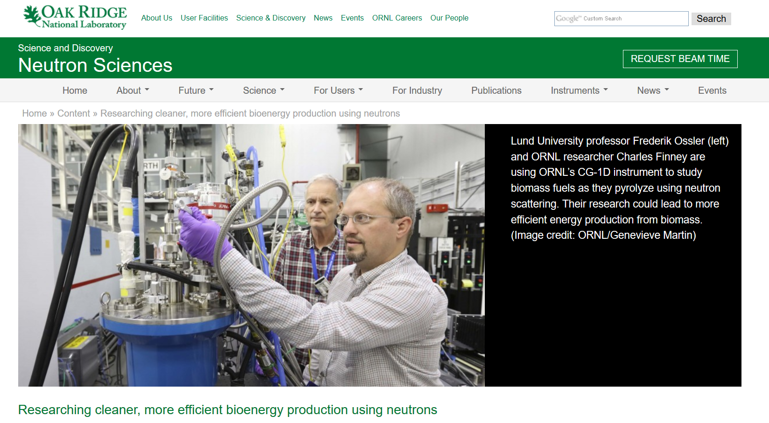
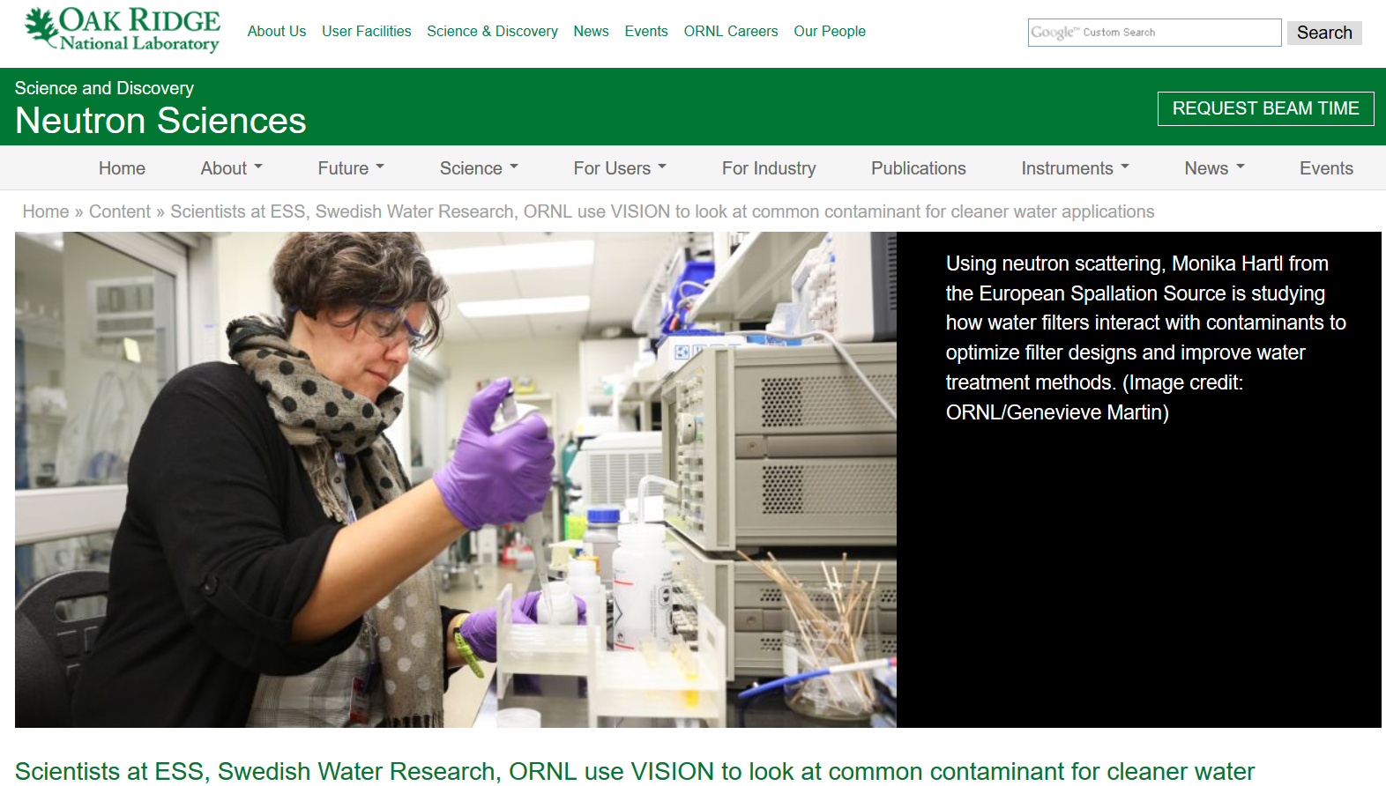
External collaborations
Physics Department (combustion physics), Lund University (F. Oessler)
Assistance in sample modification and for beamtime (one joint grant proposal submitted)
Swedish Water Research
One successful grant with Vinnova (€50k/1 year) - Maria Rindelöv (lab technician, 100% grant money: 3 month Q2, 2019)
One grant with Vinnova just submitted (€50k/1.5 year)
International grant (Melissa Sharp)
successful grant for 2 years on membrane dynamics and neutron spin echo which will allow us to procure equipment and work with a postdoc

