Slide 1
STAP Sample Environment Engineering
Zvonko Lazic
European Spallation Source ERIC
April.2019

Slide 2
Designing for the SAD – Sample Environment
ESS based design
A Scientist needs ‘something’ designed/produced
Manufacturing
Engineer conceptualises the idea
Detailed design
Arrive at acceptable solution
Finished Product

Slide 3
Designing for the SAD – Sample Environment
External design
A Scientist needs ‘something’ designed/produced
Manufacturing
Conceptualise internally (Zvonko & the scientist)
Detailed design
Pass the concept to external designer
Finished Product

Slide 4
Designing for the SAD – Sample Environment
ESS based design
A Scientist needs ‘something’ designed/produced
Extremely long time (ESS CAD procedures…)
Extremely long time (internal communication difficulties, engineering competences missing…)
Manufacturing
Engineer conceptualises the idea
Detailed design
Arrive at acceptable solution
Finished Product

Slide 5
Designing for the SAD – Sample Environment
External design
A Scientist needs ‘something’ designed/produced
Working on fixed cost (fixed time-spent) for design, no cost overruns. Still problems with timely delivery.
Manufacturing
Conceptualise internally (Zvonko & the scientist)
Detailed design
Pass the concept to external designer
Finished Product

Slide 6
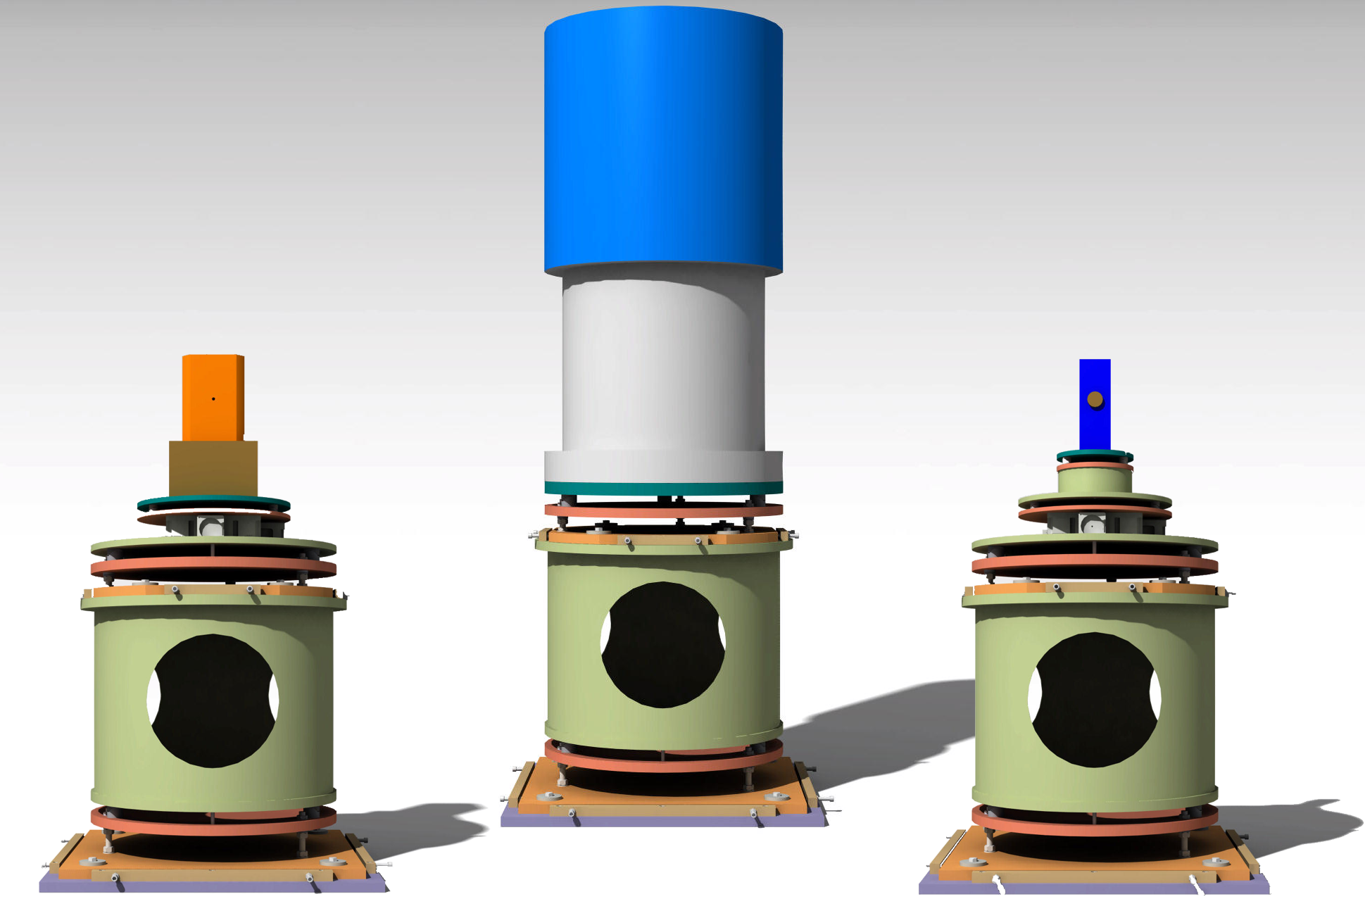
Designing for the SAD – Sample Environment
ESS based design – case study
*Done ‘all in-house’.
*The design effort took ~6 months.
*The designer – scientist communication wasn’t the best.
*The engineer was a ‘generic’ skilled person. + ESS is severely limited on engineering resources (we can either search for a particular skill, but have to wait ~6 months and more until the person is fully acquainted with the ESS CAD/PLM; or hire a software/CAD specialist without appropriate experience). + This bars us from acquiring suitable skilled designers (consultants).

Slide 7
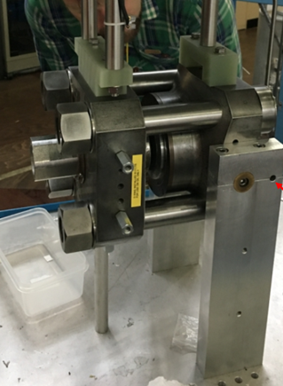
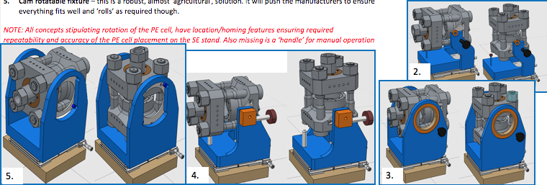
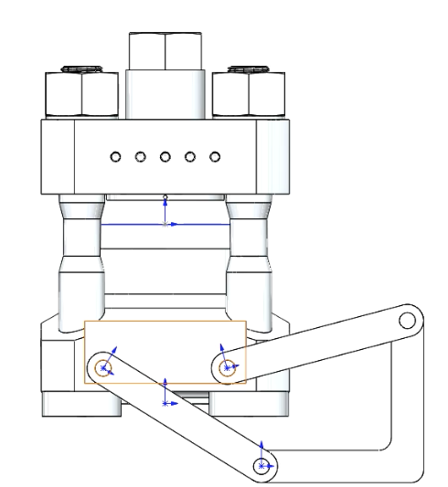
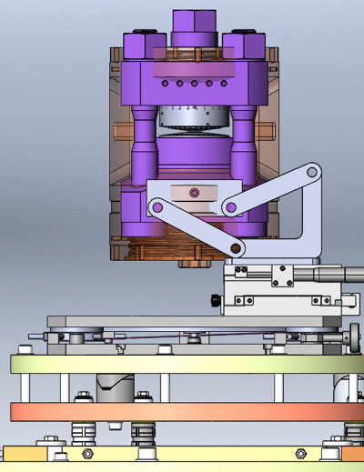
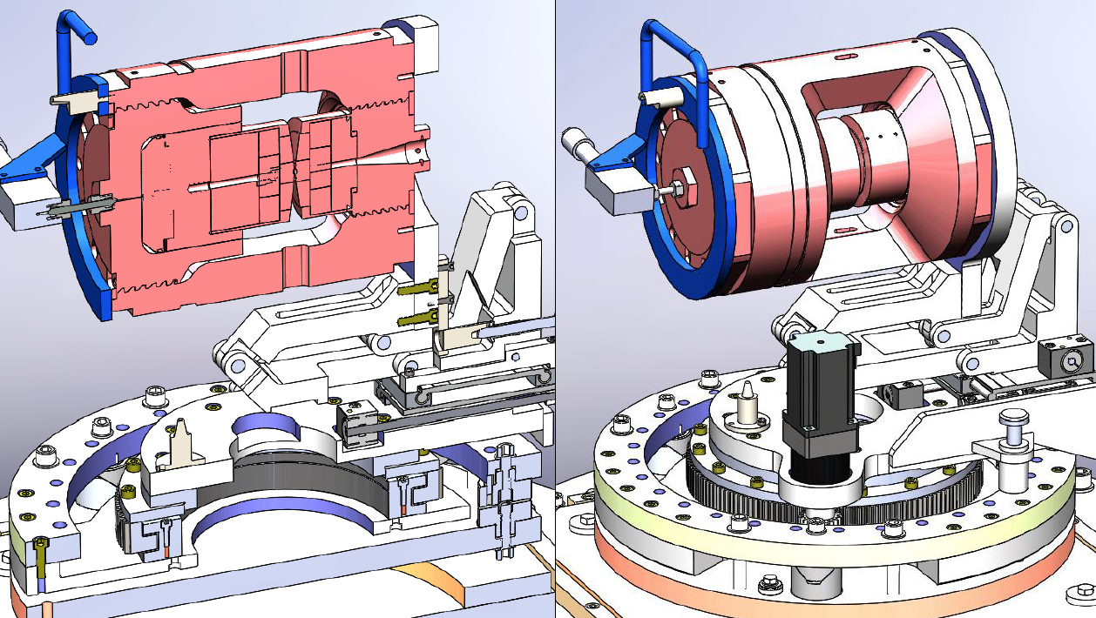
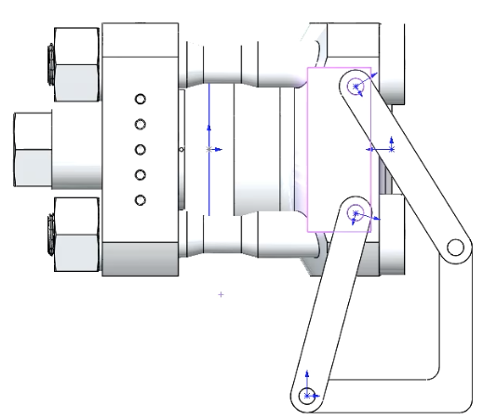
Designing for the SAD – Sample Environment
External design – case study
START
@ ESS
*Initial concept developed here.
*Concept passed to external design house.
*External design house provided a fixed price for the development and detailed design.
*Upon several rounds of iterations, the detailing was completed. *We asked the design house to proceed with the manufacturing. *The manufacturing is completed, acceptance testing and consequent adjustment(s) are outstanding.
FINISH
@ subcontractor

Slide 8
Designing for the SAD – Sample Environment
External vs. External design
External design and manufacturing timeline:
First meeting April 2018
Internal conceptual design Jul 2018-Aug2018
Kinetic engaged Sept 2018
Kinetic Conceptual design finalised Dec 2018
Detailed design Jan 2019
Manufacturing Feb 2019
Delivery March 2019
Design cost: 7 600 [EUR]
(80 [hrs] concept + 120 [hrs] det.
Manufacturing cost: 8 000 [EUR]
ESS based design
Fosters in-house expertise.
Designer-scientist at hand for discussions.
Prolonged design cycle.
Unforeseen costs.
Large overhead costs.
External design
Expertise retained by externa company.
Distance communication.
Known (fixed) cost beforehand.
Timing (schedule) management needed.
Designs done at ½ the price at (at least) 2 x the speed
Apr. ’18 | May ‘18 | June ‘18 | July ‘18 | Aug. ‘18 | Sep. ’18 | Oct. ’18 | Nov. ’18 | Dec. ’18 | Jan. ’19 | Feb. ’19 | Mar. ‘19
Initiation |  |  | ESS Conceptualisation |  | Engage ext. | Concept design finalised by ext. comp. |  |  | Det. Des. | Manuf. | Delivery

Slide 9
Q&A
Questions?

