Slide 1
STAP Central Technical Services: Manufacturing
Benjamin Davidge
Manufacturing Section Leader
European Spallation Source ERIC
April 3rd 2019

Slide 2
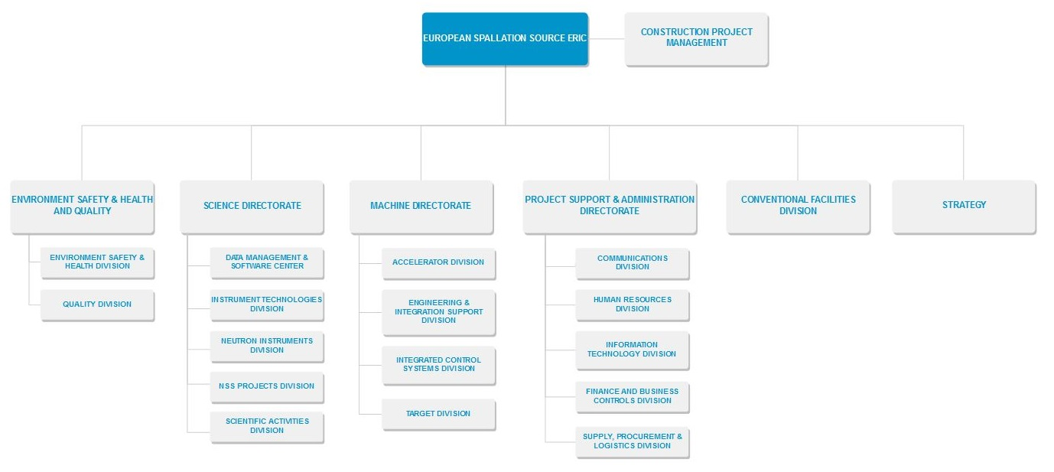
Central Technical Services: Manufacturing
STAP 2019-04-03
Manufacturing Section Mandate:
“Provide support for all mechanical disciplines of manufacturing to ESS as necessary to support installation, commissioning & operation of the facility."

Slide 3
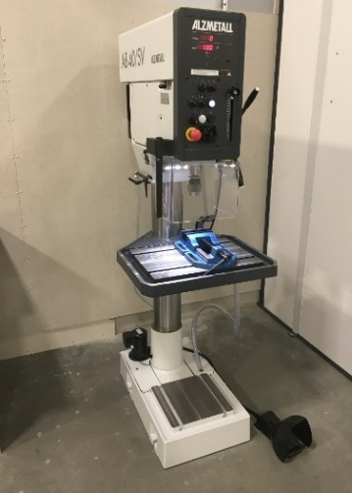
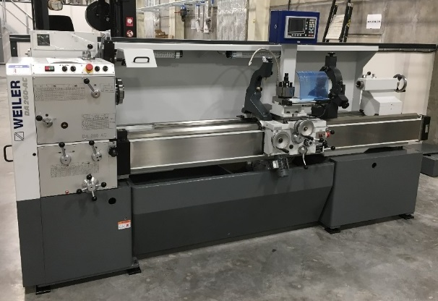
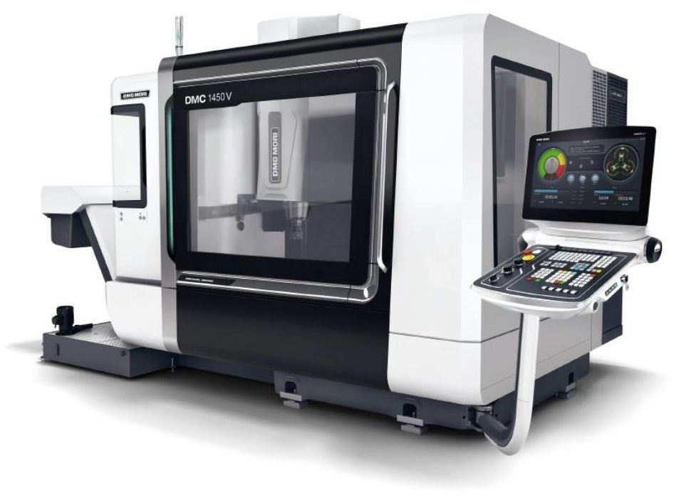
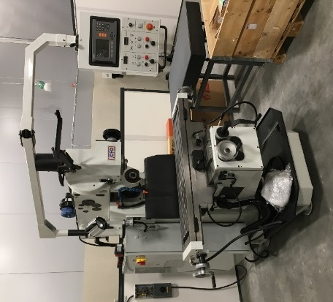
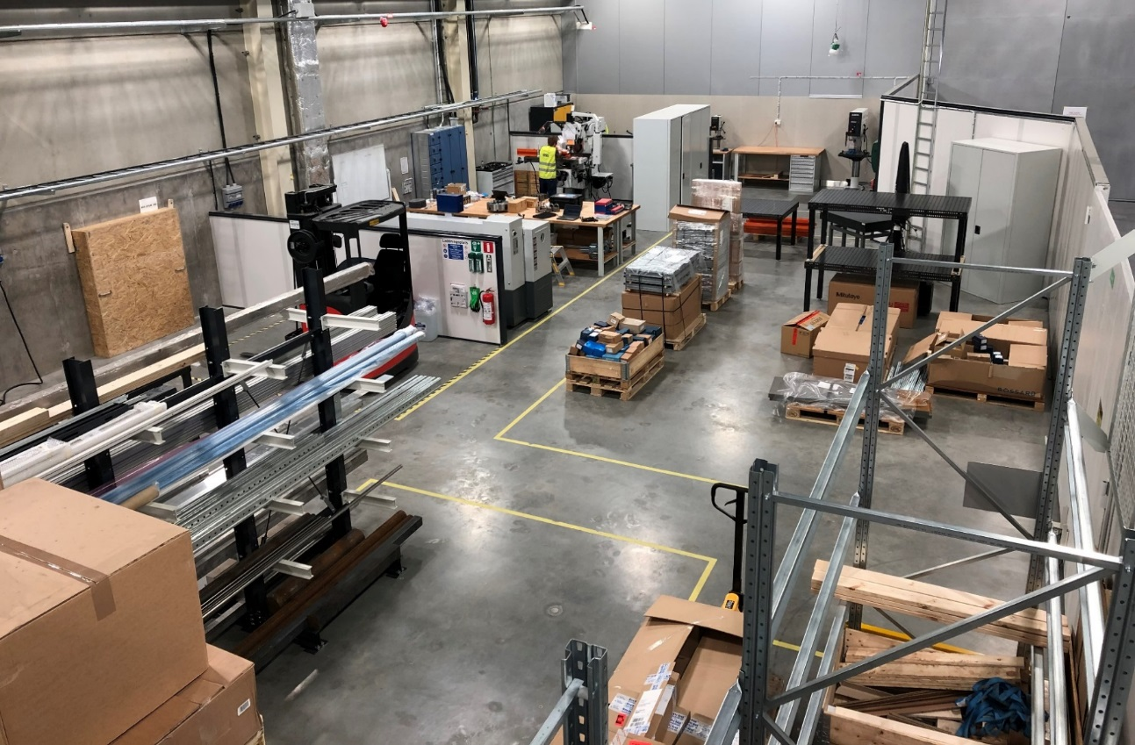
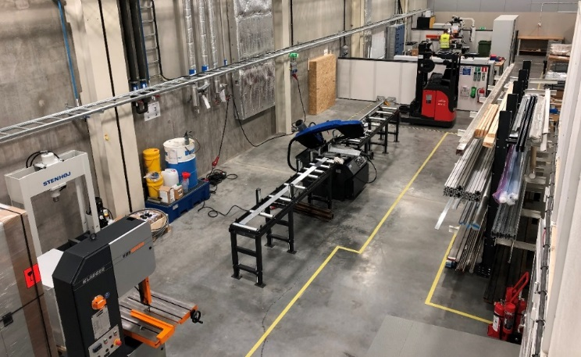
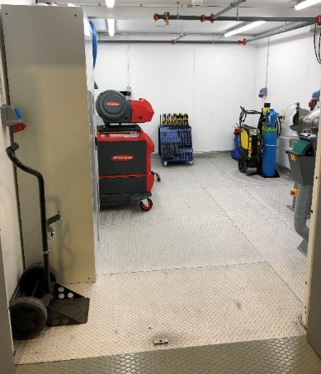
Central Technical Services: Manufacturing
STAP 2019-04-03
In 2 months our new CNC milling machine arrives
3 axis simultaneous machining
1450x700x550mm XYZ
Up to 2t on table
20 000rpm spindle
Accuracy 6µ
Temporary Technical Center (TTC)
Equipment:
Drilling (sub-mm to Ø50mm drilling capacity)
Milling (max. travel 850x300x500mm, 300kg)
Turning (max. workpiece Ø530x2000mm, 500kg)
Horizontal and vertical band saws
High-speed circular saw
MIG & TIG welding (Excluding certified welding under ISO3834)
Precision measuring equipment, including 3D arm
Hardness tester
Precision assembly equipment including bearing installation
Removal/extraction/repair tooling
Numerous hand tools
Bar stock bender & pan folder
Grinding & linishing
Hydraulic press – 40T & arbor press - 8T

Slide 4
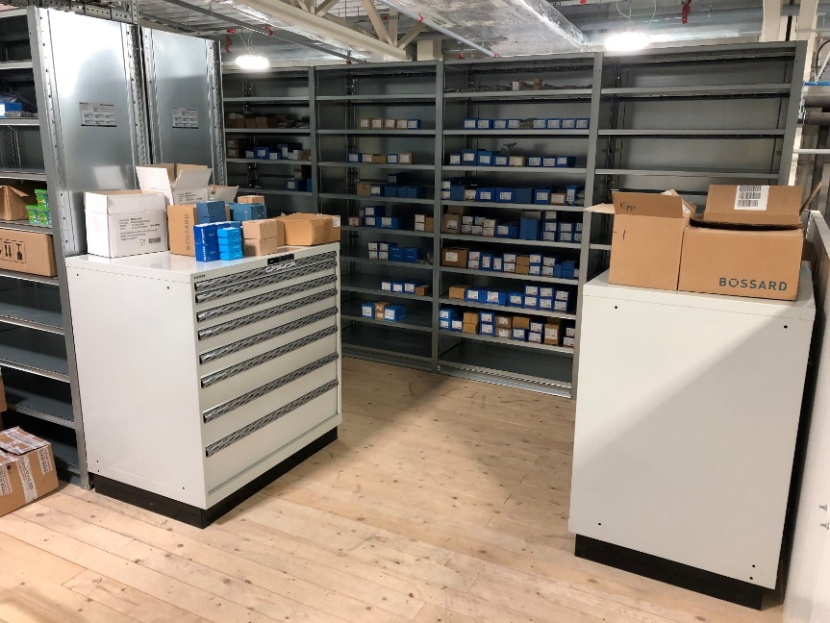
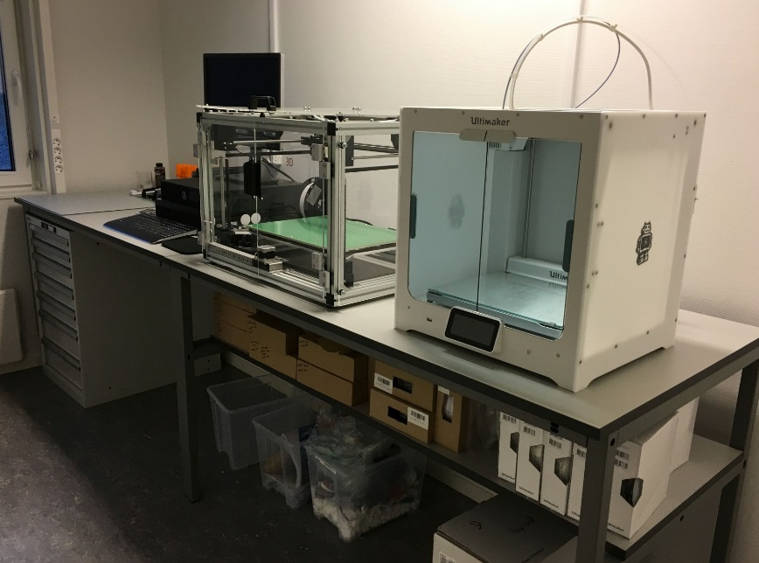
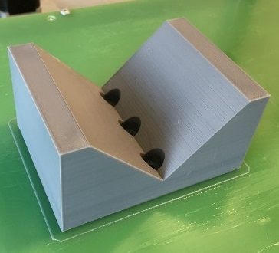
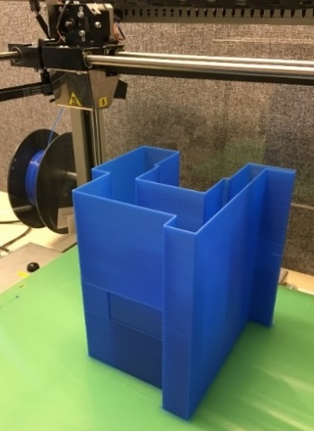
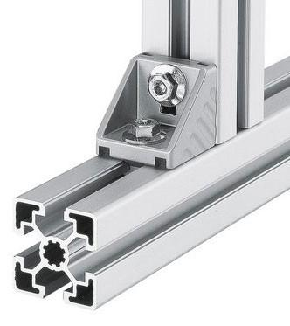
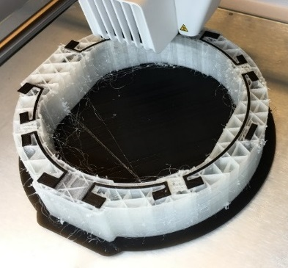
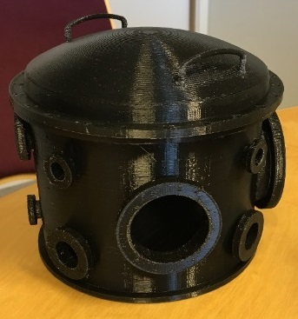
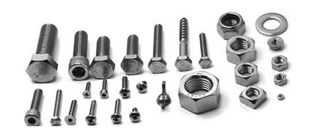
Central Technical Services: Manufacturing
STAP 2019-04-03
Fastener Stock
Fasteners in A4 stainless steel and steel 8.8
Range of sizes from M2-M24
Includes; bolts, nuts, washers, socket head screws, threaded rod, etc.
Common Bosch/Rexroth profile and components
FDM 3D Printing
Prototype mechanical components, jigs and fixtures
PLA, ABS and Glass/carbon fibre reinforced PP/Polyamide
Dual-extrusion print head allowing soluble PVA support material

Slide 5
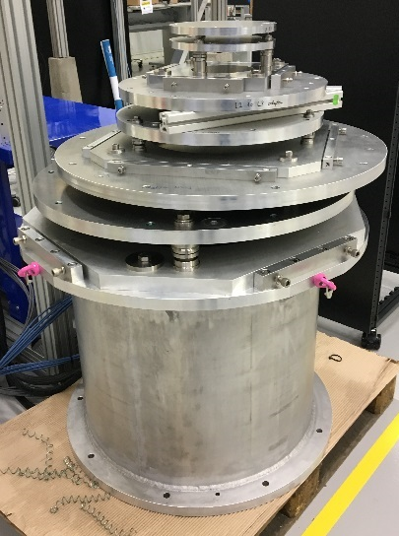
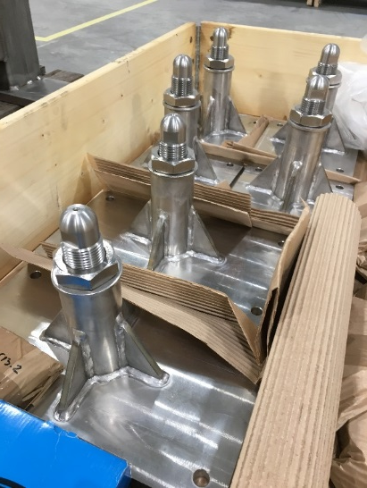
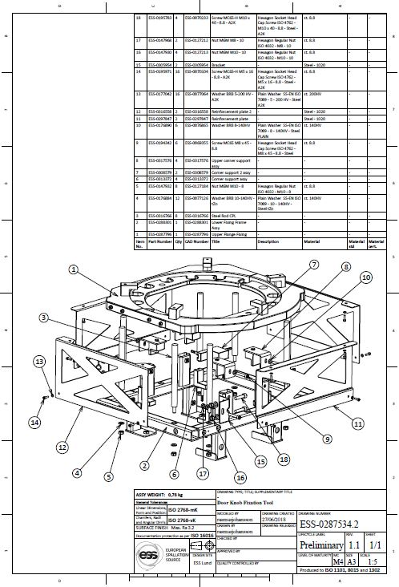
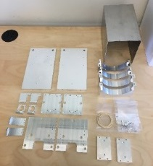
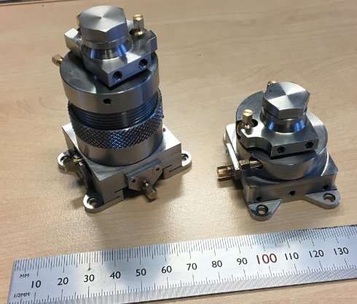
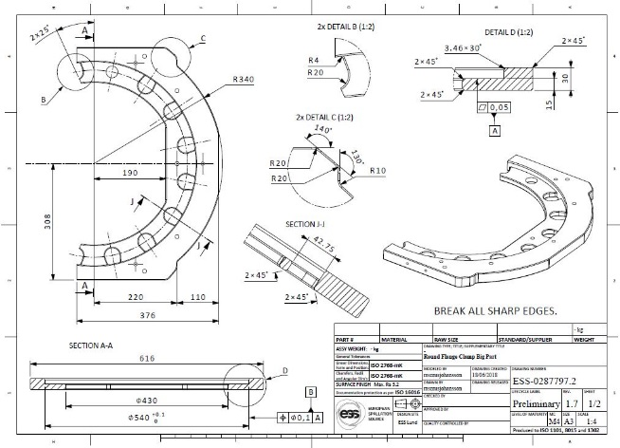
Central Technical Services: Manufacturing
STAP 2019-04-03
External Vendor Outsourcing
Local vendor network with 40+ companies
Access to MaxIV and CERN networks
Coordinate jobs on behalf of requestor with total value <€10k
Support/assist with job requests >€10k
Design Support
Cost optimization support focused on manufacturing processes
Support/advice to partners on manufacturing concerns/issues

Slide 6
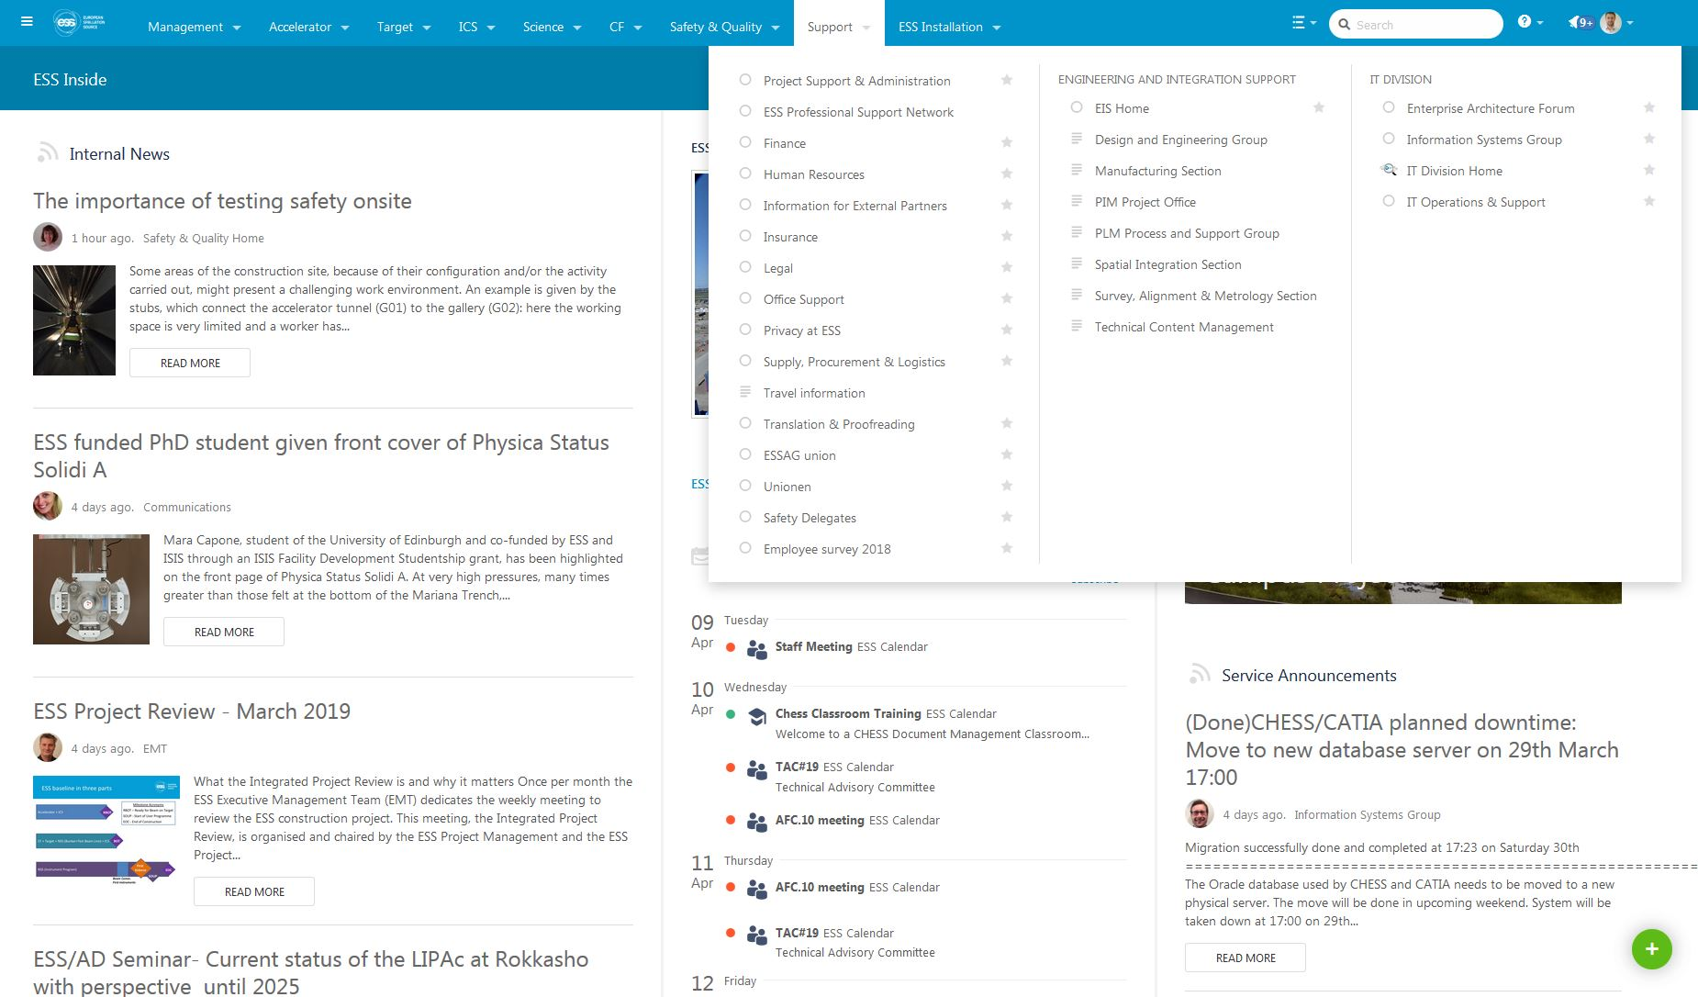
Central Technical Services: Manufacturing
STAP 2019-04-03
https://confluence.esss.lu.se/display/EIS/Manufacturing+Request

Slide 7
Central Technical Services: Manufacturing
STAP 2019-04-03
How it works
Processing job requests:
The TTC will have 3 full-time technicians by end-2019
Primarily provides time-critical mechanical support focused on installation
Additionally provides mechanical support when considered impractical to outsource (processing vs admin time, etc.)
Job prioritization works in the following way:
Coordinated directly with us and the ESS Installation Coordinators
When conflicts occur between divisions the ESS Installation Manager will decide
Production volume jobs are not intended to be processed in the TTC, they will be outsourced
Jobs able to accept lead times >2 weeks will be outsourced
External vendor service level agreements will be in place later this year to deal with peak loads
Vendor framework agreements will simplify interaction with external vendors
Who pays:
Staff, machinery and basic consumables are centrally funded
Specific materials or tooling are paid by the requestor
All outsourced jobs are paid by the requestor

Slide 8
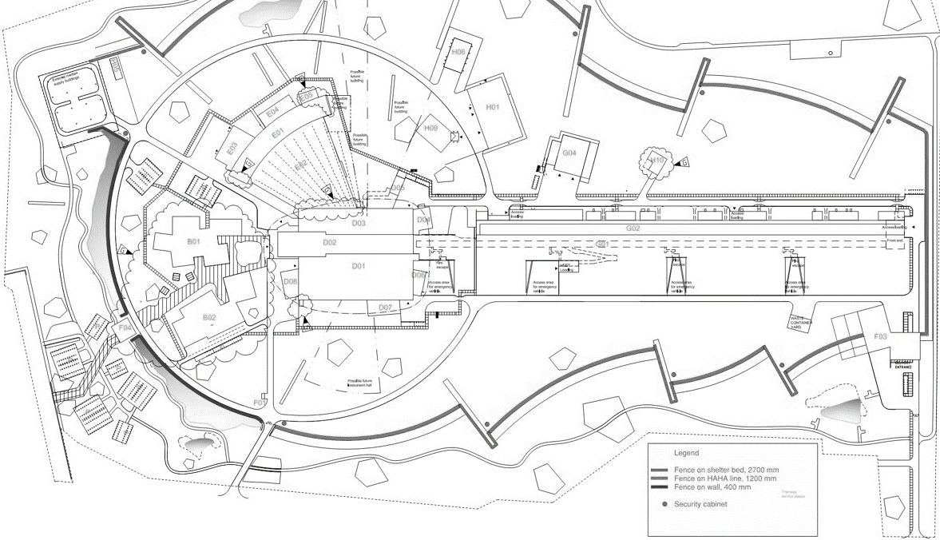
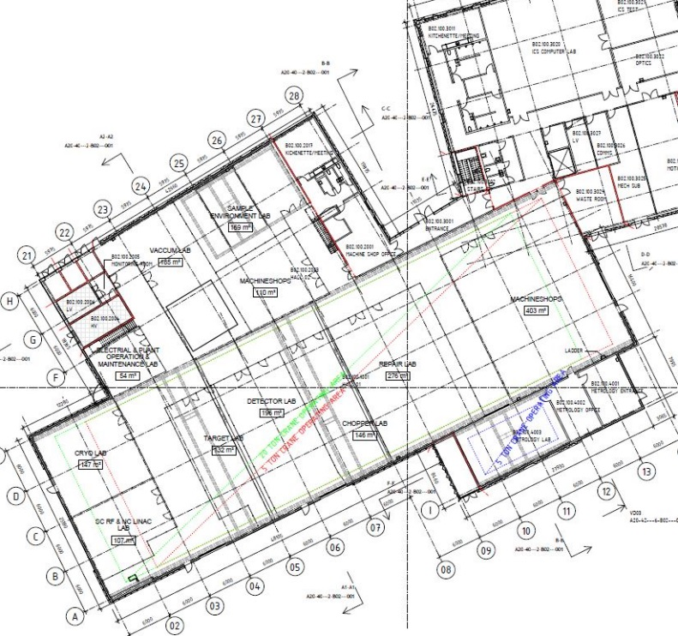
Central Technical Services: Manufacturing
STAP 2019-04-03
B02 Campus Lab/Workshop Building
B02 Central Mechanical Workshop
TTC workshop will move to B02 in Q1-Q2 2021
Expands to include more CNC machinery, wirecut and waterjet
Staff expanding to >6 central technicians by 2025
Temporary Technical Center (TTC)
B02 Mechanical Workshop
New ‘User Mechanical Workshop’ established during 2021
User workshop available to approved persons
Equipment to include:
Manual drill, lathe and milling machines
Band saw and circular saw
MMA, MIG and TIG welding equipment
Hand tools
Limited measuring equipment
B02
B02 User Mechanical Workshop
B02 Central Mechanical Workshop

Slide 9
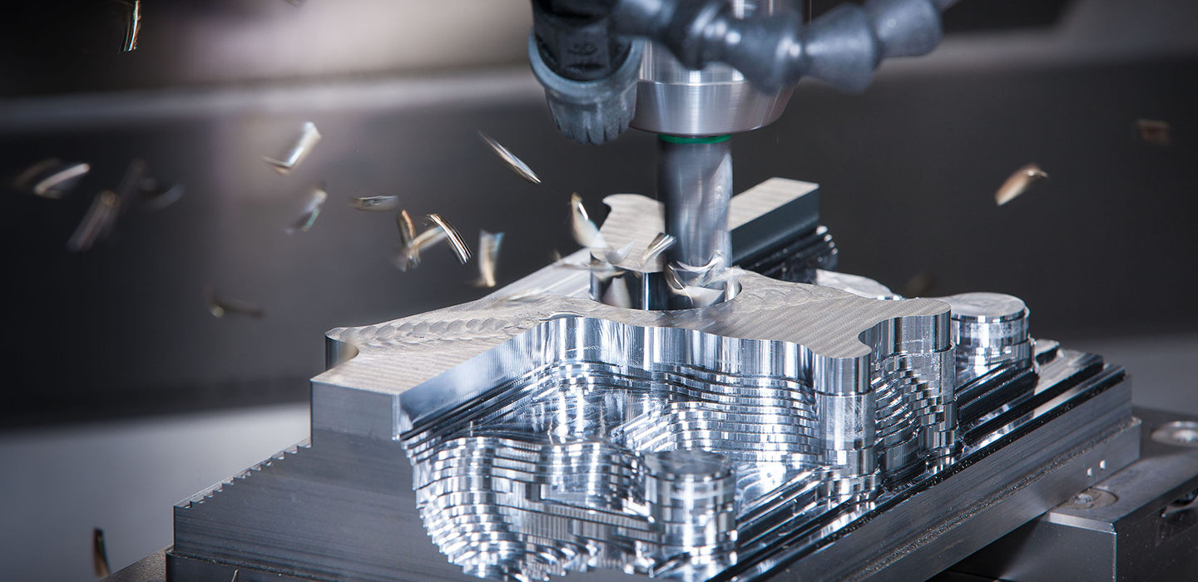
Central Technical Services: Manufacturing
STAP 2019-04-03
QUESTIONS?

