Slide 1
STAP Meeting in April 2019
–
Scientific Coordination and User Office
Update and Way Forward
Arno Hiess
Head of the Scientific Activities Division
European Spallation Source ERIC
2. April 2019

Slide 2
Scientific Coordination and User office (SCUO)
Scope, Requirements, Function - as presented and unchanged since OPS Review 2016
Requirements and Functions
  Enable user access based on scientific merit and others incl. industrial access
  Ensure community interaction and ‘industry as user’ support
  Provide training activities and collaborative industry actions.
  Internal and collaborative scientific activities; support young researchers
Scope, Features and Quality Objectives
  User program incl. proposals, feasibility, scheduling, user visits, reporting
  Scheduling minimizing losses; high availability
  User meetings, science symposia, training activities
  Organizing access for and outreach to industry; industry specific access with other hubs
  Science Focus Teams: scientific seminars and events; PhD program
Scope Exclusions, Interfaces and Responsibilities
  SCUO software maintenance [DMSC]
  External relations incl. ILO network, legal support, site access, coomunication [ADMIN, EXTREL]
  User safety training [ESH]
  Individual and collaborative scientific projects [NID, SAD]

Slide 3

Scientific Coordination – current activities
supporting future science using neutrons
Science Focus Teams internal scientific exchange, networking, web presence ‘Chemistry, Magnetic and Electronic Phenomena’ ‘Life Science and Soft Condensed Matter Research’ ‘Engineering Materials, Geosciences, Archaeology and Heritage Conservation’ ‘Particle Physics’.
Science Day in June as single event at ESS focused on Science using Neutrons.
Monthly Joint ESS / MAX IV Colloquium to start in May; further Science Seminars remain rare.
Joint ILL / ESS user meeting 2018 successful; planning for 2020 in Lund to be started
Co-located ILL / ESS booth at ECNS 2019 in preparation.
Workshop (co-) organisation, sponsoring and participation; revision of guidelines
Outreach to industry and mediators together with SINE2020 and Calipso partners: Sandvik, Synergi

Slide 4
Some Basics towards SCUO operation
To become a world leading user facility, we need scientists understanding and contributing to world leading science
Give ESS scientists some time to do science
Encourage association of our scientists with universities
Allow them to have PhD students
Build a scientific network around ESS
Host seminars, workshops and an ESS science day
Sustain and strengthen Science Focus Teams (SFTs)

Slide 5
First ILL – ESS – European Neutron User Meeting
10-12 Oct. 2018, WTC Grenoble, France
510 Participants attended (200-300 initially envisaged); very positive participants feedback
Facility Updates, Methodological Focus, User Feedback on ILL / ESS instrumentation
  Plenary presentations, Q&A session, posters, booth incl. virtual reality walk through ESS, survey
  Very much informal interaction with scientific community to ‘add value and unique possilbites for the science community … we develop our facilities with the users for the users.’ (AS)
Highlighting the great Science done using Neutrons
  10 scientific key notes, focus sessions, parallel topical workshops resulted in fire work of science (HS)
Agreed to organise such event regularly; next event 2020 in Lund (or surroundings)
https://www.ill.eu/news-press-events/press-corner/press-releases/ill-and-ess-bring-together-global-neutron-science-community-to-tackle-societys-biggest-challenges

Slide 6

User Office – current activities
Prepare for providing access to neutrons
Access Policy drafted and supported by SMT; shall soon be presented to EMT and Council; in-line with ESS statutes and European Charter of Access to RIs;
Re-baselining estimate user programme w. instr. schedule: number of users; number of PhD programme
brightnESS deliverables completed: survey, KPIs; needs KPI implementation incl. DOIs.
brightnESS2 WP2: A strategy to deliver neutrons for Europe and beyond supporting LENS WG1-2-3.
brightnESS2 WP4.3: Getting ready for industrial users
User Office Software: DMSC recruitment completed; MAX IV collaboration; lessons learned from DEMAX; functionalities: KPIs incl DOI, policy implementation; safety and security features.

Slide 7
WP2: A strategy to deliver neutrons for Europe and beyond
Objectives
2.1: Establishing a common roadmap and implementation strategy for future neutron capability in terms of the instrumentation available at neutron facilities and their partners, while taking into consideration global perspectives
2.2: Defining and reporting the needs of the user communities in terms of new neutron-based methods in alignment with the ESS facility capabilities. Regular updates will be provided when needed
2.3: Exploring and implementing new ways of working for the most efficient usage of neutrons through two pilots, an experimentally-validated Neutron Quality Label for residual stress, and strengthened soft matter and life sciences with deuterated samples, respectively
Reports on future user needs
D2.3 (M18), D2.4 (M18)
Synergies & complementarities with other Ris: D2.9 (M30)
Definition of common goals
D2.2 (M12)
Report on methodological needs
D2.5 (M24)
Common roadmap and implementation strategy: D2.10 (M34)
Engineering: D2.1 (M6), D2.6 (M24)
Soft Matter / Life Science: D2.7 (M30)
Lessons learned from pilots
D2.8 (M30)

Slide 8
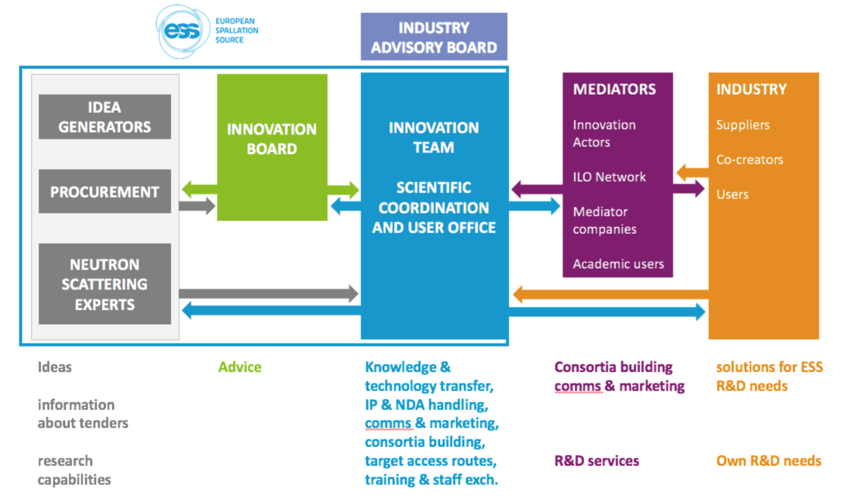
WP4.3: Getting ready for industrial users

Slide 9
WP4.3: Getting ready for industrial users
Objectives
Developing policies, processes, procedures to ensure an efficient entry point for industrial use:
  ESS Access Policy will be in line with ESS Statues and European Charter of Access to Research Infrastructures.
  Processes and procedures implemented to ensure transparent handling of contracts, including IP / NDA.
  External Industrial Advisory Board supporting implementation phase but also selection of (non-proprietary) industry-related R&D using neutrons.
  Service catalogue/price list to be developed as a sustainable and transparent offer for industrial users at ESS.
Implementing targeted access routes for industrial use:
  Project-oriented round-tables and workshops, quality assurance (such as ‘quality labels’).
  Framework for topical training for mediators and industry.
  Innovation-based (non-proprietary) access criteria.
Creating a human resources environment enabling innovation by using neutrons:
  Exchange of staff between neutron sources, mediators and industry.
  Provide hands-on training to ESS staff, increase their skills to effectively engage future industrial users of ESS.
  Provide incentives and career development based on “results for industrial users”.

Slide 10
SCUO activities for 2019 / 2020 and beyond.
Additional Information and Schedule
SCUO Deliverables in 2019 / 2020
  input to access policy and its implementation; adapt and optimise procedures based on the best practice at other facilities
  develop and promote new access modes for (academic and industrial) users; implement key performance indicators for ESS’ impact.
  liaise with with DMSC (SCUO software), local / regional / European Ris; coordinate organisation of the ESS - ILL user meeting 2020.
Brightness2 deliverables 2019 / 2020 on WP2: roadmap and strategy for neutrons
  work with partners on roadmap: common goals (M12), methodological needs (M24), implementation strategy (M34)
  liaise with ENSA and non-European partners to report on future user needs (M18), synergies / complementarities with other RIs (M30)
  liaise with the responsible for the pilot projects (engineering, deuteration) on lessons learned (M30)
  support the director for science on LENS initiative (execution board) and linking it B2.
Timeline
  Initially plan: 3 yrs; VE 4/2017: 1 yr (STAP commented to be not credible), re-baselining: 2 yrs; brightness2: back to initial planning.
Reputational damage by further delaying SCUO implementation
  Will not deliver on BrighnESS2 WP2, impacts first science during hot commissioning, high visibility with LENS & community.

Slide 11
Charge for the Scientific and Technical Advisory Panels
‘Sample Environment’ and ‘Samples and Users’
Samples and Users
  DEMAX: start initial operation deuteration & crystallisation support service incl. proposal administration & user survey.
  DEMAX: closer integration of the three DEMAX support pillars with respect to staffing & projects.
  DEMAX: synergies and consolidation of on-site and off-site lab infrastructure; options for future DEMAX location.
  DEMAX: scientific collaborations & developmental projects: establish new capability via grants (SINE2020, VR, B^2).
  DEMAX: strengthen the DEUNET network as part of LENS initiatives.
  DEMAX: own ESS priorities for first science and beyond; 3rd DEMAX chemist position (competence and activities)
  DEMAX: commercial collaboration with DEMAX “pay for play” – Should we? How?
  SULF: progress of the SULF platform in respect to installation planning and moving to the on-site labs.
  SULF: internal projects with accelerator / target; setting-off lab investment by external collaboration.
  SULF: way forward with chemical hazard analysis applying and complying with Swedish law for working with chemicals.
  SCUO: lessons learned DEMAX; way forward ESS user office software: functionalities, KPIs, DOI, policy implementation
  SCUO: next steps towards establishing SCUO; transition functions from DEMAX to SCUO.

