Slide 1
ESS Update
DEUNET Meeting, 25th April 2019
Anna Leung
www.europeanspallationsource.se
19-04-24

Slide 2
Chemical deuteration
The chemical deuteration laboratory has a
long-term home in Medicon Village (five-year lease negotiated in 2018)
Equipment: GC-FID, automated FCC, rotary evaporator, pH controller, freeze-dryer, analytical and analytical to semi-preparative HPLC system, rotating bed reactor, Nanodrop spectrophotometer, 1 L Parr reactor
Access to NMR, MS via RGD, LU
ESS
MAX IV
Chemistry D-lab
Biolab & Crystallization

Slide 3

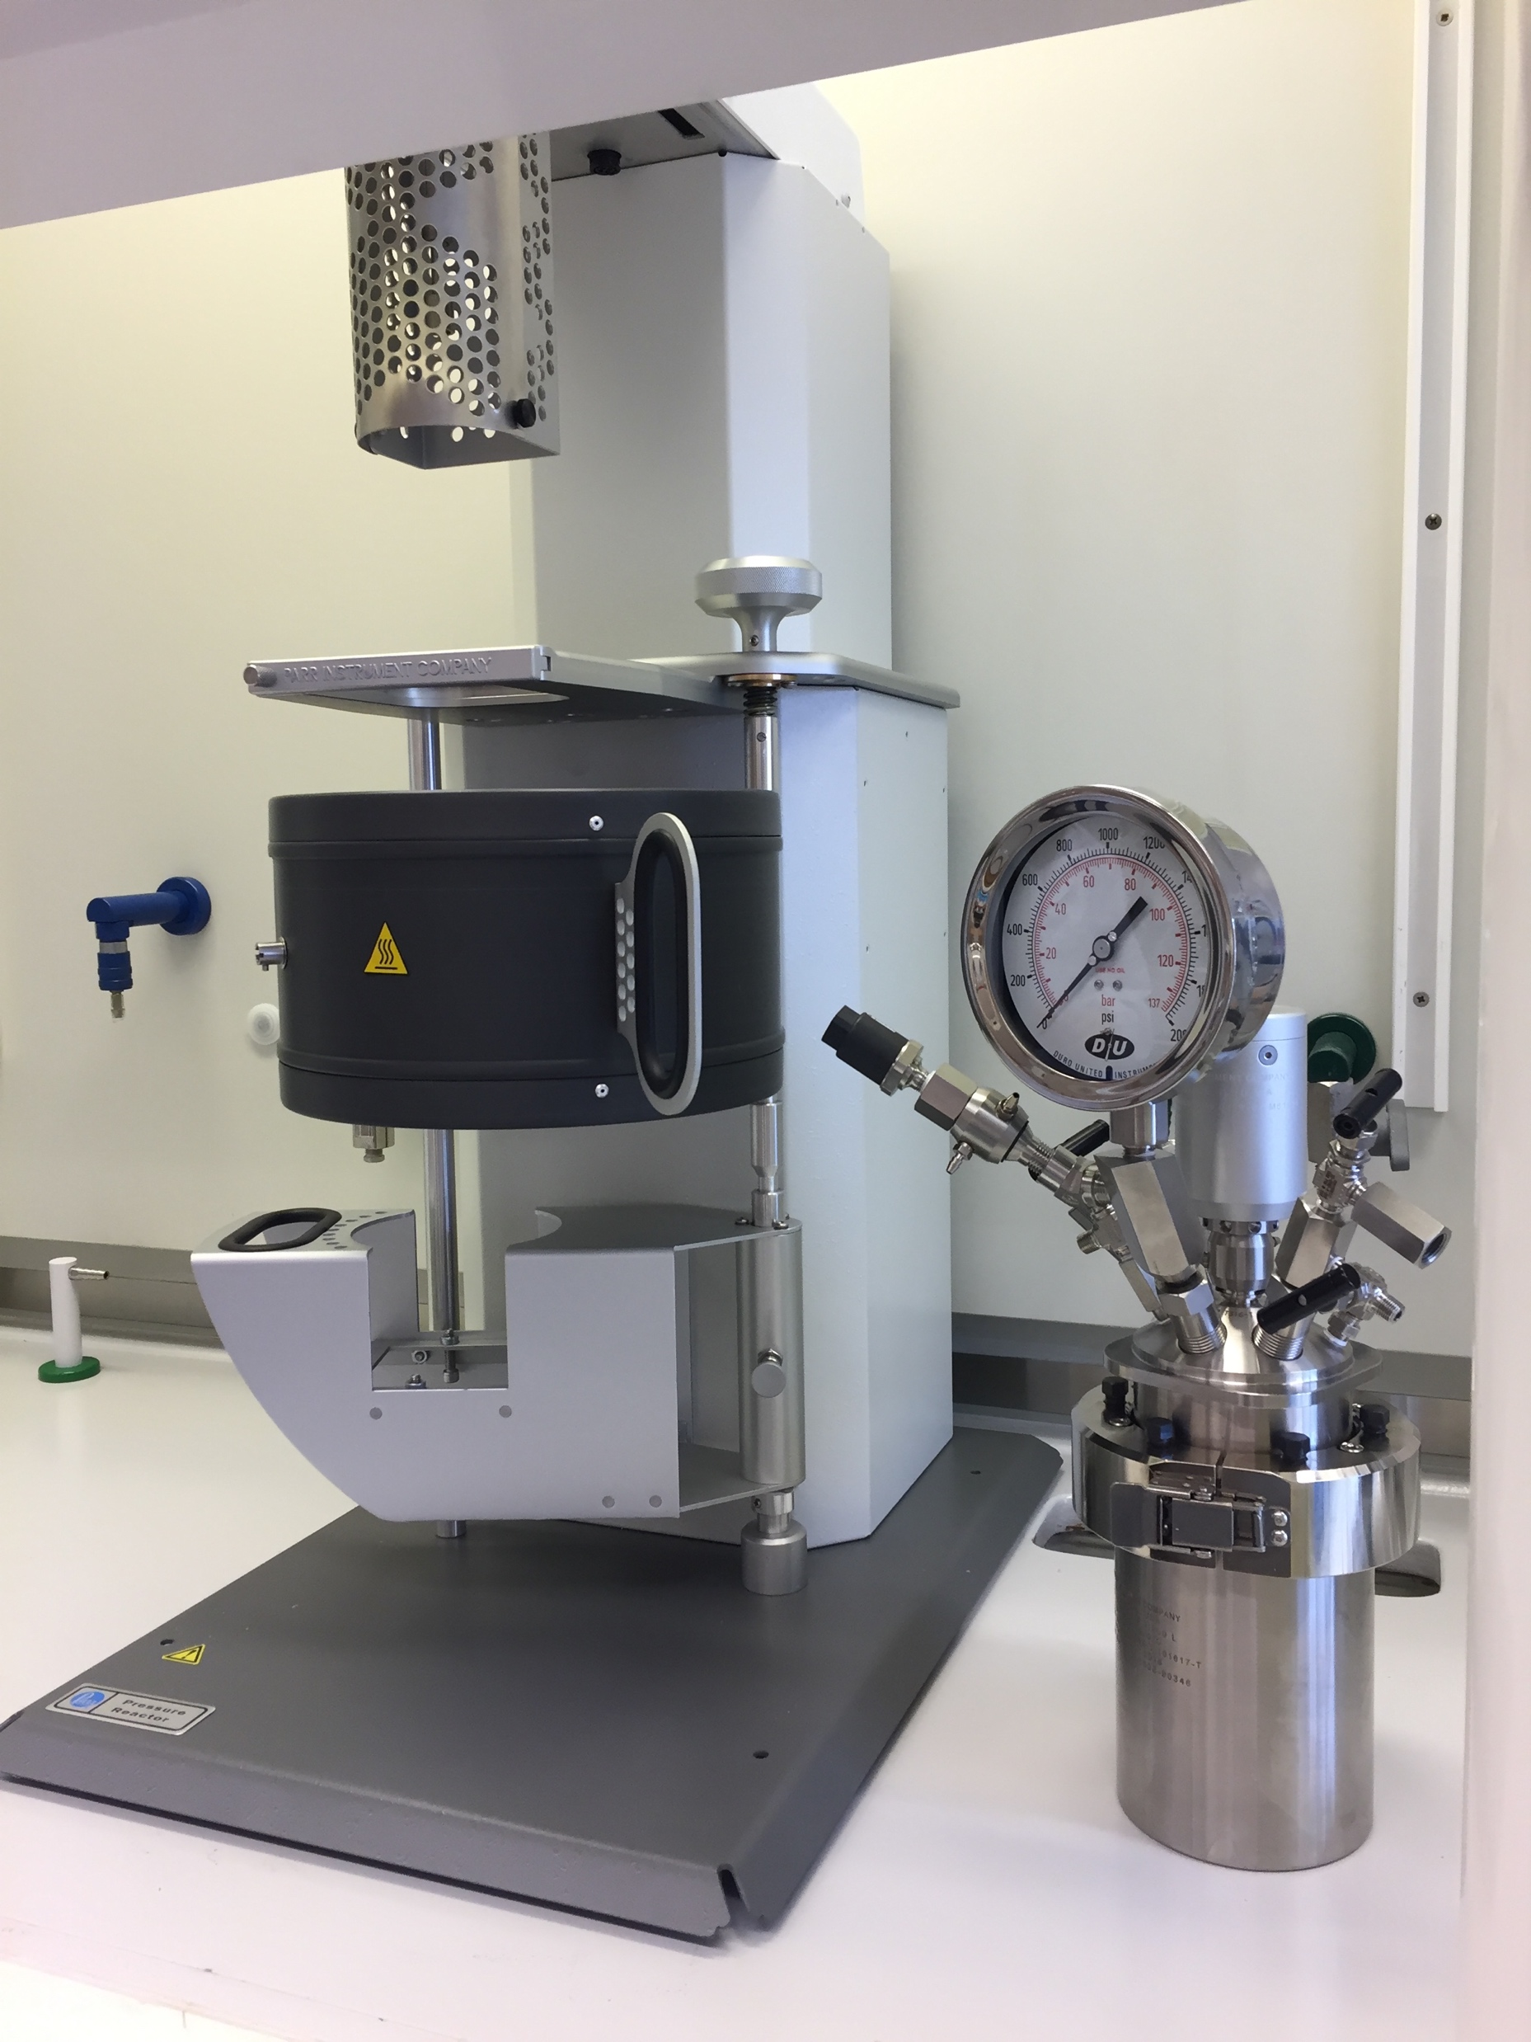
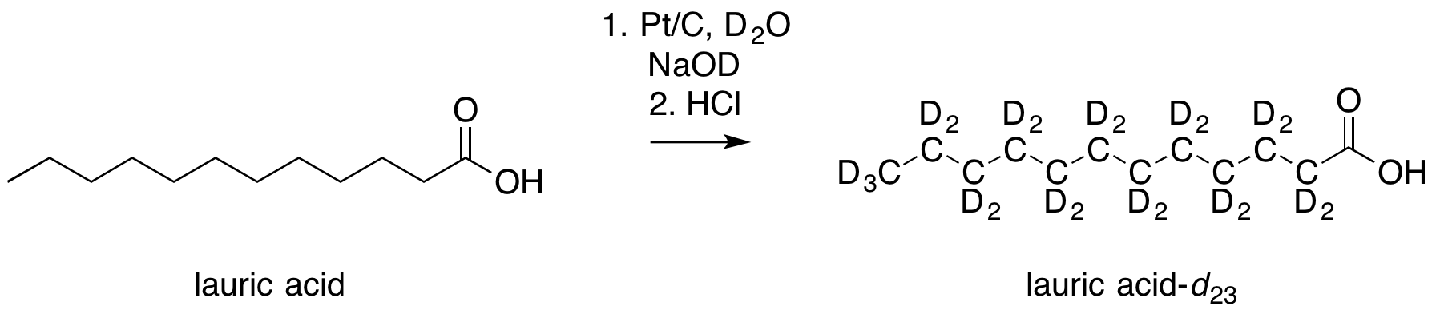
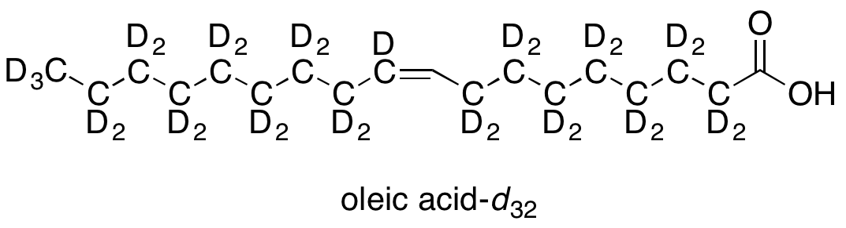
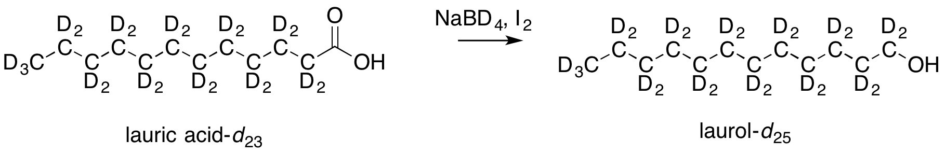
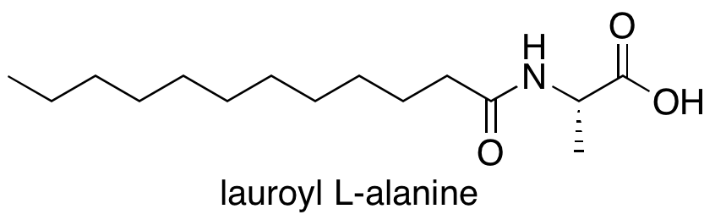
H/D exchange; synthesis of lipids and surfactants
Perdeuteration of saturated fatty acids (C9, C12, C16) and diacids (C9), and oleic acid (C18:1):
Method of reducing deuterated carboxylic acids to deuterated alcohols without LiAlD₄ (no longer commercially available); with ANSTO:
Synthesis of chiral amino acid surfactants:

Slide 4
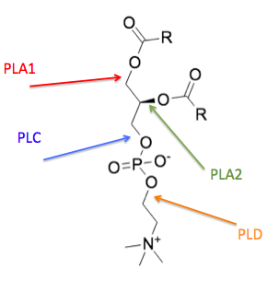
Enzymatic modification of phospholipids
Enzymes as catalysts:
CLEANER and GREENER: fewer by-products, toxic chemicals
SPECIFIC: fewer side reactions; increased atom economy, simpler purification
RECYCLABLE: if immobilised
Phospholipase enzymes (PLA1, PLA2, PLC, PLD):
React at specific positions of phospholipids
PLA1 and PLA2 can be used to specifically
exchange chains for deuterated chains
Some lipases can replace PLA1 (these are more accessible and better studied)

Slide 5
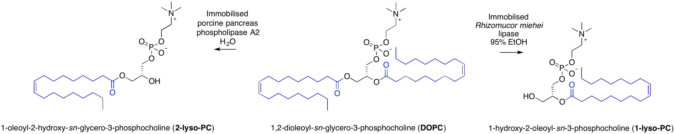
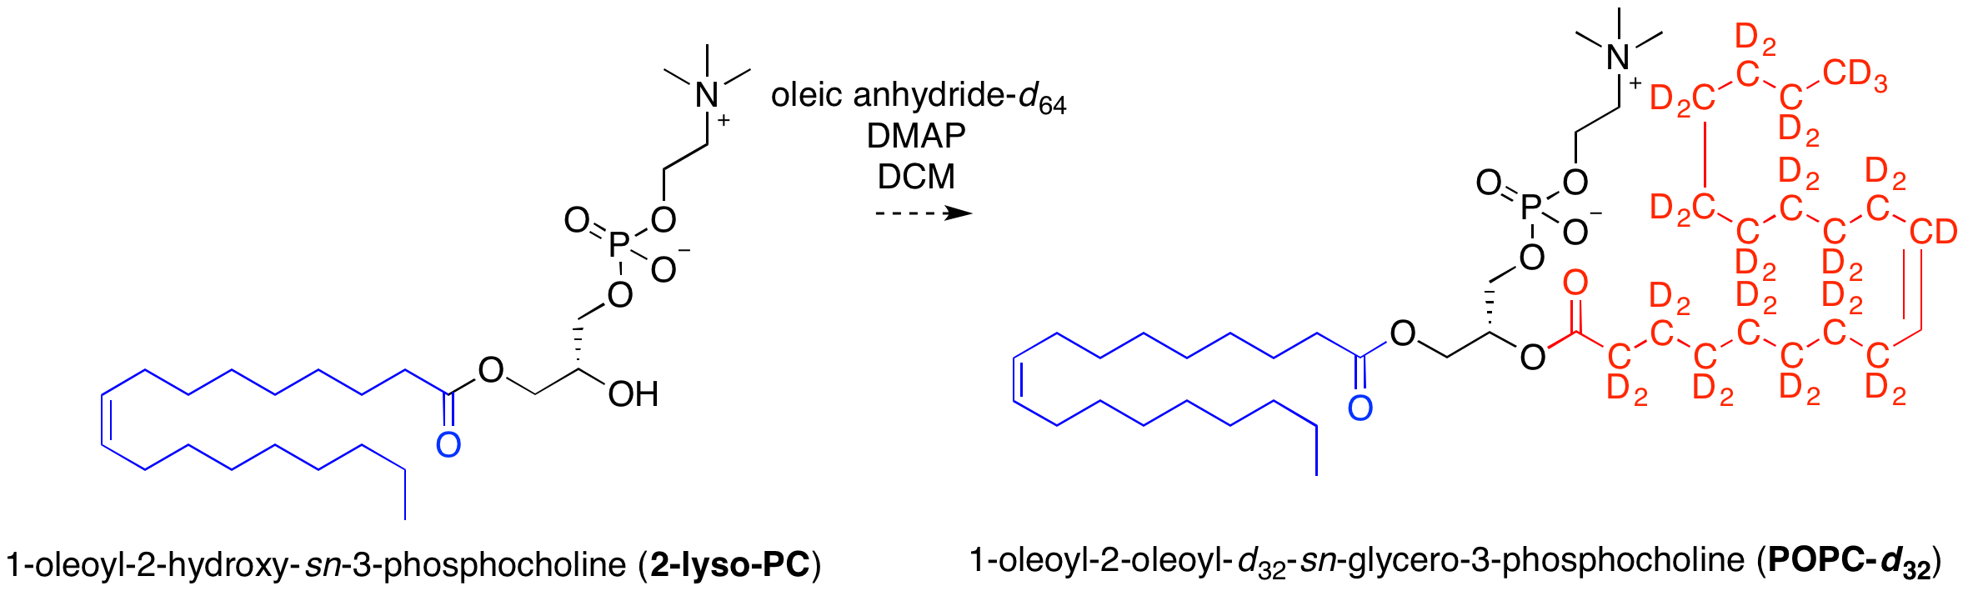
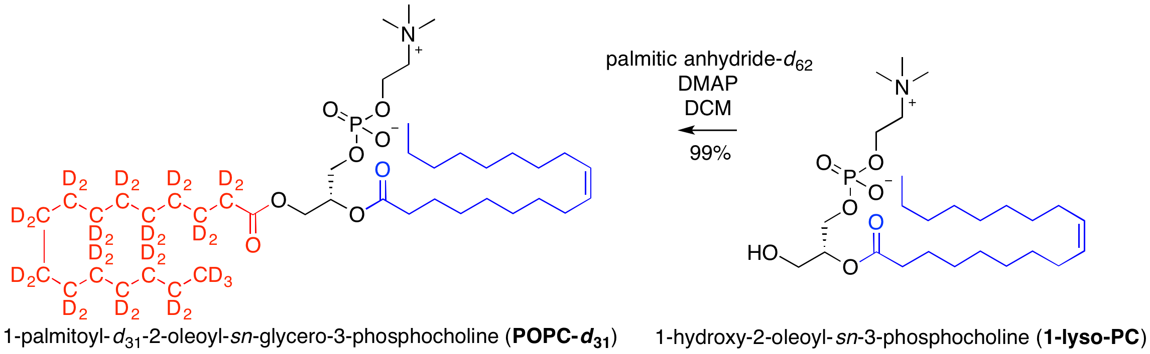
Chain-deuterated POPC in four steps (100 mg)
BrightnESS² is funded by the European Framework Programme for Research and Innovation Horizon 2020, under grant agreement 823867
Specificity of enzymes allows us to hydrolyse one chain of DOPC:
Discrimination isn’t required for the esterification reaction…

Slide 6
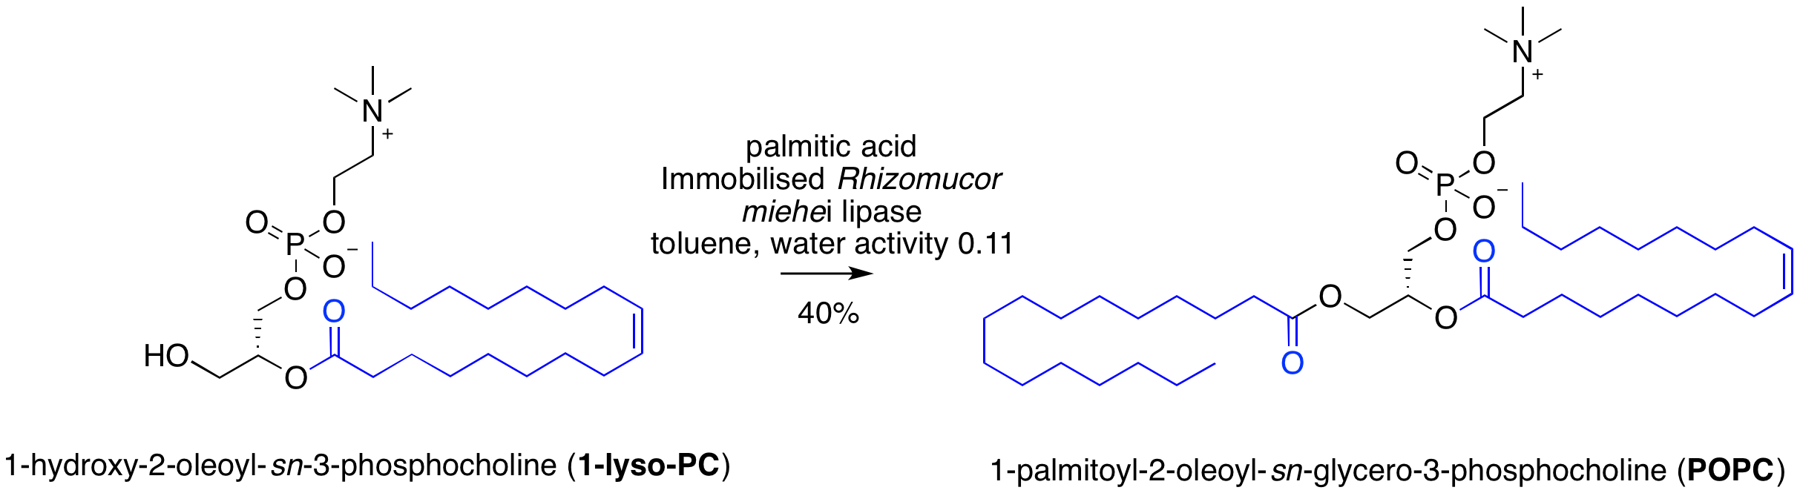
…but the chemical esterification may be problematic in other ways
  side reactions lead to impure products
Under the right conditions, the enzymes can catalyse the reaction in reverse (and suffer fewer side reactions):
Future work:
  chain-deuterated POPE
  oxidised lipids
  unnatural lipids
  perdeuterated single lipid species ie POPC (via enzymatic modification of biological lipid mixtures)

Slide 7

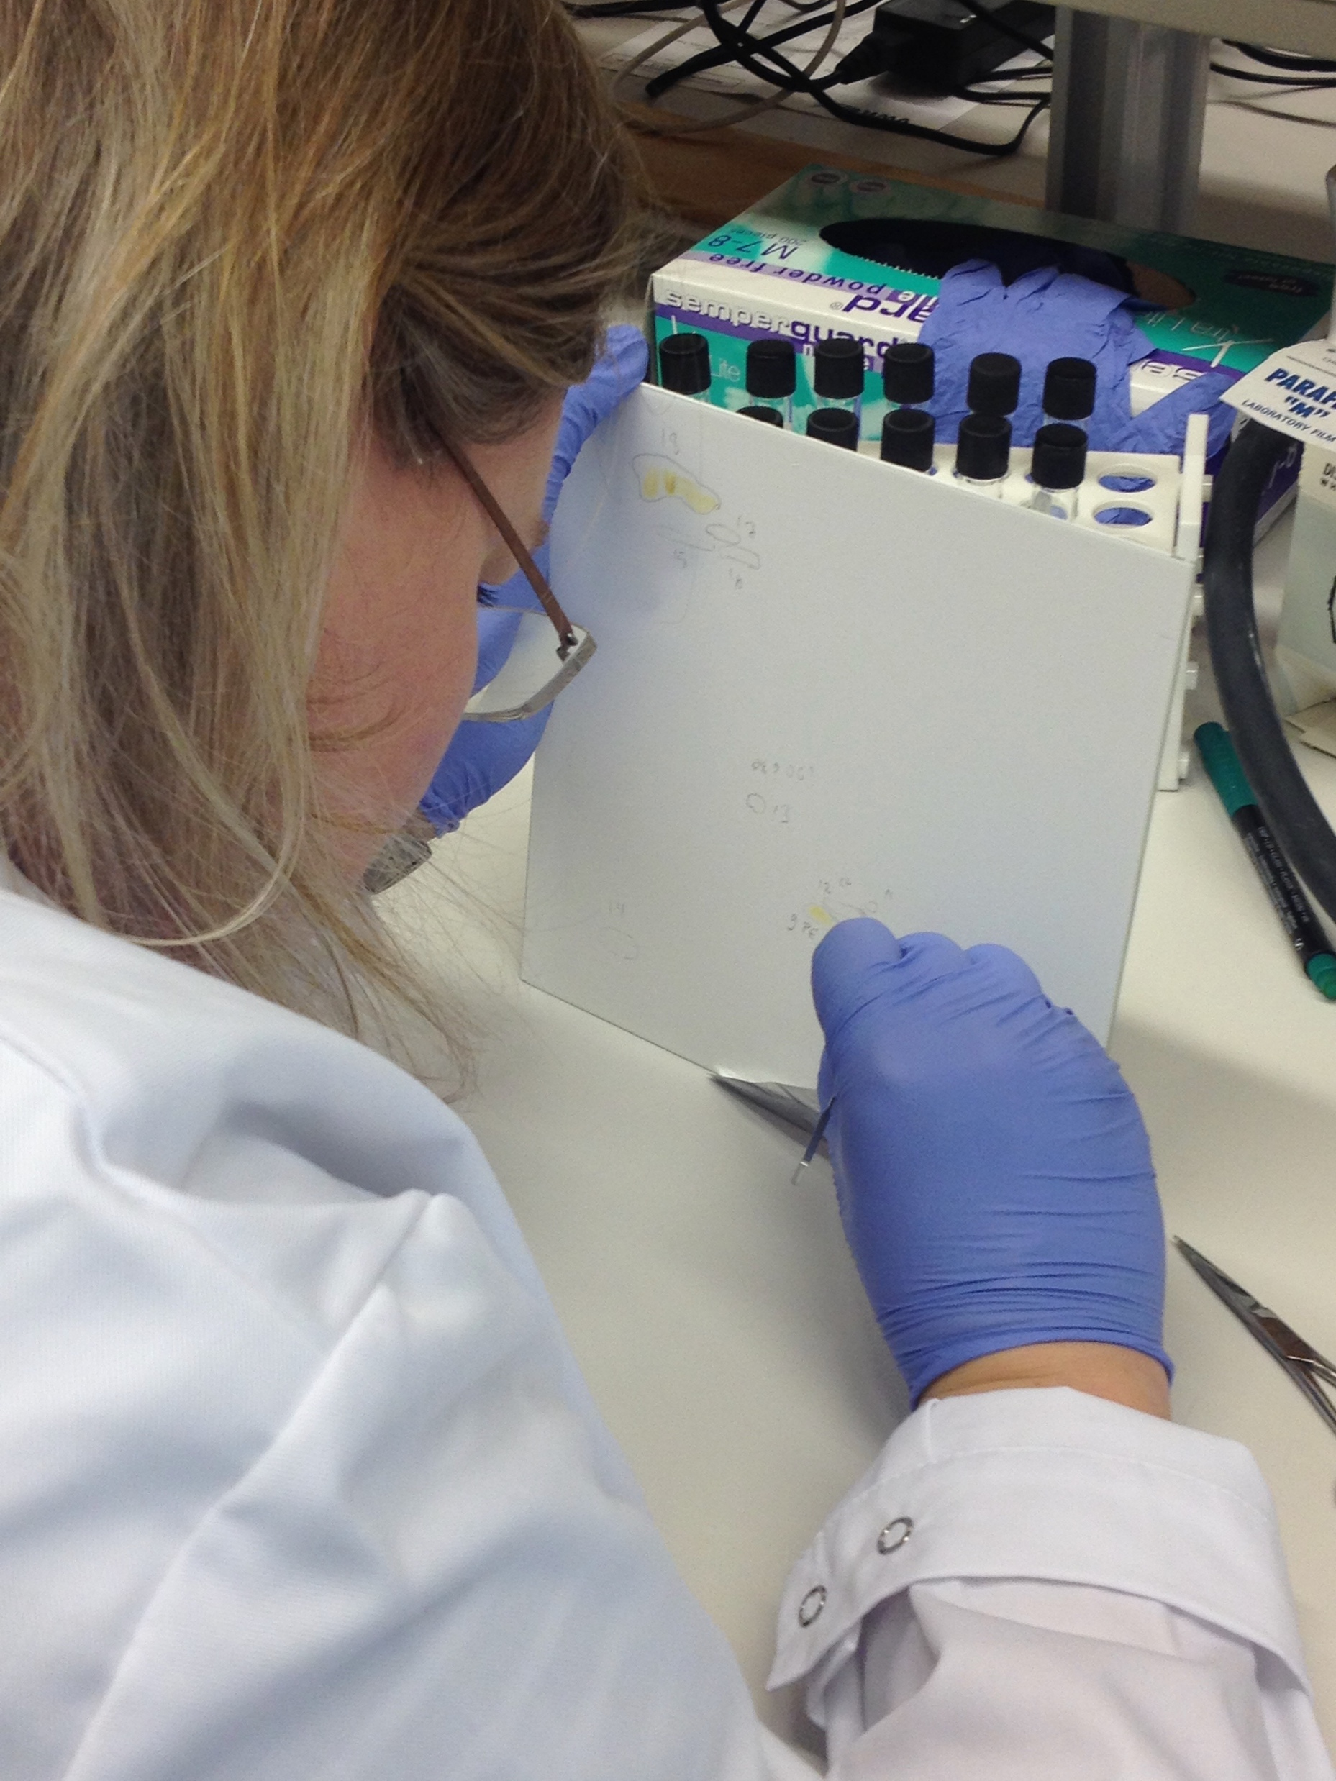
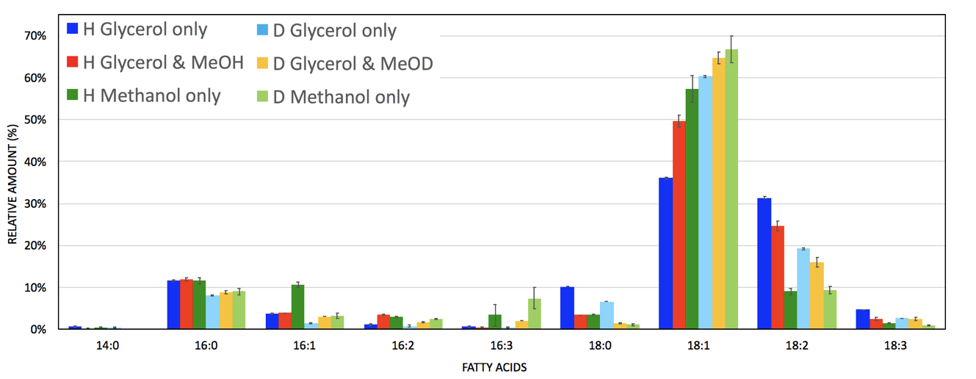
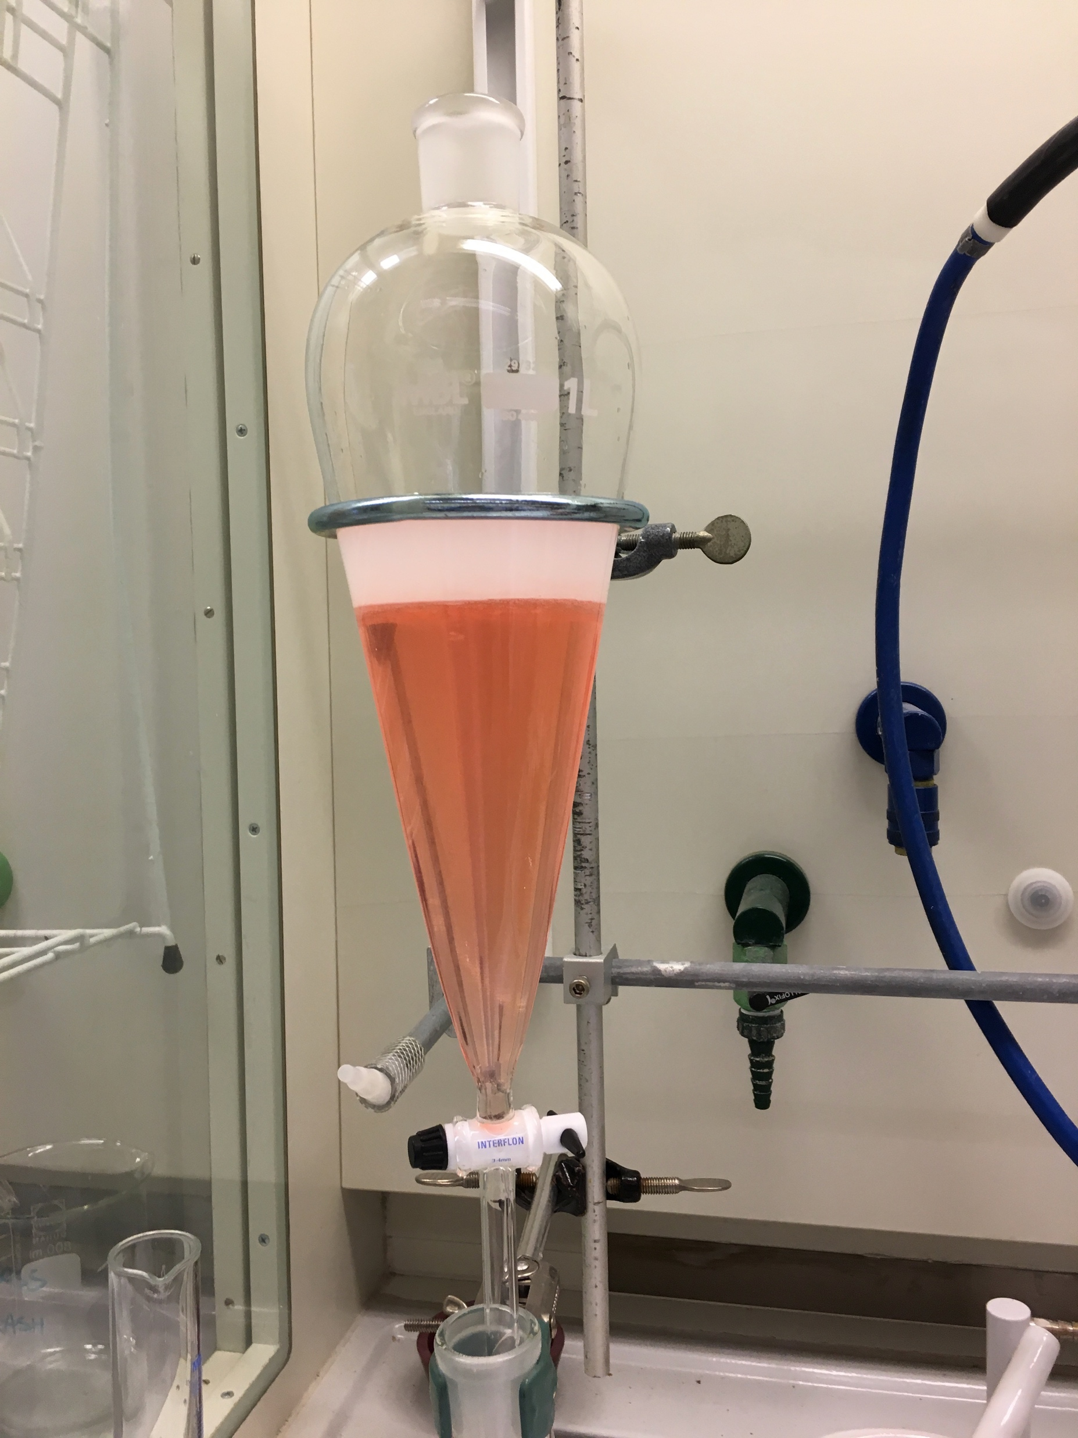
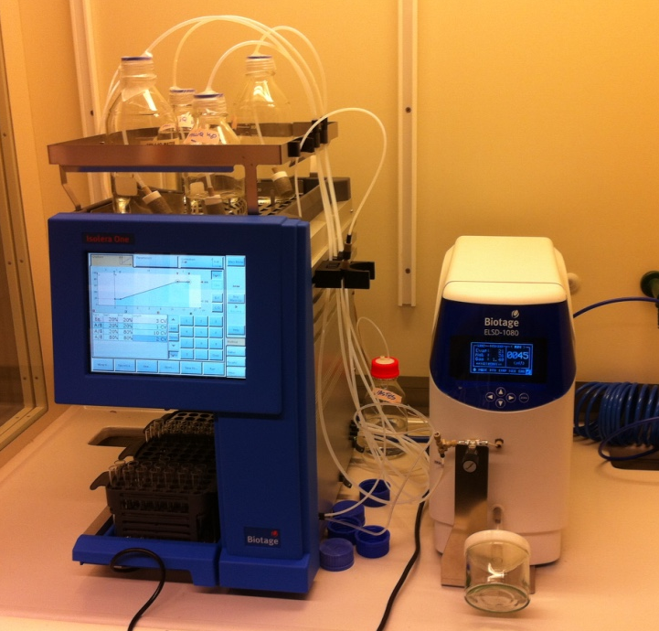
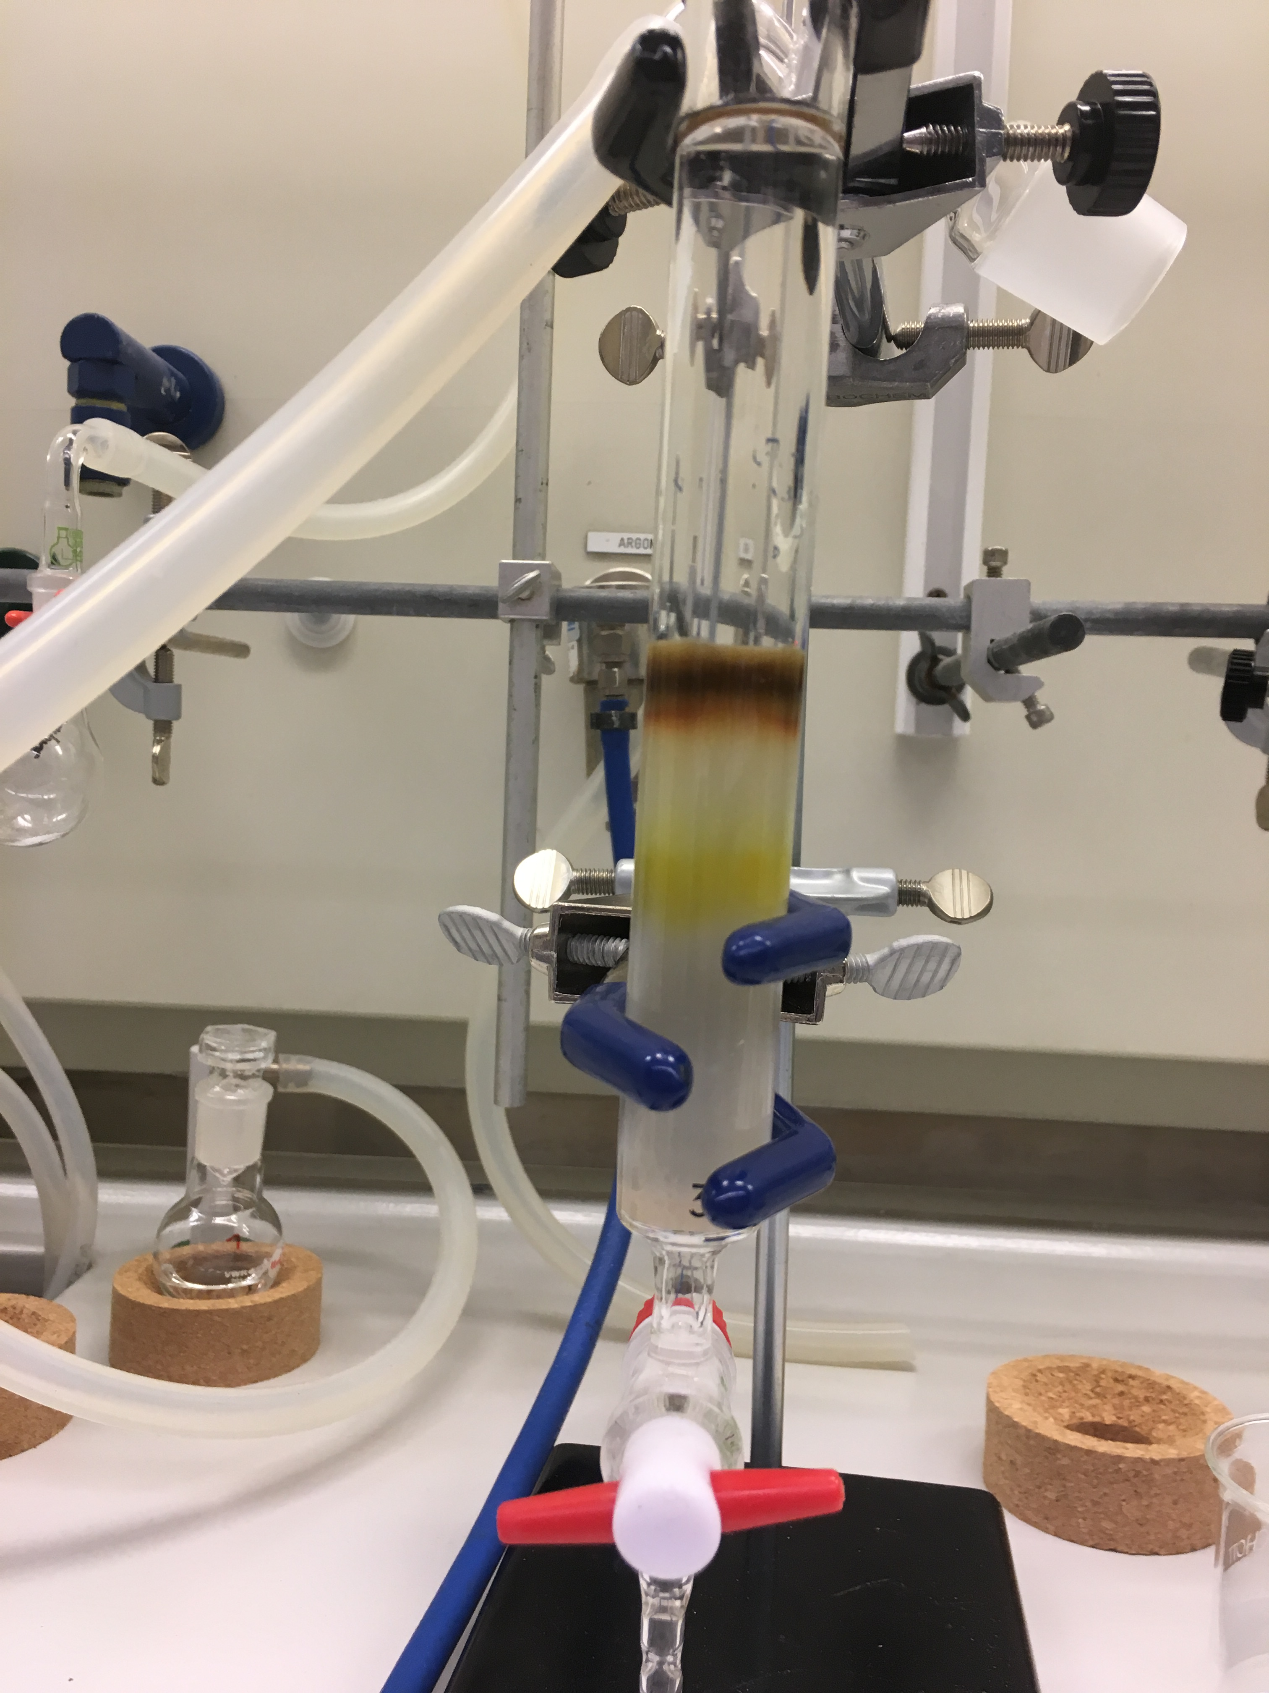
Lipid extraction, purification, analysis
Biodeuterated lipids from Pichia Pastoris yeast biomass
R.Delhom ESS/ILL PhD 2014-2017
Current capabilities:
Total lipid extracts
Non-polar lipid separation
Total phospholipid extracts
Sterols
Analysis, %d (TLC, GC, MS)
On-going:
Separation of phospholipid classes
Reverse-phase HPLC
Effect of carbon source on lipid composition
d-ergosterol
7

Slide 8
DEMAX in operations
The Deuteration and Macromolecular Crystallisation (DEMAX) Platform at ESS entered Initial Operations this year
The DEMAX team: Zoë Fisher (DEMAX Platform Leader)
Hanna Wacklin-Knecht
Anna Leung
Oliver Bogojevic
Our first proposal round was open 25th February-5th April 2019; we asked for expressions of interest in addition to offering the following materials:

Slide 9

19 proposals were received (chem/bio/cryst); these are currently under review
Successful proposers will be notified in May and materials will be delivered by November 2019
The call for the second round will be published in late 2019
https://demax.esss.se
https://deuteration.net
@deuteration_net

