Slide 1
Data Systems and Technology
STAP April 2019
Jesper Rude Selknæs

Slide 2
The team
Brian Lindgren Jensen
Jesper Rude Selknæs
Kareem Galal
Lottie Greenwoold
Jacinto Vera Garcia
Alexandre Stefanov – starting May 1st. 2019
Contract negotiation on going for an external funded position (PaNOSC)

Slide 3
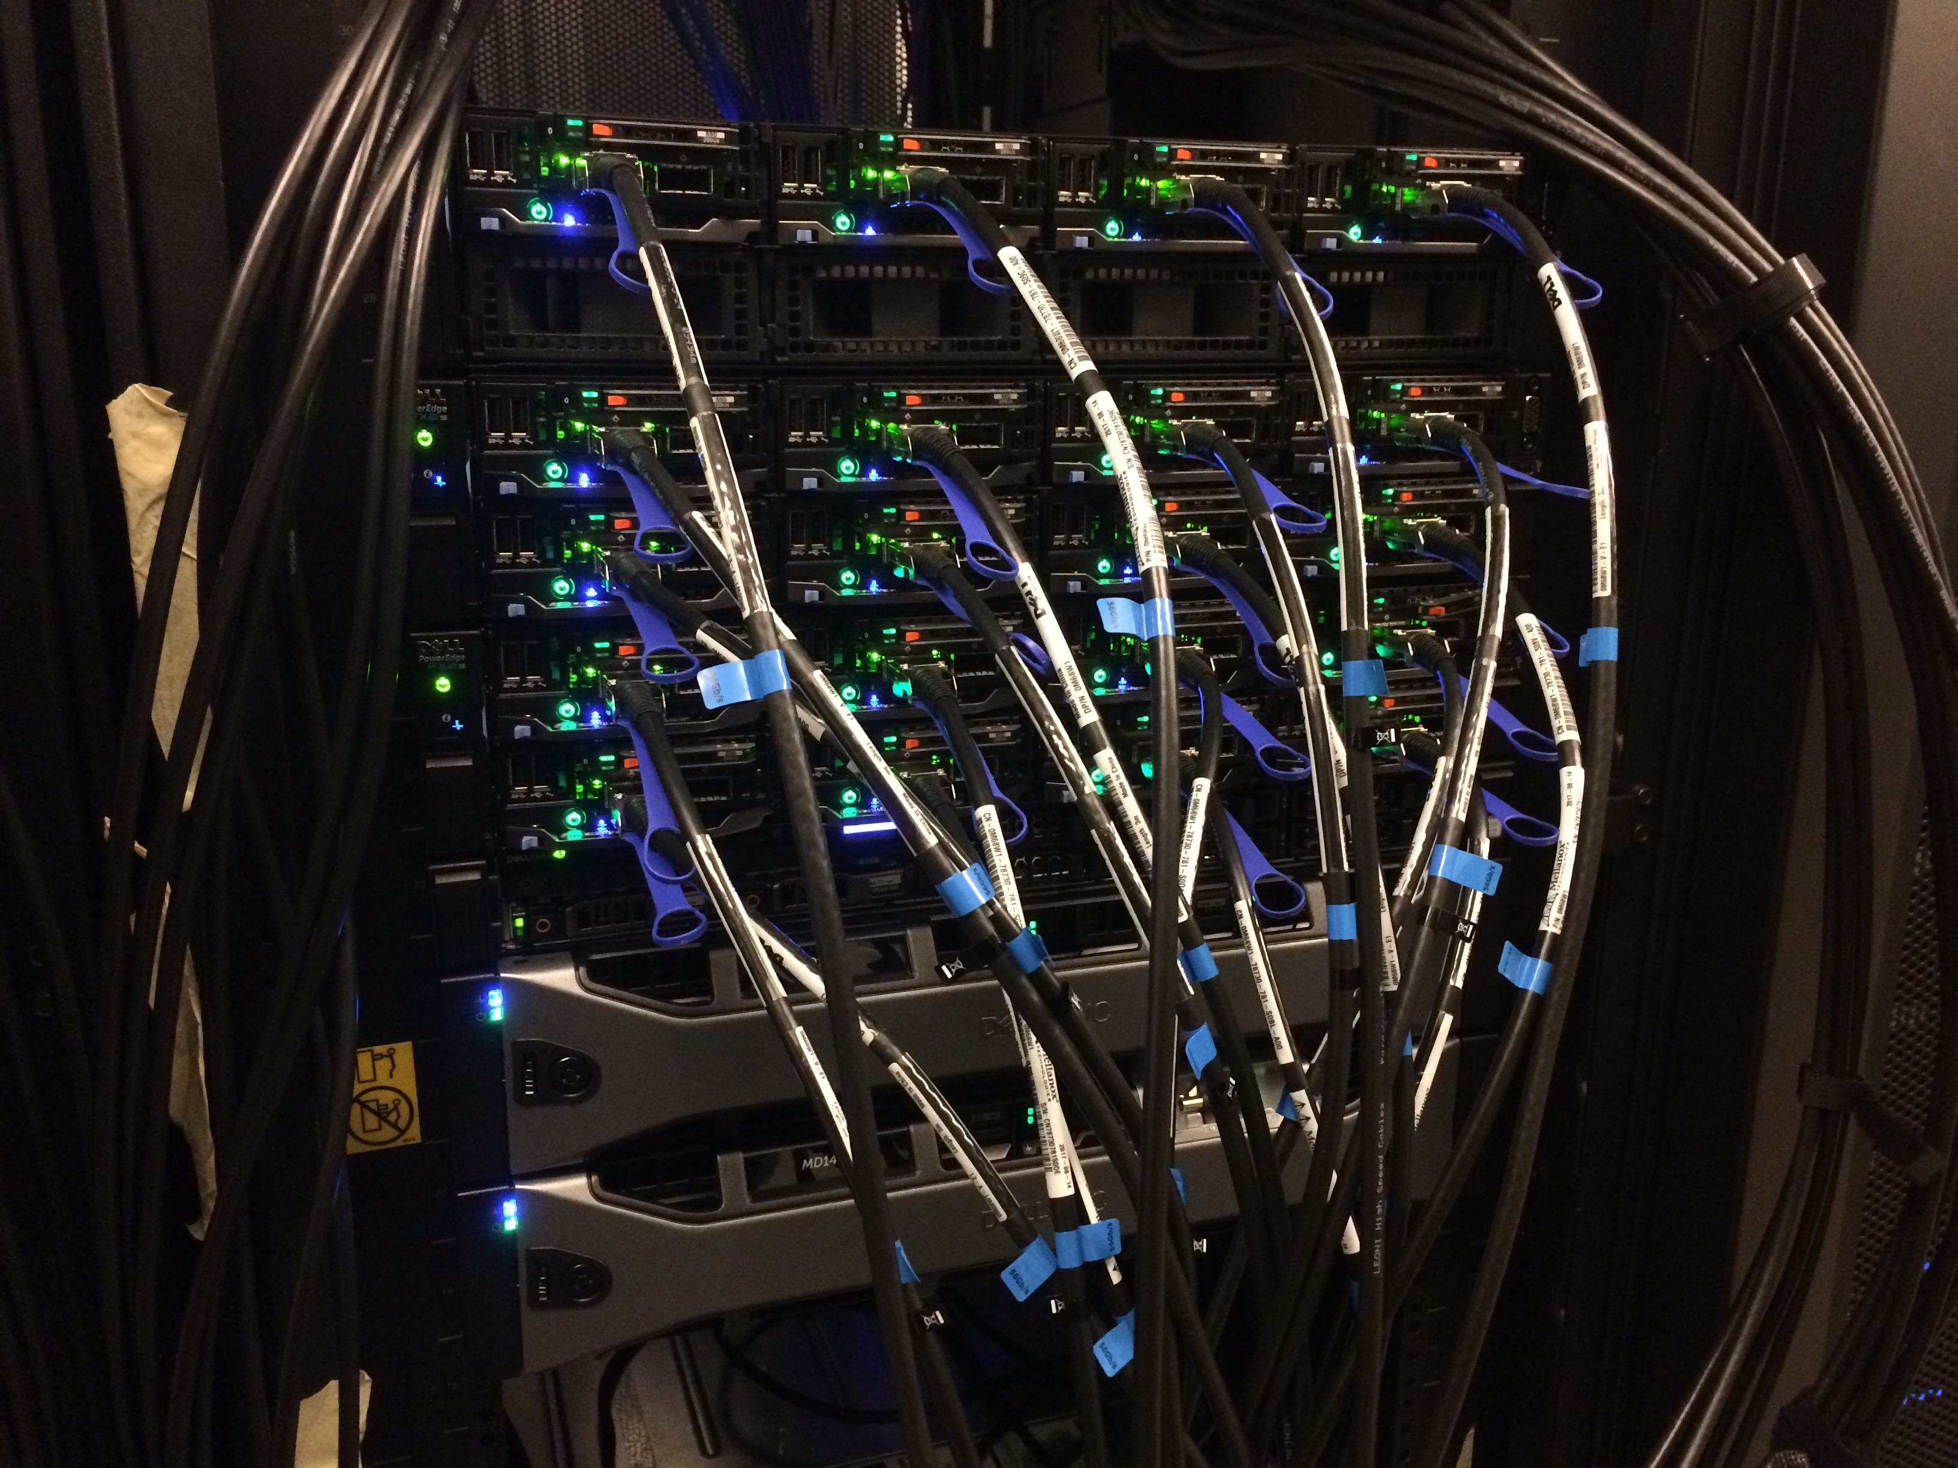
Planning our work
H2 2018 was completed with some task handled in Jan
August
September
October
November
December
Main firewall on DevOps
Storage system final design
Kubernetes cluster for Data curation
Integrated design
10G in prelim use
Ossec Monitoring
Upgrade and Puppetize Lustre
Hiring complete
Puppetize ZFS
Server rooms (CPH) +(CUB) procurement process complete
EOSC WP5 w DESY
Cooling outage
VPN to Lund for office network
Roll out of network in new DRAM offices
LDPC Demo
PaNOSC prep.
The hiring for for construction phase was completed in 2019
The final storage design is work in progress due to staff situation in the group
Procurement of the CUB (Lund) server room was finished march 2019 due to delays at ICS and procurement

Slide 4
Planning our work
H1 2019 is progressing more or less as planned
January
February
March
April
May
Procurement of site-to-site link
Storage system final design
Initial network design completed
Site-to-site link established
CPH server room design phase
Upgrade all virtual hosts to 10Gb/s backbone
RFI for storage systems published
Jupyter hub deployed for DMSC as part of PaNOSC
Plan for moving from interim data center to CPH server room in place
June
CPH server room construction started
GPN design work part 1
engaging in synergy works
CUB server room procurement completed
Initial works for site-to-site link conducted
Monitoring improvements
DevOPS improvements part 1 completed
RFQ fir storage system published
Cross facility working group on future technologies in place

Slide 5
Collaboration
Software deployment
  Strong collaboration across DMSC in the LDPC
Cyber security:
  GDPR work on going.
  DST is providing the LISO function for the division.
  Engaging with the CISO on all matter of security in the ESS organization.
Network
  Contracts in place for the site-to-site connection.
  Technical work on going
  Engaging in the network synergy group of ESS consisting of representatives from DMSC, Corporate IT and ICS
  Being an active stakeholder on the design and implementation of the General Purpose Network
  at the ESS site in Lund. This includes DMSC, Corporate IT and ICS.
External
  EOSC pilot completed
  PaNOSC project on going with DST playing a part in WP4, WP6 and WP8.
  Engaging with UCPH on collaboration regarding masters students.

Slide 6
Data center design
Server room in both Copenhagen and Lund is being driven by Brian Lindgren Jensen/DST.
Lund
  A contract for construction of the server room has been awarded.
  Ongoing discussions with CF to agree on scope.
  Current realistic access date is October 1st 2019.
  Initial arrangements has been made for temporary test space.
Copenhagen
  The construction is on-going

Slide 7
Server room Copenhagen
Phase 1: 8 racks, 150KW, Redundancy level N,
Phase 2: 15 racks, 200KW, Redundancy level N+1 – Scheduled for 2022
Phase 3: 30 racks, 300KW, redundancy level N+1 – Scheduled for approx. 2027
Phase 4: 30 racks, 600KW, redundancy at level at least N+1 - Scheduled for beyond 2030.
Status:
  Phase 1 under construction in the COBIS building
  Options for preparing for 600KW upgrade invoked since this will cause less downtime when upgrading and will result in a lower total CAPEX for all phases and also a lower OPEX when running in phases 1 through 3.
  Project on track – access date is early September 2019

Slide 8
Server room Copenhagen phase 1

Slide 9
Server room Copenhagen phase 2

Slide 10
Server room Copenhagen Phases 3 and 4

Slide 11
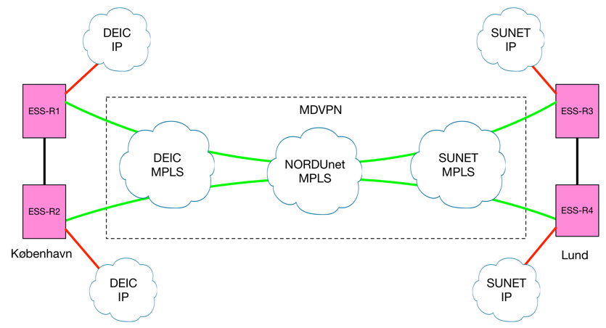
Site-to-site connection
10Gb/s L2 VPN – connection as a service
Redundant and expandable to 400Gb/s
End routers is Juniper MX204 – already installed in Lund, while CPH is on-going.
Procurement of DST equipment on-going
Temporary space for testing in Copenhagen has been identified
Temporary space for testing in Lund is to be identified.

Slide 12
Storage systems
DST has submitted a Request for Information (RFI) for storage system solution in preparation for an tender.
Detailed design work is on-going
To enable early test Tobias Richter from ECDC has arrange for a 1PB 24GB/s Spectrum Scale loaner system to be deployed for 6 months in the Utgaard lab.

Slide 13
Future technologies
Participating in the Super Computing conferences (SC18) – Lottie Greenwood
Engaged with vendors presenting current and future solutions on the following subjects:
  Off-site hosting
  Recent development in using HPC for machine learning
  Recent developments within storages systems from 3 vendor since beginning of 2018.
Participating in relevant courses:
  3 staffers on IBM Spectrum Scale course in April 2019 (Brian Lindgren Jensen, Jacinto Vera Garcia and Kareem Galal)
  1 staff member on FitSim course (Kareem Galal)
  1 staff member on C/C++ course (Brian Lindgren Jensen)
Working group on future technologies with other facilities is work in progress

Slide 14
Future hardware procurements
By engaging in the newly formed synergy groups on IT related topics DST is working towards a more coherent set if hardware components which will help on procurement processes.
It has proven valuable to have upgrade options as parts if tenders (server room and 2017 compute cluster expansion)
DST has been working actively with procurement since 2013 and has established good relations to the procurement division – not that challenges does not exists but procurement processes seems to run smother and smoother.
Experiences from larger procurements is kept on record with DST.
Most recently DST has identified the correct way of circumventing normal procurement rules in the case of a catastrophic event.
DST has submitted a crude procurement plan for 2019

Slide 15
Questions for the STAP
We request advice and recommendations on our procedures to identify core hardware technologies specifically storage technologies.

