Slide 1
Introduction, PDR Recommendations &
TS2 PSS Safety Analysis
TS2 PSS Critical Design Review
Stuart Birch
ICS-Protection Systems Group- Senior Engineer Personnel Safety Systems
ESS/ICS/PS
2019-04-09
Notes:
Appologise for not having all of the documentation ready for this review

Slide 2
Contents
Welcome
PDR Recommendations
TS2 PSS Safety analysis
  IE Analysis
  SIL Determination
  SRS
  SIL Verification
Example of the Process for a TS2 PSS function (Waveguide Removal)

Slide 3
Welcome
Thank you everyone for attending today’s CDR for the TS2 PSS.
Critical Design Review (CDR)
The CDR verifies that the specified requirements are met by the detailed design. A CDR demonstrates that the maturity of the design is appropriate to proceed into implementation and installation.
The charge for the CDR – ESS-1083622
The results of the review shall be summarized in a short report, outlining the answers to the above review questions and whether the review is considered passed, passed with action items, or failed.
The report may also provide findings, comments, and recommended actions.
Actions should be clearly categorized as one of the following:
  Must be addressed before CDR is considered closed
  Must be addressed prior to the system verification
  Must be addressed Post CDR

Slide 4
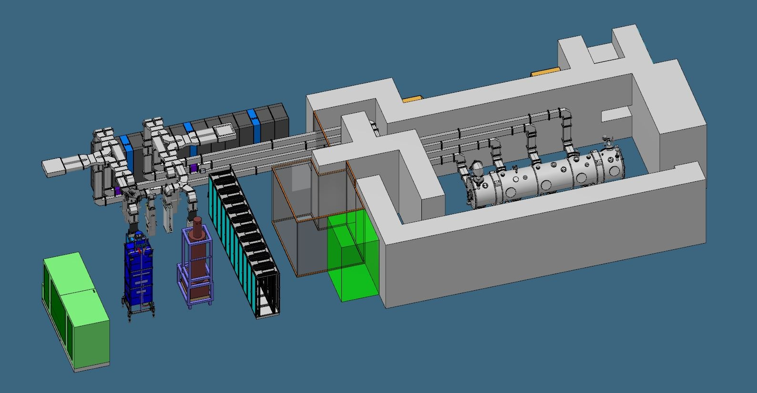
TS2
TS2 Control racks
Removable Waveguides
Heavy Shield
Door
Cryo-Module
Modulator
Bunker Access
TS2 Bunker
Klystrons

Slide 5
PDR Recommendations
TS2 PSS Critical Design Review
ESS/ICS/PS
2019-04-09

Slide 6
PDR Recommendations
PDR Recommendation 1.
Add changes in operation procedures so that the waveguide removal interlock is rated at SIL 2. Report the solution to this issue at the CDR.
ETA for TS2PSS_IE3 – Failure to remove removable part of RF waveguide before the Klystron test

Slide 7
PDR Recommendations
PDR Recommendation 2
Explicitly show the cross references and traceability between risks and requirements in the documentation.
Section 4 of Initiating Events Analysis Document ESS-0468688 Table 2. Maps the:
Initiating Event id
Hazard from Risk assessment
Hazards from the Initiating Event Register
IE ID | Hazard, from RA | Hazard, from IEs Register | IE Description
TS2PSS_IE1 | 1.1.1a, 1.1.1b, 1.1.6 | TS2_HAZ1, TS2_HAZ2 | TS2 operation (i.e. RF is delivered to CM under testing) inadvertently started
TS2PSS_IE2 | 1.1.2a, 1.1.2b, 1.1.6 | TS2_HAZ1, TS2_HAZ2 | Intrusion into TS2 bunker area during TS2 operation
TS2PSS_IE3 | 1.1.4a, 1.1.4b, 1.16.1 | TS2_HAZ1, TS2_HAZ2 | Failure to remove removable part of RF waveguide before the Klystron test
TS2PSS_IE4 | 1.5.1 | TS2_HAZ3 | Release of Helium within the bunker due to equipment failure
TS2PSS_IE5 | 1.1.3 | TS2_HAZ1, TS2_HAZ2 | High radiation outside TS2 bunker during TS2 operation

Slide 8
PDR Recommendations
PDR Recommendation 3
Use Option 2 for the ODH system. That is, tie it into the PSS system.
We have incorporated the ODH within the PSS
PDR Recommendation 4
Review explicitly possible common cause failures and present this at the CDR.
I will present this within this presentation.
PDR Recommendation 5
A verification plan specific to the TS2 PPS shall be created prior to the CDR.
Paulina Skog will present within presentation 2.

Slide 9
PDR Recommendations
ETA for TS2PSS_IE1 – TS2 operation inadvertently started

Slide 10
TS2 PSS Safety analysis
TS2 PSS Critical Design Review
ESS/ICS/PS
2019-04-09

Slide 11
Route map
TS2 Risk Assessment
Initiating Events Analysis
SIL Determination
SRS
SIL Verification
Notes:
FAN described most of this in the PDR

Slide 12
Route map
TS2 Risk Assessment
Initiating Events Analysis
SIL Determination
SRS
SIL Verification

Slide 13
TS2 PSS Initiating Events Analysis
The Initiating Event Analysis defines:
The overall safety requirements for the Test Stand 2 Personnel Safety System extracted from the TS2 Risk Assessment
Identification of the Initiating events
Initiating event analysis
Initial ETAs for the initiating events

Slide 14
TS2 PSS Initiating Events Analysis
Overall safety requirements
The overall safety requirements for the TS2 PSS have been derived Risk Assessment.
The high-level safety requirements can be expressed as follows:
TS2PSS_REQG1: TS2 bunker shall be searched prior to lock-up and search shall be controlled by PSS.
TS2PSS_REQG2: TS2 PSS shall prevent access to TS2 bunker area during operation.
TS2PSS_REQG3: TS2 PSS shall interface the RF waveguide during the Klystron testing outside of the TS2 bunker to ensure that the RF power to CM is disconnected.
TS2PSS_REQG4: TS2 PSS shall have the interface with radiation monitors outside TS2 bunker area to switch off the RF power in case of high radiation.
TS2PSS_REQG5: ODH detection system shall be installed outside the TS2 bunker (if the oxygen levels inside the bunker drop below 18% the ODH evacuation alarms shall be triggered).
TS2PSS_REQG6: TS2 PSS shall provide means within TS2 bunker to switch off the RF power in case of emergency. (PSS team Requirement! not from risk assessments!)

Slide 15
TS2 PSS Initiating Events Analysis
IEs
IE ID | Hazard, from RA | Hazard, from IEs Register | IE Description
TS2PSS_IE1 | 1.1.1a, 1.1.1b, 1.1.6 | TS2_HAZ1, TS2_HAZ2 | TS2 operation (i.e. RF is delivered to CM under testing) inadvertently started
TS2PSS_IE2 | 1.1.2a, 1.1.2b, 1.1.6 | TS2_HAZ1, TS2_HAZ2 | Intrusion into TS2 bunker area during TS2 operation
TS2PSS_IE3 | 1.1.4a, 1.1.4b, 1.16.1 | TS2_HAZ1, TS2_HAZ2 | Failure to remove removable part of RF waveguide before the Klystron test
TS2PSS_IE4 | 1.5.1 | TS2_HAZ3 | Release of Helium within the bunker due to equipment failure
TS2PSS_IE5 | 1.1.3 | TS2_HAZ1, TS2_HAZ2 | High radiation outside TS2 bunker during TS2 operation

Slide 16
TS2 PSS Initiating Events Analysis
SIFs
Hazard ID | SIF Tag | SIF Description | Mode of Operation | Req.
TS2_HAZ1, TS2_HAZ2 | TS2PSS_SIF1 | Emergency Switch-off Button: Upon detection of an emergency switch-off station pushbutton being pressed, remove the permit to energise the TS2 modulator and the Low Level RF (LLRF) via a Safety PLC. | Low | TS2PSS_REQG6
TS2_HAZ1, TS2_HAZ2 | TS2PSS_SIF2 | Door Switches: Upon detection of intrusion via the access doors to the TS2 controlled area (safety position monitoring switches), remove the permit to energise the TS2 modulator and the LLRF via a Safety PLC. | Low | TS2PSS_REQG2
TS2_HAZ1, TS2_HAZ2 | TS2PSS_SIF3 | TS2 PSS Main Key: Upon removal of the TS2 PSS Main key from the key exchange system, remove the permit to energise the TS2 modulator and the LLRF via a Safety PLC. | High | TS2PSS_REQG2
TS2_HAZ1, TS2_HAZ2 | TS2PSS_SIF4 | Personnel Access Door Lock: Upon detection of the removal of the Personnel Access Door (PAD) Key from PAD lock, lock the PAD to the TS2 controlled area via a Safety PLC and a Solenoid. | High | TS2PSS_REQG2
TS2_HAZ1, TS2_HAZ2 | TS2PSS_SIF5 | Waveguide: Upon detection of the dedicated removable part of the RF waveguide in place during Klystron testing, remove the permit to energise the TS2 modulator and the LLRF via a Safety PLC. | Low | TS2PSS_REQG3
TS2_HAZ1, TS2_HAZ2 | TS2PSS_SIF6 | High Radiation: Upon detection of high radiation (from the radiation monitors installed outside the TS2 controlled area), remove the permit to energise the TS2 modulator and the LLRF via a Safety PLC. | Low | TS2PSS_REQG4
TS2_HAZ1, TS2_HAZ2 | N/A | NON-SIF, Search procedure | N/A | TS2PSS_REQG1
TS2_HAZ3 | N/A | NON-SIF, ODH alarm | N/A | TS2PSS_REQG5
SIFs action
Remove permit to energise the TS2 modulator and the LLRF
TS2PSS_SIF04 action
  Electrically lock the personnel access door

Slide 17
TS2 PSS Initiating Events Register ESS-0507830
Initiating Event (IE) ID | IE description | Hazard ID | Hazard | IE Likelihood | Consequence | Risk * | Protection layers | Target risk* | Comment
TS2PSS_IE1 | TS2 operation inadvertently started This covers the scenario where a person is present in the bunker during TS2 operation. TS2 operation, means RF is delivered to the Cryo Module (CM). A person left in the bunker would be exposed to the radiation hazards. | TS2_HAZ1 | Ionising radiation (X-rays) | 1.2 per year Justification: One CM is tested per month in a maximum 2-week period (10 working days). Assuming TS2 operation is conducted once per work day during the CM test period, this would give 10 TS2 operations per month, and 120 TS2 operations per year. Human error probability has been estimated as 1 in 100 (trained personnel following writing procedure, under low level of stress).The overall frequency for the IE would be 1.2 per year [1]. | >20mSv/event | GSO matrix: H [2] | a) Warning lights and sounder to alert people inside and outside of TS2 bunker area, that operation is permitted. b) Formalised search procedure to make sure there is no one left in the TS2 bunker area before TS2 operation. c) Key exchange system to remove the permit to energise the RF systems. d) Possibility to manually switch-off the RF systems from inside the TS2 bunker area. | GSO matrix: L [2] | a) The protection layers required for mitigating against Ionising radiation, mitigate against the non-ionising radiation as well. b) It is not currently known what the likely radiation from the cryomodules will be, it is therefore assumed to be greater than 20mSv in the bunker area (ESS-0488867) [2].
 |  | TS2_HAZ2 | Non-ionising radiation (radio frequency) |  | Microwave exposure leading to burns to personnel in bunker area. | Conventional risk matrix: C4 [2] |  | Conventional risk matrix: C5 [2]
TS2PSS_IE2 | Intrusion into TS2 bunker area during TS2 operation This covers the scenario where a person is trying to gain access to the bunker area during TS2 operation. A person that enters the bunker would be exposed to the radiation hazard. | TS2_HAZ1 | Ionising radiation (X-rays) | 1 per year Justification: During TS2 operation, the TS2 bunker will be locked with signs to warn personnel of the radiation hazard. It is estimated that personnel may attempt to enter the TS2 bunker whilst TS2 operation is ongoing, with a frequency of 1 per year [1]. | >20mSv/event | GSO matrix: H [2] | a) Warning lights and sounders to alert people inside and outside of TS2 bunker, that operation is permitted. b) A SIS that prevents access to bunker during operation. c) Concrete bunker around TS2 | GSO matrix: L [2] | a) The protection layers required for mitigating against Ionising radiation, mitigate against the non-ionising radiation as well.
 |  | TS2_HAZ2 | Non-ionising radiation (radio frequency) |  | Microwave exposure leading to burns to personnel in bunker area. | Conventional risk matrix: C4 [2] |  | Conventional risk matrix: C5 [2]
TS2PSS_IE3 | Human error, failure to remove removable waveguide before the Klystron test This covers the scenario where the Klystron test is started without following the correct procedures. A person inside the bunker would be exposed to the radiation hazard. | TS2_HAZ1 | Ionising radiation (X-rays) | 0.1 per year Justification: There are approximately 10 Klystron tests to be conducted per year. Human error probability has been estimated as 1 in 100 (trained personnel following writing procedure, under low level of stress) [1]. | >20mSv/event | GSO matrix: H [2] | a) Written procedure for removing the part of RF waveguide upon klystron testing. b) Monitor the position of the removable part of RF waveguide. c) RF shutter switch | GSO matrix: L [2] | a) The protection layers required for mitigating against Ionising radiation, mitigate against the non-ionising radiation as well.
 |  | TS2_HAZ2 | Non-ionising radiation (radio frequency) |  | Microwave exposure leading to burns to personnel in bunker area. | Conventional risk matrix: C4 [2] |  | Conventional risk matrix: C5 [2]
TS2PSS_IE4 | Release of helium within the bunker due to equipment failure (i.e. valves, flanges, pipes and instrument connections). | TS2_HAZ3 | Oxygen deficiency | See, Accelerator Division’s requirements for the oxygen deficiency detection system to be installed in Test Stand 2 Bunker [3] | Low oxygen levels in bunker causing ODH symptoms, possibly ultimately death, to personnel in the bunker | Conventional risk matrix: 3D [2] | a) Warning lights and sounders to alert people inside the TS2 bunker area about ODH. b) Warning ODH lights at entry points to the TS2 bunker. c) Helium to be routed outside bunker from relief valves. | Conventional risk matrix: 4D [2]
TS2PSS_IE5 | High radiation outside TS2 bunker area due to leakage from bunker openings. | TS2_HAZ1 | Ionising radiation (X-rays) | Analysis TBC. The hazard could be continuously present if the IE is due to the deficiency in the bunker design [1]. | >20mSv/event | GSO matrix: H [2] | a) Interface with radiation monitors and remove the permit to energise the RF systems in case of high radiation. b) Concrete bunker around TS2 | GSO matrix: L | Note that in the first revision of the Test Stand 2 Risk Assessment (ESS-0488867) [2], says that the target risk is H, however this will be changed in the next revision.
* | For more information, see the Conventional risk and GSO risk matrices in this document". Note that the likelihood mentioned in those matrices are the likelihood for the hazardous equipment going to a hazardous state and is not the same as the IE likelihood, which is also considering if people are there at the same time the equipement is in a hazardous state.

Slide 18
Route map
TS2 Risk Assessment
Initiating Events Analysis
SIL Determination
SRS
SIL Verification

Slide 19
SIL Determination
The SIL Determination of the TS2 PSS shall:
Determine the frequency and consequence of identified hazards;
Determine the risk reduction provided by other measures and the resulting risk gap, if any;
Assign SIL requirements for SIFs to any resulting risk gaps in accordance with IEC 61511.

Slide 20
SIL Determination ESS-0288441
LOW Demand SIFs (demands <1/yr)
SIF Tag | SIF Description | Hazardous Event (Deviation) | Risk Target (/yr) | PFD Target | Selected SIL Target
TS2PSS_SIF1 – Emergency Switch-off Button | Emergency switch-off | TS2 operation started by mistake | 1.0E-6 | 2.8E-2 | SIL 1
TS2PSS_SIF2 – Interlock on Intrusion | Intrusion interlock | Intrusion into TS2 bunker | 1.0E-6 | 1.0E-3 | SIL 2
TS2PSS_SIF5 –Waveguide interface during Klystron Testing | Waveguide interlock | High RF during Klystron testing | 1.0E-6 | 1.0E-3 | SIL 2
TS2PSS_SIF6 – Interlock on High Radiation | High radiation interlock | High Radiation during TS2 operation | 1.0E-6 | TBC | TBC
HIGH Demand SIFs (demands >>1/yr)
SIF Tag | SIF Description | Hazardous Event (Deviation) | Risk Target (/hr) | PFH Target | Selected SIL Target
TS2PSS_SIF3 – Interlock on TS2 PSS Main Key | Key switch interlock | TS2 operation started by mistake | 1.1E-10 (1.0E-6/yr) | 3.7E-6 | SIL 1
TS2PSS_SIF4 – Access door Lock | Personnel access door lock | Intrusion into TS2 bunker | 1.1E-10 (1.0E-6/yr) | 1.1E-7 | SIL 2

Slide 21
Common Cause
Common Cause Failure analysis
Common Cause Failures (CCFs) have been considered during the SIL Determination. IPLs used in LOPA have been examined to ensure that they are independent from each other and each IPL is independent from the initiating events.
Other typical CCF factors are considered below:
Loss of power supply. Loss of power supply to the PSS system would affect all SIFs at the same time. However, since the TS2 PSS SIFs are designed as de-energised to trip, loss of power would put the system in a safe state (i.e. permit to energise TS2 modulator or LLRF removed).
Major accidents. A major accident such as earthquake, fire, flood etc. could lead to power loss affecting all SIFs. Loss of power supply would put the system in a safe state, see the bullet point above.

Slide 22
Route map
TS2 Risk Assessment
Initiating Events Analysis
SIL Determination
SRS
SIL Verification

Slide 23
SRS – List of Safety Requirements
PSS ID | Requirement Description
TS2PSS_REQG7 | The TS2 PSS HMI shall allow acknowledge TS2 PSS alarms and reset triggered SIFs.
TS2PSS_REQG8 | The TS2 PSS HMI shall be password protected and can only be accessed by authorised TS2 operators and PSS team members.
TS2PSS_REQG9 | There shall be a read-only TS2 PSS screen for TS2 operators in the control room.
TS2PSS_REQG10 | The read-only TS2 PSS operator screen shall provide operators with the following information: The current mode of TS2 PSS The state of TS2 PSS permits to the Stakeholder Associated Equipment (SAE, i.e. the TS2 modulator)
TS2PSS_REQG11 | TS2 PSS shall be in Alarm Mode at SIS start-up / restart, until acknowledged from the HMI.
TS2PSS_REQG12 | Siemens proven-in-use devices and safety library shall be used.
TS2PSS_REQG13 | Any constraints and limitations listed in Siemens Safety PLC manual shall be observed.
TS2PSS_REQG14 | There shall be a delay of 500ms from removing the permit to acting on the UVR coil.
TS2PSS_REQG15 | Proof Test procedure and schedule shall be developed.
TS2PSS_REQG16 | TS2 PSS shall send information to the operator screen in the LCR via a separate network through Gateway PLC.
TS2PSS_REQG17 | Security analyses will not be conducted for TS2, but security measures (e.g. physical access control to the TS2 PSS cabinets, access control to the TS2 PSS HMI, application program validation via checksum) shall be taken into account.
TS2PSS_REQG18 | Loss of power supply shall put TS2 in a safe state.
TS2PSS_REQG19 | TS2 PSS SIFs shall be reset manually via the TS2 PSS HMI following an activation of the SIFs except for SIF4 PAD Lock.
TS2PSS_REQG20 | There shall be no overrides / inhibits / bypasses for any of the TS2 PSS SIFs except for SIF4 PAD Lock (a special key may be used to unlock the PAD under emergency circumstances, e.g. fire).
Notes:
Safety Requirements Specification (SRS) for TS2 PSS SIFs
Inputs
Results from SIL Determination
Requirements from IEC 61511
ConOps
Outputs
SRS (ESS-0288460), used for
Design and engineering
SIL Verification (ESS-0478596)
To confirm the design meet SIL targets from SIL Determination
Subsequent safety lifecycle stages
FAT, SAT, commissioning, operation, maintenance, etc.

Slide 24
Route map
TS2 Risk Assessment
Initiating Events Analysis
SIL Determination
SRS
SIL Verification

Slide 25
SIL Verification – ESS-0478596
SIL Verification of the TS2 PSS, conducted in accordance with IEC 61511.
The random hardware reliability, and minimum architecture in terms of hardware fault
tolerance of each SIF has been addressed, comprising input devices, logic modules, actuator
and final element devices.
Based on the test and maintenance strategy, the maximum allowable SIL for the SIF was
calculated and compared with the requirements identified by the SIL Determination report.

Slide 26
SIL Verification – ESS-0478596 Summary of Results
Summary of Results – LOW Demand SIFs
SIF Tag | Hazardous Event (Deviation) | PFD Target | PFD Achieved | Selected SIL Target | Max Allowable SIL (Arch. Constraints) | Result
TS2PSS_SIF1 – Emergency Switch-off Button | TS2 operation started by mistake | 2.8E-2 | 2.2E-4 | SIL 1 | SIL 2 | Passed
TS2PSS_SIF2 – Interlock on Intrusion | Intrusion into TS2 bunker | 1.0E-3 | 4.9E-5 | SIL 2 | SIL 2 | Passed
TS2PSS_SIF5 – Interlock on Waveguide during Klystron Testing | High RF during Klystron testing | 1.0E-3 | 5.9E-4 | SIL 2 | SIL 3 | Passed
Summary of Results – HIGH Demand SIFs
SIF Tag | Hazardous Event (Deviation) | PFH Target | PFH Achieved | Selected SIL Target | Max Allowable SIL (Arch. Constraints) | Result
TS2PSS_SIF3 – Interlock on Permit Key | TS2 operation started by mistake | 3.7E-6 | 2.5E-8 | SIL 1 | SIL 2 | Passed
TS2PSS_SIF4 – Personnel Access Door Lock | Intrusion into TS2 bunker | 1.1E-7 | 1.1E-7 | SIL 2 | SIL 2 | Passed

Slide 27
TS2 PSS Safety Analysis
Example - Failure to remove waveguide
TS2 PSS Critical Design Review
ESS/ICS/PS
2019-04-09

Slide 28
Safety Analysis - IE Analysis
The overall safety requirements for the TS2 PSS have
been derived from the Risk Assessment.
3. TS2PSS_REQG3: TS2 PSS shall interface the RF waveguide during the Klystron testing outside of the TS2 bunker to ensure that the RF power to CM is disconnected.
TS2 Risk Assessment

Slide 29
Safety Analysis - IE Analysis
Identification of the Initiating events
TS2 Risk Assessment
IE ID | Hazard, from RA | Hazard, from IEs Register | IE Description
TS2PSS_IE1 | 1.1.1a, 1.1.1b, 1.1.6 | TS2_HAZ1, TS2_HAZ2 | TS2 operation (i.e. RF is delivered to CM under testing) inadvertently started
TS2PSS_IE2 | 1.1.2a, 1.1.2b, 1.1.6 | TS2_HAZ1, TS2_HAZ2 | Intrusion into TS2 bunker area during TS2 operation
TS2PSS_IE3 | 1.1.4a, 1.1.4b, 1.16.1 | TS2_HAZ1, TS2_HAZ2 | Failure to remove removable part of RF waveguide before the Klystron test
TS2PSS_IE4 | 1.5.1 | TS2_HAZ3 | Release of Helium within the bunker due to equipment failure
TS2PSS_IE5 | 1.1.3 | TS2_HAZ1, TS2_HAZ2 | High radiation outside TS2 bunker during TS2 operation
Initiating Events

Slide 30
Safety Analysis - IE Analysis
Hazard ID | SIF Tag | SIF Description | Mode of Operation | Req.
TS2_HAZ1, TS2_HAZ2 | TS2PSS_SIF1 | Emergency Switch-off Button: Upon detection of an emergency switch-off station pushbutton being pressed, remove the permit to energise the TS2 modulator and the Low Level RF (LLRF) via a Safety PLC. | Low | TS2PSS_REQG6
TS2_HAZ1, TS2_HAZ2 | TS2PSS_SIF2 | Door Switches: Upon detection of intrusion via the access doors to the TS2 controlled area (safety position monitoring switches), remove the permit to energise the TS2 modulator and the LLRF via a Safety PLC. | Low | TS2PSS_REQG2
TS2_HAZ1, TS2_HAZ2 | TS2PSS_SIF3 | TS2 PSS Main Key: Upon removal of the TS2 PSS Main key from the key exchange system, remove the permit to energise the TS2 modulator and the LLRF via a Safety PLC. | High | TS2PSS_REQG2
TS2_HAZ1, TS2_HAZ2 | TS2PSS_SIF4 | Personnel Access Door Lock: Upon detection of the removal of the Personnel Access Door (PAD) Key from PAD lock, lock the PAD to the TS2 controlled area via a Safety PLC and a Solenoid. | High | TS2PSS_REQG2
TS2_HAZ1, TS2_HAZ2 | TS2PSS_SIF5 | Waveguide: Upon detection of the dedicated removable part of the RF waveguide in place during Klystron testing, remove the permit to energise the TS2 modulator and the LLRF via a Safety PLC. | Low | TS2PSS_REQG3
TS2_HAZ1, TS2_HAZ2 | TS2PSS_SIF6 | High Radiation: Upon detection of high radiation (from the radiation monitors installed outside the TS2 controlled area), remove the permit to energise the TS2 modulator and the LLRF via a Safety PLC. | Low | TS2PSS_REQG4
TS2_HAZ1, TS2_HAZ2 | N/A | NON-SIF, Search procedure | N/A | TS2PSS_REQG1
TS2_HAZ3 | N/A | NON-SIF, ODH alarm | N/A | TS2PSS_REQG5
Define the SIFs
Initiating Events
Define SIFs

Slide 31
Safety Analysis - IE Analysis
Initial ETAs for the initiating events
New
Define SIFs
Initial ETAs for the IEs

Slide 32
Original TS2 PSS Initiating Events Analysis
ETA – Failure to remove waveguide

Slide 33
Safety Analysis – SIL Determination
IE Analysis
Determine the frequency and consequence of identified hazards;
Determine the risk reduction provided by other measures and the resulting risk gap, if any;
Assign SIL requirements for SIFs to any resulting risk gaps in accordance with IEC 61511.
SIL Determination

Slide 34
TS2 PSS SIL Determination
Methodology – LOPA
Target Risk
Risks arising from dangerous failures in the process & in the BPCS
Demands
F3
Risk
Risk reduction achieved by Conditional Modifiers
Risk reduction achieved by Other Risk Reduction Measures
Risk reduction
achieved by SIS/SIF
Notes:
Fan Described this in the PDR

Slide 35
TS2 PSS SIL Determination
Methodology – LOPA
Target Risk
Risks arising from dangerous failures in the process & in the BPCS
Demands
F3
Risk
Risk reduction achieved by Conditional Modifiers
Risk reduction achieved by Other Risk Reduction Measures
SILs
4
3
2
1

Slide 36
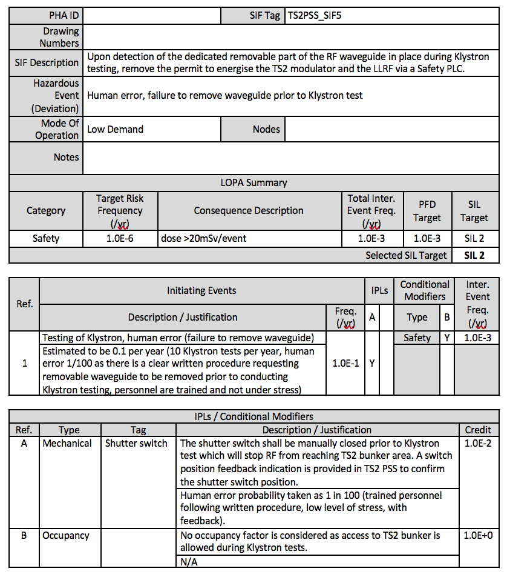
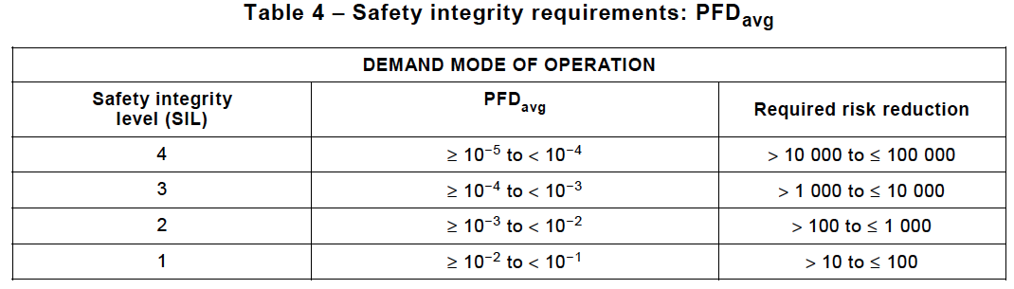
Safety Analysis – SIL Determination
SIL Determination
LOPA

Slide 37
Safety Analysis – SRS
Safety Requirements Specification (SRS) for TS2 PSS SIFs
Inputs
  Results from SIL Determination
  Requirements from IEC 61511
  ConOps
Outputs
  SRS (ESS-0288460), used for
    Design and engineering
    SIL Verification (ESS-0478596)
      To confirm the design meet SIL targets from SIL Determination
    Subsequent safety lifecycle stages
      FAT, SAT, commissioning, operation, maintenance, etc.
SIL Determination
SRS

Slide 38
Safety Analysis – SRS
    TS2PSS_SIF5 – Interlock on Waveguide during Klystron Testing
SIF Details
SIF Tag | TS2PSS_SIF5
Drawing Number | N/A
Hazardous Event | Human error, failure to remove waveguide prior to Klystron test
SIF Description | Upon detection of the dedicated removable part of the RF waveguide in place during Klystron testing, remove the permit to energise the TS2 modulator and the LLRF via a Safety PLC.
Sources of Demand | Human error, failure to follow procedure for RF testing (which requires the removable waveguide to be removed prior to RF testing).
Demand Rate on SIF | Estimated to be less than once per year.
Trip Points | Waveguide in place during Klystron testing (detected by position switches)
Success Criteria | TS2 is OFF due to power supply being isolated
Functional Relationship (Between Input and Output) | RF OFF upon detecting waveguide in place during Klystron testing.
SIL Determination
SRS
Safety Requirements
Common Cause Failures
Electrical Power Loss | TS2 shall be in a safe state upon power loss.
Compressed Air Loss | N/A
Hydraulic Pressure Loss | N/A

Slide 39
Safety Analysis – SRS
    TS2PSS_SIF5 – Interlock on Waveguide during Klystron Testing
Process Details
Safe State Definition | Hazardous equipment is de-energised and the area is safe from radiation.
Hazards from Concurrent Safe States | None identified.
Process Safety Time | About xx seconds.
Requirement to Survive a Major Accident | None identified. Loss of power due to major accidents shall put TS2 in safe state.
SIL Determination
SIL Data
Mode of Operation | Low Demand
SIL | Target | SIL 2 | Achieved
PFD / PFH | Target | 1.0E-03 | Achieved
Spurious Trip Rate (/hr) | Target | None specified | Achieved
Target Proof Test Interval (Months) | Sensor Subsystem |  | Final Element Subsystem
 | Position switch | 24 | Relays and UVR coils | 24
Mean Repair Time (hours) | Sensor Subsystem |  | Final Element Subsystem
 | Position switch | 8 | Relays and UVR coils | 8
SIF Response Time Achieved
SRS
Safety Requirements

Slide 40
Safety Analysis – SRS
    TS2PSS_SIF5 – Interlock on Waveguide during Klystron Testing
SIL Determination
Trip Actions
Manual Shutdown Requirements | Emergency switch-off is provided via a pushbutton; the process can also be shutdown via BPCS.
Energise / De-Energise To Trip | De-energise to trip
Requirements for Resetting after Shutdown | TS2 PSS SIFs shall be reset manually via the TS2 PSS HMI following a shutdown.
Overrides / Inhibits / Bypasses (including control measures for when these are in use) | There shall be no overrides / inhibits / bypasses for this SIF.
Dangerous Combinations of Output States | None identified.
Actions to Achieve / Maintain Safe State | Ensure power supply to RF sources is isolated.
SRS
Safety Requirements

Slide 41
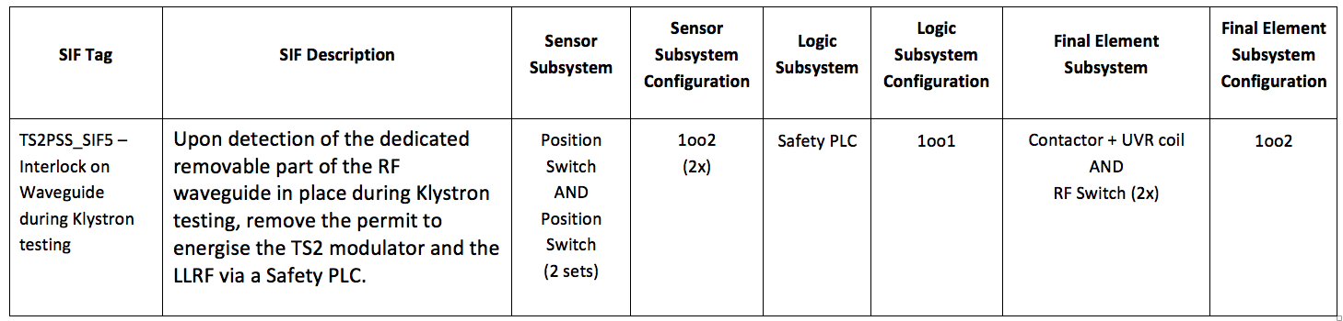
Safety Analysis – SIL Verification
SRS
SIL Verification
Based on the test and maintenance strategy, the maximum allowable
SIL for the SIF was calculated and compared with the requirements
identified by the SIL Determination report.

Slide 42
Safety Analysis – SIL Verification
TS2PSS_SIF5 – Waveguide interlock during Klystron test RBD
The configuration achieves SIL 3 in terms of architectural constraints in accordance with IEC 61508.
SRS
SIL Verification
RBD

Slide 43
Safety Analysis – SIL Verification
The FTA shows the achieved PFD for TS2PSS_SIF5 is 5.9E-04. This falls into SIL 3 band.
SIL Verification
RBD
SIL Verification FTA

Slide 44
Safety Analysis – SIL Verification
ETA03 – Human error while conducting Klystron test
SIL Verification
FTA
SIL Verification ETA

Slide 45
Safety Analysis – SIL Verification
Summary of Results – LOW Demand SIFs
SIF Tag | Hazardous Event (Deviation) | PFD Target | PFD Achieved | Selected SIL Target | Max Allowable SIL (Arch. Constraints) | Result
TS2PSS_SIF1 – Emergency Switch-off Button | TS2 operation started by mistake | 2.8E-2 | 2.2E-4 | SIL 1 | SIL 2 | Passed
TS2PSS_SIF2 – Interlock on Intrusion | Intrusion into TS2 bunker | 1.0E-3 | 4.9E-5 | SIL 2 | SIL 2 | Passed
TS2PSS_SIF5 – Interlock on Waveguide during Klystron Testing | High RF during Klystron testing | 1.0E-3 | 5.9E-4 | SIL 2 | SIL 3 | Passed
SRS
SIL Verification

Slide 46

Questions?
Thank you for your attention!

Slide 48
TS2 PSS SRS (ESS-0288460)
Safety Requirements Specification (SRS) for TS2 PSS SIFs
Inputs
  Results from SIL Determination
  Requirements from IEC 61511
  ConOps
Outputs
  SRS (ESS-0288460), used for
    Design and engineering
    SIL Verification (ESS-0478596)
      To confirm the design meet SIL targets from SIL Determination
    Subsequent safety lifecycle stages
      FAT, SAT, commissioning, operation, maintenance, etc.

Slide 49
Dependences
Completed TS2 shield bunker complete with all shielding
Electrical power interfaces with TS2 PSS (new electrical board)
Heavy shield door, operational and ready for PSS interfaces
Fenced area and bunker entrance ready for PSS interfaces
Modulator PSS interface (UV coil installed within the breaker for PSS)
Waveguide Switch
LLRF PSS interfaces installed (co-axial switches 1U box)
Removable waveguide with PSS interface switches installed
EPICS interfaces
UPS backup.
REMs Interface definition.

Slide 50
PDR Recommendations
SFF. It is defined as the sum of the potentially dangerous failures revealed by auto-test together with those which result in a safe state, as a fraction of the TOTAL number of failures. SFF = Total revealed hazardous failures + Total safe failures Total failures.
IEC 61511 defines minimum hardware fault tolerance (HFT) requirements for the sensors, logic solvers and final elements that make up each safety function

