Slide 1
TS2 PSS
Electrical and mechanical design
Alberto Toral Diez
Critical Design Review
Notes:
The purpose of this presentation is to give an overview about the hardware detail design for TS2 PSS

Slide 2
Applicable Standards and regulations
TS2 PSS is a low- voltage protection and monitoring system:
  ESS-0015433, ESS Rules for electrical design 2019
  SS-4364000, Swedish standard for Low-voltage electrical installations
  SS-EN 60204-1, Safety of machinery - Electrical equipment of machines
  IEC 61511, Safety instrumented systems for the process industry sector
Notes:
ESS Rules for electrical design, revision of 2019
For the installation, the Low voltage Swedish standard
Safety of machinery for the equipment or cabinets
61511 Functional Safety Standard

Slide 3
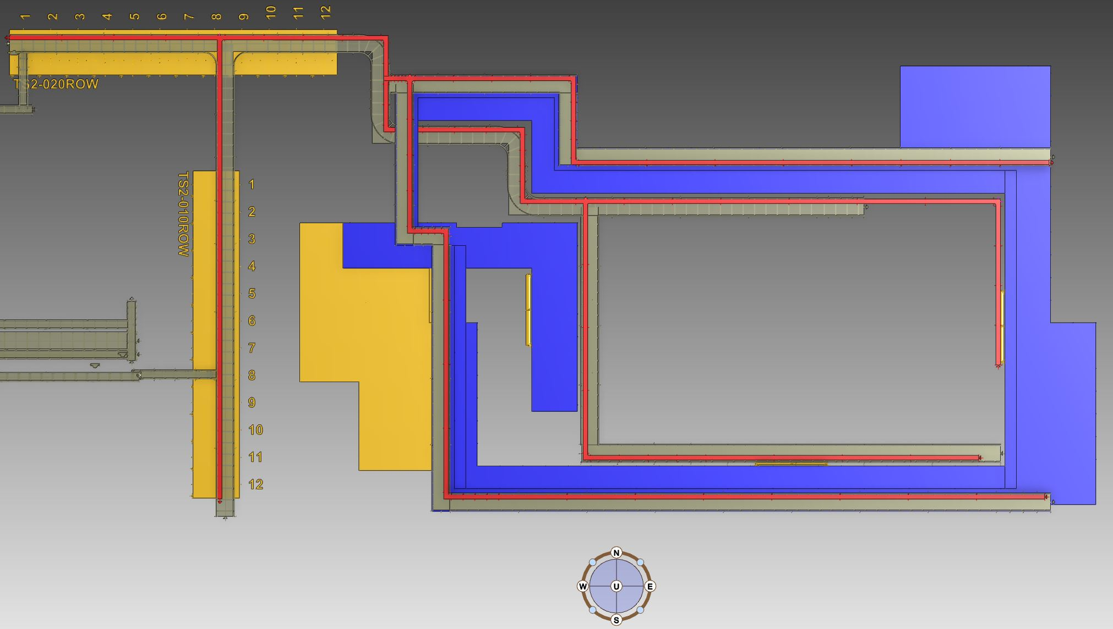
TS2 PSS cabinets location in KG-GTA
Key Exchange Cabinet
PLC Cabinet
Notes:
TS2 PSS has two electrical cabinets. The PLC cabinet and the Key Exchange cabinet. The cabinets are located in the rack row 10 and a divider is installed between them, also each cabinet has key lock system coded differently between them

Slide 4
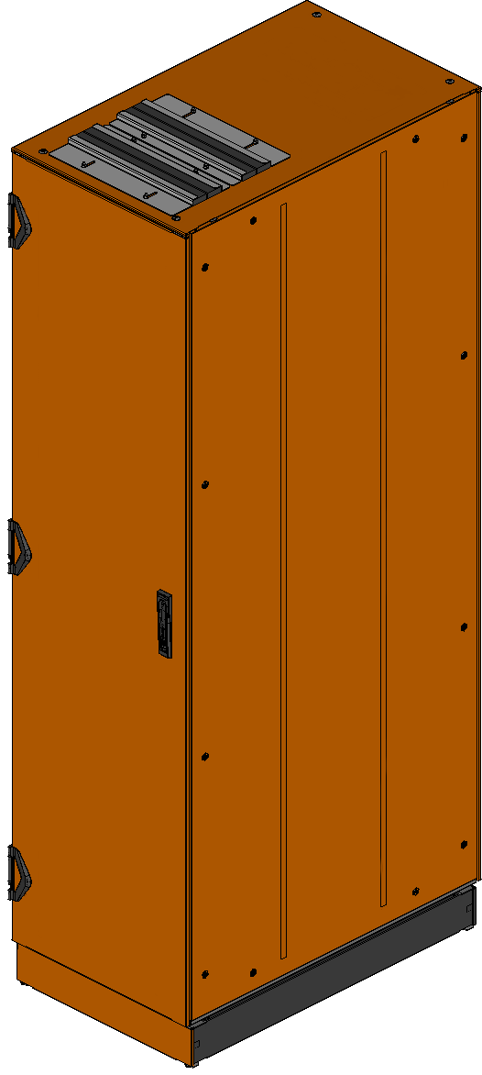
TS2 PSS cabinet design
  Manufacturer:
  NVENT/SCHROFF
  Dimensions:
  WHD 600x2200x1000 mm
  Variant:
  Varistar EMC cabinet, floor standing
  Double-door, color RAL2000
  IP 55 rating (IEC 60529)
Notes:
Double door enclosure that meets the EMC requiremetns

Slide 5
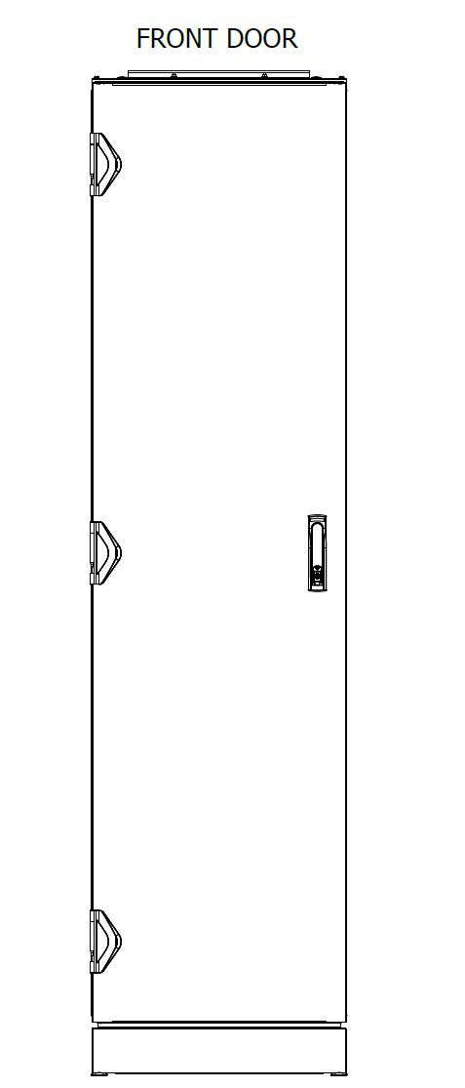
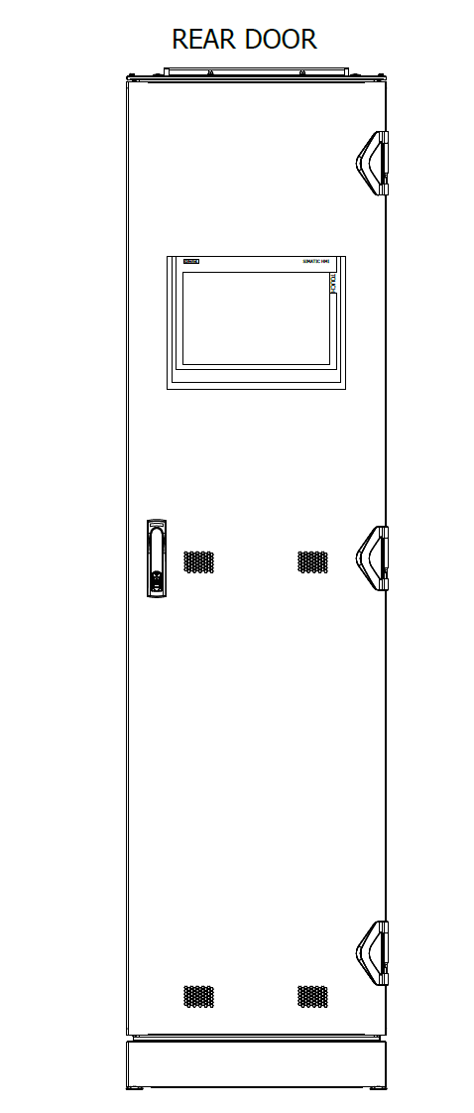
TS2 PSS PLC cabinet design
  Front door has no perforation.
  Rear door is perforated in the bottom half and has a dust filter
  Rear door has the 15" HMI installed in the top half
  Both doors are equipped with ASSA cylinder and key system

Slide 6
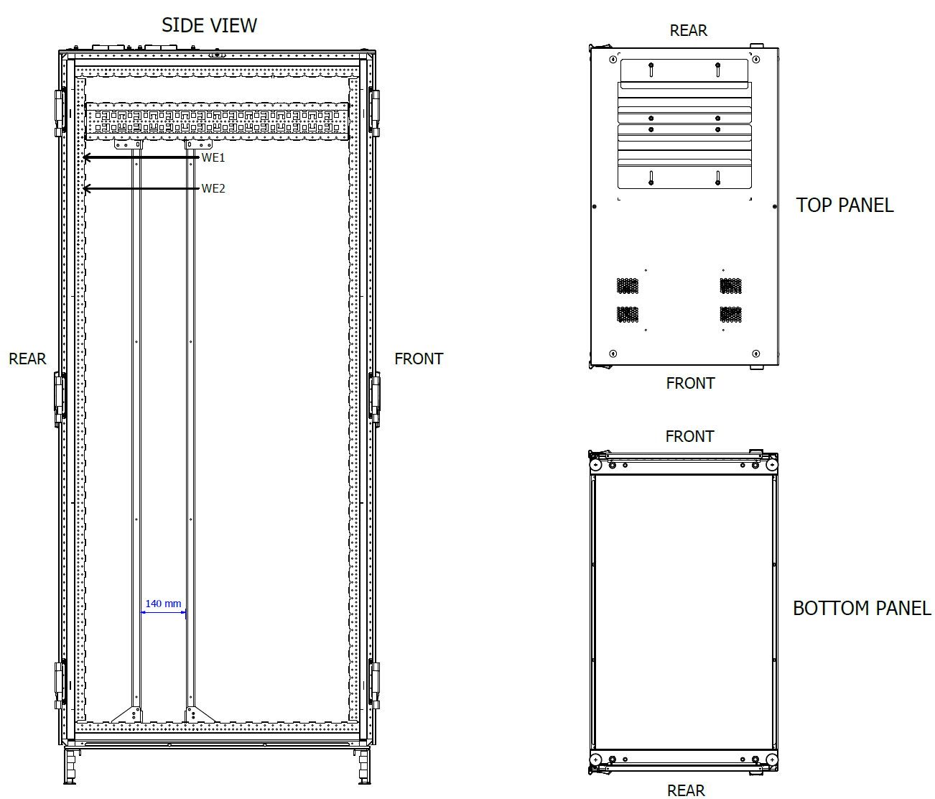
TS2 PSS PLC cabinet design
  WE1
  Protective Earth Bonding Busbar.
  WE2
  Functional Earth Bonding Busbar.

Slide 7
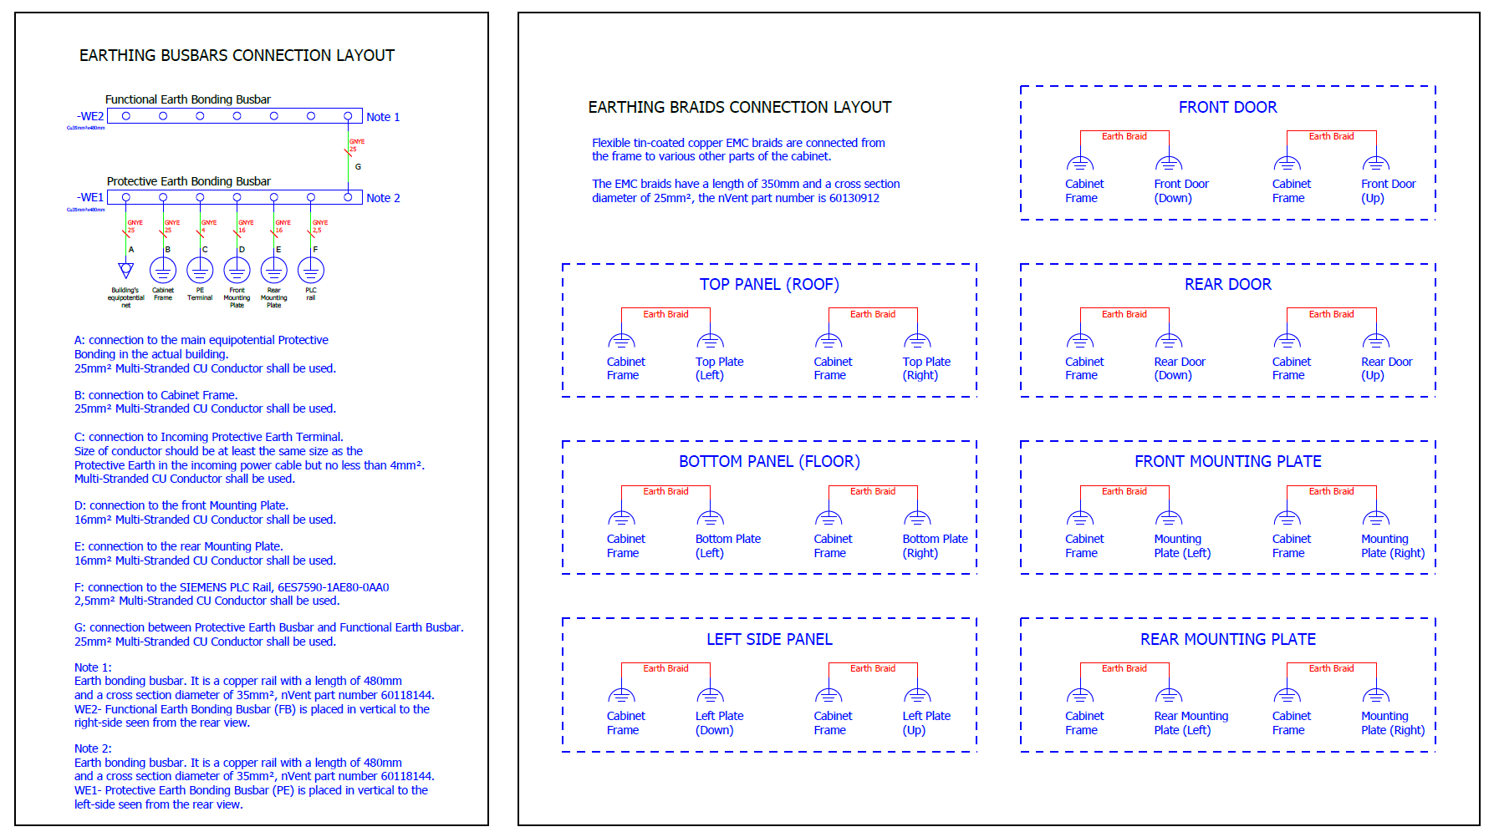
PLC cabinet equipotential earth overview

Slide 8
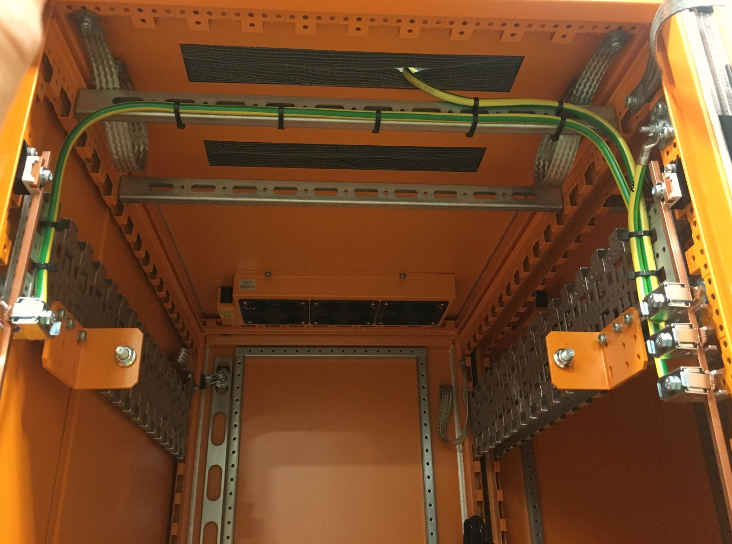
TS2 PSS PLC cabinet design
Rear view
  WE1 – (PE)
  Protective Earth Bonding Busbar.
  WE2 – (FB)
  Functional Earth Bonding Busbar.

Slide 9
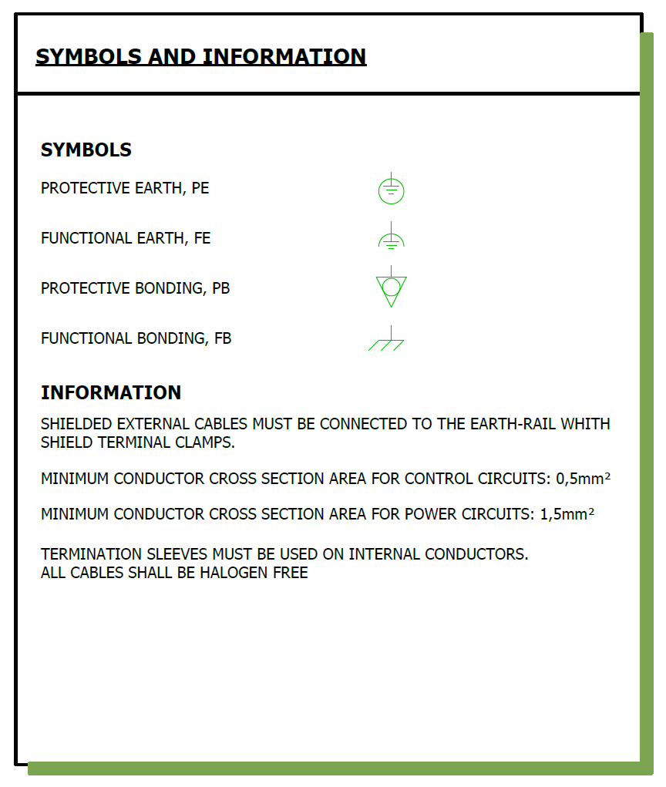
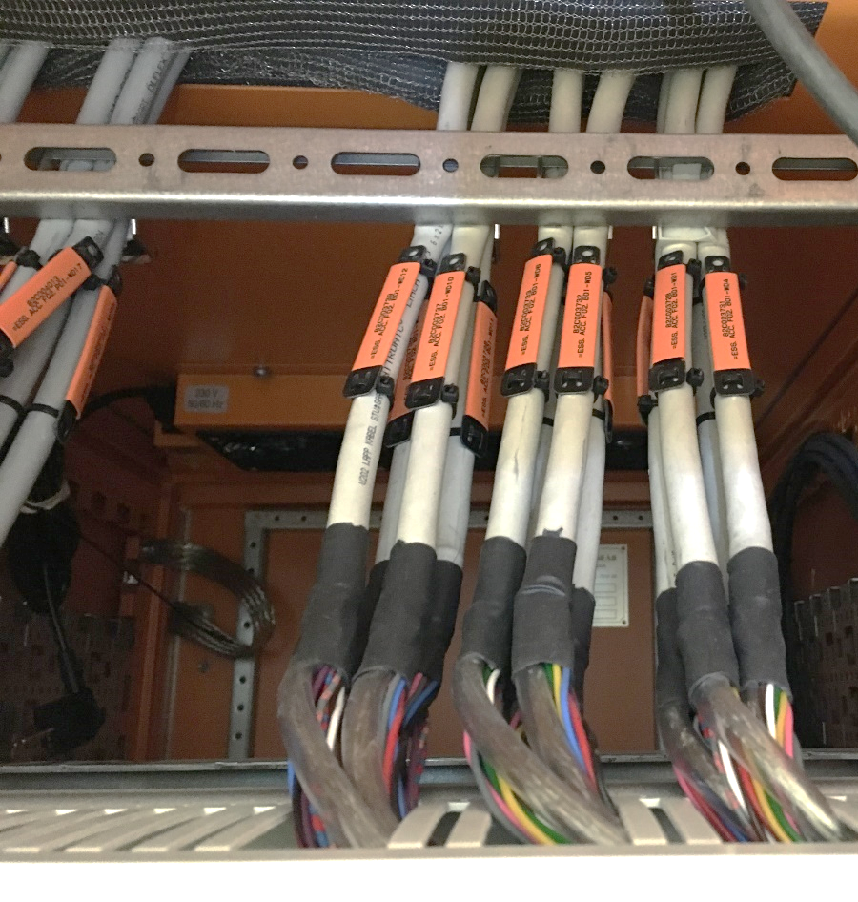
Symbols information

Slide 10
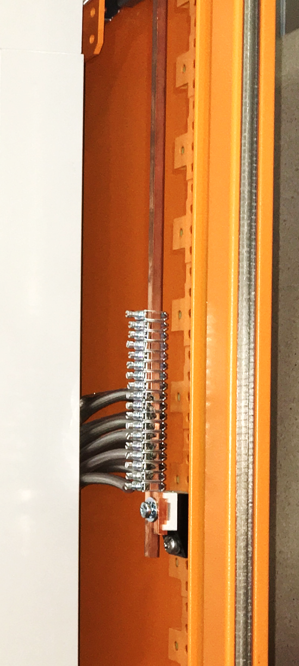
Symbols information

Slide 11
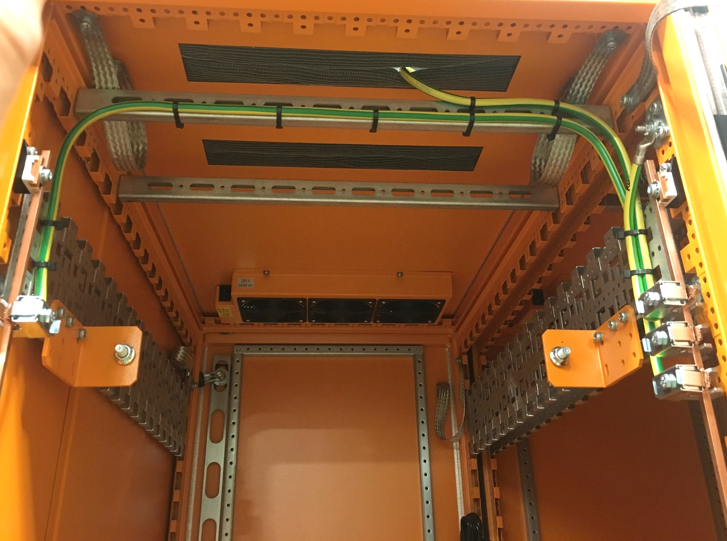
TS2 PSS PLC cabinet design
Rear view
  The cabinet is air cooled. The top plate has a 3 fans installed that extract the air from the cabinet.

Slide 12
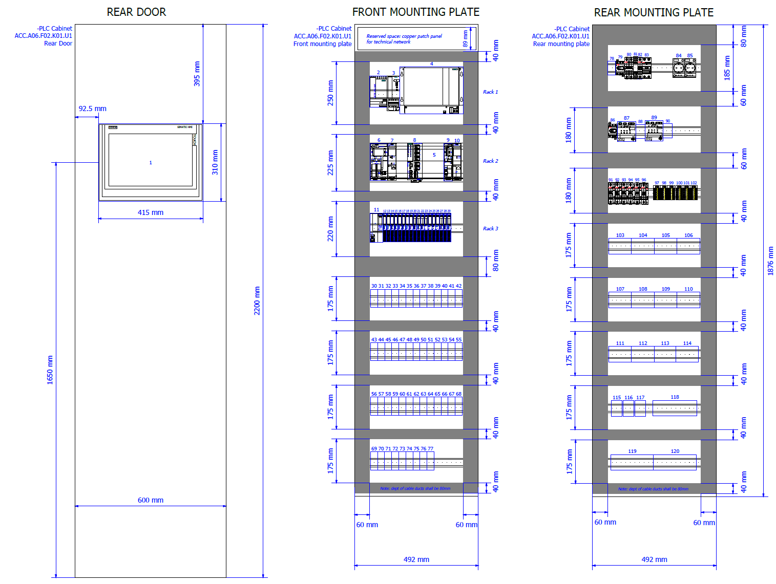

Slide 13
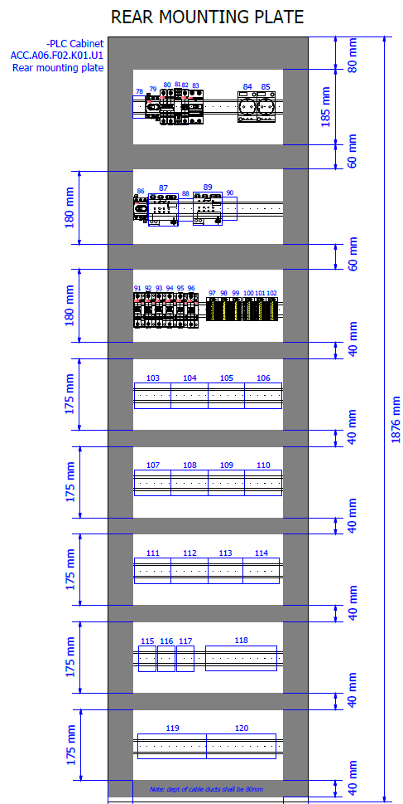
TS2 PSS PLC cabinet design
  Rear mounting plate contains:
  Power arrival terminals
  Switch disconnectors
  MCB’s
  RCD and 2 power socket outlets
  SPD (surge arrester type 3)
  SIEMENS Selectivity modules
  24V DC Potential distributors
  Terminal blocks

Slide 14
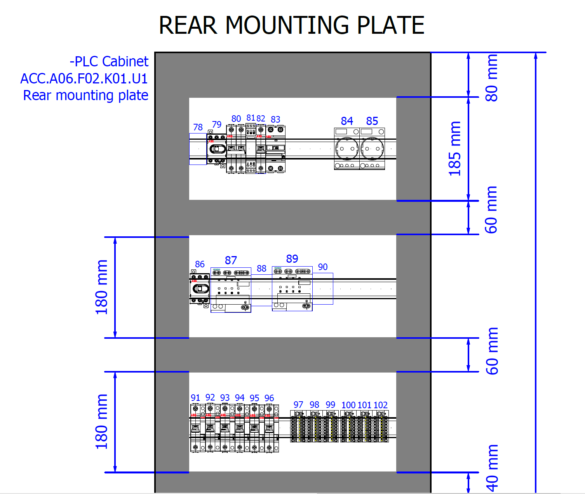

TS2 PSS PLC cabinet design
  230V AC is only present in the first top row from the Rear mounting plate

Slide 15
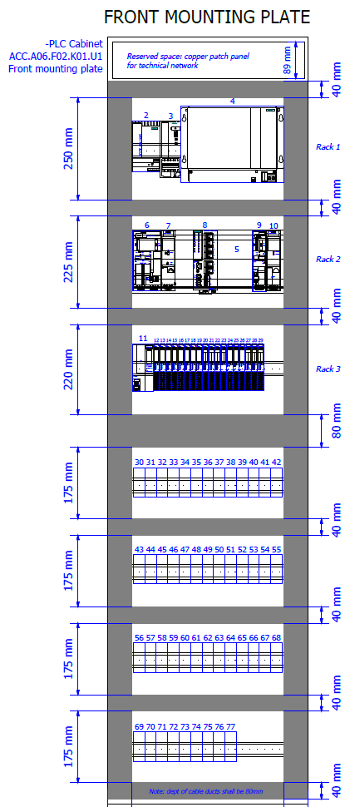
TS2 PSS PLC cabinet design
  Front mounting plate contains:
  Network patch panel
  PLC hardware:
    - CPU’s, Communication Processor, Communication Module, SCALANCE Switch, ET200SP interface module and I/O modules
  Power supply, UPS controller and battery unit.
  Relays 3W, 24V DC (48 units)

Slide 16
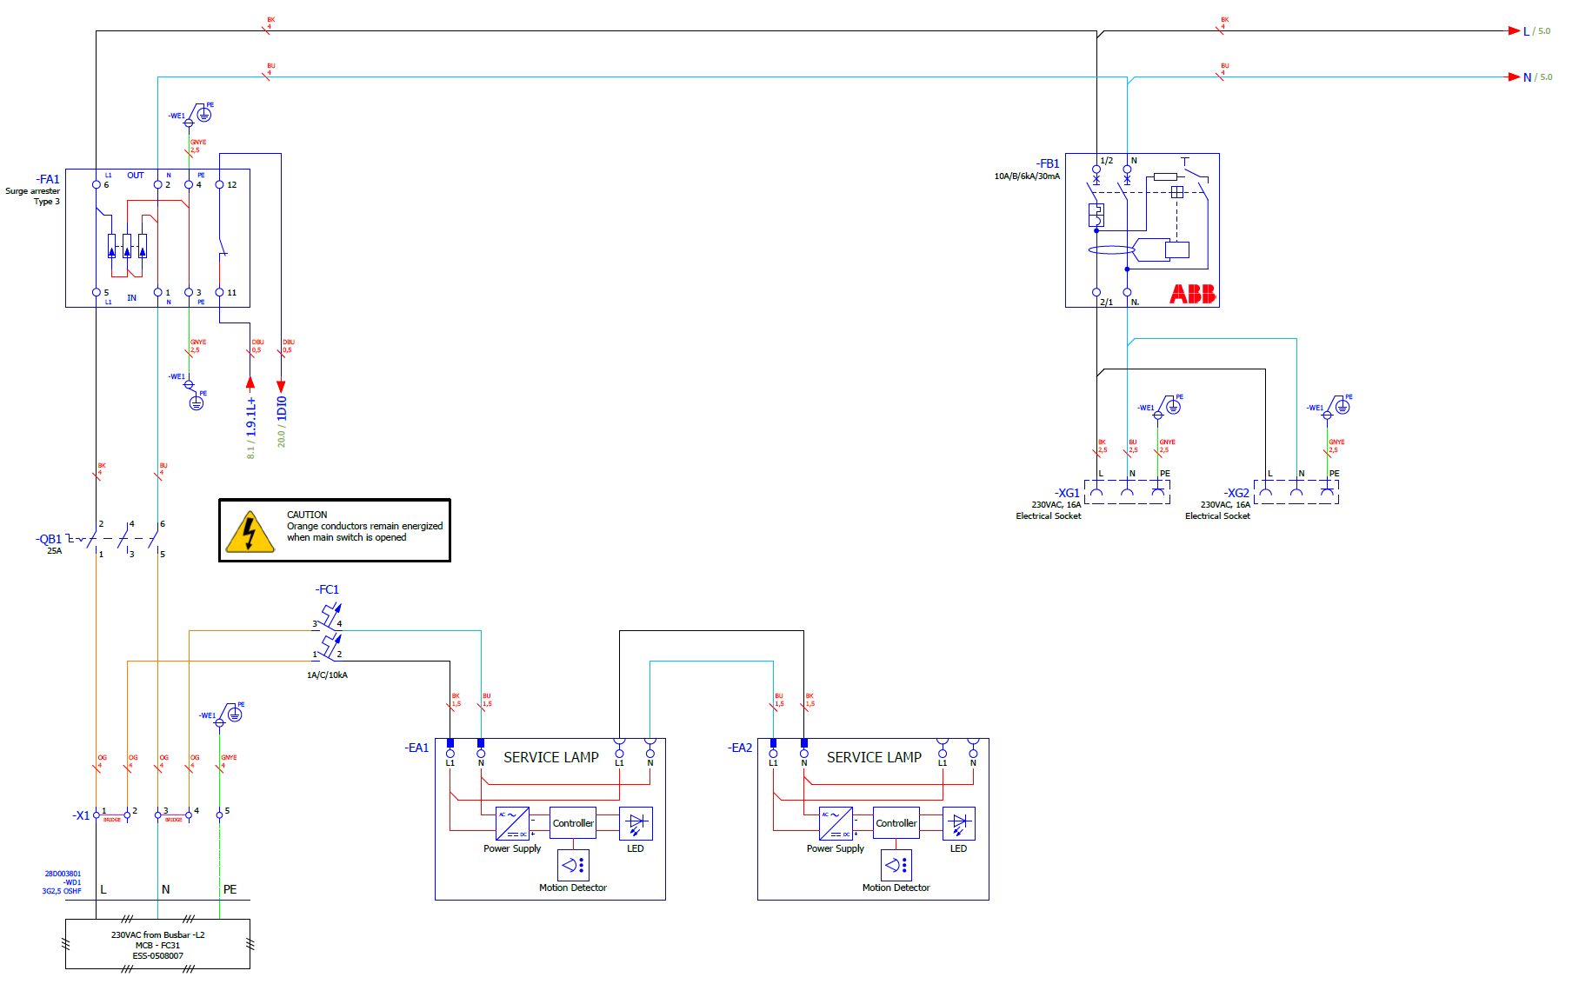
TS2 PSS PLC cabinet design
Notes:
Main power arrival terminals // Then Disconnector Switch // Surge Protection Device

Slide 17
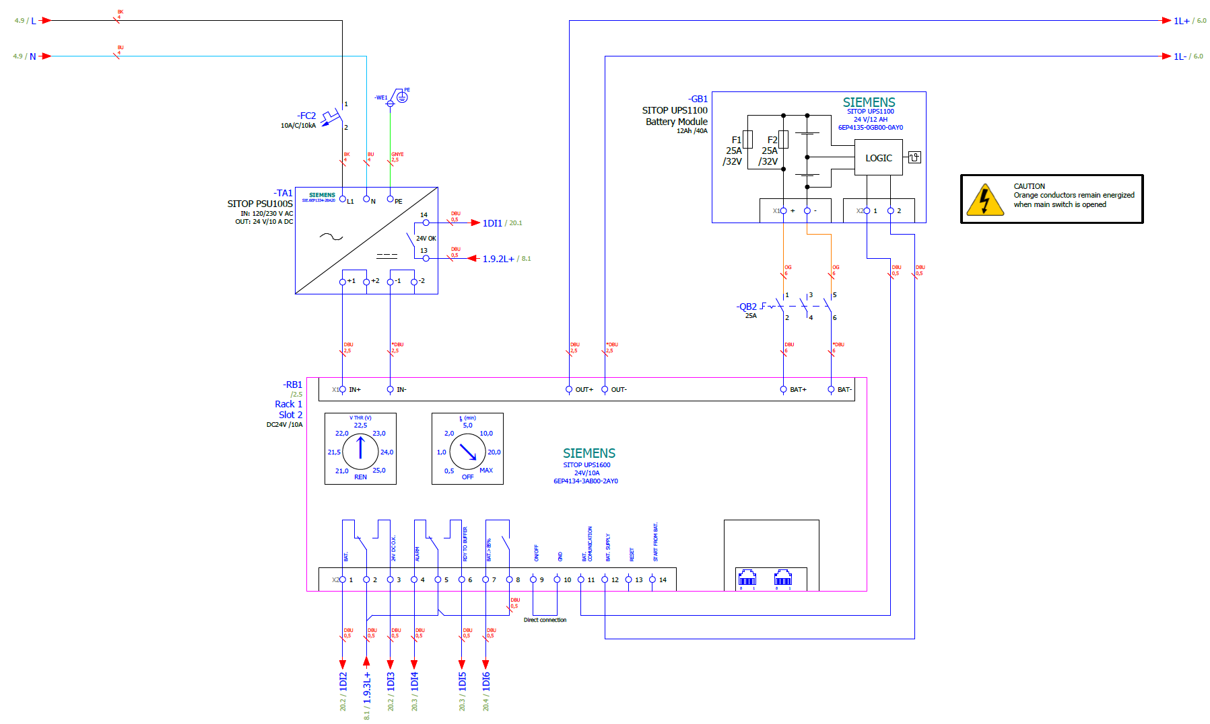
TS2 PSS PLC cabinet design
Notes:
Power Supply // internal Battery // UPS controller. Is a temporary solution in the future the cabinets will be powered by external UPS power

Slide 18
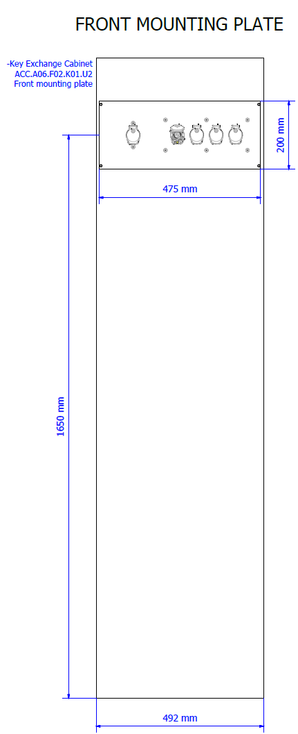
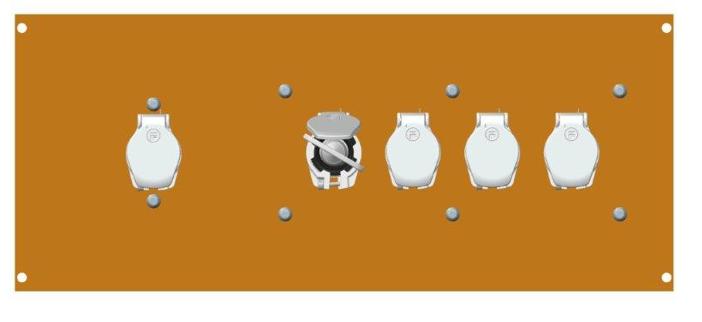
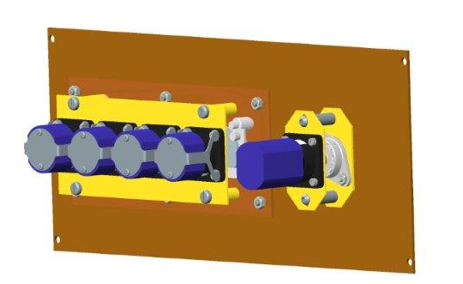
TS2 PSS Key Exchange cabinet design
Front view
Rear view
Note: Each key in the key exchange system is uniquely coded

Slide 19
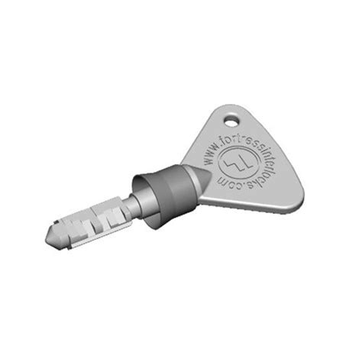
TS2 PSS Key Exchange cabinet design
Front view
Key Switch
Key
Note: The Key Switch is suitable for isolation or switching current

Slide 20
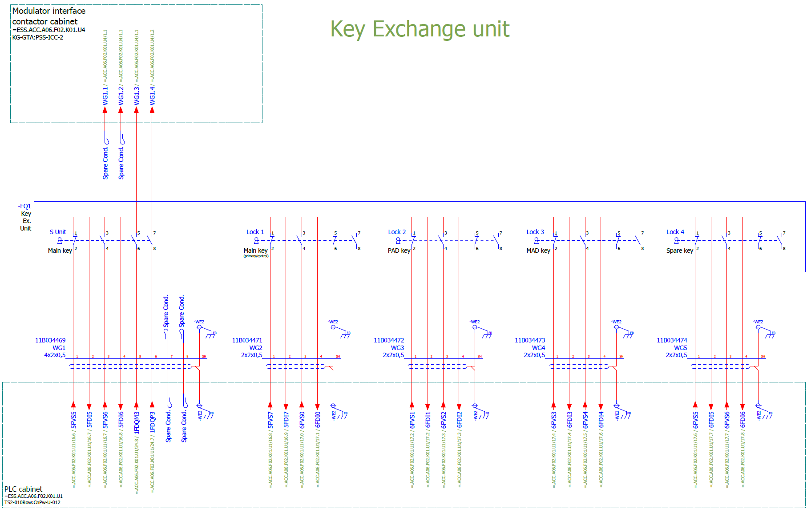

Slide 21
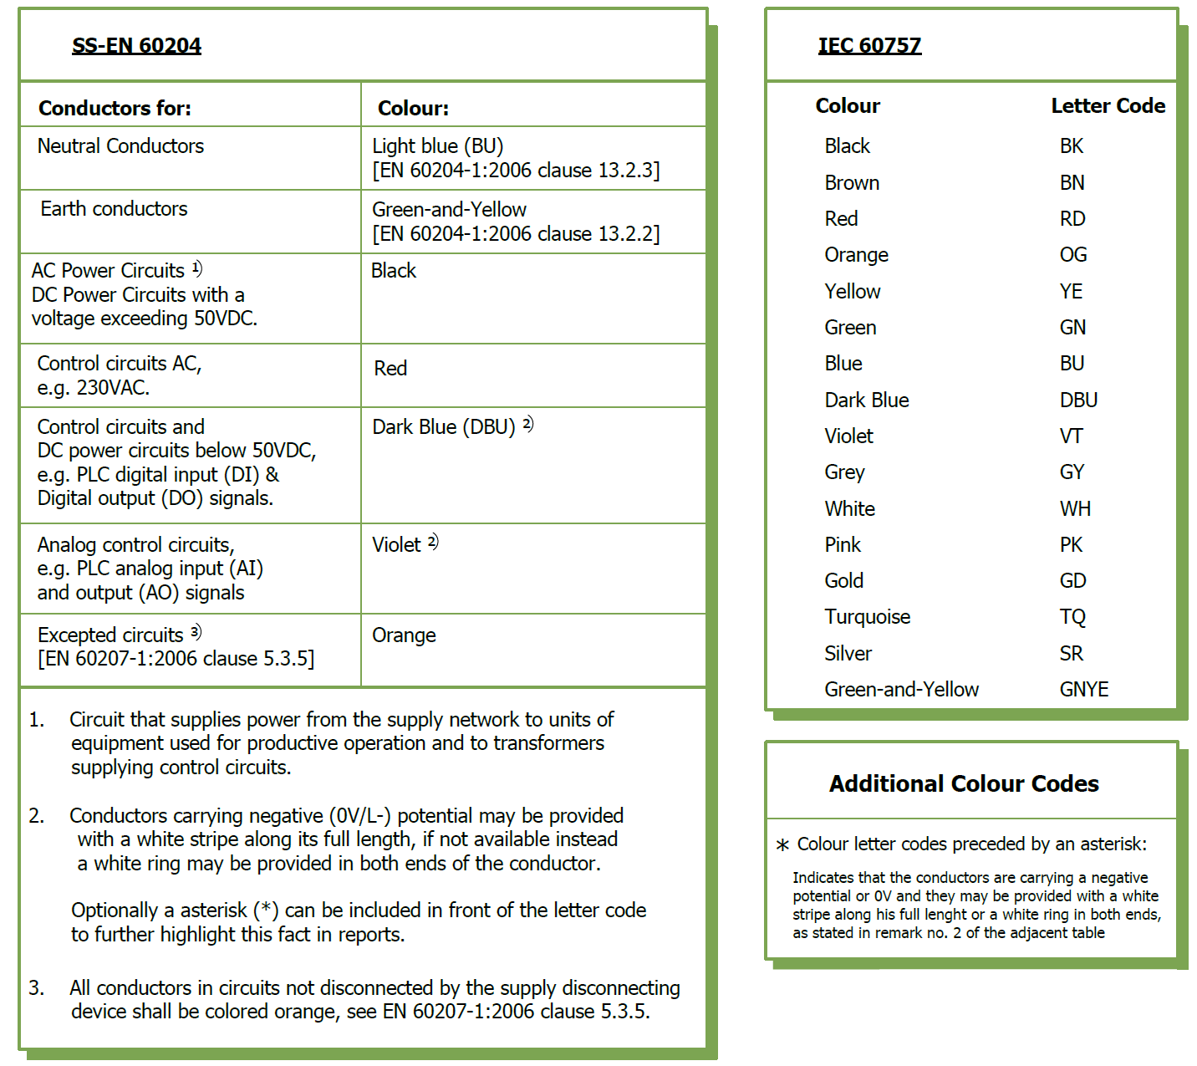
Identification of conductors by colour
Notes:
As I said before… 60204

Slide 22
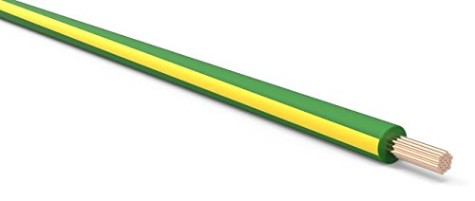
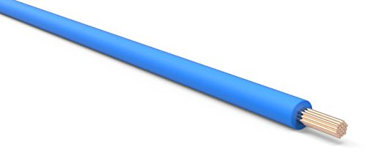
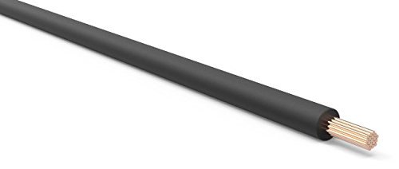
Single core conductors
Earth: GREEN-AND-YELLOW → EN-SS 60204-1 clause 13.2.2
Neutral: LIGHT BLUE → EN-SS 60204-1 clause 13.2.3
AC Power circuits, DC Power circuits exceeding 50V: BLACK

Slide 23
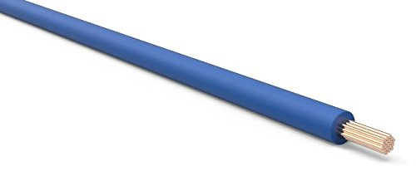
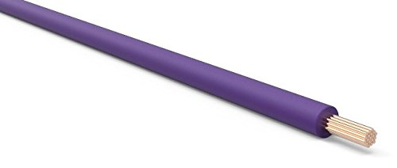
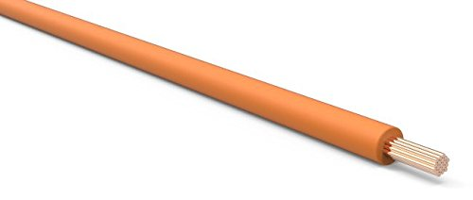
Single core conductors
DC Control circuits, DC Power circuits below 50V: DARK BLUE
Analog Control circuits: VIOLET
Excepted circuits: ORANGE → EN-SS 60204-1 clause 13.2.4 in accordance with 5.3.5

Slide 24
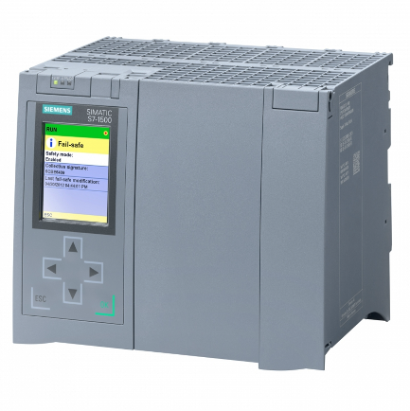
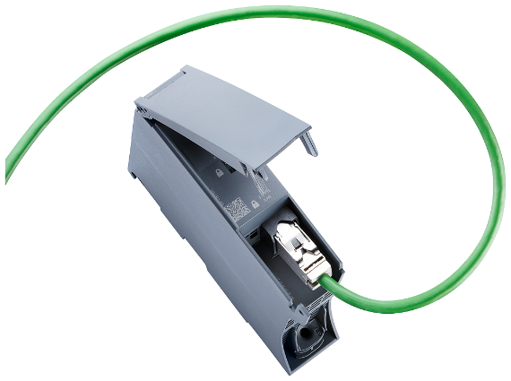
PLC hardware
TS2 PSS is a single-train system comprised of.
  Siemens S7-1500 series safety PLC (main CPU):
  CP for connection to PSS engineering Workstation via industrial Ethernet:

Slide 25
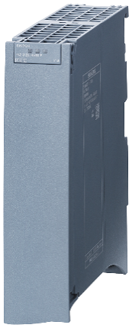
PLC hardware
  Siemens S7-1500 series standard PLC (gateway CPU):
  Communication module 1542-1 for connection to Technical Network via PROFINET (EPICS interface):

Slide 26
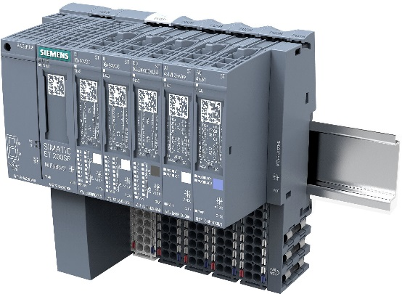
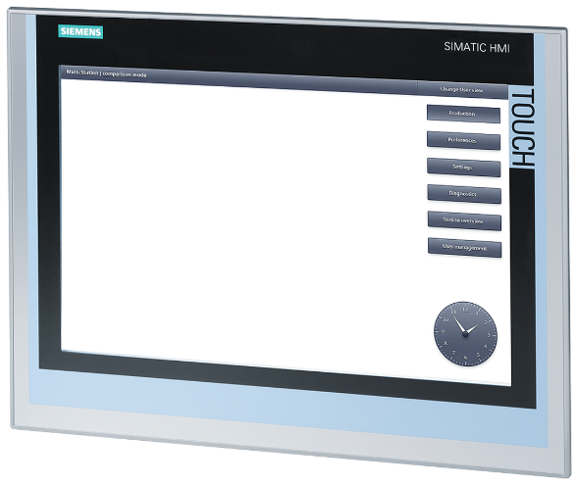
PLC hardware
  ET 200SP, PROFINET Interface-Module + I/O Modules:
  HMI TP1500 Comfort, for touch operation, 15" widescreen:

Slide 27
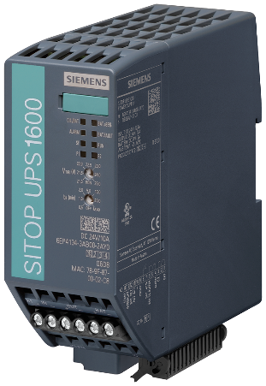
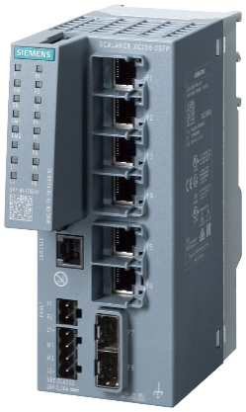
PLC hardware
  Uninterrupted Power supply UPS1600 10 A with PROFINET:
  SCALANCE Switch XC206-2SFP manageable layer:

Slide 28
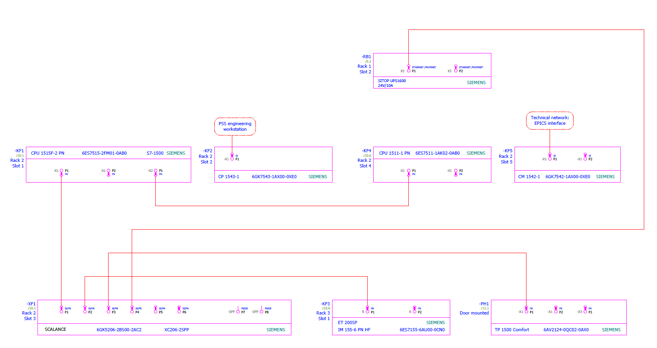
Network Physical Topology

Slide 29
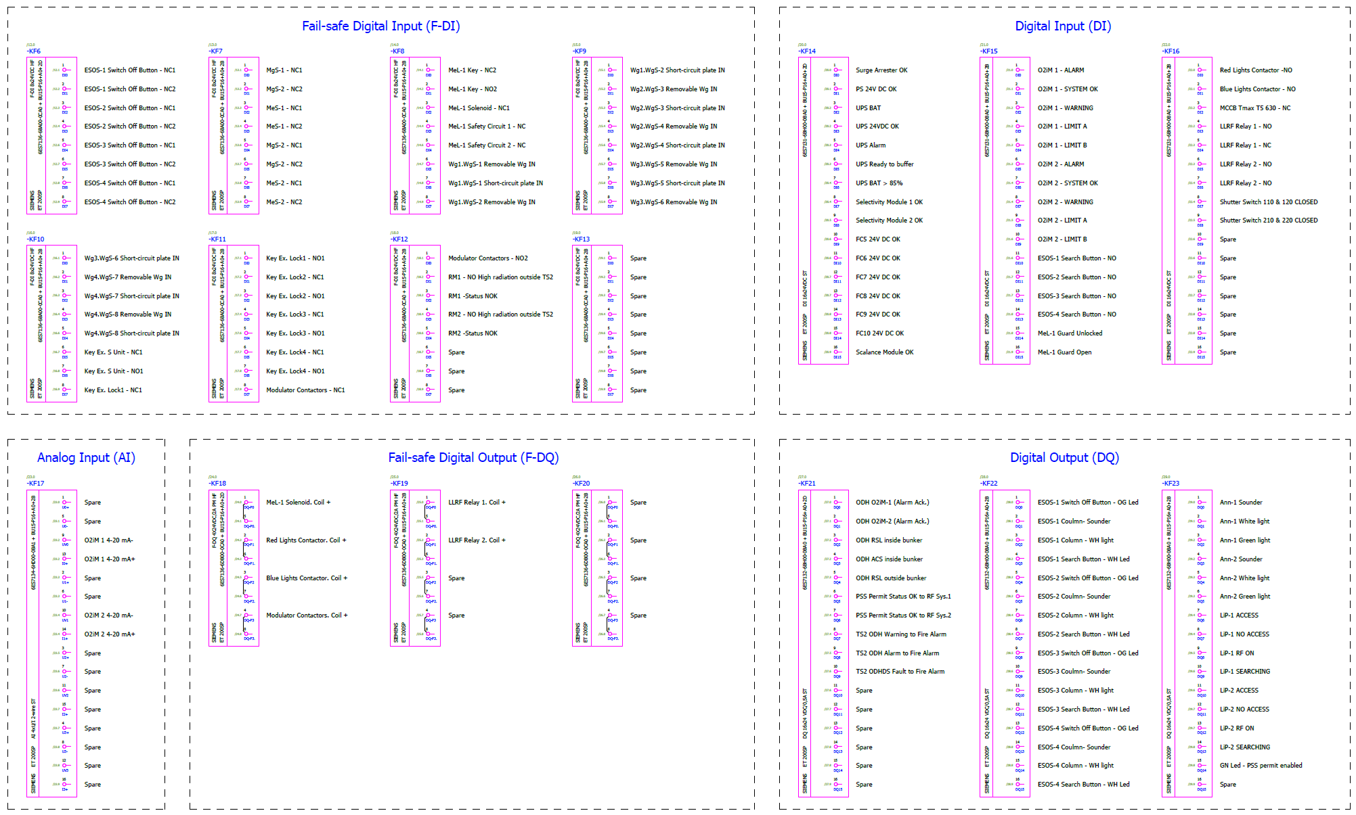
PLC modules overview

Slide 30
PLC I/O modules overview
Inputs:
  53 Fail-safe Digital Inputs
  41 Standard Digital Inputs
  2 Analog Inputs
Outputs
  6 Fail-safe Digital Outputs
  41 Standard Digital Outputs

Slide 31
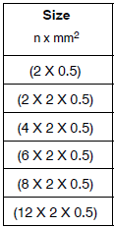
TS2 PSS cables overview
Signal cables used for field devices inside TS2 Bunker are HUBER+SUHNER, RADOX 125:
  Radiation resistant, (up to 1000 kGy)
  High temperature (up to 125 °C)
  Low frequency
  Flexible
  Overall screen to mitigate the EMI effect
Other cables types are used where in non-radiation areas: Unitronic® LiHCH and ÖLFLEX® CLASSIC 135 CH

Slide 32
TS2 PSS multicore cables overview
56 cables in total:
  11 cables for interfaces with other systems,
  (Radio-Frequency, Radiation Monitoring and Fire Alarm)
  37 cables for connection to the PSS Field Devices,
  (including ODHDS)
  8 cables for the Blue/Red lighting system

Slide 33
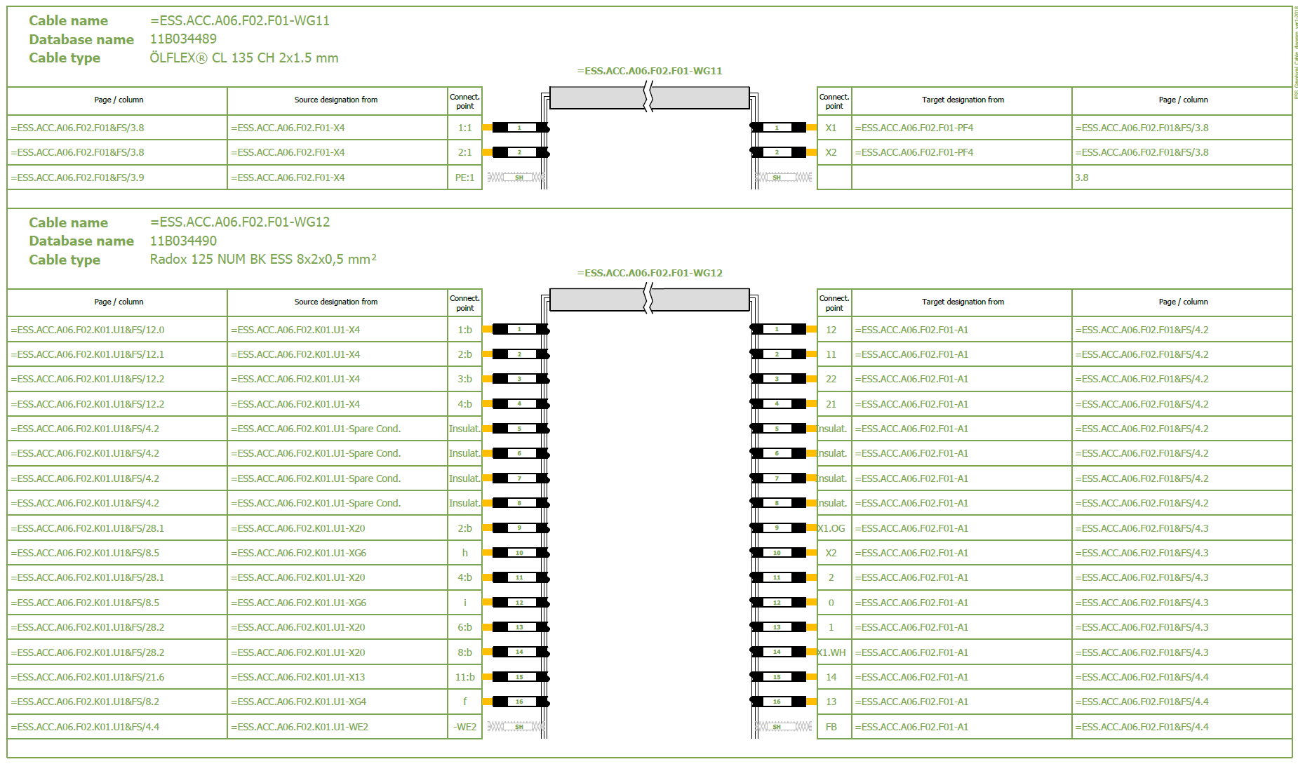
Graphical cable diagram reports

Slide 34
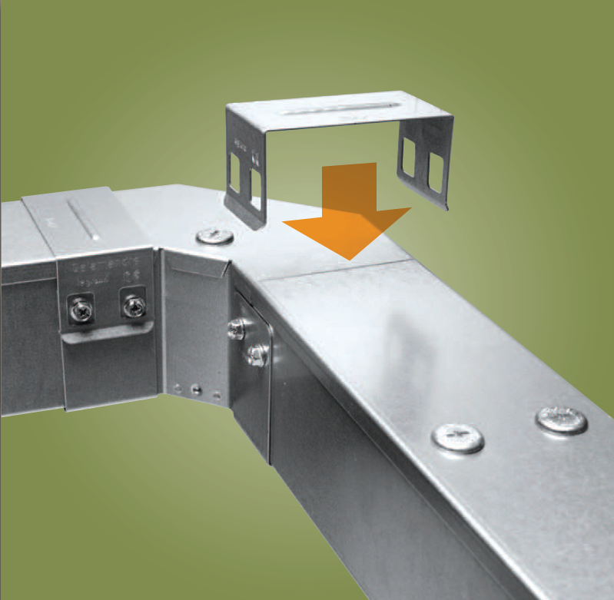
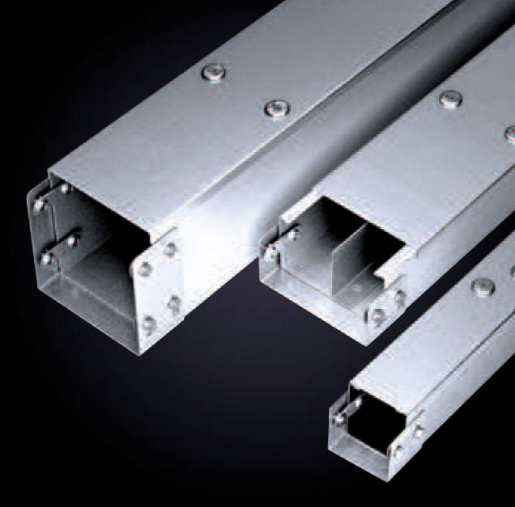
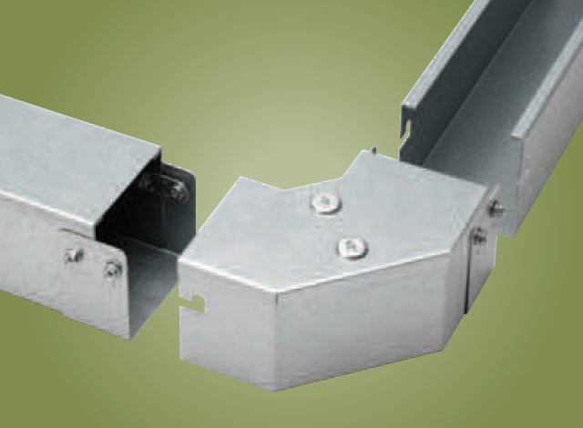
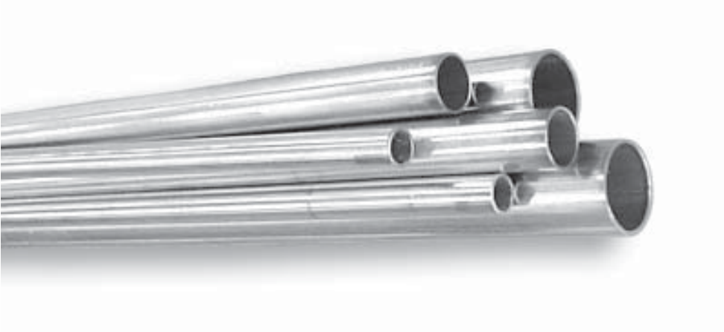
Cable containment system
Legrand Salamandre distribution trunking
Stainless steel conduits
16x1mm Stainless Steel cable conduit. | Part No. 33-004
22x1.5 mm Stainless Steel cable conduit. | Part No. 33-007

Slide 35
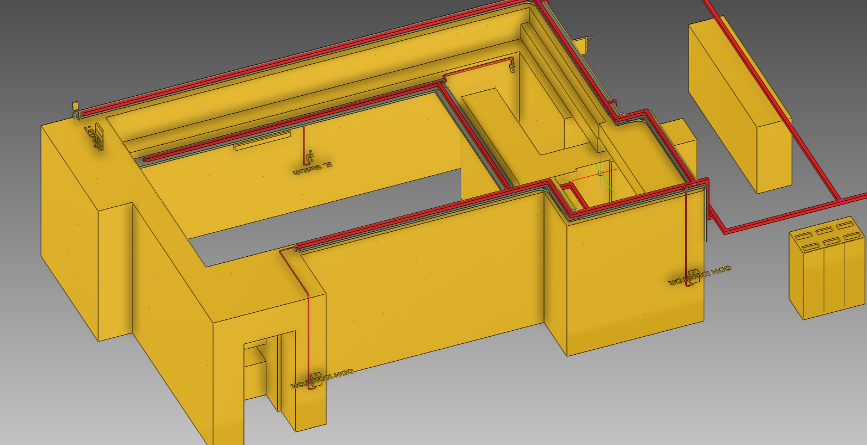
Cable containment system

Slide 36
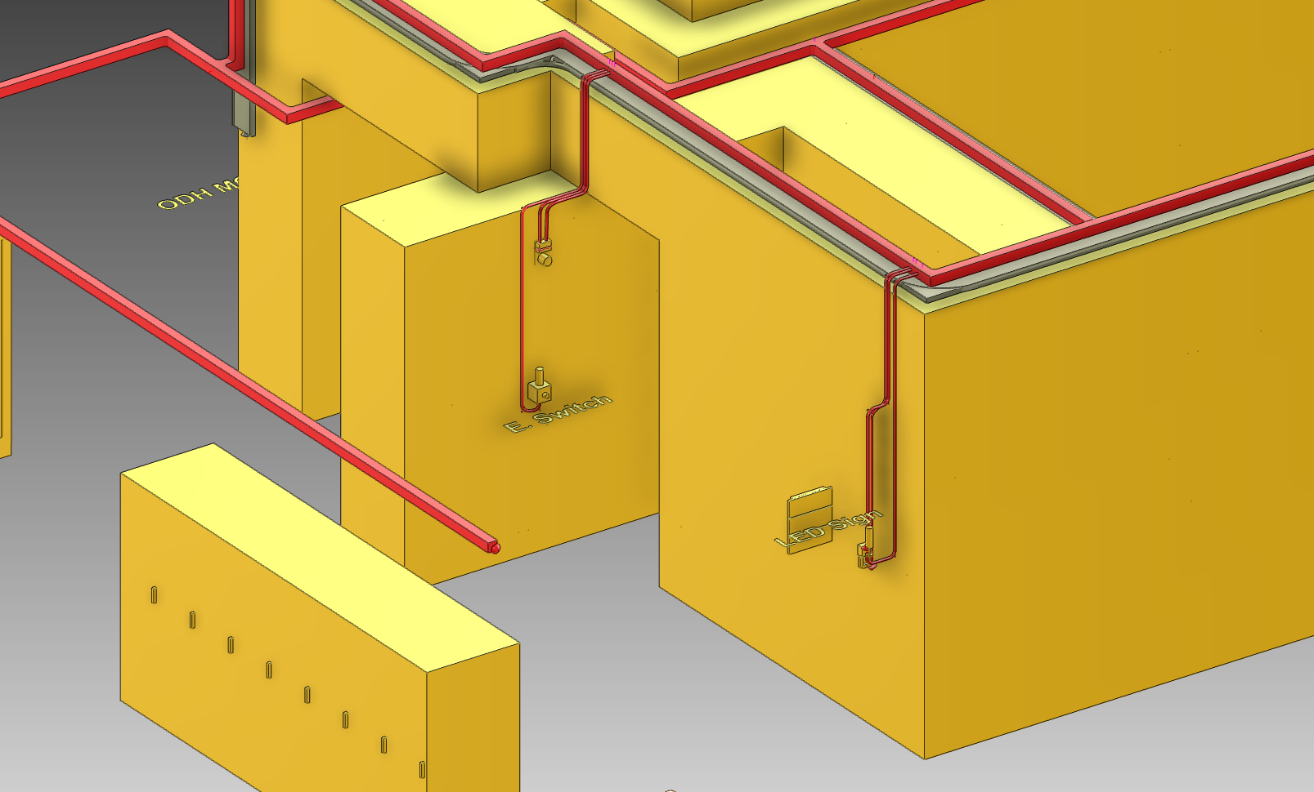
Cable containment system
Notes:
PAD

Slide 37
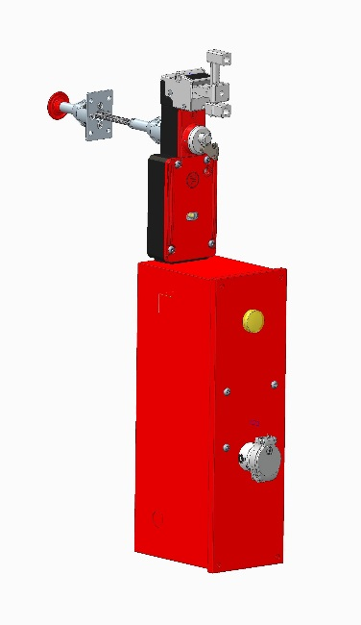
Field Devices: PAD Fortress Mechanical Lock
Spring locked (power to unlock)
Escape release from inside (mechanical push button to release door)
A special key to unlock the unit from outside (to be used by authorized personnel in case of emergency)

Slide 38
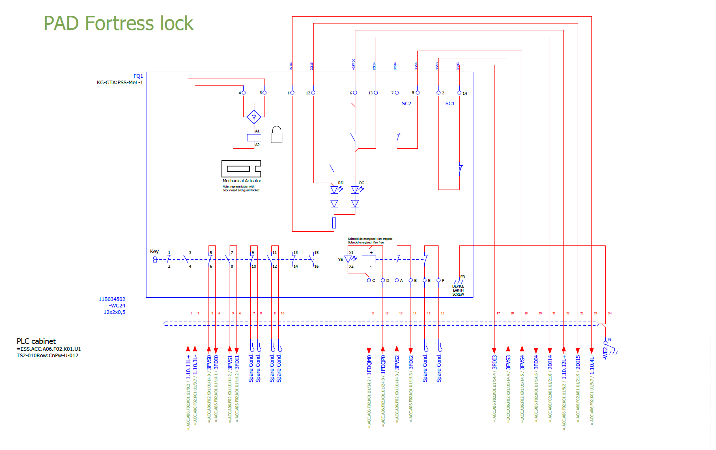
Field Devices: PAD Fortress Mechanical Lock
Notes:
Wiring layout for Fortress ProLok with INDEPENDENT safety circuits

Slide 39
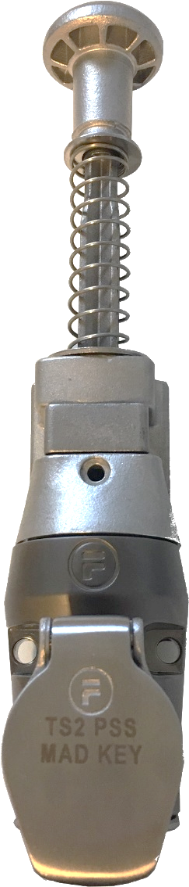
Field Devices: MAD Key-bolt
Opening and closing the MAD is incorporated into TS2 PSS key exchange procedures, by installing a Fortress DM lock on the MAD, which is a simple mechanical solution to lock the MAD without the need for wiring.
Fortress part number DM1-CLSI-A.
Notes:
Material Access Door

Slide 40
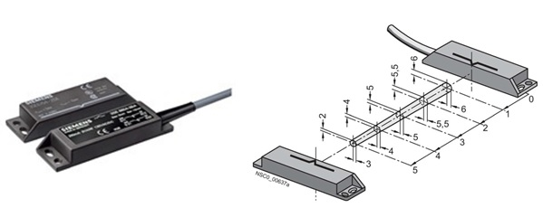
Field devices: Non-contact magnetically operated safety switches
A magnetically operated switch comprises a coded switching magnet and a contact block (sensor unit).
Features:
  Tamper-proof protective door monitoring
  Small footprint
  SIL 3 acc. to IEC 61508, achievable with single switch pair
Notes:
PSS has DIVERSITY in the position switches on each entry door there is one magnetical switch and one mechanical.

Slide 41

Field Devices: Mechanical Safety Switches with Separate Actuator
The NC contacts of the switch are forced open mechanically, positively-driven and reliably by the plunger.
An internal mechanism forcibly separates normally closed contacts and prevents them from welding together - allowing the safety circuit to open.

Slide 42

Field devices: signaling columns
Search Buzzer
Safe state (Green LED)
Search status (White LED)

Slide 43

Field devices: Emergency Switch-Off Stations
Search Buzzer
Search status (White LED)
Emergency Switch Off Button
Search button
Note: Box painted in Orange RAL2000

Slide 44

Field devices: information panels
Lasermet LED information panels are installed outside the TS2 Bunker entrances
24V DC powered (0,7 to 1A) with dimming option
Dimensions:
WHD 470x540x63.2mm
Notes:
ACCESS/NO ACCESS

Slide 45

Notes:
“ACCESS” and “NO ACCESS”
“RF ON”
“SEARCHING”

Slide 46

Field Devices:
Oxigraf O2iM – High Flow Single port
O2iM oxygen deficiency monitor. The Oxigraf sensor uses laser diode absorption technology to measure oxygen concentration in the gas sample.
The O2iM measures and displays the oxygen concentration in a gas sample drawn through the instrument. Gas is pumped sequentially from the input sample port, through the oxygen sample cell, and out the exhaust port.

Slide 47


Slide 48

Field Devices: Alarm Plates
Comprised of:
  A red flashing light. Solex xenon from Eaton. Part number: 531024FULL-0088.
  An audible alarm. Multi-tone sounder from Werma. Part number: 14015050
The flashing lights and sounders will turn on when there is Oxygen Deficiency Hazard (ODH)
Notes:
ODH when O2 level is below 18%

Slide 49

Blue and red fluorescent lighting system
A total of four blue and red lights are installed in TS2 PSS controlled areas.
The BLUE lights will turn on when the TS2 PSS permit to RF system is enabled
The RED lights will turn on when there is Oxygen Deficiency Hazard (ODH)
Power: 230V AC, 134W
GLAMOX Part Number: MIR089463

Slide 50

Blue/Red lights contactor cabinet

Slide 51

Blue/Red fluorescent lighting system

Slide 52

Thank you,
any questions?

