Slide 1
Hardware integration and interfaces
TS2 PSS Critical Design Review
Peter Holgersson
Senior Technician for Personnel Safety Systems, ICS
www.europeanspallationsource.se
19-04-09

Slide 2
Content
Hardware integration activities
TS2 PSS interfaces with TS2 RF systems
TS2 PSS interfaces with radiation monitors
TS2 PSS integration into EPICS

Slide 3
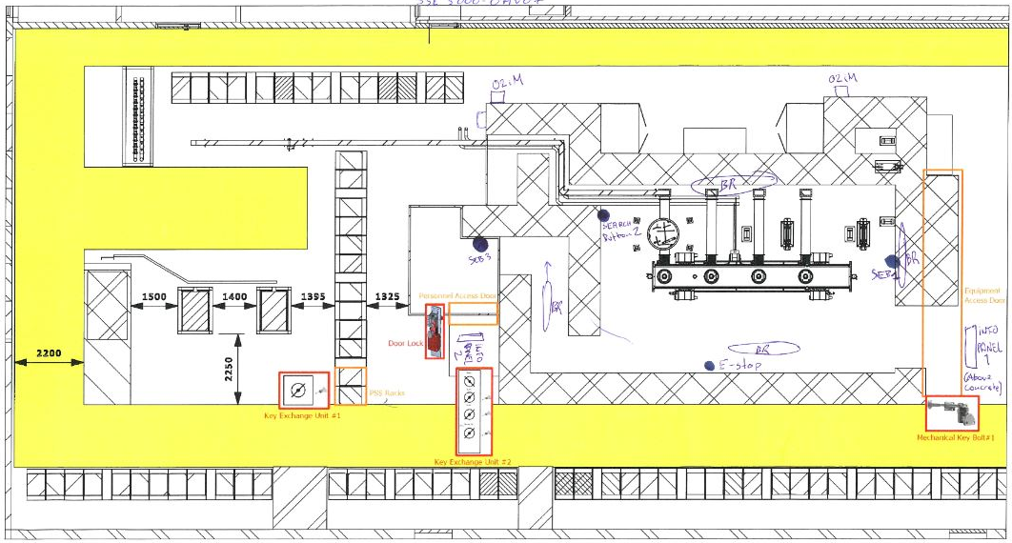
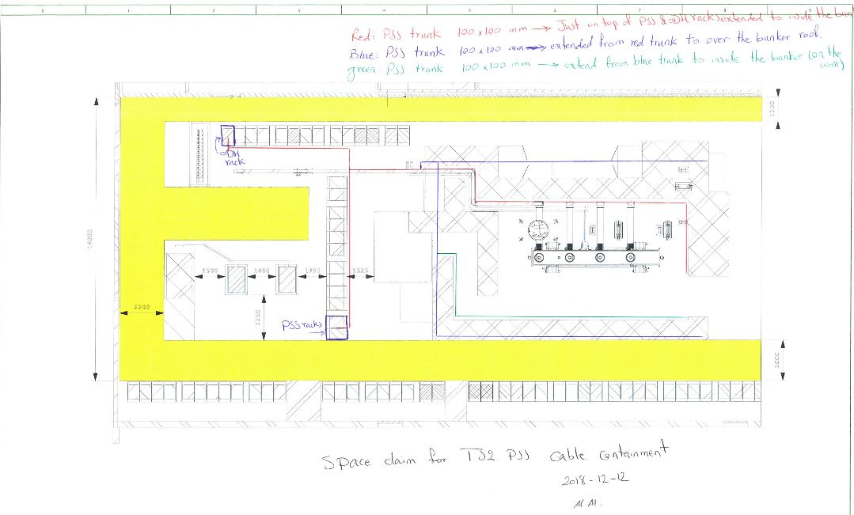
Hardware integration activites
Conceptual design
Cable Raceways
Field Devices
Notes:
Cable raceways was agreed with Owen
Spatial integration team

Slide 4
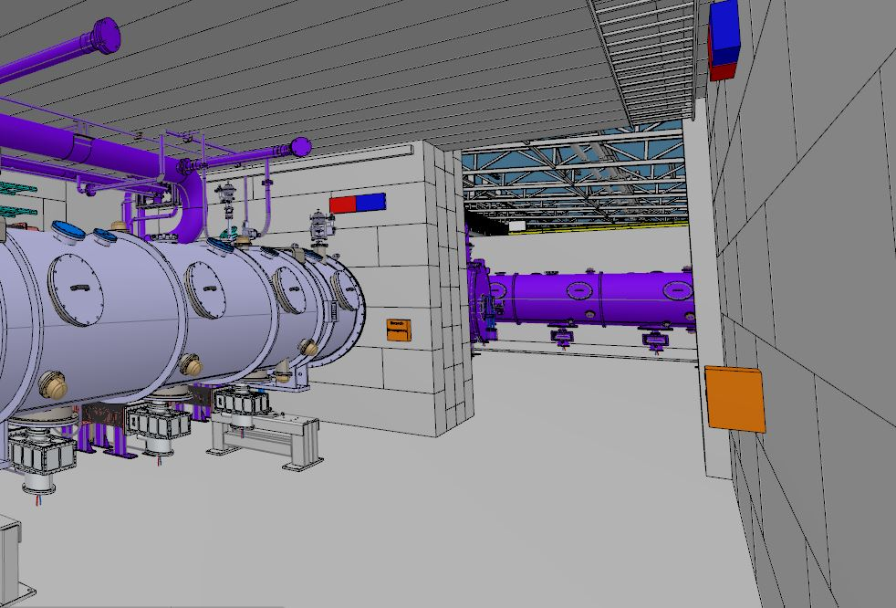
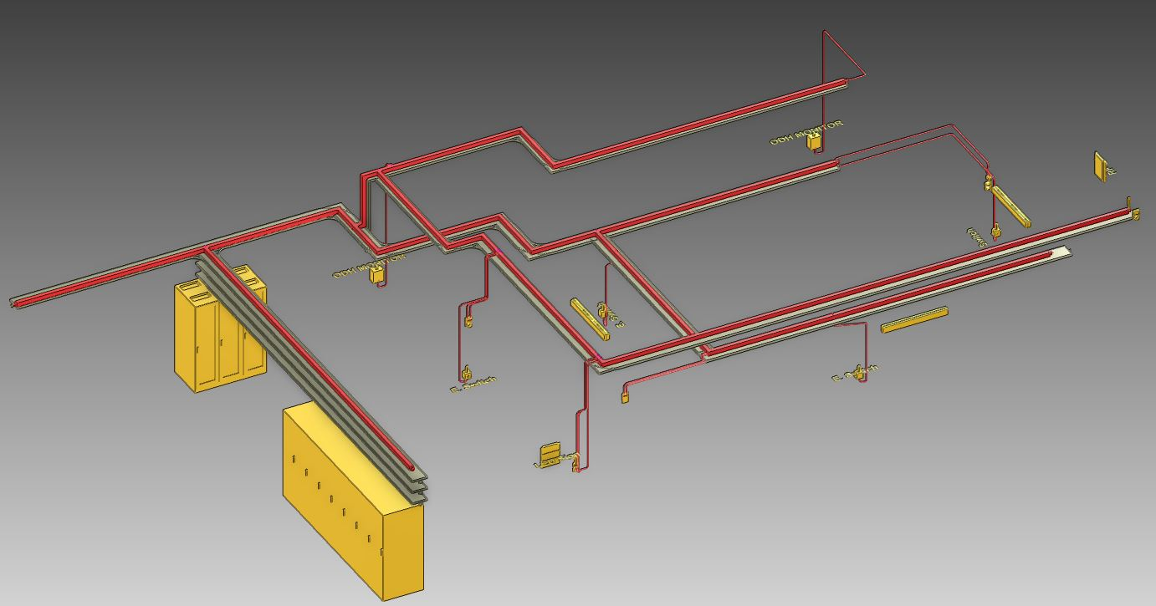
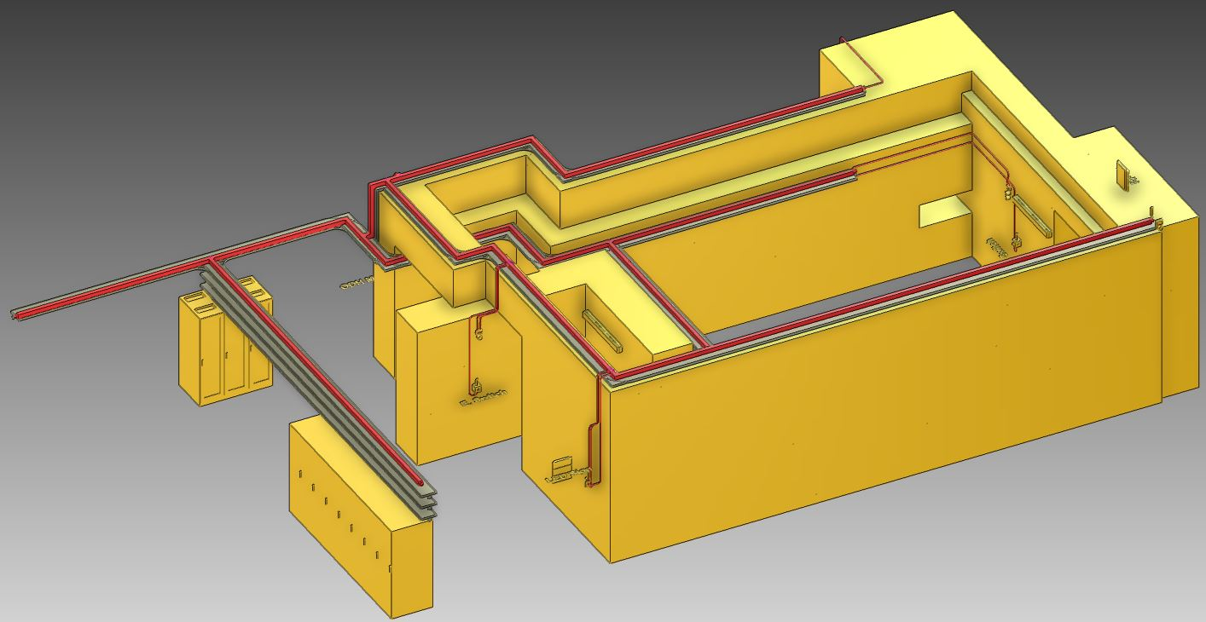
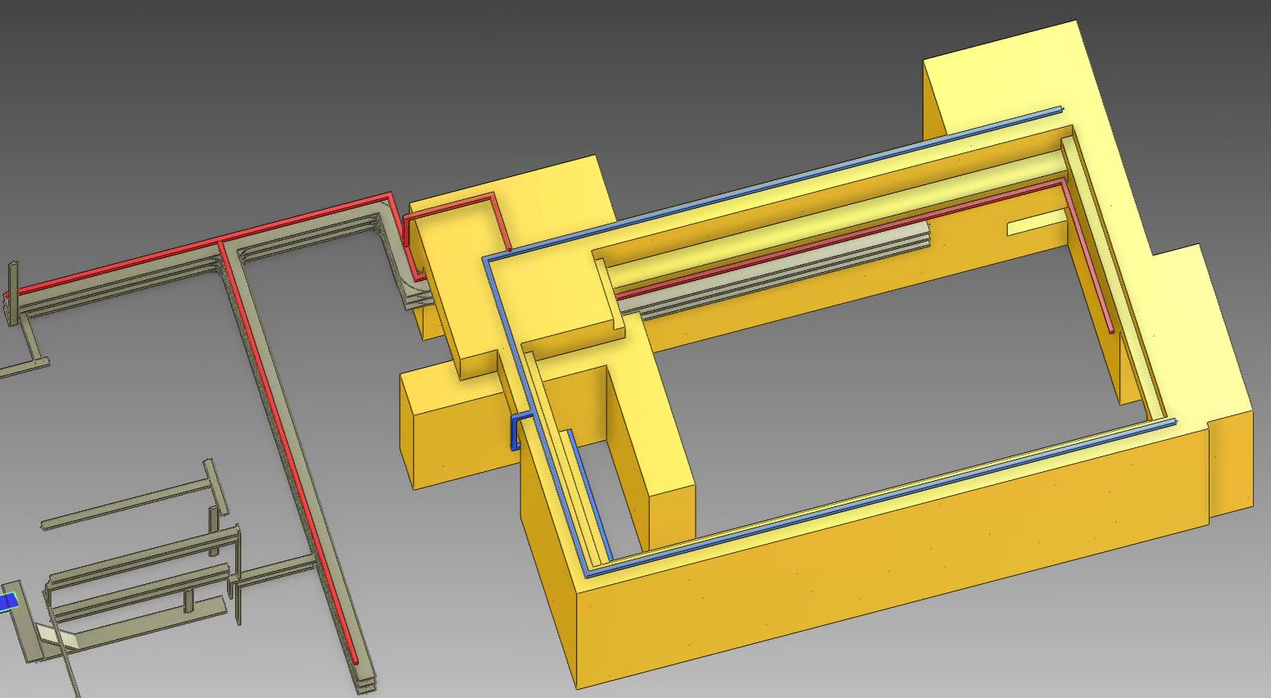
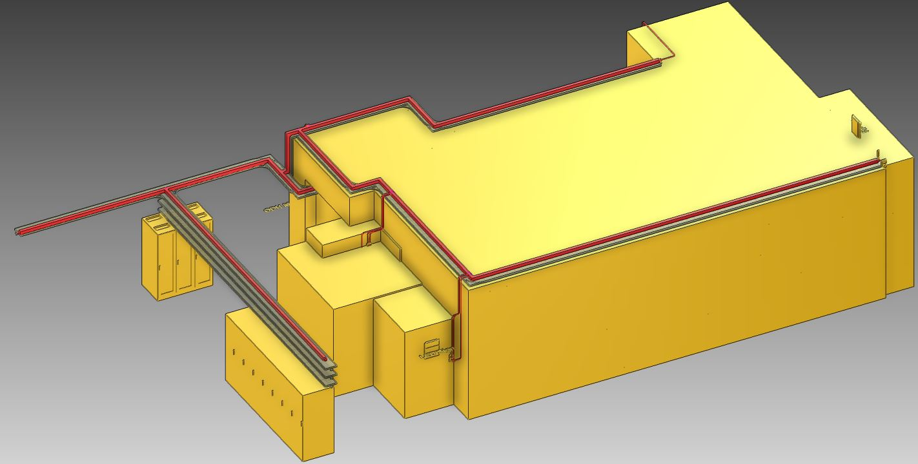
Hardware integration activites
Conceptual design
Space claims for catia
Design in Aveva E3D

Slide 5
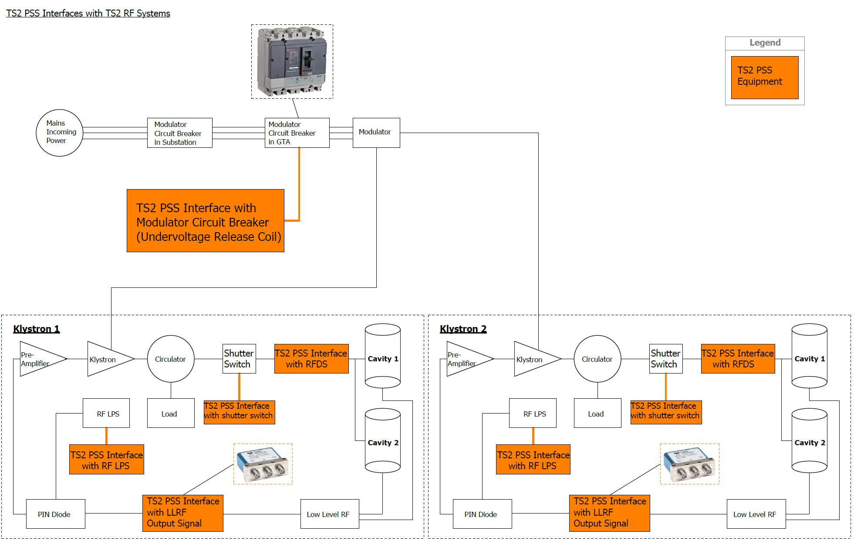
TS2 PSS interfaces with TS2 RF systems
Power Converters
Modulator interface
RF Sources
LLRF: interlock the output signal of LLRF
RFDS: removable waveguides
RF LPS:
Inform RF LPS about the status of PSS permit to modulator,
read from RF LPS the status of shutter switches

Slide 6
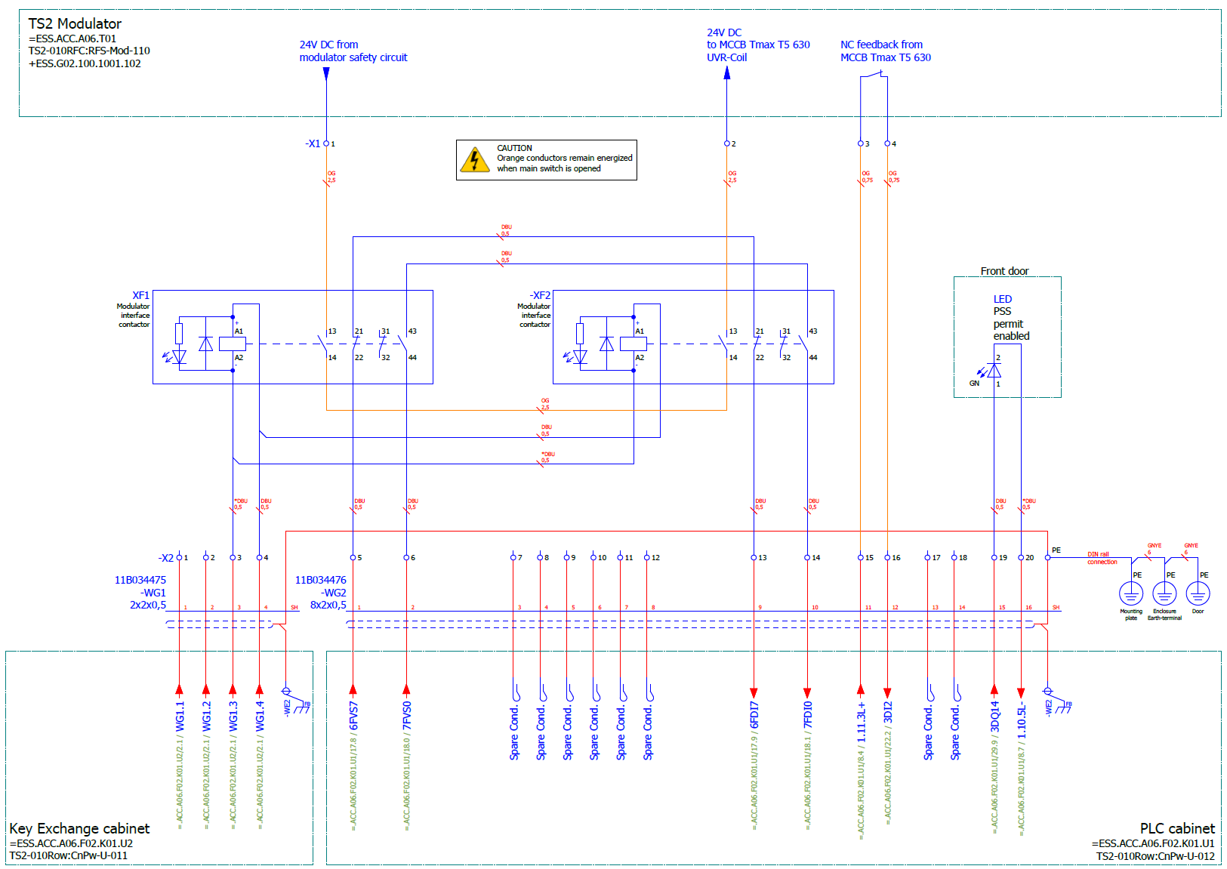
TS2 PSS interface with modulator
Undervoltage Release (UVR) will trip circuit breaker when connected voltage drops to 35-70% of the undervoltage release voltage rating. Will allow circuit breaker to close when voltage is approximately 85% of the rated voltage.
TS2 PSS permit to modulator | NO contact status (contactor relays) | Power to UVR coil | LED indicator on the PSS box | NC contact status (feedback from MCCB)
Enabled | Closed | 24 VDC | ON | Open
Disabled | Open | - | OFF | Closed
Notes:
The TS2 modulator is supplied with a MCCB (type: ABB T5S 630 PR221DS-LS – 630A – 3 Poles, switch-disconnector).
TS2 PSS interfaces the MCCB by controlling the supply voltage to the instantaneous Under Voltage Release (UVR) coil of the MCCB.
TS2 PSS interlocks the supply voltage to the UVR, TS2 PSS also get a NC feedback signal from the MCCB which indicates the on/off status.
The supply voltage of the UVR coil passes through the Normally Open (NO) contacts of the two TS2 PSS contactor relays. The contact for the feedback signal are provided via terminals located close to the MCCB. The two contactor relays are installed in a dedicated TS2 PSS box coloured in RAL 2000, the PSS box is installed on the cable raceway on top of the modulator.
Prior to (500 milliseconds) disabling the TS2 PSS permit to the UVR coil, TS2 PSS informs TS2 modulator system of the forthcoming interlock. This notification is sent through EPICS.

Slide 7
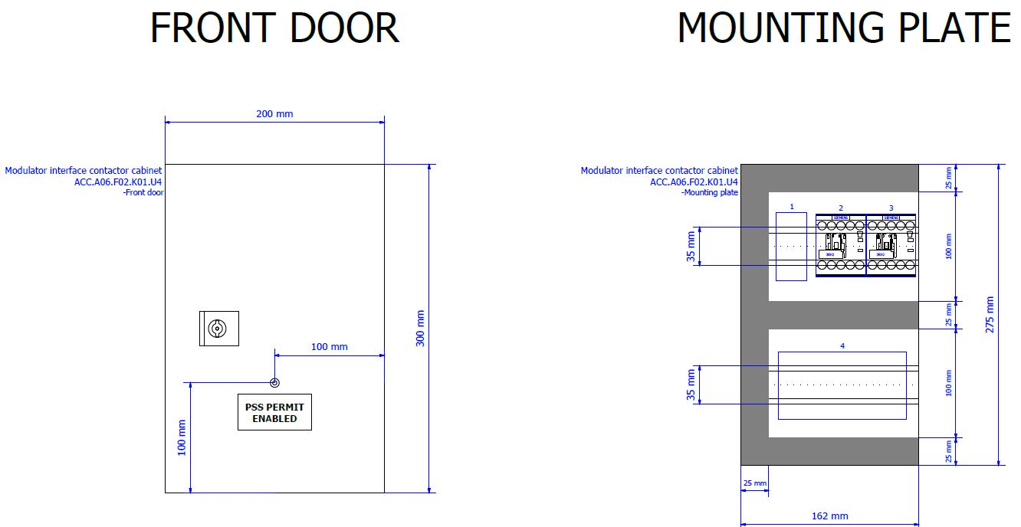
TS2 PSS interface with modulator
Notes:
The TS2 modulator is supplied with a MCCB (type: ABB T5S 630 PR221DS-LS – 630A – 3 Poles, switch-disconnector).
TS2 PSS interfaces the MCCB by controlling the supply voltage to the instantaneous Under Voltage Release (UVR) coil of the MCCB.
TS2 PSS interlocks the supply voltage to the UVR, TS2 PSS also get a NC feedback signal from the MCCB which indicates the on/off status.
The supply voltage of the UVR coil passes through the Normally Open (NO) contacts of the two TS2 PSS contactor relays. The contact for the feedback signal are provided via terminals located close to the MCCB. The two contactor relays are installed in a dedicated TS2 PSS box coloured in RAL 2000, the PSS box is installed on the cable raceway on top of the modulator.
Prior to (500 milliseconds) disabling the TS2 PSS permit to the UVR coil, TS2 PSS informs TS2 modulator system of the forthcoming interlock. This notification is sent through EPICS.

Slide 8
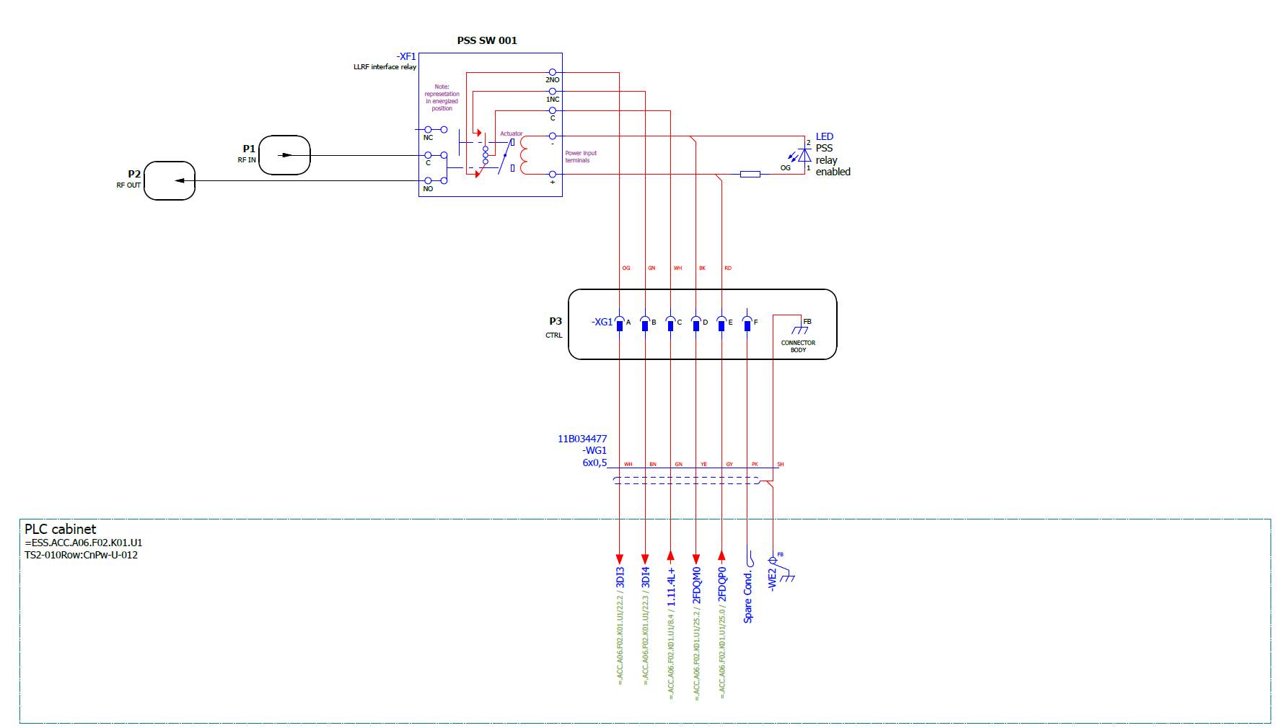
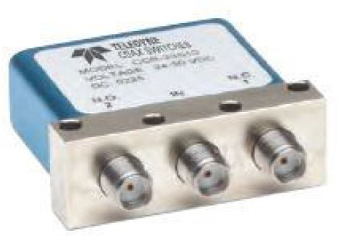
TS2 PSS interface with output signal of LLRF
TS2 PSS permit to RF switch | NO contact status (RF switch) | NC contact status (feedback from RF switch) | NO contact status (feedback from RF switch) | LED indicator on the PSS box
Enabled | Closed | Open | Closed | ON
Disabled | Open | Closed | Open | OFF
Notes:
TS2 PSS interlocks the output signal of the LLRF systems by controlling the RF switch installed on the output signal of the LLRF systems.
The output signal of LLRF passes through the NO contact of the RF switch. The RF switch is installed in a dedicated PSS Relay Switch box coloured in RAL 2000 with the following dimensions, Width: 480 mm, Height: 1U (45 mm), Depth: 150 mm. On the front of the box there are a LED showing the status of the permit.

Slide 9
TS2 PSS interface with output signal of LLRF
Notes:
TS2 PSS interlocks the output signal of the LLRF systems by controlling the RF switch installed on the output signal of the LLRF systems.
The output signal of LLRF passes through the NO contact of the RF switch. The RF switch is installed in a dedicated PSS Relay Switch box coloured in RAL 2000 with the following dimensions, Width: 480 mm, Height: 1U (45 mm), Depth: 150 mm. On the front of the box there are a LED showing the status of the permit.

Slide 10
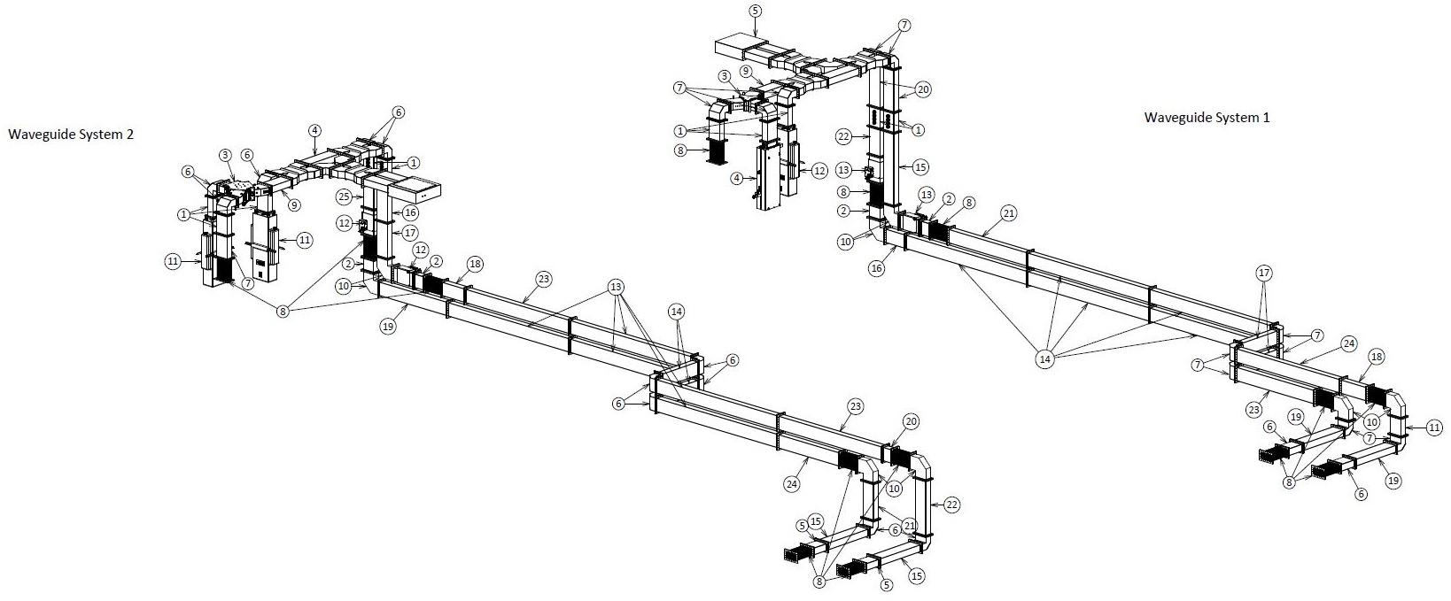
TS2 PSS interfaces with TS2 RFDS
Notes:
TS2 PSS have two interface with LPS as described in 3.4.1 and 3.4.2:
TS2 PSS sends a hardwired signal to RF LPS to inform the status of TS2 PSS permit to TS2 modulator. TS2 PSS provides this signal through a NO dry contact of a relay in TS2 PSS rack. The relay is installed in TS2 PSS rack (FBS name: =ESS.ACC.A06.F02.K01.U1, ESS name: TS2-010Row:CnPw-U-012).

Slide 11
TS2 PSS interfaces with TS2 RFDS (removeable waveguide)
Switch hood with female insert and contacts
Switch housing with male insert and contacts (Circuit A)
Cable to TS2 PSS
- Situation I (Waveguide in place)
- Circuit A (normal operation; RF to cavity when there is no access to TS2 bunker)
RF Waveguide
Removable Waveguide
RF Waveguide
Switch hood with female insert and contacts
Switch housing with male insert and contacts (Circuit B)
Cable to TS2 PSS
- Situation II (Waveguide removed
and short circuit plate in place)
- Circuit B (RF test in GTA during access to TS2 bunker)
RF Waveguide
RF Waveguide
Short circuit plate
Removable Waveguide

Slide 12
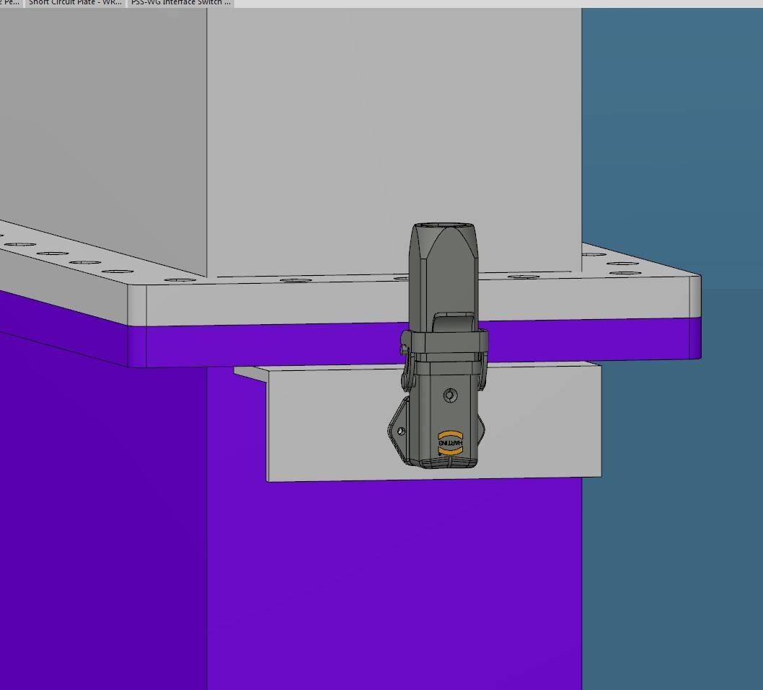
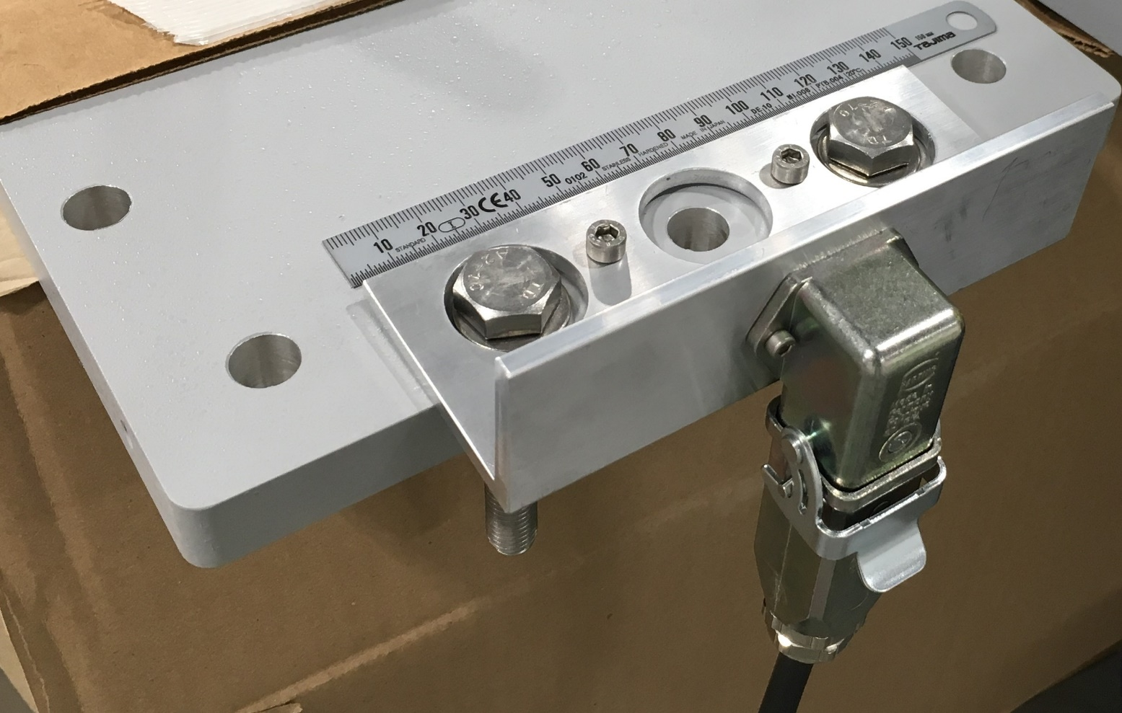
TS2 PSS interfaces with TS2 RFDS (removeable waveguide)
Notes:
TS2 PSS monitors the position of the removable waveguides (4 off) on the TS2 RFDS.
PSS switches are installed on two sides of the removable waveguides.
• If circuit A is TRUE and circuit B is FALSE, the removable waveguide is in place.
• If circuit A is FALSE and circuit B is TRUE, the removable waveguide is removed and the short circuit plate is in place.

Slide 13
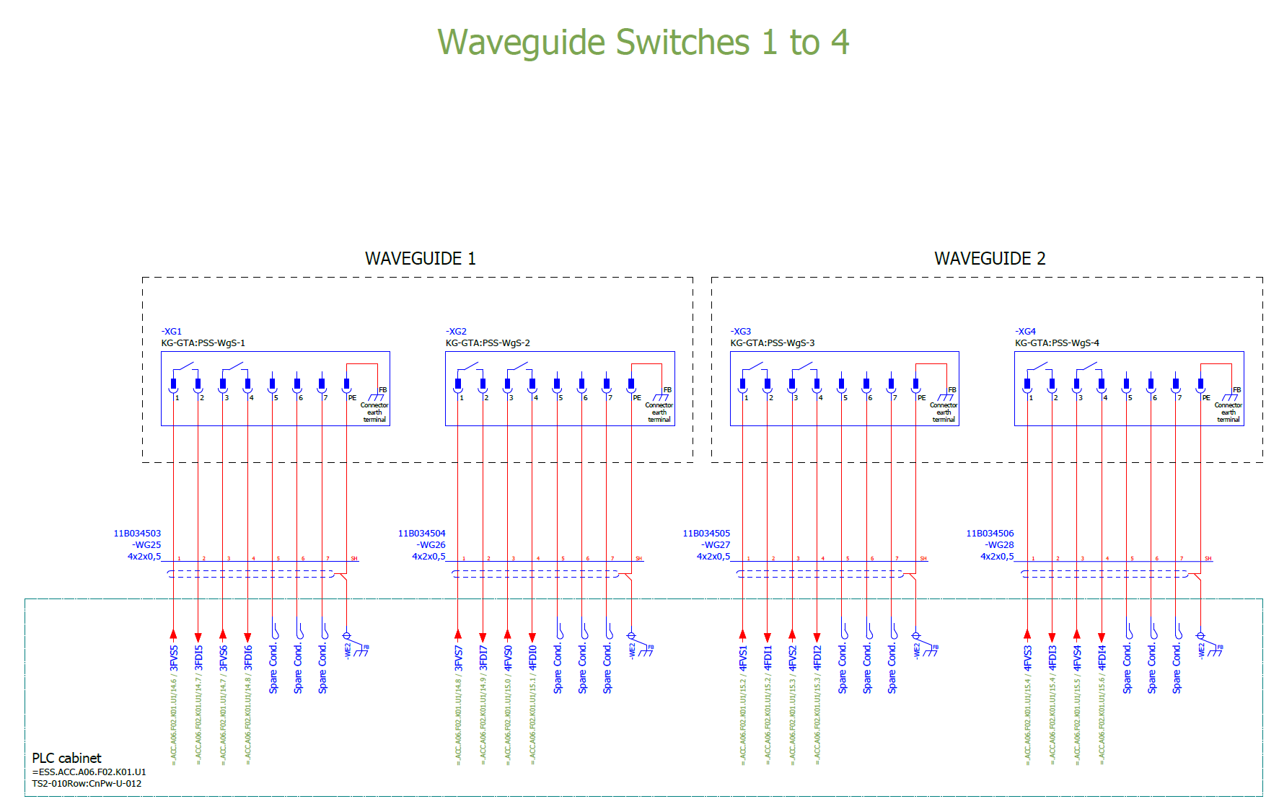
TS2 PSS interfaces with TS2 RFDS (removeable waveguide)
Notes:
TS2 PSS monitors the position of the removable waveguides (4 off) on the TS2 RFDS.
PSS switches are installed on two sides of the removable waveguides.
• If circuit A is TRUE and circuit B is FALSE, the removable waveguide is in place.
• If circuit A is FALSE and circuit B is TRUE, the removable waveguide is removed and the short circuit plate is in place.

Slide 14
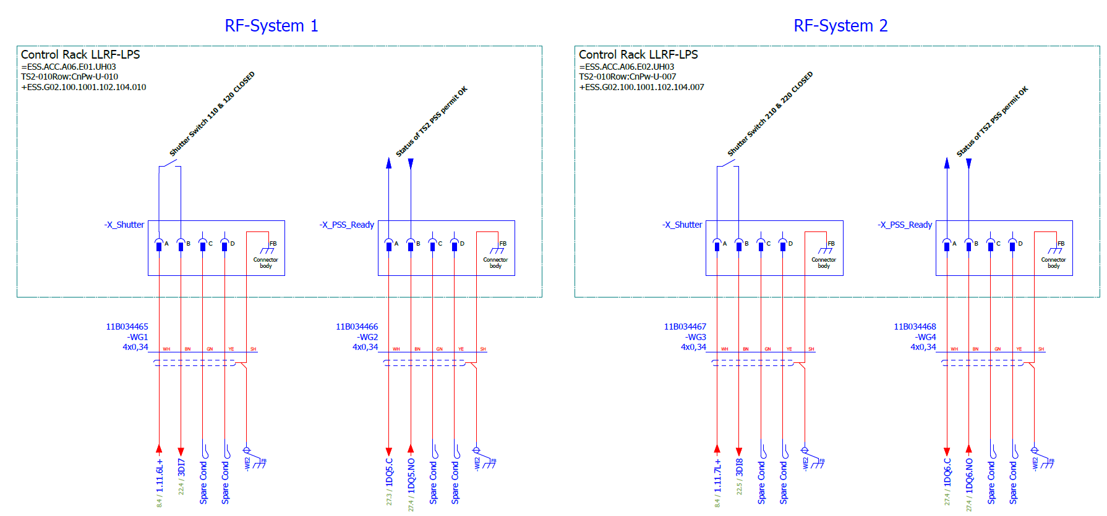
TS2 PSS interfaces with TS2 RF LPS (status of shutter switches, and status of PSS permit to modulator)
The table below shows the status of the shutter switch from the RF LPS:
The table below shows the status of TS2 PSS permit to the RF LPS:
RF LPS status of shutter switch | NO contact status (LPS relay) | RF LPS signal to TS2 PSS
Open | Open | -
Closed | Closed | 24 VDC
TS2 PSS permission status to modulator | NO contact status (PSS relay) | TS2 PSS signal to RF LPS
Enabled | Closed | 24 VDC
Disabled | Open | -
Notes:
TS2 PSS have two interface with LPS as described in 3.4.1 and 3.4.2:
TS2 PSS sends a hardwired signal to RF LPS to inform the status of TS2 PSS permit to TS2 modulator. TS2 PSS provides this signal through a NO dry contact of a relay in TS2 PSS rack. The relay is installed in TS2 PSS rack (FBS name: =ESS.ACC.A06.F02.K01.U1, ESS name: TS2-010Row:CnPw-U-012).
LPS monitors the position of the two RF shutter switches which is located upstream of the removable waveguide in each of the two RF Systems. LPS provides each of these signals through a NO dry contact of a relay in the TS2 LPS/LLRF racks.
The shutter switches are directly connected to the RF LPS systems, RF LPS provides the signal through a NO dry contact of a relay in the following racks:
The shutter switch connected to RF System1 (Thales): name of the switch
ESS name: TS2-010Row:CnPw-U-010
FBS: =ESS.ACC.A06.E01.UH03
LBS: +ESS.G02.100.1001.102.104.010
The shutter switch connected to RF System2 (CPI): name of the switch
ESS name: TS2-010Row:CnPw-U-007
FBS: =ESS.ACC.A06.E02.UH03
LBS: +ESS.G02.100.1001.102.104.007

Slide 15
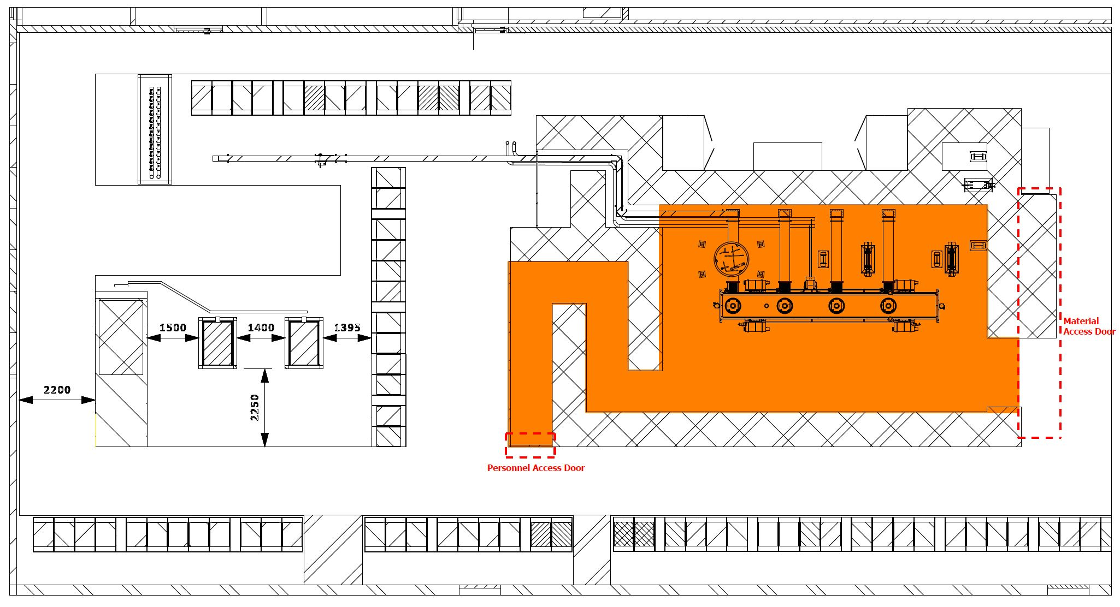
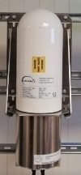
TS2 PSS interfaces with radiation monitors
RM2
RM2
RM1

Slide 16
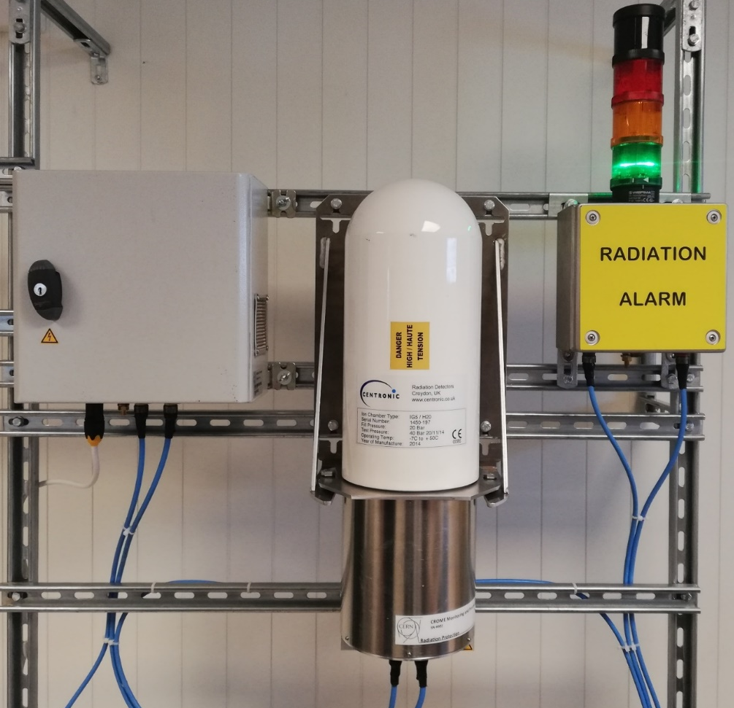
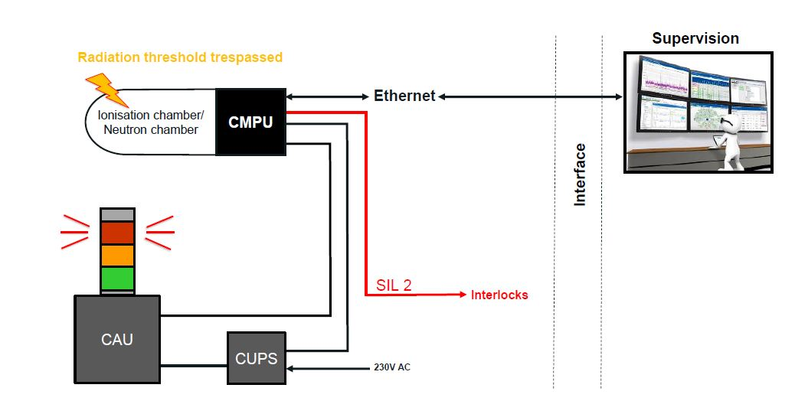
CROME (CERN Radiation Monitoring Electronics)

Slide 17
TS2 PSS Interfaces with radiation monitors
Interlock relays are installed in CMPU.
High radiation alarm (this relay is triggered based on the calculated dose rate and a defined/preset threshold)
Radiation monitor fault (power loss, detector failure, alarm unit failure, etc.)
Type of cable termination: LEMO FGN-2M-312-XLC
NO contact status (high radiation alarm) | NO contact status (radiation monitor fault) | TS2 PSS permit to RF system
Closed | Closed | Enabled
Open | Closed | Disabled
Closed | Open | Disabled
Open | Open | Disabled

Slide 18
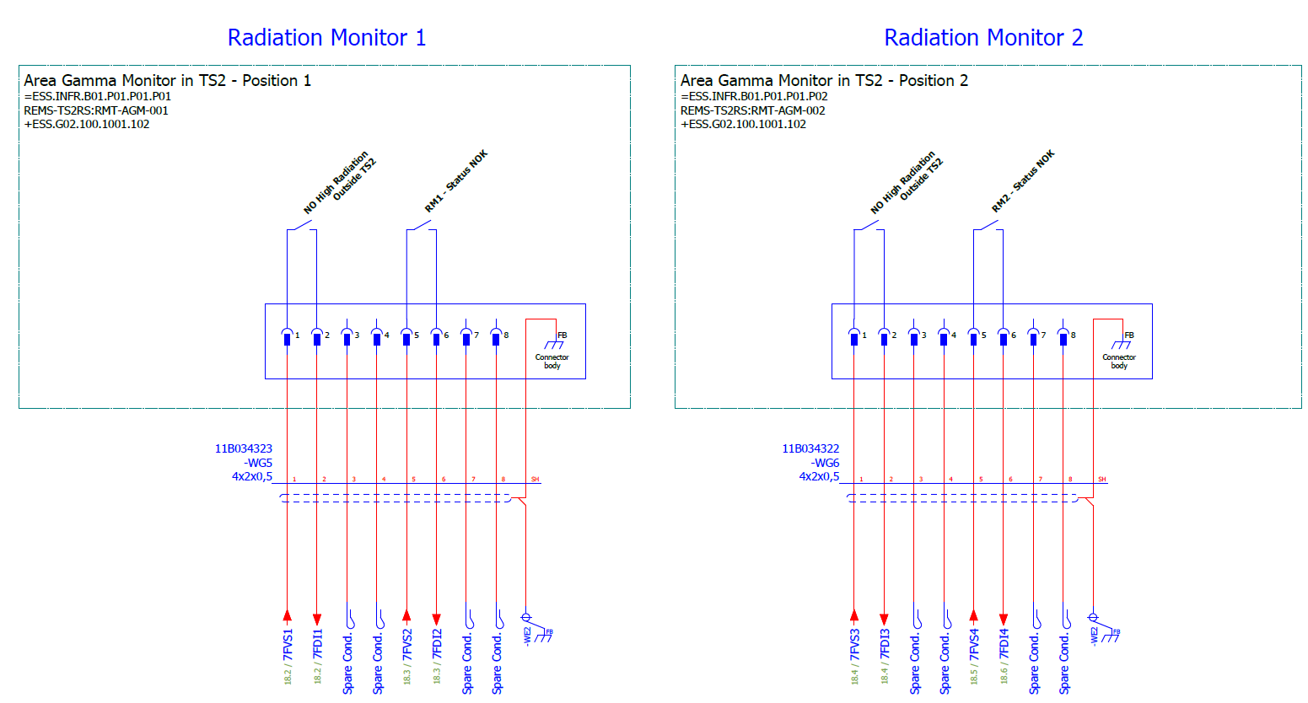
TS2 PSS Interfaces with radiation monitors

Slide 19
TS2 PSS integration into EPICS
The activities to integrate TS2 PSS into EPICS are identified. [link]
Krisztian Löki has been assigned to implement the EPICS integration for TS2 PSS.
Initial meeting with Krisztian was held to agree on the list of activities and responsibilities.
Preliminary list of devices and PVs created. [link]

Slide 20
Summary
See more details in respective ICD:
TS2 PSS and TS2 RF System ICD ESS-0517355
TS2 PSS and TS2 Radiation Monitors Interface Control Document ESS-0517371
Details can also be found in:
TS2 PSS Electrical and Mechanical Drawings ESS-0508473

Slide 21
Thank you!

