Slide 1
TS2 PSS
Software Requirements and Software Design
TS2 PSS Critical Design Review
Denis Paulic
ESS/ICS/PS
2019-04-09

Slide 2
Contents
Software Requirements
Software Architecture
Software Design
  Modes of operation
  Formalised search
  ODH detection system
  TS2 PSS SIFs
Software Testing
Development setup

Slide 3

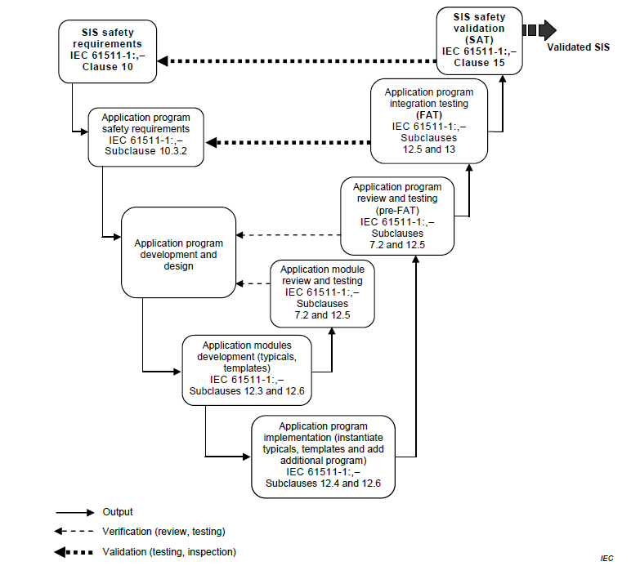
TS2 PSS Software Documentation
ConOps
HWRS
SRS
ICDs
SWRS
Software Design Document
Software Summary
SRS = Safety Requirements Specification
AP= Application Program
Notes:
Architecture Design description: Identify set of methods and techniques for developing the AP and justify use of them.
Development Support planning: Select a suitable list of tools; consider availability of support during the SIS lifetime; suitable set of procedures for tool usage; justify choice of programming language if needed.
Software Development: Ladder logic, Simulation and Integration test

Slide 4
Software Requirements
Sensors and Actuators
Important system conditions
Requirements on how are they connected and read in the software.
Defined internal variables to be used in the software.
Internal variables and requirements for calculating the status of TS2 PSS controlled area.
“shall”, “should” and “can”
Startup and alarm conditions.
To be moved to Software Design Document

Slide 5
Software Requirements
System Interfaces
Operator Interfaces
Variables and requirements to communicate with RF LPS and TS2 control system.
TS2 PSS HMI requirements.
LCR OPI requirements.
To be moved to Software Design Document

Slide 6
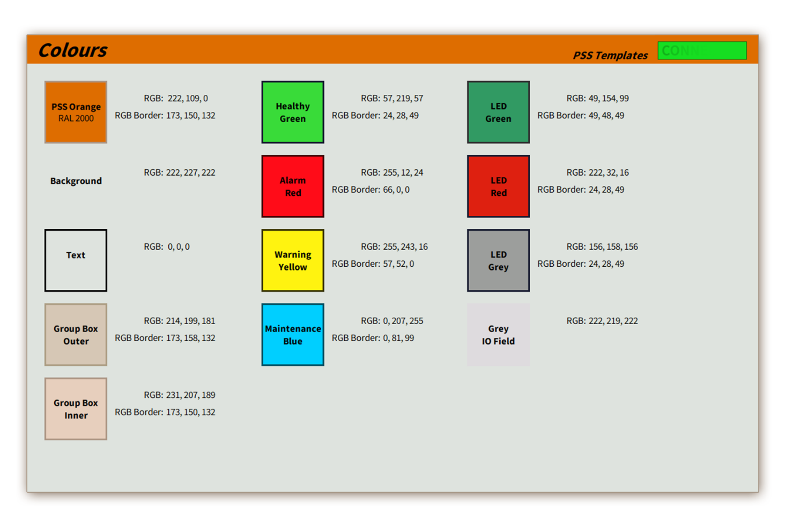

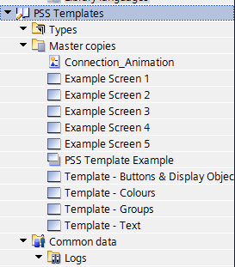
HMI Guideline
PSS HMI and OPI Guidelines*
(ESS-0517393)
* PSS HMI and OPI guidelines are based on OPI Development Style guide developed by C. Rosati (ICS-SW)
Big thanks to D. Nordt (ICS-SW) for a great support to develop PSS templates!

Slide 7



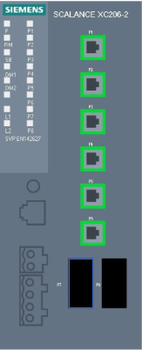

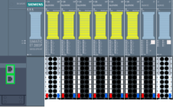
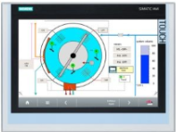



Network Architecture
PSS Engineering Workstation
Industrial Ethernet
1515F-2PN with CP1543-1
SCALANCE
XC206-2SFP
ET 200SP
HMI (PLC cabinet)
UPS 1600
PROFINET TCP/IP
1511-1PN with CM1542-1
PSS Supervision Station (LCR)
Technical Network
CP = Communication Processor
CM = Communication Module
HMI = Human Machine Interface
EPICS = Experimental Physics and Industrial Control System
LCR = Local Control Room

Slide 8
Software Architecture

Slide 9
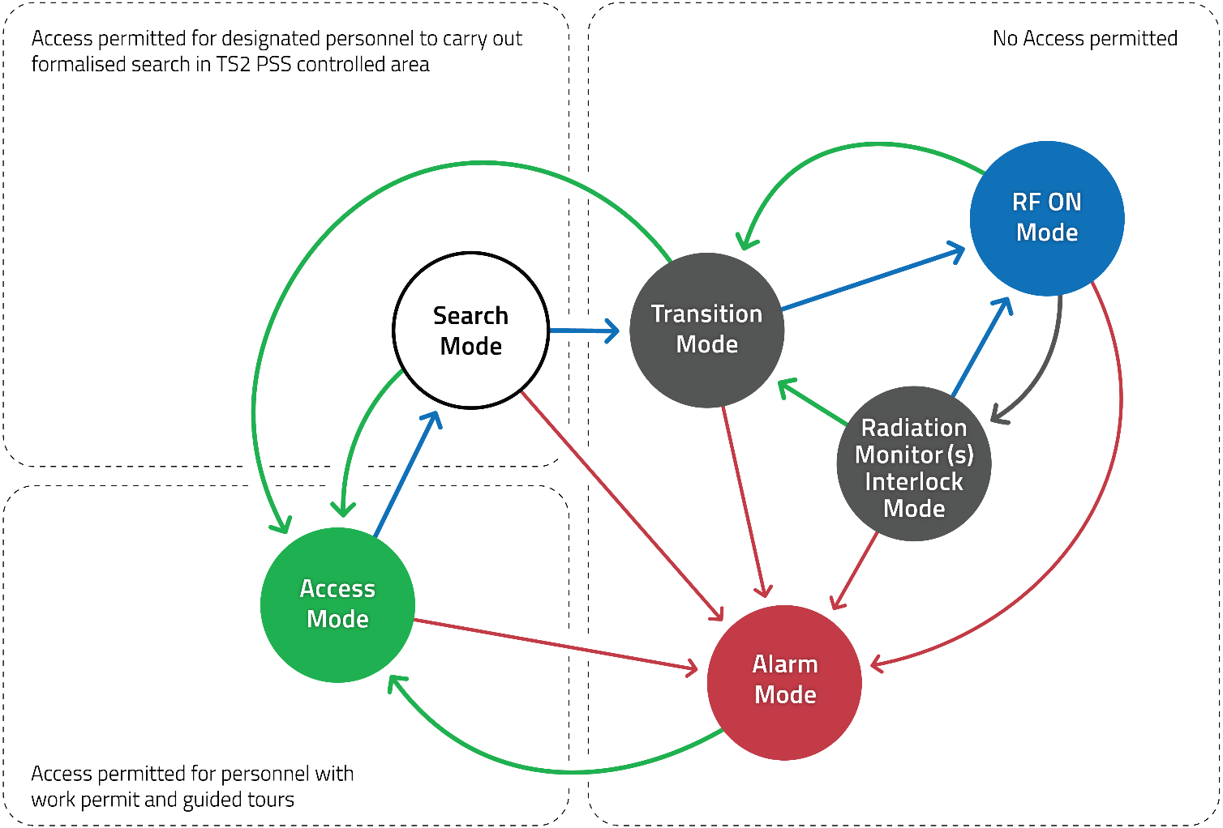
Modes of Operation
Drawing courtesy of D. Nordt

Slide 10
Alarm Mode

Slide 11
Access Mode

Slide 12
RF ON Mode

Slide 13
Formalised Search – Search broken

Slide 14


Formalised Search – Search Start
Search button 1
Search button 2

Slide 15
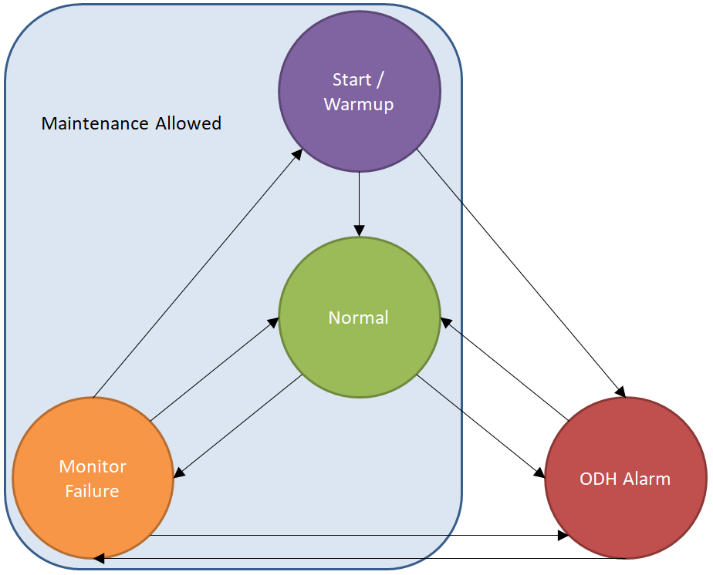
ODH Detection System Modes
Drawing courtesy of S. Crossland

Slide 16
ODH Detection System - Normal Mode
The system will be in Normal mode when:
  All alarms have been acknowledged.
  Both monitors are in a normal state and have finished warming up.

Slide 17


ODH Detection System – ODH Alarm Mode

Slide 18
TS2 PSS SIFs
SIF description
Hardware setup
Time delays and response time
Acknowledgment and data logging
Diagnostic tests
Formal description

Slide 19
Example – TS2PSS_SIF1
Description
  Upon detecting input from emergency switch-off button, the SIS logic solver shall send the command (with a delay) to remove the permit to energise TS2 modulator and LLRF, and system shall transition to Alarm mode.
  This function shall be enabled in all TS2 PSS modes of operation.
  If the emergency switch-off button is pressed and a command from the PLC is active to request switch-off and if the system does not receive feedbacks from RF systems that they are de-energised within 1 second, the system shall transition to Alarm mode.

Slide 20
Example – TS2PSS_SIF1
Time delays and response time
  When TS2PSS_SIF1 interlock request is detected, the system shall wait for at least 500 milliseconds before sending a command to remove the permit.
  The response time to perform this safety function including the time delay shall be lower than 1 second.
Acknowledgment and data logging
  The interlock from the TS2PSS_SIF1 function shall be manually acknowledged from the HMI.
  Every time the interlock is caused by TS2PSS_SIF1, the action shall be logged on the HMI.

Slide 21
Example – TS2PSS_SIF1
Formal Description using Plain Text and Boolean formulas:
  Activation of the Alarm mode and removing the permit to power the TS2 modulator and LLRF by pressing the emergency switch-off button:
    IF any of 2 normally closed (NC) contact modules inside any of the emergency switch-off buttons is detected open, indicating that the button has been pressed;
    THEN
      Send a command to TS2 control system and LPS to request switching-off of the TS2 modulator and LLRF system (notification that a TS2 PSS permit is going to be removed).
      Start a timer to count 500 ms for a required time delay.
      Remove commands for issuing a permit to energise the TS2 modulator and LLRS after the time delay exceeds.
      Set the Alarm mode, reset current mode and require acknowledgment.
      Activate the internal signal for critical alarm.
IF (E_SwitchOFFX == FALSE) THEN (StartTimer500ms = TRUE AND ToTS2cspermit = FALSE AND ToLPSpermit = FALSE)
IF (Timer500ms.OK == TRUE)
THEN (AlarmMode = TRUE AND CriticalAlarm = TRUE AND ModulatorUVR = FALSE AND LLRFrelayX = FALSE AND RFONMode = FALSE AND AccessMode = FALSE AND SearchMode = FALSE AND TransitionMode = FALSE AND RMInterlockMode = FALSE)

Slide 22
Example: TS2PSS_SIF1 – Implementation

Slide 23
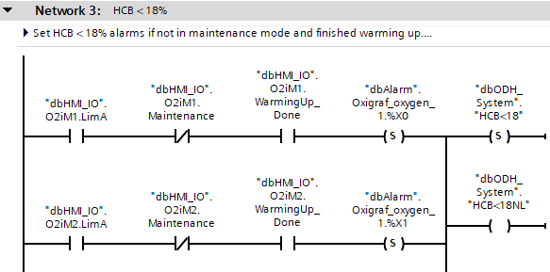
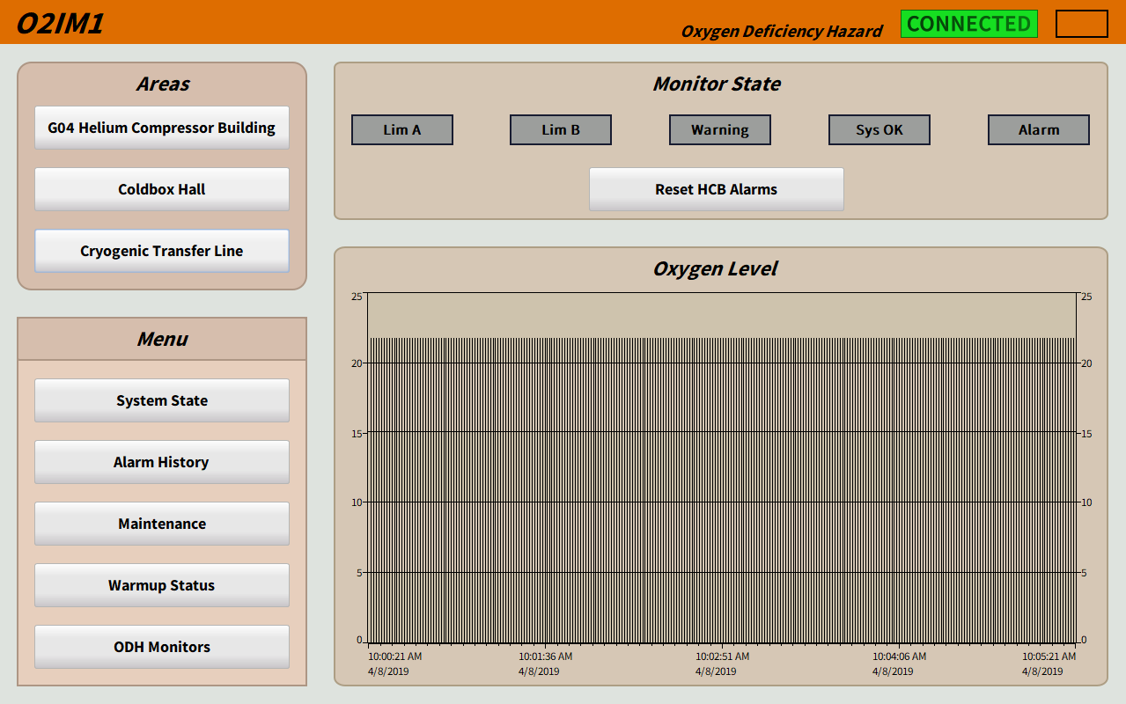
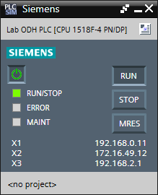
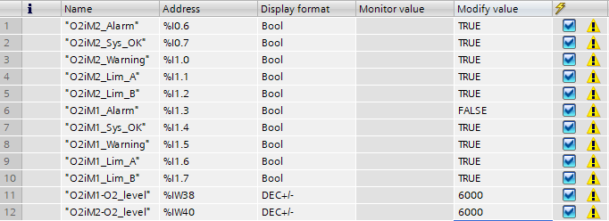
Simulation Testing
Code and Modification Tables
PLCSim
WinCC Runtime
Code is developed and passed to PLCSim
PLCSim executes code the same way as a physical PLC.
  Modification tables allow the user to change tag values in PLCSim.
PLCSim connects to WinCC Runtime simulation.
  Data is passed back and forth as in the real world.
Slide courtesy of S. Crossland

Slide 24
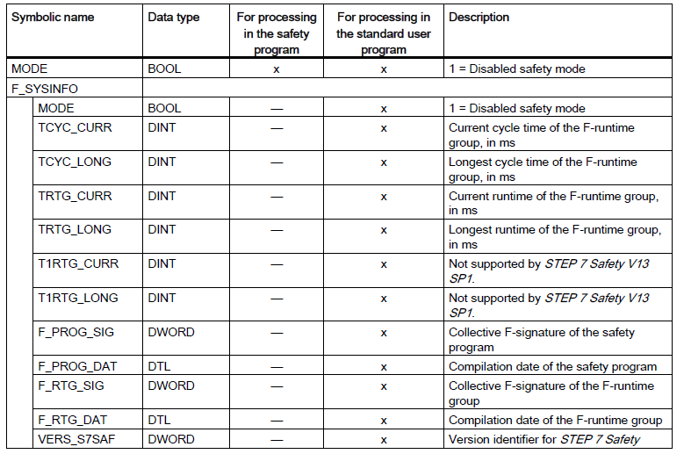
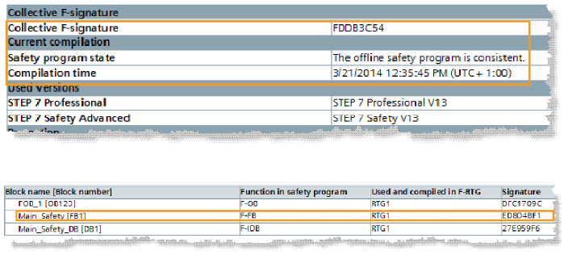
Checksum Test - F-runtime Group Information DB

Slide 25
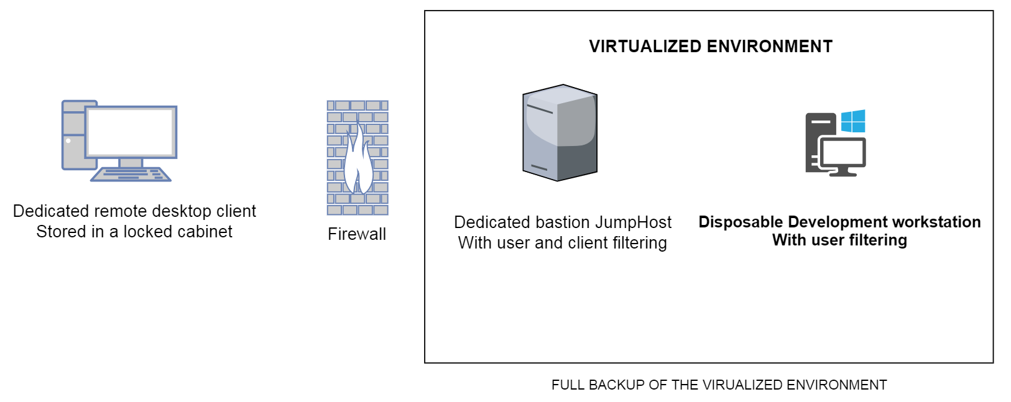
Software Development Setup
To be done (work on-going):
Define a physical location for the dedicated remote desktop client
Waiting for a final approval by the Chief Information Security Officer
End-user feedback required - performance/functionality
Drawing courtesy of S. Armanet

Slide 26

Questions?
Thank you for your attention!

Slide 27
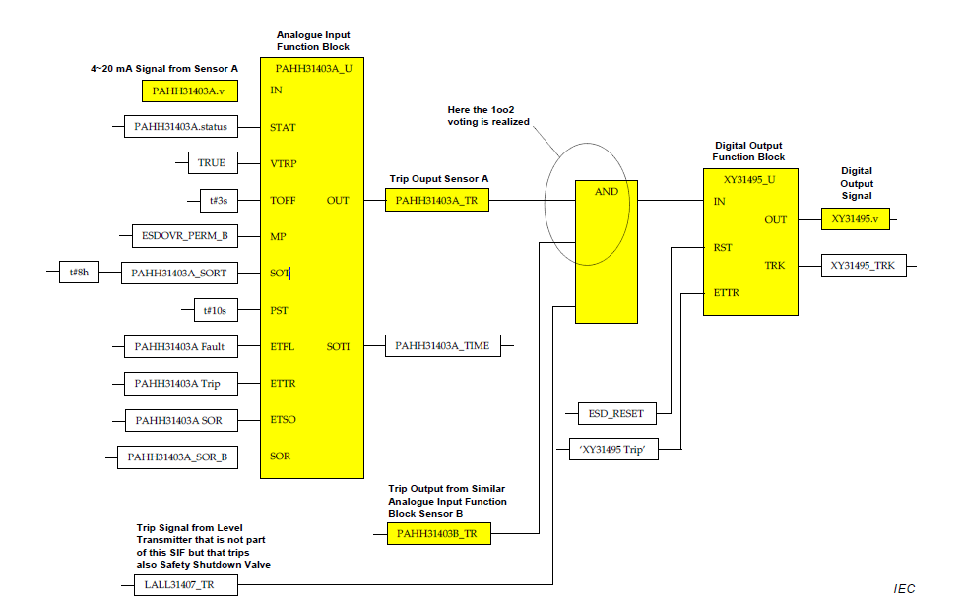
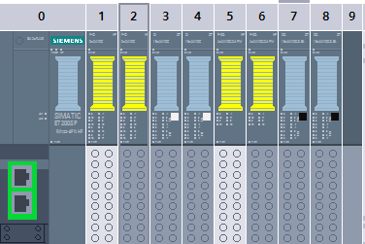
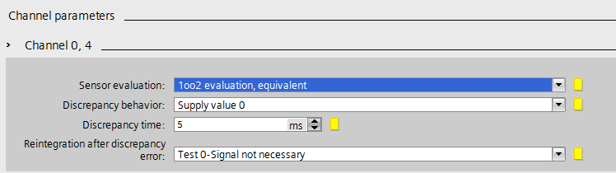
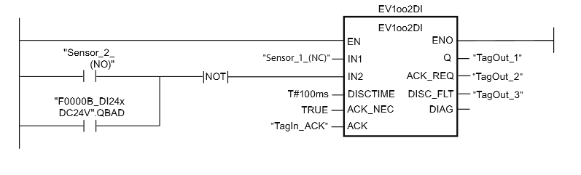
Example of 1oo2 Voting

Slide 28
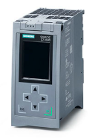
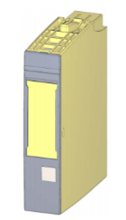
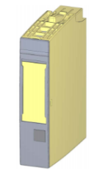
Devices for TS2 PSS Fail-safe Application
Fail-safe CPU (1515F-2 PN)
  Network separation: Integrated PROFINET interface with 2 ports for line structure and 1 additional interface for Ethernet connection and basic PROFINET functionality;
  Integrated system diagnostics;
  Integrated security (copy, access and integrity protection).
Fail-safe digital input module (8x24VDC HF)
  8 inputs (SIL3/Cat.4/PLe);
  Diagnostics: short circuit, wire break → channel-specific;
  load voltage missing → module-specific;
Fail-safe digital output module (4x24VDC/2A PM HF)
  4 outputs, PM-switching (SIL3/Cat.4/PLe)
  Diagnostics: short circuit, wire break, load voltage missing
Notes:
Functional safety is implemented principally through safety functions in the software. Safety functions are executed by the SIMATIC Safety system in order to bring the system to a safe state or maintain it in a safe state in case of a dangerous event. Safety functions are contained mainly in the following components: ● In the safety-related user program (safety program) in the F-CPU ● In the fail-safe inputs and outputs (F-I/O) The F-I/O ensure the safe processing of field information (sensors: e.g. emergency STOP pushbutton, light barriers; actuators, e.g. for motor control). They have all of the required hardware and software components for safe processing, in accordance with the required Safety Integrity Level. The user only has to program the user safety function. The safety function for the process can be provided through a user safety function or a fault reaction function. In the event of an error, if the F-system can no longer execute its actual user safety function, it executes the fault reaction function; for example, the associated outputs are shut down, and the F-CPU switches to STOP mode, if necessary.

Slide 29
Example: RFON Mode
Mode | Description
RFONMode | TS2 PSS controlled area searched and ready for operation, Main key in position ON and all the permits to operate issued. AreaReadyForOperation = TRUE AreaSearched = TRUE SafetyCircuitX = TRUE PADKey = TRUE MADKey = TRUE AreaSafeToAccess = FALSE ModulatorCBClosed = TRUE LLRFrelayXEnergised = TRUE AlarmAckRequired = FALSE MainKey = TRUE Active commands: ModulatorUVR = TRUE LLRFrelayX = TRUE

Slide 30
TS2 PSS Software Timers
T1 - minimum time between pressing 2 consecutive search buttons
  15 seconds
T2 - maximum time for search process
  120 seconds
T3 - time for de-energizing the Modulator UVR coil
  500ms

Slide 31
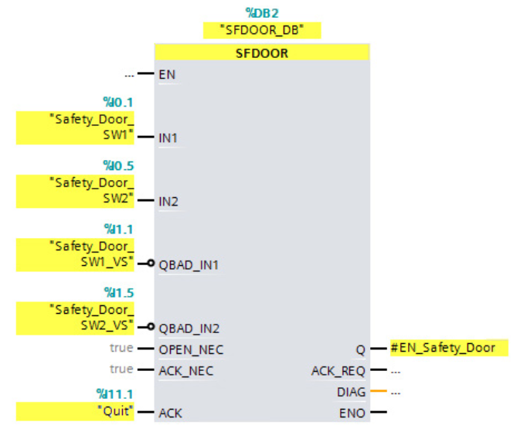
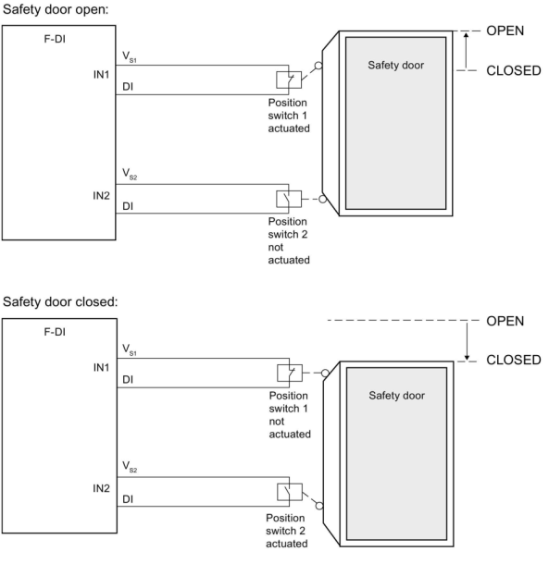
SIF02 – Siemens Safety Library Function
SFDOOR: Safety door monitoring
  Enable signal Q is reset to 0 as soon as one of the inputs IN1 or IN2 take a signal state of 0 (safety door is opened). The enable signal can be reset to 1, only if:
    Inputs IN1 and IN2 both take a signal state of 0 prior to opening the door (safety door has been completely opened)
    Inputs IN1 and IN2 then both take a signal state of 1 (safety door is closed)
    An acknowledgment occurs

Slide 32
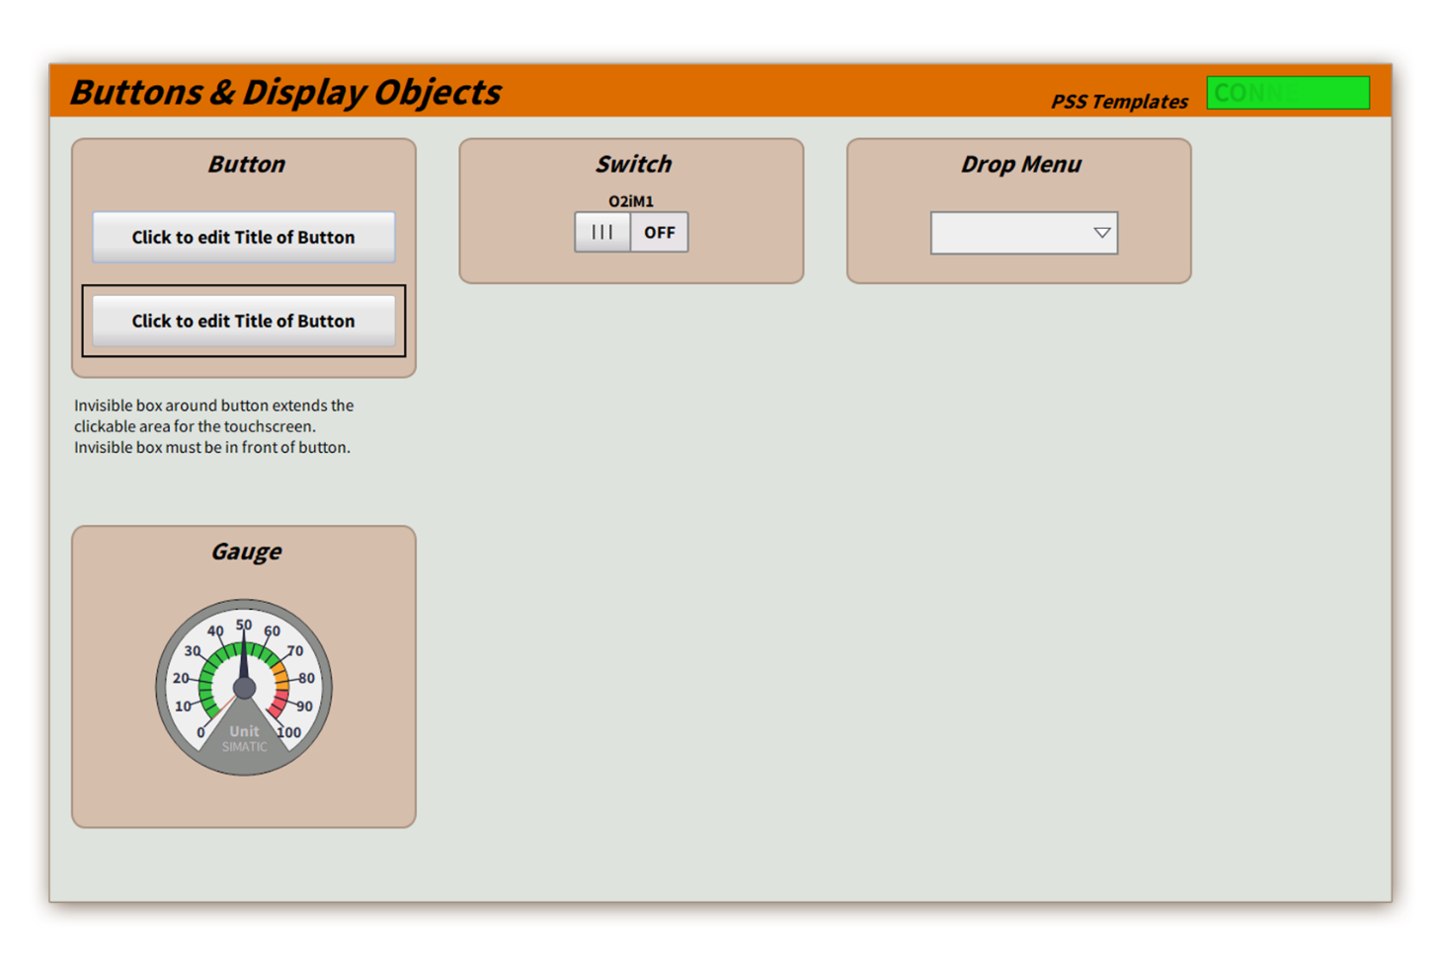
HMI Guideline

