Slide 1
Safety at Tollgate reviews workshop
13:00 – 13:10 TG3 general introduction [Judith Freita Ramos]:
13:10 – 13:40 TG3 deliverables including Radiation Safety Analysis TG3 deliverable and ES&H involvement [Gabor Laszlo]
13:40 – 13:50 CE marking [Helena Ramsing]
13:50 – 14:00 NSS installation plan and safety aspects [Antonio Bianchi]
14:00 – 14:10 Safety Readiness Review process for the accelerator [Thomas Hansson]
14:10 – 14:20 TG5 process preliminary definition [Peter Sångberg]
14:20 – 15:00 Further discussion on TG3

Slide 2
Phase 2 and TG3 introduction
- Safety at Tollgate reviews -
Judith Freita Ramos
NSS Instrument Project Tollgate Coordinator
www.europeanspallationsource.se
5 April 2019

Slide 3
DESIGN
Phase 2
REVIEW
TG3

Slide 4
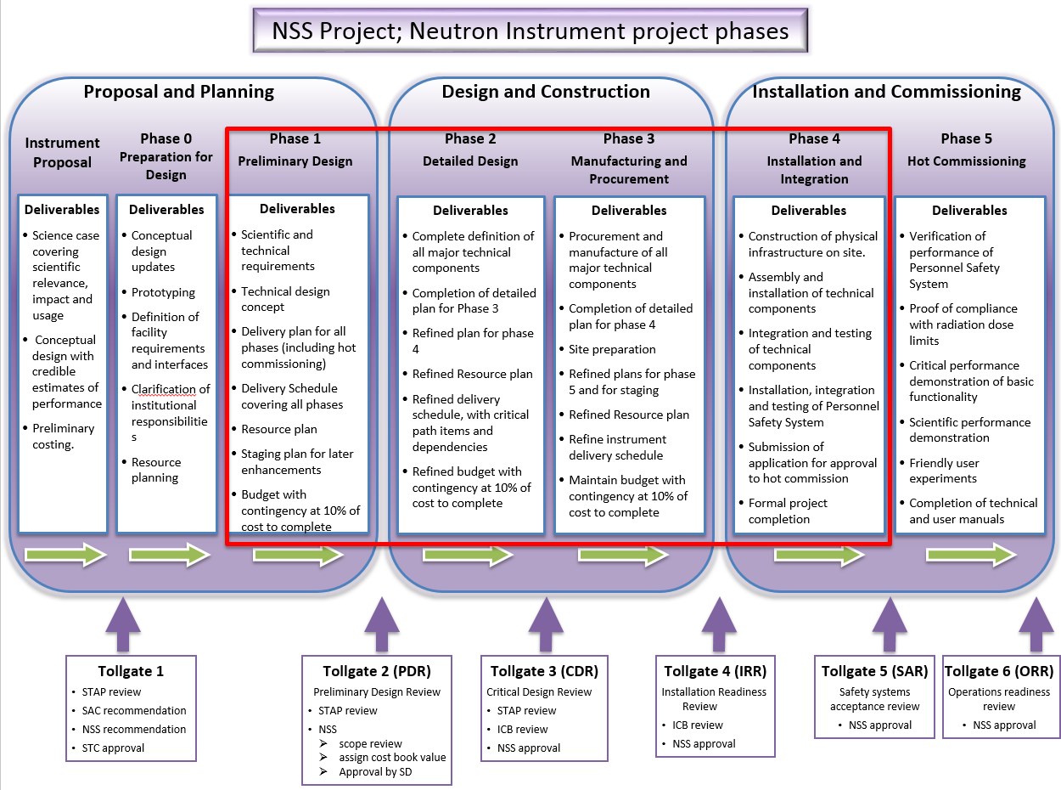
Where the TG3 sits

Slide 5
Staged Detailed Engineering Process
Phase 2 (Detailed engineering)
Phase 2/1
(In monolith optics)
Phase 2/2 (TG3-2)
In bunker components
(TG3-n-1)
Phase 2/n-1
(Final TG3)
Phase 2/n
Sub TG3-1
Sub TG3-2
Sub TG3-n-1
Final TG3
Goal: Facilitate early procurement
Challange: complex review process and schedule

Slide 6
Making TG3 an agile process
CTV- Call for Tender Verification at any time. Outsourcing detailed design.
IDR - Intermediate Design Review for complex sub-systems/components
Sub-TG3
Hub: NSS Lead Instrument Engineer
Review Transmittal for tracking issues
ESS Reviewer Teams available and working together with the Inst. Teams along the development of their detailed design

Slide 7
ESS Design Review Scope
Justification for the depth of the requested TG3 content
Radiation safety
requirements
Conventional safety
requirements
QA
Requirements
CE marking
Need for integration and support, future operational aspects
(Maintenance and reliability)

Slide 8
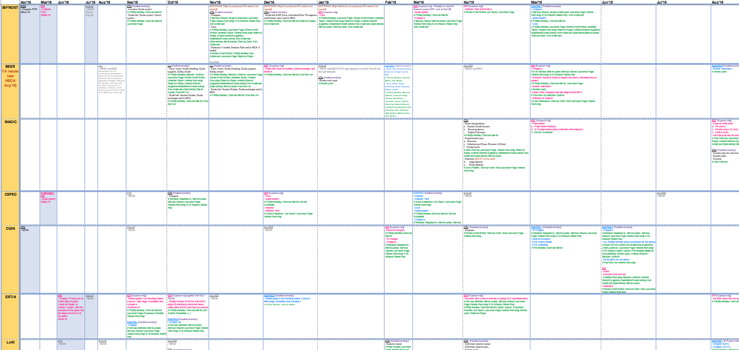
TG3 schedule
3,5 years schedule
45 CTVs, 37 IDRs, 45 Sub-TG3s
Alignment with:
Primavera
I-K TAs
TG4s
Instruments prioritisation

Slide 9
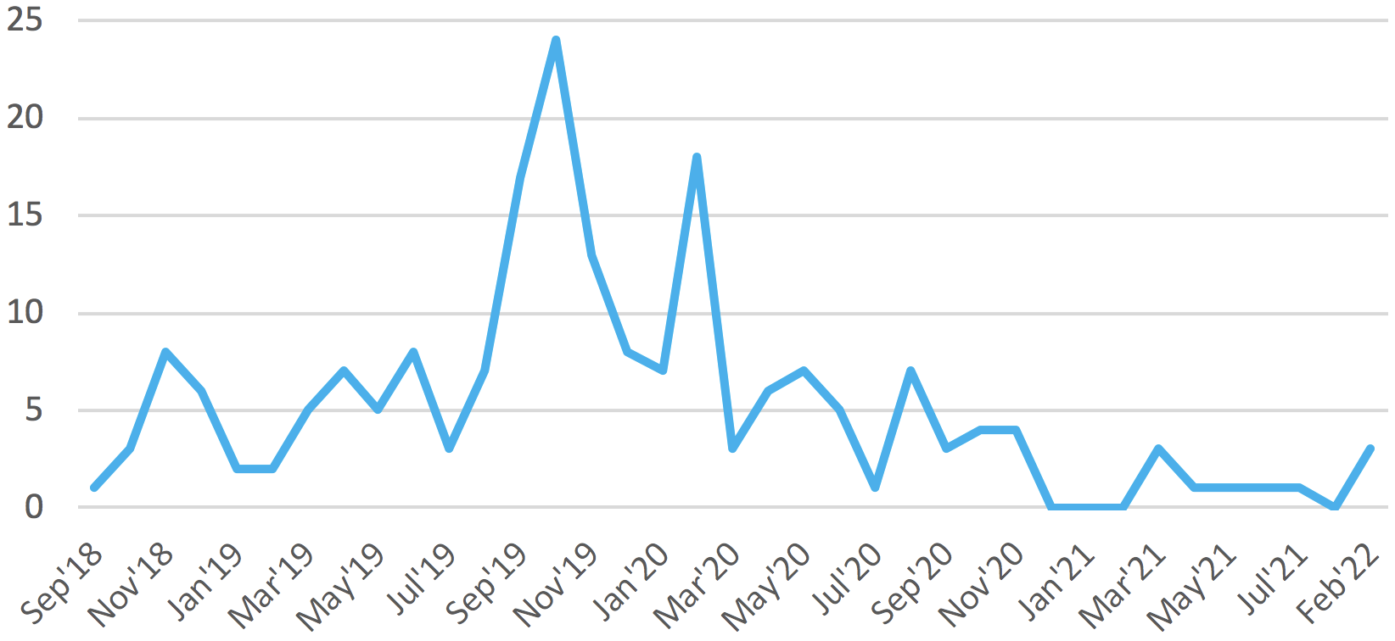
TG3 schedule: date facts
Summary of timeline:
ODIN
FREIA
Oct’18
Jan’20
Feb’22
First CTV and IDR
First Final TG3
Last Final TG3
TG3 reviews and related meetings
Busiest: Jun’19-May’20

Slide 10


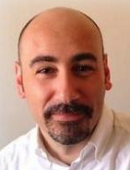
Resources: TG3 Team and Reviewers
NSS Lead Instrument Engineer
NSS Instrument Project Tollgate Coordinator
Instrument Integration Engineer
NSS TG3 Team:
Pool of Reviewers: 52 ESS experts
ESS experts and allocated roles:
Expert-To-Be-Notified:
Expertise relevant, but not core for the specific component.
Shall be made him/herself available to the Inst. Team while working on the detailed design process.
Notified and invited to the review events.
Offers feedback to Gabor.
Marked as “To be notified” on CHESS.
Reviewer:
Main expert(s) at a given review.
Reviews and provides core feedback
Main contact for the Inst. Team while working on the detailed design process.
Notified and invited to the review events.
Marked as “Reviewer” on CHESS.

Slide 11
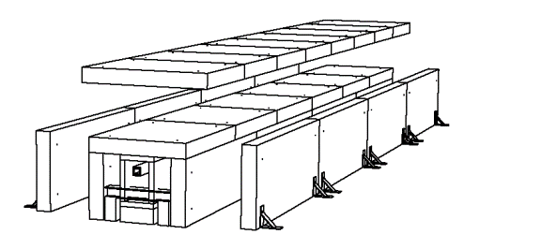
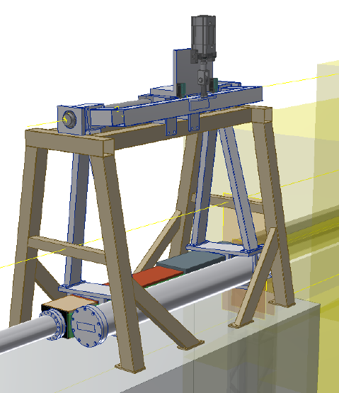
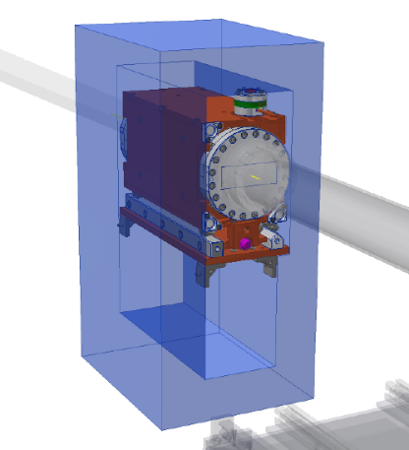
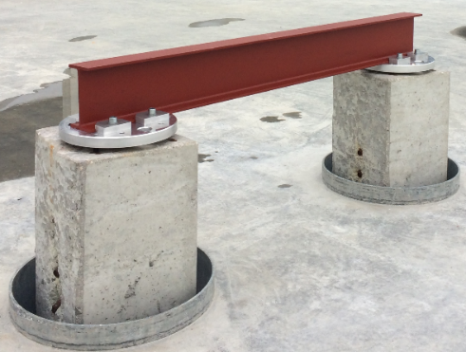
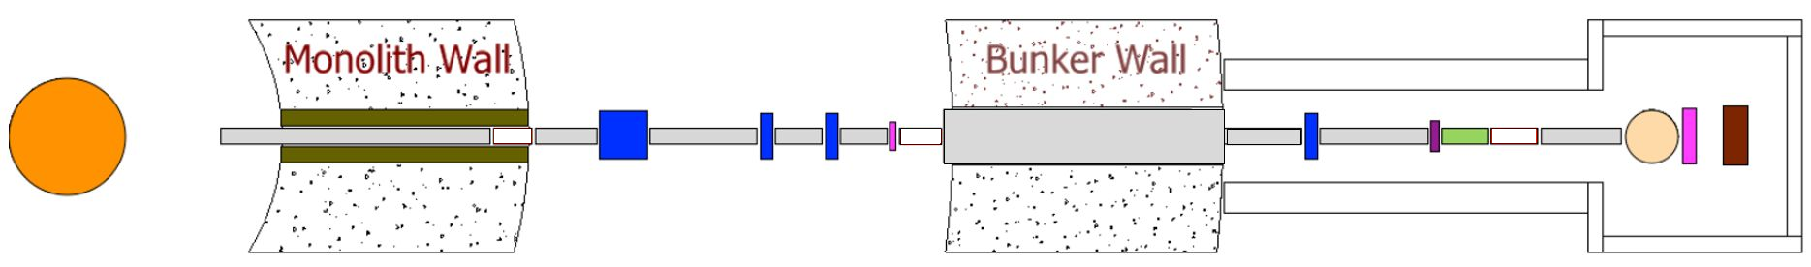
NSS input beyond Reviewer role
Design / procurement / installation / coordination / integration/ technical support
standard neutron guide shielding
chopper pits
bunker utilities for instruments
standard heavy shutter
BBG
monolith optics
E02 Pile interfaces
Test Beam Line
instrument power distribution network
Detector readout electronics design
Bunker and Beam stop
T0 chopper
Motion Control Unit development
Remote/Active handling develop
Materials testing; radiation tolerance
...

Slide 12
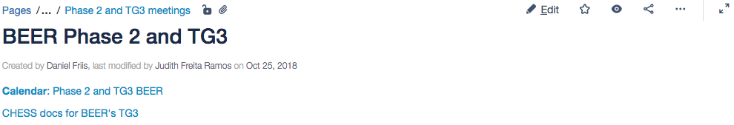
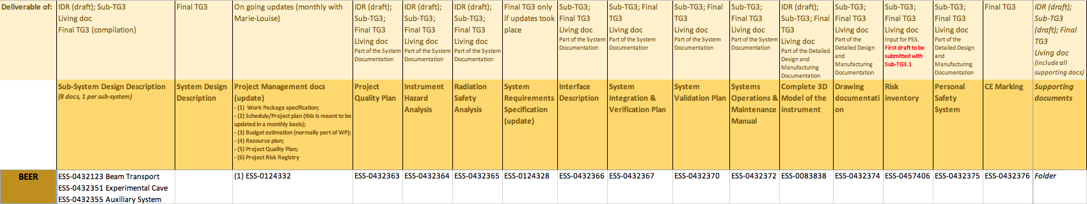
Deliverables in CHESS

Slide 13
Considerations for a successful TG3
Resources
Information and clarity
Costs and schedule
Alignment with requirements and schedules
Alignment with ESS high level requirements
Notes:
Founding Members
Czech Republic
Denmark
Germany
Estonia
France
Italy
Hungary
Norway
Poland
Sweden
Switzerland
Founding observers
Belgium
Spain
Netherlands
United Kingdom
Ireland

Slide 14
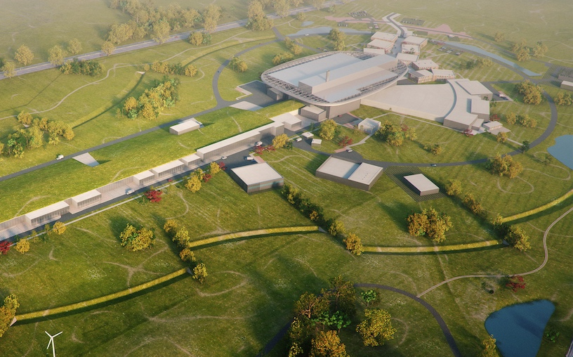


Thank you
2025
ESS Construction Phase Complete
2014
Construction Starts on Green Field Site
2023
ESS Starts
User Program
2009
Decision to Site ESS in Lund
2019
Start of Initial Operations Phase
2012
ESS Design Update Phase Complete
2003
European Design of ESS Completed

