Slide 1
ACCSYS (Accelerator) sub-project
Mats Lindroos
Head of Accelerator Division and ACCSYS sub-project
European Spallation Source ERIC

Slide 2
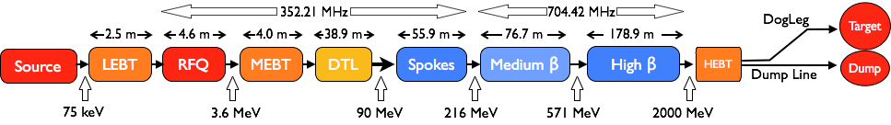
Accelerator – Scope
Accelerator Technical performances
Key parameters:
    -2.86 ms pulses
    -2 GeV
    -62.5 mA peak
    -14 Hz
    -Protons (H+)
    -Low losses
    -Minimize energy use
    -Flexible design for mitigation and future upgrades
Design Drivers:
High Average Beam Power
5 MW
High Peak Beam Power
125 MW
High Availability
95%
18 IK partners in 8 countries and 5 collaboration partners
1.3 GeV capacity with 2 MW on target for 2025 with remaining RF sources (40) to be installed after 2026

Slide 3







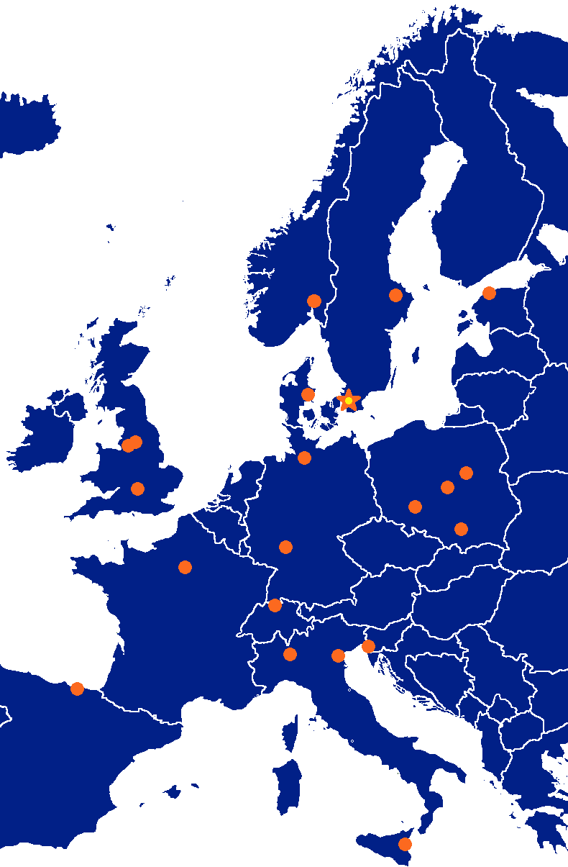

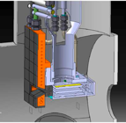


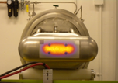
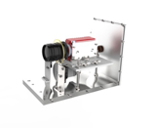





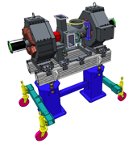









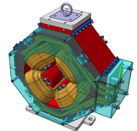

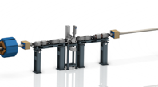



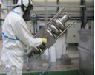












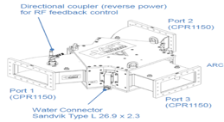
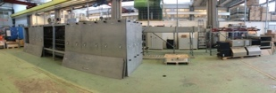
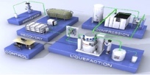







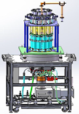
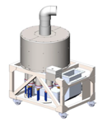






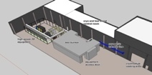
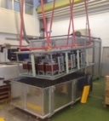

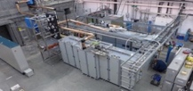
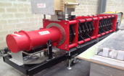
Accelerator Collaboration
3

Slide 4
High level accomplishments in 2018
Ion source and LEBT commissioning under way
RFQ machining progressing with first segment brazed
MEBT assembly started in Bilbao
M-ECCTD tested at CEA-IRFU
DTL machining of all parts started with 5 vacuum tanks ready for copper plating (1 section out of 20 copper plated)
All contracts signed for all sub-elements for the Elliptical CM series and manufacturing in progress
Spoke prototype CM test, all parts for series contracted and under manufacturing
5 series klystrons delivered
Final design of modulator, test of all sub-systems and assembly started of 1 series modulator
LLRF assembly started and reference line installation in tunnel close to complete
Test stand 2 construction close to completion and DTL workshop at ESS ready
RF wave guide, circulator and load installation in gallery and stubs started
Instrument cryoplant is operational, Accelerator and Target moderator plant being installed and commissioned.
Cryodistribution lines under manufacturing
And more as we are in the middle of construction, assembly and installation

Slide 5
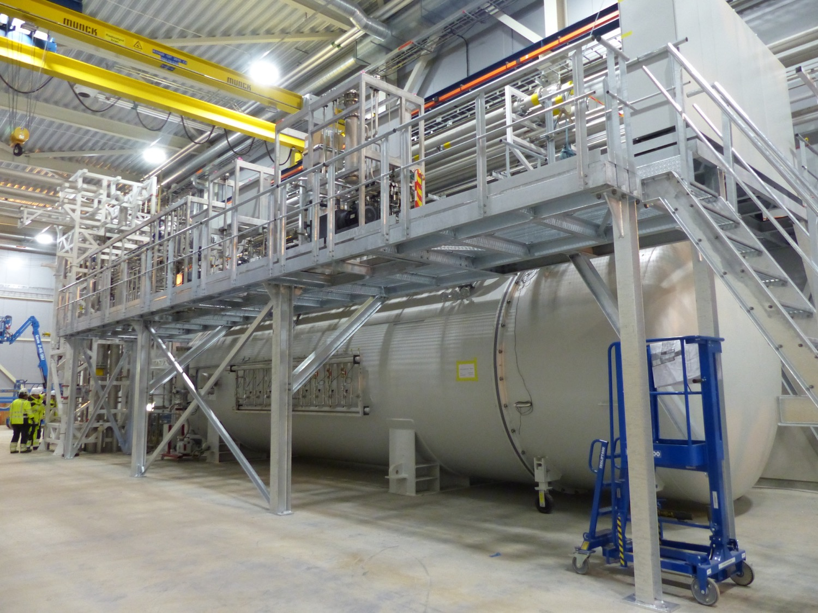
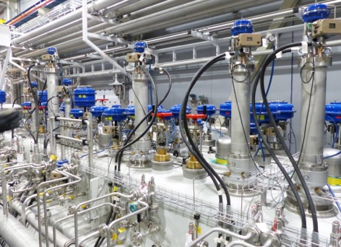
Cryogenics

Slide 6
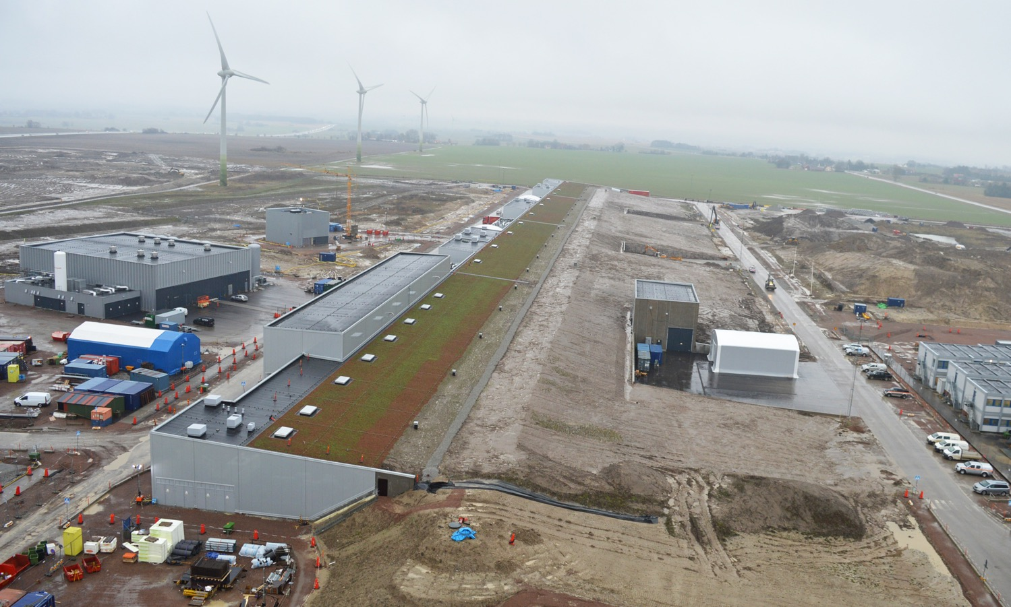
Accelerator & Klystron Gallery
Thanks to Anders Ingels

Slide 7
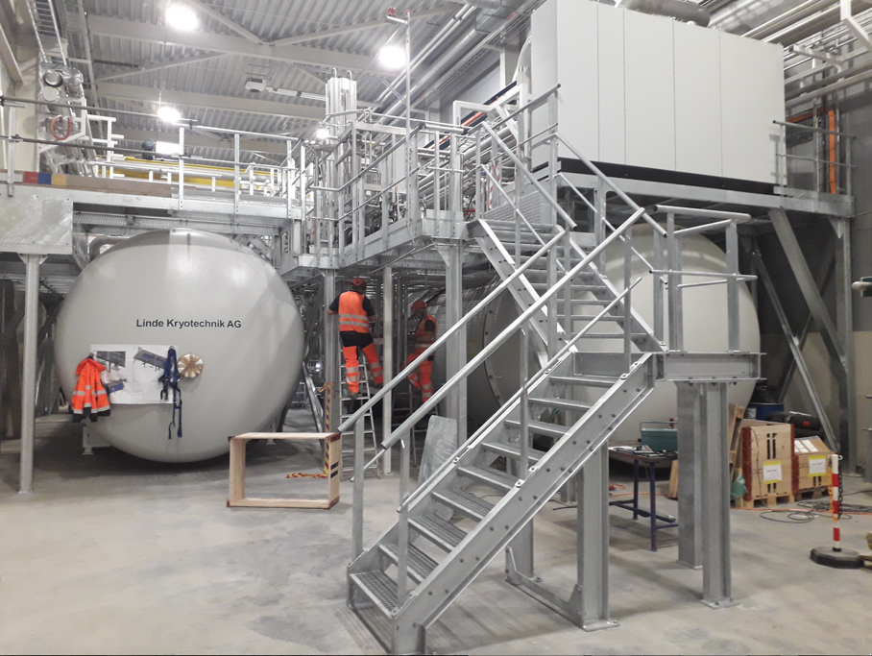
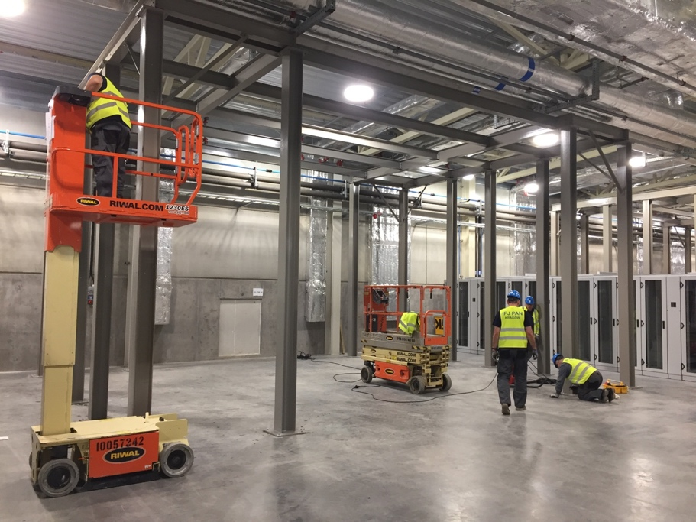
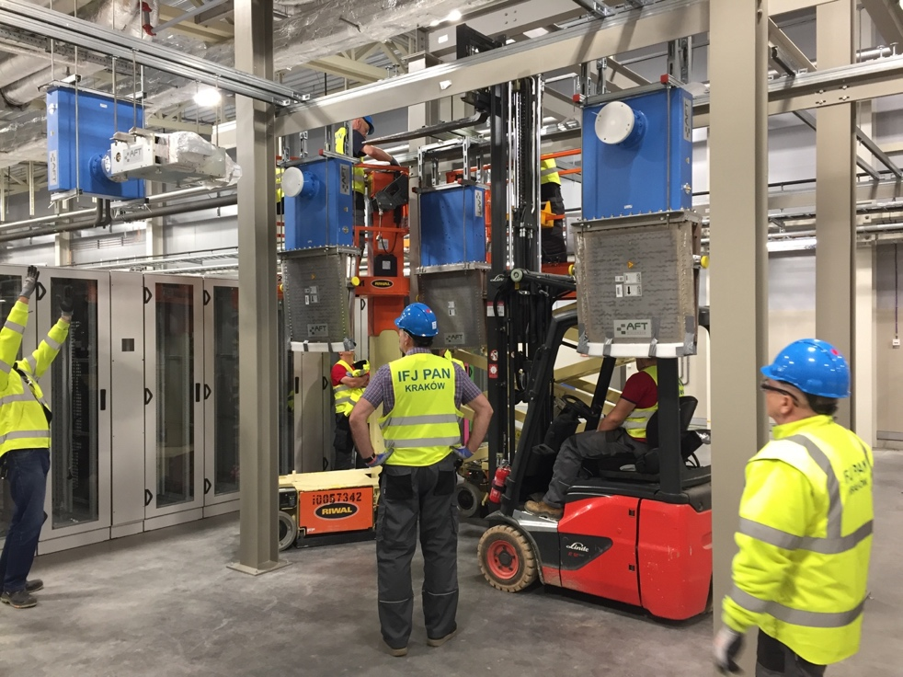
Cryoplants and infrastructure
TMCP cryoplant to the left and ACCP to the right (TICP not visible in this photo)

Slide 8
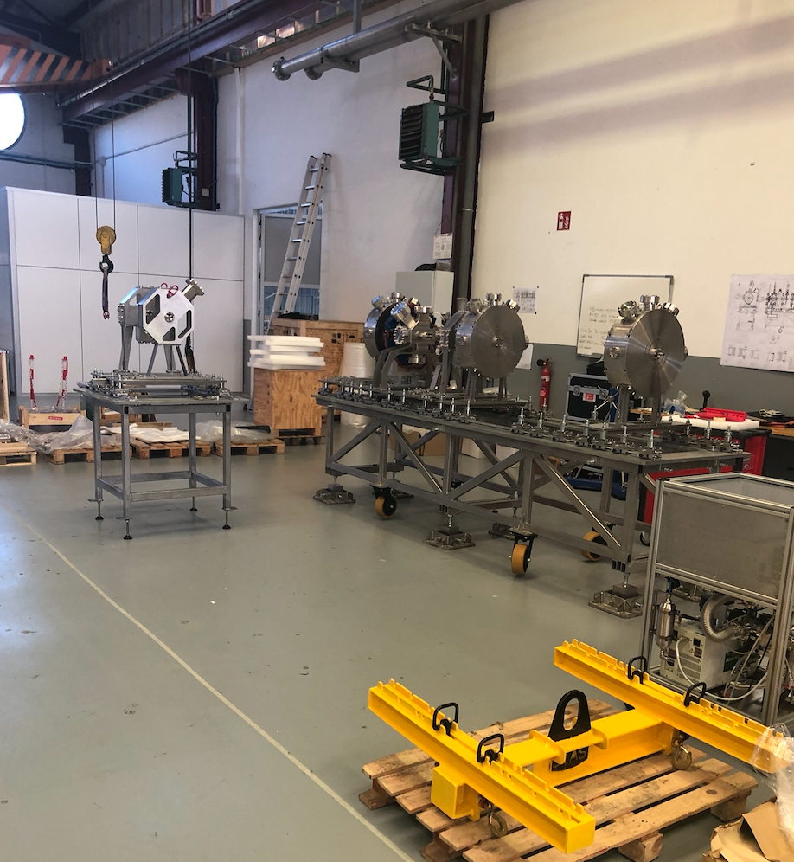
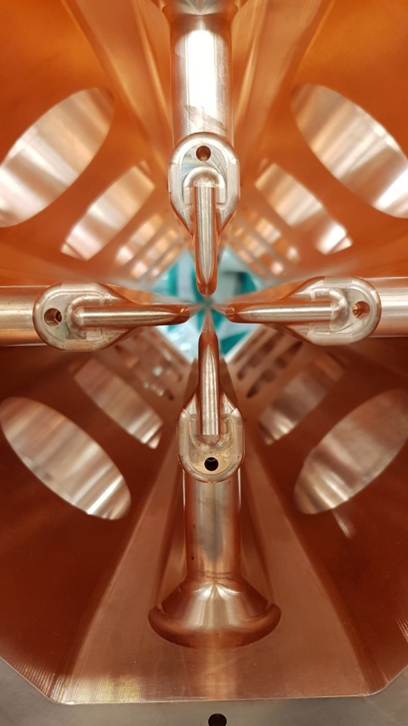
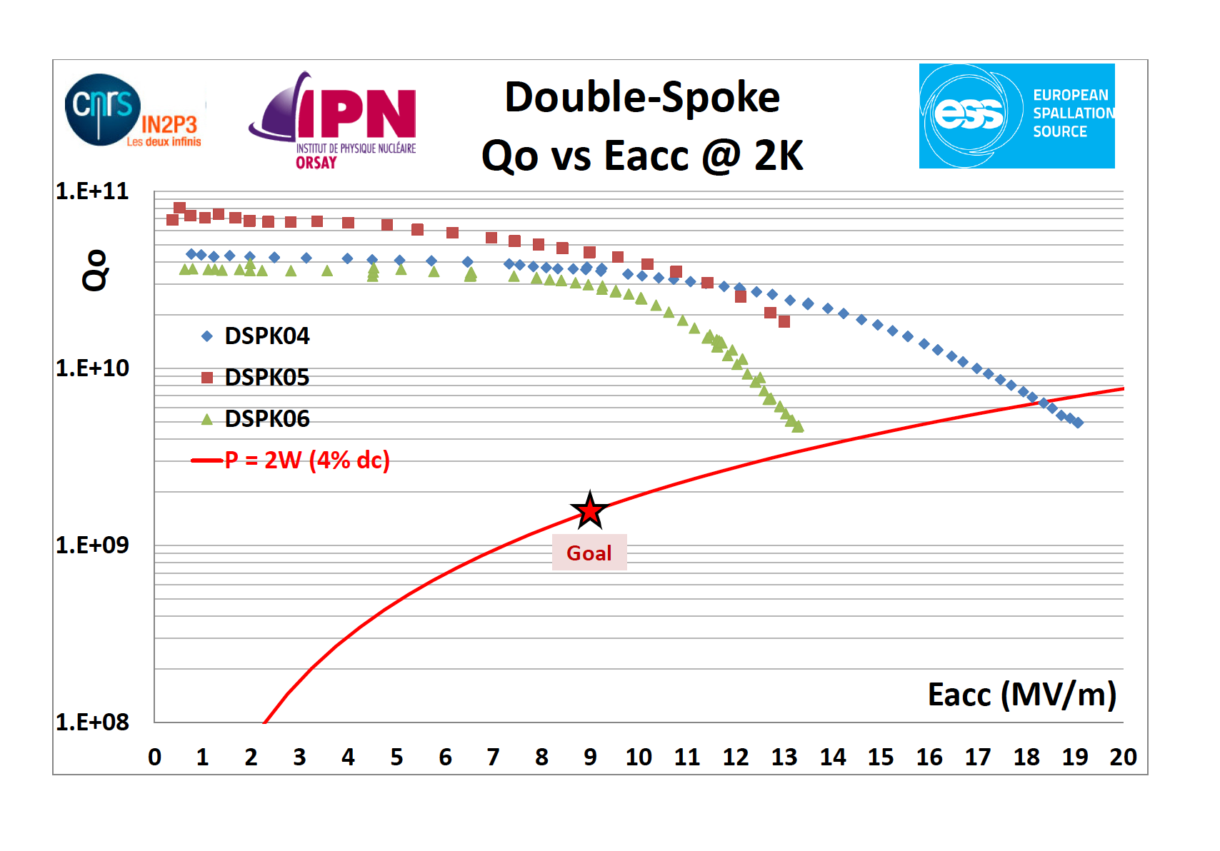
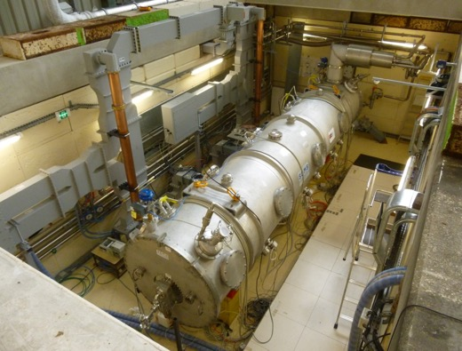
Accelerator

Slide 9
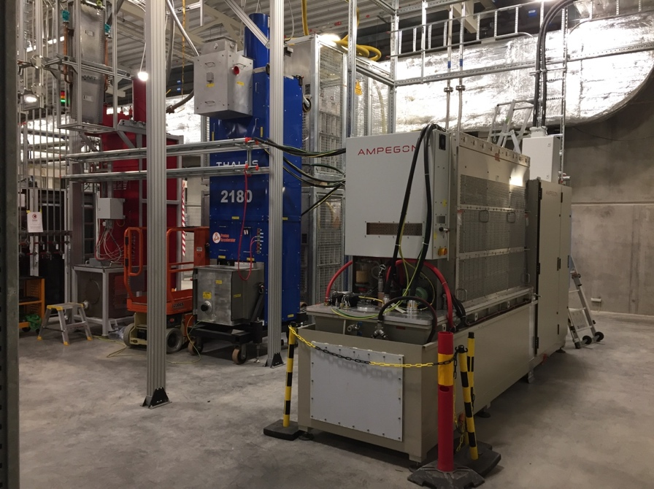
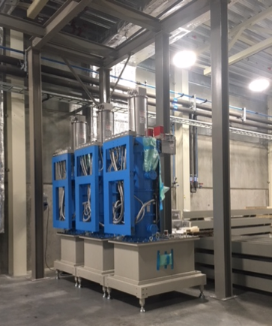
RF systems and MEBT

Slide 10
High level schedule for ACCSYS
ISrc to Beam Dump (BOD)
26/4/2021
ISrc to DTL1
ISrc to DTL4
RBOT
2018
11/11/2019
13/7/2020
9/8/2021
2022
2018
Today
2019
2020
2021
2022
11/11/19 - 14/02/20
13/07/20 - 09/10/20
ISrc to DTL1 Beam Commissioning
14 wks
26/04/21 - 23/07/21
ISrc to DTL4 Beam Commissioning
13 wks
160 days
ISrc to DMPL Beam Commissioning
13 wks
04/03/19 - 11/10/19
105 days
NCL Installation (RFQ/MEBT)
17/02/20 - 10/07/20
395 days
NCL Installation (DTLs)
07/01/19 - 10/07/20
13 wks
NCL RF System Installation
19/08/19 - 15/11/19
38 wks
SPK CDS Installation
18/11/19 - 07/08/20
14 wks
SPK CM Installation
22/06/20 - 25/09/20
154 wks
SPK LWU Installation
08/01/18 - 18/12/20
SPK RF System Installation
36 wks
11/03/19 - 15/11/19
54 wks
Elliptical CDS Installation
02/12/19 - 11/12/20
24 wks
MBL CM Installation
17/08/20 - 29/01/21
143 wks
MBL LWU Installation
05/03/18 - 27/11/20
29 wks
MBL RF System Installation
27/09/21 - 15/04/22
29 wks
HBL CM Installation
27/09/21 - 15/04/22
77 wks
HBL RF System Installation
07/01/19 - 26/06/20
223 wks
HEBT/A2T LWU Installation
08/01/18 - 15/04/22
Infrastructure

Slide 11
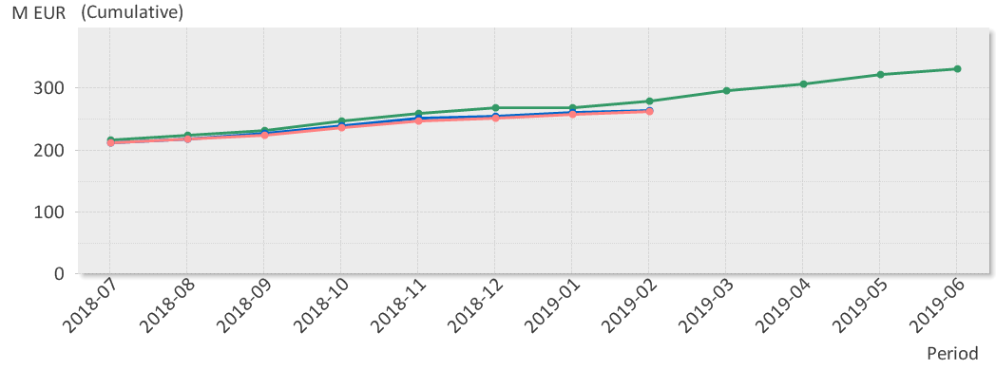
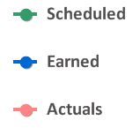
EV Graph
(* No InKind included)
Current Status
Cost Variance is by end of Jan 2.8 M€.
  Main reason for the positive CV is need of additional re-planning to reflect actual cost.
Schedule variance is by end of Feb -12.9 M€.
  Main contributors to the SV are NCFE: Delay in copper plating for the DTL tank sections. DTL schedule have been re-planned in P6. Beam Diagnostics: re-planning in progress. RF Systems: delay in ESS Bilbao, Atomki IK activities.

Slide 12
Evolution of Accelerator Major Milestones

Slide 13
Accelerator Division– organigram for line org (in white) and contractors/visitors for the sub-project + In-kinds
Head Count: 138 (2018-11-09)
92 employees
35 from Eng & Integr Support, Visitors, Consultants, Students, Planners
12 In-kind
Mats Lindroos – Head of Division
Håkan Danared – Deputy Head of Division
John Weisend II – Deputy (sub) Project Leader
Administration
Caroline Prabert
Inga Tejedor
WeiYing Li
Planning and Project Control
Lena Gunnarsson
Magnus Israelsson
Ciprian Plostinar
Diana Bergenholtz
IN-KIND from IFJ PAN Poland
Leszek Hajduk
Krzysztof Myalski
Michal Sienkiewicz
Tadeusz Ostrowicz
Edward Gornicki
Wawrzyniec Gaj
Marek Skiba
Karol Kasprzak
Pawel Halczynski
IN-KIND from Warsaw University of Technology
Krystian Bec
Installation
Peo Gustafsson
Olle Lagerblad
Dennis de Wit (C)
Carl-Johan Hårdh (C)
Mats Pålsson (C)
Pontus Jönsson (C)
Jenny Cerne (C)
Rasmus Johansson (C)
Nicolas Eke (C)
Dennis Schön (C)
IKC Coordination
Håkan Danared
Ebbe Malmstedt (C)
Quality
Björn Rundcrantz (C)
Beam Physics, Operations & Beam Diagnostics
Andreas Jansson - GL
IN-KIND from Norway
Greyson Christoforo, Oslo
IN-KIND from INFN, Italy
Gianluigi Cibinetto
Beam Physics
Mamad Eshraqi – SL
Renato de Prisco
Ryoichi Miyamoto
Yngve Levinsen
Ciprian Plostinar
Natalia Milas
Björn Gålnander
Emelie Nilsson
YuanShuai Qin (S)
ZhiJun Wang (V)
Benjamin Bolling (S)
Linac
Håkan Danared- GL
Cecilia Maiano
Iñigo Alonso
Radio Frequency Systems
Anders Sunesson- GL
Specialized Technical Services
John Weisend II – GL
Gunilla Jacobsson
Accelerator Utilities group
Vacant - GL
Power Converters
Carlos Martins – SL
Göran Göransson
Marko Kalafatic
Rutambhara Yogi
Petro Pohorilo
Dana McKenzie
Matthew Bergstrom
Anders Andersson (C)
Cryogenics
Philipp Arnold – SL
Jaroslaw Fydrych
Xilong Wang
Xiaotao Su
Johnny Råström
Mattias Olsson
Per Nilsson
Romain Goncalves
Christer Sjöblom (C)
Piotr Tereszkowski (C)
Ole Øystein Bakke (C)
Frans Rödström (C)
Beam Diagnostic
Tom Shea– SL
Cyrille Thomas
Hooman Hassanzadegan
Hinko Kocevar
Irena Dolenc Kittelmann
Rafael Baron
Edvard Bergman
Clement Derrez
Slava Grishin
Dmitri Gudkov (at CERN)
Elena Donegani
Kaj Rosengren
Thomas Grandsaert (EIS)
Johan Norin (C)
Mehdi Mohammadnezhad (C)
Front End & Magnets
Edgar Sargsyan – SL
Georg Hulla
Janet Schmidt
Richard Bebb
Alejandro Garcia Sosa
Emmanouil Trachanas
Frank Hellström (C)
Saverio Ardovino (C)
Superconducting RF
Paolo Pierini – SL
Christine Darve
Felix Schlander
Saeid Pirani
Nuno Elias (EIS)
Fredrik Håkansson (C)
RF Sources
Morten Jensen – SL
Rihua Zeng
Rafael Montano
Bruno Lagoguez
Chiara Marrelli
Staffan Ekström
Stevo Calic
Iñigo de la Fuente
Anders Svensson
Christian Amstutz
Walther Borg
Anirban Krishna Bhattachanyya
Linus Ternelius Svensson
Utilities and Test Stand Wolfgang Hees - SL
Anton Lundmark
Frithiof Jensen
Emilio Asensi
Owen Buchan
Steven McGlasson
Lars Rosberg
Antonio Muras Montejo (fr.14 Jan 2019)
Jörgen Jönsson (EIS)
Akif Coku (C)
Andreas Olenmark (C)
Fredrik Persson (C)
Weiming Yue (V)
Vacuum
Marcelo Juni Ferreira – SL
Hilko Spoelstra
Simone Scolari
Christophe Jarrige
Fabio Ravelli
Kristell Barthélemy
Ralf Huber
Laurence Page
Fredrik Svensson
Henric Gunnarsson
Peter Ladd (C 50%)
Operations
Lali Tchelidze – SL
Marc Munoz
Frank Kornegay (C 15%)

Slide 14
Accelerator Systems (sub-) Project (ACCSYS) – organization
WBS/WP# | TITLE | LEADER | EXT. WP | DEPUTY WP LEADER for EXTERNAL WPS
11 11.01 | ACCSYS MANAGEMENT | M. LINDROOS J.G. WEISEND II | NO
11.02 | ACCELERATOR PHYSICS | M. ESHRAQI | NO
11.03 | NORMAL CONDUCTING FRONT END | S. GAMMINO | YES | E. SARGSYAN
11.04 | SPOKE CRYOMODULES | G. OLRY | YES | C. DARVE
11.05 | ELLIPTICAL CRYOMODULES | P. BOSLAND | YES | C. DARVE
11.06 | BEAM DELIVERY SYSTEMS | S. MØLLER | YES | I. ALONSO
11.07 | BEAM DIAGNOSTICS | T. SHEA | MIX
11.08 | RF SYSTEMS | M. JENSEN | MIX
11.09 | Not used
11.10 | TEST STANDS | W. HEES | MIX | Infrastructure sub-project
11.11 | CRYOGENICS | P. ARNOLD | MIX
11.12 | VACUUM | M. JUNI-FERRERA | MIX
11.13 | SAFETY & OPS | L. TCHELIDZE | NO
11.14 | LINAC | H. DANARED | NO
11.15 | ELECTRICAL SUPPORT | F. JENSEN | NO | Infra-structure sub-project
11.16 | COOLING SUPPORT | A. LUNDMARK | NO | Infra-structure sub-project
11.17 | POWER CONVERTERS | C. MARTINS | MIX
11.18 | ENGINEERING RESOURCES | obsolete | NO
11.19 | SUPERCONDUCTING RF | P. PIERINI | NO
11.98 | GENERAL INSTALLATION SUPPORT | PO GUSTAFSSON | NO | Infra-structure sub-project
11.99 | INSTALLATION | PO GUSTAFSSON | NO
Accelerator Collaboration Board (ACB) – meets twice annually:
Reps from each IKC & collaborating institute (one elected as chair)
ESS Technical Director
ACCSYS Sub-Project leader
Accelerator Technical Board (ATB) – meets quarterly:
AccMT & all WP leaders and deputies
Reps of all contracted institutes if not already a WP leader
ESS Machine Management Team members invited
Accelerator (Project) Management Team (AccMT) – meets weekly:
Mats Lindroos: Project Leader
Caroline Prabert: Administration
John Weisend II: Dep. Proj Leader (WP 1) & STS (WPs 11,12,15,16)
Lena Gunnarsson & Magnus Israelsson: Project Planners
Diana Bergenholtz: Controller
Lali Tchelidze: Section leader Operations, including radiation safety (WP13)
Peo Gustafsson: Installation coordinator and infrastructure sub-project leader (WP 98)
Håkan Danared: Linac systems leader (WPs 3,4,5,6,14) and IKC coordination manager
Andreas Jansson: Beam Physics, Diagnostics, Init ops planning mgr (WPs 2,7)
Anders Sunesson: RF power systems leader (WPs 8,17)
Note: Section Leaders (AD line) can be called to participate in AccMT meetings
IKC coordination, IKC liaisons & BrightNESS IKC ‘field coordination’:
Håkan Danared: IKC coord mgr Ebbe Malmstedt (C): assists overall IKC coord and risk manager at AD
Georg Hulla: for WP 3 IKC Felix Schlander: for WP 4 & WP 5
Frank Hellström (C): for WP 3 IKC Nuno Elias: for WP 4 & WP 5 IKC
Fredrik Håkansson (C): for WP 4 & 5

Slide 15
ACCSYS Major In-kind Collaborations
Item | Value (M€) | Partner | Date of final equipment delivery | Agreement Status: Planned /Agreed | Status of Execution (R, Y, G)
MEBT | 4.5 | ESS Bilbao | February 2019 | Agreed
RFQ | 8.7 | CEA-IRFU | March 2019 | Agreed
DTL | 16.8 | INFN-LNS | March 2020 | Agreed
Spoke CMs | 17.4 | CNRS-IPN | May 2020 (To UU) | Agreed
Spoke linac cryodistribution | 2.4 | CNRS-IPN | August 2019 | Agreed
Elliptical Medium beta cavities | 11.2 | INFN-LASA | February 2020 | Agreed
Medium beta CMs | 17.4 | CEA-IRFU delayed by medium beta cavities being late | September 2020 | Agreed
Elliptical high beta cavities (11 CMs) | 25.2 | STFC | February 2021 | Agreed
High beta CMs (11 CMs) | 40.6 | CEA-IRFU | September 2021 | Agreed
Elliptical linac cryodistribution | 6.6 | WUST | June 2019 | Agreed
Spoke RF sources | 19.4 | ELETTRA-INFN | December 2020 | Agreed
NC linac RF systems | 7.3 | ESS Bilbao | February 2020 | Agreed
Linac warm units | 10.4 | STFC | August 2020 | Agreed
Linac magnets with power supplies | 9.4 | ELETTRA-INFN | November 2019 | Agreed
Installation services | 12.6 | IF-JPAN | December 2020 | Agreed
LLRF systems | 4.5 | PEG | December 2021 | Agreed
RF distribution systems | 19.0 | STFC | August 2019 | Agreed
Target imaging system | 2.0 | Oslo University | December 2019 | Agreed | 2013 schedule
More details on each of some 150 deliveries from IK partners in break-out session
Some IK have issues with prolonging contracts and keeping staff as the project is delayed compared to the 2013 baseline
Being on the critical path doesn’t necessarily mean an IK partner is late, they can be delayed by others including ESS

Slide 16
ACCSYS major collaboration agreements
Item | Value (M€) | Partner | Date of final equipment delivery | Agreement Status: Planned /Agreed | Status of Execution (R, Y, G)
Testing (Spoke CM, Modulator, Cavity proto,…) | 12.9 | Uppsala University | Not applicable | Agreed
Rastering system and beam diagnostics | 3.1 | Aarhus university |  | Agreed | 2013 schedule
LLRF and modulator design and prototype | 3.3 | Lund university | Not applicable | Agreed

Slide 17
ACCSYS Top risks
Risk: Insufficient ICS resources for accelerator (# 240)
Mitigation:
    Develop strategy
    On-going. Further follow up meeting/review is planned on the firmware framework
Risk: CE marking has to be implemented (#241)
Mitigation:
    Develop long term strategy for CE marking
Risk: In Kind contributors don’t meet scope and schedule requirements (#2)
Mitigation:
    ESS single point Partner contact. Reporting progress to IKC. IKC provides a written monthly report on progress
    Formal reviews and regular video or F2F meetings with IK partners
    IKC WP milestones are tracked as P6 schedule
Risk: Lack of spares when needed (# 242)
Mitigation:
    Identify and quantify amount per system, find funding

Slide 18
Major activities for 2019
Installation of the RFQ, MEBT and first DTL tanks in tunnel
Installation of infrastructure for tunnel and RF gallery
Commissioning of cryoplants completed and installation of cryo-distribution system completed
Test stand 2 in Lund in operation
2 medium beta cryomodules assembled and 8 spoke cryomodules assembled
NC , spoke and Medium beta RF systems installation ongoing with system operational for NC linac commissioning
HEBT installation completed with magnets and beam pipe
Integration of P6 Installation Plan into the P6 Live plan and infrastructure project plan in P6.

Slide 19
ACCSYS Summary
All essential components for Ready for Beam on Target (RBOT), except the RF Power Stations for Spokes, are under construction, assembly and testing.
The ion source and LEBT are under commissioning with the operations team in charge of the work
The cryoplants are under testing or final stages of installation
The new infrastructure sub-project handles infrastructure and component installation for accelerator
A new organization for testing and commissioning for AD and associated ICS activities has been put in place
The present prediction is that RBOT will be delayed with 3 months mainly due to issues with copperplating of DTL tanks, RFQ manufacturing and some delays for elliptical cavity fabrication.
  Delays with RF systems for the NC linac have for early testing, conditioning and commissioning of the RFQ been mitigated
The large majority of IK partners can deliver to the agreed Ready-for-Installation dates in the May 2018 re-baseline review
The very good results from testing of e.g. series spoke cavities, elliptical cavities and prototype modulators gives confidence that the high performance goals for the SC linac can be reached

Slide 20
Back-up slides
The following slides are kept in the presentation as back-up

Slide 21
Accelerator: staff categories through time
ESS employees evolving according to the approved accelerator staff plan.
In-kind personnel working abroad: calculated as 30% of the yearly “planned & agreed” in-kind contributions (P6), divided by the average rate per person (60€/hour x 1800 hours/year)
Total = 114 employees in 2026 and onwards→ consistent with
Steady State Operations’ approved numbers
 | 2014 | 2015 | 2016 | 2017 | 2018 | 2019 | 2020 | 2021 | 2022 | 2023 | 2024 | 2025
ACCELERATOR STAFF | 51 | 62 | 68 | 92,5 | 103,5 | 107,5 | 107,5 | 107,5 | 113,5 | 114,5 | 114,5 | 113,5
ESS STAFF-NON ACCELERATOR (planners, EIS staff, controller) | 4 | 4 | 5 | 5 | 6 | 6 | 6 | 6 | 6 | 6 | 6 | 6
CONSULTANTS | 4 | 6 | 14 | 23 | 47 | 47 | 20 | 5 | 0 | 0 | 0 | 0
LONG TERM IN-KIND/PhD's/TEMP CONTRACTS/STUDENTS/VISITORS | 0 | 2 | 6 | 11 | 18 | 20 | 17 | 15 | 15 | 5 | 5 | 5
Number of IN-KIND personnel WORKING ABROAD for the AD (*) | 7 | 24 | 69 | 106 | 187 | 148 | 65 | 20 | 11 | 0 | 0 | 0

