Slide 1
Status of Beam Diagnostics
Tom Shea
European Spallation Source ERIC
March 27th, 2019

Slide 2
Outline
Intro:
  Beam Diagnostics Organization
  Instrumentation Suite
Status
  LEBT results
  Systems for NC linac commissioning
  Systems for beam on target
Plans
  State of Diagnostics presented at TAC one year ago
  Lessons learned
  Path forward

Slide 3
Organization
Make readable
System Team
Technical Team
Technical Area | Responsible | Additional Experts
Electronics | Clement Derrez, Hooman Hassanzadegan
Software, EPICS integration | Hinko Kocevar
FPGA, digital architecture | Kaj Rosengren | Mehdi Mohammednezhad(BCM), David Bang-Hauge (Oslo, Imaging), LTH (Grid, APTM), Łodz (ICBLM, nBLM),
Mechanical | Thomas Grandsaert
Motion Control | Clement Derrez
Radiation effects | Irena Dolenc Kittelmann,Elena Donegani
Protection | Irena Dolenc Kittelmann, Thomas Grandsaert
Cabling | Edvard Bergman
Installation Manager | Viatcheslav Grishin
Verification | Clement Derrez
Commissioning (LEBT) | Cyrille Thomas
Laboratory Manager | Edvard Bergman
Data Management | Johan Norin
Project Planning | Johan Norin
System | System Lead | Additional team members in Lund | In-kind partners and collaborators (many are not shown here)
Aperture Monitor(fixed and moveable) | Cyrille Thomas |  | Anders J Johansson(electronics; LTH)
BCM (BCM, fast BCM, IS supply current) | Hooman Hassanzadegan |  | Ibon Bustinduy, @Seadat Varnasseri (MEBT toroids; ESS-Bilbao)
BLM (nBLM, ICBLM, X-Ray spectroscopy) | Irena Dolenc Kittelmann | Viatcheslav Grishin(detector testing), Clement Derrez(electronics) | Thomas Papaevangelou(nBLM; CEA-Saclay)
BPM (BPM, fast BPM) | Hooman Hassanzadegan | Rafael Baronassisting during his academic leave | Ibon Bustinduy, Seadat Varnasseri (MEBT striplines; ESS-Bilbao), Marco Poggi (DTL striplines; Legnaro), Silke Vilcins-Czvitkovits(LWU buttons; DESY), Paul Aden (LWU button integration; Daresbury),
Doppler | Cyrille Thomas |  | Franck Senee (Doppler; CEA-Saclay)
EMU (Alison, slit-grid) | Clement Derrez | Roxana Tarkeshian | Unknown User (oliviertuske)(LEBT EMU; CEA-Saclay), Ibon Bustinduy Angel Rodriguez (MEBT EMU; ESS-Bilbao)
FC | Elena Donegani | Rafael Baronassisting with electronics Thomas Grandsaert(simulations and mechanics) Clement Derrez(motion control) | Angel Rodriguez , Ibon Bustinduy (MEBT FC; ESS-Bilbao)
Imaging | Cyrille Thomas |  | Erik Adli (Oslo)
Insertable Beam Stops | Elena Donegani | Thomas Grandsaert(simulations and mechanics) Clement Derrez
LBM (BSM) | Irena Dolenc Kittelmann
NPM (IPM, BIF) | Cyrille Thomas | Roxana Tarkeshian | Jacques Marroncle (IPM; CEA-Saclay)
Scraper(MEBT) | Cyrille Thomas |  | Ibon Bustinduy , Angel Rodriguez (Actuator and motion control; ESS-Bilbao) Anders J Johansson(readout electronics, protection function; LTH)
Target Grid | Cyrille Thomas |  | Anders J Johansson(electronics; LTH)
WS(scanning, fast) | Clement Derrez | Dmitry Gudkov(Fast wire scanner mechanics at CERN) | Ibon Bustinduy, Angel Rodriguez(MEBT actuators; ESS-Bilbao), Søren Pape Møller (LWU actuators; Århus), Mario Ferianis (electronics; Trieste), Ray Veness (fast WS; CERN)

Slide 4
Proton Beam Instrumentation Suite
(will make graphic with readable font size)
 | Variant | System | ISrc | LEBT | RFQ | MEBT | DTL | Spk | MBL | HBL | HEBT | DMPL | A2T | Target | Sum |  | Beam line tot | Electronic tot
 | APTMM | APTM | 0 | 0 | 0 | 0 | 0 | 0 | 0 | 0 | 0 | 1 | 1 | 2 | 4 |  | 9 | 10
 | BCM | BCM | 1 | 1 | 1 | 2 | 5 | 0 | 1 | 1 | 2 | 2 | 3 |  | 19 |  | 57 | 79
 | FBCM | BCM | 0 | 0 | 0 | 1 | 0 | 0 | 0 | 0 | 0 | 0 | 0 |  | 1 |  | 1 | 6
 | ICBLM | BLM | 0 | 0 | 0 | 0 | 5 | 52 | 36 | 84 | 49 | 6 | 34 |  | 266 |  | 266 | 335
 | nBLM | BLM | 0 | 0 | 0 | 4 | 42 | 26 | 2 | 2 | 2 | 0 | 4 |  | 82 |  | 107 | 201
 | BPM | BPM | 0 | 0 | 0 | 7 | 15 | 14 | 9 | 21 | 16 | 4 | 12 |  | 98 |  | 196 | 280
 | FBPM | BPM | 0 | 0 | 0 | 1 | 0 | 0 | 0 | 0 | 0 | 0 | 0 |  | 1 |  | 2 | 8
 | COLL | COLL | 0 | 0 | 0 | 3 | 0 | 0 | 0 | 0 | 0 | 0 | 0 |  | 3 |  | 24 | 17
 | DPL | DPL | 0 | 1 | 0 | 0 | 0 | 0 | 0 | 0 | 0 | 0 | 0 |  | 1 |  | 4 | 11
 | EMUAS | EMU | 0 | 1 | 0 |  | 0 | 0 | 0 | 0 | 0 | 0 | 0 |  | 1 |  | 17 | 23
 | EMUSG | EMU | 0 | 0 | 0 | 1 | 0 | 0 | 0 | 0 | 0 | 0 | 0 |  | 1 |  | 11 | 14
 | FC | FC | 0 | 1 | 0 | 1 | 2 | 0 | 0 | 0 | 0 | 0 | 0 |  | 4 |  | 33 | 18
 | GRD | GRD | 0 | 0 | 0 | 0 | 0 | 0 | 0 | 0 | 0 | 0 | 0 | 1 | 1 |  | 1 | 20
 | IBS | IBS | 0 | 0 | 0 | 0 | 0 | 1 | 1 | 0 | 0 | 0 | 0 |  | 2 |  | 8 | 18
 | IMG | IMG | 0 | 0 | 0 | 0 | 0 | 0 | 0 | 0 | 0 | 1 | 0 | 2 | 3 |  | 3 | 31
 | LBM | LBM | 0 | 0 | 0 | 1 | 0 | 1 | 1 | 0 | 0 | 0 | 0 |  | 3 |  | 6 | 15
 | BIF | NPM | 0 | 2 | 0 | 2 |  | 0 | 0 | 0 | 0 | 0 | 1 |  | 5 |  | 102 | 26
 | IPM | NPM | 0 | 0 | 0 | 0 | 0 | 1 | 3 | 1 | 0 | 0 | 0 |  | 5 |  | 10 | 23
 | FWS | WS | 0 | 0 | 0 | 0 | 0 | 0 | 0 | 0 | 3 | 0 | 0 |  | 3 |  | 27 | 26
 | WS | WS | 0 | 0 | 0 | 3 | 0 | 3 | 3 | 1 | 0 | 0 | 1 |  | 11 |  | 74 | 93
 | XRS | XRS | 0 | 0 | 0 | 0 | 0 | 0 | 1 | 0 | 0 | 0 | 0 |  | 1 |  | 1 | 0
Totals |  |  | 1 | 6 | 1 | 26 | 69 | 98 | 57 | 110 | 72 | 14 | 56 | 5 | 515 | 0 | 959 | 1254
 | Deferred to initial operations: |  |  |  |  |  |  |  |  |  |  |  |  |  |  |  | total maintained units: | 2213
 | target position monitoring and protection
 | profile/halo monitors for DTL
 | longitudinal monitors for medium beta and high beta
 | integration and verification of 50% of BPMs, 75% of BLMs in SCL/HEBT
 | Advanced BLMs
 | Data analysis and machine diagnostic software development

Slide 5
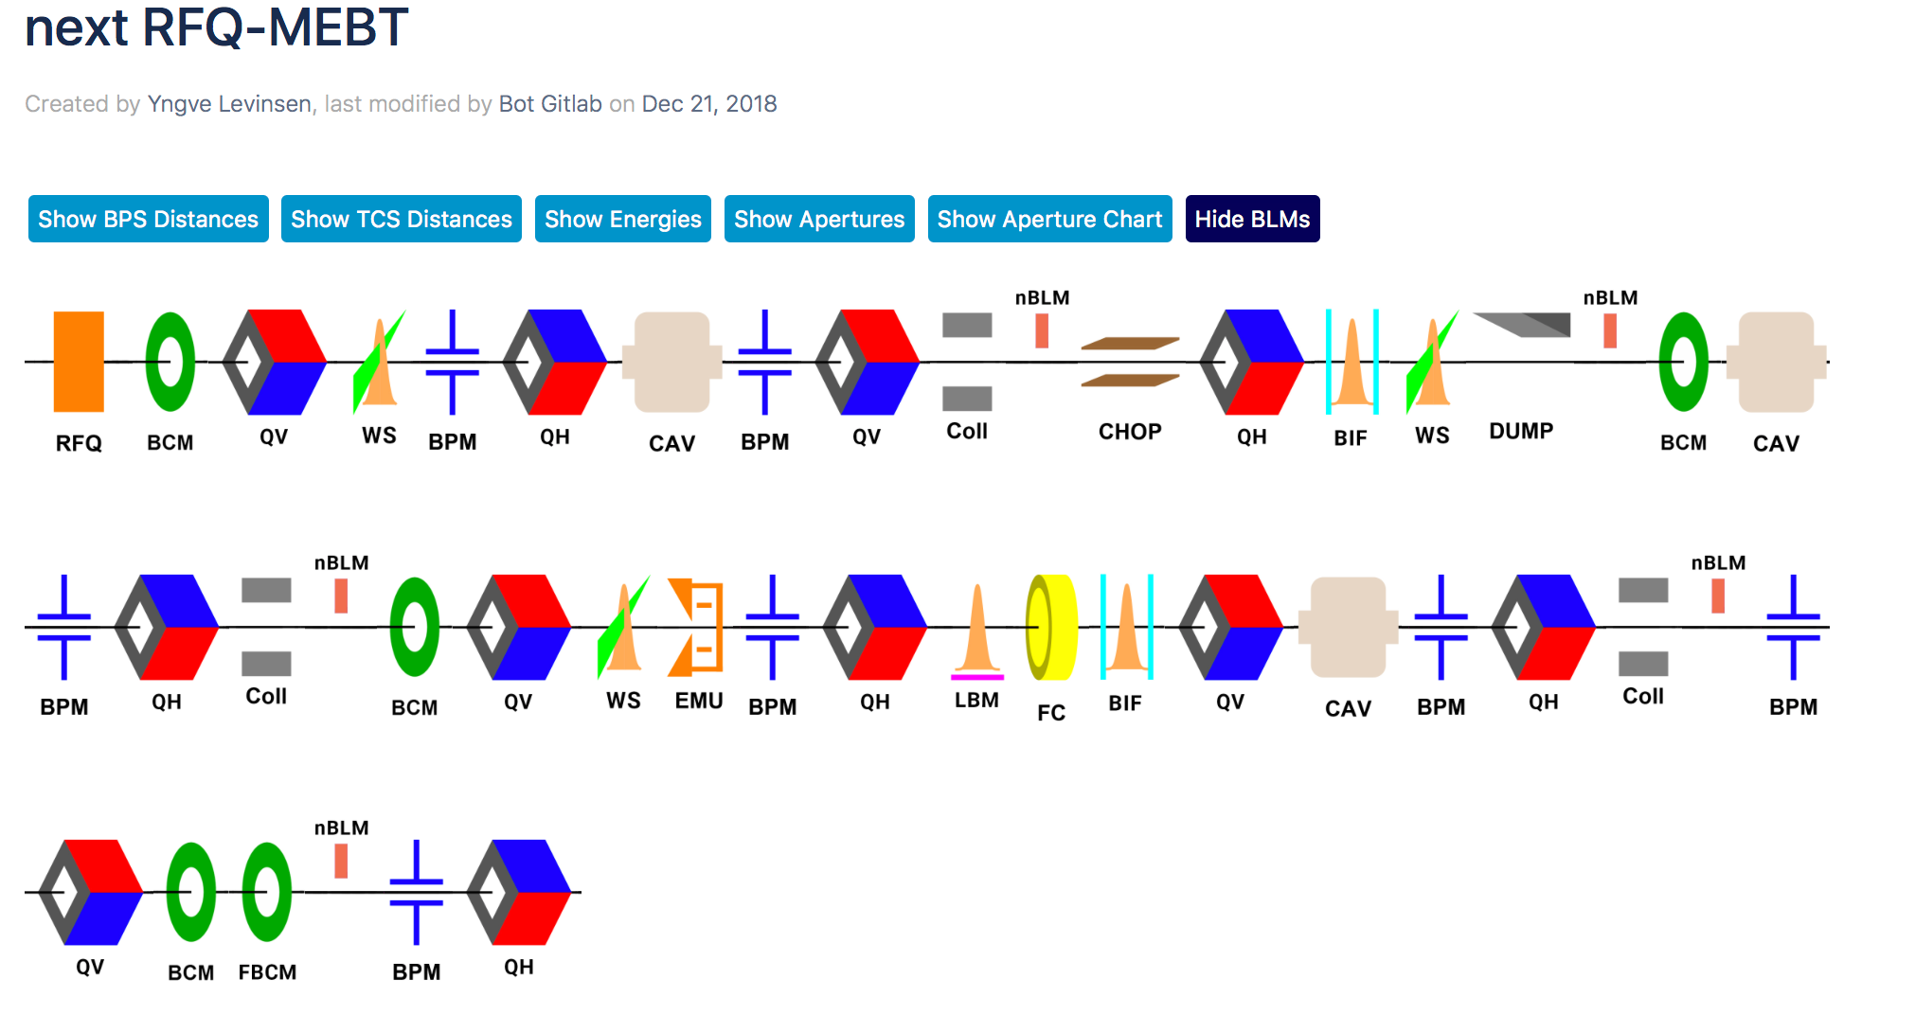
MEBT Beam Diagnostics Overview
Latest Lattice / synoptic viewer
System | Quantity
BCM | 4 (5)
EMU | 2
FC | 1
BPM | 7
NPM | 2
WS | 3
LBM | 1
SC | 3 (6)
nBLM | 4

Slide 6
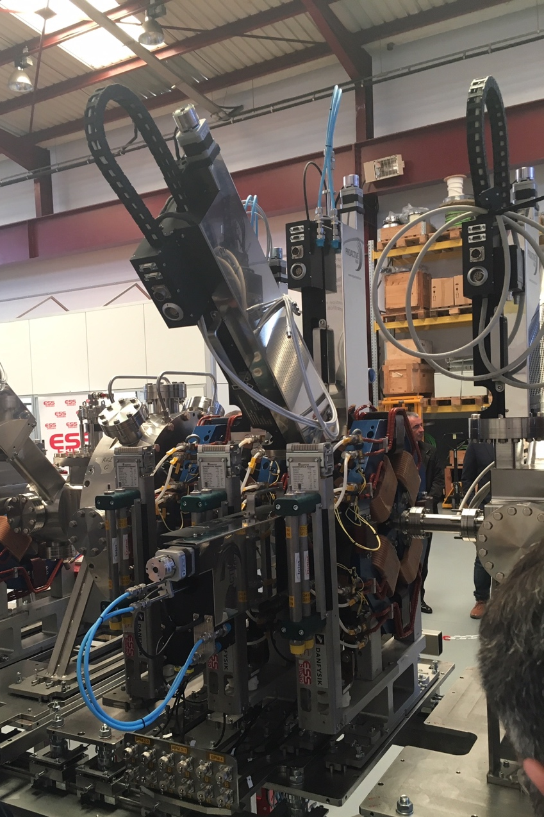
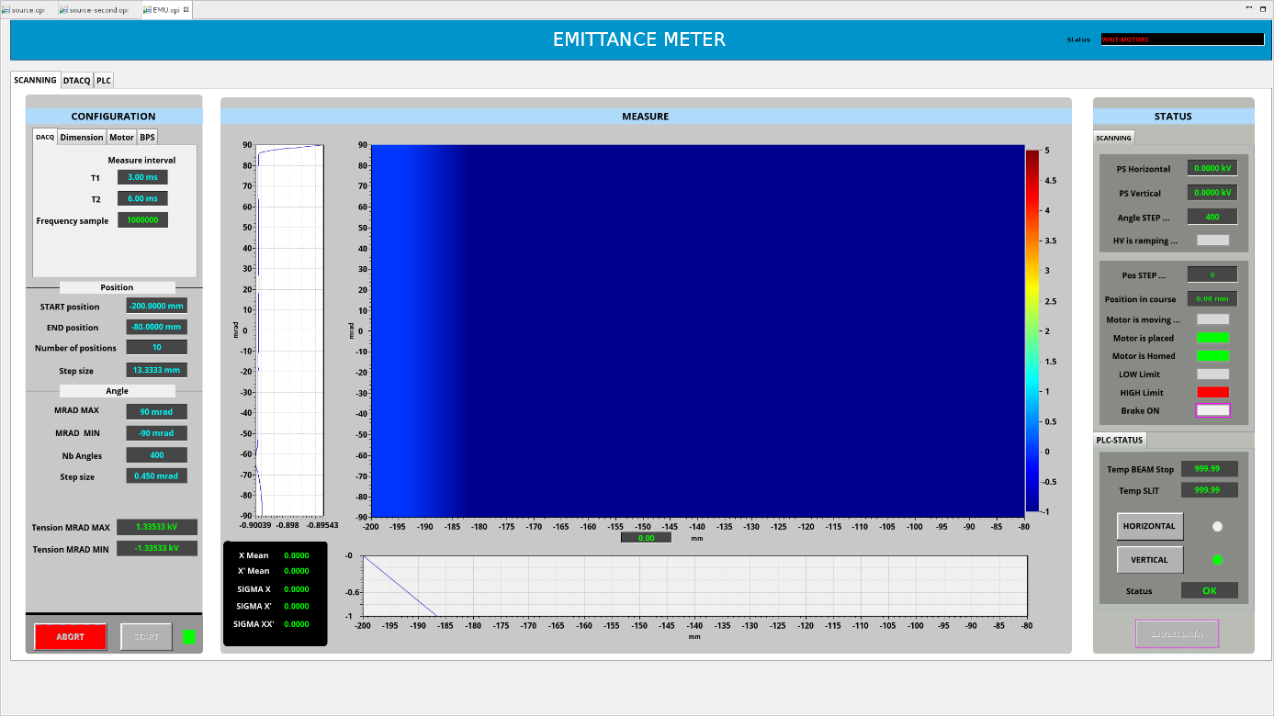
Emittance Measurement Units
LEBT EMU installed in Lund in August 2018, being integrated in ESS control system by ICS Group.
MEBT EMU vertical test perform at ESS Bilbao. Significant work needed to complete integration in ESS control system

Slide 7
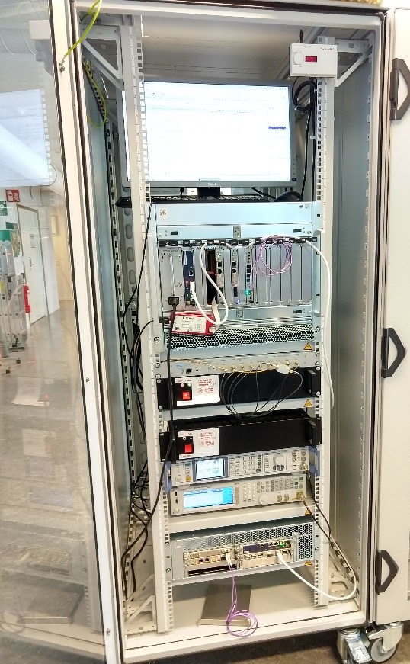
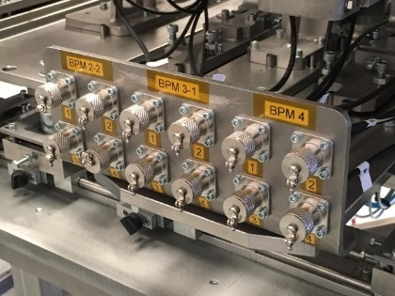
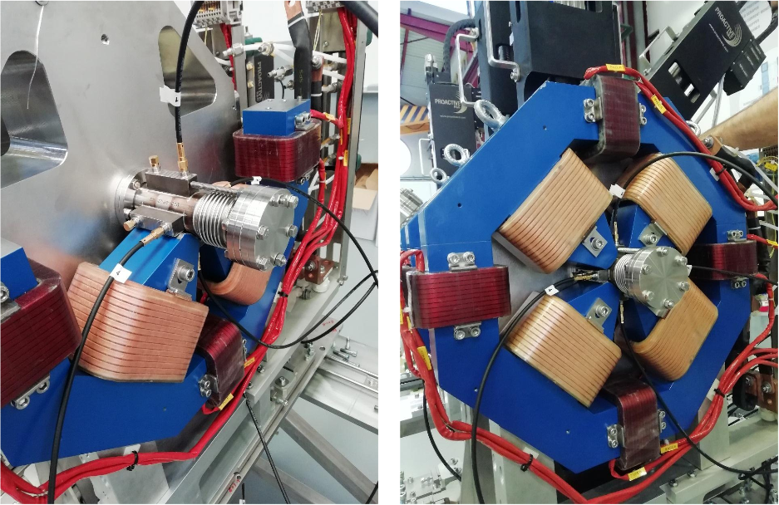
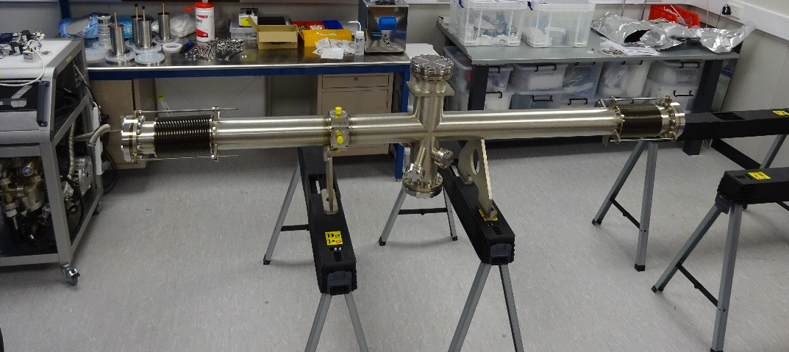
BPM
MEBT BPM sensors and BPM electronics verified with beam tests at CEA Saclay IPHI accelerator: 3 MeV, 0.4 mA to 50 mA, proton beam, 352.2 MHz RF
LWU BPMs are being assembled into the LWU’s.
Complete acquisition chain verified during vertical integration tests with team from Elettra using MEBT and High Energy actuators.
Analog Front Ends are designed and tested. Cost savings are in progress by adding embedded functionalities and improvements.

Slide 8
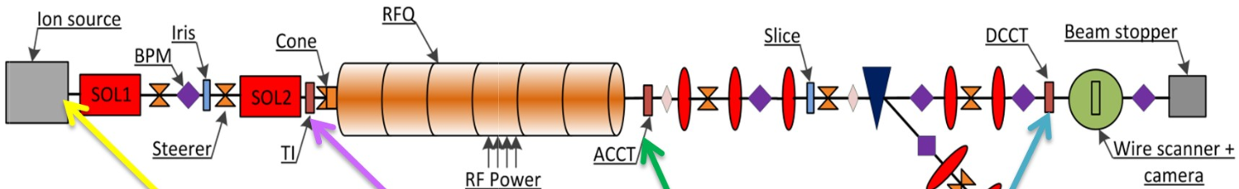
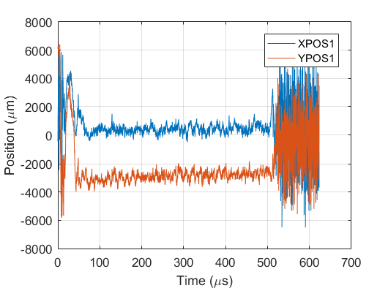
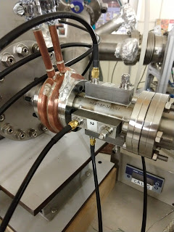
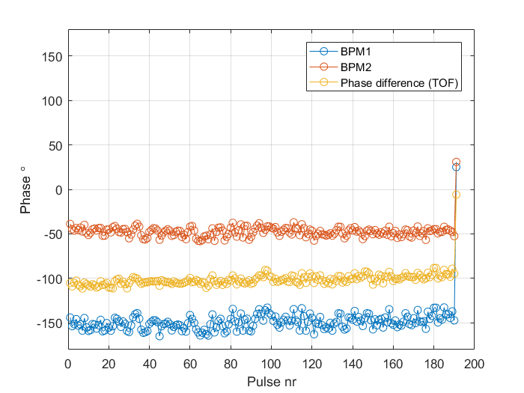
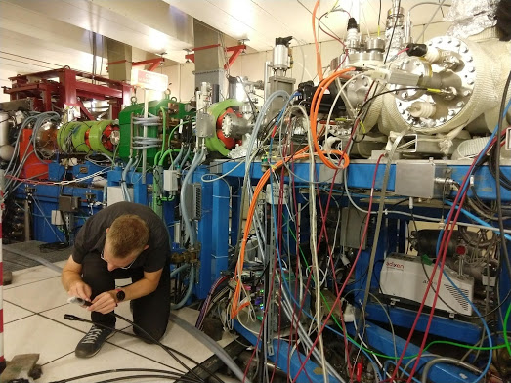
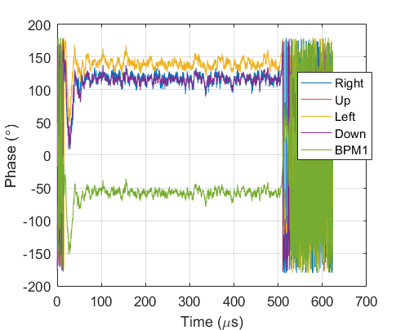
BPM
5 m
MEBT BPM
CEA Saclay IPHI accelrator MEBT BPM beam tests.
3 MeV, 0.4 mA to 50 mA, proton beam, 352.2 MHz RF

Slide 9
Non Invasive Profile Monitors
(Beam Induced Fluorescence)
 |  | Additional references
Verification plan | ESS-1086834
Key Interfaces
Beam line elements | Update with chess document and reference from Cyrille Mechanical integration verification shall be done according to ESS-0036710 Coating of chamber: Insertion of baffles. Deisgn done and ready for production. | ESS-0036710
Infrastructure & Electronics | Design ongoing based on 3 interface requirements point: viewport provides 0.22 numerical aperture, reflectance of the chamber is less than 5%, volume occupied by the NPM assembly is defined and remains free from any interference.
Next steps | Preparation for IRR Electronics validation Viewports to produce system tests Complete the user manual OPI: to translate to ESS standards in order to get it approved for control room deployment

Slide 10
Non Invasive Profile Monitors
(Beam Induced Fluorescence)
Beam being measured with LEBT NPM during commissioning in Lund

Slide 11
Faraday Cup

Slide 12
Longitudinal Bunch Monitor (Bunch Shape Monitor)
3D model vs Reality

Slide 13
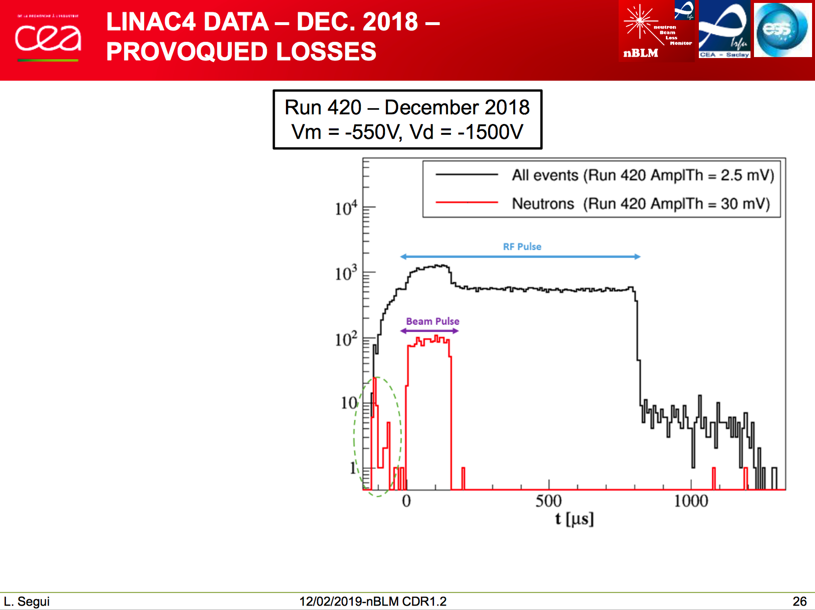
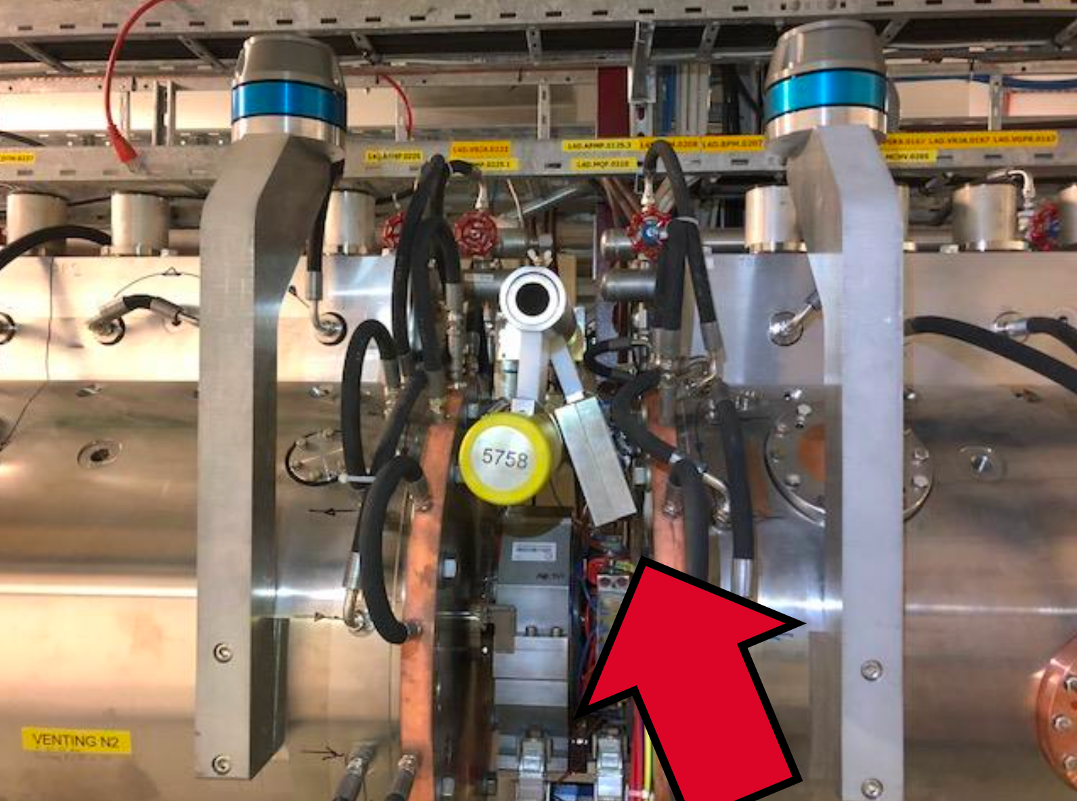
Neutron Beam Loss Monitors (Fast & Slow detectors)
Tests at LINAC4, pre series detectors. Quoting Laura at the CRD in Paris in February.

Slide 14
Installation status
Racks, cables, Asset Management, etc
Slava
WUT team

Slide 15
Lessons Learned and Risks
Lessons learnt from LEBT installation verification and commissioning
  Patch panels, mechanical integration verification (accurate 3D models)
  EMC issues took months to solve
  PDUs & system status monitoring is still an issue
  Duration of electronics deployment and IOCs configuration (all LEBT systems)
  OPIs (approval and release for each and every system) and manuals
Resource limitations from ICS
  Integration
  Platform

Slide 16
Status: Controls Integration
99% integrated = 100% failure
System | Total Field-Replaceable Units | Number of instruments | Provides Protection Function? | Electronics baselined | Technology demo | Final prototype | FPGA/readout electronics readiness | EPICS readiness
Movaeable aperture monitor | 20 | 2 | Yes |  | DAMC | IOxOS
Stationary aperture monitor | 21 | 2 | Yes |  | DAMC | IOxOS
Beam Current Monitor | 134 | 19 | Yes |  | Struck | Struck
Beam Position Monitor | 476 | 98 | Yes |  | Struck | Struck
MEBT Scraper systems | 44 | 3 | Yes |  | DAMC | IOxOS
Doppler Ion Species Monitor | 12 | 1 | No |  | IPC | IPC
Allison scanner | 42 | 1 | No |  | VME | IOxOS
Slit and grid emittance measurement unit | 27 | 1 | No |  | VME | IOxOS
Fast beam current monitor | 7 | 1 | No |  | Teledyne | Teledyne
fast beam position monitor | 10 | 1 | No |  | Teledyne | Teledyne
Faraday cups | 52 | 4 | No |  | Struck | Struck
Grid | 21 | 1 | Yes |  | DAMC | IOxOS
Insertable Beam Stops | 28 | 2 | No |  | Struck | Struck
Ion chamber loss monitors | 561 | 266 | Yes |  | DAMC | IOxOS
imaging systems for target and tuning dump | 35 | 3 | Yes |  | MPSoC | IOxOS
Longitudinal bunch shape monitor | 22 | 3 | No |  | NI | IOxOS
Neutron detector beam loss monitors | 222 | 82 | Yes |  | DAMC | IOxOS
Beam-induced gas fluorenscence monitors | 134 | 5 | No |  | IPC | IPC
Ionization profile monitor for superconducting linac | 33 | 5 | No |  | IPC | IPC
Wire scanner | 172 | 11 | No |  | Struck | Struck
Fast wire scanner | 54 | 3 | No |  | Struck | Struck
TOTAL | 2127 | 514

Slide 17
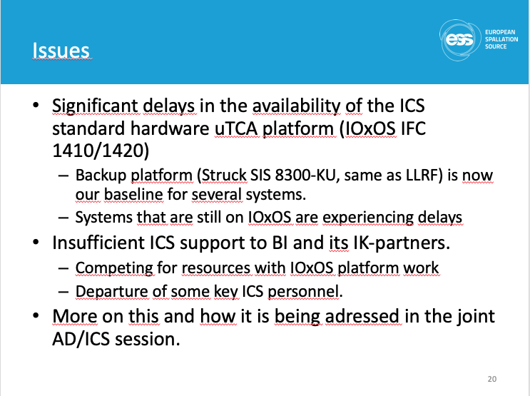
Since TAC one year ago
Descoping
Transferred tech labor (4 FTE-years)
  Defer integration of two thirds of BLMs, one third of BPMs, all fast WS
Defer third longitudinal monitor
Defer advanced BLM
Schedule update
(P6 summary from Johan)

Slide 18
Plan with ICS
P6 Plan (Milestones, EVM)
Prep
  Define first proton functionality
  Features, not systems - Don’t throw out entire classes of measurement or protection
Program forum
  ICS and key stakeholders
  Agree on objectives (prioritize features needed for first protons).
Tighten communications.
  Take a more lean approach to documentation and procedures
  So far, most successful systems have been developed by multidisciplinary teams: (Examples: J-PARC experiment, BPM, …)
  Team approach can reduce communication overhead
Program Board
2 months
Team Boards
2 weeks
On same project

Slide 19
Thank you! Questions?

