Slide 1
SRF at ESS
Paolo Pierini
Superconducting RF Section
European Spallation Source ERIC
April 3rd 2019
Notes:
CDS 29/04-30/12 2019
CDS testing in January 2020
CDL in TS2 tested after Easter

Slide 2
Session on SRF
Contents of the agenda
Intro
Component Readiness
  Status of IK work and deliveries, Christine
  Status of Freia Test Stand Roger
  Status of TS2 Preparation Wolfgang
  CM transports to ESS Felix
Testing
  Elliptical module reception/preparation (up to RFI) Michal
  SRF Test Plan Cecilia
  TS2 CM Controls Emilio
Discussion/Q&A

Slide 3
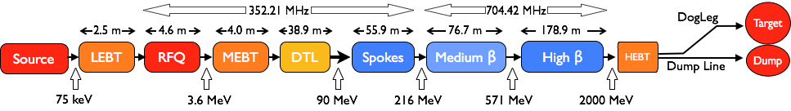
The ESS Accelerator
Scope, Parameters, Technical Performances
Key parameters & Design criteria:
    Pulse length: 2.86 ms pulses
    Max Energy: 2 GeV
    Pulse peak current: 62.5 mA
    Pulse Repetition rate: 14 Hz
    Particles: Protons (H+)
    Low losses
    Minimize energy use
    Flexible design for risk mitigation and future upgrades
Design Drivers:
High Average Beam Power
5 MW
High Peak Beam Power
125 MW
High Availability (User Facility)
95%
Collaborative: 18 IK partners in 8 countries,
5 collaboration partners
Staged: 1.3 GeV capacity with 2 MW on target for 2025
remaining RF sources (40) installed after 2026

Slide 4



ESS, large in kind scope
Technical SRF work so far at IK, shift to ESS for test/install/commissioning
Almost all components of the linac are designed and provided as in kind contributions
After handover scope transferred to ESS
For the SRF linac, the partners are organized in the ESS SRF Collaboration with the workshare:
  Spoke cavities and cryomodules (including prototype) by IPNO, FR
  Testing of spokes modules by FREIA laboratory of Uppsala University, S
  Medium beta cavity production, by INFN, IT
  High beta cavity production, by STFC, UK
  Cryomodule assembly and prototyping, CEA, FR
  Testing of elliptical module at TS2@ESS
Construction project:
  External WP4 (IPNO) WP5 (CEA) for preparation and delivery of components
  Internal WP19 for testing, installation, commissioning and initial operation
ESS Organization: Accelerator Division/Linac Group/SRF Section
➜ Christine

Slide 5
From Construction to installation and operation
(from IK to ESS)
In Construction Phase (Past)
  Most of the SRF activities during the Construction Phase so far has been performed by the
  In-Kind partners at the home institutions (CEA, IPNO, INFN and STFC) ➜ Christine
  Design, construction and prototyping of cavities and modules
  ESS in charge of the CM “interface” agreements towards neighboring WPs
Testing & Installation is getting very close (Now)
  Delivery of prototypes at test stand happened and first series components in Mid 2019
  Start of the Test Stand 2 operation for the Elliptical CM testing ➜ Wolfgang
  Start of the FREIA Test Stand operation at UU for Spoke CM testing ➜ Roger
Getting ready for testing and commissioning (Now & Future)
  Transfer know-how from IK, capture design intent, get ownership of SRF components
  Ramp up of local “hands-on” SRF activities at ESS ➜ Cecilia
  Current ESS staff cannot fully cope the installation and testing needs!
Construction to Test and Operation

Slide 6
95% of the ESS energy gain by an SRF linac
Where are SRF-related activities at ESS?
  WP 4: Spoke Cryomodules (IPNO)
    Prototype activities
    Design, realization, shipment of spoke CM to ESS
Organization
Currently 138
92 ESS staff
EIS, Consultants, Students, Planners
12 InKind (10 from PL institutes)
Construction
Project WPs
External
  WP 5: Elliptical Cryomodules (CEA)
    Prototype activities
    Design, realization, shipment of elliptical CM to ESS
    Cavities: inkind contribution of
        INFN (Medium Beta)
        STFC (High Beta)
ACCELERATOR DIVISION
time
BEAM PHYSICS
LINAC
RF
Tech Services
Est. 12/2017
Front End
Power Convert
Cryo
  WP 19: SRF
    SRF testing of spoke/elliptical CM (UU & TS2)
    Installation, commissioning and operation
  + “Support” WPs
    …
    WP08: RF Systems
    WP11: Cryo
    WP17: Pow Conv
SRF
RF Sources
Vacuum
Internal
Test Stand & Utilities
  WP 10: Test Stands
    Setup/operation of the test facilities at UU/Lund

Slide 7
Resources: SRF Staffing at ESS
In SRF Section and “at large” for TS2
SRF Section, currently 4+2+(1 soon) FTEs (“steady state” staff 8 FTEs)
  3 permanent staff members (Engineer)
  1 PhD student (09/2019)
  2 Engineering staff from other units in ORG chart (1 EIS + 1 LINAC)
  1 permanent Technician starting May 2nd
Existing IK agreement with IFJ-PAN for (non-SRF) TS2 operation ➜ Wolfgang
  Total of 55 FTE for Mechanical, Vacuum, Cryo ➜ Michal
Collaboration agreement in final stage with IFJ-PAN for SRF testing scope at TS2
  Total of 11 FTE of SRF engineers (~3 FTEs/year) ➜ Cecilia
Contribution by collaborating institutions (IMP-CAS, IHEP), through medium/long-term visits
Support from other AD units (TS2+Install+…)
Coordination with operation group for testing (e.g. shift organization and LCR responsibility)

Slide 8
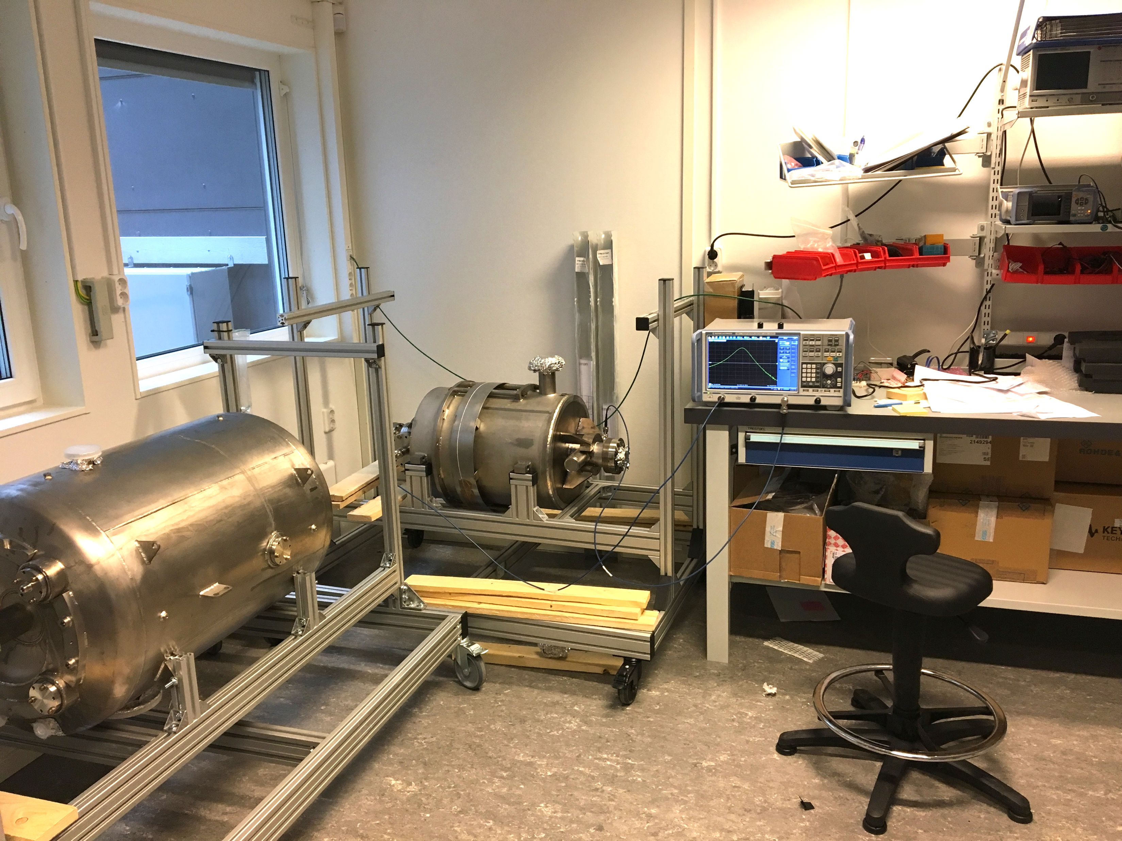
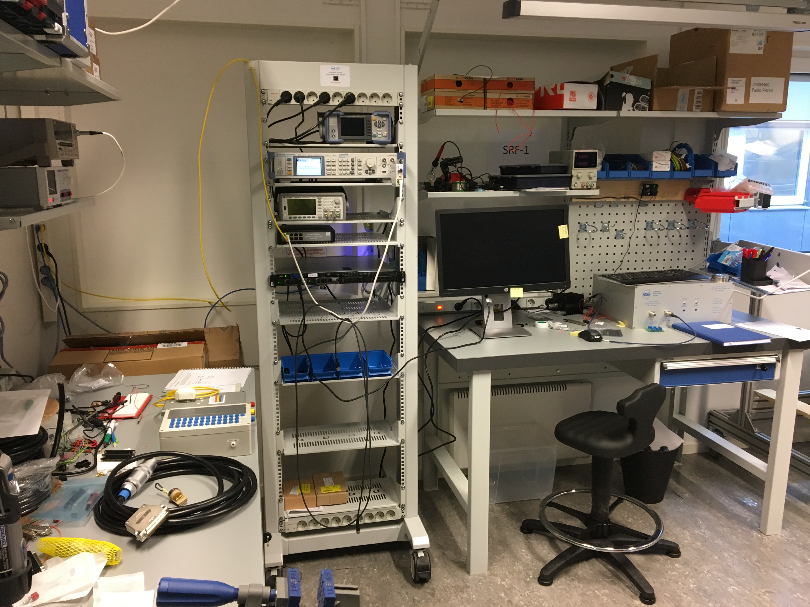
Preparation activities: SRF
Incoming RF activities: Setup of an SRF laboratory
From September 2017 to now:
  Setup of SRF Laboratory for the preparation of all incoming reception measurement at warm
  Lab will be moved to B02 lab building when available
SigGen
Racks
IPC (IOC)
Meters
RF Amp
…
INFN β=0.5
5-cell
elliptical
20W SSA
IPNO ESS
Double Spoke

Slide 9
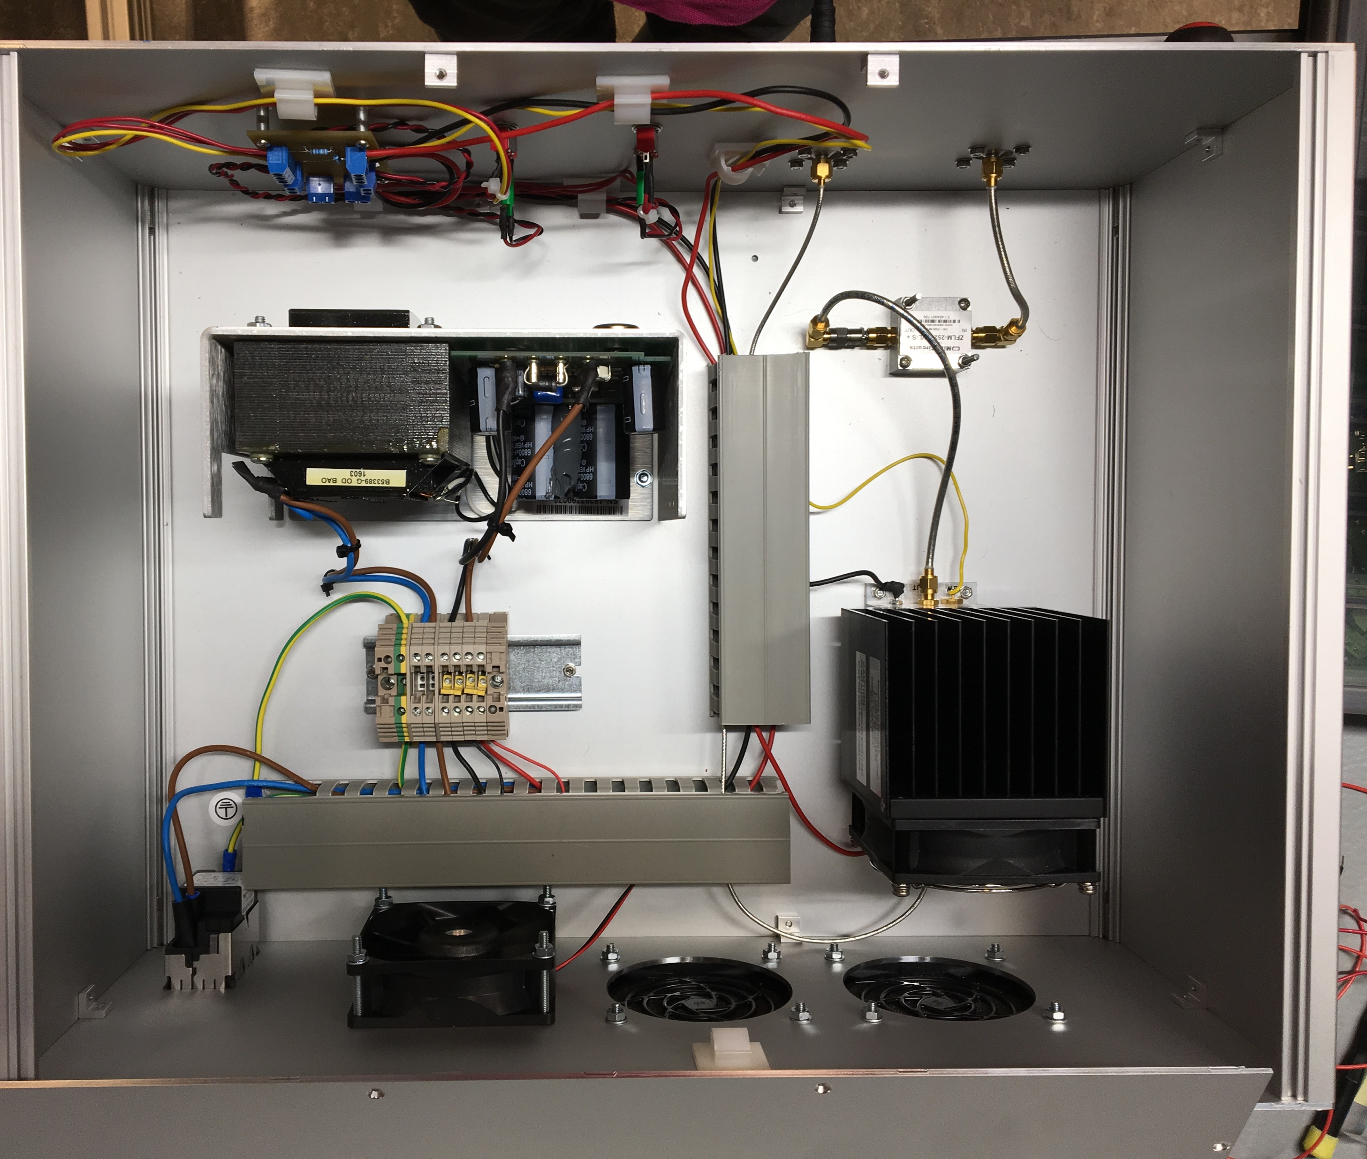
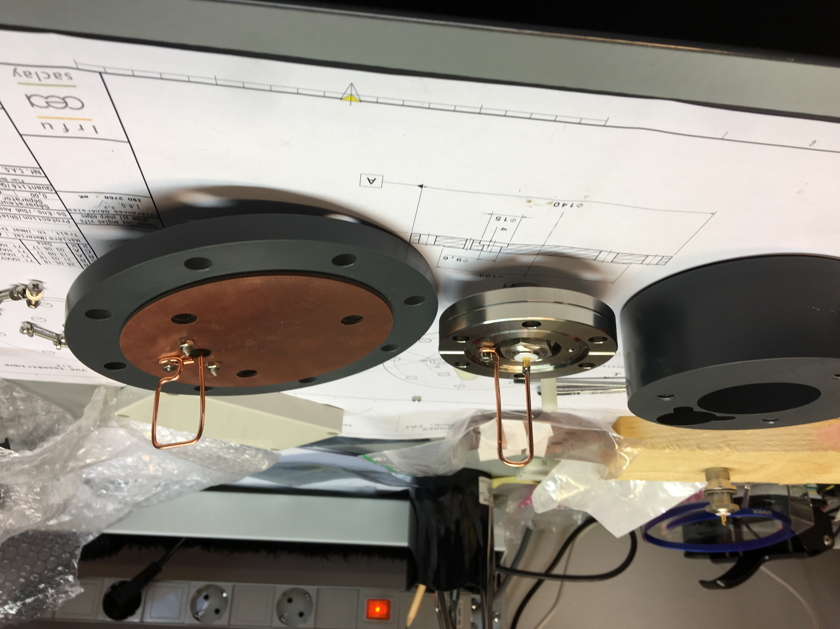
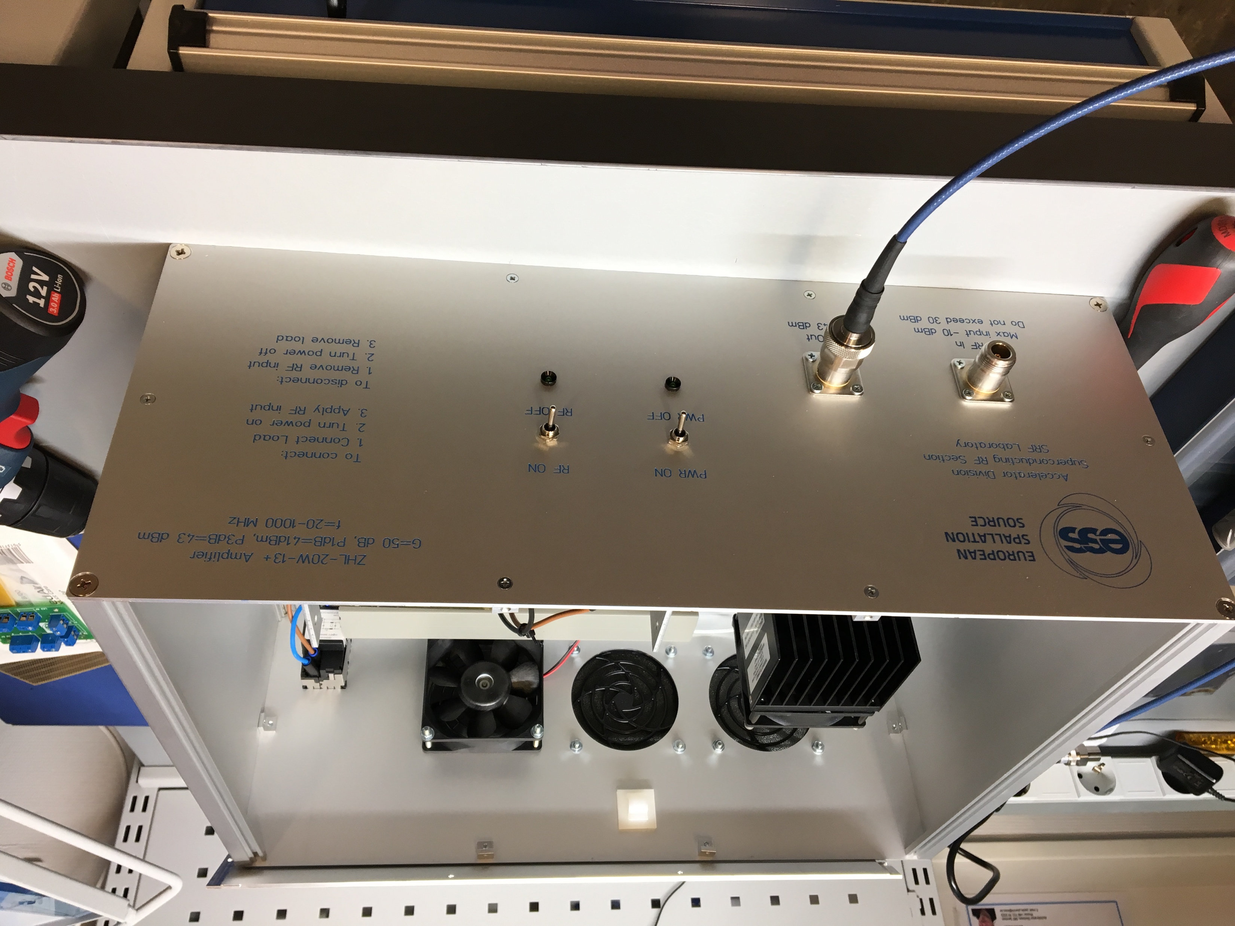
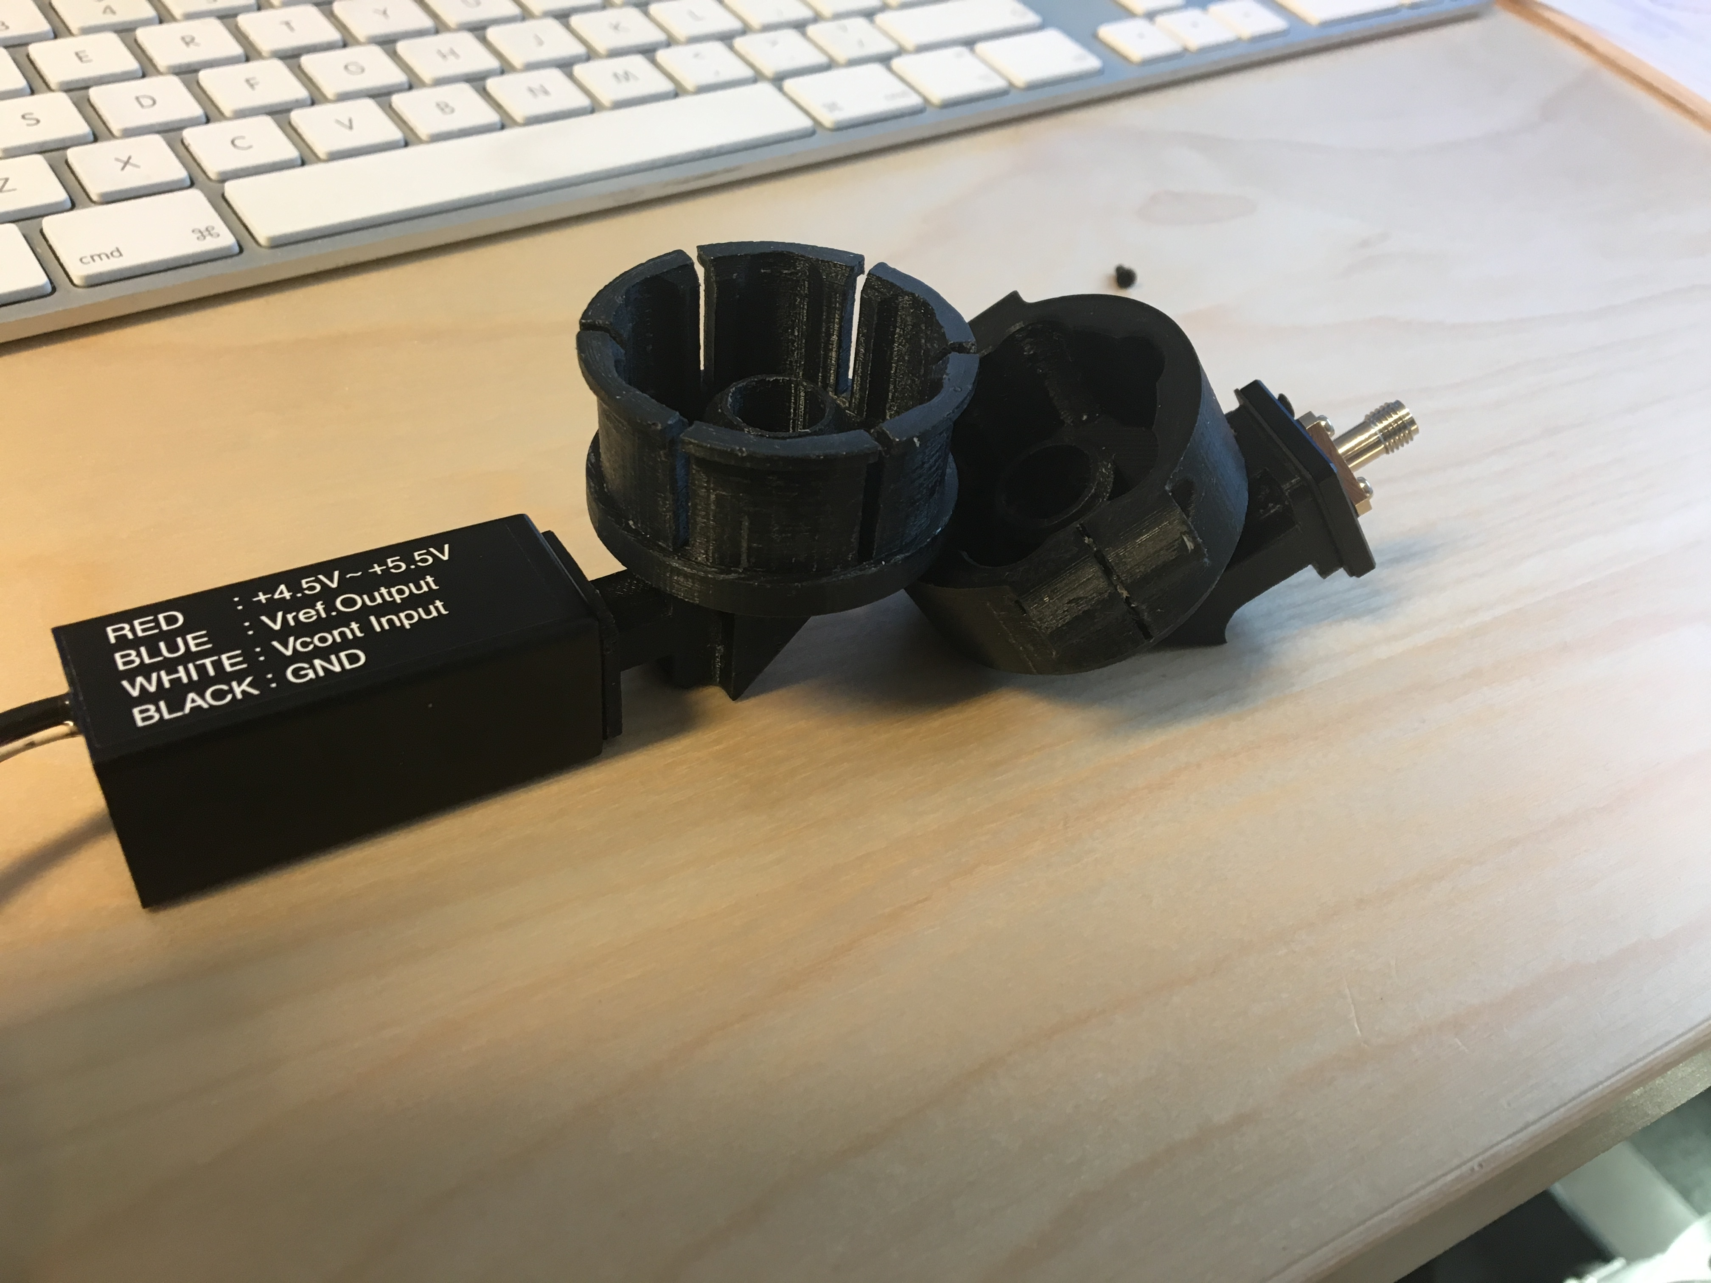
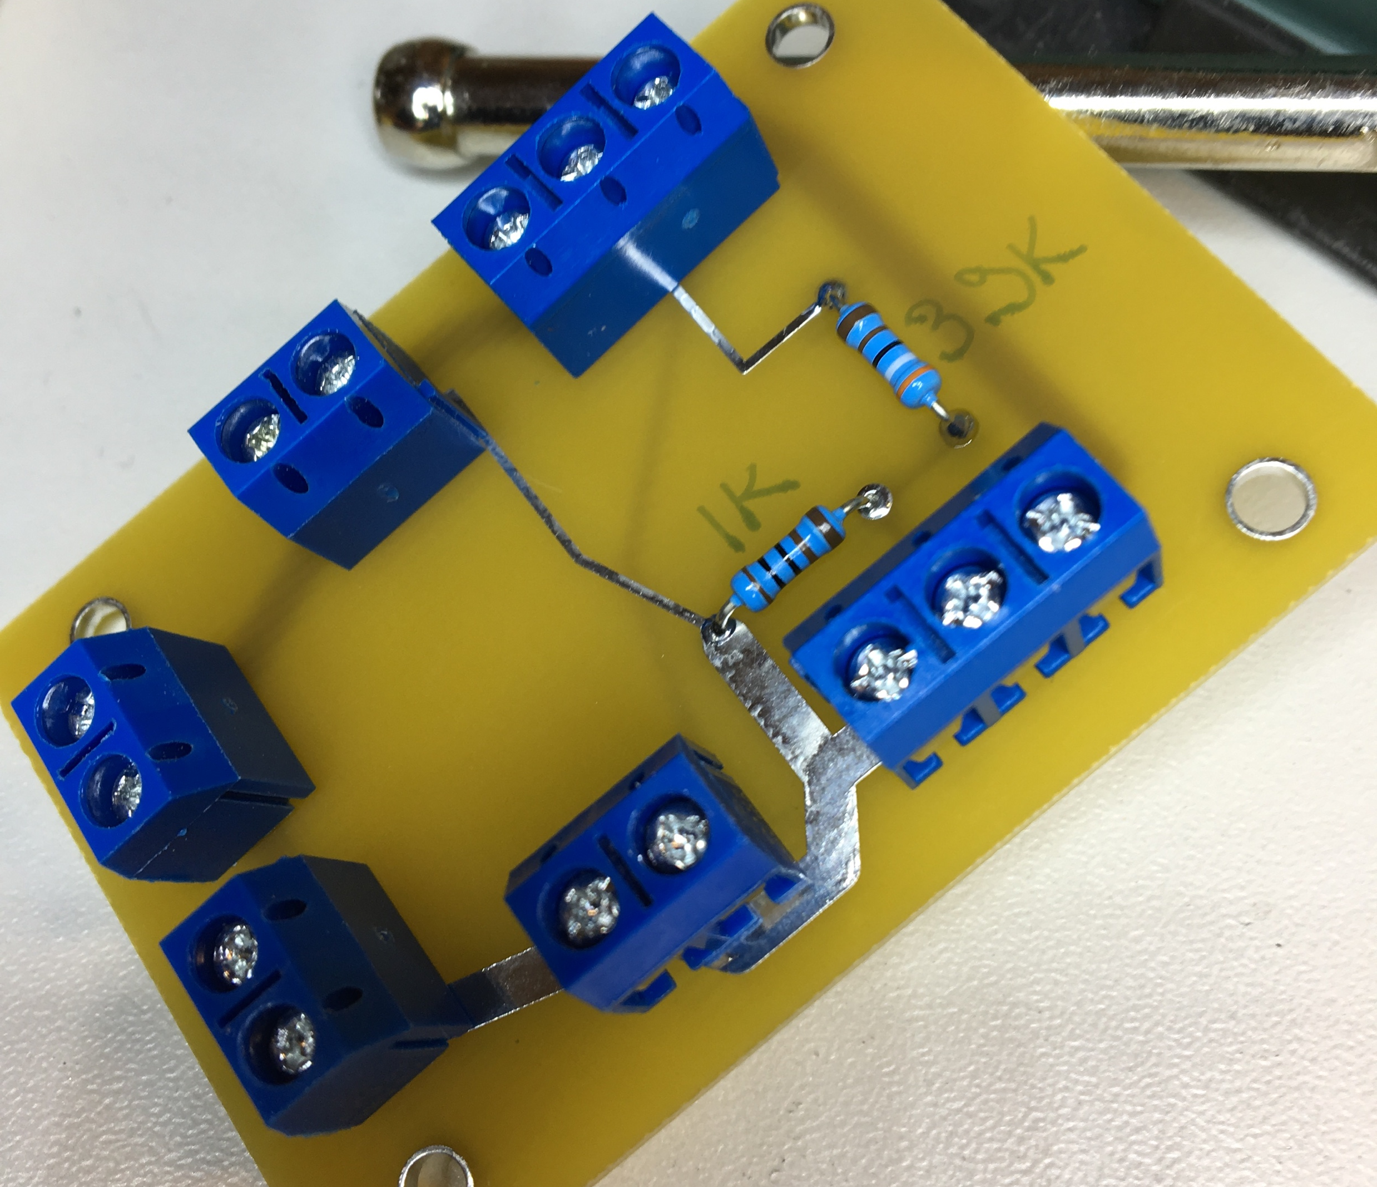
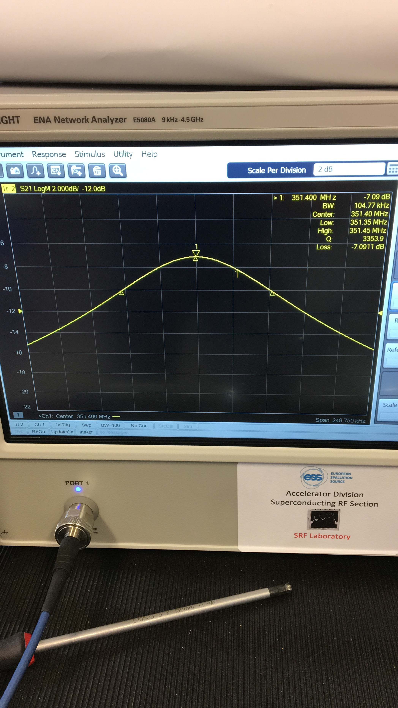
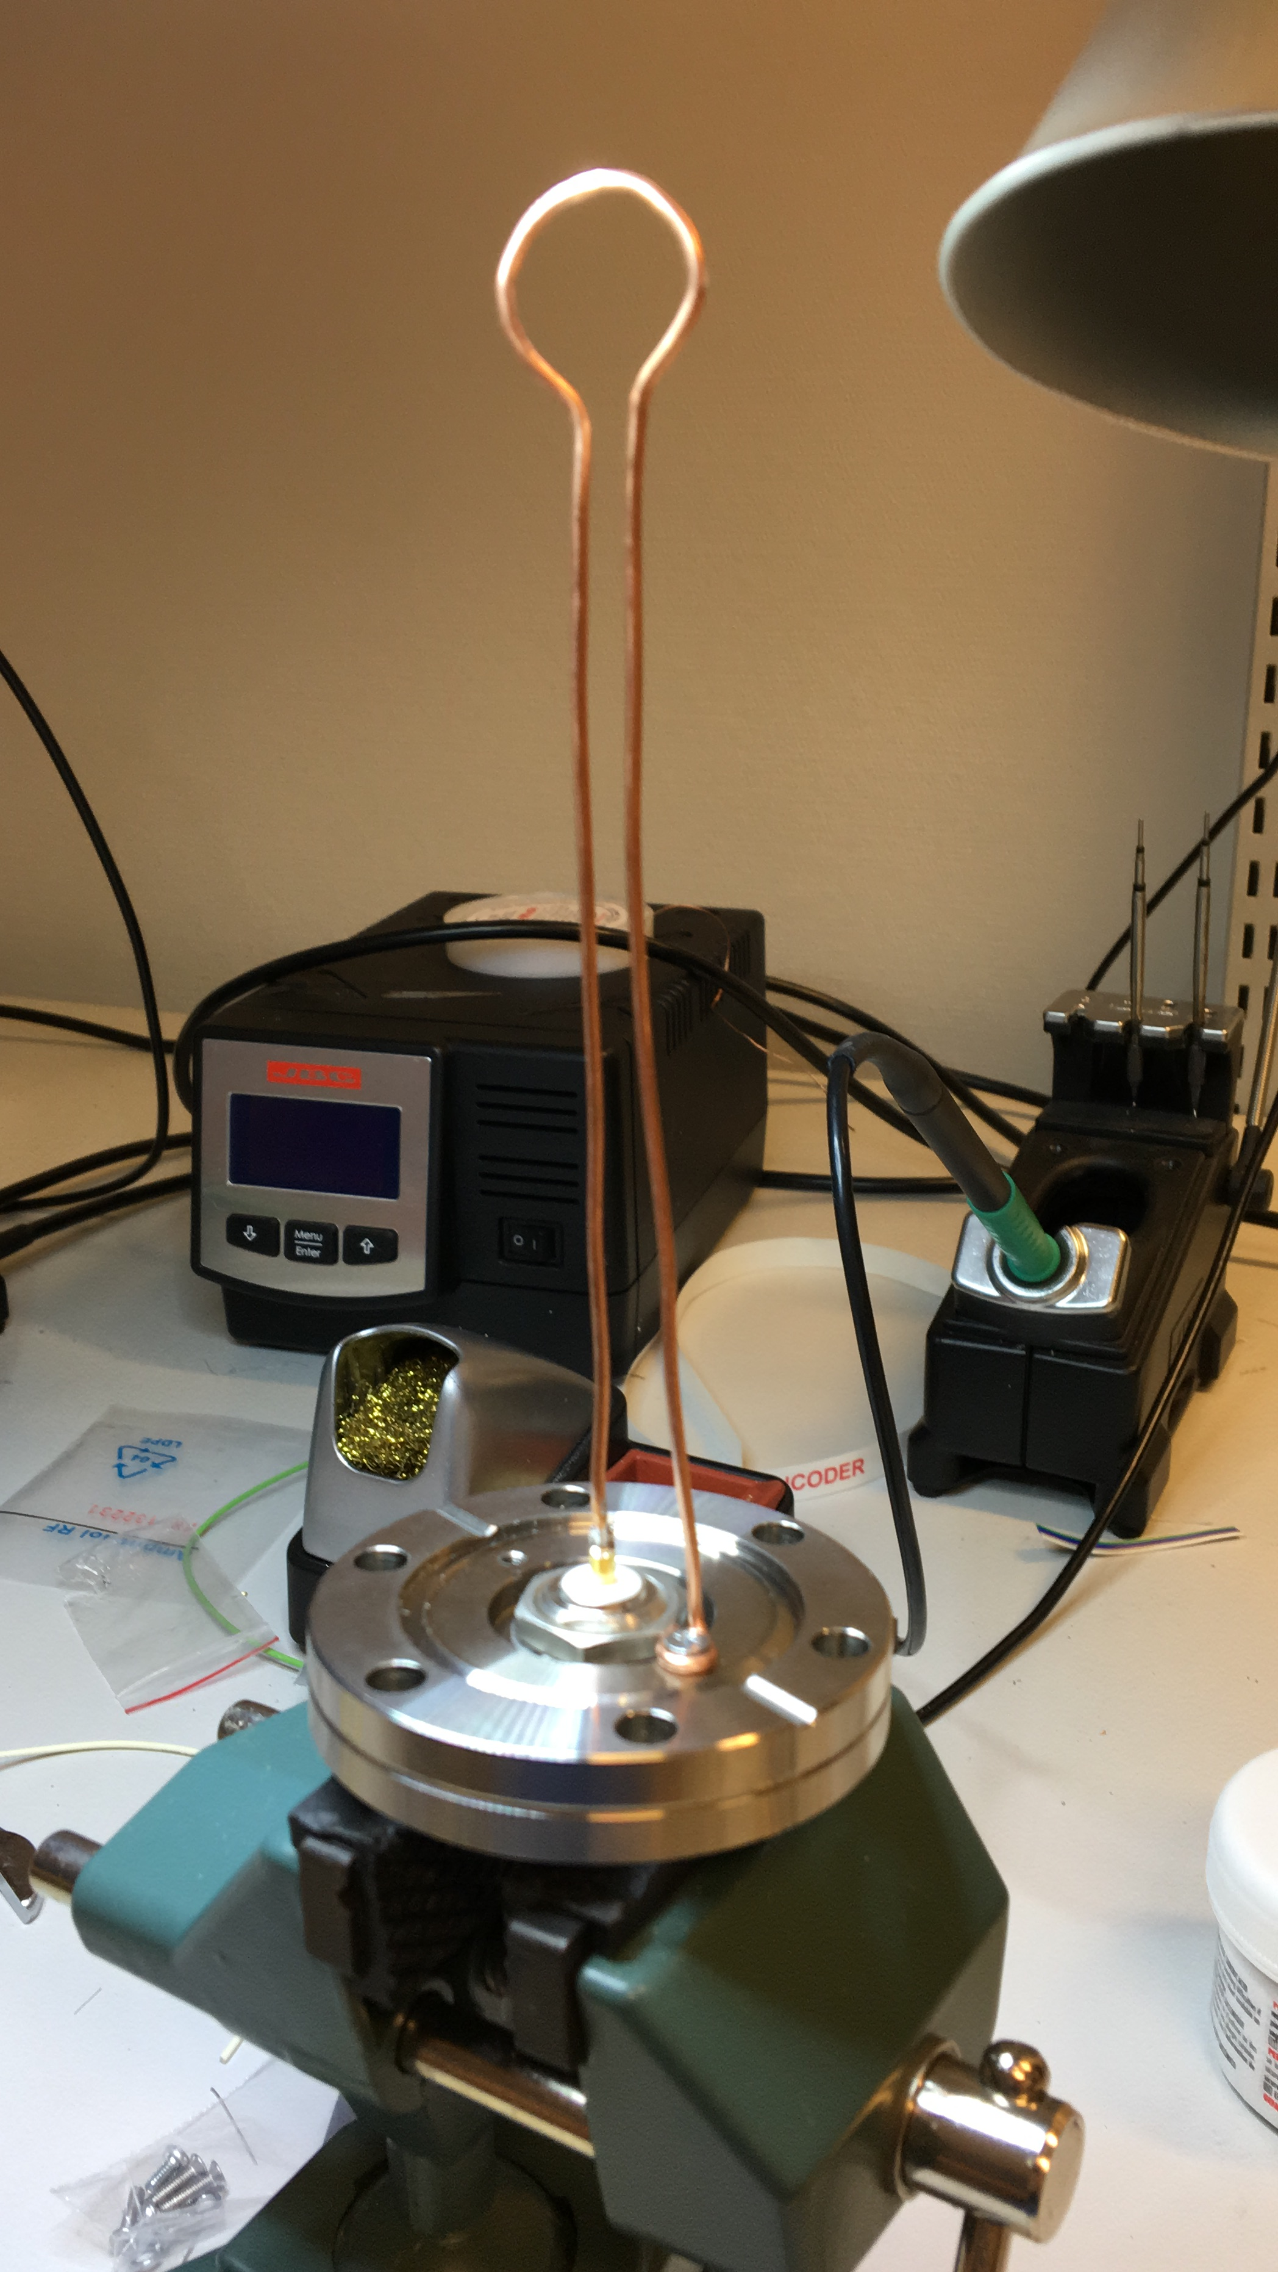
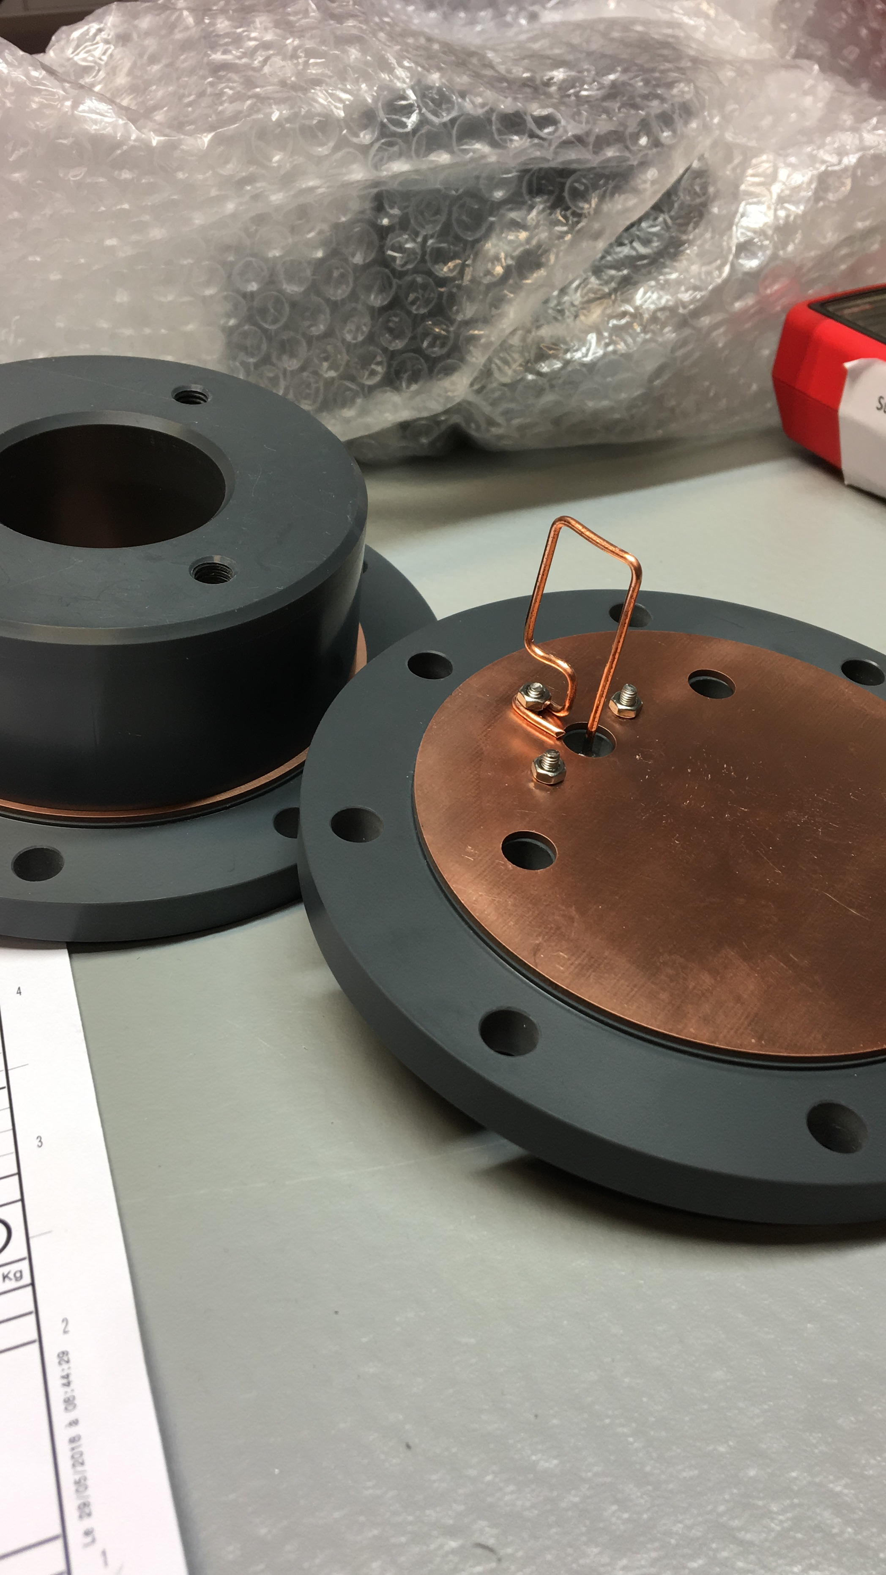
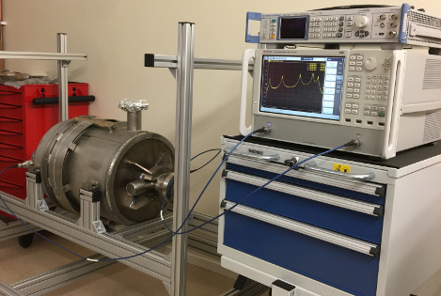
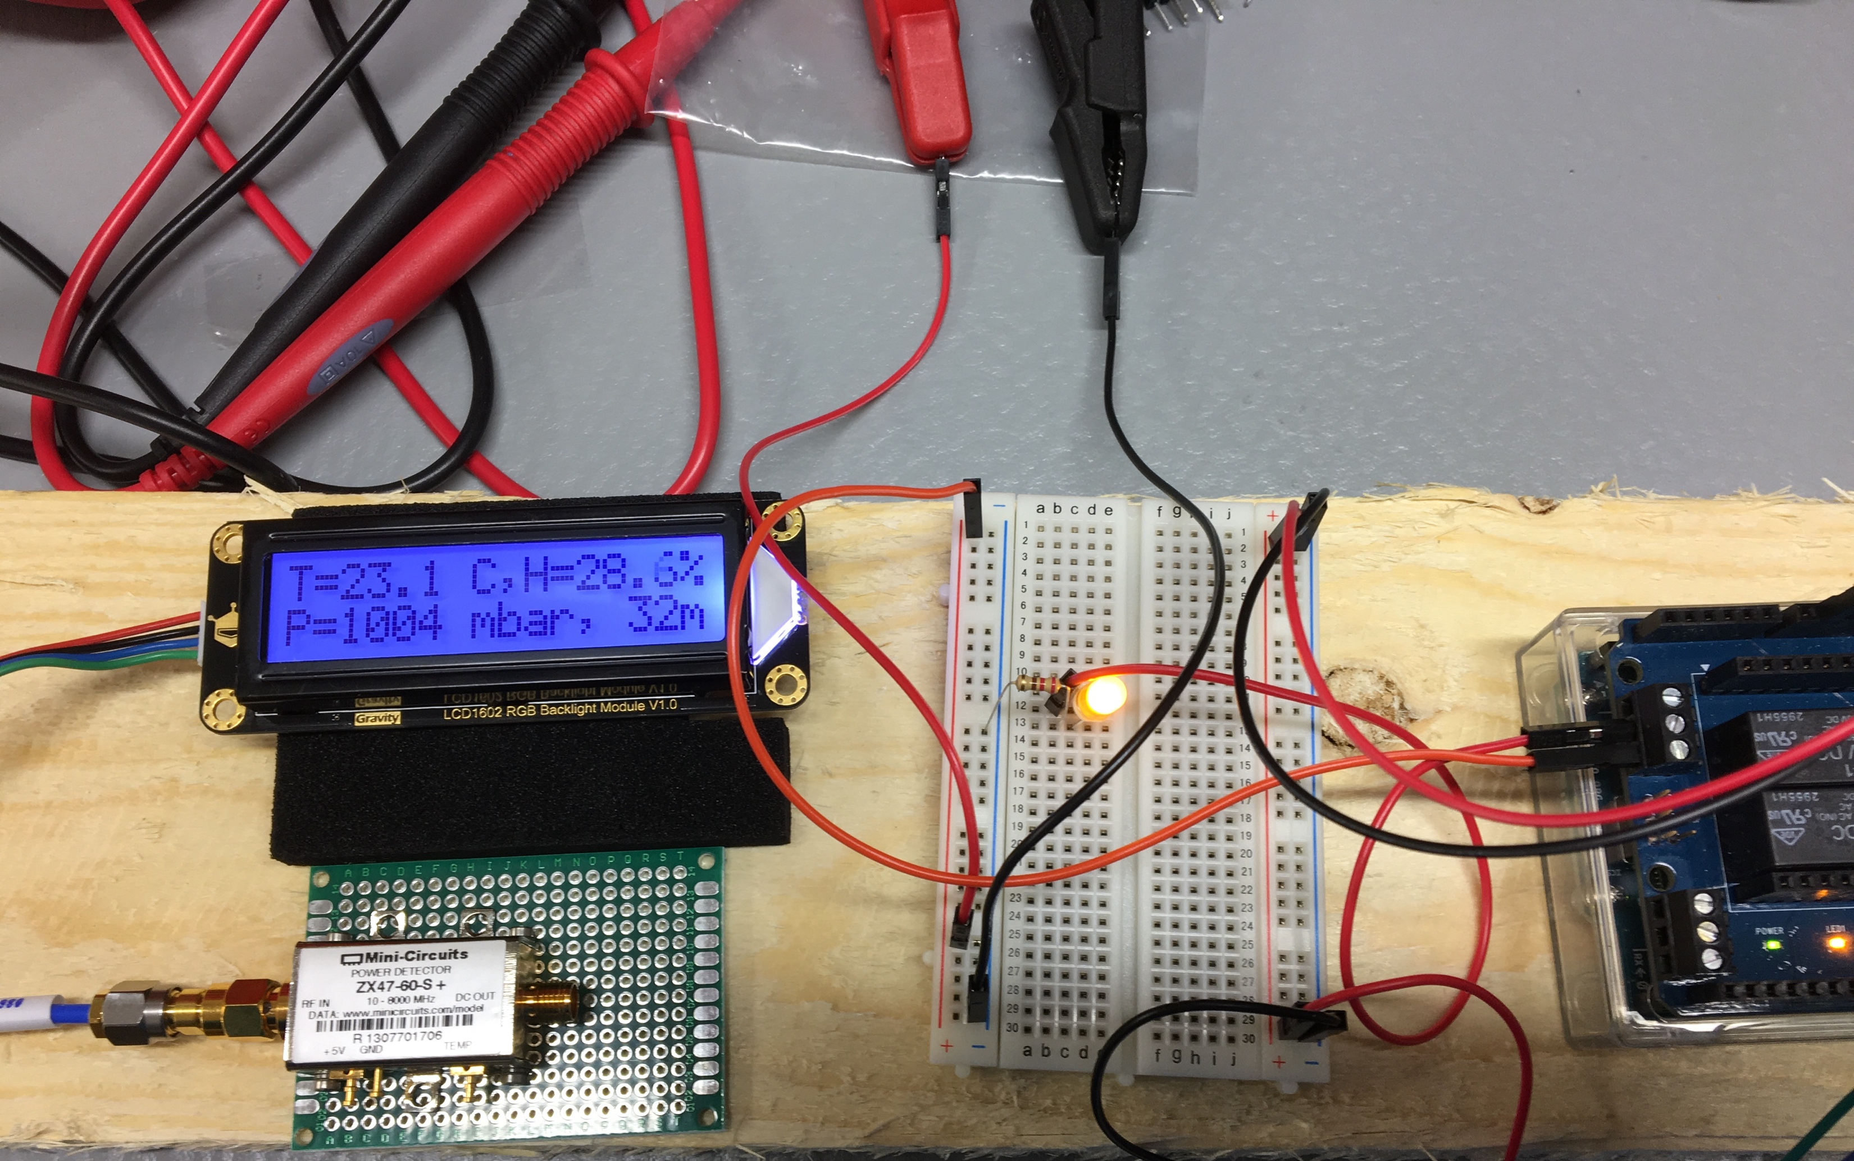
Preparation activities: “hands-on” SRF
Start of regular SRF “Lab life” and local development capabilities
Acknowledging help/support/collab from IK and more importantly all over ESS (RF, STS, EIS, ICS…)

Slide 10
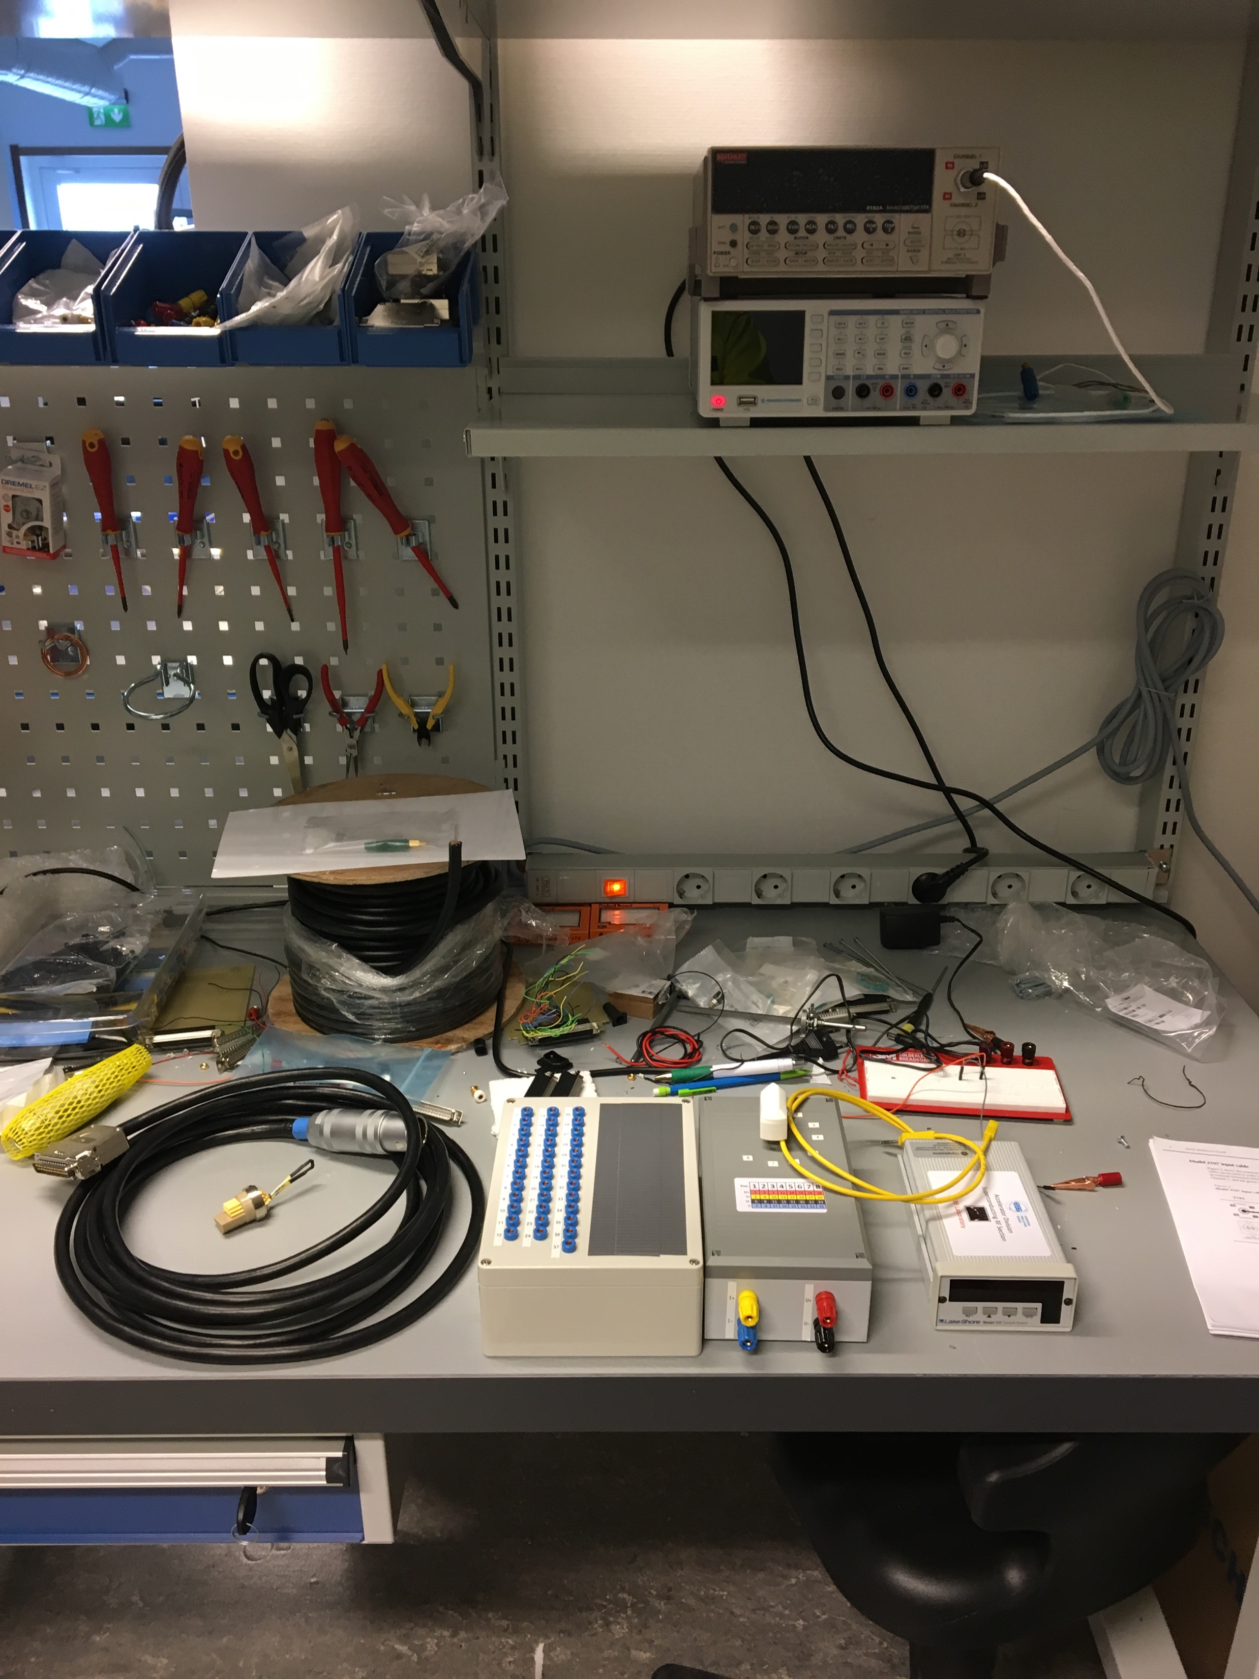
Preparation activities: Signals
Incoming reception of internal instrumentation
SRF section provides support for the development and realization of the needed instrumentation in the scope of the incoming tests
  Laboratory development & testing environment
  Procurement, maintenance of instruments, tools and consumables
Activity relying on strong support of IFJ-PAN team
  Preparation of the hardware for the toolboxes to check the internal sensors of the modules (CERNOX, PT, Heater, Motors, …)
  Prepare the incoming reports for the assessment with the outgoing documentation from CEA
  Definition of # and contents of inspection reports ➜ Michal

Slide 11
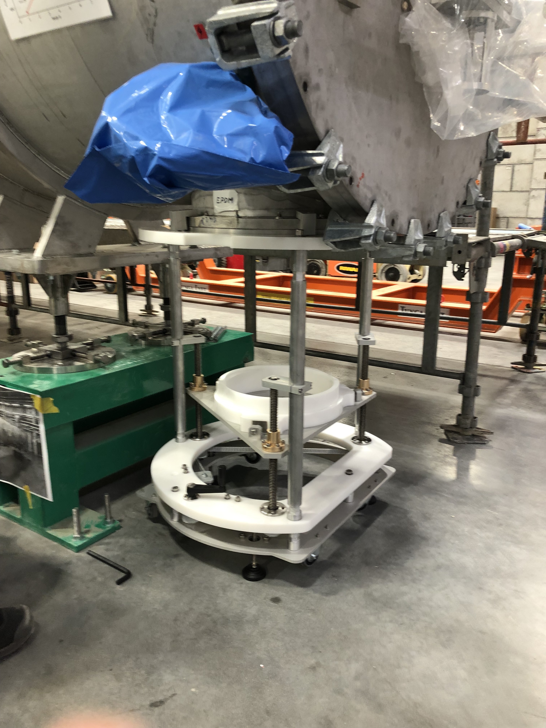
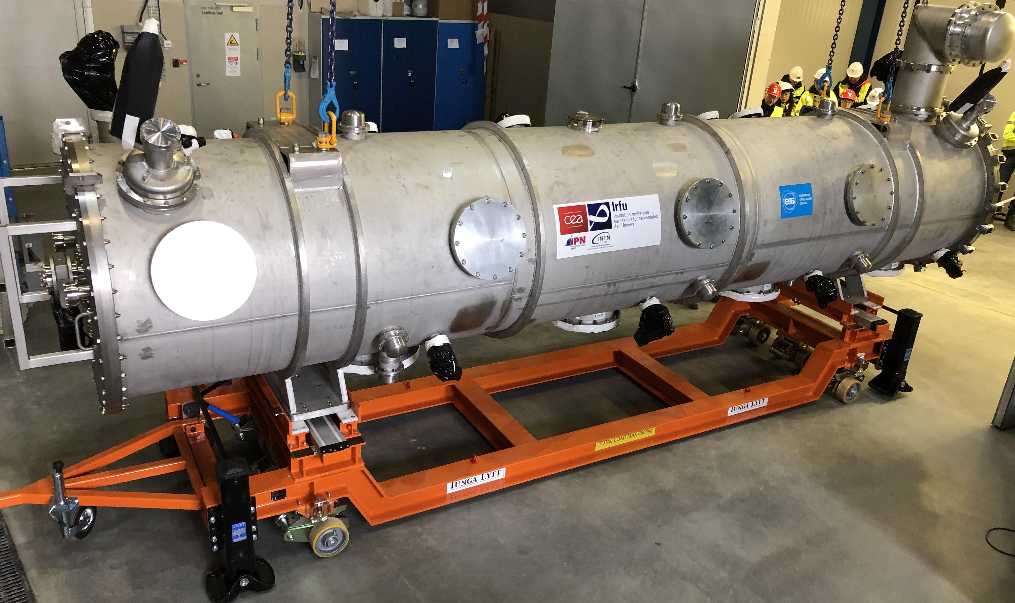
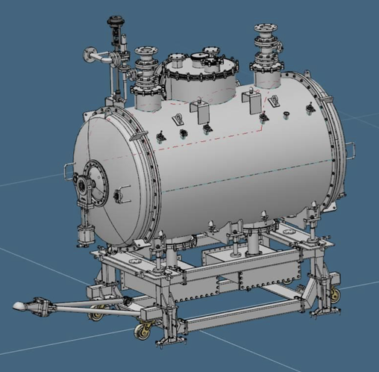
Preparation activities: Mechanical
EIS Legend
MS: Manufacturing Section
METS: Mechanical Engineering & Technology
SAM: Survey, Alignment and Metrology
Development of ESS tools
ESS responsibility for transport tools (IK, internal) and supports
  In close contact with ESS Rigging/SAM/MS ➜ Felix
Customization of CEA assembly tools to adapt to the TS2/Tunnel
  e.g. Doorknob Installation Tool
  Support from EIS, from METS/MS for engineering and manufacturing
Design at ESS discussed with IK
  Part of know-how transfer process
On site transport cart
DK installation tool (ESS)

Slide 12
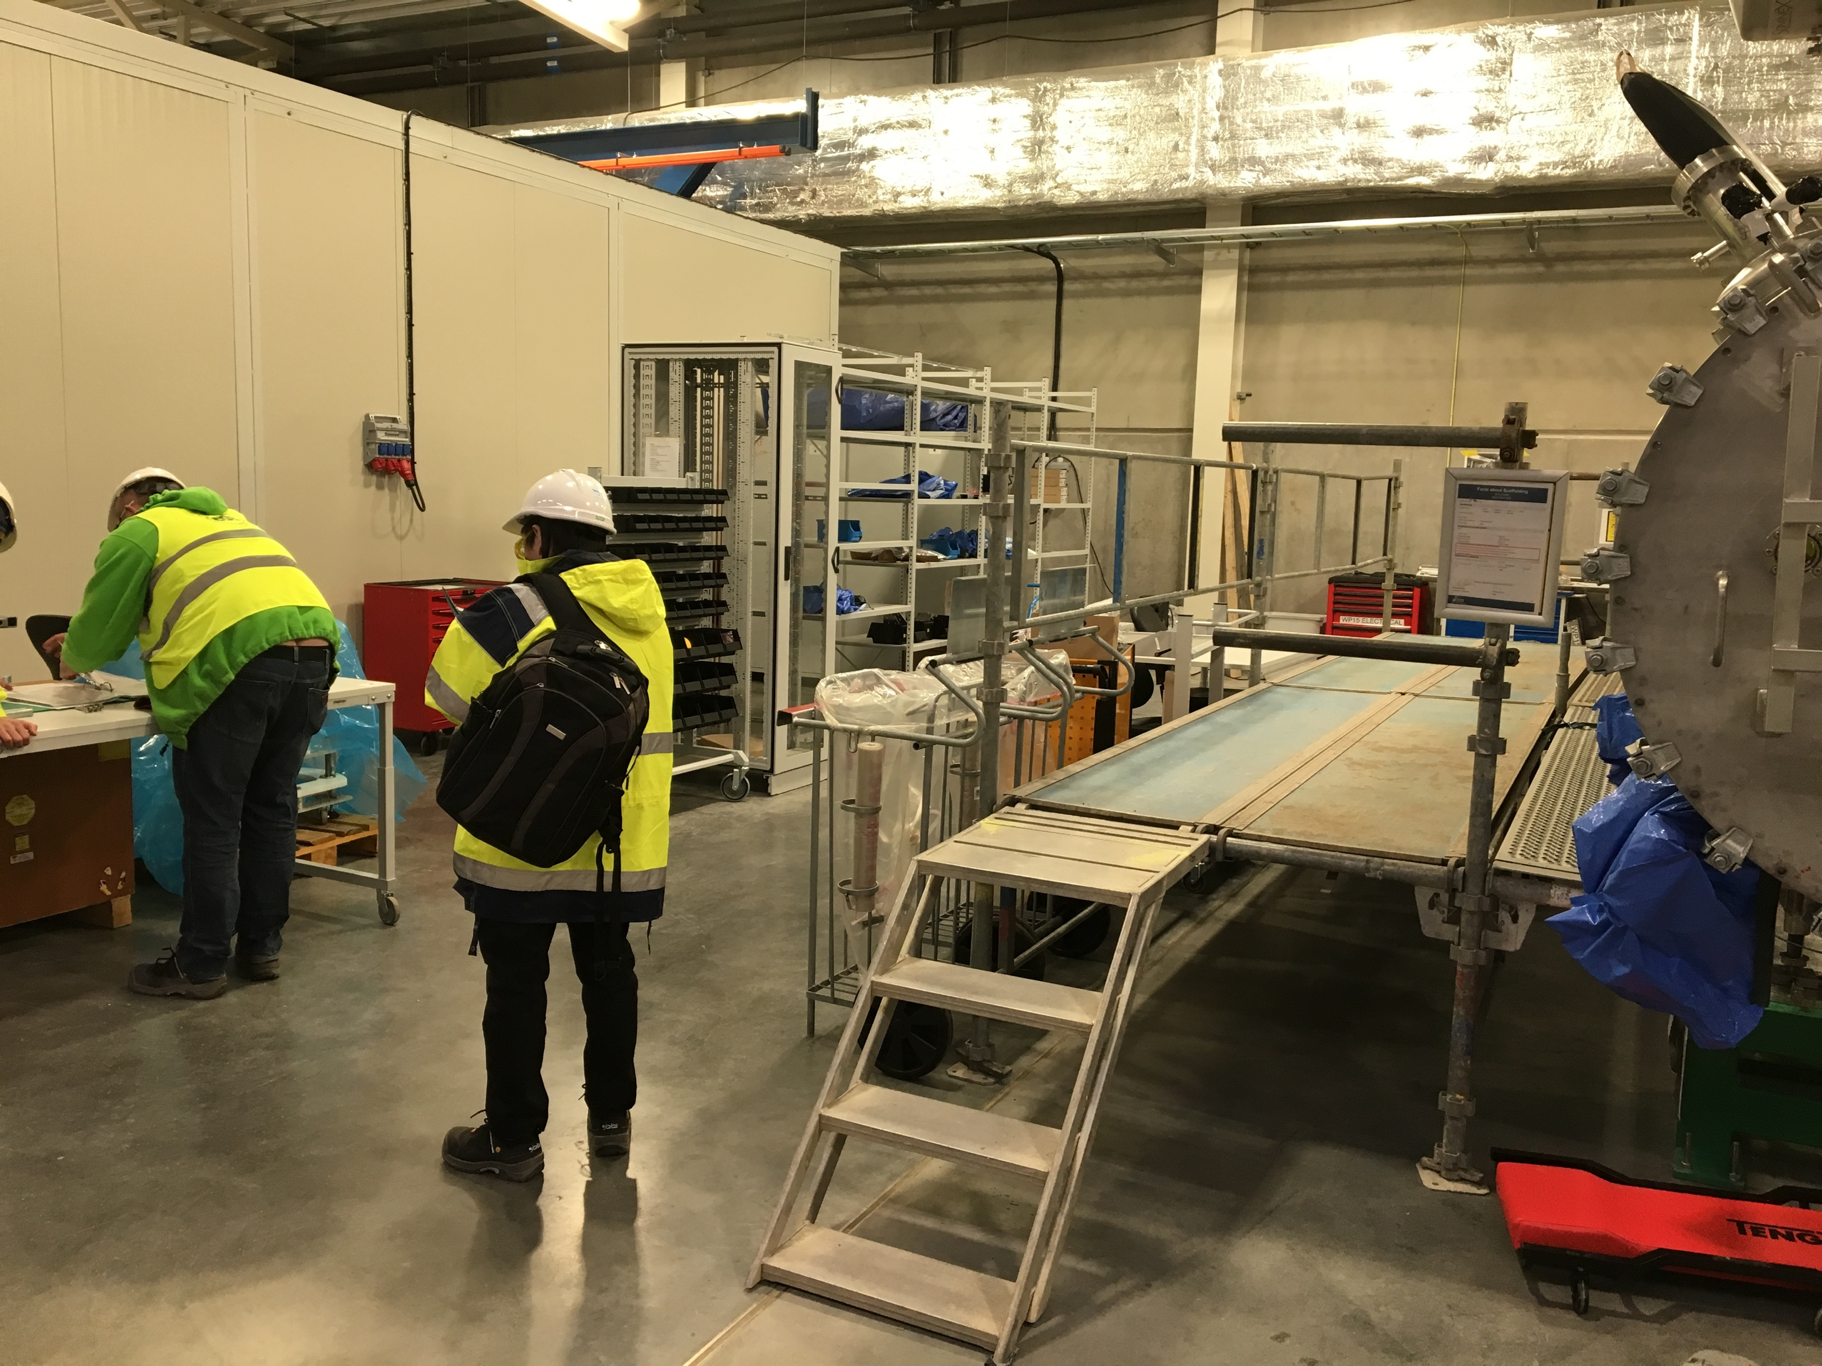
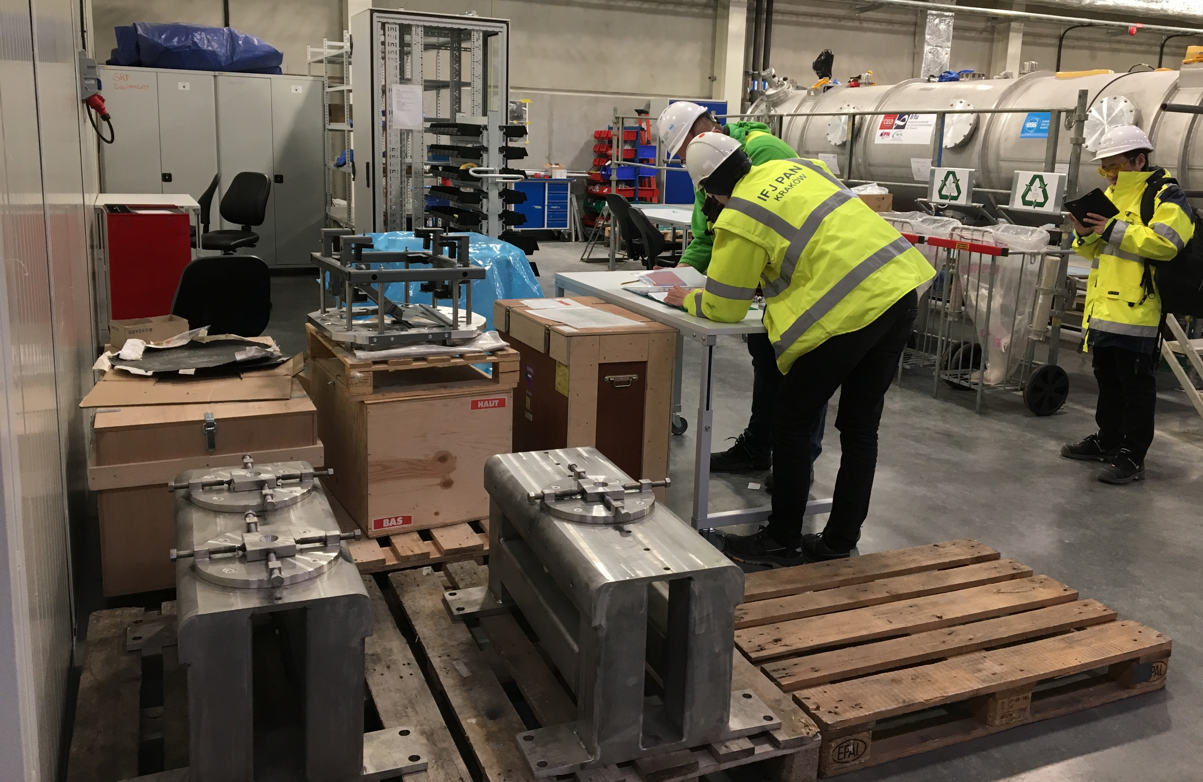
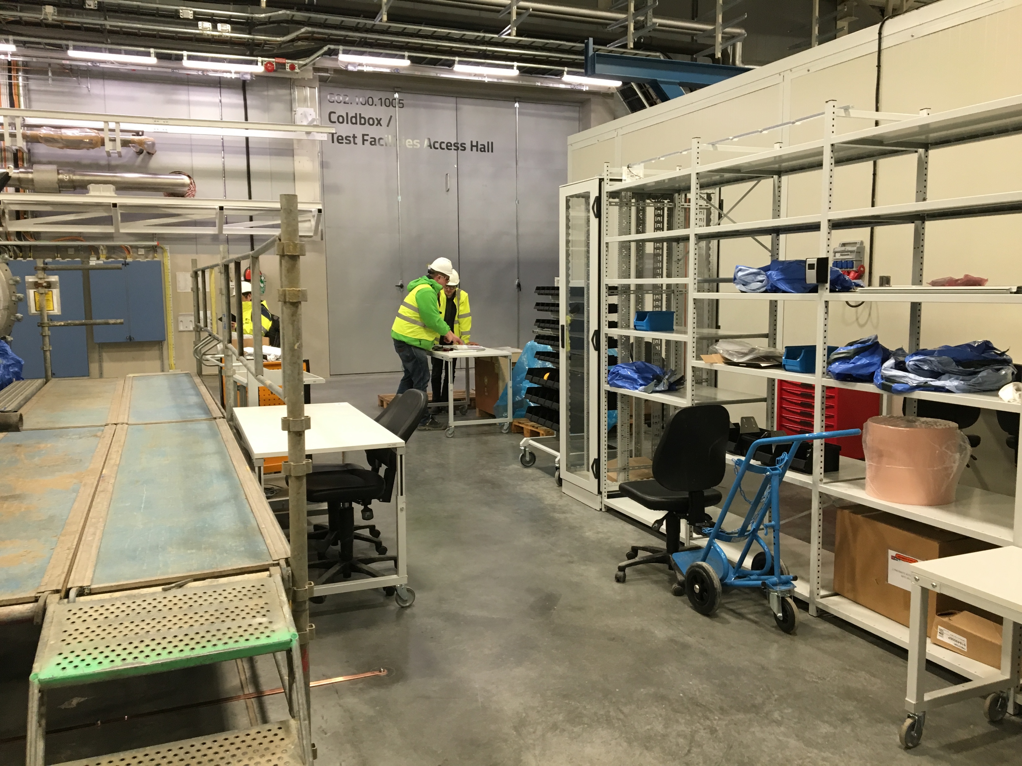
Preparation activities: Test workflow at TS2
Setup of Module reception area
➜ Michal
Preparation of areas for
  Storage of components/instrumentations/tools
  Workstations for mechanical, electrical and RF incoming inspections
  Workstations for activities needed for the TS2 test/tunnel
    E.g. dismount/remount of transport fixations on thermal shields and string
  Local instrumentation
  racks
  Training teams!
    Performed main
    mechanical reception
    operations
    Started vacuum
    procedures
    Started RF incoming
    measurements
    Soon electrical
DK Fixation
Doorknobs (to be assembled)
TS2 Bunker Supports

Slide 13
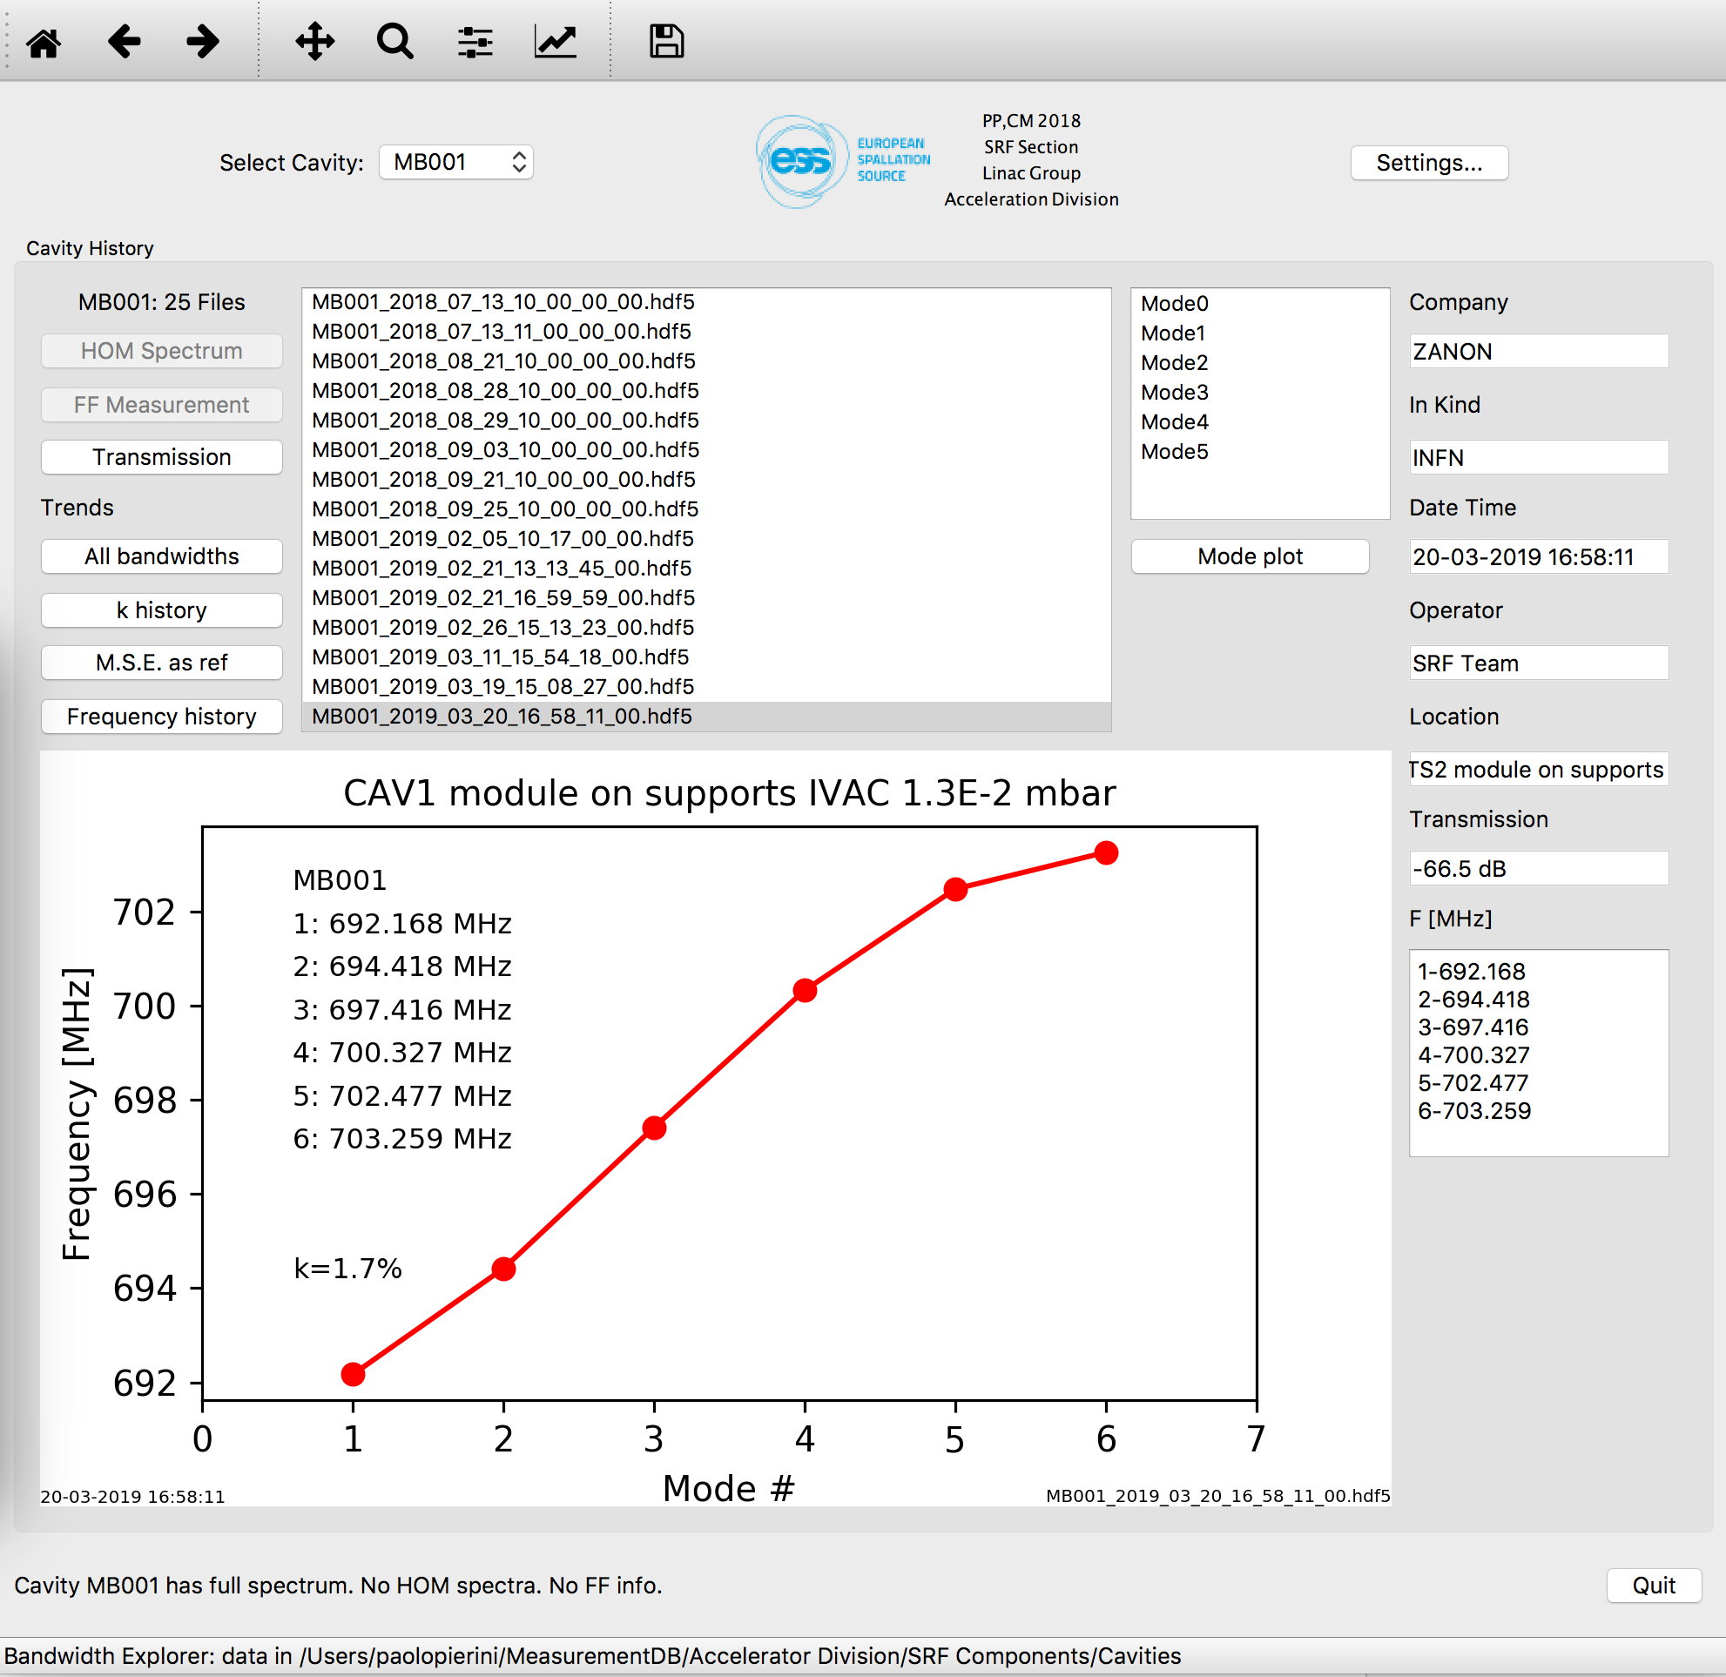
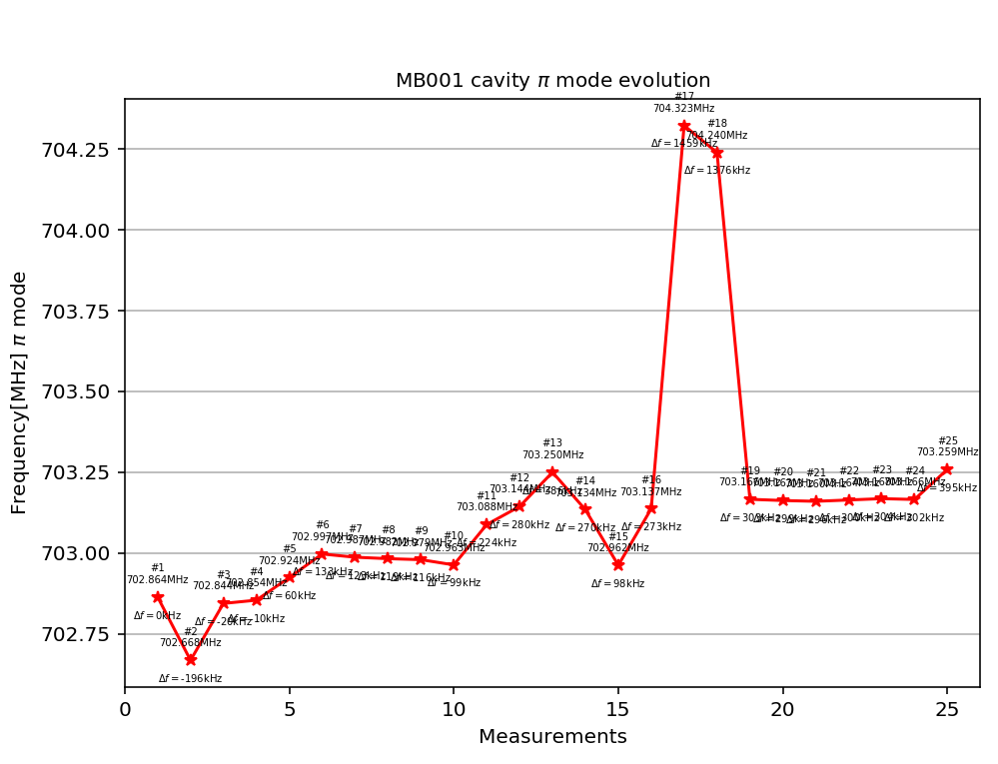
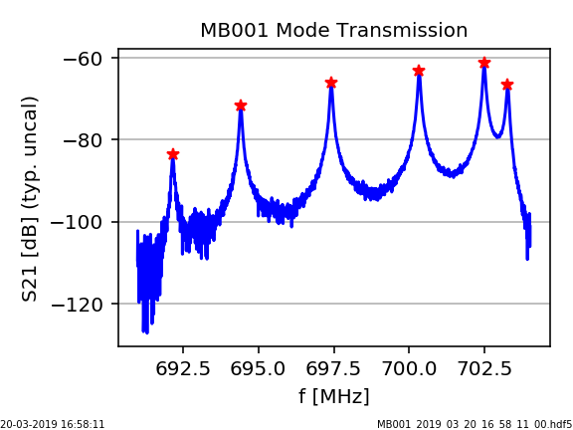
Preparation activities: We need to know our cavities!
Setup of a Measurement DB
Measurement at IK are transferred into Measurement DB, to allow reception and evaluation at TS2 ➜ Cecilia
  Part of handover process IK-CEA-ESS
Data at ESS then adds on it
MECCTD f history
ESS Reception
String ASSY@CEA
Fabrication
Cooldown @ CEA

Slide 14
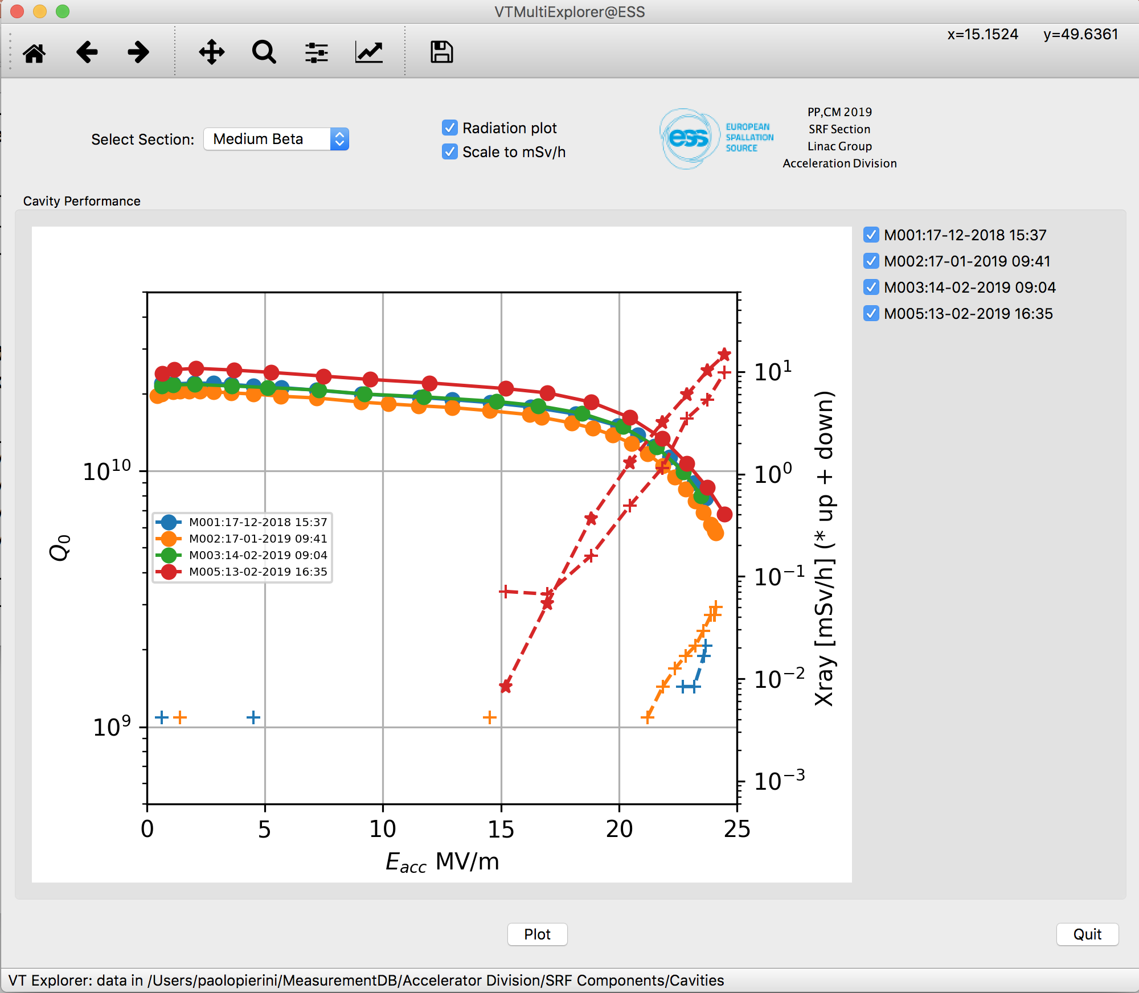
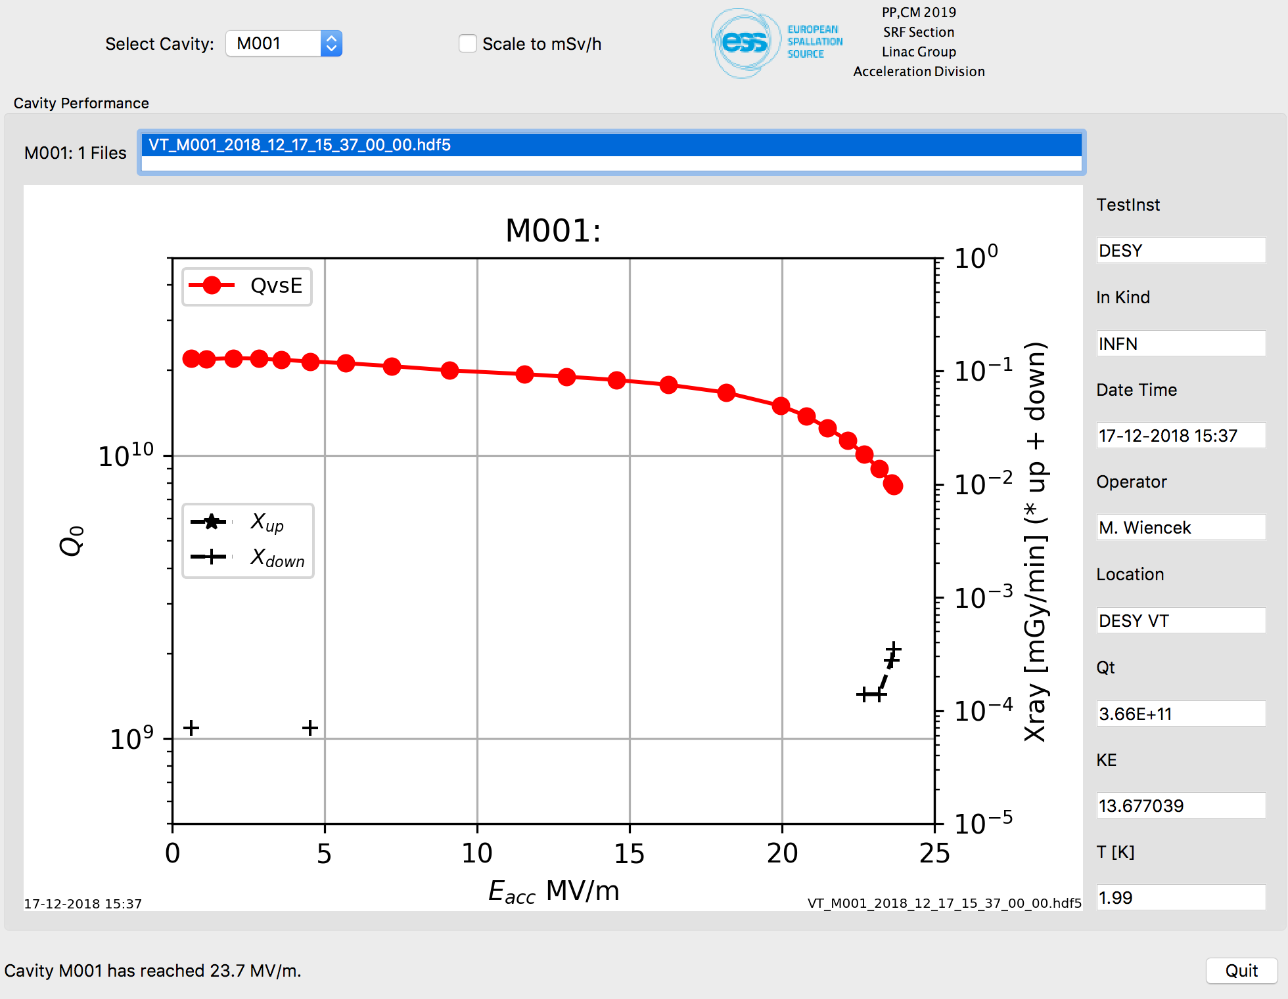
Preparation activities: Cavity performance data
First four cavities of M1 string, real time transfer
In the handover we also receive from the IK the summary data of the vertical tests
  Performance data
  Calibration data for TS2
e.g. PU calibration data from DESY VT

Slide 15
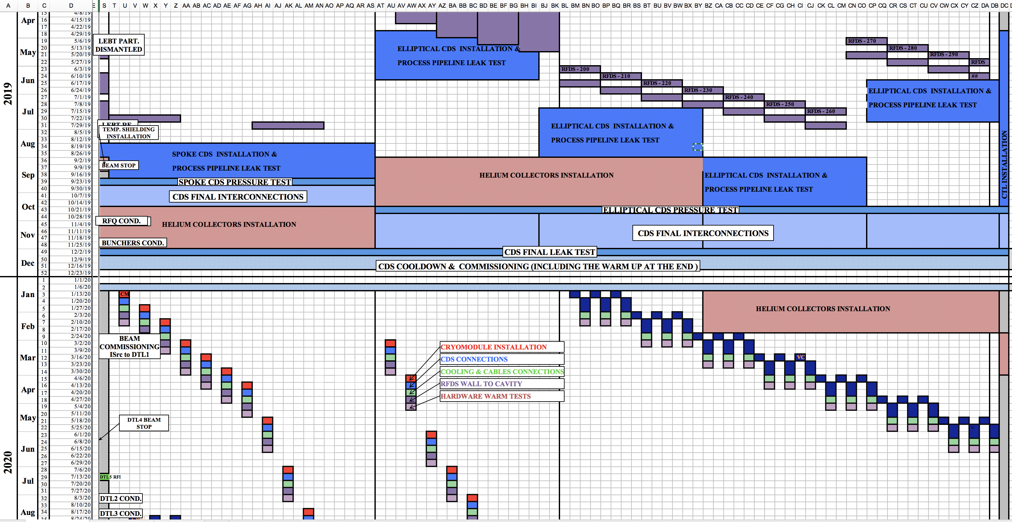
Component flow to current installation plan
Start TS2 operation

Slide 16
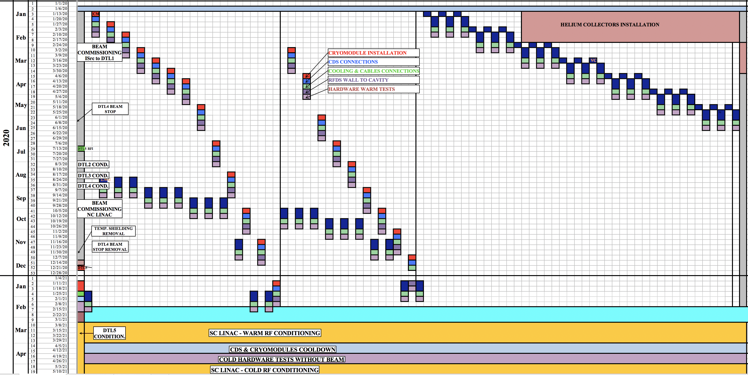
2020, concurrent SPK/MB ELL Component installation
13 Spokes
9 MBEll

Slide 17
Long term maintenance of the facility
Spares, SRF Module repair facility at ESS?
ESS linac mainly consists of SRF components provided by European Institutions through In Kind
  State of the art infrastructures for development, testing and assembly are in partner laboratories
The ESS long term implies provisions for maintenance, repair and possible upgrades
  Outside the realistic timeframe of collaboration agreements with the partners providing the components
  SRF technology may loose focus at partner laboratories
Plan for long term SRF maintenance to be developed
  A local SRF facility as a place to ensure maintainability and to perform activities that would enable retaining motivated and competent staff to perform it
Not in the current scope of construction phase
Goal for availability ~2025, ~4 years, est. cost 12 ME
Needs benchmarked against EU facilities (lead by HD), update of 2016 assessment of WH
Wish list for new building on site ~ 1000 m²
  Module assembly/disassembly hall, ~200 m²
    Space with mechanical workshop, module assembly/disassembly area, lifting devices, tooling for sliding the string on its rail system
  Large clean room for cavity and string handling, ~300 m²
    Adjacent to assembly hall, ISO 7-4 (EN ISO 14644-1) areas to receive the cavity string for disassembly and reassembly,
    Cavity chemical treatment facility in ISO 7
      Buffered Chemistry facility for cavity etching
      Cleaning and rinsing cabinets with UPW
    Clean preparation area in ISO 4
      High pressure rinsing station
      String assembly and disassembly area
  Cavity Test Stand, ~50 m²
    Vertical cryostat for individual cavity performance assessments
  Module Test Stand, ~450 m²
    Radiation shielded bunker for High power testing of complete cryomodules
    Currently TS2 is in contingency space of Linac gallery, to be relocated

Slide 18
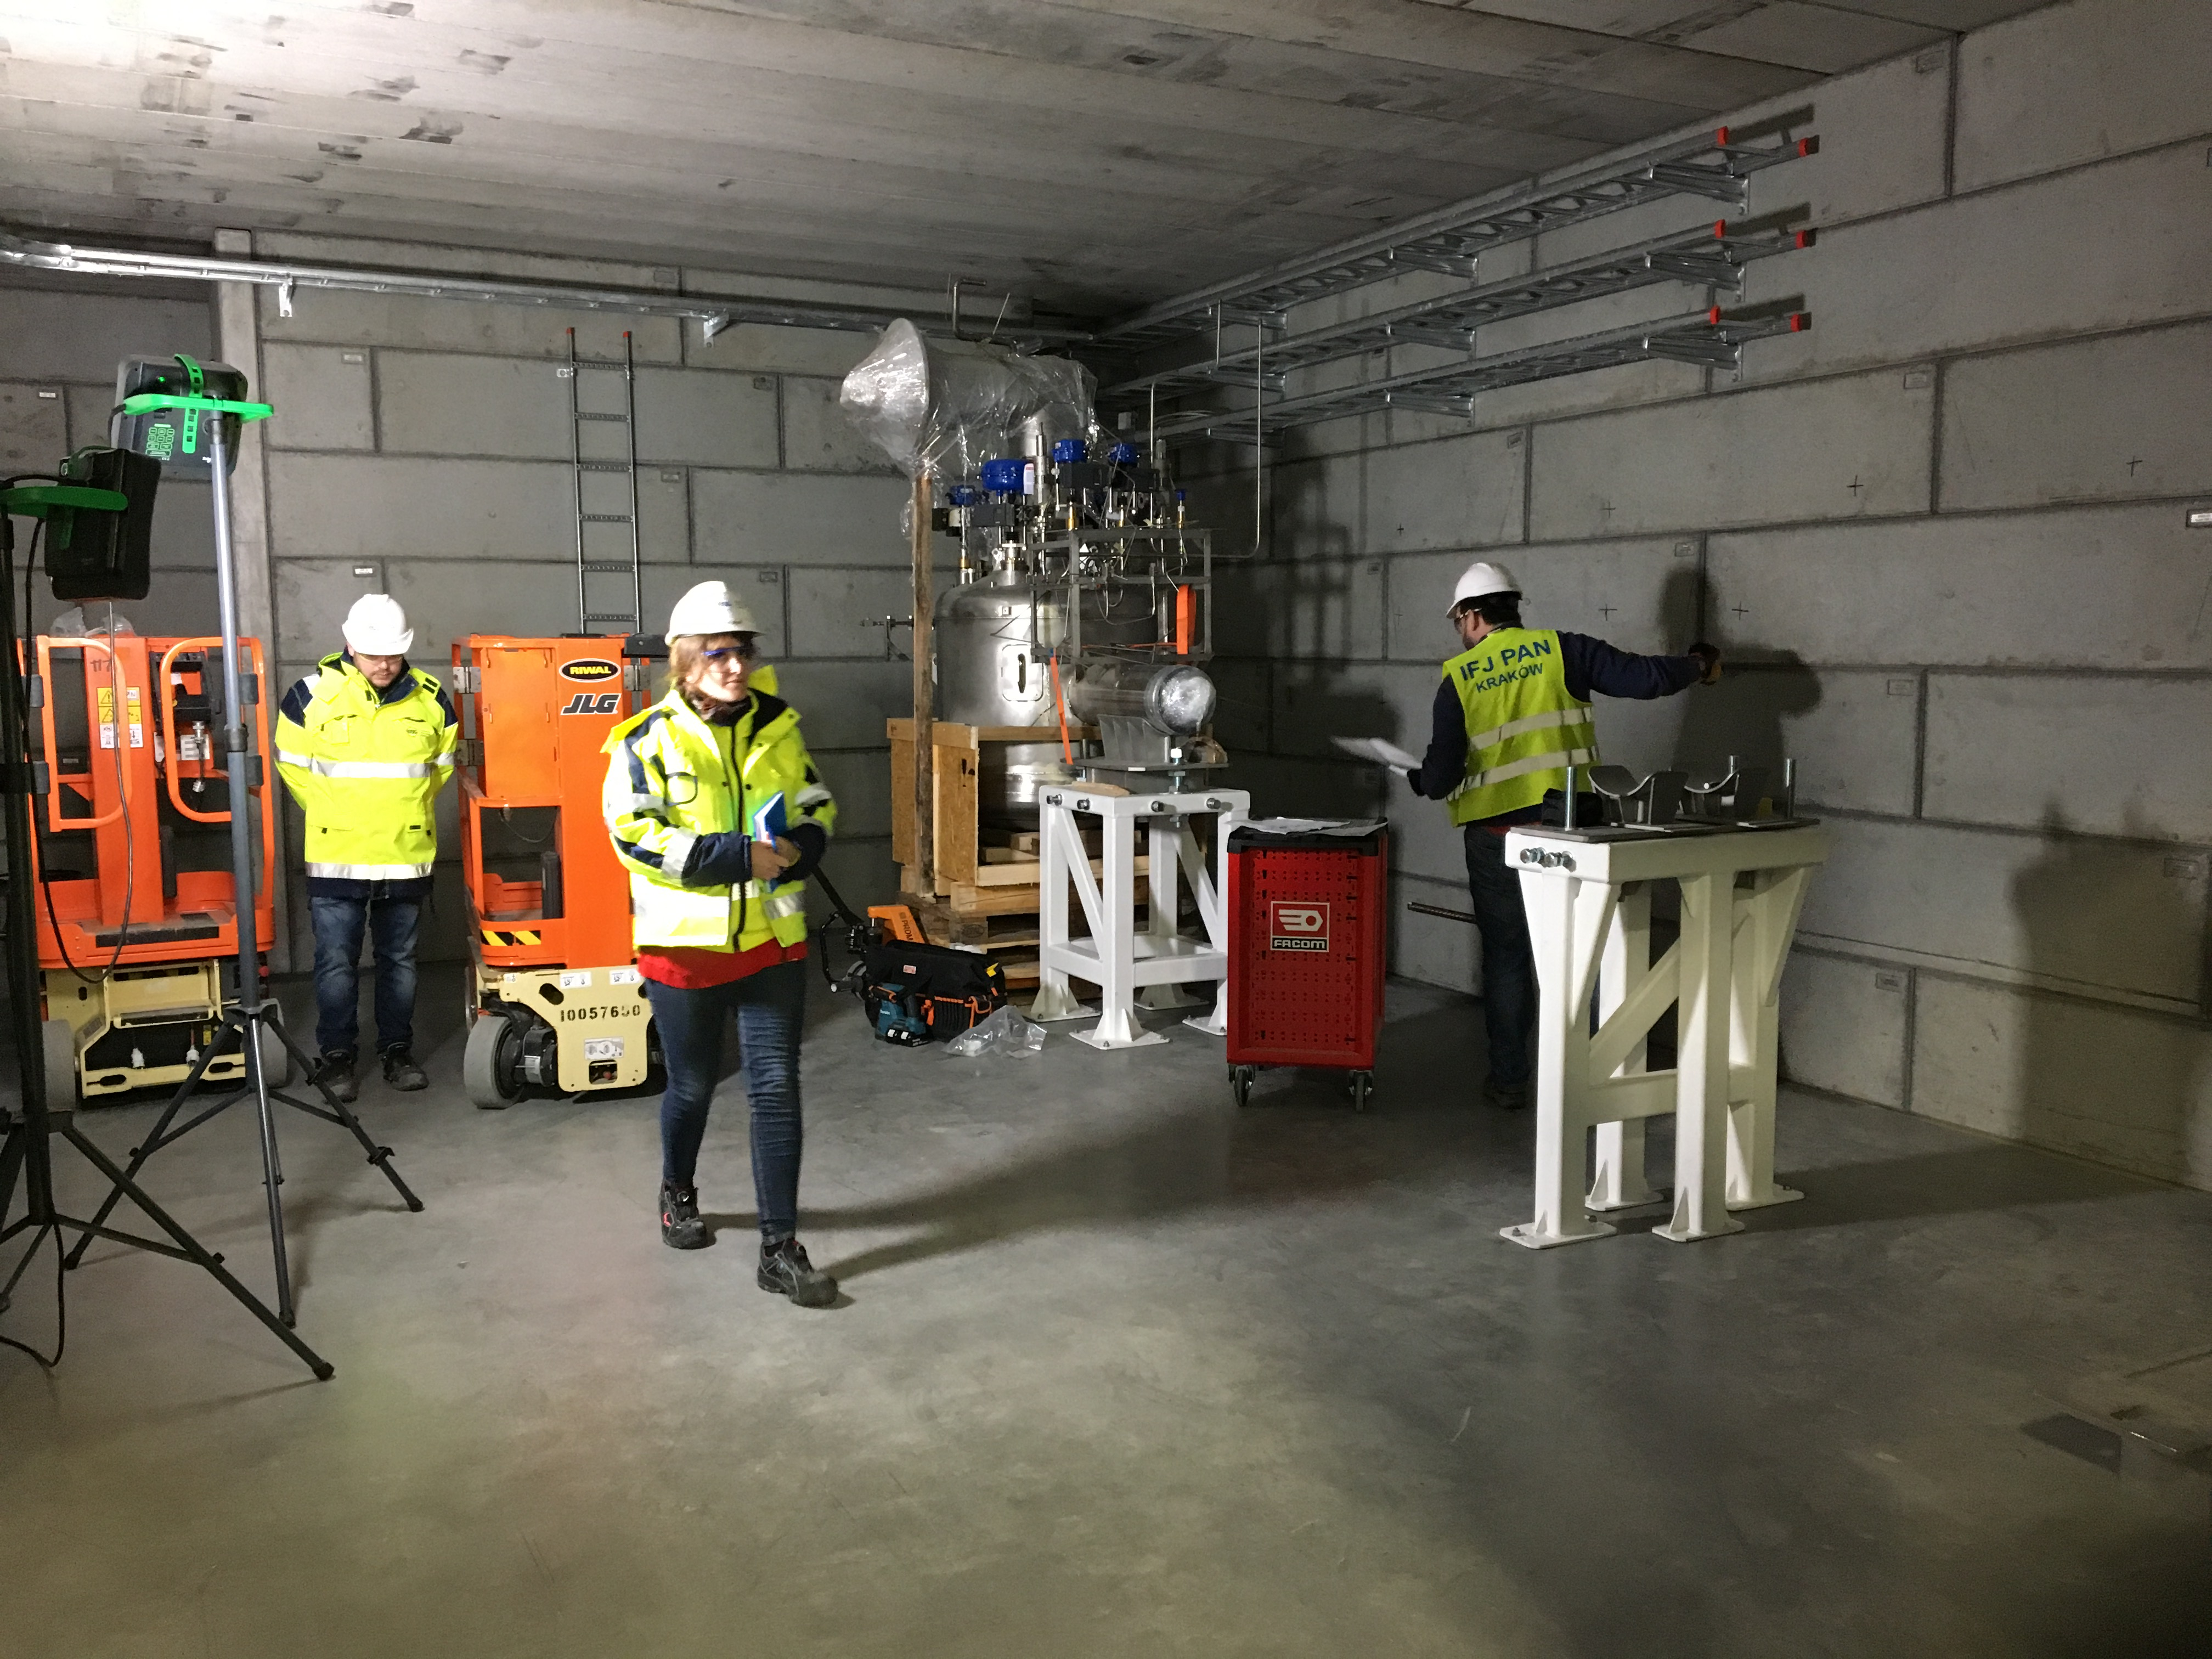
A busy 2019 awaits us all!
Ramping up of “hands-on” SRF activities at ESS, soon…
Thanks for the attention!
DISCLAIMERS:
No IK partners were harmed in the making of this presentation, as no picture displayed has been taken at our IK partner premises
Nothing, however, could have been shown here without our great IK partner work!

