Slide 1




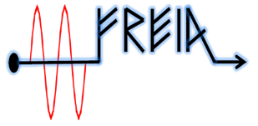

Status of In-Kind work and deliveries
Christine Darve
Deputy WP leader of external WP04 and WP05
TAC19 - DRY RUN
https://confluence.esss.lu.se/display/CRYOM
2nd April 2019

Slide 2
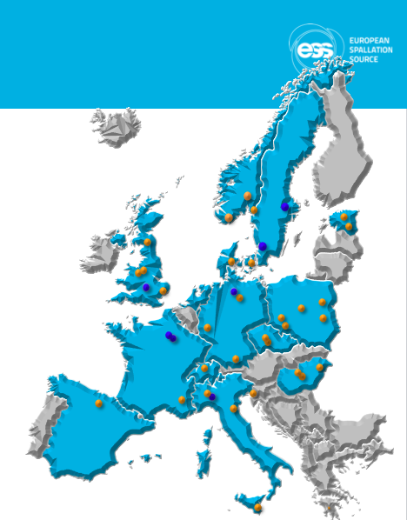
Outline
Collaborative Project
Spoke Status
Elliptical Status

Slide 3
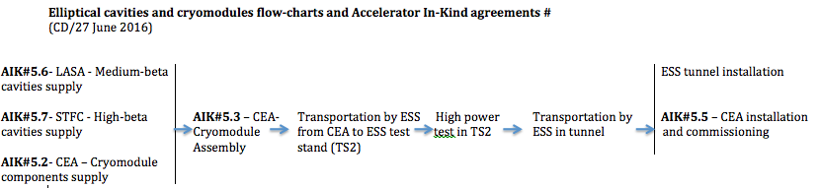
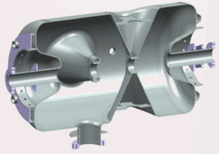






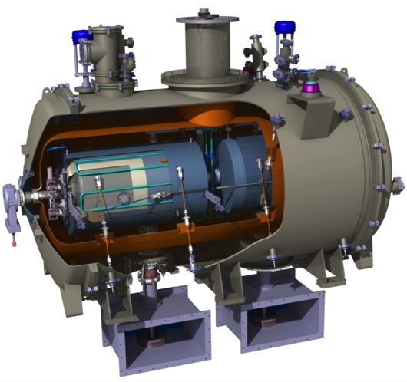



ESS Linac – A Collaborative Project
WP03
WP04
WP05
WP05
M-β
H-β
NC FE
Elliptical
Series
Spoke
Prototype
 | Spoke | Medium-β | High-β
# Cavities | 26 | 36 | 84
In-Kind production | IPNO | LASA | STFC
# Cryomodules | 13 | 9 | 21
Components & Assembling | IPNO | CEA | CEA
Cryomodule Tests | UU | ESS | ESS
3x
6x
5x
1x
2x
352.21 MHz
704.42 MHz
2.4 m
4.6 m
3.8 m
39 m
56 m
77 m
179 m
Target
Source
LEBT
RFQ
MEBT
DTL
Spokes
Medium β
High β
HEBT & Contingency
75 keV
3.6 MeV
90 MeV
216 MeV
571 MeV
2000 MeV

Slide 4
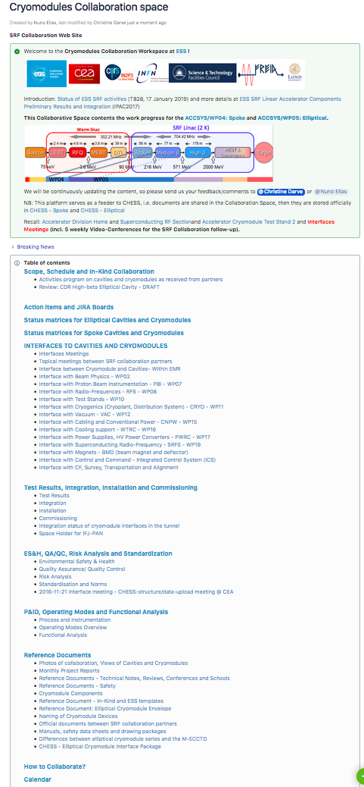
Coordination Team !
Cryomodule Collaboration Space
https://confluence.esss.lu.se/display/CRYOM
➔ Monthly reports by In-Kind partners
➔ Weekly video-conferences:
  Interface Uppsala – Mondays
  Interface Saclay – Tuesdays
  Interface IPNO – Wednesdays (bi)
  Interface SRF Collaboration – Fridays
  Overall Schedules – Fridays (bi)
➔ Every 3 months: SRF Collaboration Meetings
➔ Daily activities coordination with In-Kind partners and ESS other Work Packages
Notes:
Daily phone calls

Slide 5
Outline
Collaborative Project
Spoke Status
Elliptical Status
Notes:
Status

Slide 6
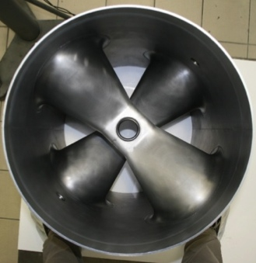
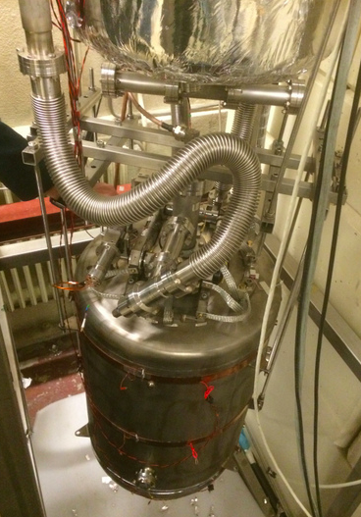
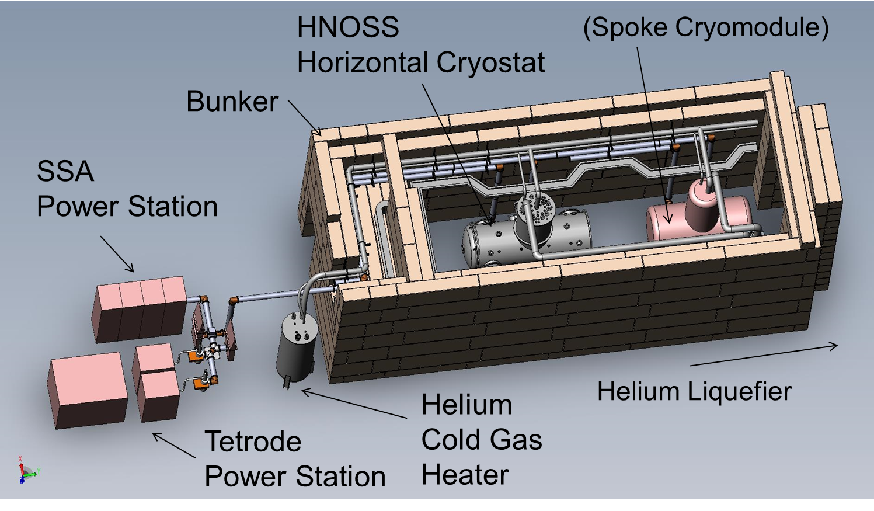
Prototype: Double Spoke cavities
Step 1: Spoke cavity
@ IPNO
@ UU - HNOSS
Double spoke cavity, 352.2 MHz, β=0.50
Goal: Eacc = 9 MV/m [Bp= 62 mT; Ep = 39 MV/m]
Lorentz detuning coeff.: ~-5.5Hz/(MV/m)²
Tuning sensitivity Δf/Δz = 130 kHz/mm

Slide 7
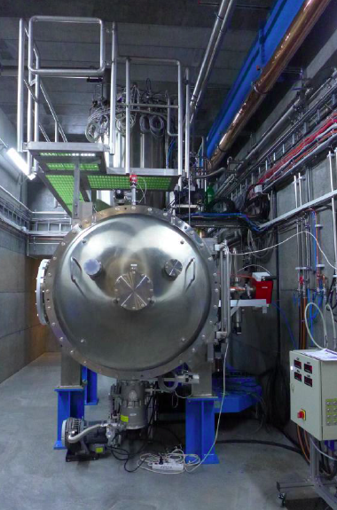
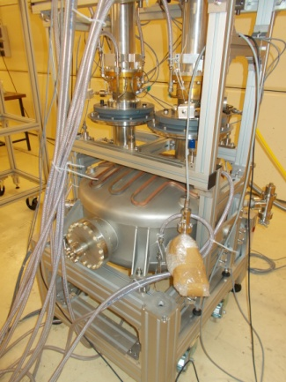
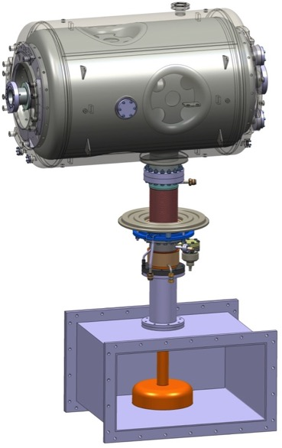
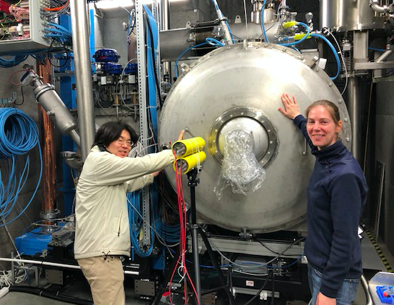
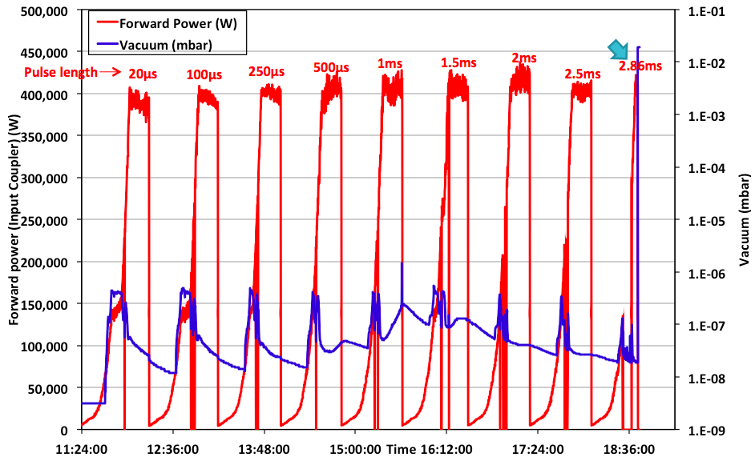
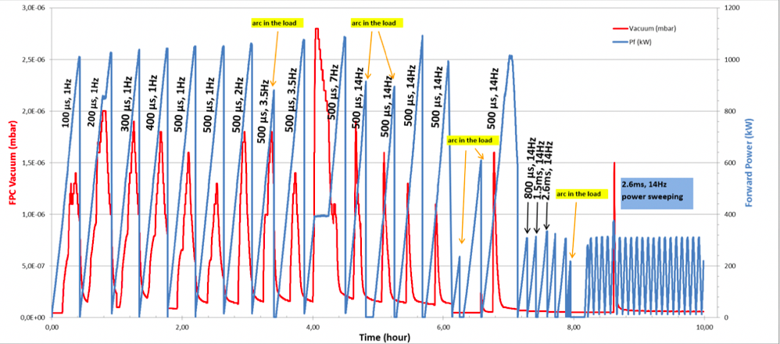
Prototype: Spoke Cryomodule
Step 2: Spoke cavity packages
@ IPNO
@ UU - HNOSS
RF conditioning of power- coupler
Step 3: Cryomodule at high power
@ UU - FREIA
Courtesy: Guillaume Olry
Courtesy: Han Li
See talk by Roger Ruber

Slide 8

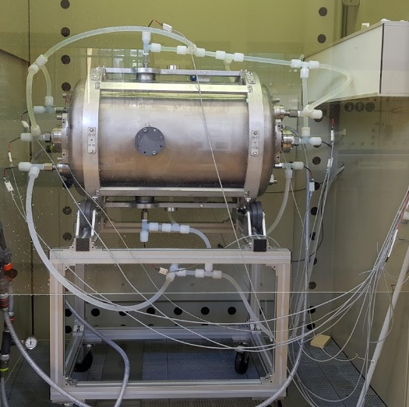
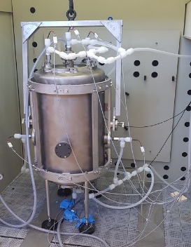
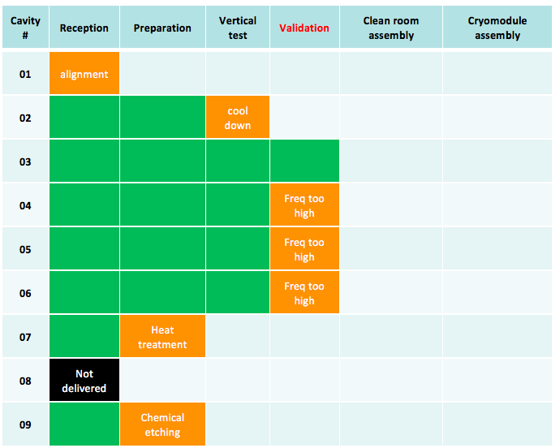
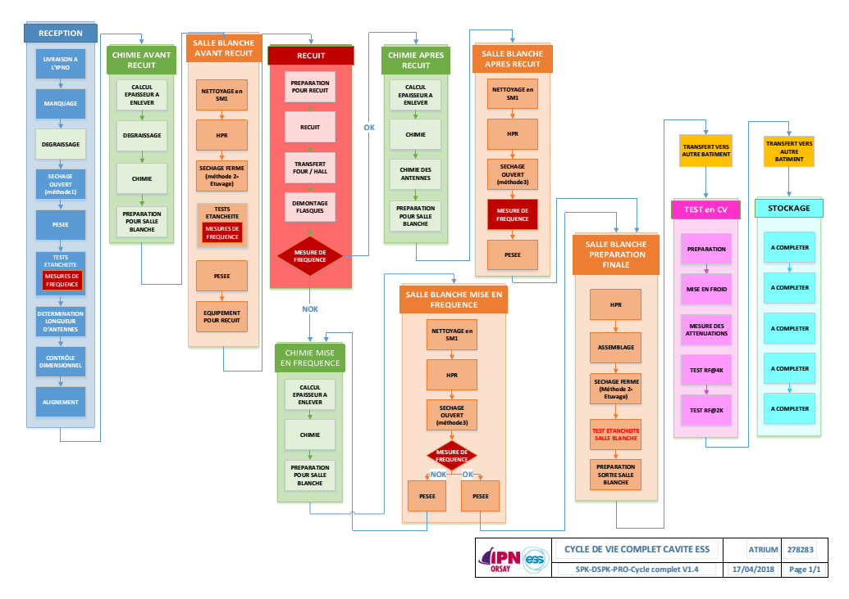
Series: Double Spoke cavities
Cavities Matrix readiness
Qualification of complete cavity lifecycle

Slide 9
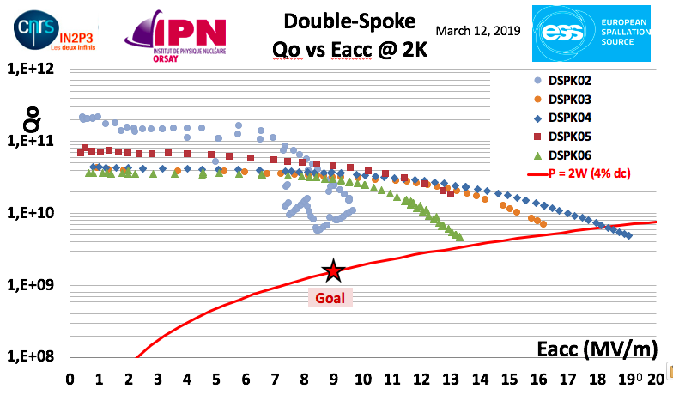
Series: Double Spoke cavities

Slide 10
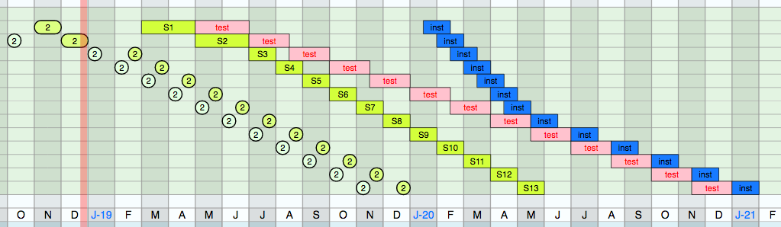
Serie: Spoke cryomodules planning
To be updated
Risk: Procurement of bellows and door-knobs inducing at least 2 months of delay in delivering the 1st cryomodule to Uppsala
Notes:
→ additional test in Freia

Slide 11
Outline
Collaborative Project
Spoke Status
Elliptical Status

Slide 12
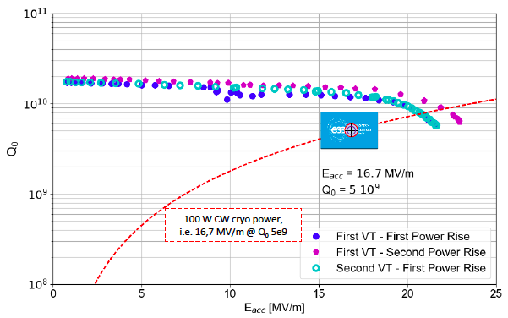
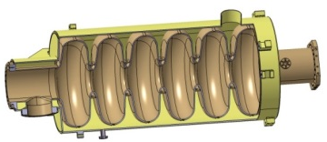
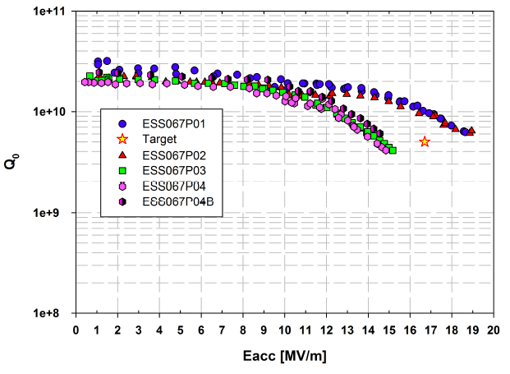
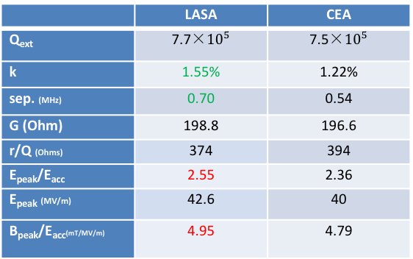
Prototype: Medium-β cavities
Step 1: Elliptical cavities
Medium-beta
@ Saclay
@ LASA
Vertical test of Mb prototype cavity with tank (CW, 2K)
 | LASA | CEA
Q_{ext} | 7.7×${10}^{5}$ | 7.5×${10}^{5}$
k | 1.55% | 1.22%
sep. (MHz) | 0.70 | 0.54
G (Ohm) | 198.8 | 196.6
r/Q (Ohms) | 374 | 394
E_{peak}/E_{acc} | 2.55 | 2.36
E_{peak} (MV/m) | 42.6 | 40
B_{peak}/E_{acc}(mT/MV/m) | 4.95 | 4.79
Cavity | Rs (nΩ) | Q0 at 1MV/m@2K
MP01 | 3.14 | 3.2x10¹⁰
MP02 | 6.09 | 2.2x10¹⁰
MP03 | 6.06 | 2.1x10¹⁰
MP04 | 7.09 | 1.9x10¹⁰
MP04 (b) | 4.85 | 2.5x10¹⁰
Notes:
Qo exceeding results
Radiation - Larger field emission on cavity #3 and 4
…measured on the vertical cryostat top plate during cavity vertical tests

Slide 13
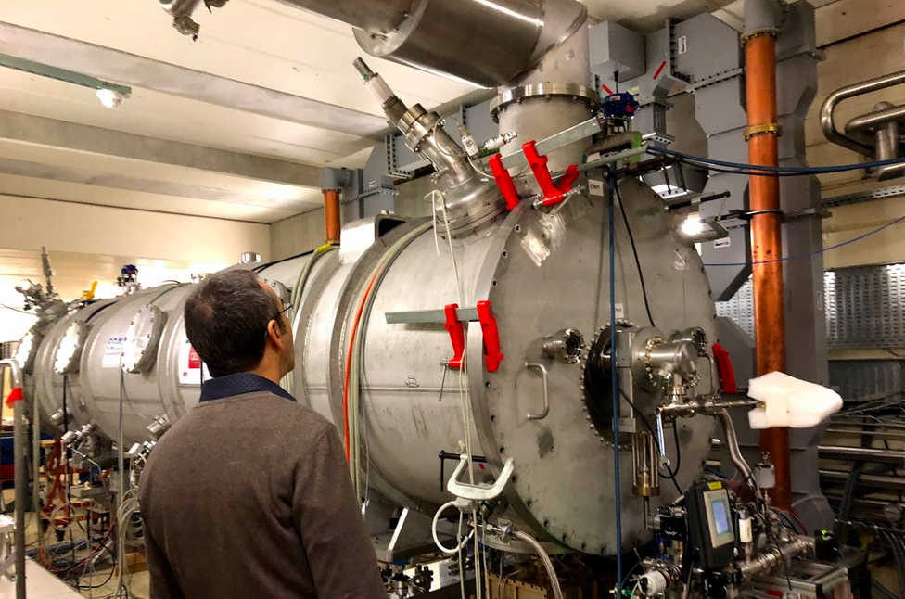
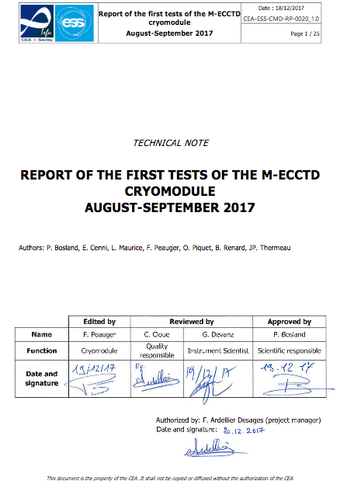
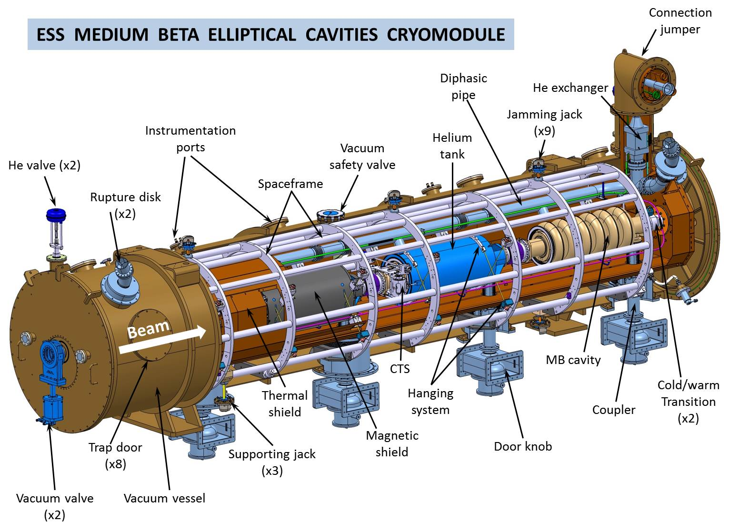
Prototype: Elliptical cryomodules
Step 2: Cryomodule M-ECCTD
@ Saclay
@ Lund – TS2
See talks by Paolo Pierini
M-ECCTD = 3 CEA cavities + 1 LASA cavity

Slide 14
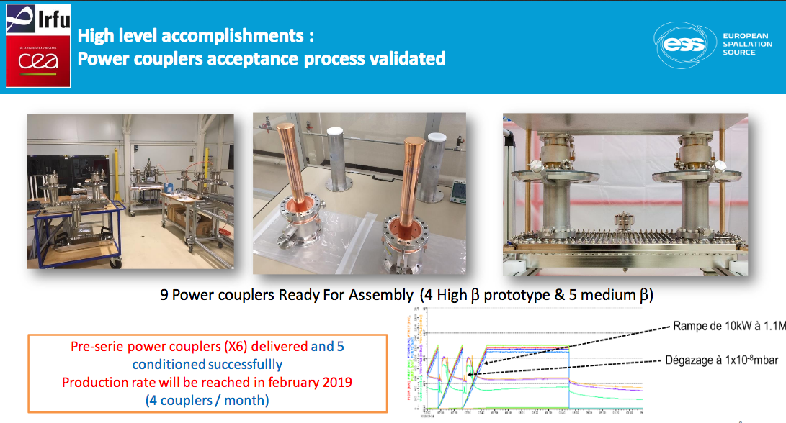
Prototype: Elliptical cryomodules
F. Ardellier, presented at Annual Review, 2018, Dec 18

Slide 15
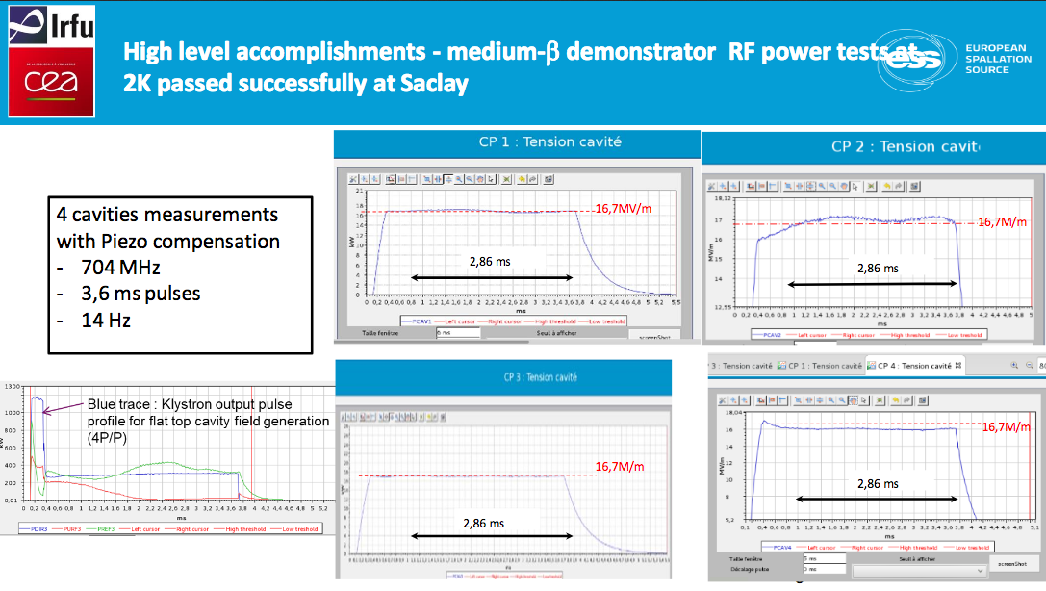
Prototype: Elliptical cryomodules
F. Ardellier, presented at Annual Review, 2018, Dec 18

Slide 16
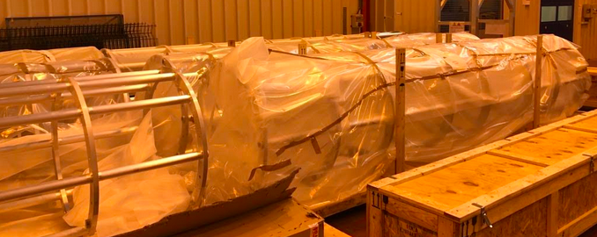
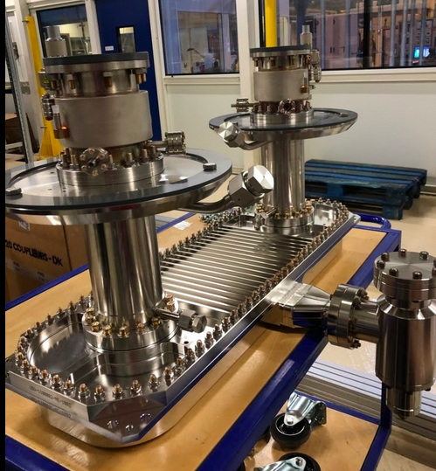
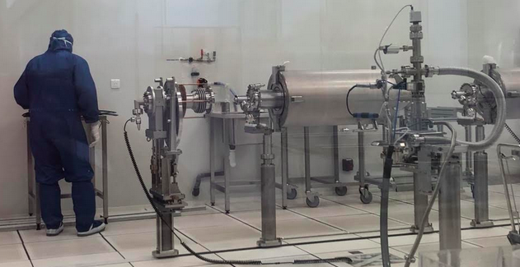
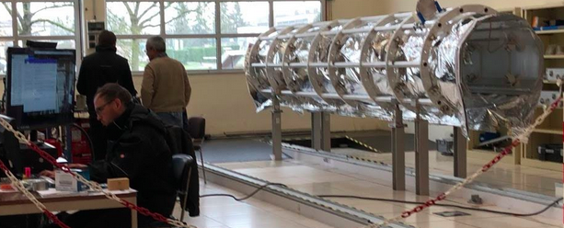
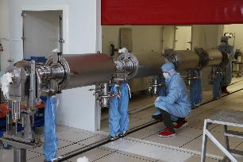
Series: Elliptical cryomodules
Vacuum vessels | Contract awarded to ACPP. The first unit is delivered.
Power couplers | Contract awarded to PMB, the 6 couplers of the pre-series are delivered.
Coupling boxes for coupler conditioning | Contract awarded to SDMS, all units delivered.
Thermal shieldings | Contract awarded to SDMS, 7 first units delivered
Spaceframe | Contract awarded to SDMS, 7 first units delivered
Cold Tuning Systems (mechanical part) | Contract awarded to YVON BOYER. 6 first pre series delivered
Motors for cold tuning systems | Contract awarded to TSA (PHYTRON), 112 motors received
Cryogenic heat exchanger | Contract awarded to SDMS, two first units of the pre-series delivered.
Magnetic shielding | Contract awarded to MECA MAGNETIC, first 3 shieldings delivered.
MLI | Contract awarded to SODITECH, kick off meeting done
Internal instrumentation | Contract awarded to SODITECH, first 6 delivered.
Intercavity bellows, cold-warm transitions | Contract awarded to SDMS, kick-off meeting done.
Cavity supporting systems (tie rods) | Contract awarded to SPG. Kick off meeting done.
Cryogenic circuits, diphasic tubes, tubes for rupture disks, coupler bells | Cryogenic circuits awarded to CRYODIFFUSION fabrication on going Di-phasic tubes awarded to SDMS, fabrication on going Ti bellows: fabrication on going
Cryogenic valves CV01 and CV02 | Contract awarded to VELAN. 9 first units delivered
Level sensors | Contract awarded to CRYOFORUM, all the components received
Temperature sensors | Contract awarded to CRYOFORUM, several batches already delivered
Safety valves | Contract awarded to LESER. Kick off meeting done.
Controlled safety valves | Contract awarded to Velan. Kick off meeting done.
Rupture disks | Contract awarded to BS&S. Kick off meeting done.
RF cables | Contract awarded to HABIA. First batch for 10 CM received.
RF feedthroughs | Contract awarded to MDC Vacuum. All the components are received (2x32 feedthrough)
Pressure transmitters | Contract close to be signed
Screws for clean room assembly | Several contracts awarded
Vacuum components | All item ordered HV90 purge valves: contract awarded to VAT. Standard pumps and gauges awarded to Pfeiffer RGA and baratron gauges: awarded to MKS. Delivery scheduled end of January
Vacuum pumping groups | Contract awarded to 40-30. A first pumping group is delivered.
Cryomodule assembly | Contract awarded to B&S. The work starts with the assembly of CM01.

Slide 17
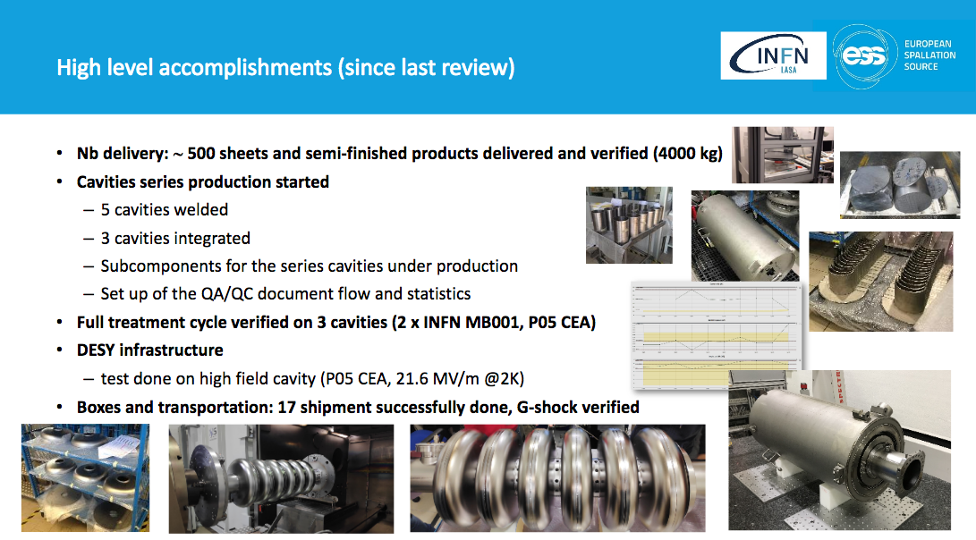
Series: Medium-β cavities
P. Michelato, presented at the Annual Review, 2018, Dec 18

Slide 18
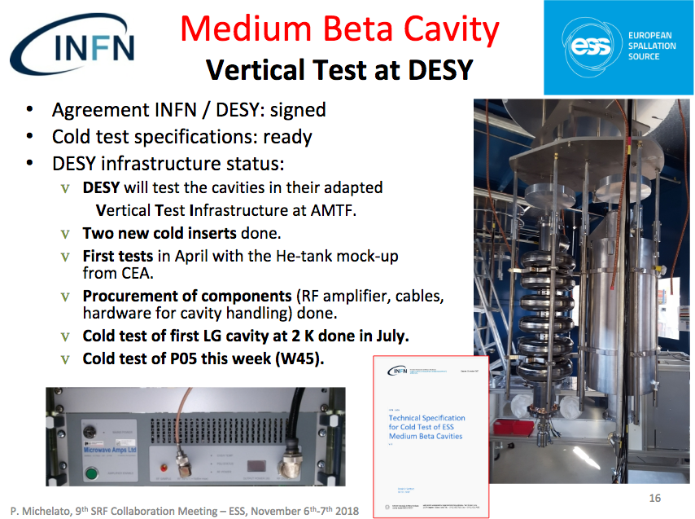
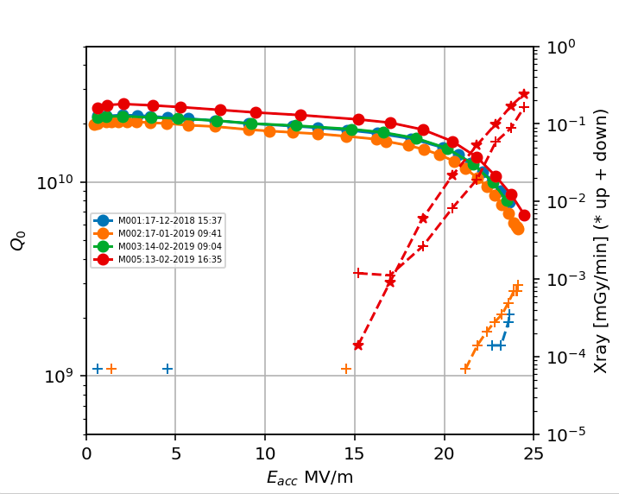
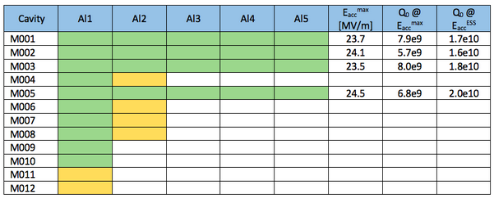
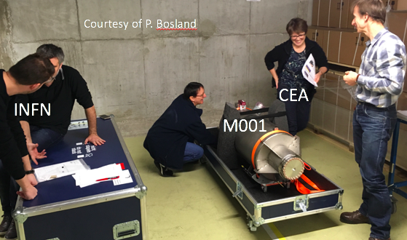
Series: Medium-β cavities

Slide 19

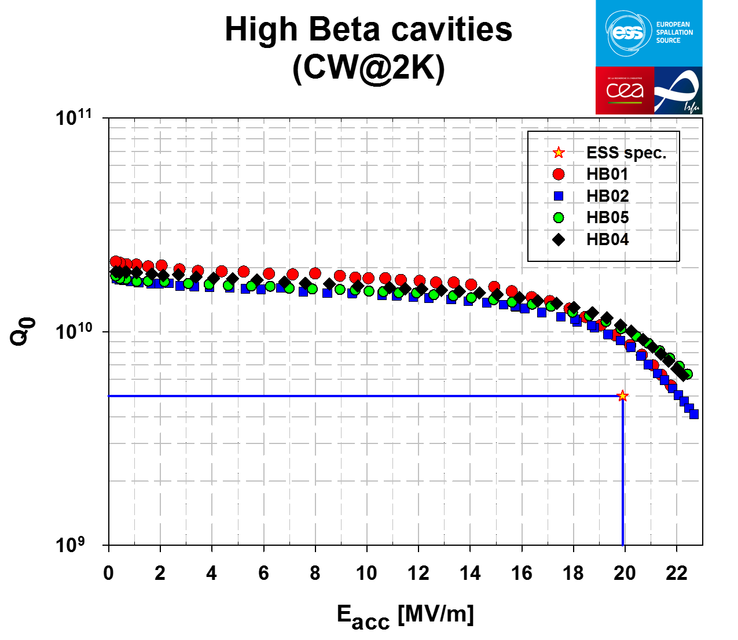
Prototype: High-β cavities
High-β prototype cavities sent to RI for weld of the helium titanium tank.
Then sent to ZANON for final flash BCP and HPR rinsing before mounting of the antennas.
HB02 tested in vertical cryostat, Qo=1e10 at nominal field.
HB04 received today
Possibly 2 more cavities tested before water system shutdown (04/11-05/28)

Slide 20
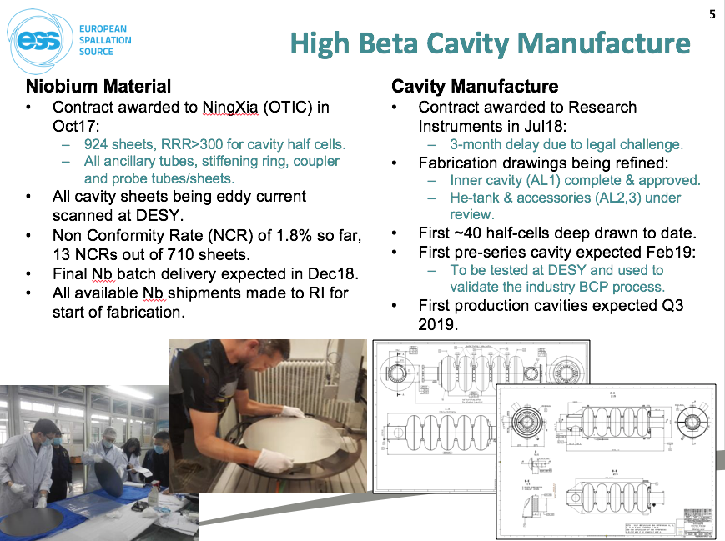
Series: High-β cavities
P. McIntosch, presented at the Annual Review, 2018, Dec 18

Slide 21
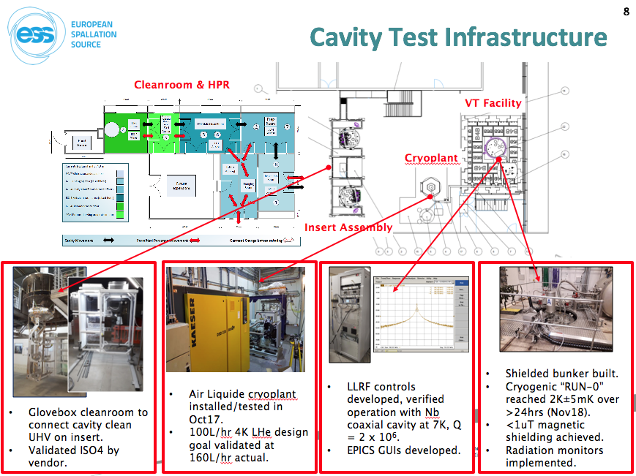
Series: High-β cavities
P. McIntosch, presented at the Annual Review, 2018, Dec 18
2K cooldown of VT with CEA
cavity on-going
Pre-series cavity fabricated and to be testing at DESY in May 2019

Slide 22
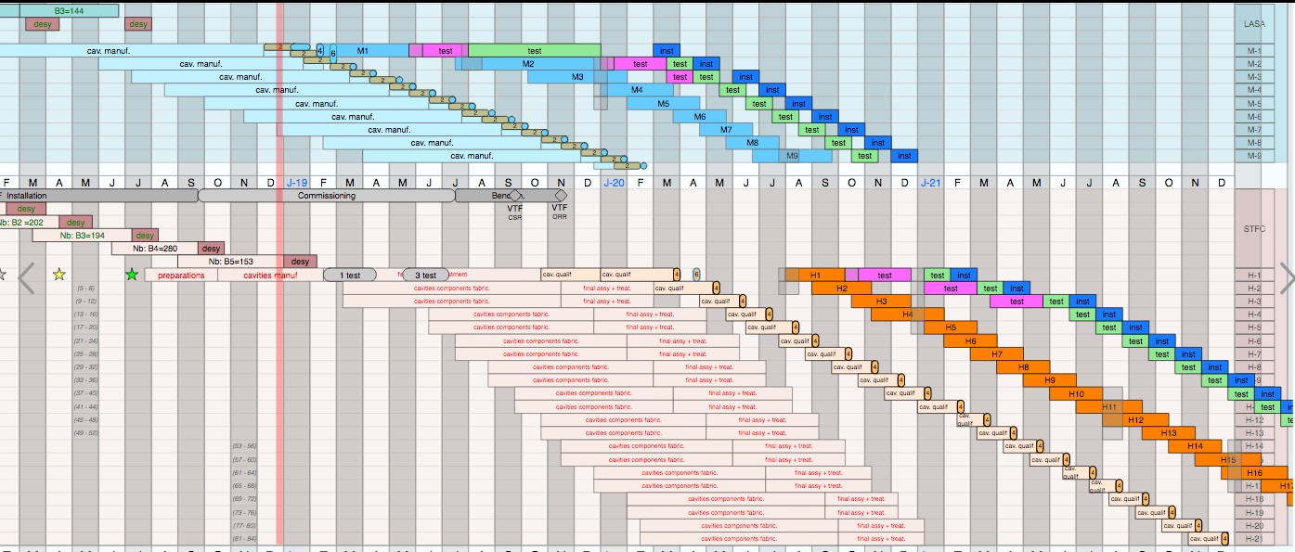
Serie: Elliptical cryomodules planning
Risk: No spare: any component failure during the fabrication sequence imply a direct delay

Slide 23

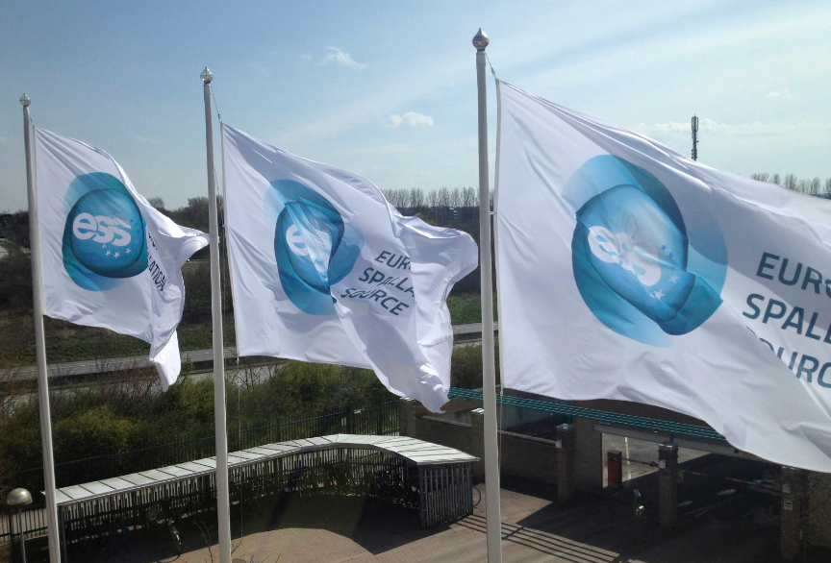
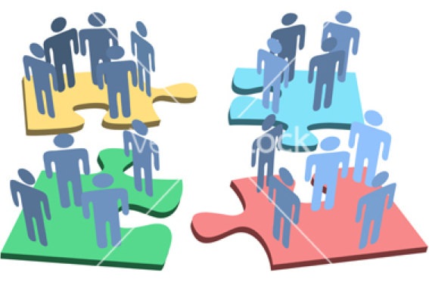



Thank you for your attention!
First results in for the SRF linac are promising even if many challenges still need to be addressed. Many lessons learned !
The Devil is in the details and in the Interfaces !

Slide 24
EXTRA

Slide 25
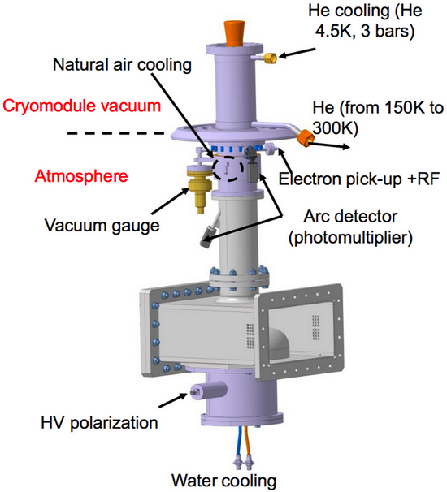
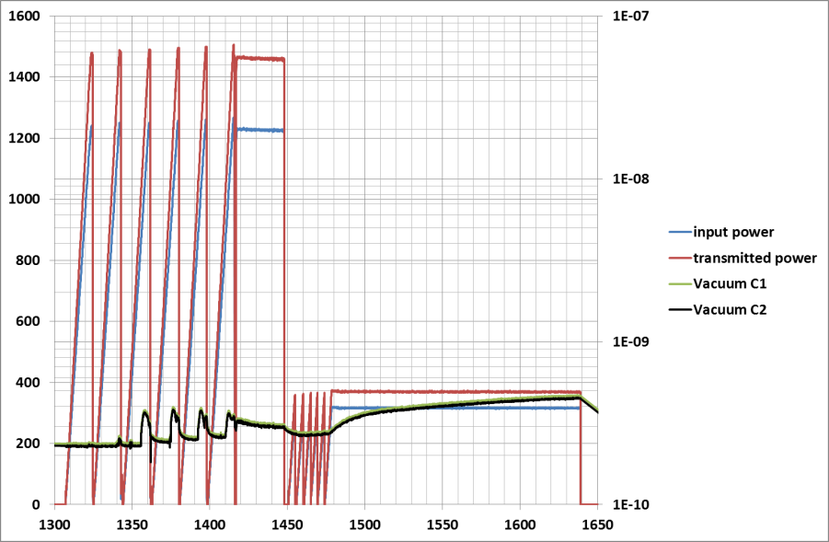
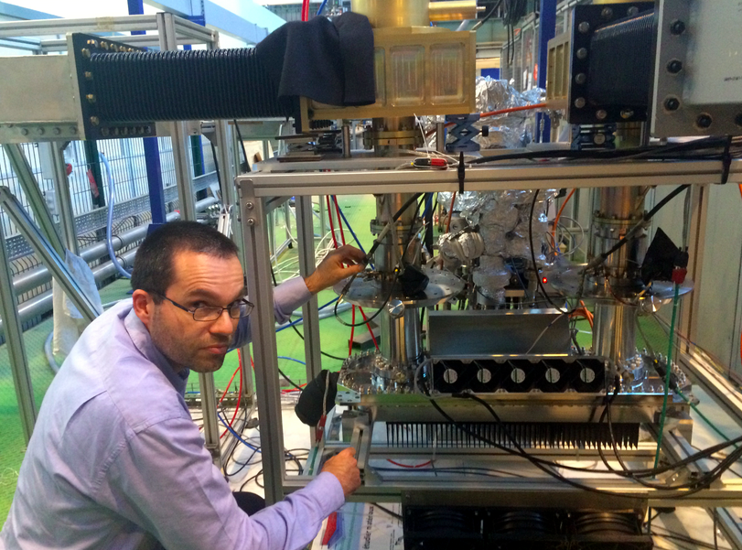
Prototype: Power-coupler status
Power and vacuum measurement:
Traveling Wave, 1 Hz
Standing Wave, 14 Hz
1
2
3
4
5
6
1:50 µs
2: 100 µs
3:200 µs
800 µs
1.6 ms
2 ms
2.5 ms
3 ms
3.6ms
4:300 µs
5:400 µs
6:500 µs
Power (kW)
Pressure (mbar)
Time (minutes)
Notes:
E pu, (that is also used to measure the RF power close to the ceramic level)
Copper deposit thickness. 10 micron

