Slide 1
Status of TS2 Infrastructure preparation
Wolfgang Hees
WP Leader TS2
TAC 2019-04-02

Slide 2
Test Stand 2 system overview
electrical substation
water
substation
CF
CF
TICP
cryoplant
controls
WP11
WP10
power cabling
CWM
cooling water
WP15
WP16
timing system
motion control
ICS
ICS
modulator
WP17
LTS2
cryo distribution
LLRF
klystron
klystron
WP11
WP8
WP8
WP8
racks
WP15
controls cabling
WP15
SRF measurement
RF distribution
RF distribution
SRF
WP8
WP8
coupler cooling circuit
valve
box
WP16
WP11
cryomodule
WP5
vacuum pumps &
clean room
comp. air
WP12
WP16
concrete door
PSS
bunker
prep station
ICS
WP10
WP10
access cage
RAD monitoring
lights & power
building
HVAC
ES&H
WP15
CF
CF
W. Hees
E. Asensi
2019-03-20

Slide 3
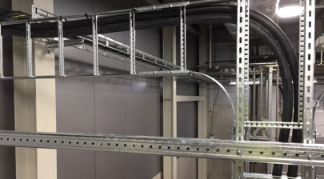
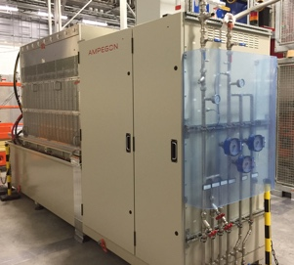
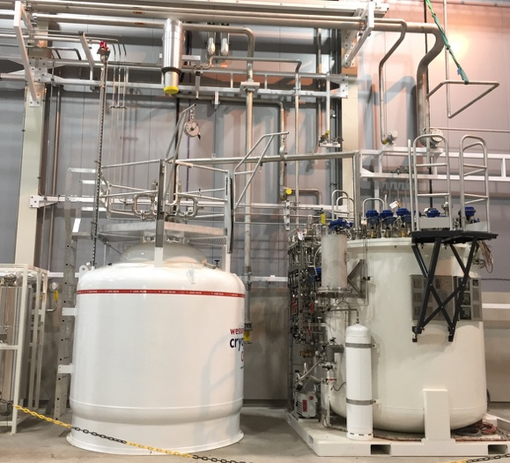
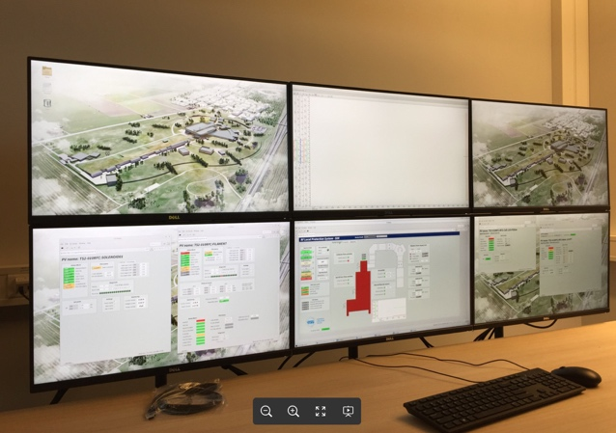
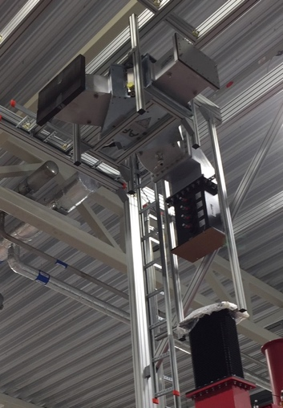
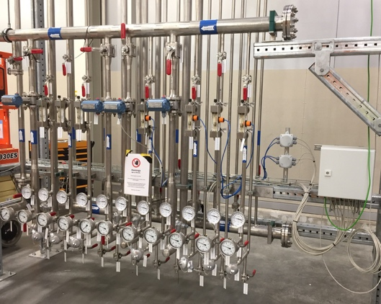
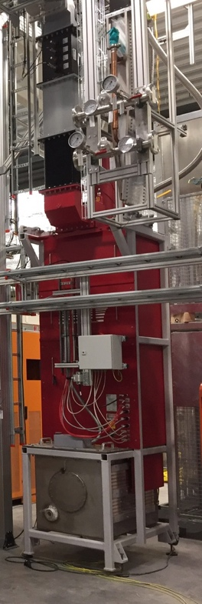
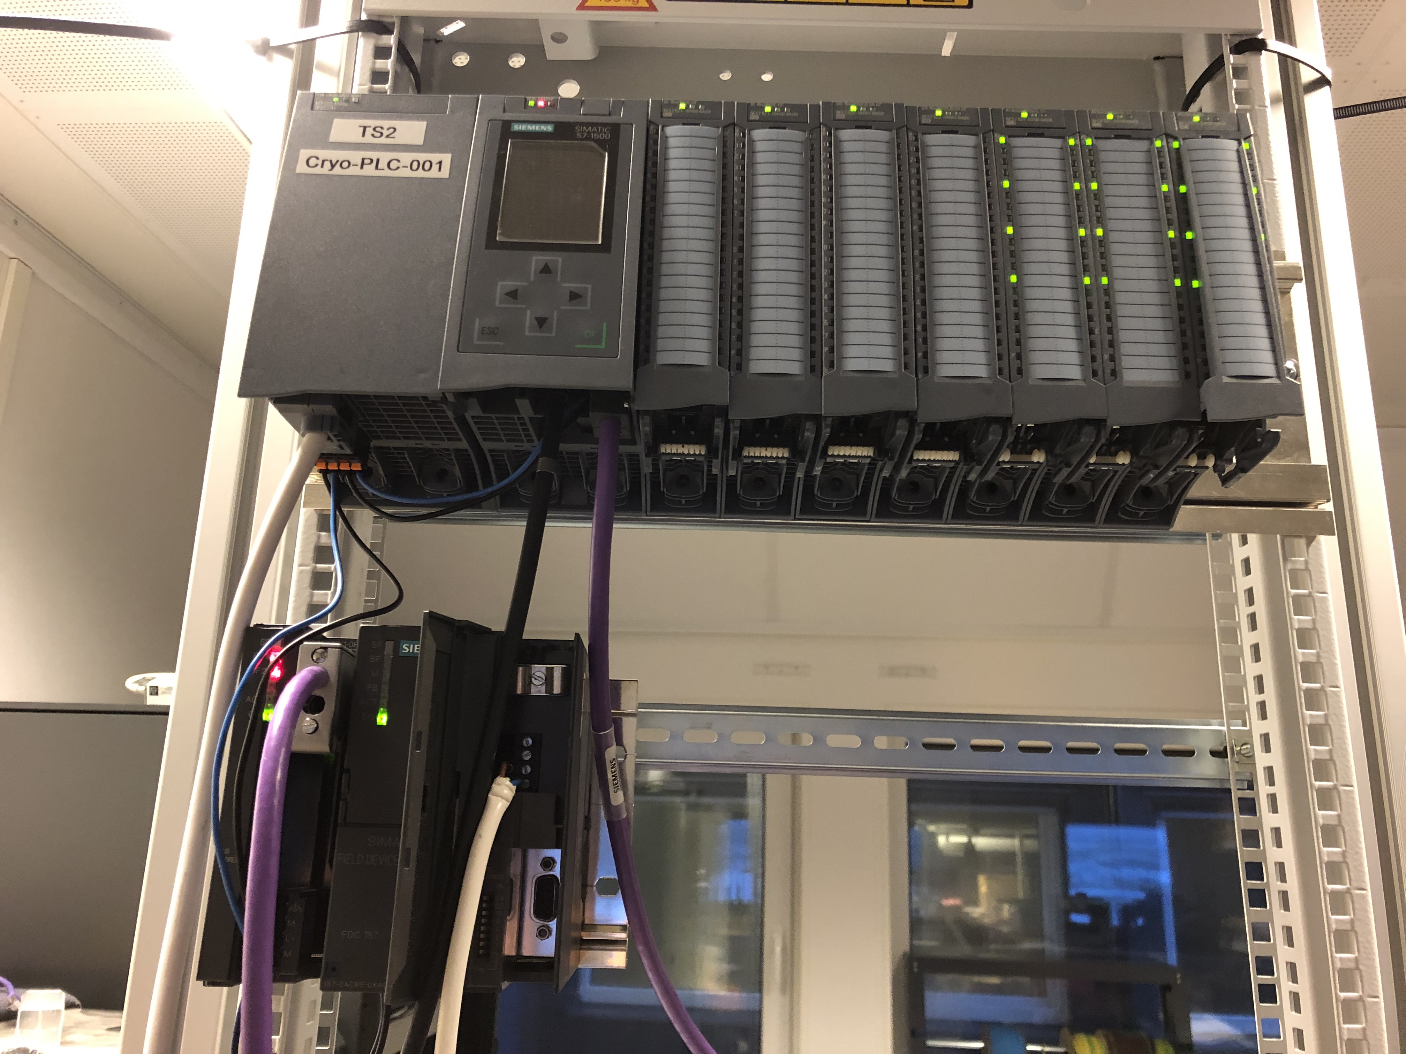
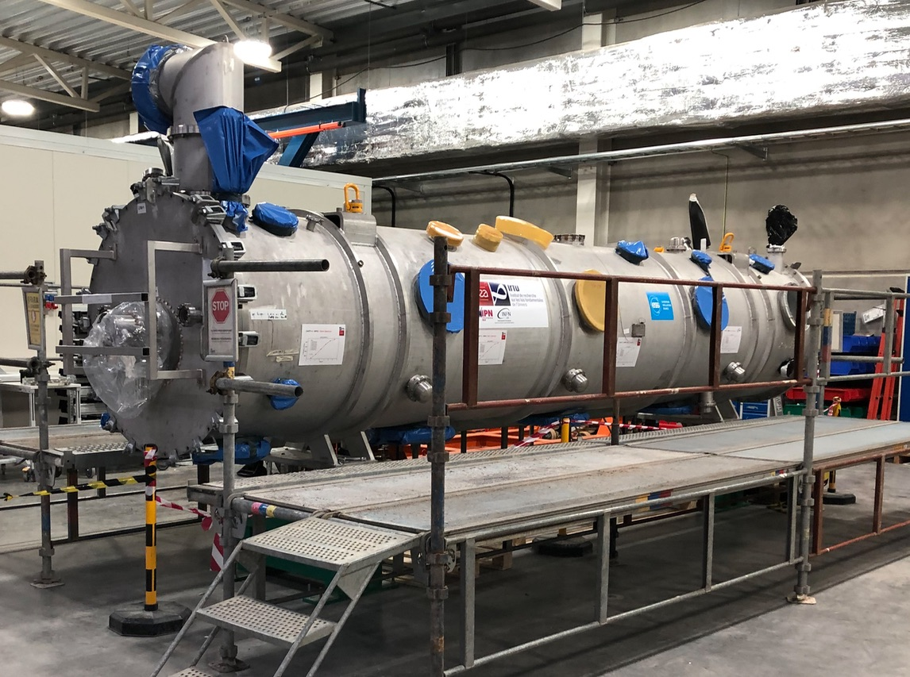
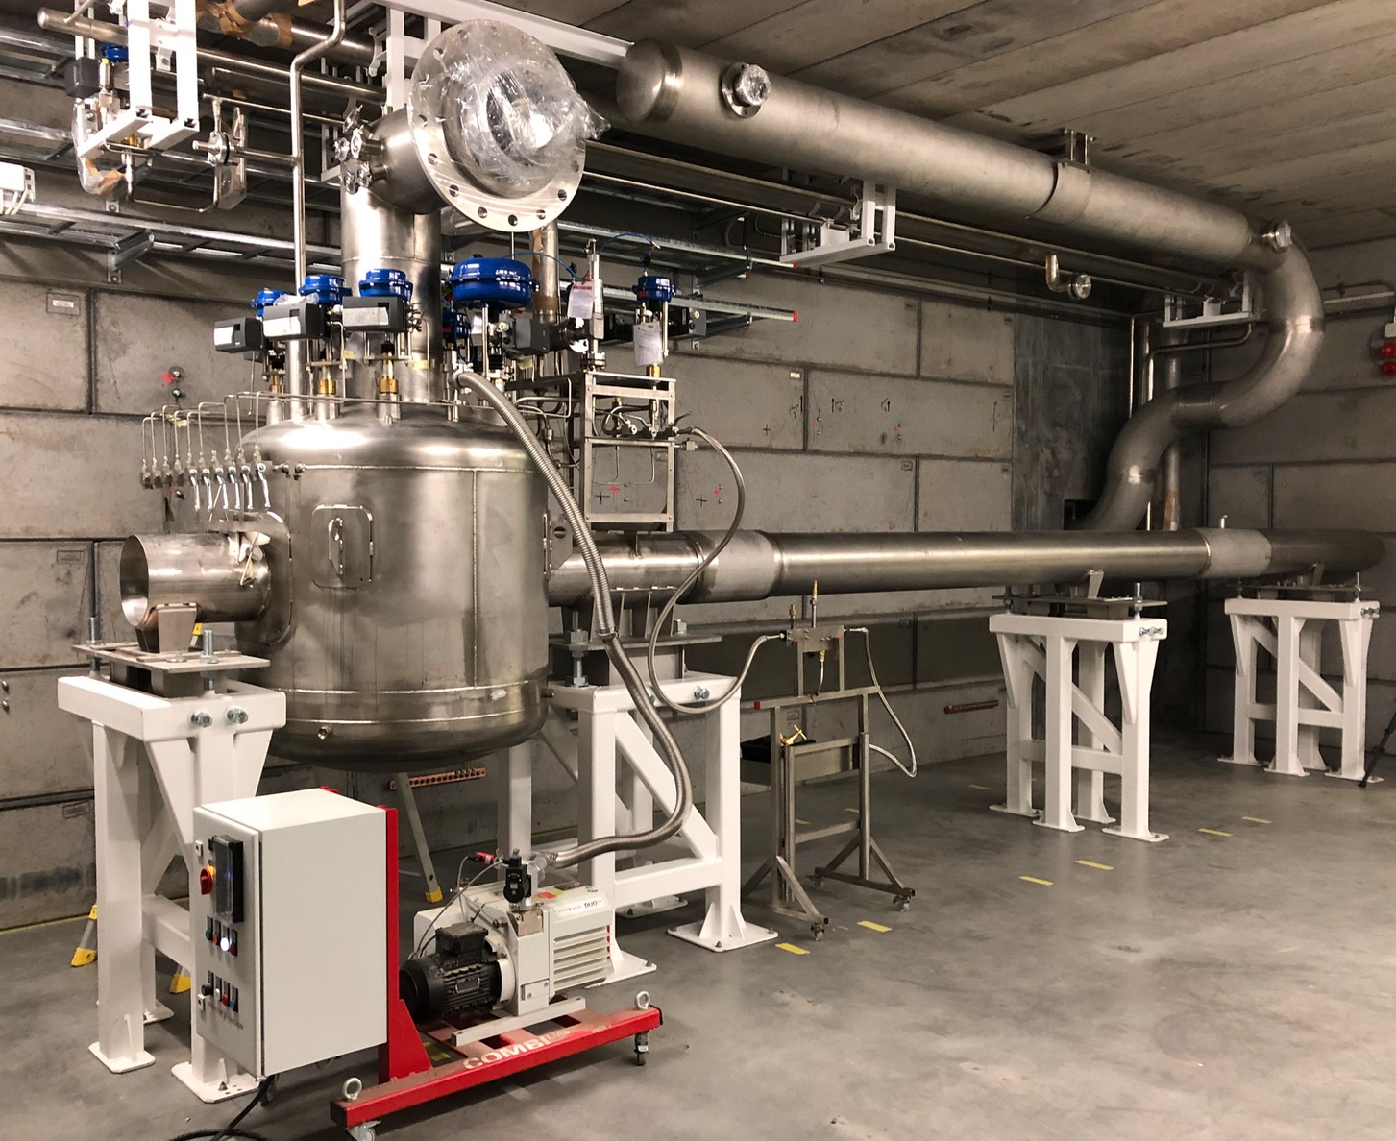
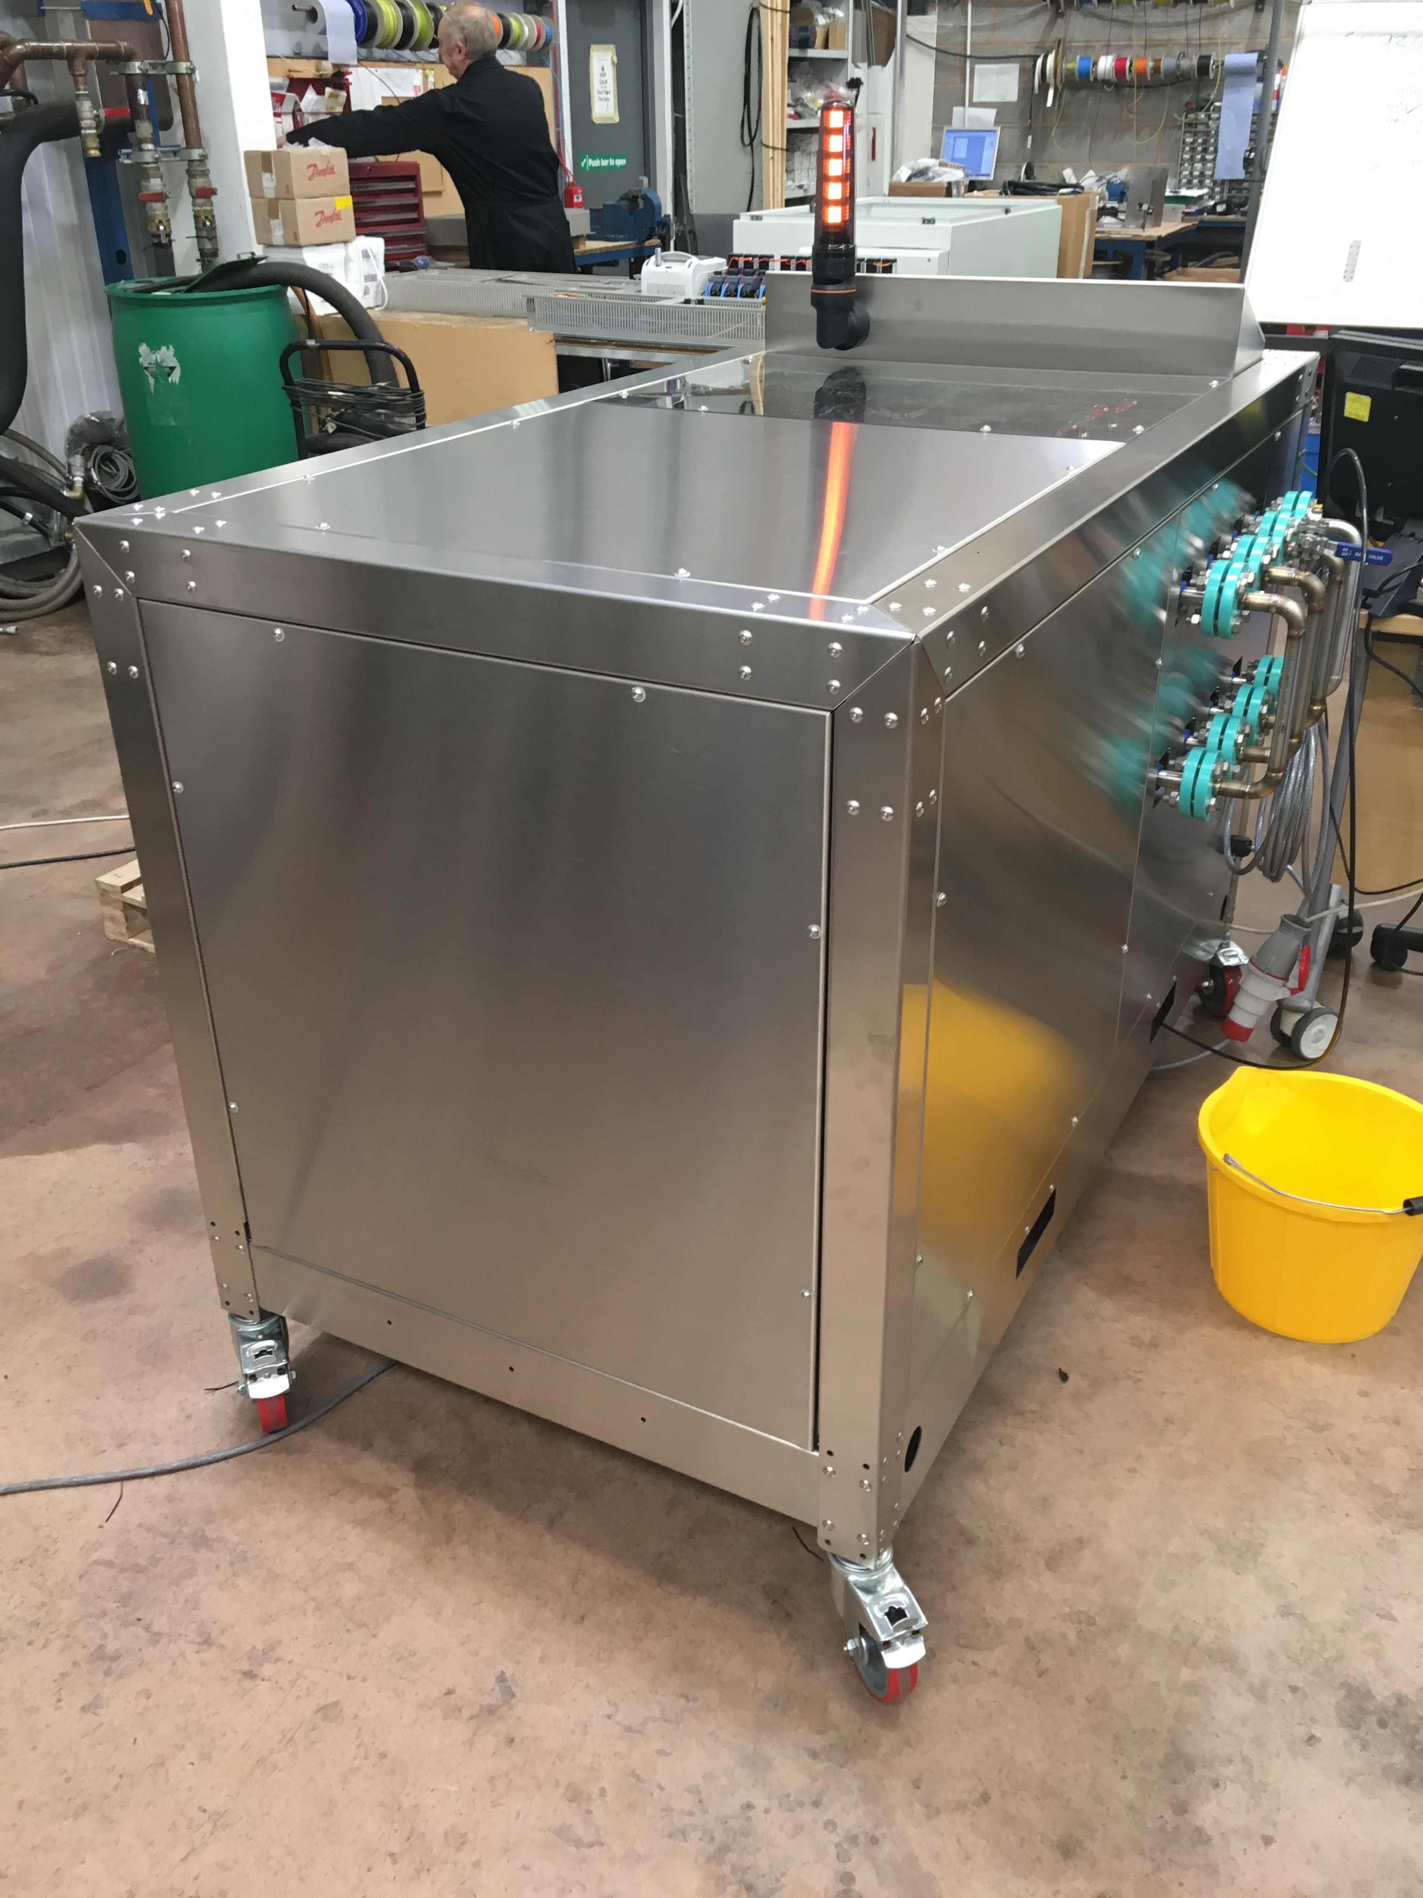
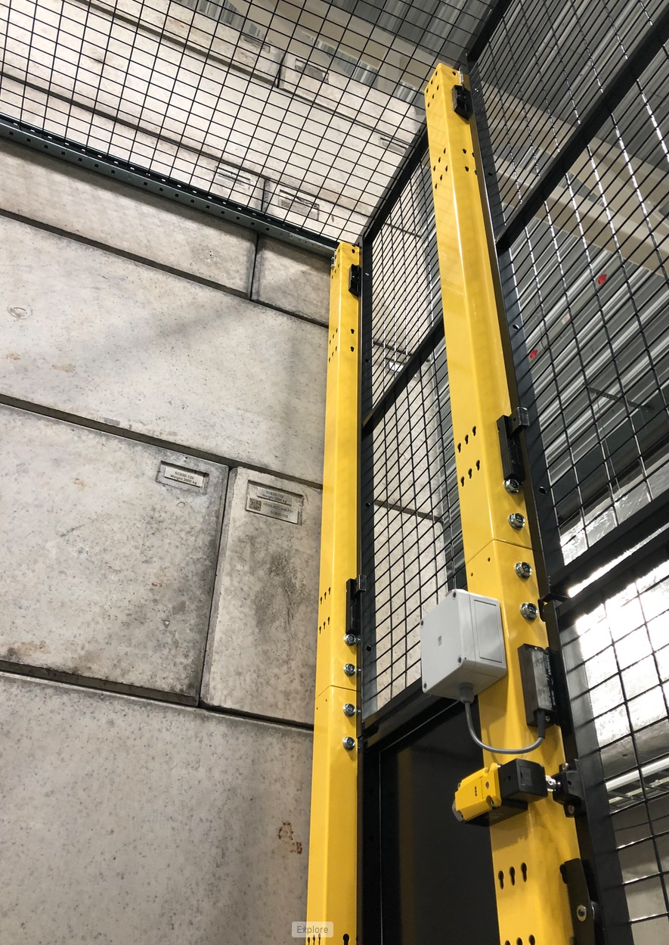
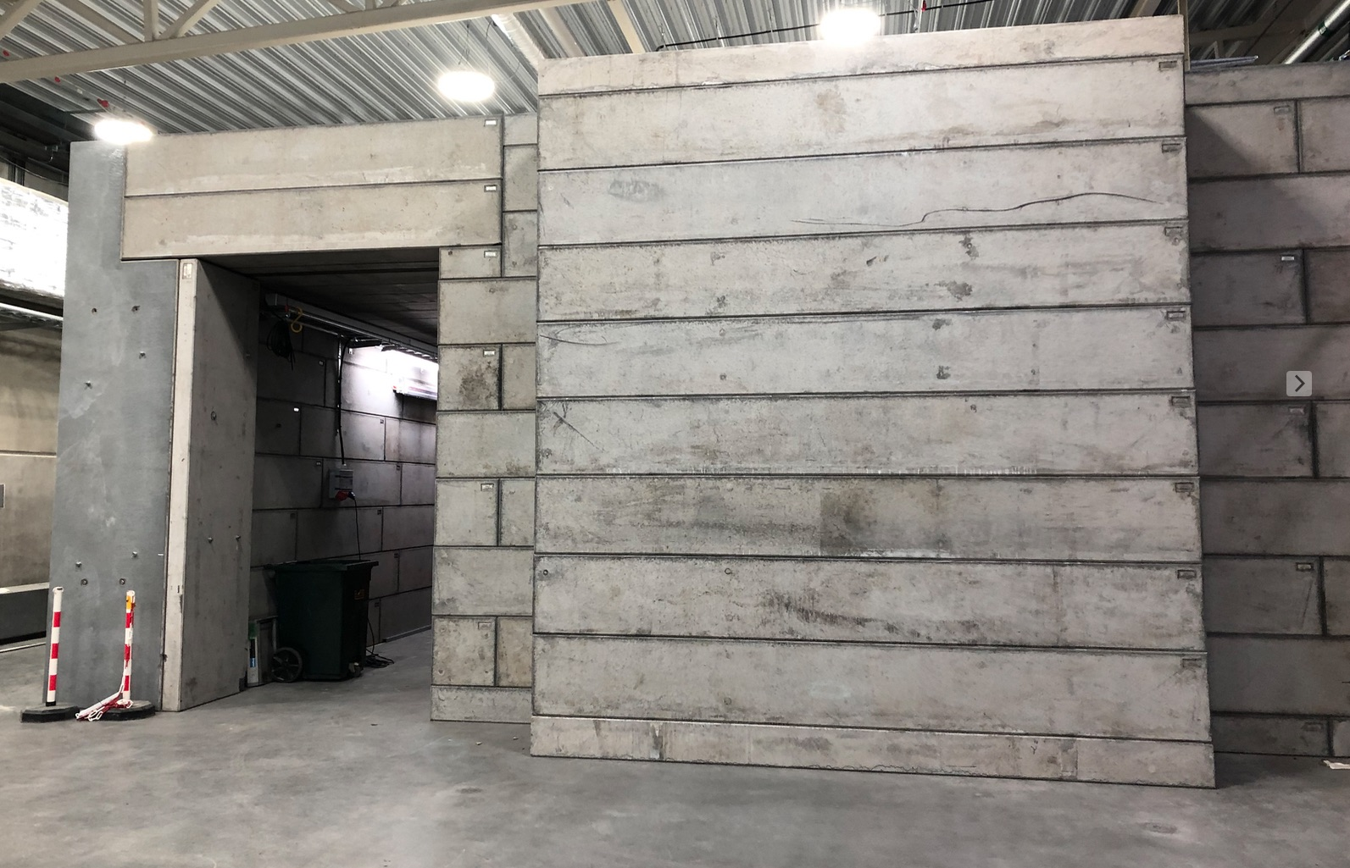
Test Stand 2 system overview
completed
electrical substation
water
substation
CF
CF
TICP
cryoplant
controls
WP11
WP10
power cabling
CWM
cooling water
WP15
WP16
timing system
motion control
ICS
ICS
modulator
WP17
LTS2
cryo distribution
LLRF
klystron
klystron
WP11
WP8
WP8
WP8
racks
WP15
controls cabling
WP15
SRF measurement
RF distribution
RF distribution
SRF
WP8
WP8
coupler cooling circuit
valve
box
WP16
WP11
cryomodule
WP5
vacuum pumps &
clean room
comp. air
WP12
WP16
concrete door
PSS
bunker
prep station
ICS
WP10
WP10
access cage
RAD monitoring
lights & power
building
HVAC
ES&H
WP15
CF
CF
W. Hees
E. Asensi
2019-03-20

Slide 4
TS2 progress
Progress has been made in the main sub-projects of TS2:
Cryogenics:
  commissioning and acceptance of TICP
  completion of installation of CDS, commissioning in progress
Controls: integration of instrumentation, panels
Utilities:
  powering of HV
  start of cooling water operation
Bunker: completion of main structure
SRF: prep station installed and equipped
Licencing: TS2a licence application sent
Vacuum: delivery of all major pieces of equipment
PSS: CDR, start of installation
RF: →

Slide 5
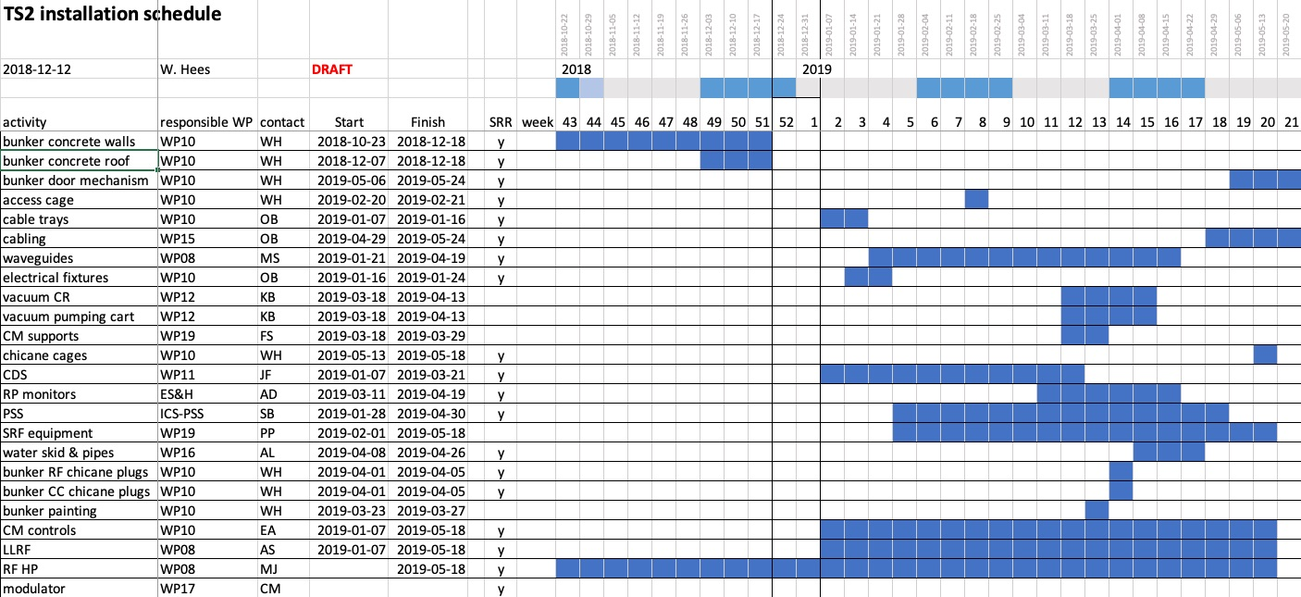
TS2 schedule

Slide 6
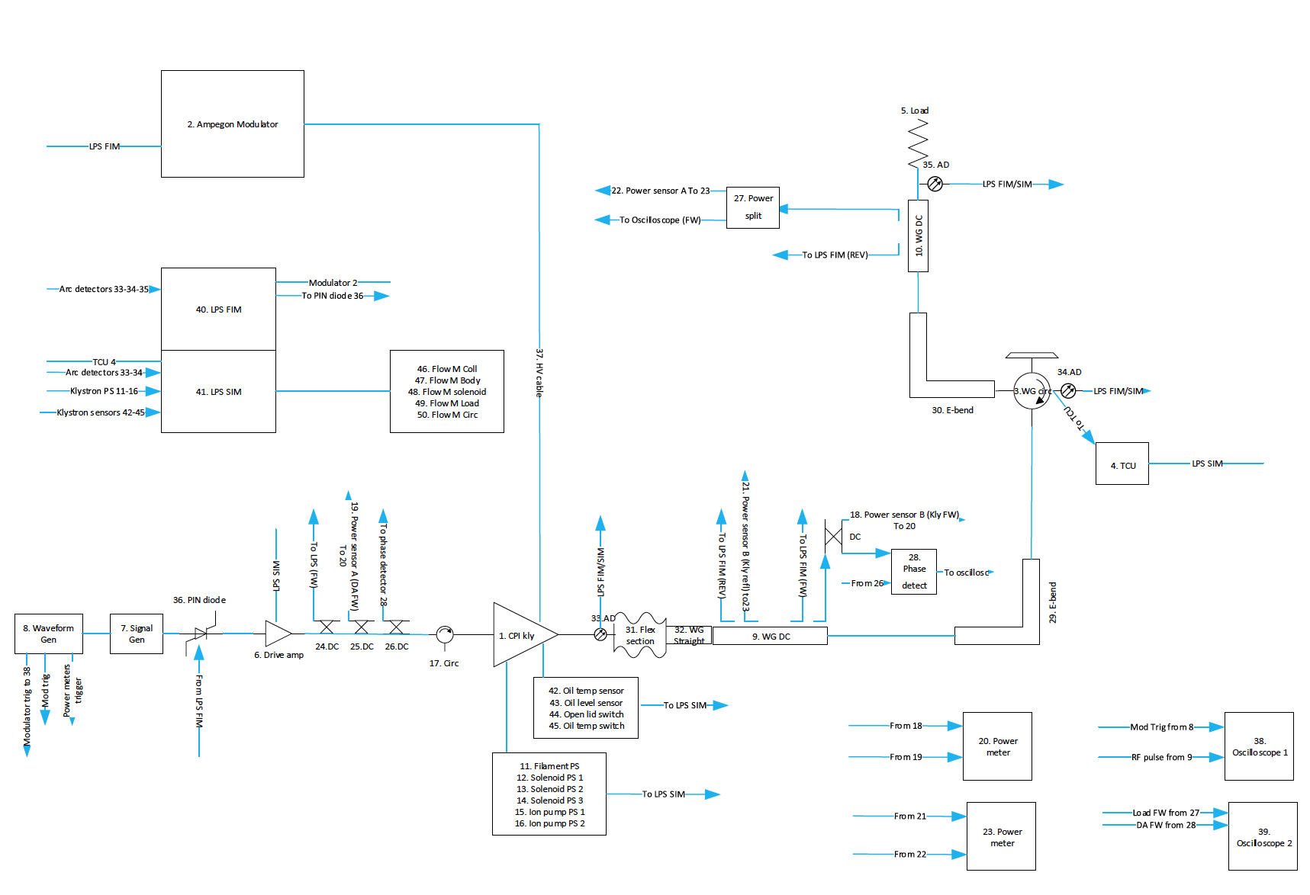
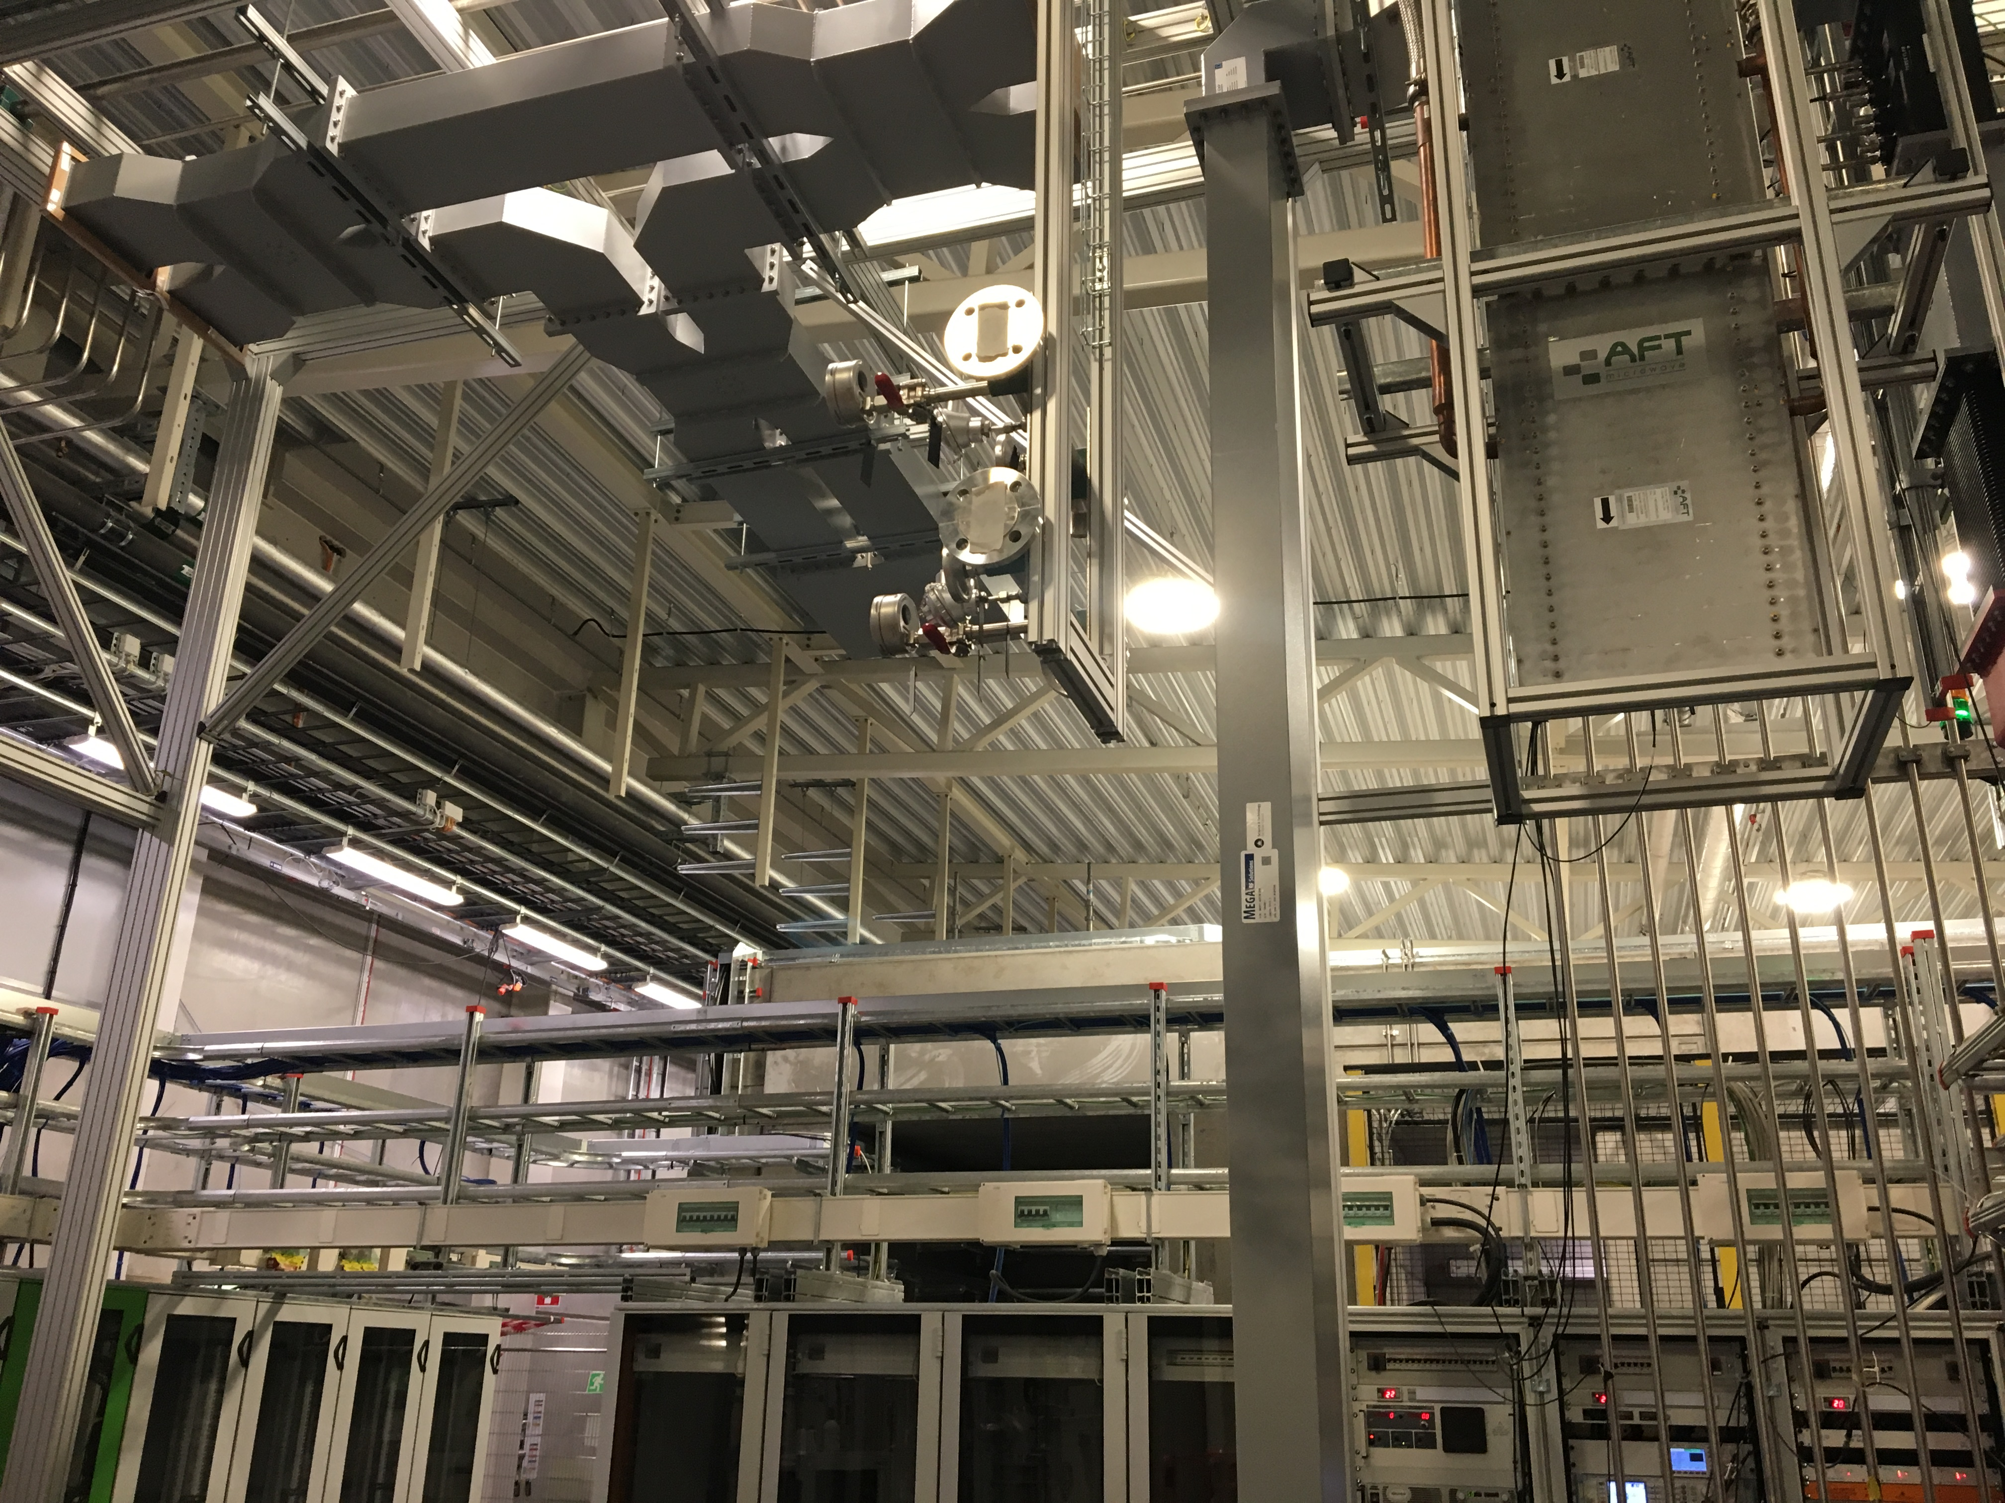
TS2 RF Activities
SAT of CPI prototype klystron
  repetition of all FAT tests
  new E-bend at the klystron output to solve the phase non-monotinicity issue
  integration of MicroStep type arc detector at the klystron output
Test of new SS driver amplifier (for MB series klystrons)
Test of new interface boards for the interlock system
Stepper motor controller for the RF variable power dividers (VPD) provided by ICS
RF signal level test of VPD
One VPD installed

Slide 7
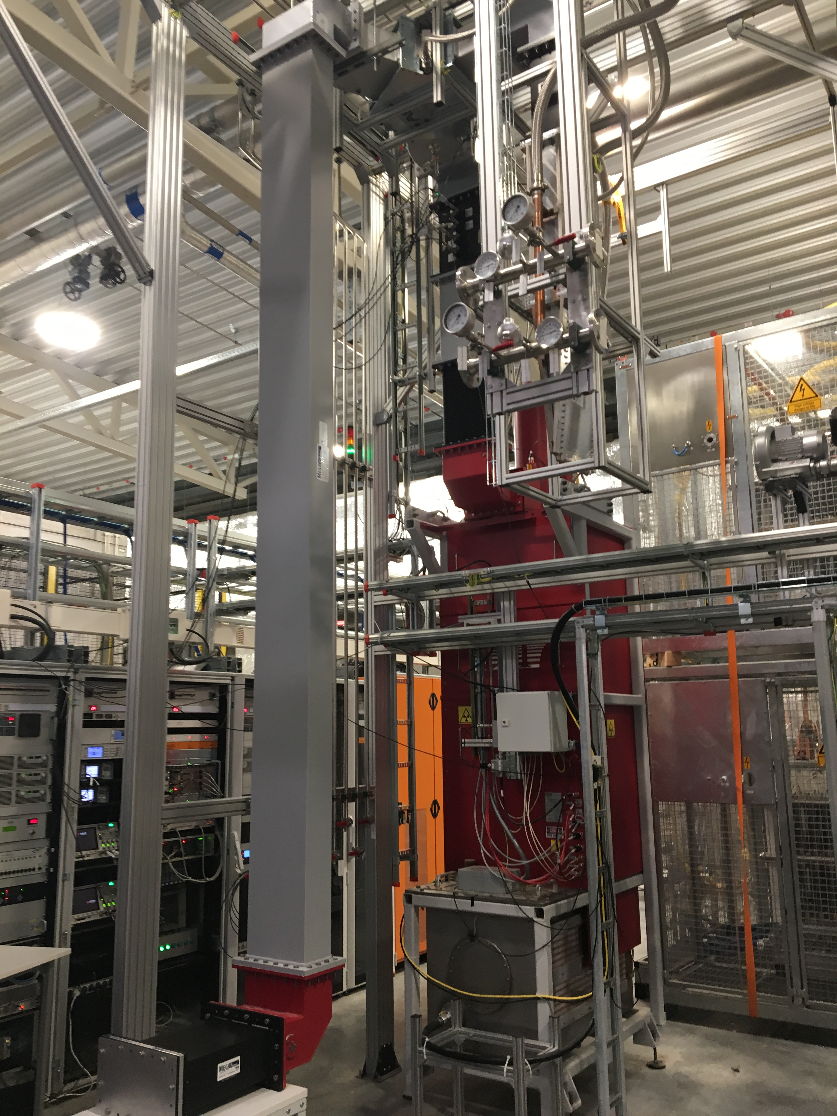
RF distribution components high power tests
CPI klystron with max. output power (~1.5 MW) used for testing of components and imperfections:
  WR1150 RF window
  WR1150 bellow
  Different types of anomalies inside of the waveguides
    deep scratches in the walls, including long burrs
    welding residual bumps in the corners
    foreign object (steel nut) moved around
    flange misalignment
The tests confirmed that all of these imperfections are RF tolerant.

