Slide 1
Cryomodule transport to ESS
Felix Schlander
European Spallation Source ERIC
2019-04-11

Slide 2
Outline
Means of transport
Transport and handling tests
First elliptical module (medium beta demonstrator) arrived at ESS

Slide 3
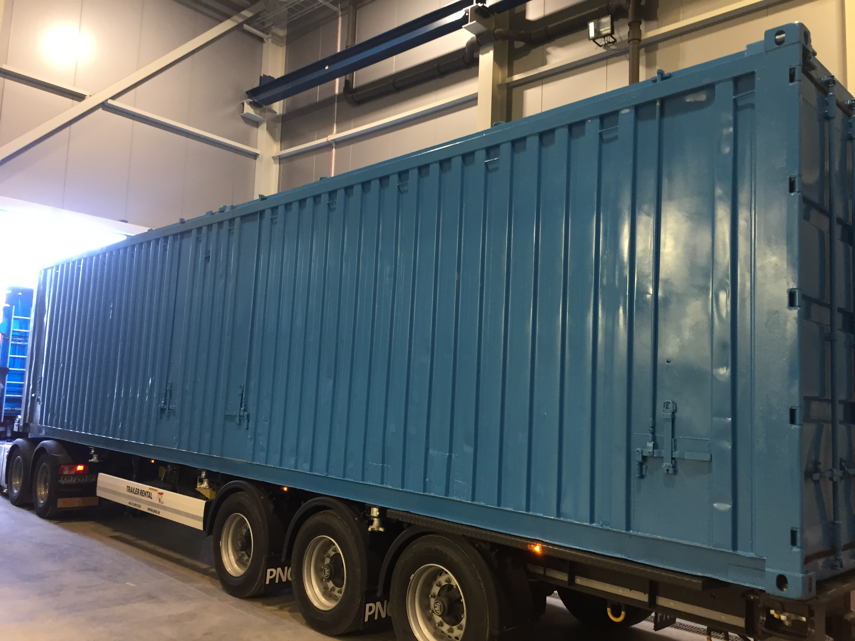
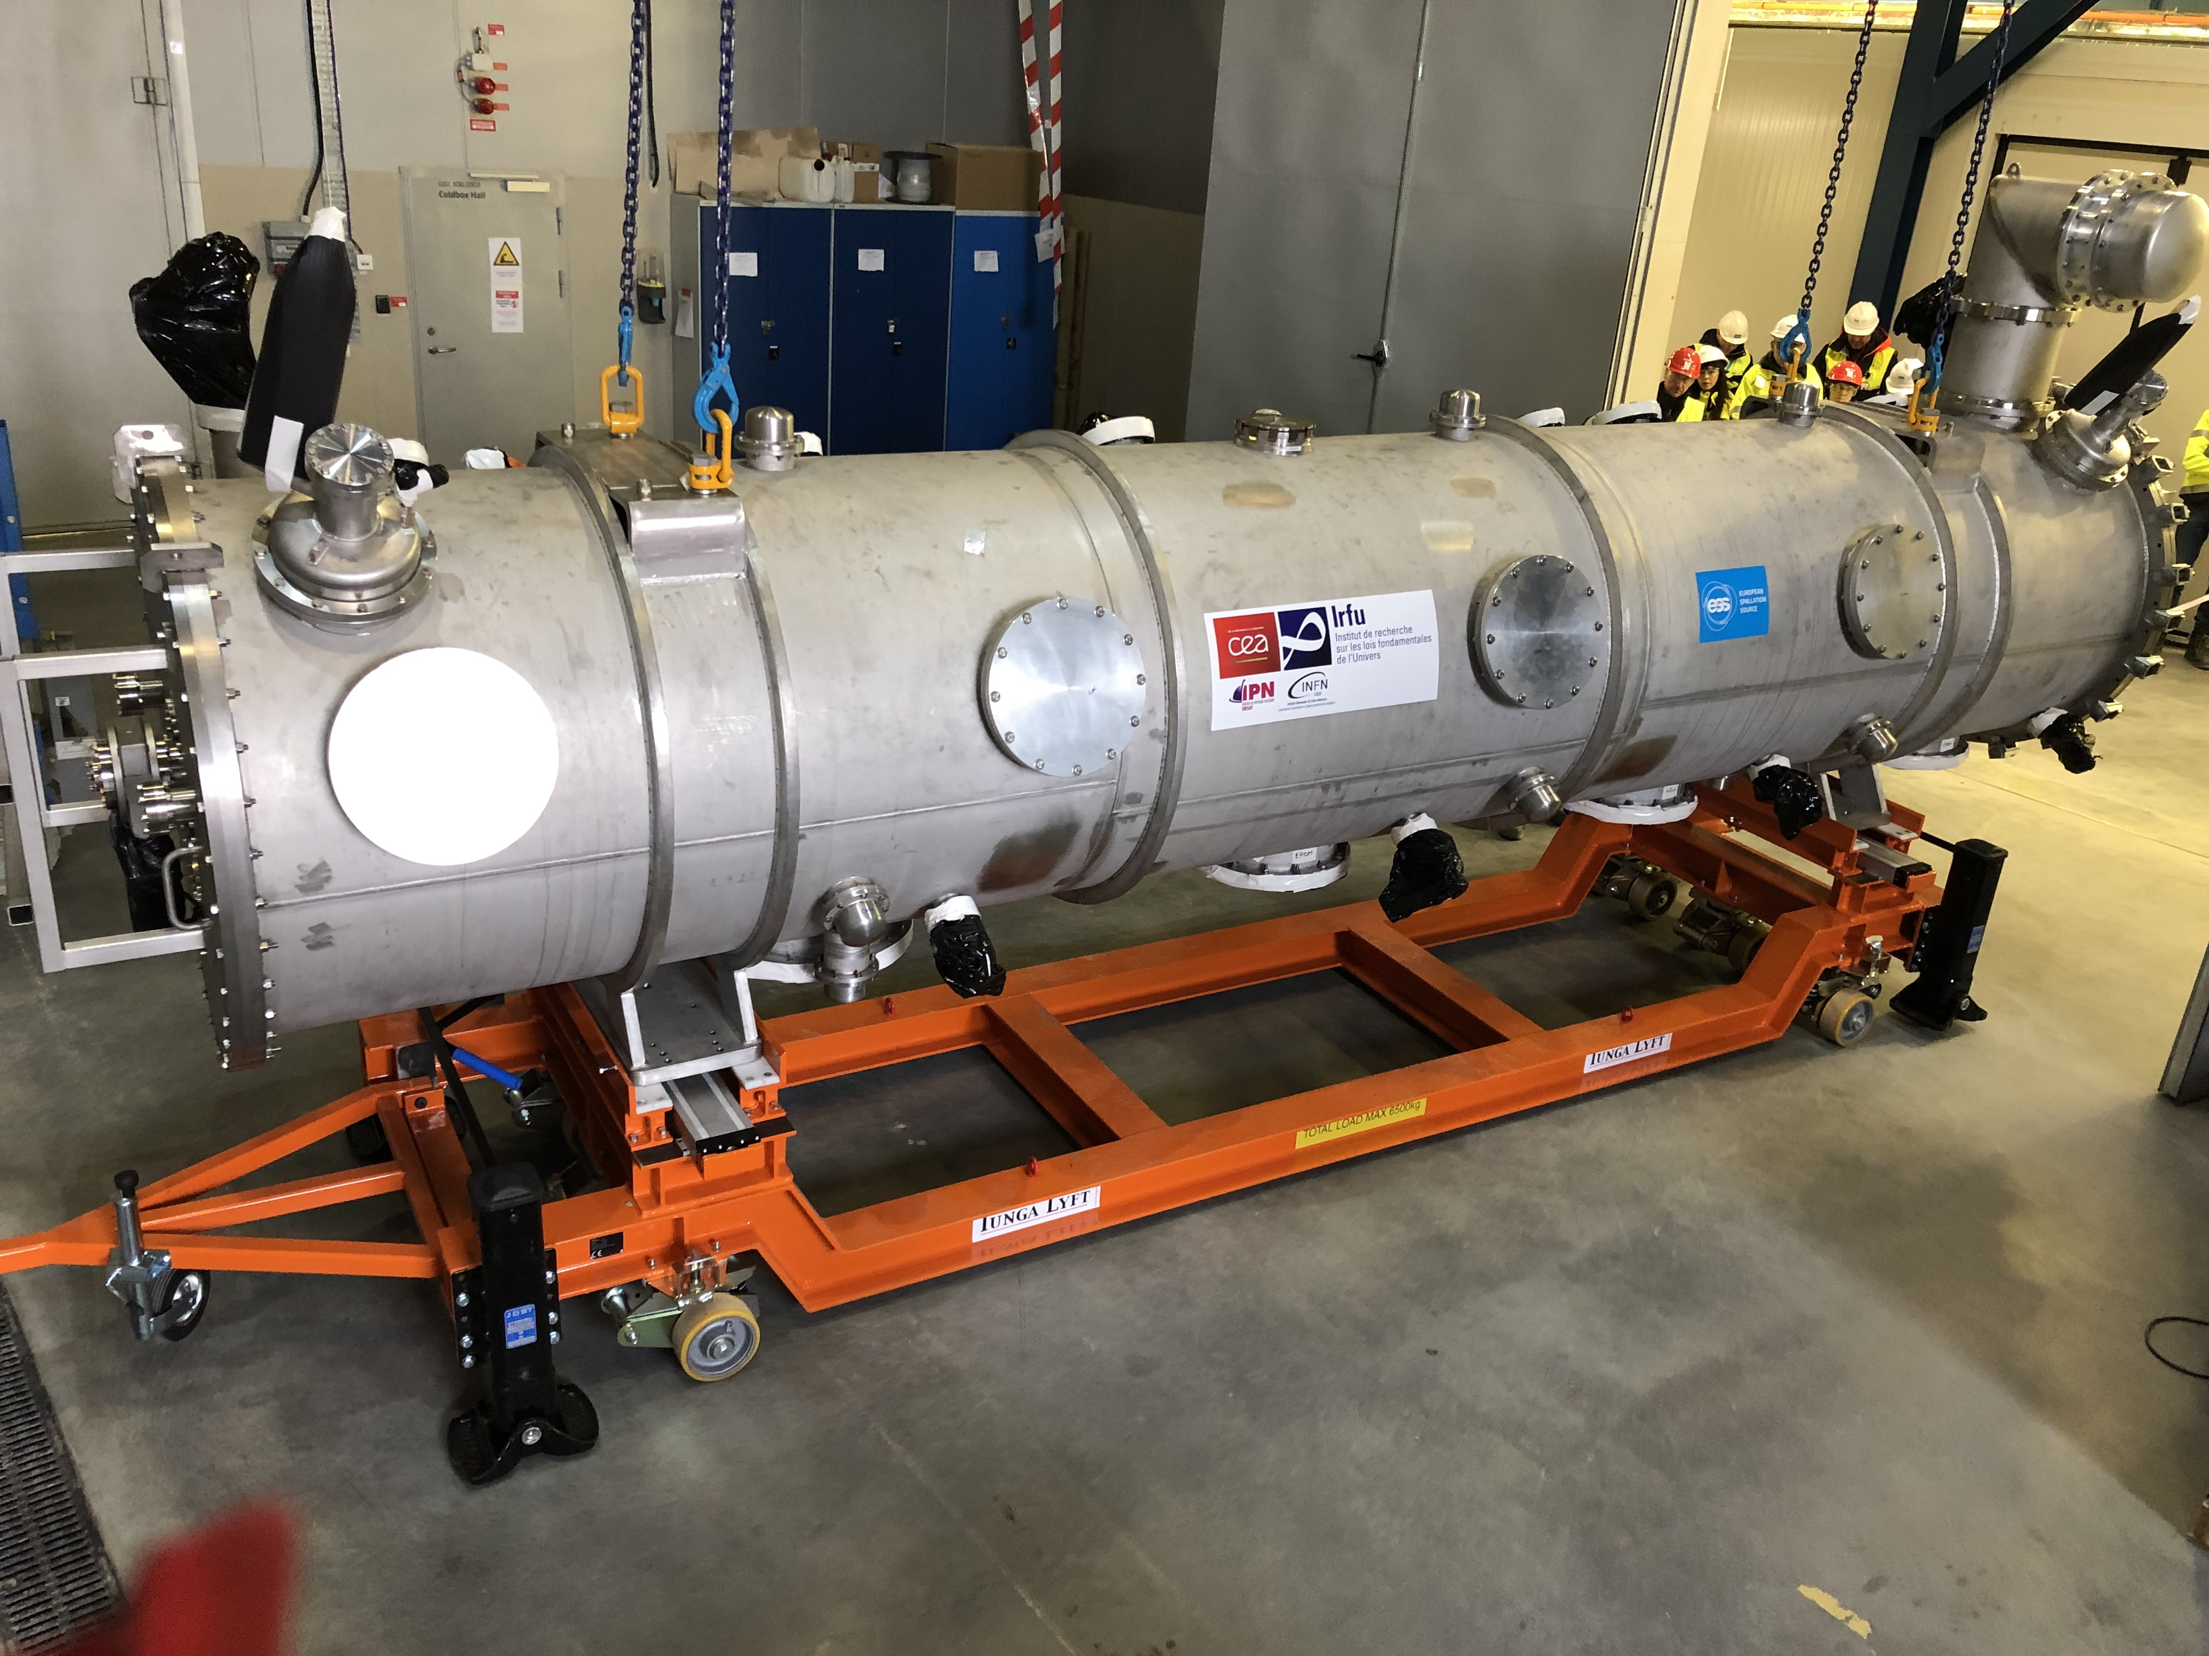
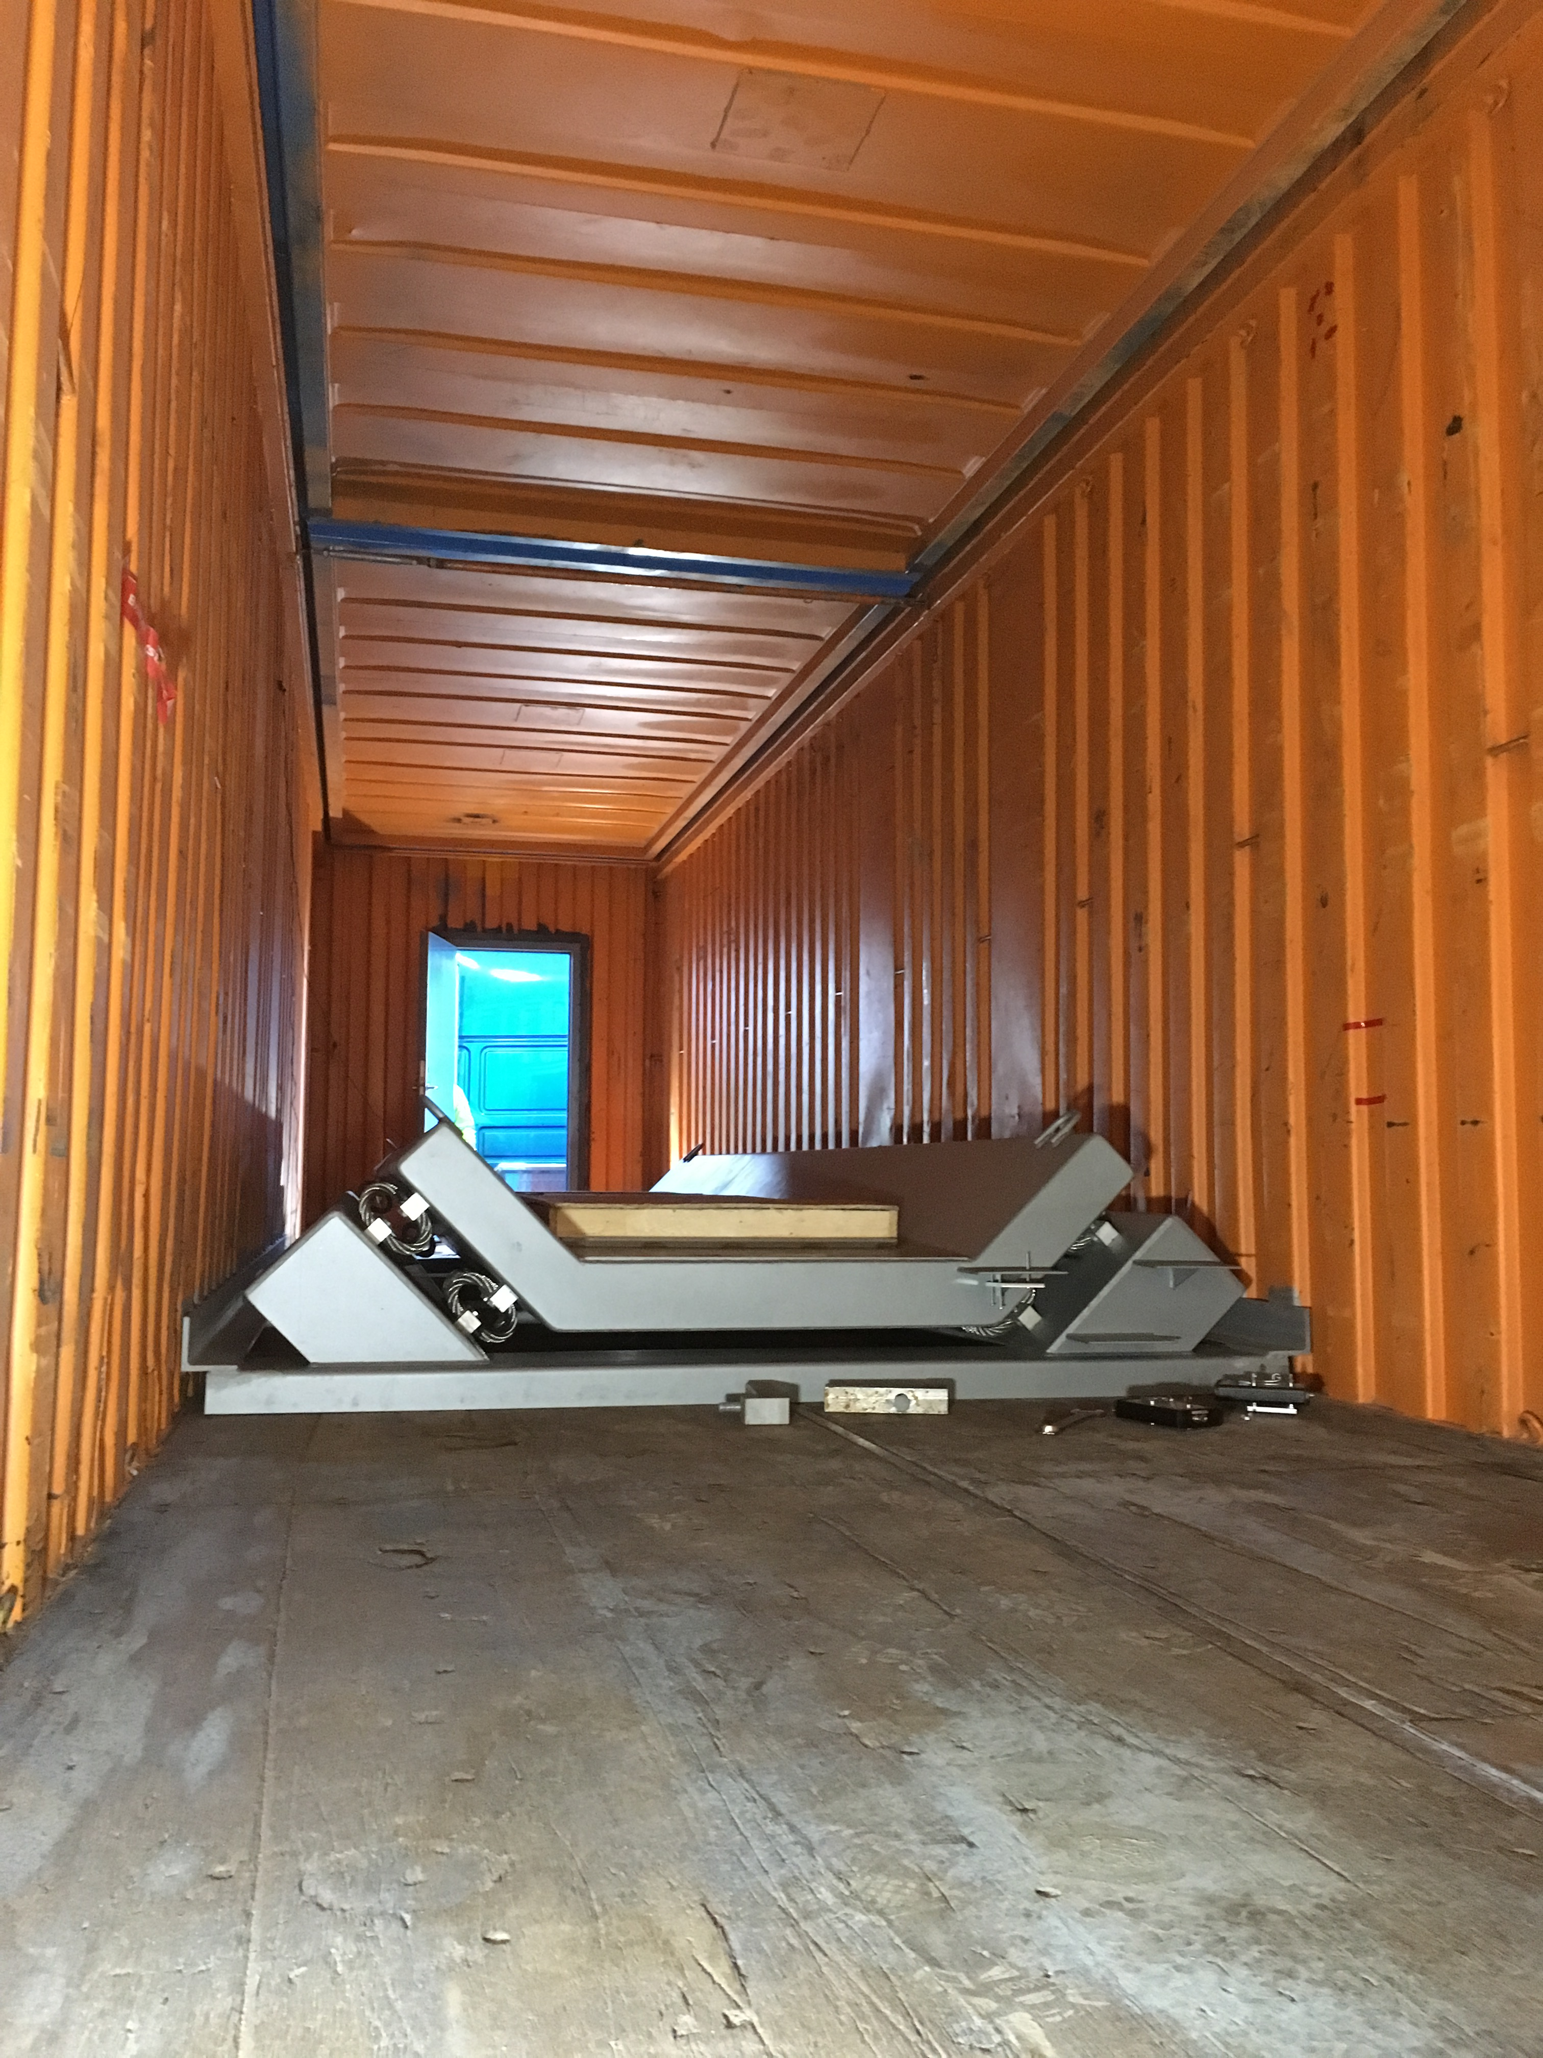
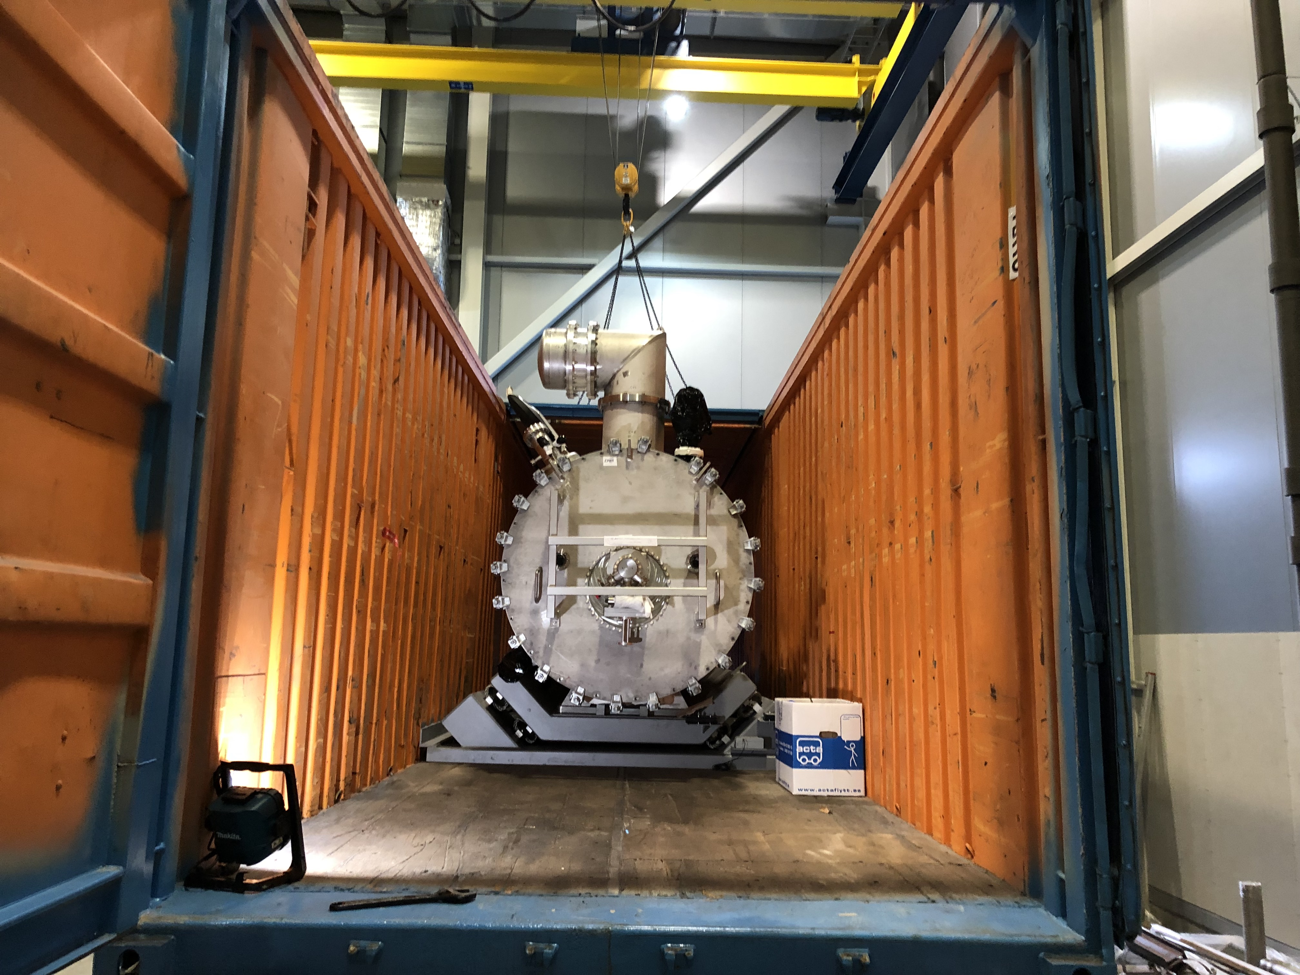
Means of transport
Elliptical cryomodule
Transport frame in container based on the DESY/XFEL design

Slide 4
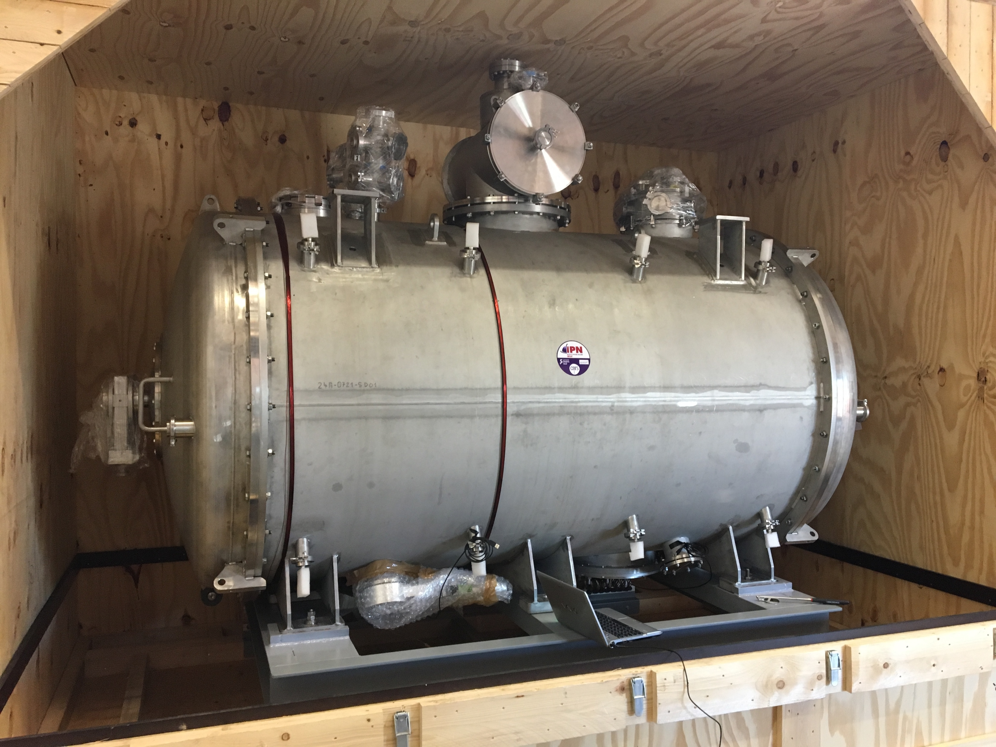
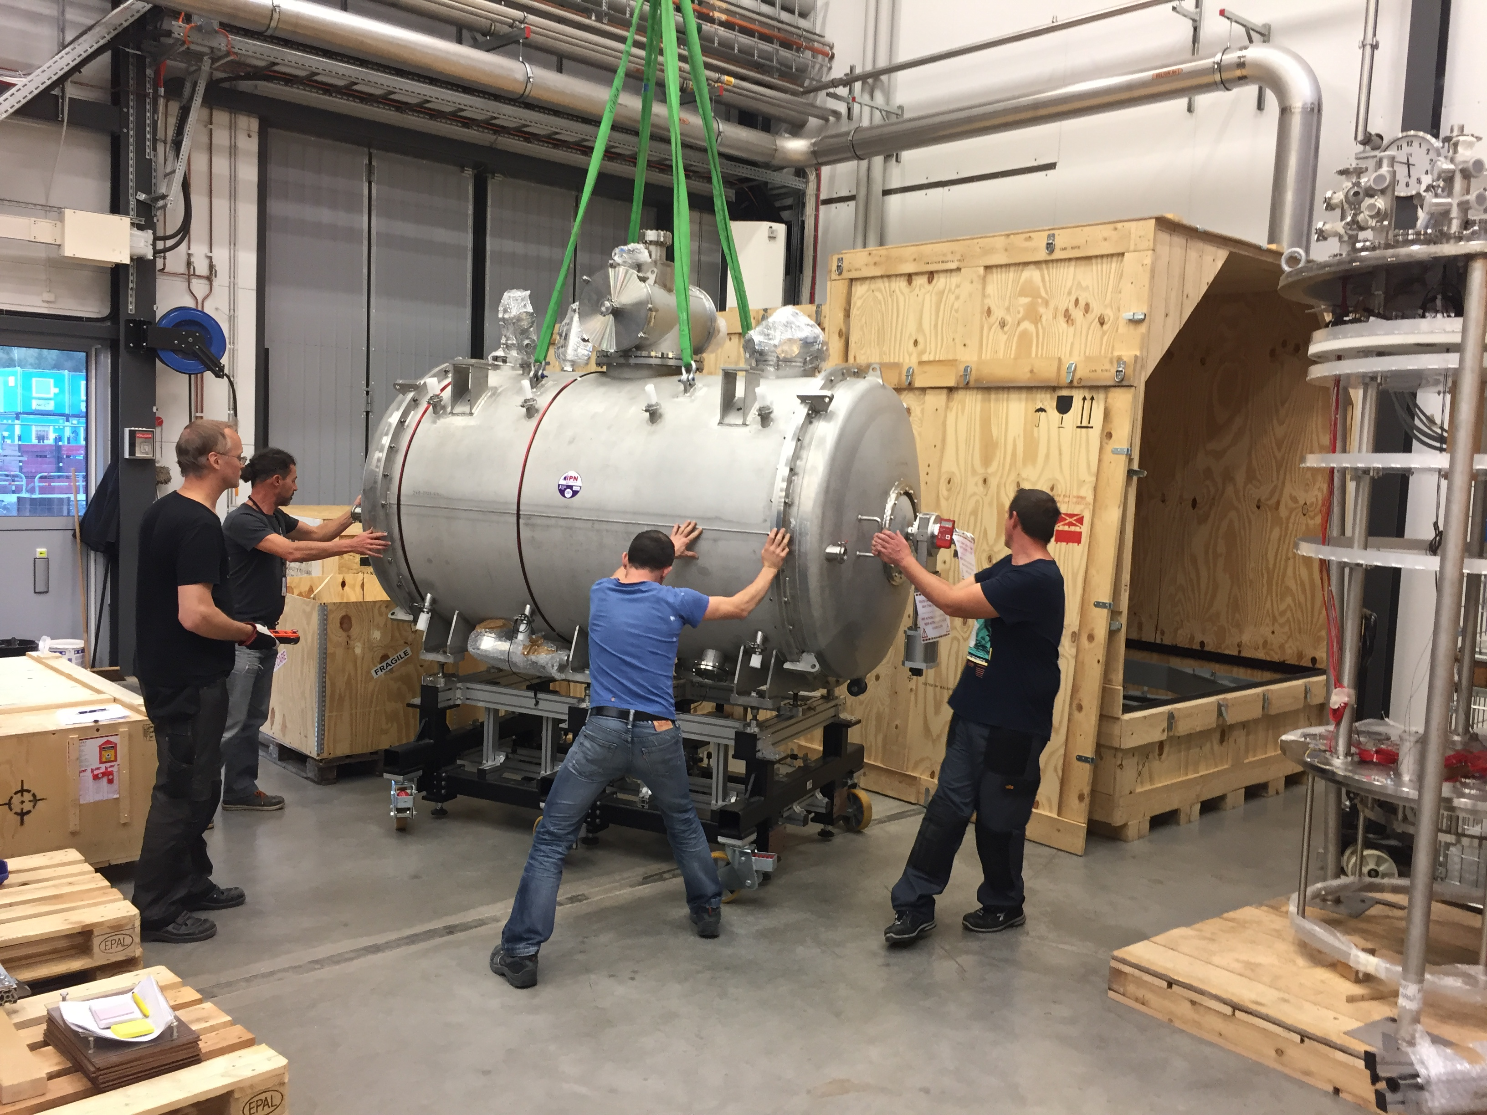
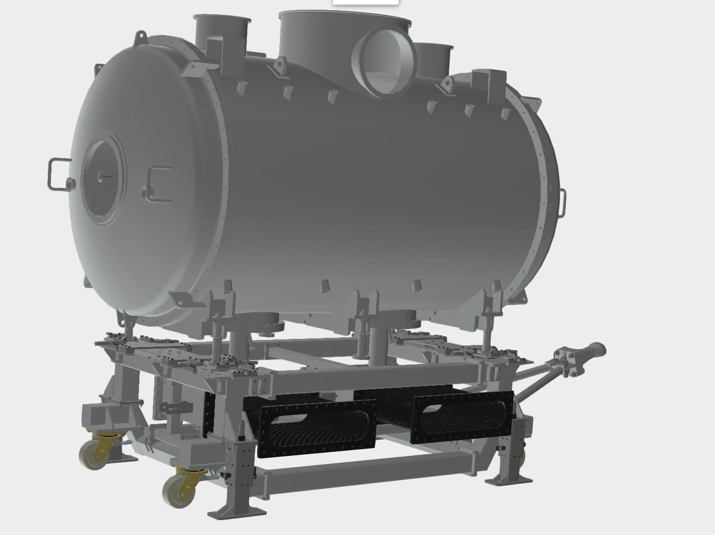
Means of transport
Spoke cryomodule
Transport box design from IPNO
Transport unit used at Uppsala U not suitable for tunnel transport (long distance, w/o crane support > new design necessary
First transport/support unit (prototype) to arrive in May

Slide 5
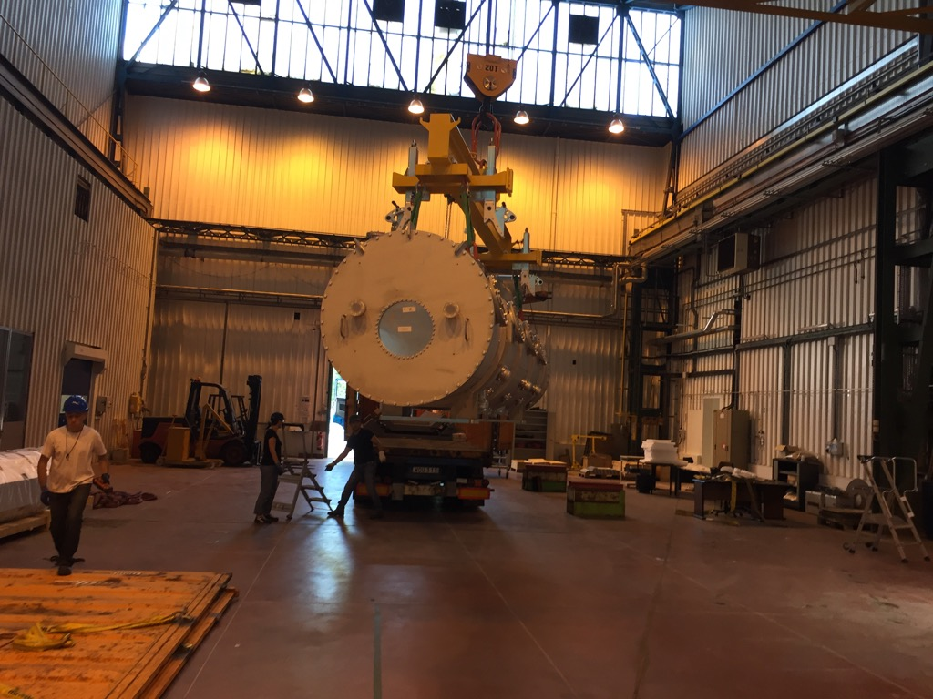
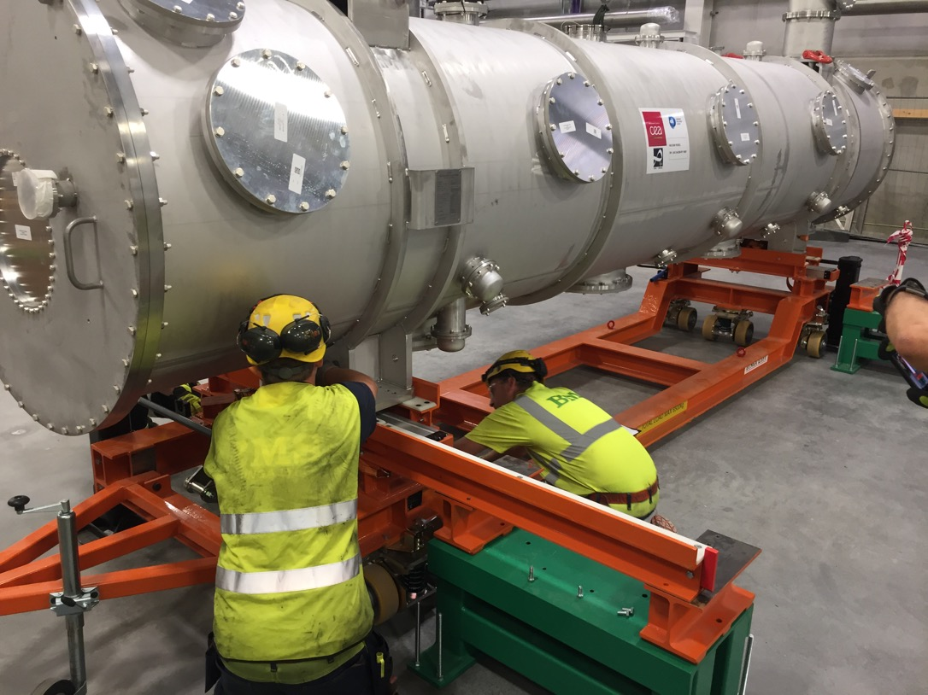
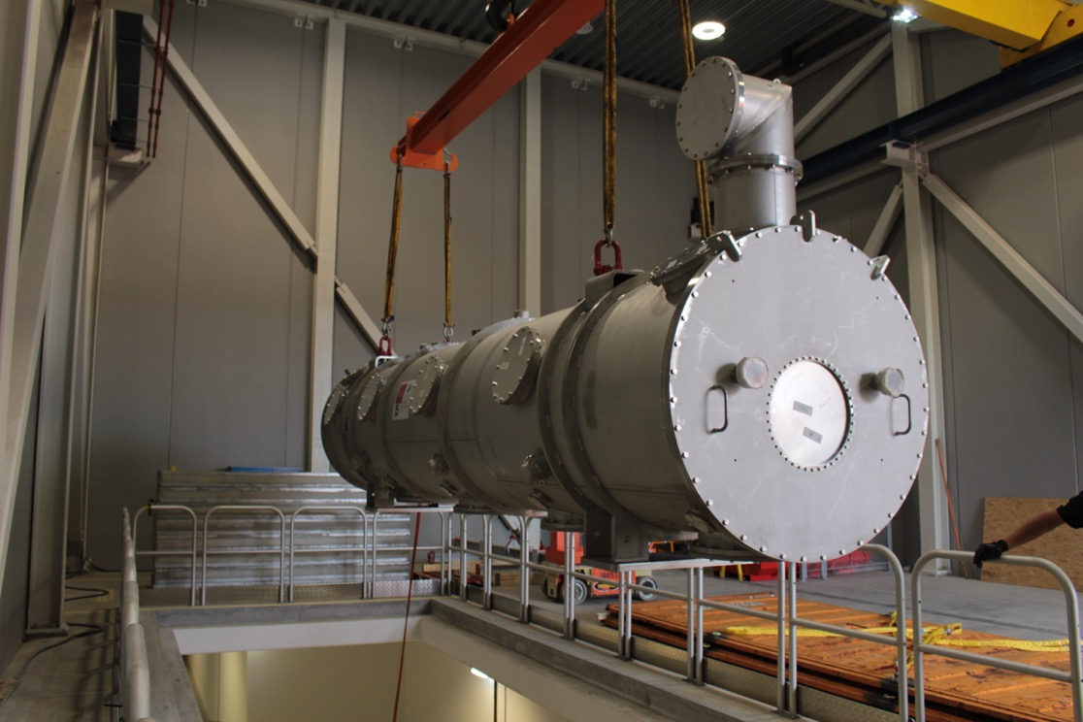
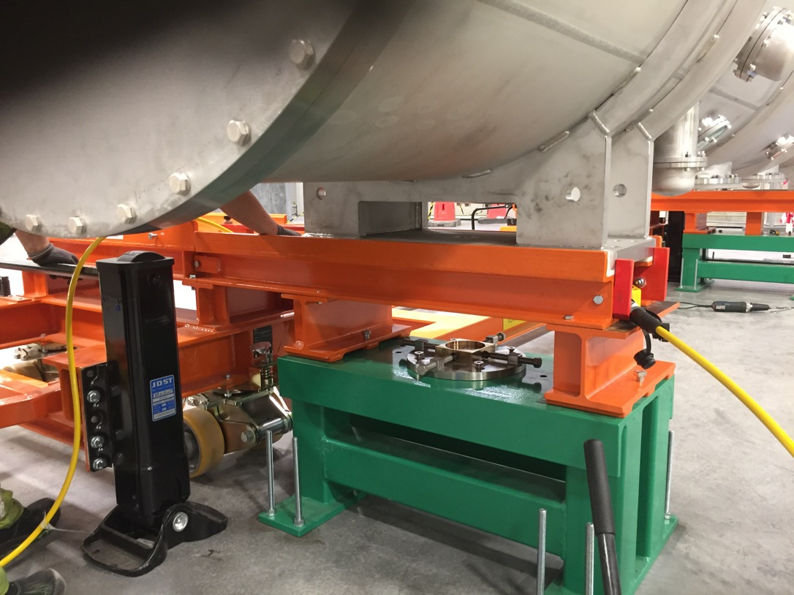
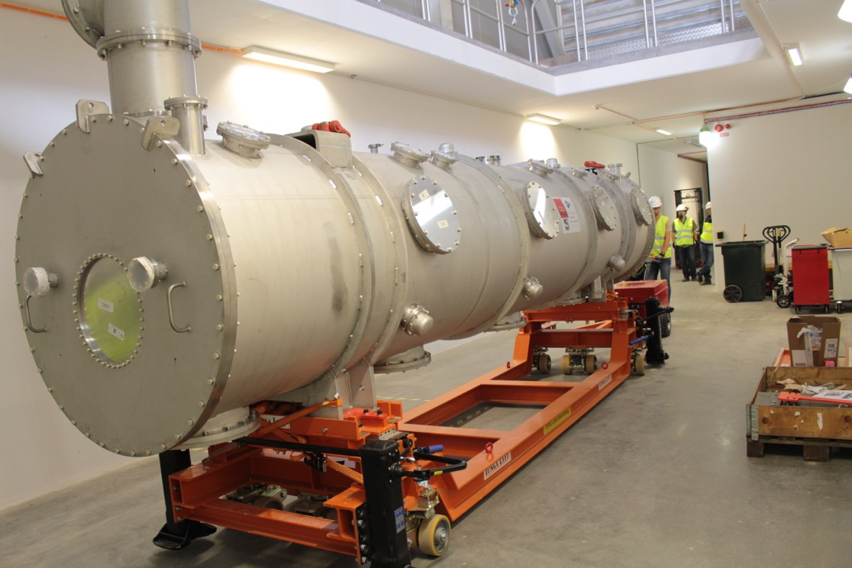
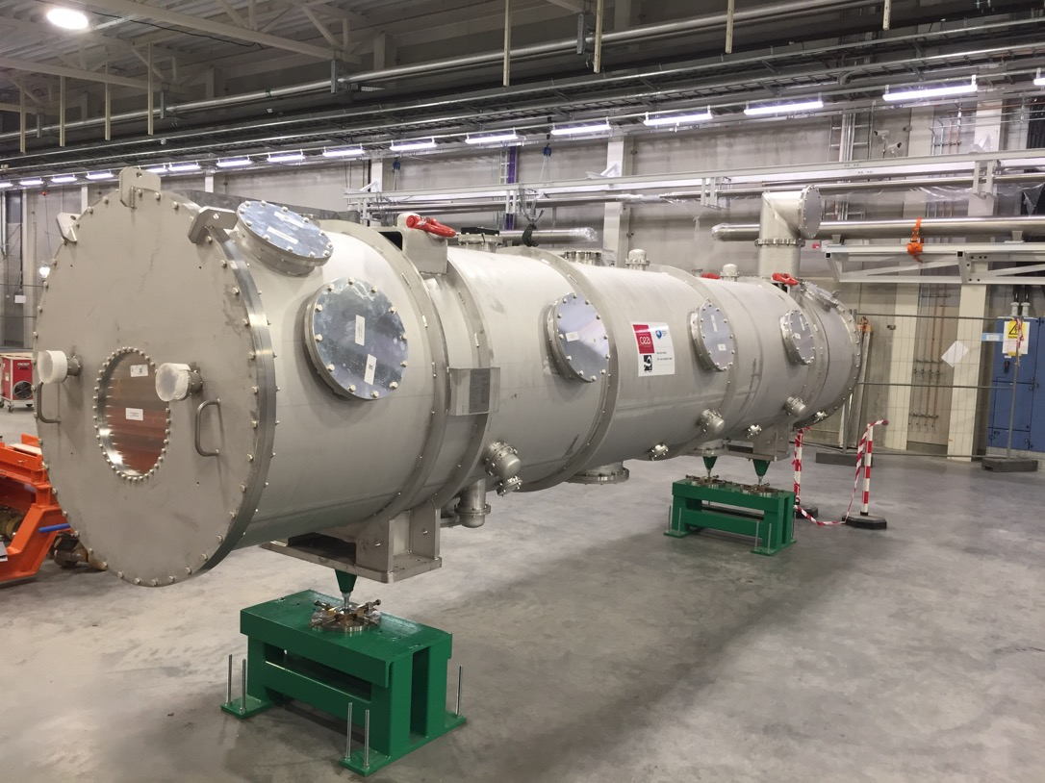
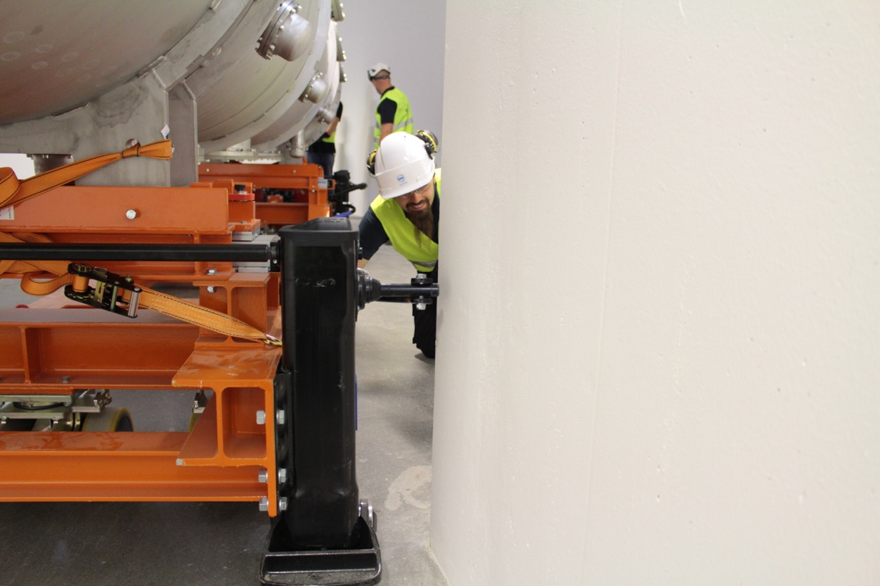
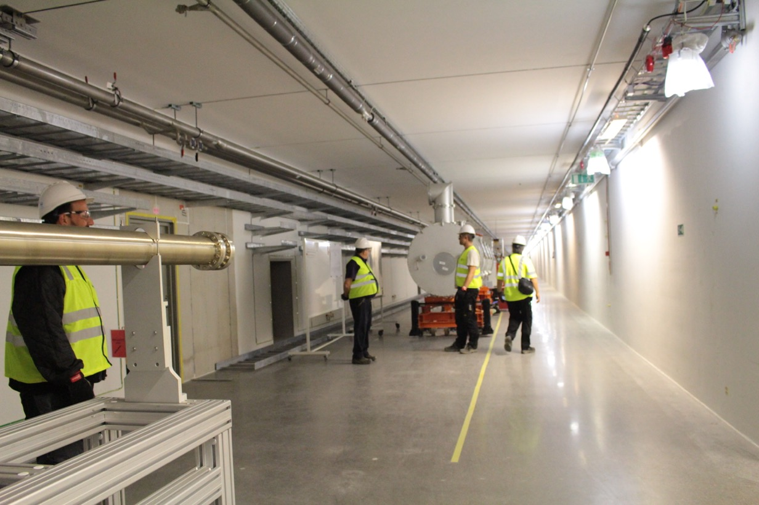
Vacuum vessel transport & handling (summer 2018)

Slide 6
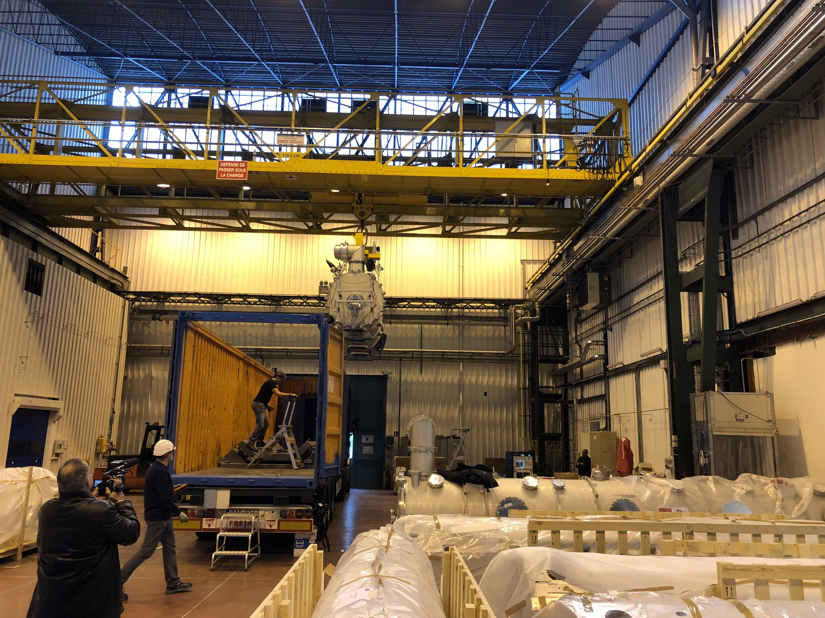
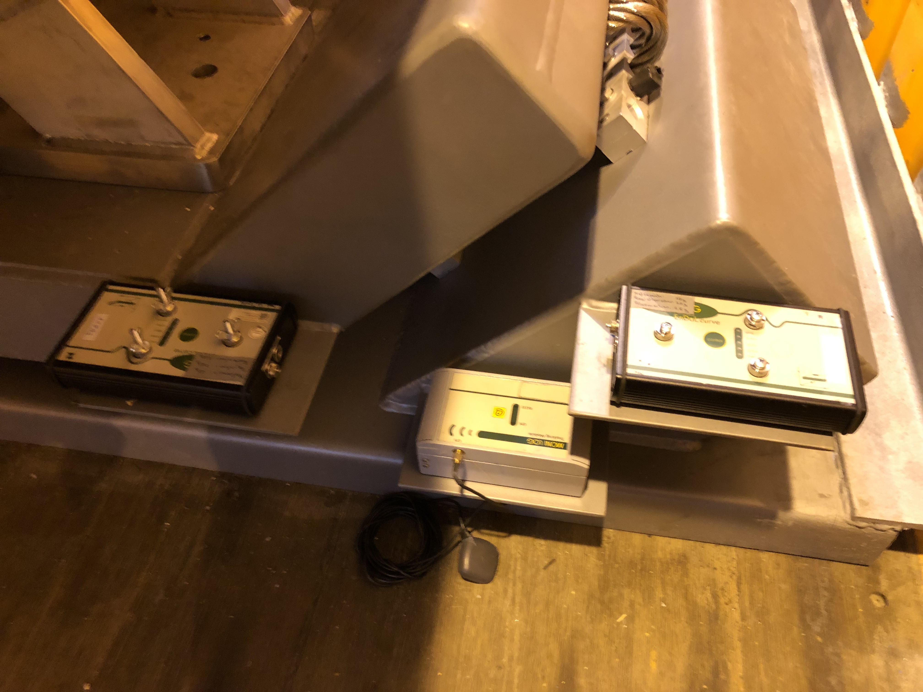
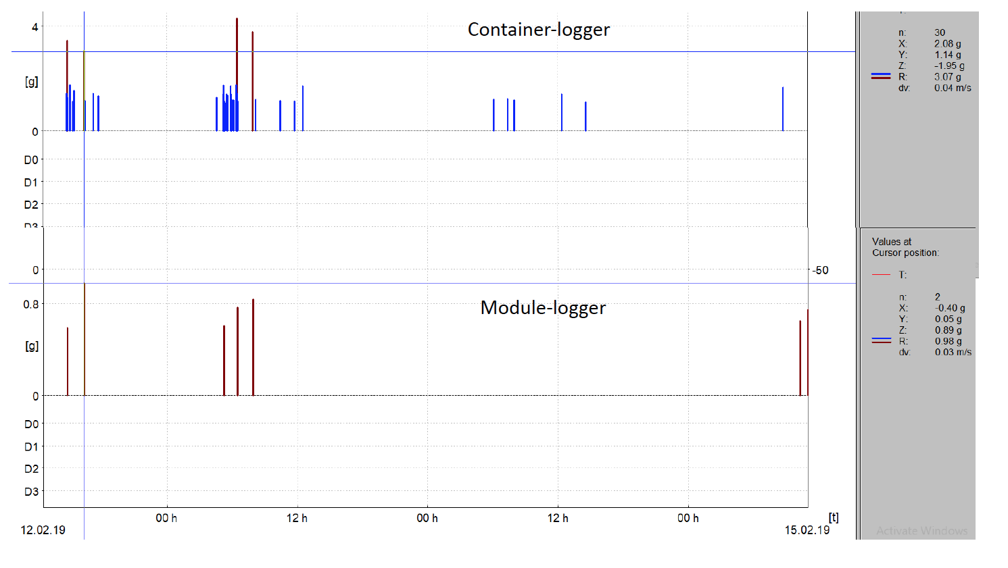
Transport of medium beta prototype (M-ECCTD)
February 2019
The transport was a success, but further improvements planned:
Different spreader beam to have module more balanced during lift
additional shock loggers inside the cryomodule to track movements of the cavity string
Some optimisation of the installation of module on the cryomodule supports
0.98 g max.
Units kindly loaned from DESY

Slide 7
Summary
First cryomodules (spoke- and medium beta prototype) have been shipped successfully
Handling procedures at ESS have been tested for the elliptical cryomodules
The prototype of the spoke transport and support device to be used at ESS is scheduled to arrive end of May
!!! Thanks to all people involved making transportation and handling a success !!!

