Slide 1
High level ESS SRF test plan
Cecilia Maiano
TAC 2019 Apr 10th - 12th

Slide 2
Elliptical Cavity Measurement Data at ESS
Measurements of all elliptical cavities are needed for the testing, commissioning and operation of ESS cryomodules. Data are consolidated into the Measurementv& Calibration DB from ICS @ESS (owncloud, HDF5 format).
Gathering of the IK data and the development of the handling tools are in the scope and responsibility of the SRF Section of the Accelerator Division.
Let’s have a look at the present system and at its main features

Slide 3
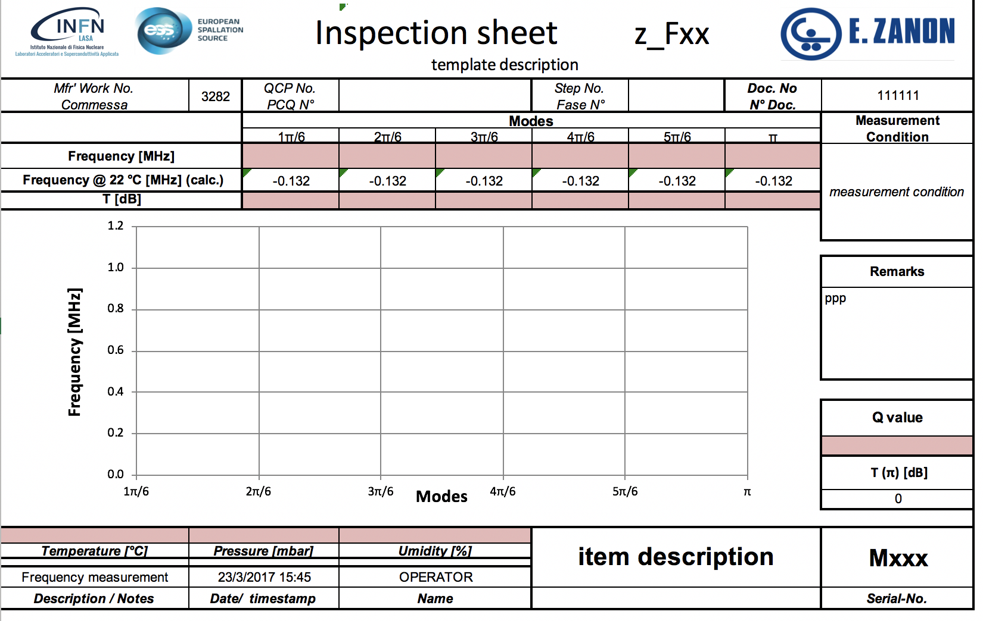
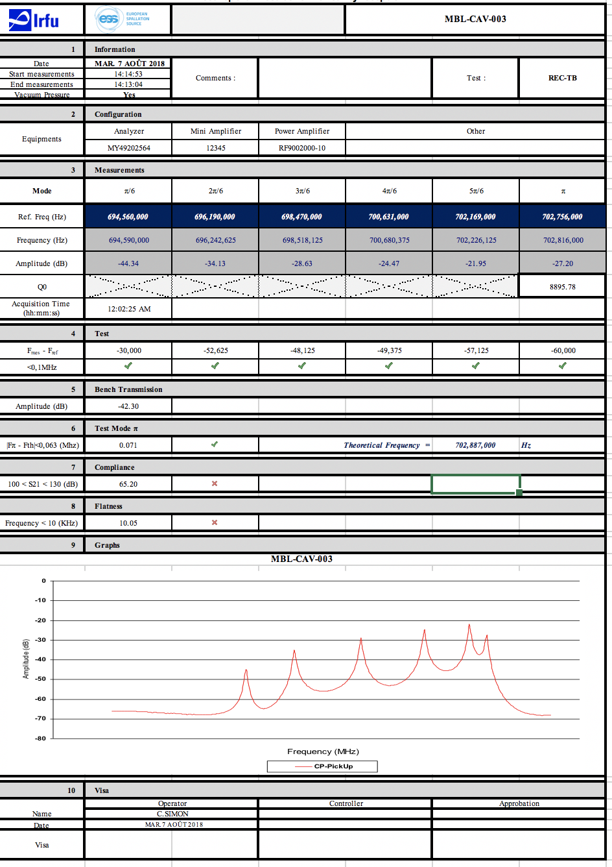
Frequency data at ESS (1)
Following requirements for long term maintenance plan of facility
ESS Scope
MEASUREMENTS @ IKC
After fabrication
Intermediate handover
Outgoing
Measurement&Calibration DB
(ownCloud service)
ESS Asset Management
ID Installation Structure
https://meas01.esss.lu.se/owncloud/index.php/login
Live Staging Area
(WFT files)
Transfer
Tagging (in metadata)
Script
Save
https://gitlab.esss.lu.se/SRF_Section
Normalized Data
(HDF files, metadata)
APPLICATIONS
Browse
Compare
Assess
MEASUREMENTS @ ESS
Incoming
Preparation TS2/Linac
Script

Slide 4
Frequency data at ESS (2)
Present system
Mechanisms for transferring the relevant subset of important measurements performed at the IK partners during production and at the handover phases (construction, testing, assembling, shipping between partners of the SRF collaboration,...)
Measurements taken at ESS will use the same live data area and final repository
Data is uniquely associated at each accelerating cavity/module and will later be associated with the proper tags (including the EAM asset ids)
The SRF Section has the responsibility to develop all the tools to load, browse, compare and access the data.
Data and tools should be, as much and as early as possible, shared with the project IK partner for proper followup after delivery of the components to ESS

Slide 5
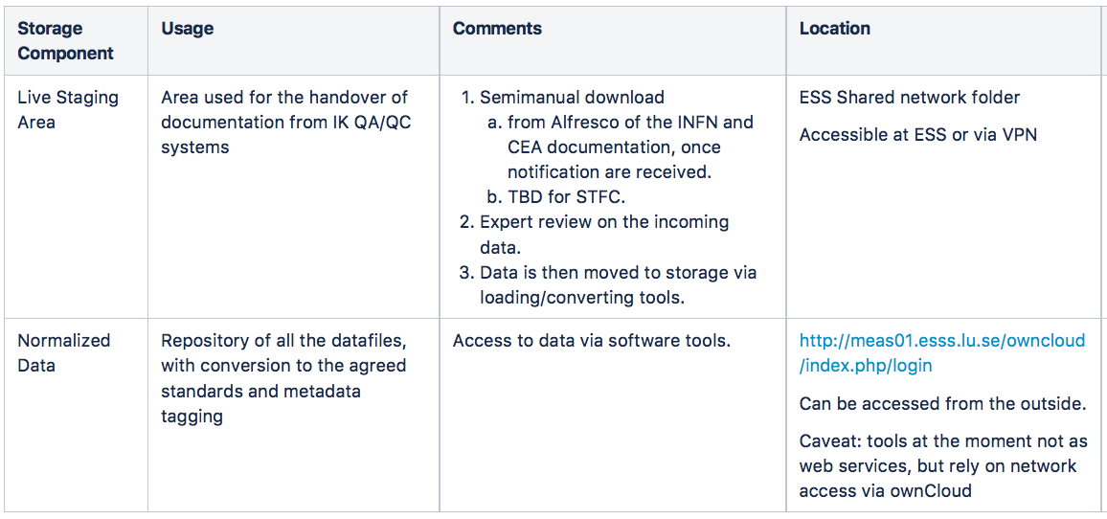
Present Architecture for data storage

Slide 6
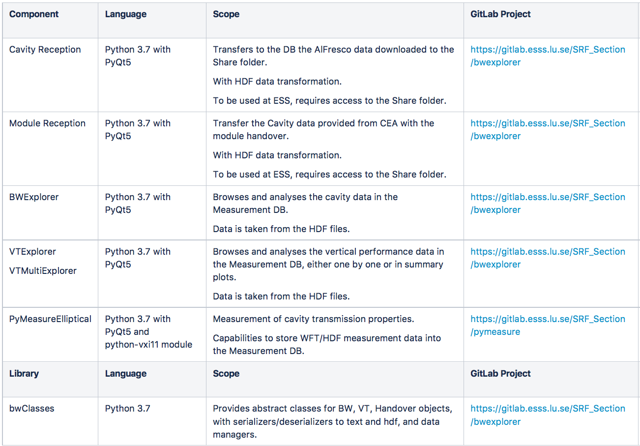
Existing tools (all on ESS Gitlab)

Slide 7
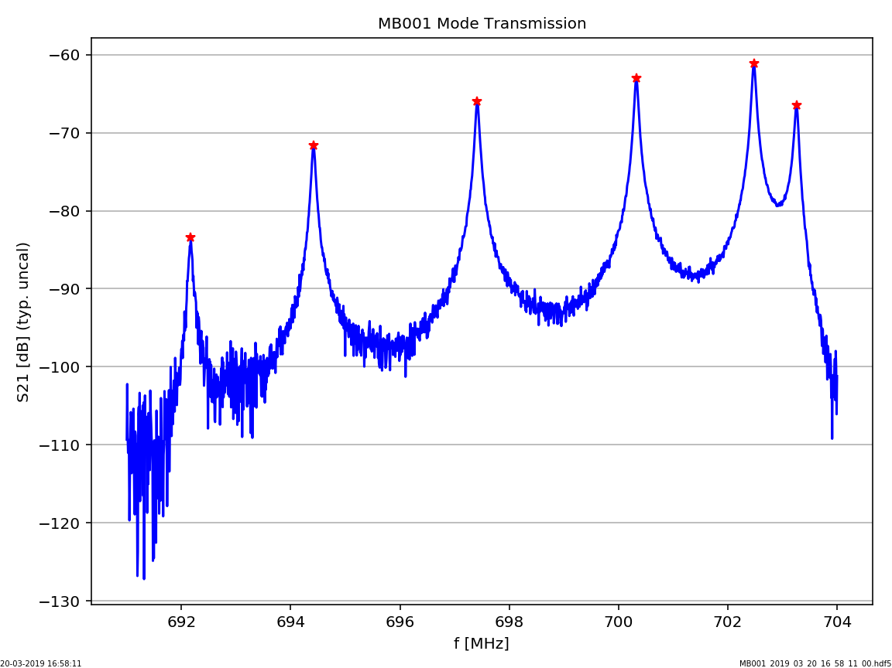
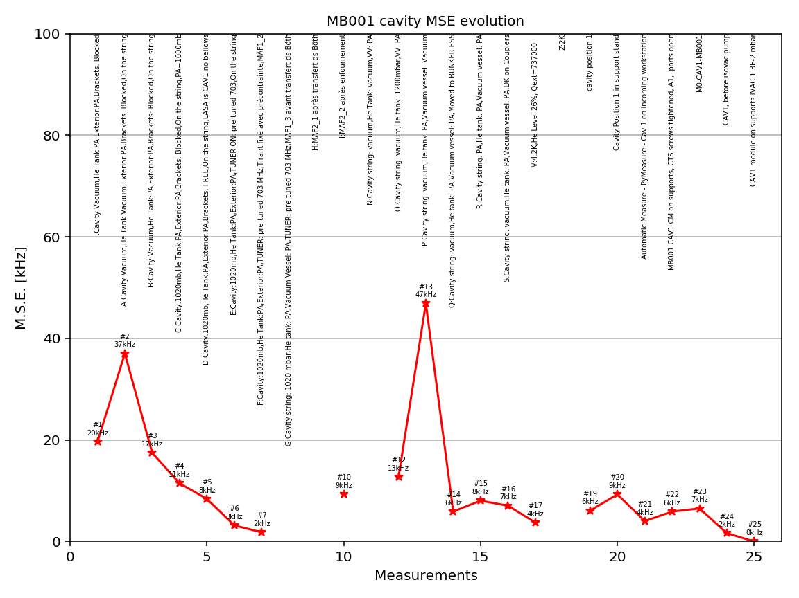
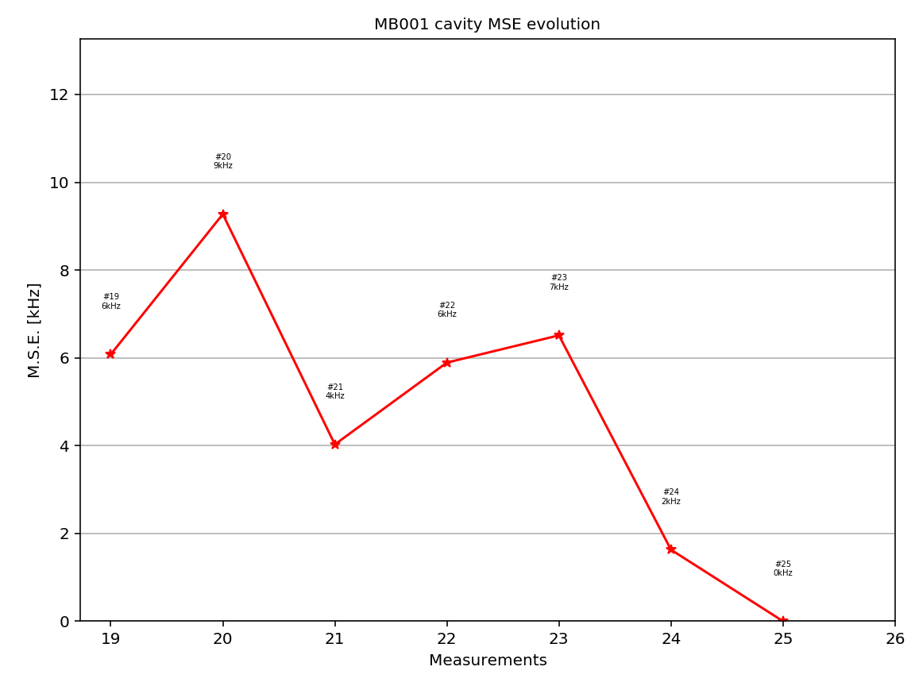
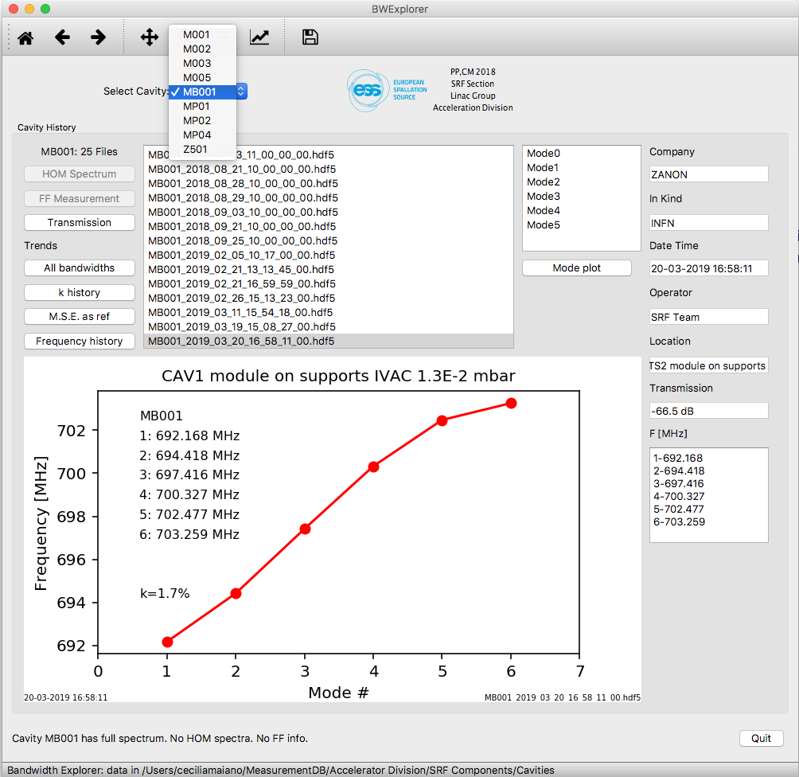
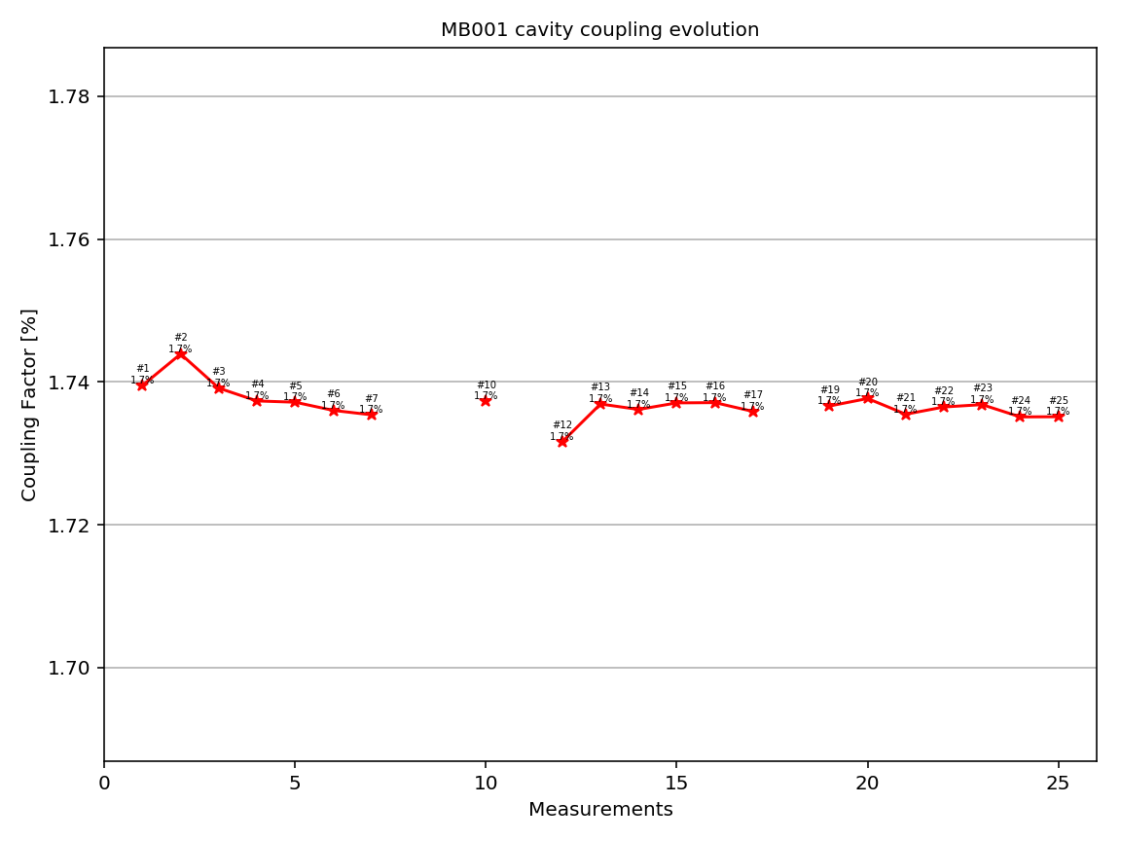
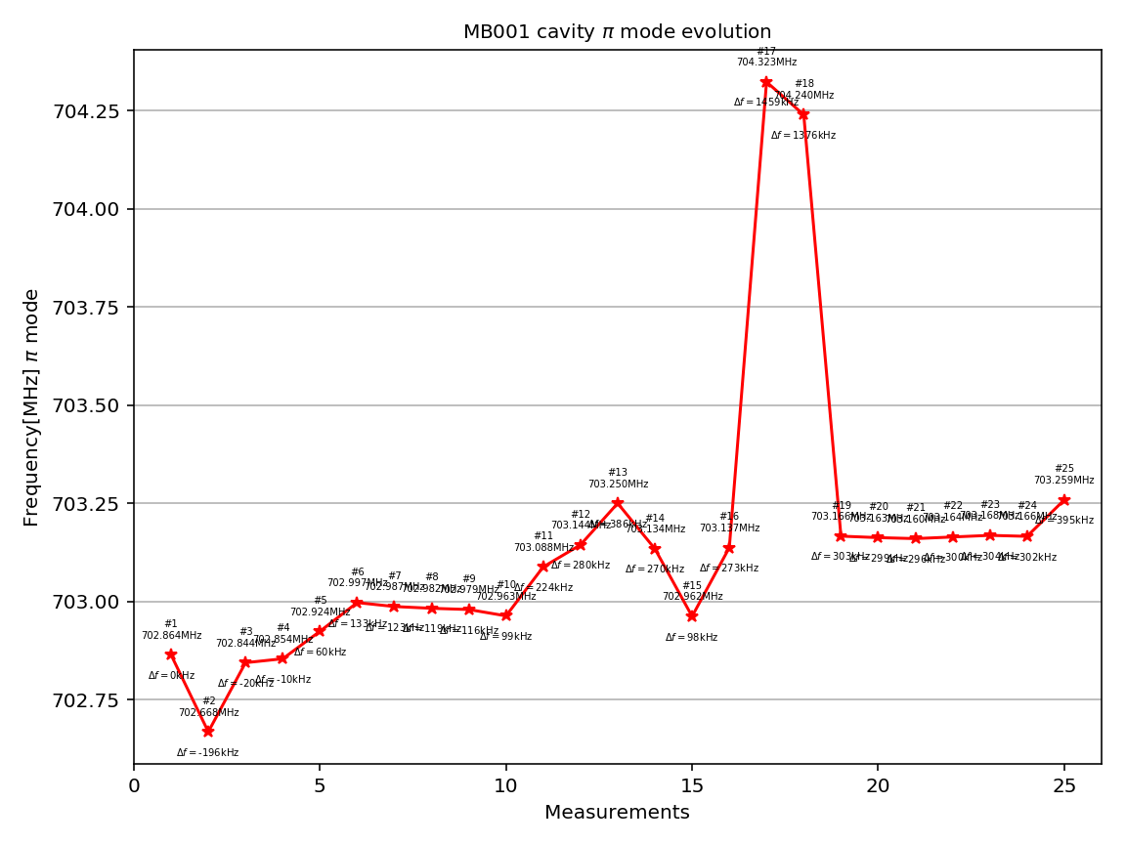
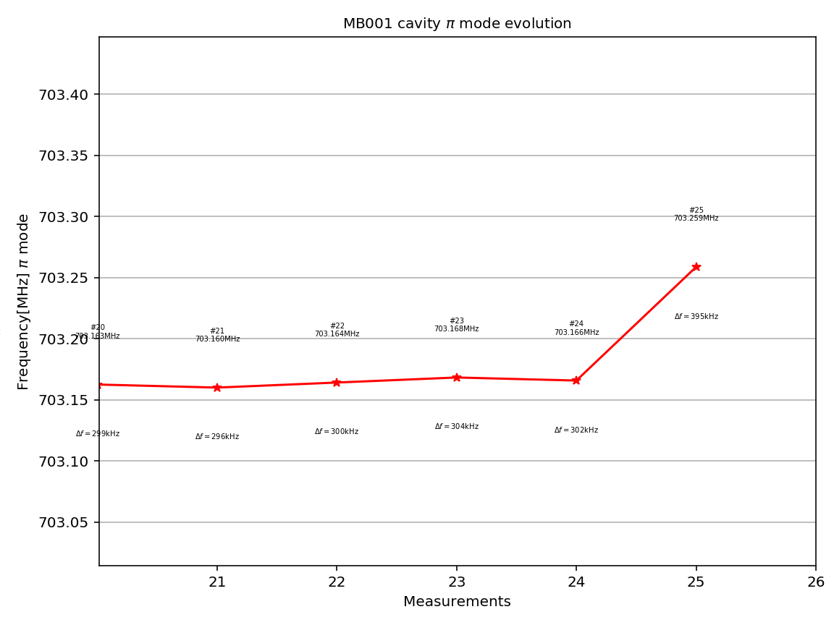
Bandwidth Explorer
Allows to browse the cavities and choose to display & analyze the associated measurements.
Buttons are enabled/disabled to access the further data

Slide 8
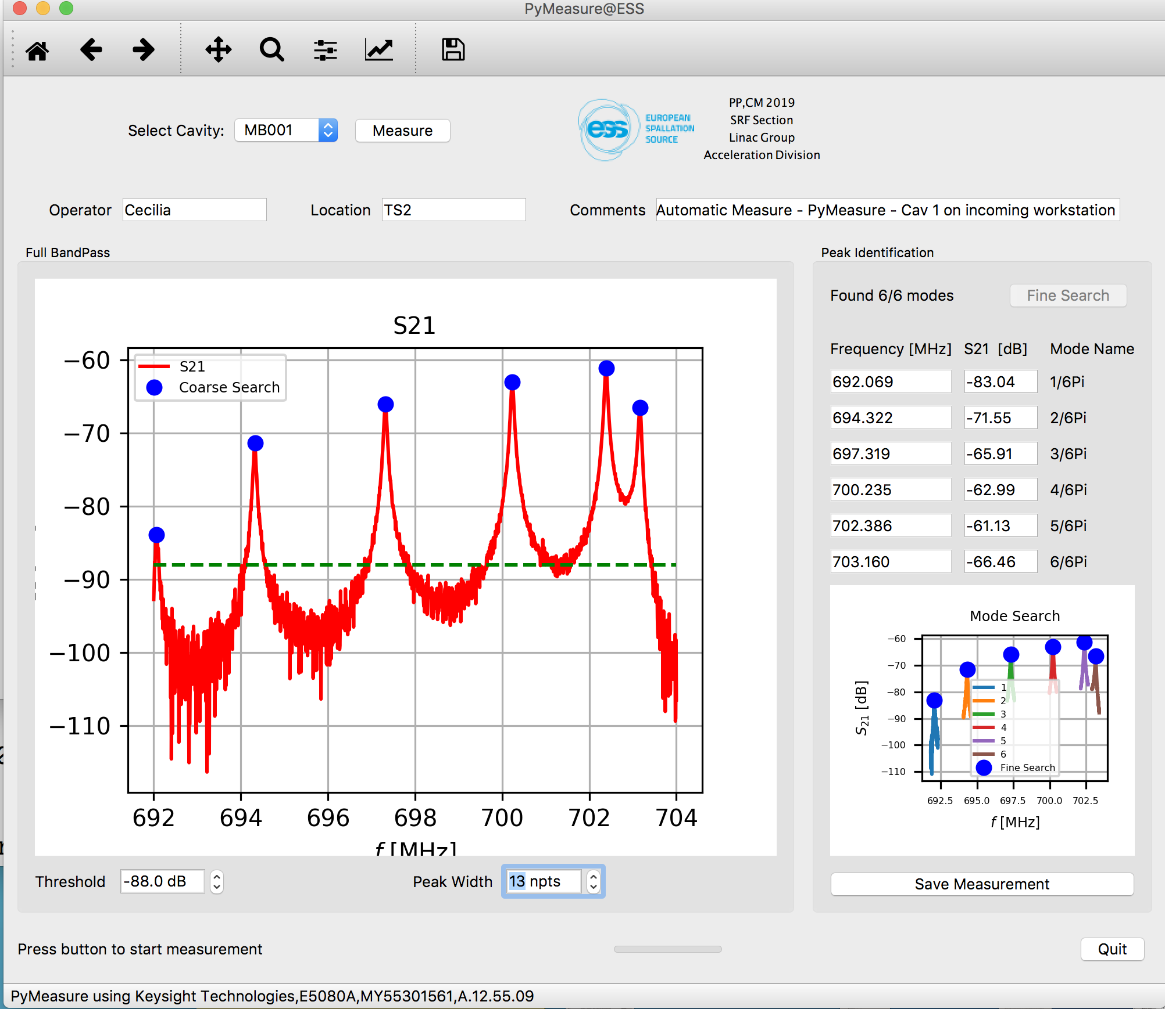
Measurement tools at ESS
Allows to measure cavities (S21, with VNA) and store data automatically in the Cavity DB
Used for all measurements of M-ECCTD, after reception
  Bandwidth (coarse & fine search)
  Transmission
  HOM spectrum

Slide 9
M-ECCTD analiysis
From the demonstrator data we could derive the following data
Parameter, all data kHz | CAV1 M001 | CAV2 MP04 | CAV3 MP01 | CAV4 MP02 | <AVE> SPREAD
Effect of Brackets (also, hysteresis due to mechanical slack) | 70 | 165 | 107 | 112 | 114±48
From string in vacuum, VV&tank PA, to 4.2 K | 1186 | 1181 | 1169 | 1150 | 1172±18
From string in vacuum, VV&tank PA, to 2K | 1103 | 1107 | 1091 | 1080 | 1095±14
4.2K to 2K, col, (Pressure sensitivity 1 bar to 30 mbar ) | -83 | -74 | -78 | -70 | -76±7
String from air to vacuum (tuner, tank & vv air, RT) | 174 | 177 | 190 | 195 | 184±11
Vessel from air to vacuum (tuner, string vacuum, tank air, RT) | 111 | 105 | 107 | 75 | 99±18
Data fairly stable, to be used during TS2/Tunnel preparation phases
  T data not available for all measurements (approx. 5 kHz/C around RT)

Slide 10
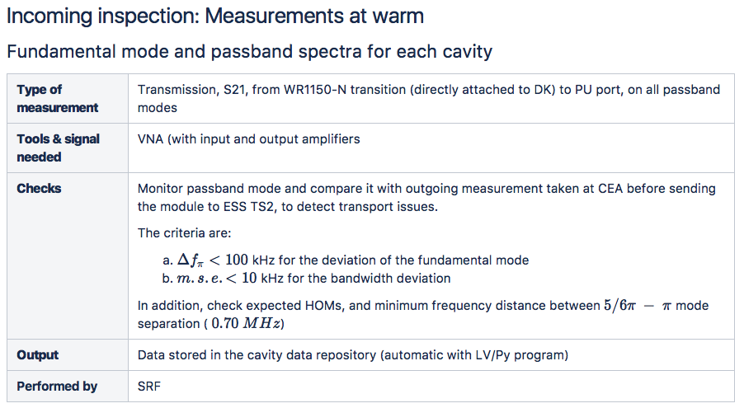
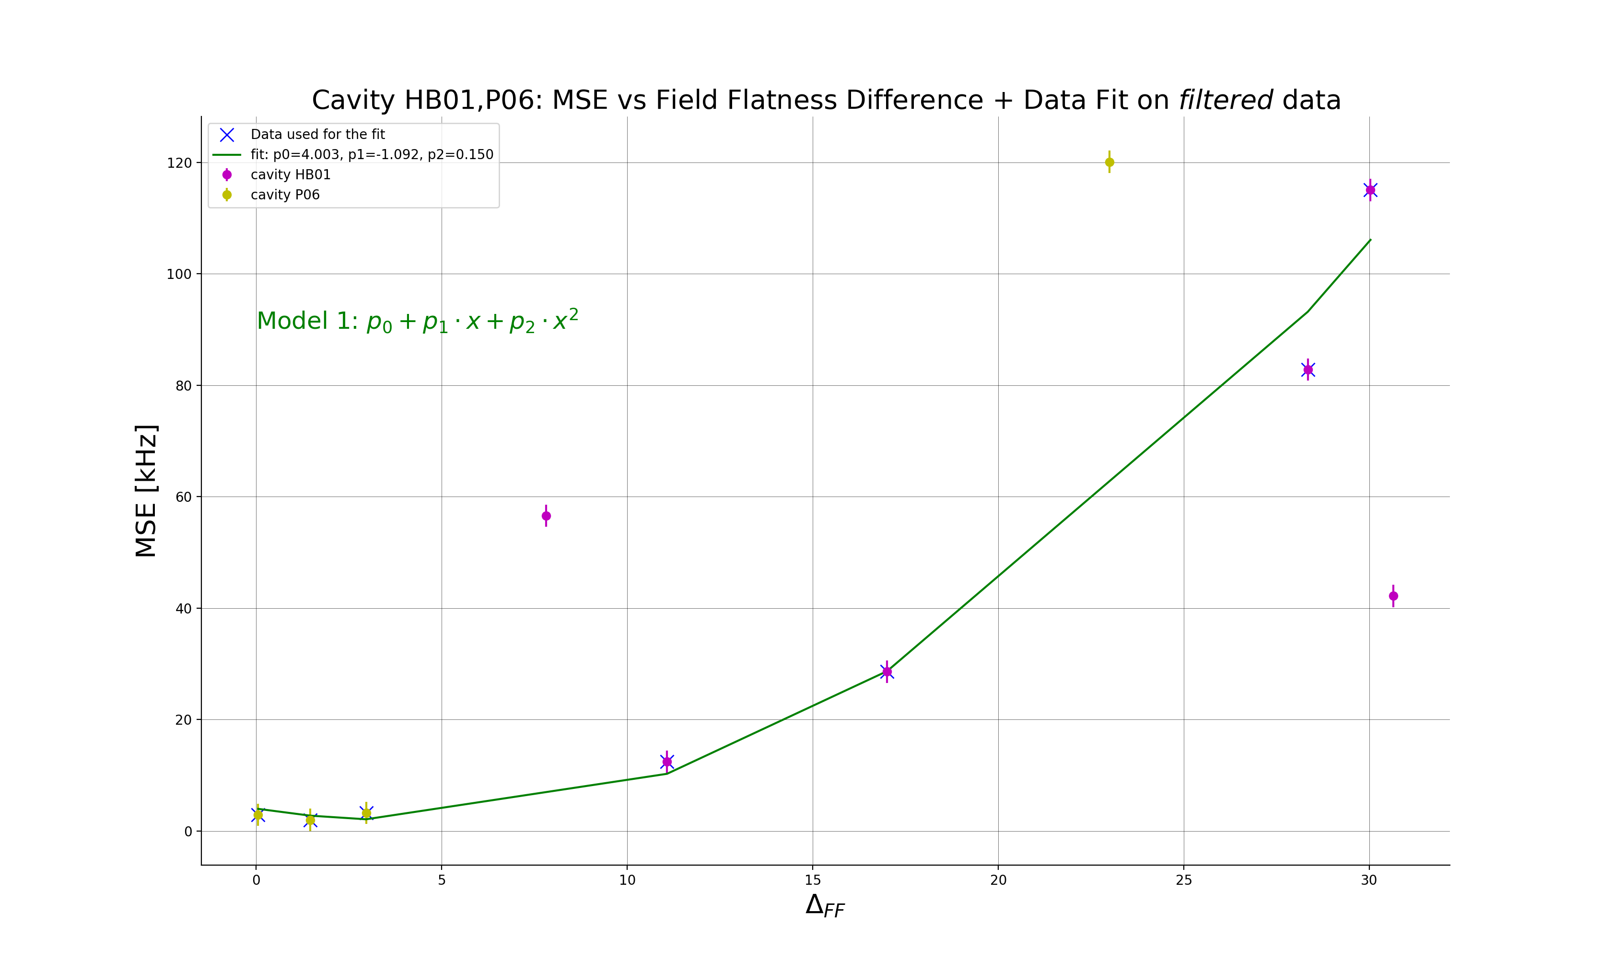
Cavities & Module measurements workflow
Incoming test before connection
Fundamental mode and passband spectra for each cavity at warm
Extimation of Q_{ext} at warm
Verification of inner cabling & components
Check of the Cold Tuning System CTS (after continuity checks)
  Slow tuning system check
  Piezo check

Slide 11
Calibration, Conditioning amdn Measurements at TS2
Before Cooldown
  Warm Cable & Component Calibration availability
  Warm Input RF Couplers Conditioning
After cooldown no HP RF
  4K cavities passband measurement
After reaching stable conditions @2K no HP RF
  Cold cable calibration
  2K cavities passband measurements, before tuning
  Cavities slow Tuners Test and Cavities Tuning
  2K cavities passband measurements, after tuning

Slide 12
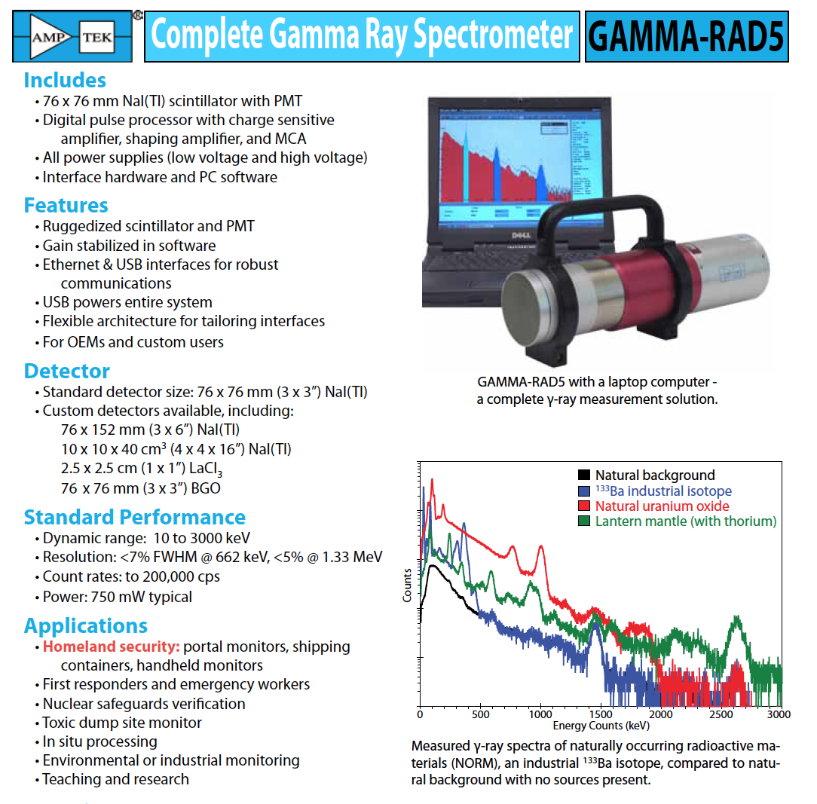
Calibration, Conditioning amdn Measurements at TS2 (2)
After reaching stable conditions @2K starting HP RF
  Cold coupler conditioning (off-resonance)
  Start open loop operation at low forward power
  Fine tuning with Pt
  Calibration
  Power ramp up (cavities on resonance)
  Field emission measurements (dose & energy spectrum)
Test goals
  Performance
  Limiting mechanisms (quench, FE, Power limitations)
  Comparison/correlation wrt VT results (and cryomodule results, where possible)
  Store data for future Linac operations

Slide 13
Thank you for your attention!

