Slide 1
TS2 Cryomodule Controls
Emilio Asensi
Project Engineer
www.europeanspallationsource.se
2 April 2019

Slide 2
“Our vision is to build and operate the world’s most powerful neutron source…”
European Spallation Source ERIC website
“Power is nothing without control.”
Pirelli & C. S.p.A.

Slide 3
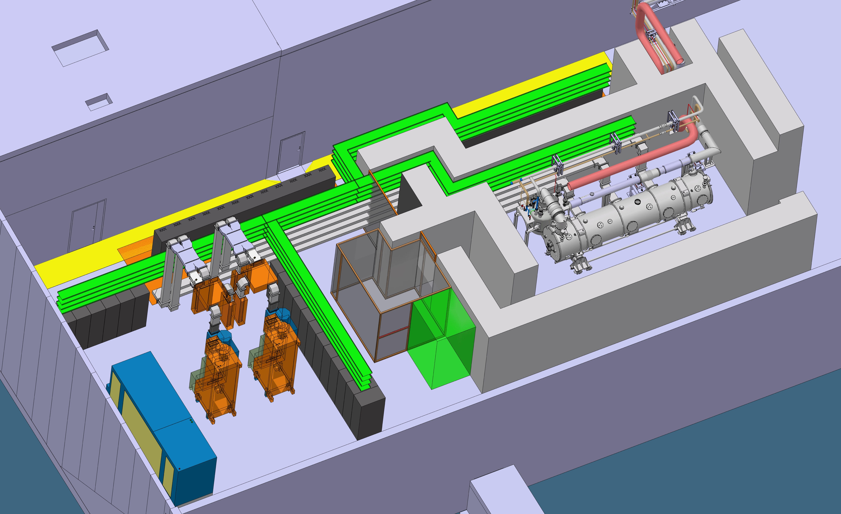
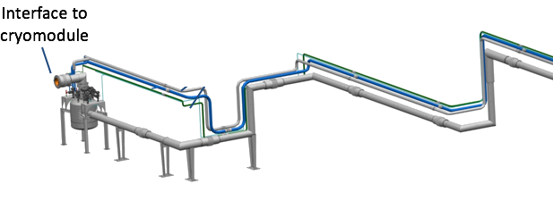
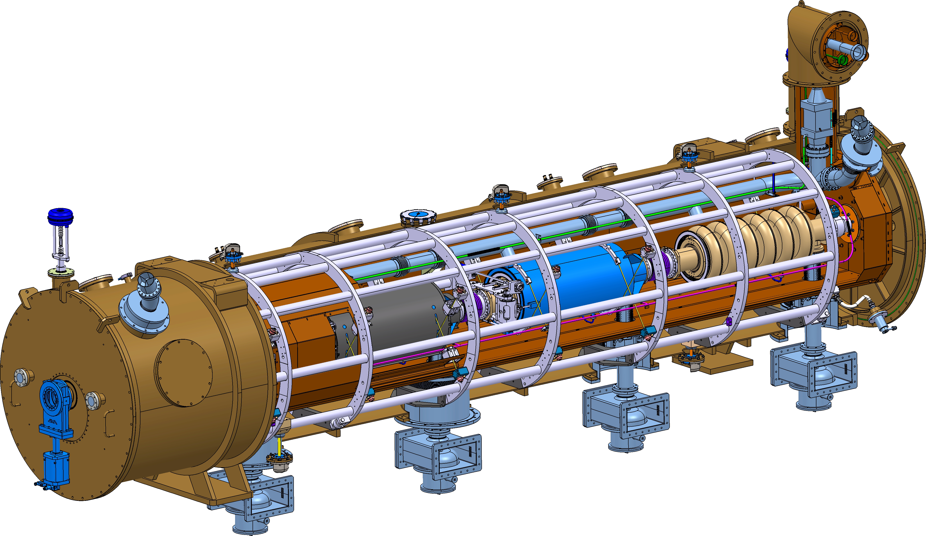
Context
Phase 1
Interface to TICP
50 m
Phase 2

Slide 4
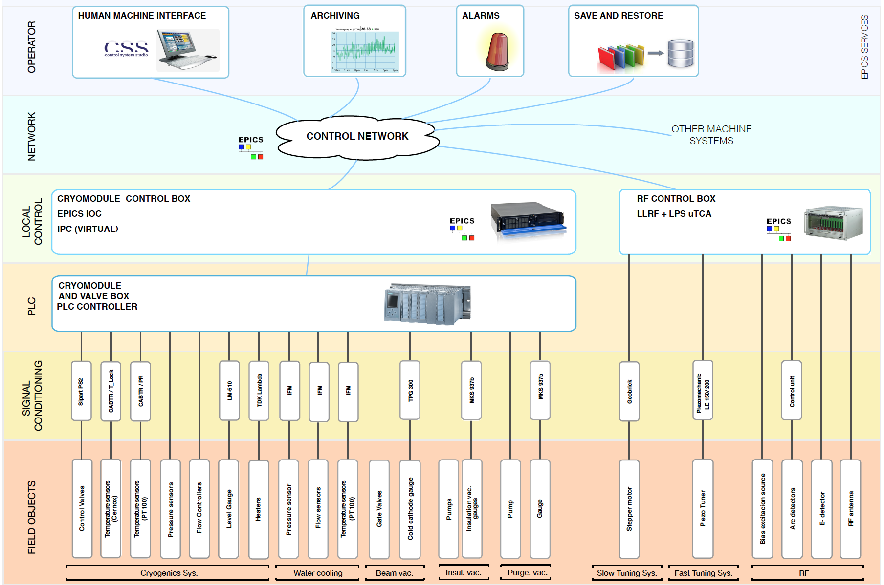
Architecture
Very similar to LINAC
N.Elias

Slide 5
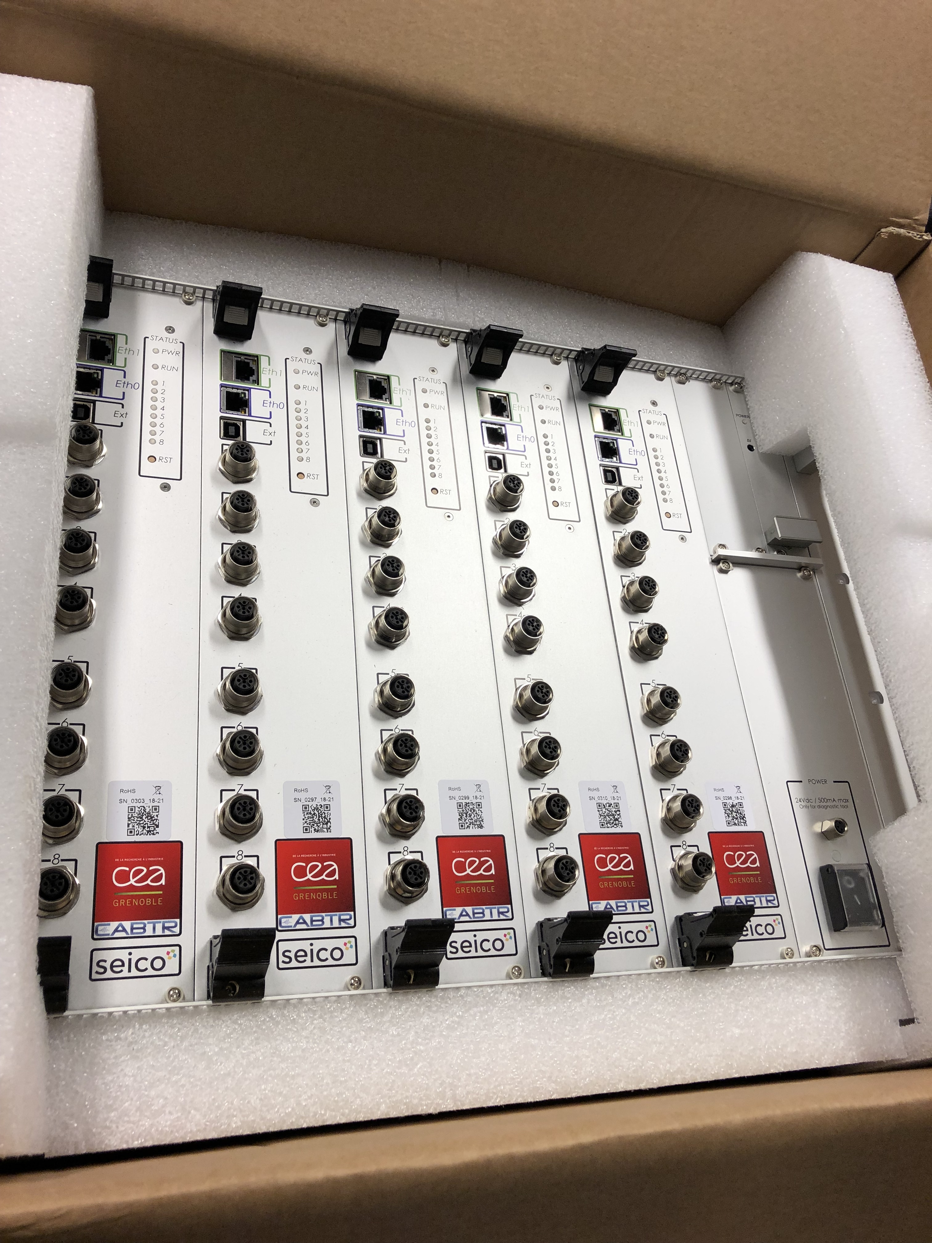
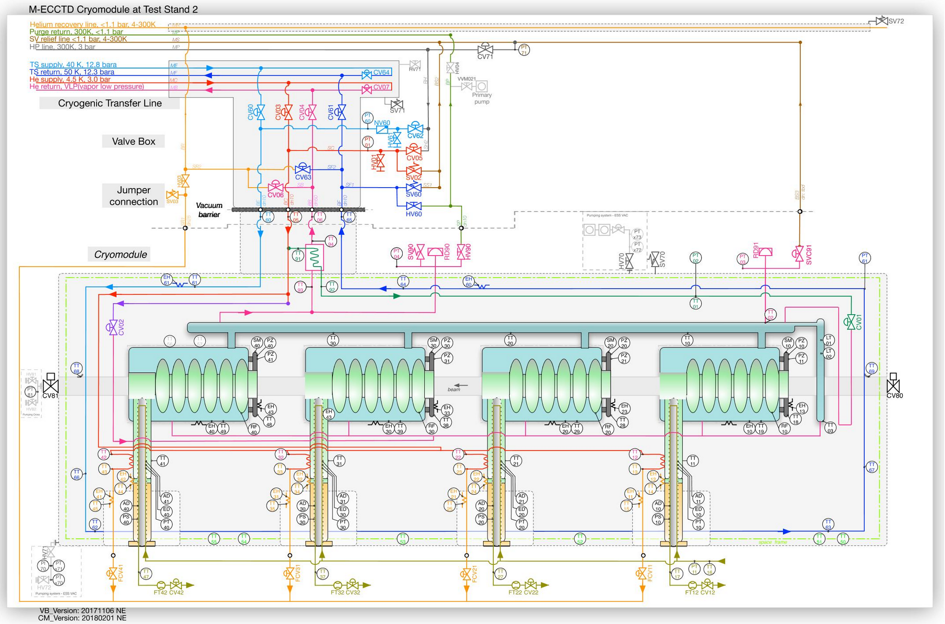
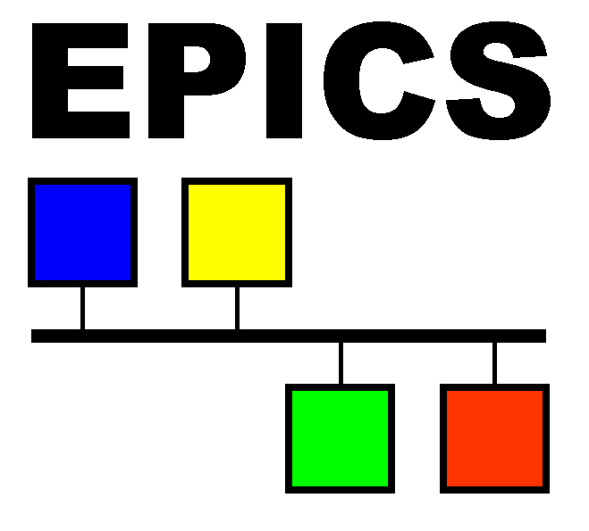

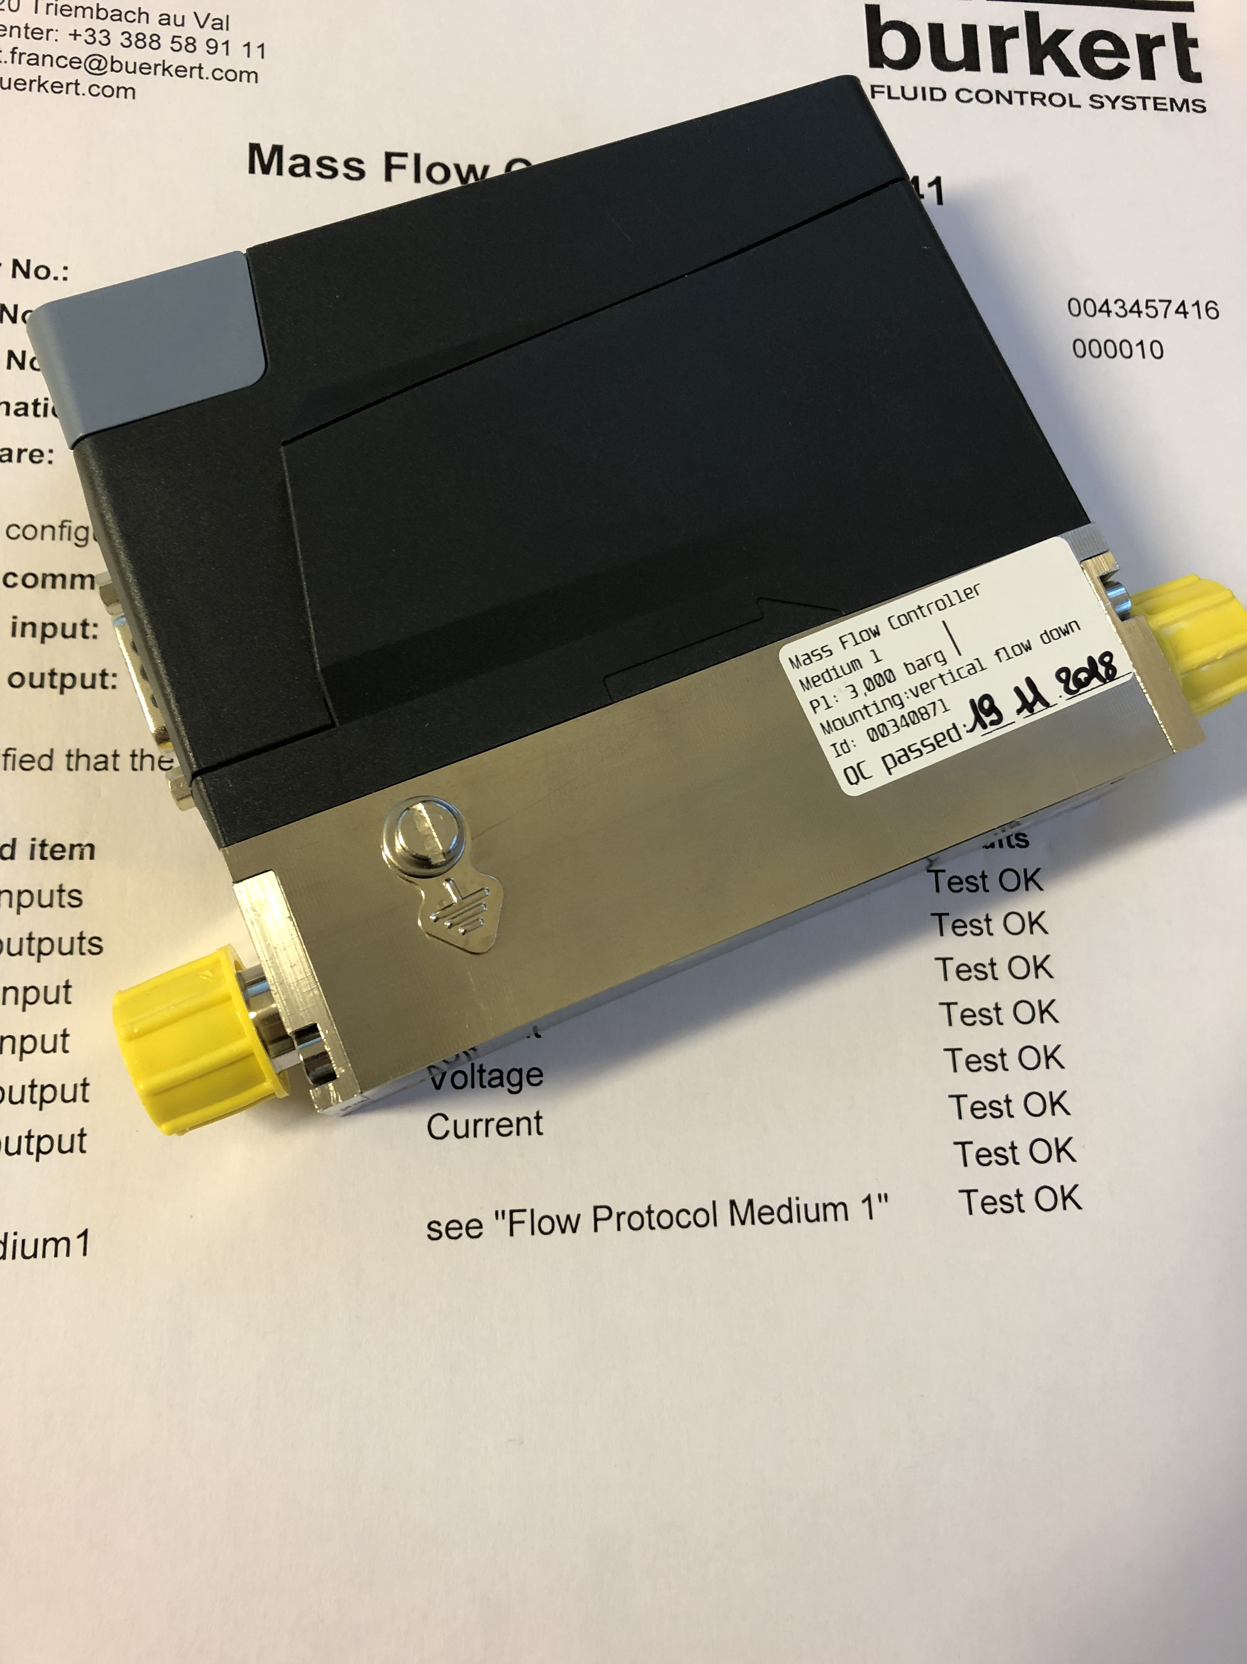
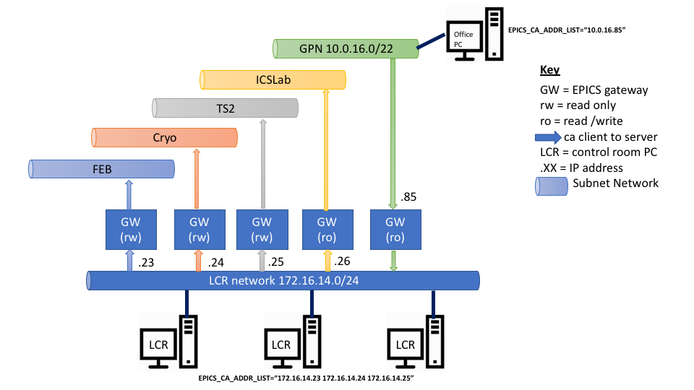
Methodology
P&I D
Field objects list
ESS names
Cable DB
FBS
Electrical Analysis
Device Selection
SC list
Procurement
Tests
FBS
ePlan objects
Diagrams
Installation
Cabling
PLC IO list
Procurement
CCDB
Definition Files
PLC Factory
HW Configuration
Read/Write
Tests
Process Logic Implementation
VersionDog
PLC Factory
IOC Factory
PV list
EPICS Implementation
CSEntry
Virtual IPC
Technical Network
CSStudio objects
Faceplates
OPI development
Alarms
Archive
Process Logic revision
Logbook
Operations
Initiation
Planning
Execution
Monitoring
Documentation

Slide 6
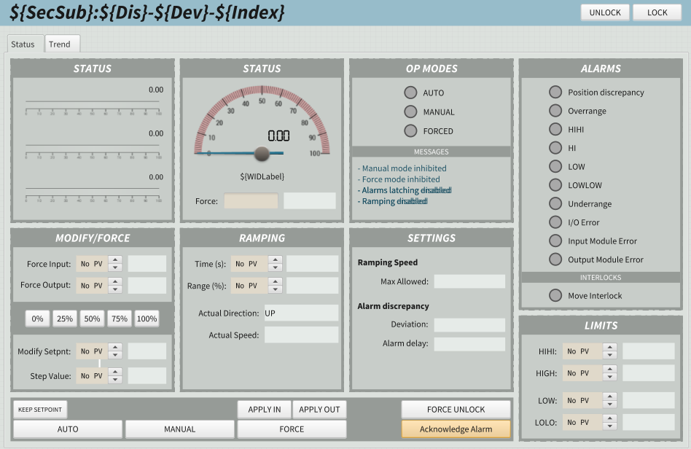
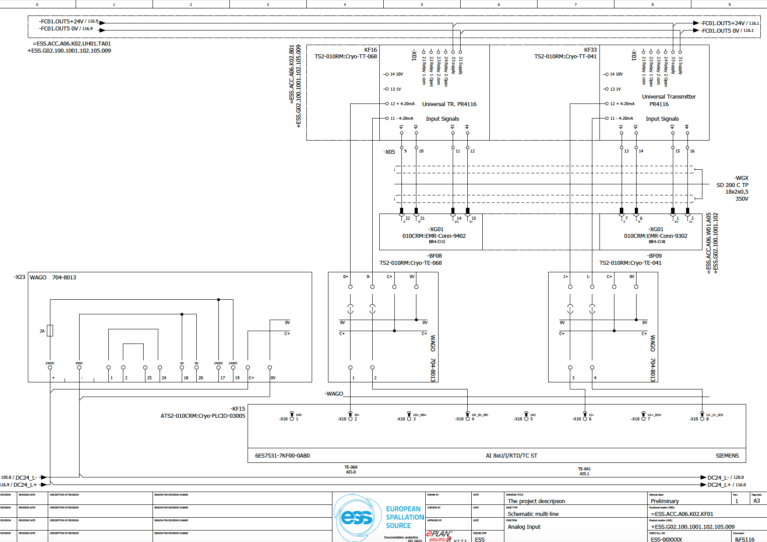
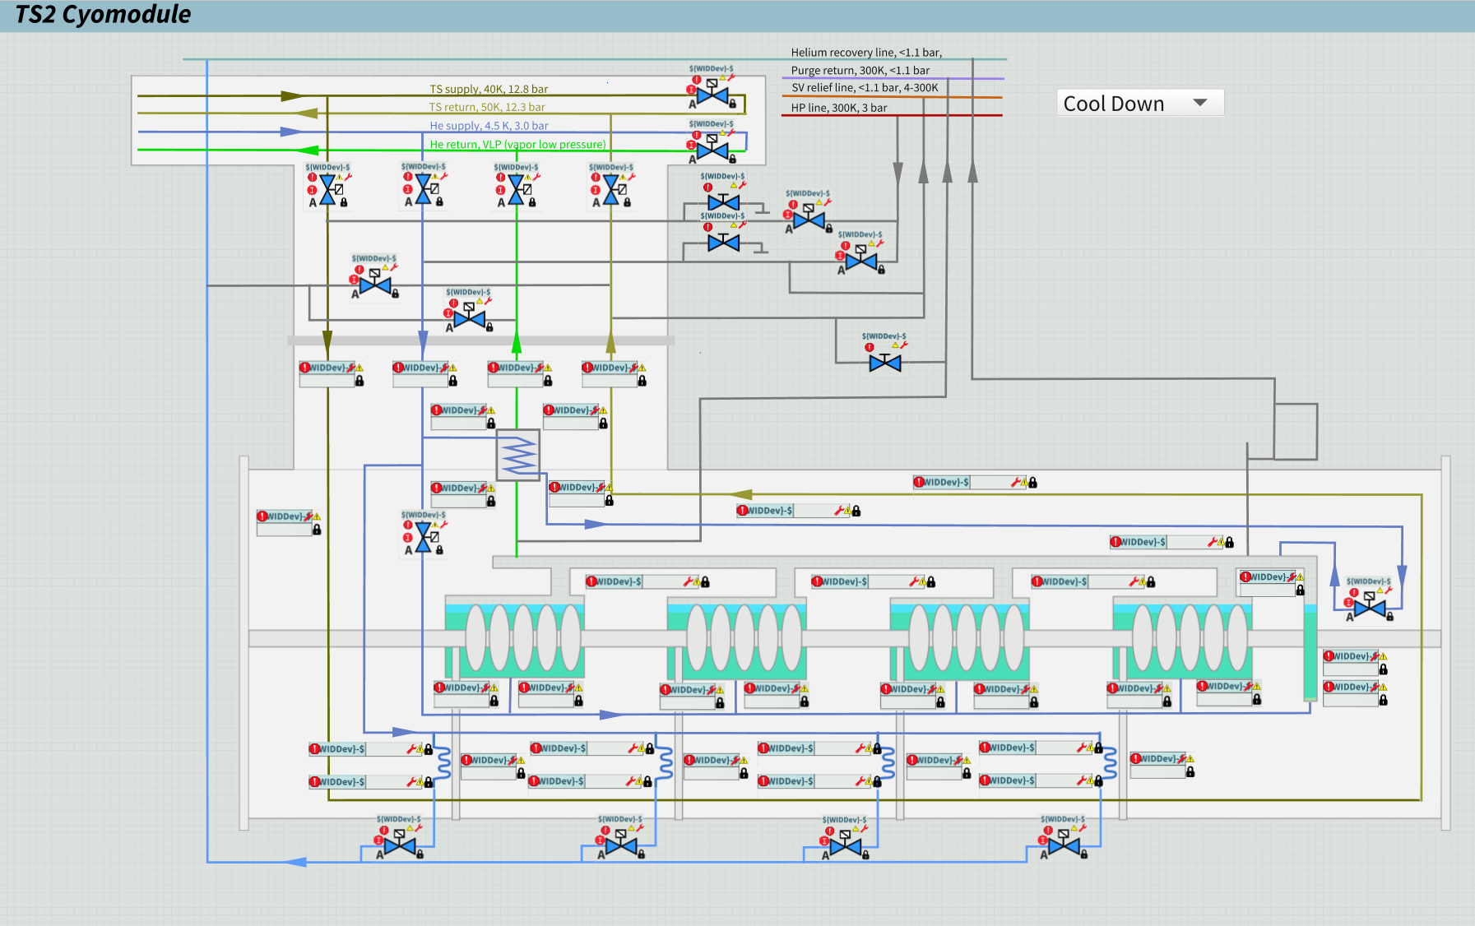
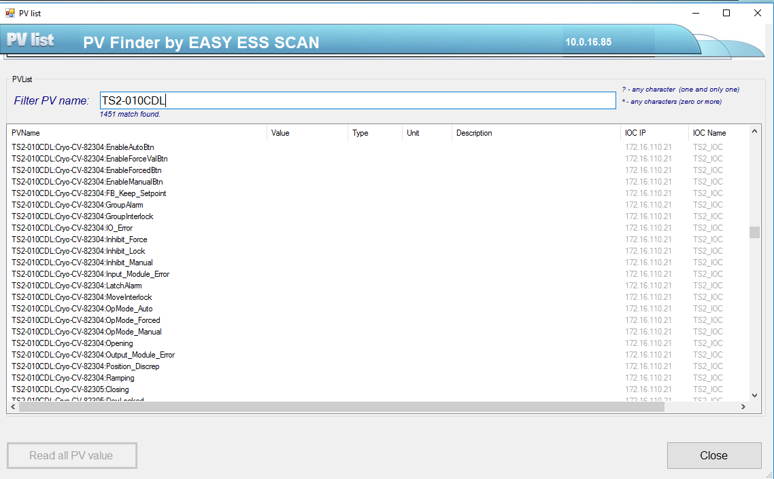
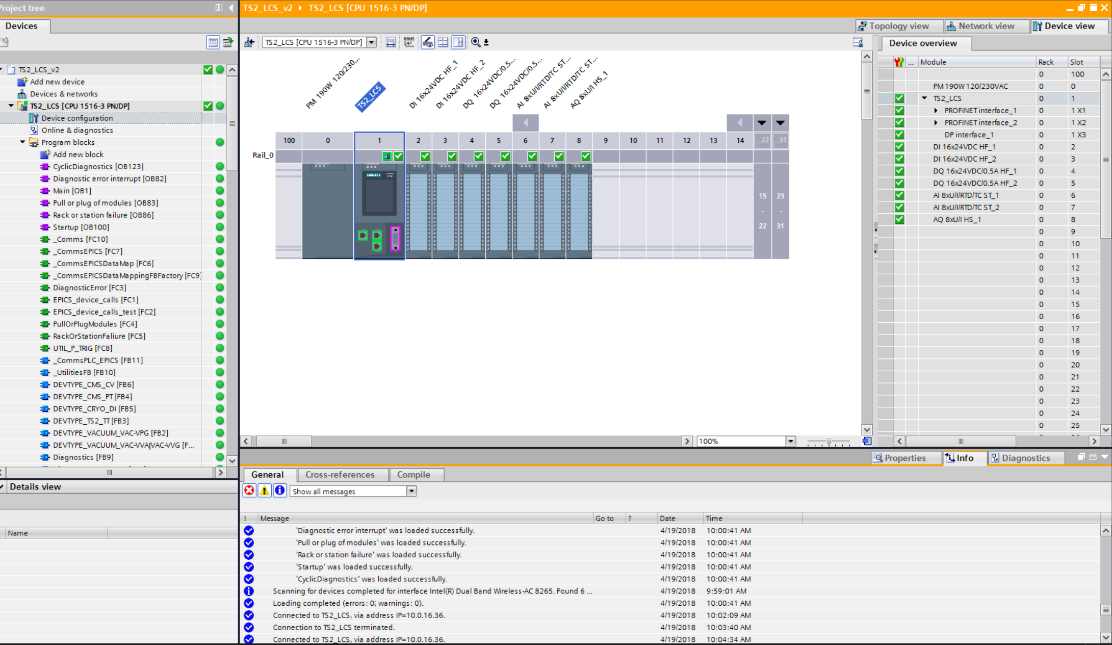
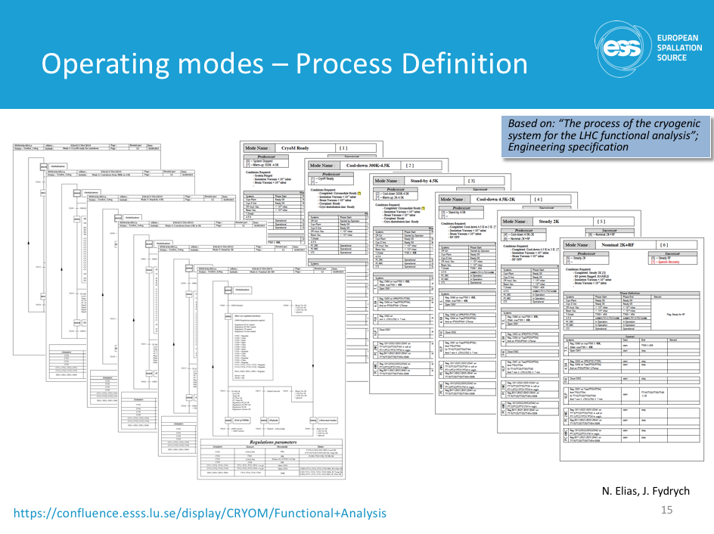
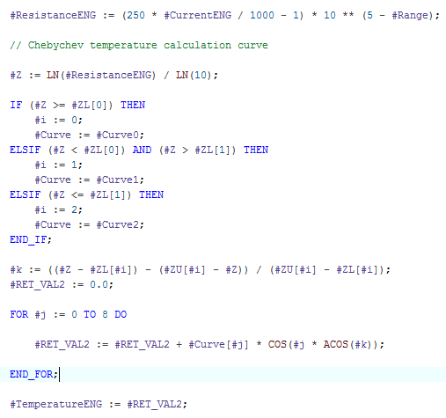
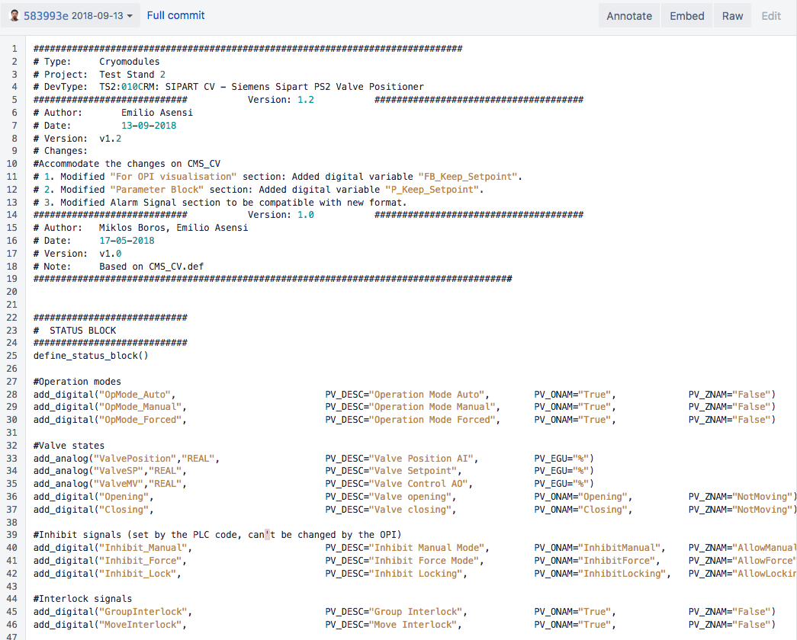
Status

Slide 7
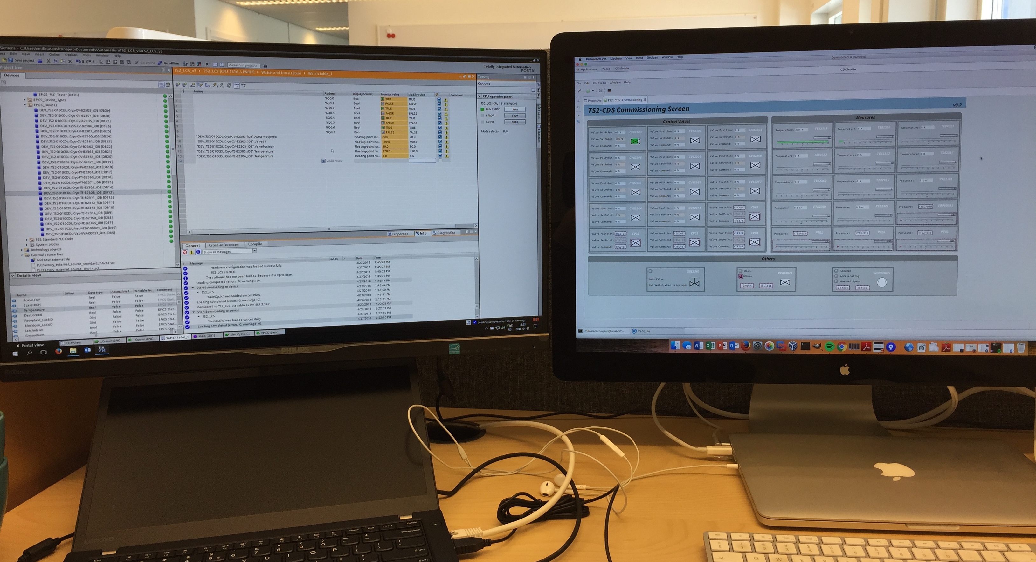
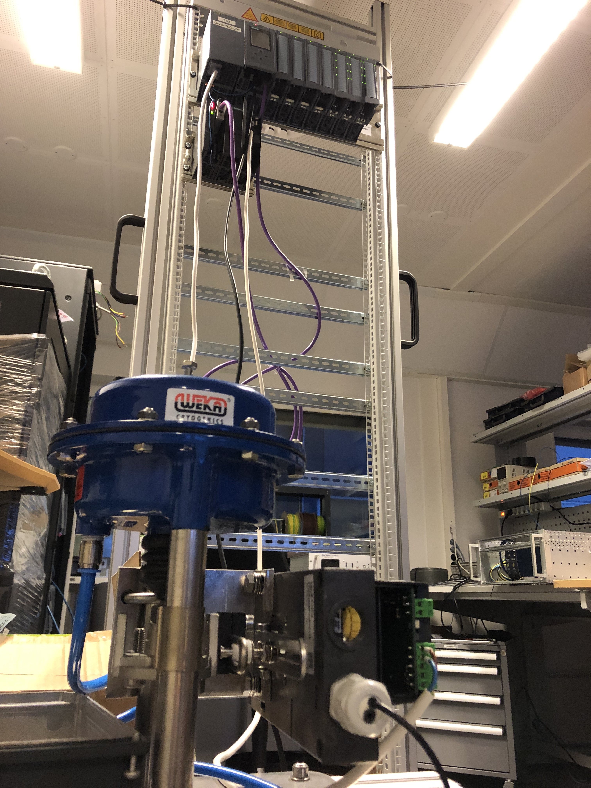
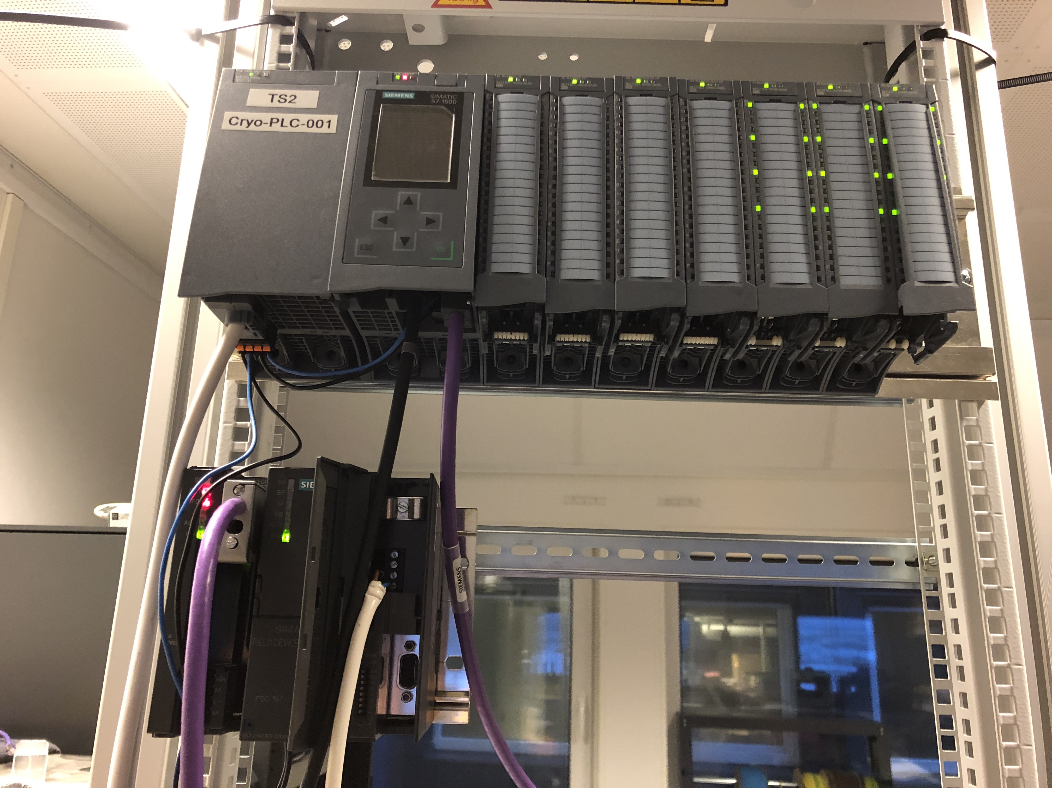
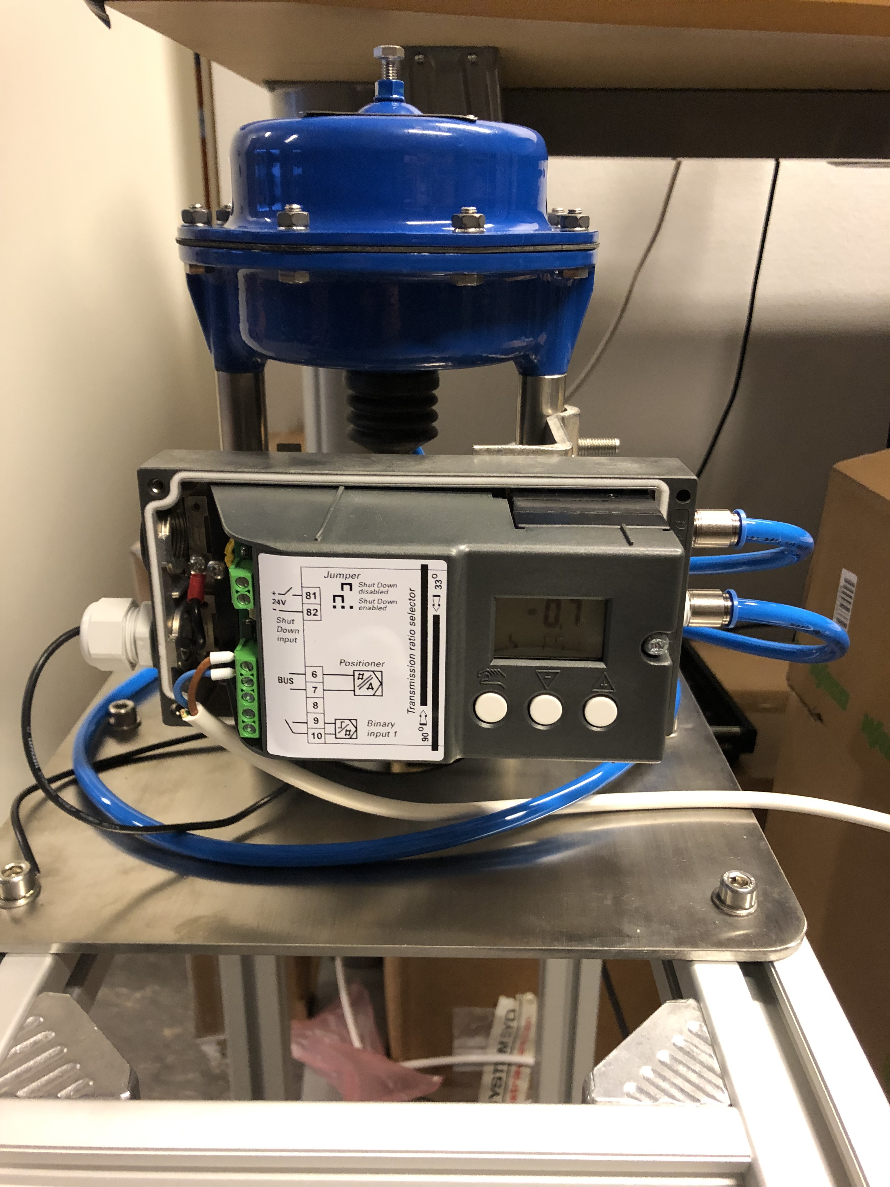
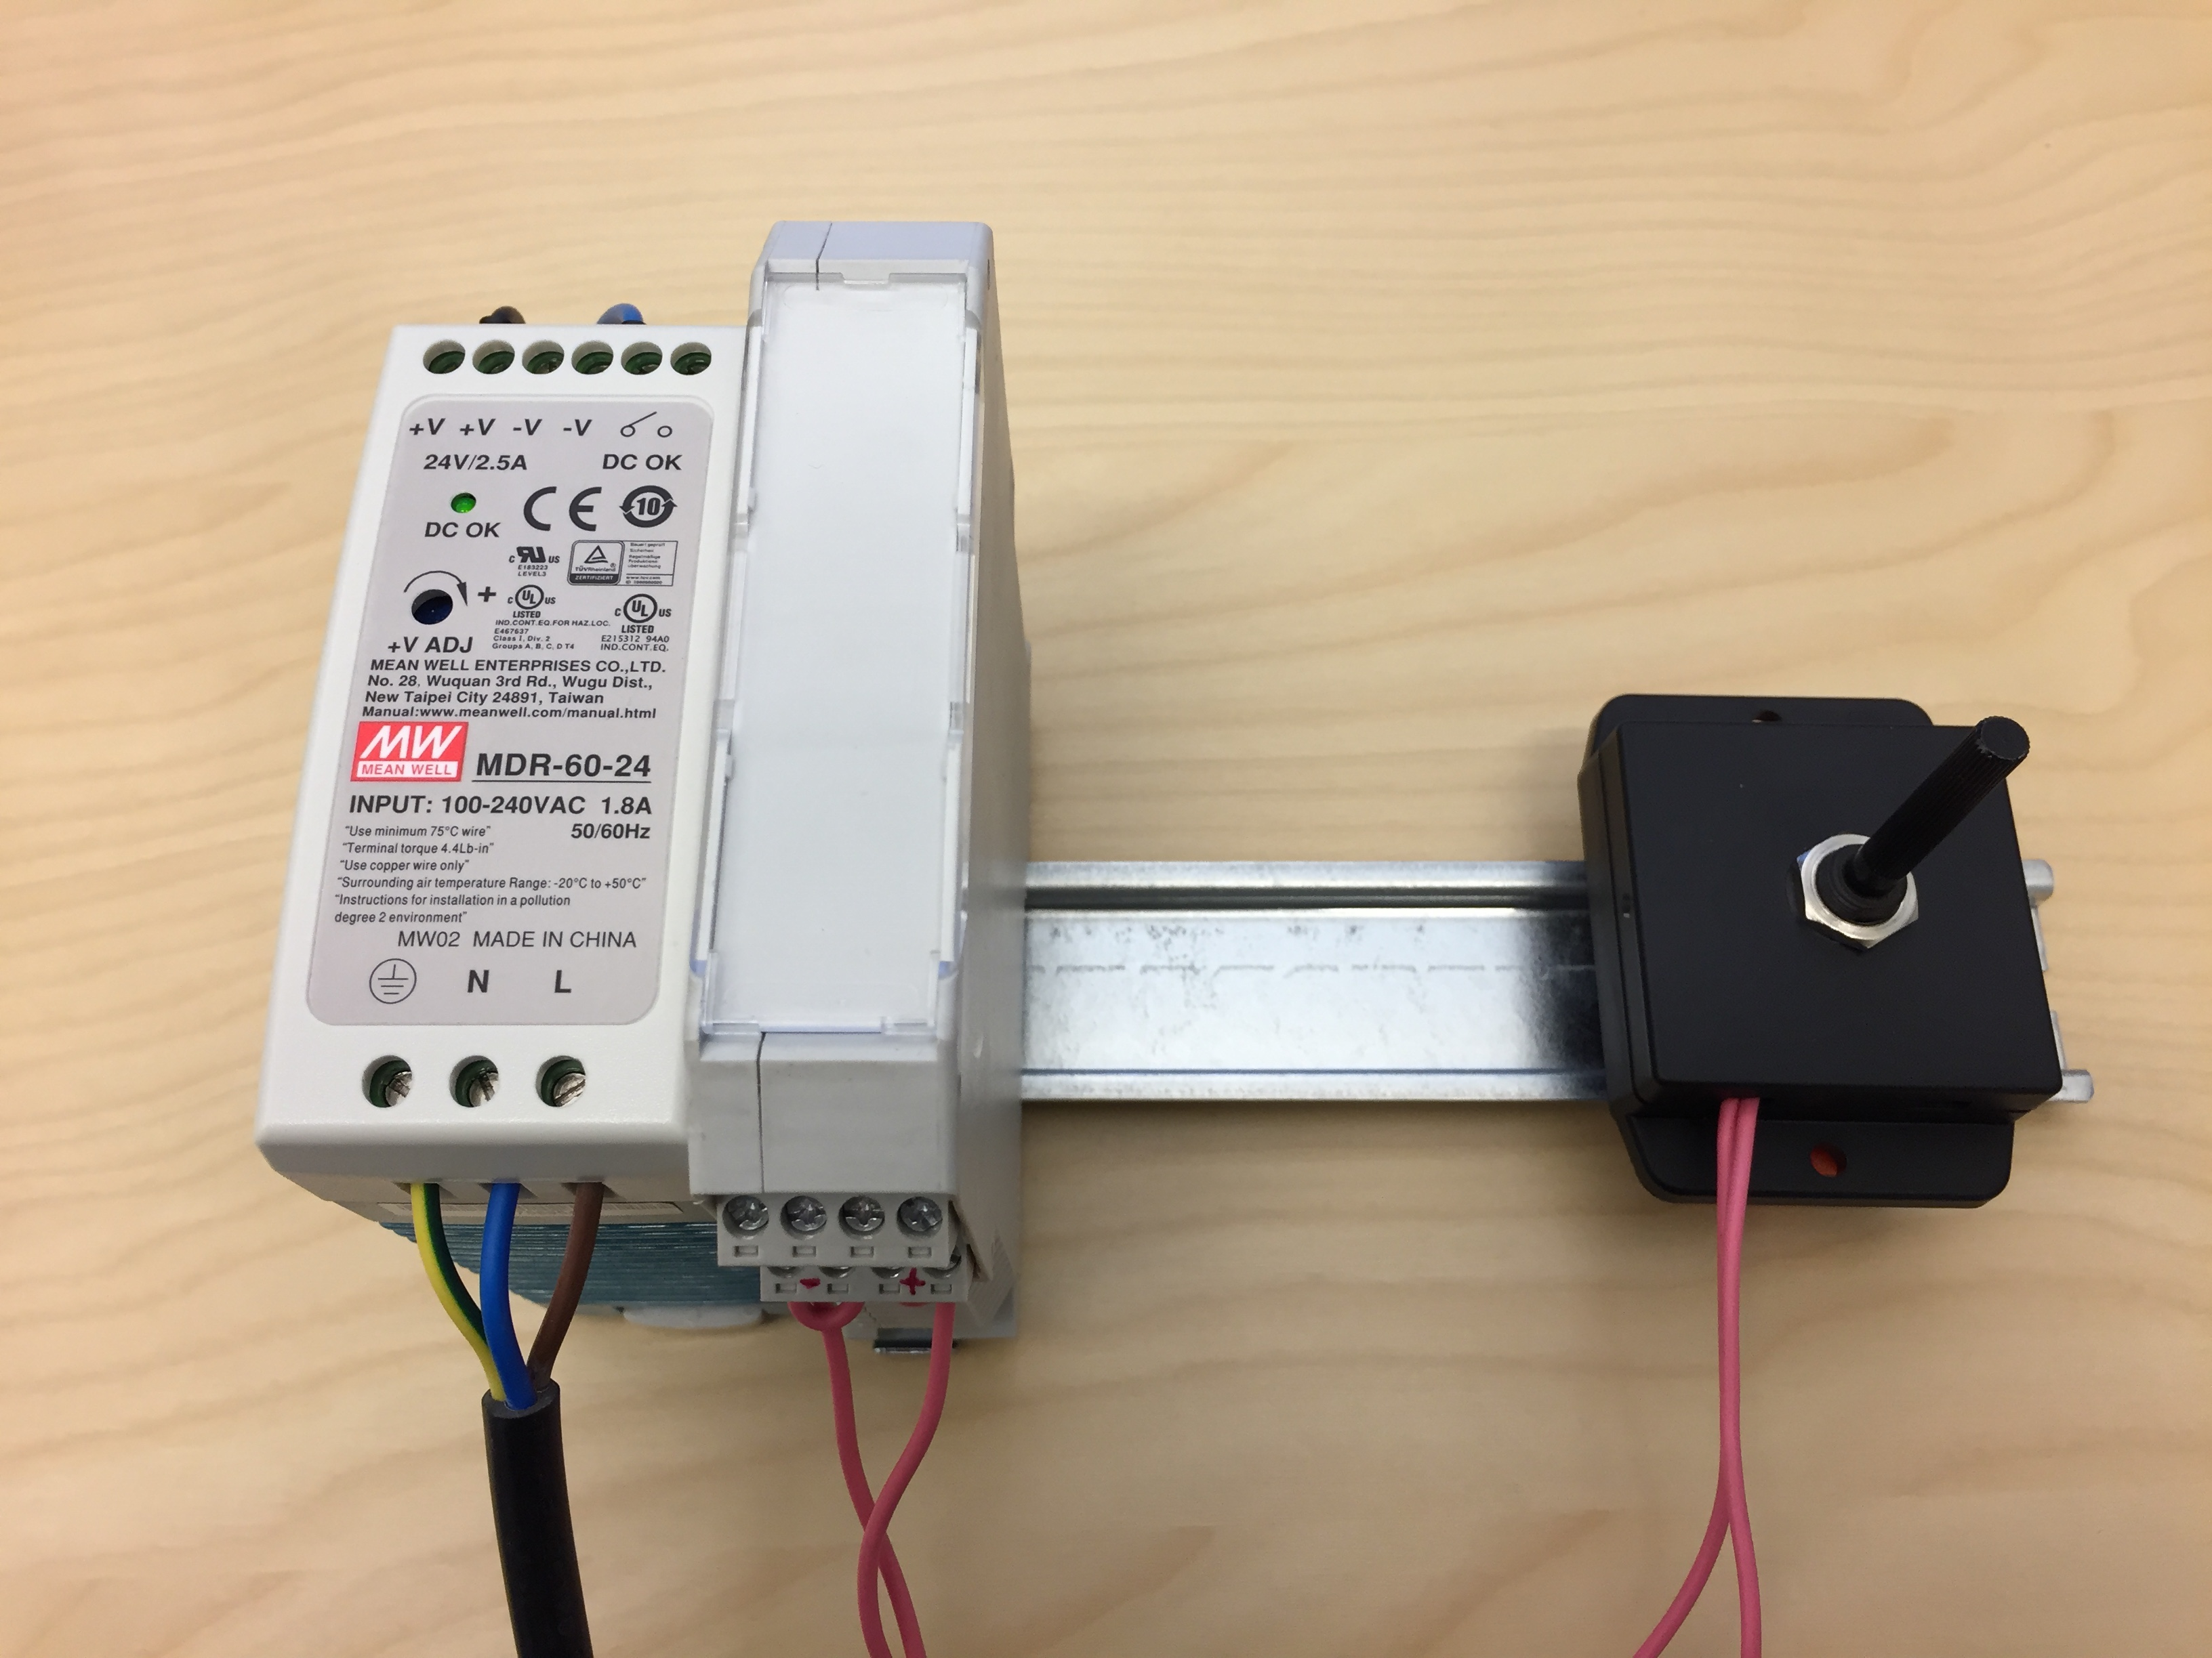
Preliminary Tests

Slide 8
Schedule
SRR

Slide 9
Team
TS2 Controls
LINAC Controls
External ICS contract
Emilio Asensi (AD):
Instrumentation and System Integration, Project Lead
Miklos Boros (ICS):
Software and Hardware Integration
Nuno Elias (AD):
Coordination and Commissioning
Wawrzyniec Gaj (IFJ PAN):
Operations and OPI development
Peter Van Velze (ICS):
Installation and Racks
Peter Asvany (EIS):
Electrical Diagrams
0 FTEs 100%

Slide 10


