Slide 1
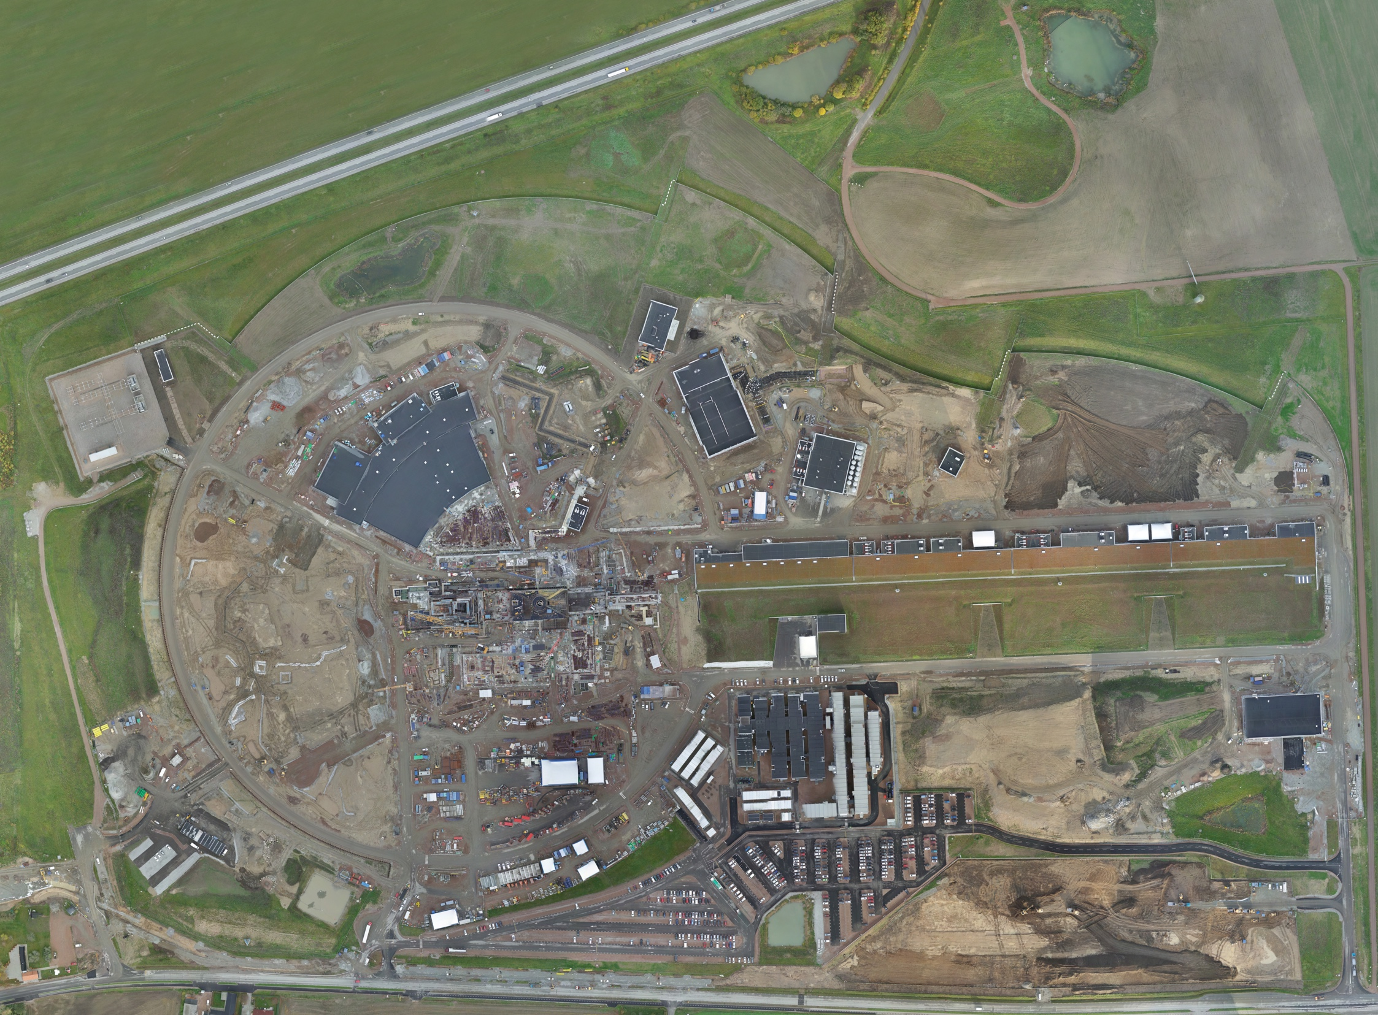

Mechanical Design
aTAC – 11 of April 2019
Nick Gazis
Section Leader
Mechanical Engineering & Technology (MET) Section

Slide 2
Outline
Overview intro
Requirements based design
ESS Engineering Sequence
Design according to the ESS Engineering Handbook:
  Systematic flow for the Mechanical Design in CATIA
    Integration
    Mechanical Design
    2D & 3D Released for Installation
    Release process
Prototypes and produced components

Slide 3
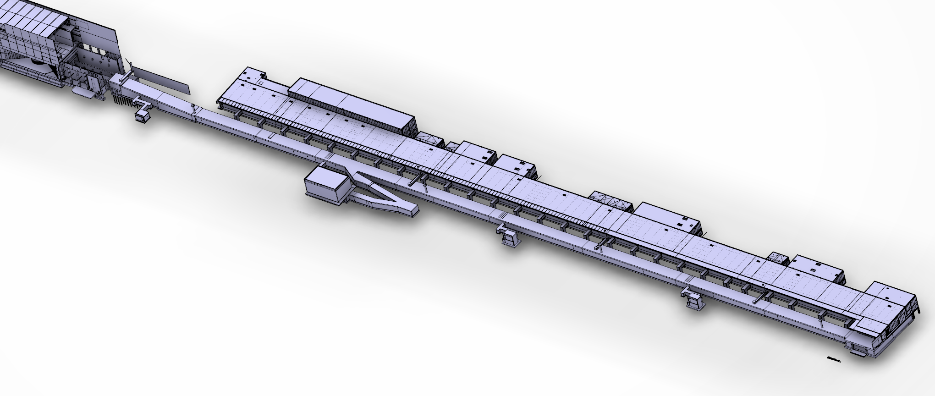
High level overview of ESS Accelerator
Target
A2T ← DgLg ← HEBT
2000 MeV
High β
Cryo
(179 m)
Medium β
571 MeV
(77 m)
Spoke
Warm
DTL
216 MeV
(56 m)
MEBT
90 MeV
(39 m)
(3.8 m)
RFQ
3.6 MeV
(4.6 m)
LEBT
(2.4 m)
Source
75 keV

Slide 4
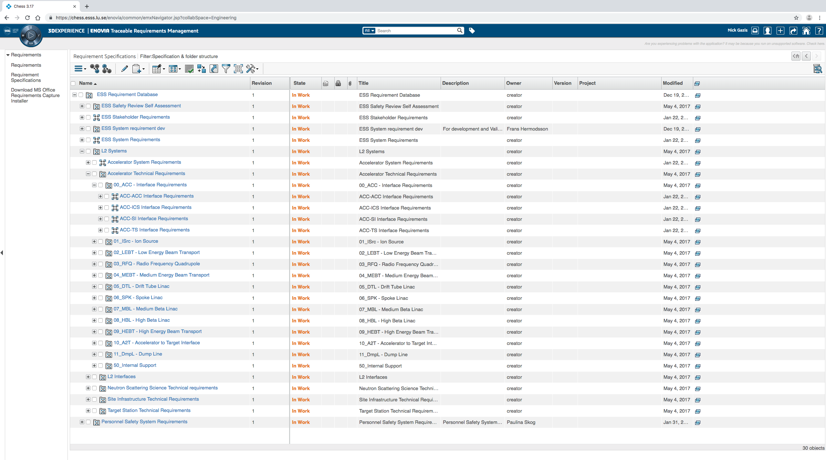
Information and specification flow
from Requirements to Accelerator digital mock-up
ESS FACILITY
L1
ICS – INTEGRATED CONTROL SYSTEMS
‘CONTROLS’
SI – SITE INFRASTRUCTURE
‘CONVENTIONAL FACILITIES’
NSS
‘INSTRUMENTS’
RMHF – RADIOACTIVE MATERIALS HANDLING FACILITY
L2
ACC – LINEAR ACCELERATOR (LINAC)
‘ACCSYS’
TS – TARGET STATION
‘TARGET’
ESS Projects
L3
ISRC
LEBT
RFQ
MEBT
DTLs
SPK
(LWUs, CMs)
MBL
(LWUs, CMs)
HBL
(LWUs, CMs)
HEBT*
A2T
Beam to Target
LINAC Assemblies
Dmpl (incl.Beam Dump)
PWRC
PS, HV Power Convertors
ISS
Ion Source
Specialties
BMD
Beam Magnets &, Deflectors
EMR
EM Resonators
(Bunchers, RFQ, DTLs,
CMs)
PBI
Proton Beam Instrumentation
ID*
Intercepting Devices
L4
Discipline
Systems
RFS
Radio Frequency
Systems
VAC
Vacuum
CRYO
Cryogenics Systems
WTRC
Water Cooling
CNPW
Conventional Power
SA
Survey &
Alignment
Safety
*Intercepting devices that are not part of VAC and PBI (not instrumented)
** Some vacuum chambers supplied by WP3, for raster magnets by WP6
*** RFQ and DTL cooling skids supplied by WP3
CM =CryoModule PWRC =PoWeR Convertors
HEBT=High Energy Beam Transport ISS =Ion Source Specialities
LWU=Linac Warm Unit CNPW=CoNventional PoWer
Courtesy of Eugene Tanke ESS-0008904, R7

Slide 5
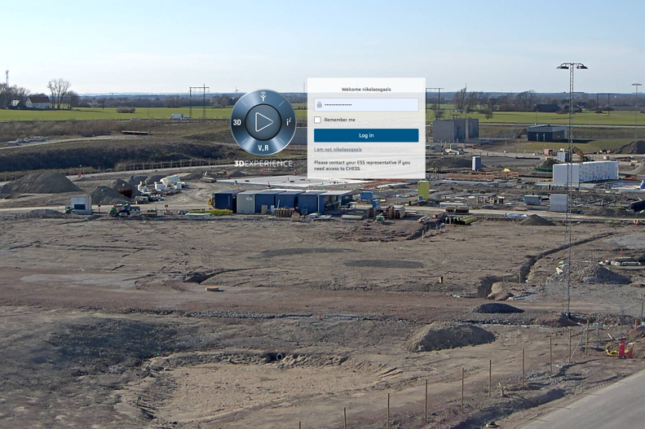
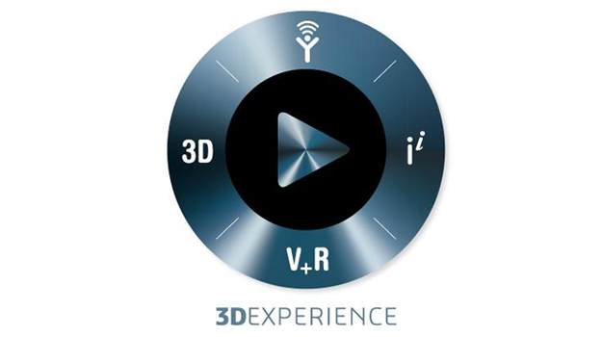

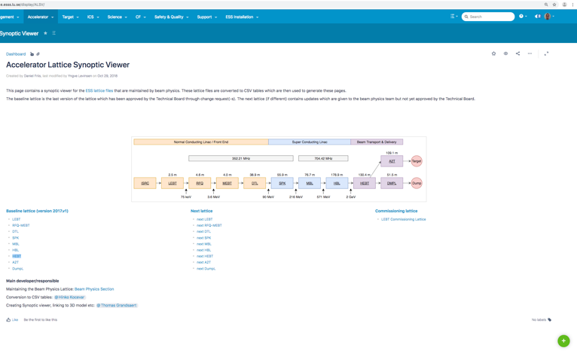
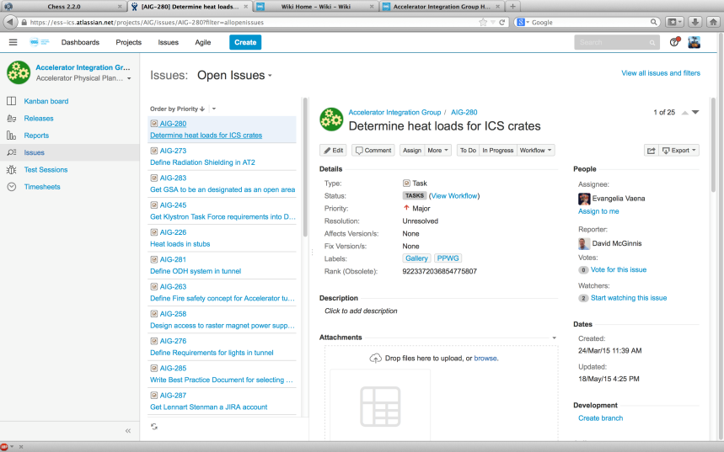

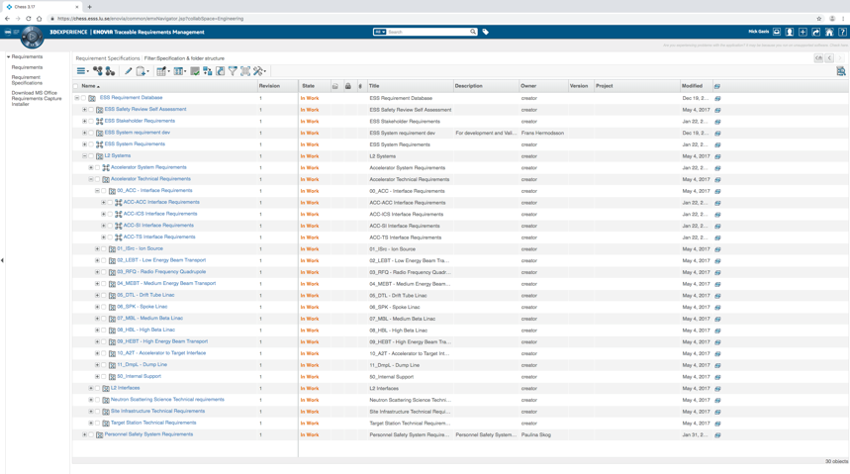
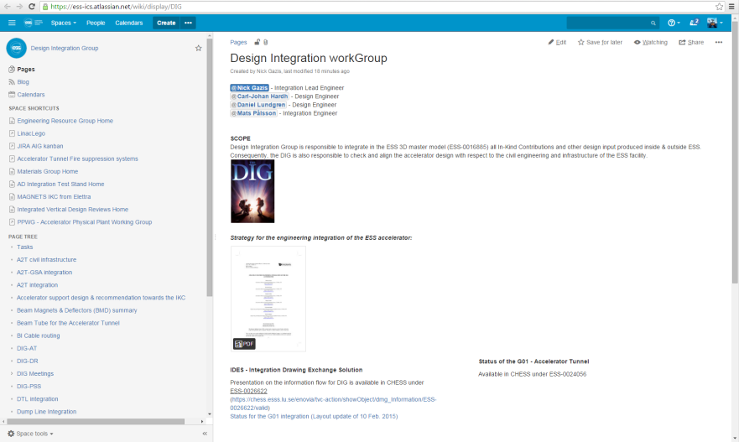

ESS engineering sequence
3. CHESS (in-house & IKC input)
4. Spatial Integration (see F.Rey talk)
5. Mechanical Design – see next slide for details
2. Machine Skeleton
(Lattice)
Atlassian tool suite
5. Design progress monitoring with JIRA tasks
1. Requirements (TRM)
6. Release Installation/Manufacturing Drawings
7. Deliverable:
Accelerator at ESS, ready for Operation

Slide 6
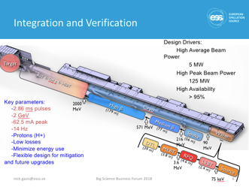
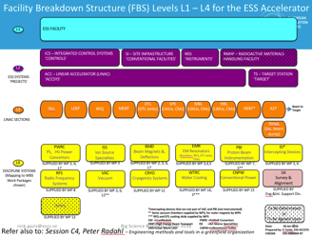
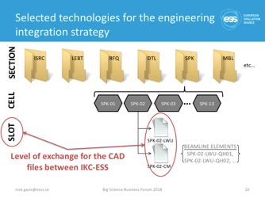
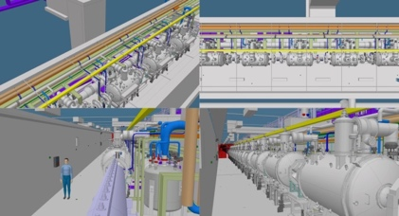
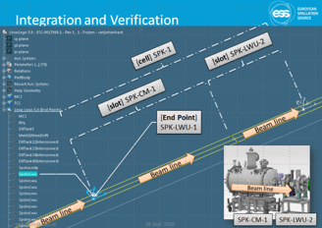
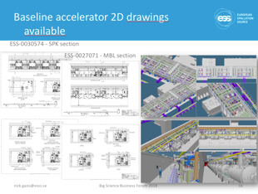
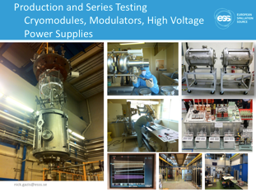
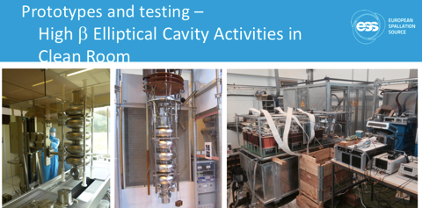

Systematic flow for the Mechanical Design in CATIA:
based on the ESS Engineering Handbook
from Physics Needs & Project Reqs.
via
Verification
Validation
Traceability
to Eng. Deliverables Machines, Parts, Eng. Services,
Operat.,
Integrat. Exp.
Areas,
etc.
1. Physics Needs,
Case Study etc.
2. Requirements,
Systems & Disciplines, Risks
*
9. As-built DWGs,
Commissioning, Maintenance
3. System spatial Integration
*
4. Preliminary Design,
Simulations, Integration& CDR
8. Assembly, Installation,
Red Line update DWGs
LoM ASB
5. Detailed Design
& Baseline
7. “Series” Manufacturing
(manuf. DWGs), QA/QC etc.
LoM C
*
6. Mock-up*, Prototype Fabrication
Tests & QA/QC method verification
LoM P
6

Slide 7
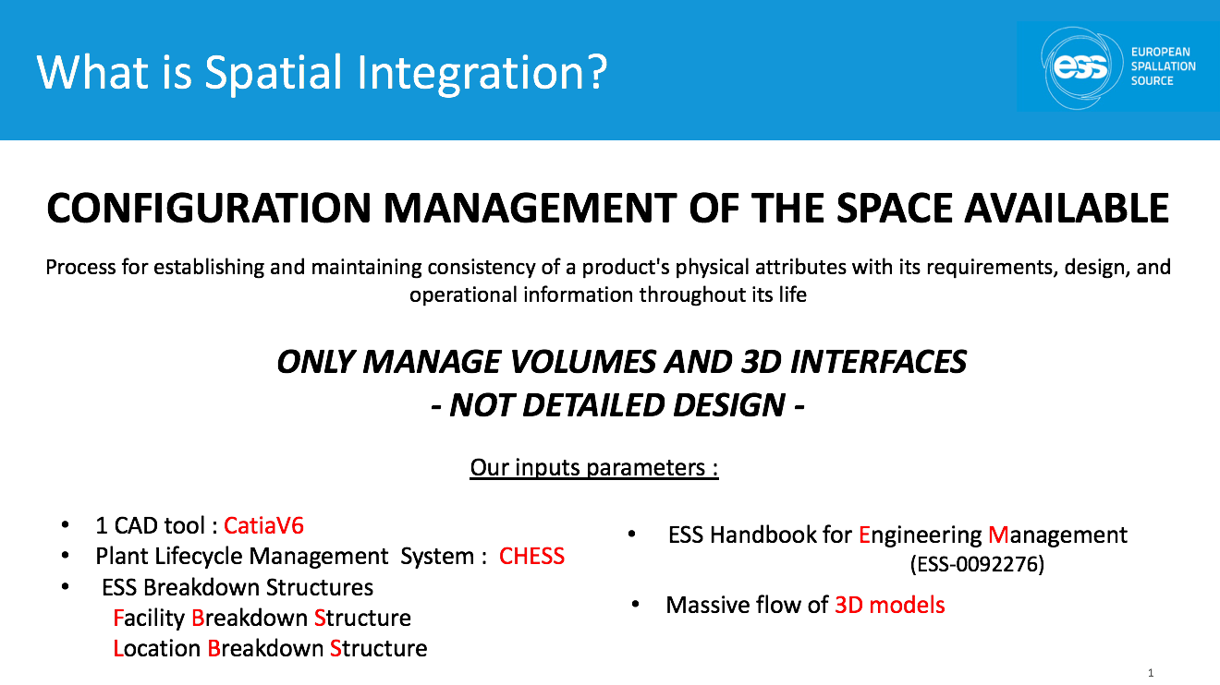
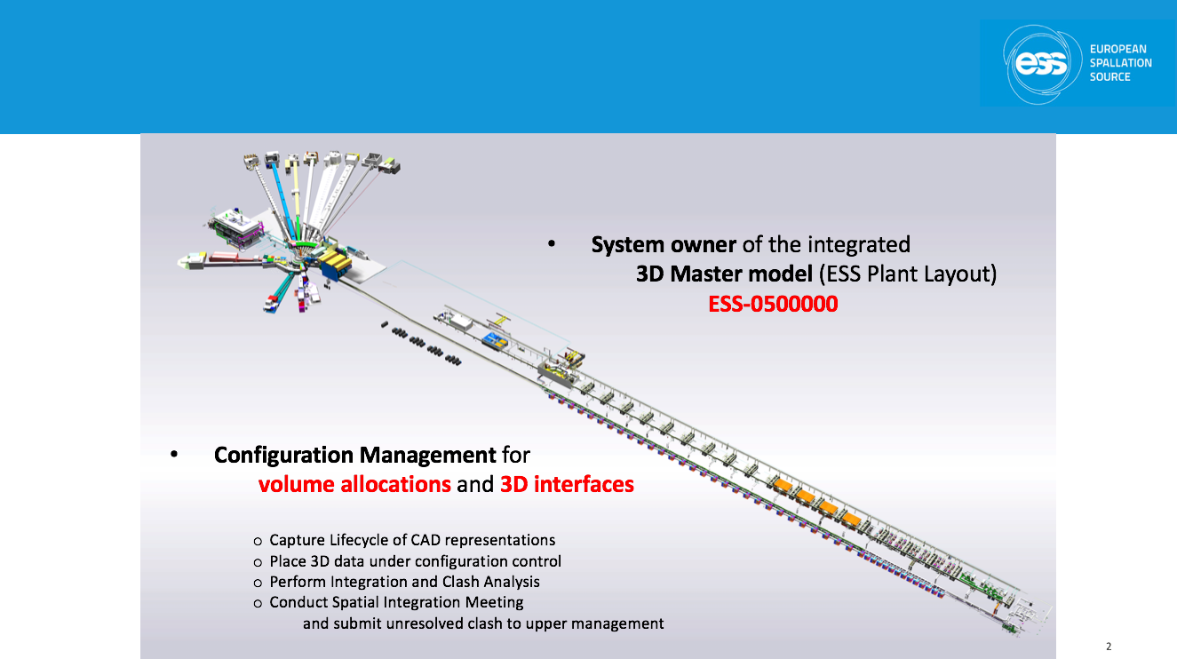
Integration, Design, Verification & Installation
CAD skeleton
See F.Rey talk on Integration
7

Slide 8
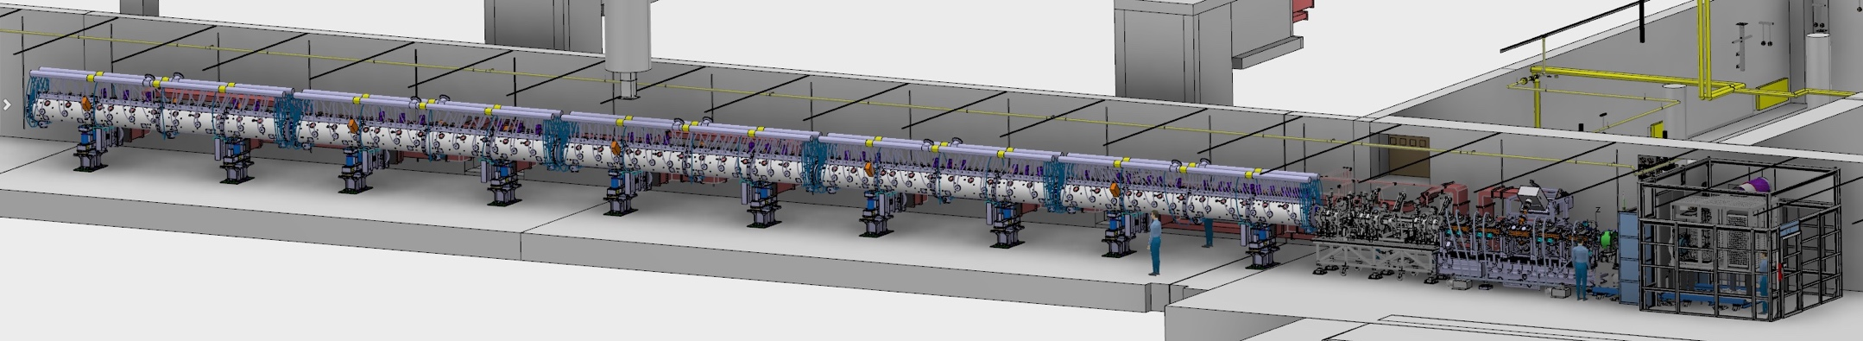
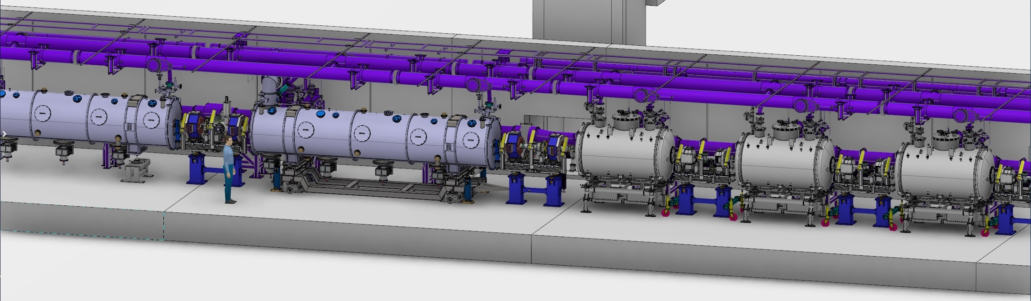
Integration & Design prior to Accelerator Installation

Slide 9
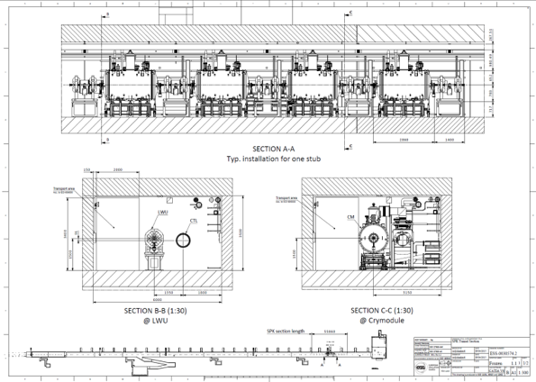
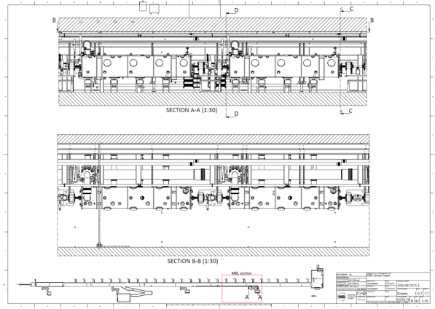
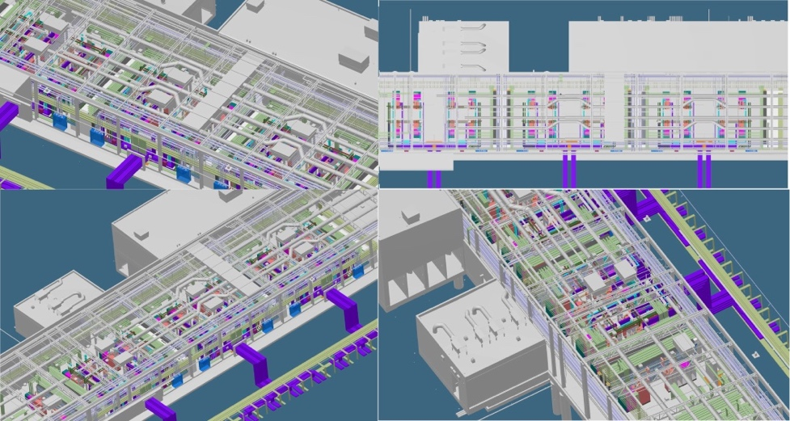
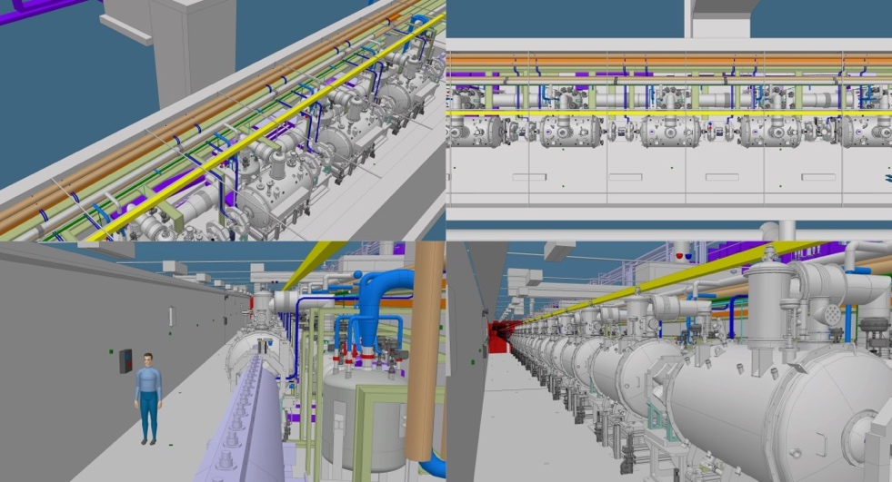
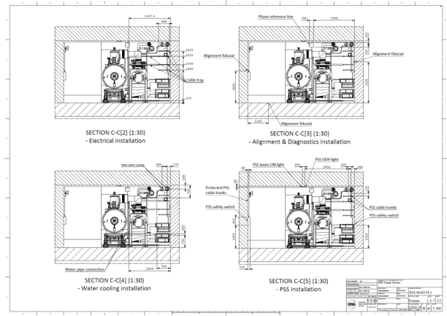
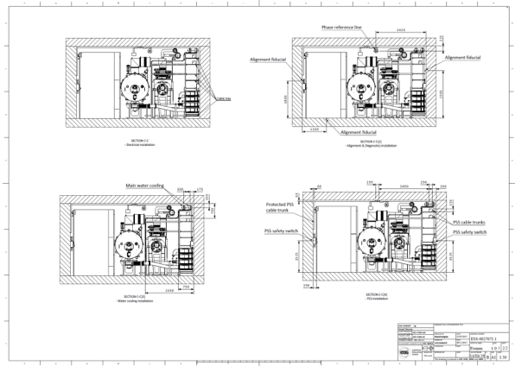
2D & 3D installation drawings and maps
ESS-0030574
SPK section
ESS-0027071
MBL section

Slide 10
Checking & releasing engineering design according to Engineering Handbook
V2: 12-10-2018
Sub Project
Mechanical Design
A
B
C
D
P
R
ASB
ASC
Electrical
Process Piping
Design
Issue for
System Design
Issue for
System Design
Detailed design
Issue for Quotation
Issue for Construction
Issue for Installation
As-Built
As-Scanned
CHESS
Release
Development Phase
Production Phase
Release Models
with Level Of Maturity
Including Space Reservation for
Designer
Installation
Operation
Remote Handling
Maintenance
Work Package/ Project Leader
CAD model management, engineering analysis (design, integration, simulation, …)
& communication as single-point-of-truth (under revision control)

Slide 11
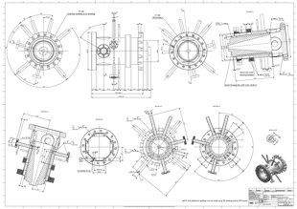
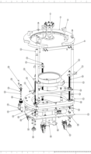
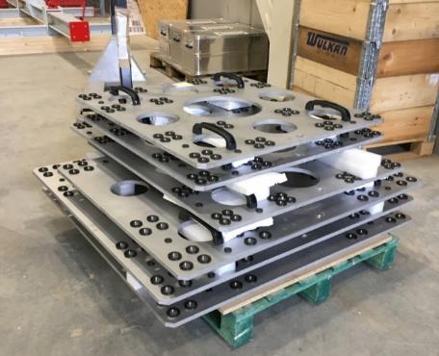
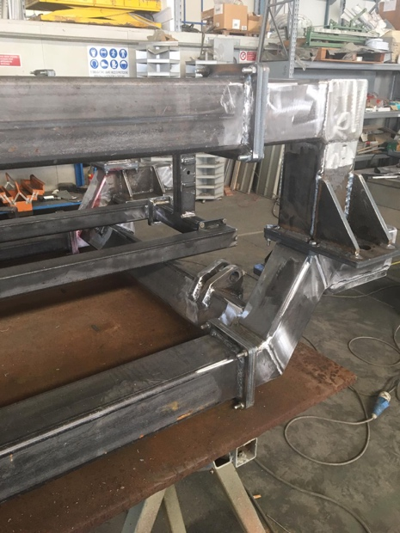

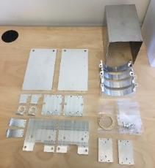
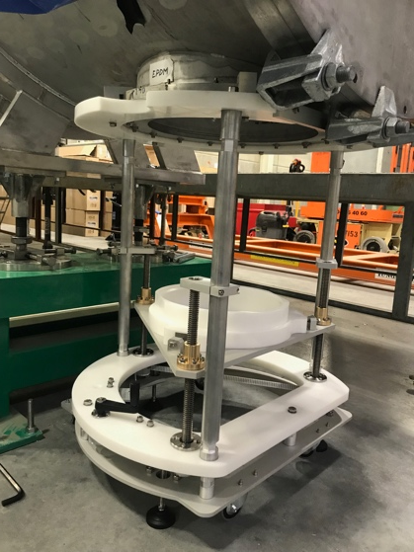
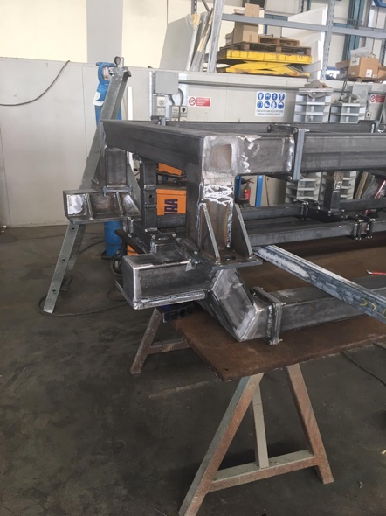
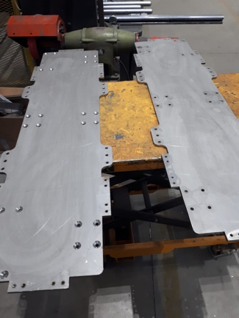
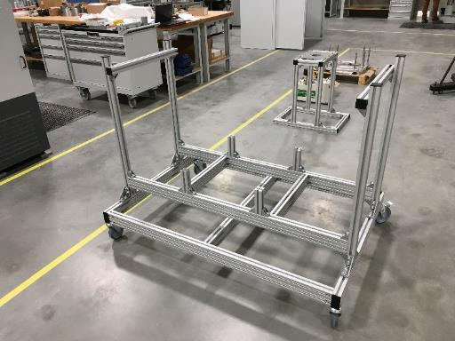
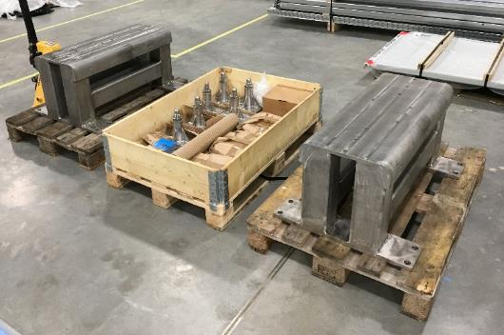
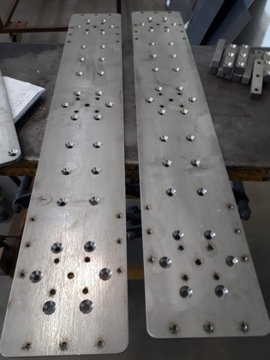
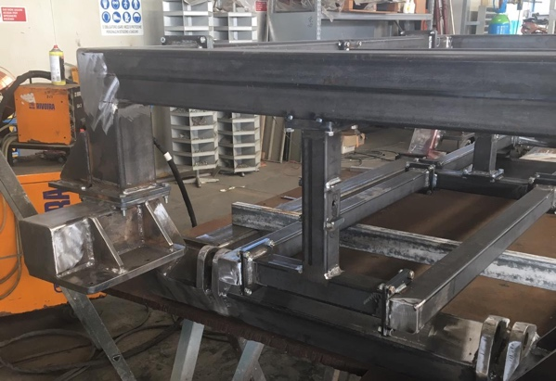
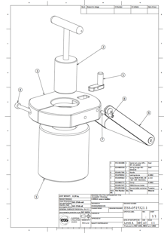
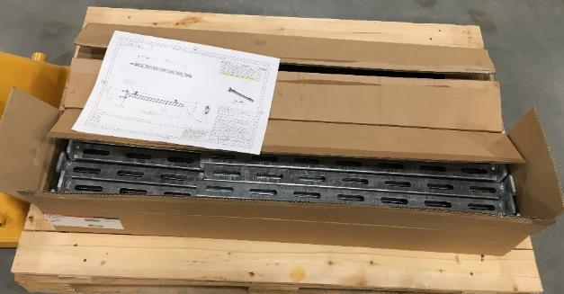
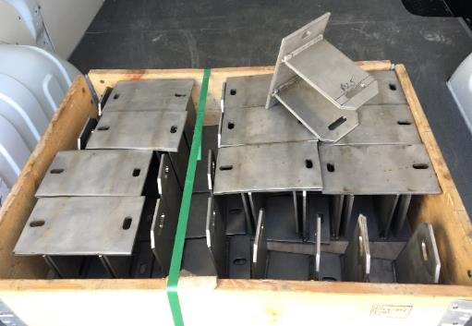
Parts and prototypes designed and produced in-house

Slide 12
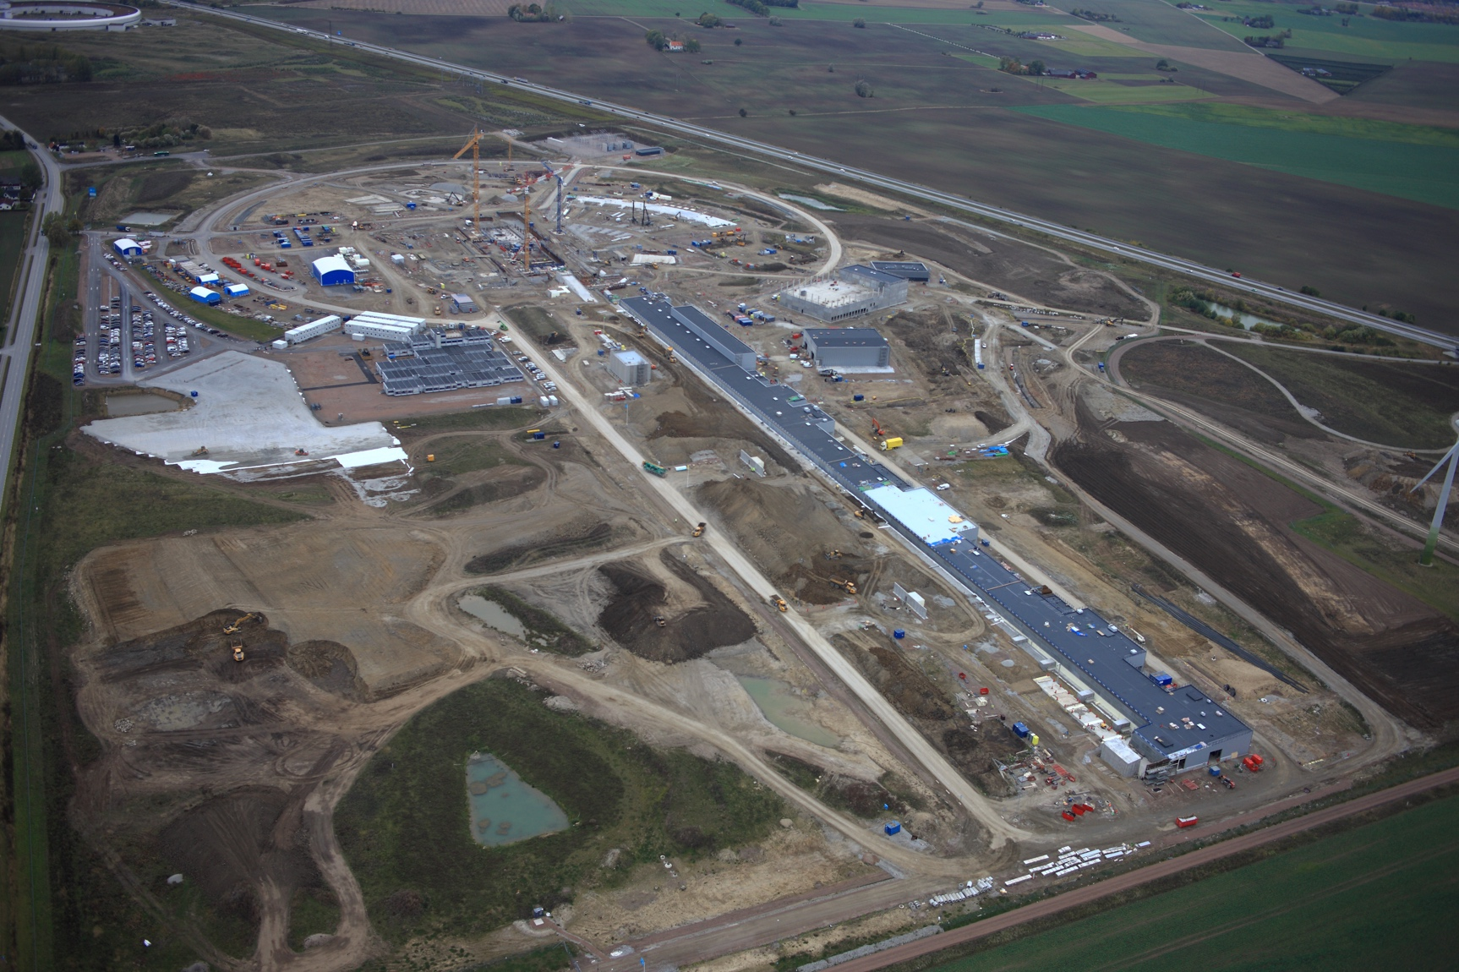
Thank you

Slide 13
Non-Destructive Testing
Scope & Objectives
SPARE SLIDE
Scope
Implementation of Resonant Ultrasound Spectroscopy at the ESS accelerator to service
high availability and reliability goals for the ESS machine
  Real-time diagnostics of the micro- and macro- properties engineering behaviour
  Monitoring of the integrity of components
  Schedule preventive maintenance
  Reduce maintenance time and lower beam down-times
  Gathering of information for the normal-operation spectrum response of parts
  Generation and maintenance of a database for engineering properties and responses
        beam-off (reference)
        beam-on (operation)
  Measuring of components’ integrity (on shut-downs)
  Fast and practical identification of modal resonant responses

Slide 14
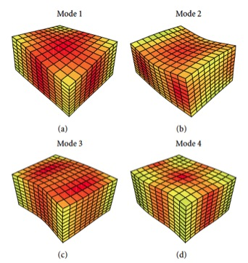
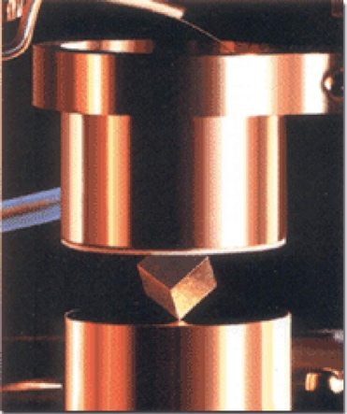
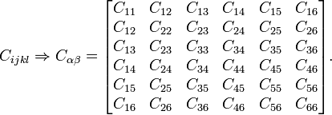
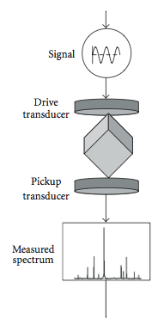
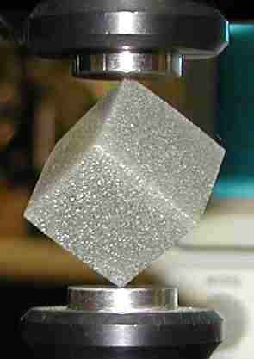
The ESS NDT method (1/2)
SPARE SLIDE
What? : Resonant Ultrasound Spectroscopy is a well-studied, non-destructive method to characterize the elastic properties of isotropic or anisotropic solid materials and probe the mechanical properties of solids .
Why? : This technique relies on the fact that solid objects have natural frequencies at which they vibrate when mechanically excited. The natural frequency depends on the elasticity, size, and shape of the object -- RUS exploits this property of solids to determine the elastic tensor of the material.
The great advantage of this technique is that the entire elastic tensor is obtained from a single sample in a single rapid measurement.
How? : A typical experimental setup consists of a sample, held in contact between two transducers: one transmitting or driving, the other receiving. The transmitting transducer drives a signal through the sample, whereby the signal undergoes a frequency sweep. The response of the sample is detected by the receiving transducer and the spectrum is collected. A resonant peak is observed when the frequency of the driving transducer corresponds to one of the sample Eigen-frequencies. The eigenfrequencies depend on a plethora of factors such as the elastic constants, the sample shape, and the orientation of the crystallographic axis with respect to the sample. By measuring a large number of resonant frequencies on one sample, the complete elastic constant matrix can be derived.

Slide 15
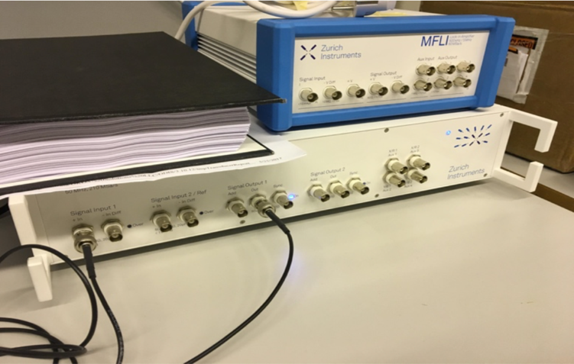
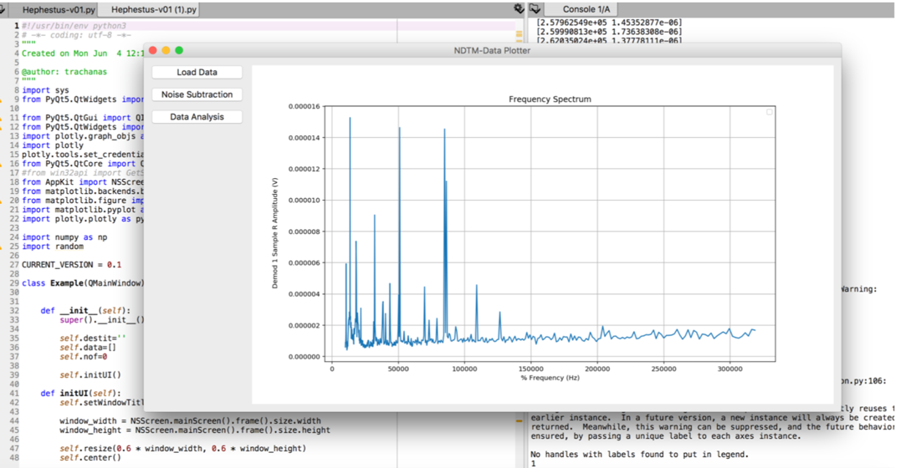

The ESS NDT method (2/2)
SPARE SLIDE
Frequency sweep on spectral area 10kHz-500MHz (preferance in kHz)
Define number of sampling points (e.g. few thousands)
Using averaging sweep: for every sampling point, multiple values are measured and averaged to reduce the noise background
Feeding 10V signal to sample (need for development)
Measuring different material samples on various orientation (repeatable) and different assembly and contact points (edge or corner contacts)
The received data are collected and processed by the DAQ using the dedicated Graphical User Interface (GUI)
Data Analysis and Pre-Measurement Simulations
Why at ESS:
ESS requires high reliability and availability of neutron beams during operations.
The accelerator operations plan includes specified goals on the reliability and availability of the accelerator machine itself. Consequently, Meeting these, will require preventive studies on machine structure and regular maintenance. In addition, non-destructive mechanical testing is being investigated for its potential as an asset to contribute to the reliability, availability and efficiency of the accelerator.

Slide 16






Samples of Nb, SS304, Alu6061
Reliability measurements & ANSYS FEA
SPARE SLIDE
1mm Sample
3mm Sample

Slide 17
Working points for NDT for the ESS machine Operations
SPARE SLIDE
RUS/L-RUS produce useful spectra from accelerator systems that are firmly “hyperstatic” supported and aligned
We can correlate data from
different NDTM techniques i.e.
  Strains/deformations Vs stress
  Vs radiation background
  Vs thermal dilatation
  Vs time of duty cycles
  Vs beam stability
  Vs luminosity
  Vs beam dynamics
  Vs..
What is the most efficient NDTA technique
for accelerators?
  RUS // L-RUS // Quasar // HD-FOS //
  // Optical fibers with (rad hard) FBGs //
  or other
Engineering design integration & non-destructive testing for the ESS accelerator
N. Gazis, S. Molloy, G. Solbrekken, E. Tanke, D. McGinnis, Hellenic Nuclear Physics Society, HNPS 2016: Advances in Nuclear Physics Vol.

Slide 18
SWOT analysis on ESS NDT method
SPARE SLIDE
S
Strengths
NDT method
On-line & ad-hoc results
Stand-alone applicability
Harsch environment applicable
Portable (small dimensions) measuring apparatus
Simple and “handy” DAQ
Innovative measuring apparatus (patent submitted)
W
Weaknesses
Scientific knowledge needed for measurements
Scientific knowledge needed for result analysis
RUS based – physical contact and assembly needed
Measurements dependancy on eigenfrequencies
Pinducers availability from industry
O
Opportunities
Mechanical/material properties database generation/expansion/development
Structural integrity monitoring over Facility lifetime
Possibility of various industrilization methods
Applicability/Utilization in various facilities
QA/QC assessment
Limited competition – extensive open market for the product
T
Threats
Loss of key staff
Assembly process might become time consuming
Assembly timing is crucial (i.e. during shutdowns of facilities, etc.)
Natural (high) eigenfrequencies drive the measuring apparatus cost
Cost infaltion/deflation following (mainly) pinducers availability

Slide 19





Design Integration references for AD –
3 international papers, 1 CHESS document,
1 Tech.Board strategy decision
SPARE SLIDE
Engineering design integration & non-destructive testing for the ESS accelerator
N. Gazis, S. Molloy, G. Solbrekken, E. Tanke, D. McGinnis, December 2016, Hellenic Nuclear Physics Society, HNPS 2016: Advances in Nuclear Physics Volume, approved to be published
Strategy for the engineering integration of the ESS accelerator
N. Gazis, D. McGinnis, S. Molloy, E. Tanke, C. J. Hardh, D. Lundgren, March 2016, International Journal of Modern Physics, World Scientific, Vol. 44 (2016), pp 1660208-1/1660208-7
[DOI: 10.1142/S2010194516602088]
IKC 3D model guidelines - ESS-0023754
  https://chess.esss.lu.se/enovia/tvc-action/showObject/dmg_Information/ESS-0023754/valid
  References for warm linac interface drawings included
  Integration Drawing Exchange Solution - ESS-0026622
  https://chess.esss.lu.se/enovia/link/ESS-0026622/21308.51166.13312.29813/valid
Constructing the ESS Linear Accelerator: Pragmatic Approaches to Design and System Integration at the European Spallation Source
G. Lanfranco, M. Conlon, E. Tanke, N. Gazis, E. Vaena, June 2014, 5th IPAC 2014 proceedings (http://www.jacow.org), WEPRO076, pp 2131-2133

Slide 20
The ESS engineering handbook
SPARE SLIDE

