Slide 1
Spatial Integration
Survey Alignment Metrology
Draft V2.1
Missing Illustrations
A journey through ESS lifecycle
Fabien Rey
April 2019

Slide 2


A journey through ESS lifecycle
2 sections
Survey
Alignment
Metrology
Spatial
Integration
ESS lifecycle
Design
Construction
Commissioning
Operation
Requirements & Analysis
System Design
Detailed Design
Manufacturing & Preparation for Installation
Installation
Commissioning
Operation
#
Functional Review
#
Preliminary Design Review
#
Critical Design Review
#
Installation Readiness Review
#
Test Readiness Review
#
System Acceptance Review
#
Operation Readiness Review
Handbook for Engineering Management(ESS-0092276)

Slide 3
Engineering & Integration Support Division (EIS)
Machine Engineering Service Group (MES)
Survey Alignment Metrology
Spatial Integration
Establishment and maintenance of the geodetic reference network
Accurate positioning of beam line components according to specifications
Geometrical control and metrology works
  Survey & Alignment
  3D Scanning - Marking
  Dimensional Control – Metrology and As-built
System owner of the integrated 3D Master model (ESS Plant Layout)
Configuration Management for volume allocations and 3D interfaces
  Capture Lifecycle of CAD representations
  Place 3D data under configuration control
  Perform Integration and Clash Analysis
  Conduct Spatial Integration Meeting
Mandate
&
Scope
Budget
Fully centralized – Initial Operation
Fully centralized – Initial Operation
*1fte Construction budget NSS
Staff
1 CAD tool : CatiaV6
Plant Lifecycle Management System : CHESS
ESS Breakdown Structures
Facility Breakdown Structure
Location Breakdown Structure
Laser Trackers
Laser Scanner
3D Arm
Digital /Optical Level
Software:
Spatial Analyser/Panda
Cyclone-3D/Reshaper
Tools
VR Room
Job Requests
Request form in Confluence
Request form in Confluence
https://confluence.esss.lu.se/display/EIS/Requests+for+SAM+Services
https://confluence.esss.lu.se/display/EIS/Spatial+Integration+Request

Slide 4
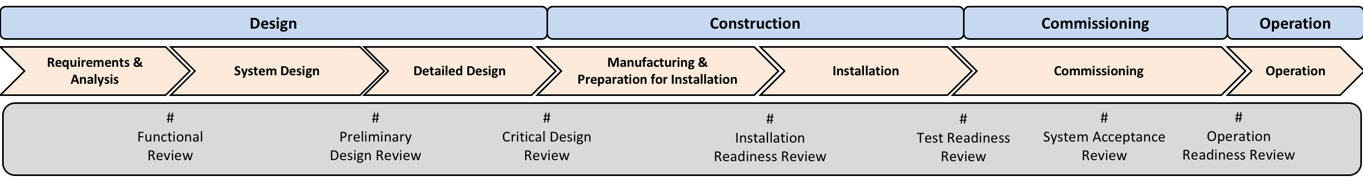
CF
files
Integrate flow of models
Spatial Integration
Skanska
C
O
N
S
T
R
U
C
T
I
O
N
Network
Establishment
Scanning
-Concrete Works-
Survey Alignment Metrology

Slide 5
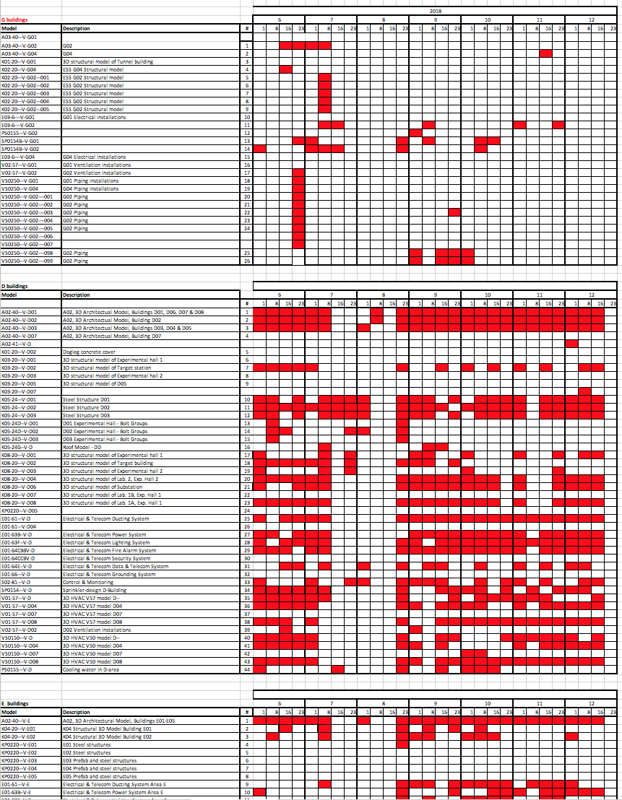
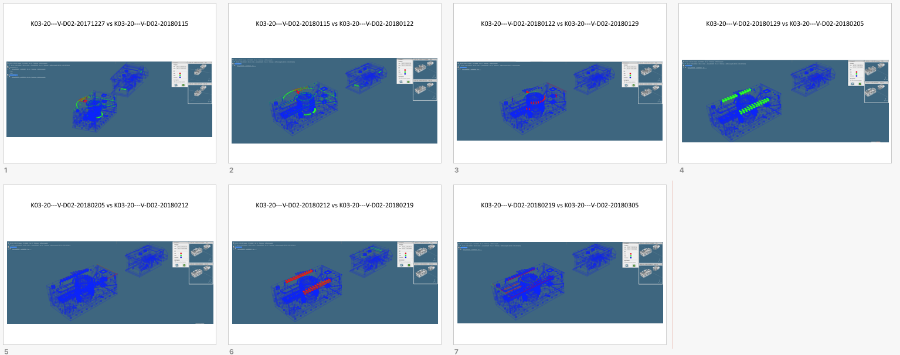
CF files and Skanska Construction
https://confluence.esss.lu.se/display/EIS/CF+Models

Slide 6
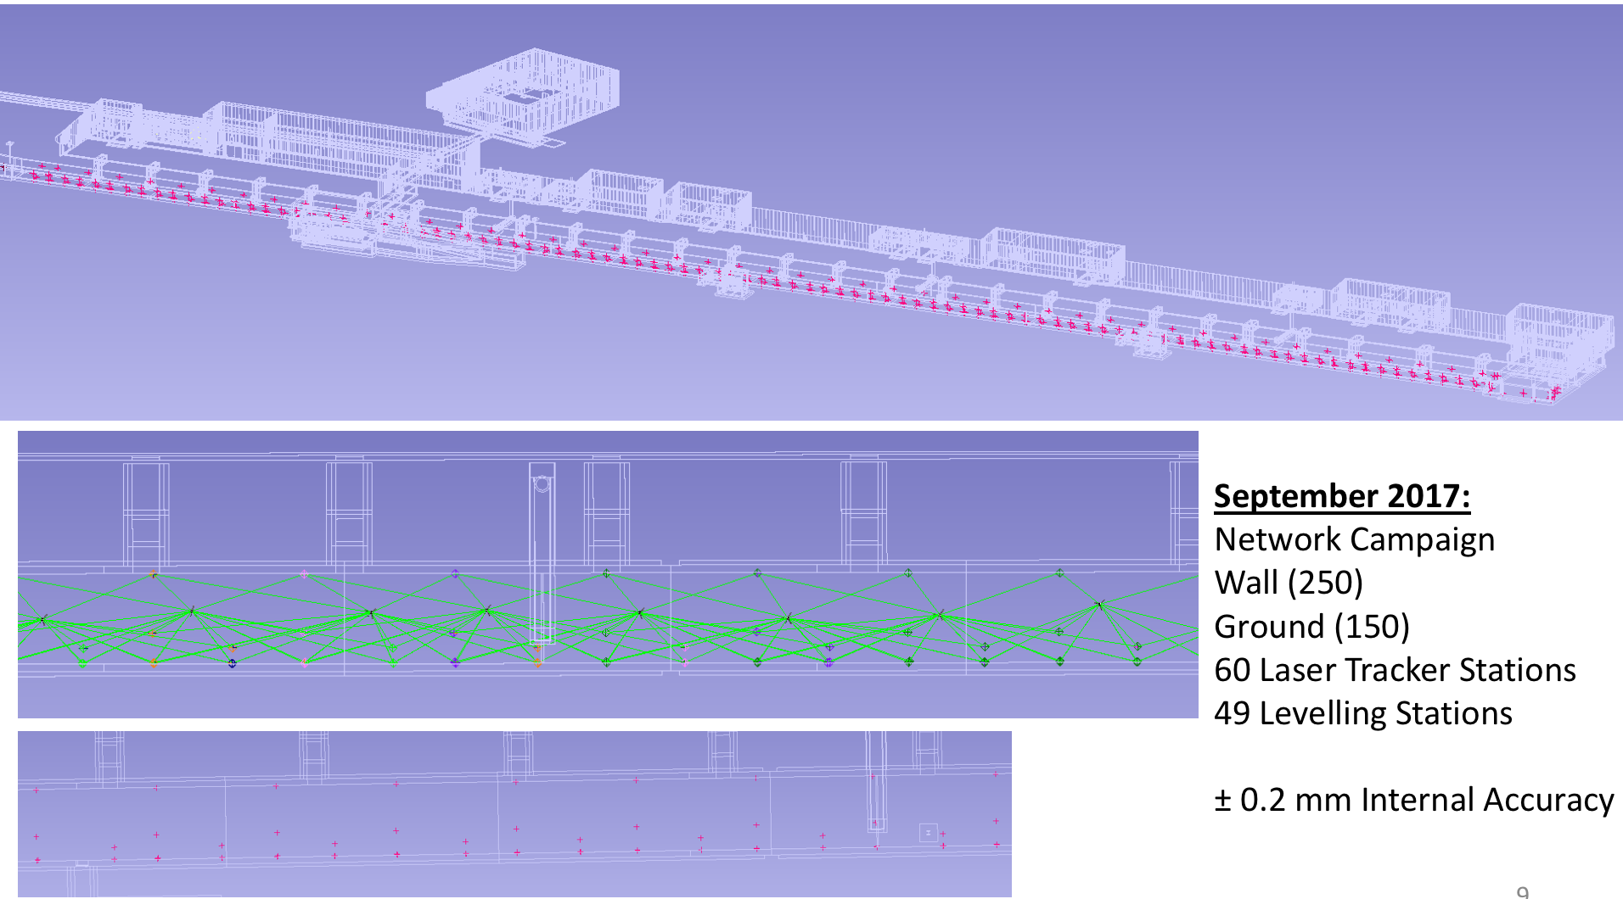
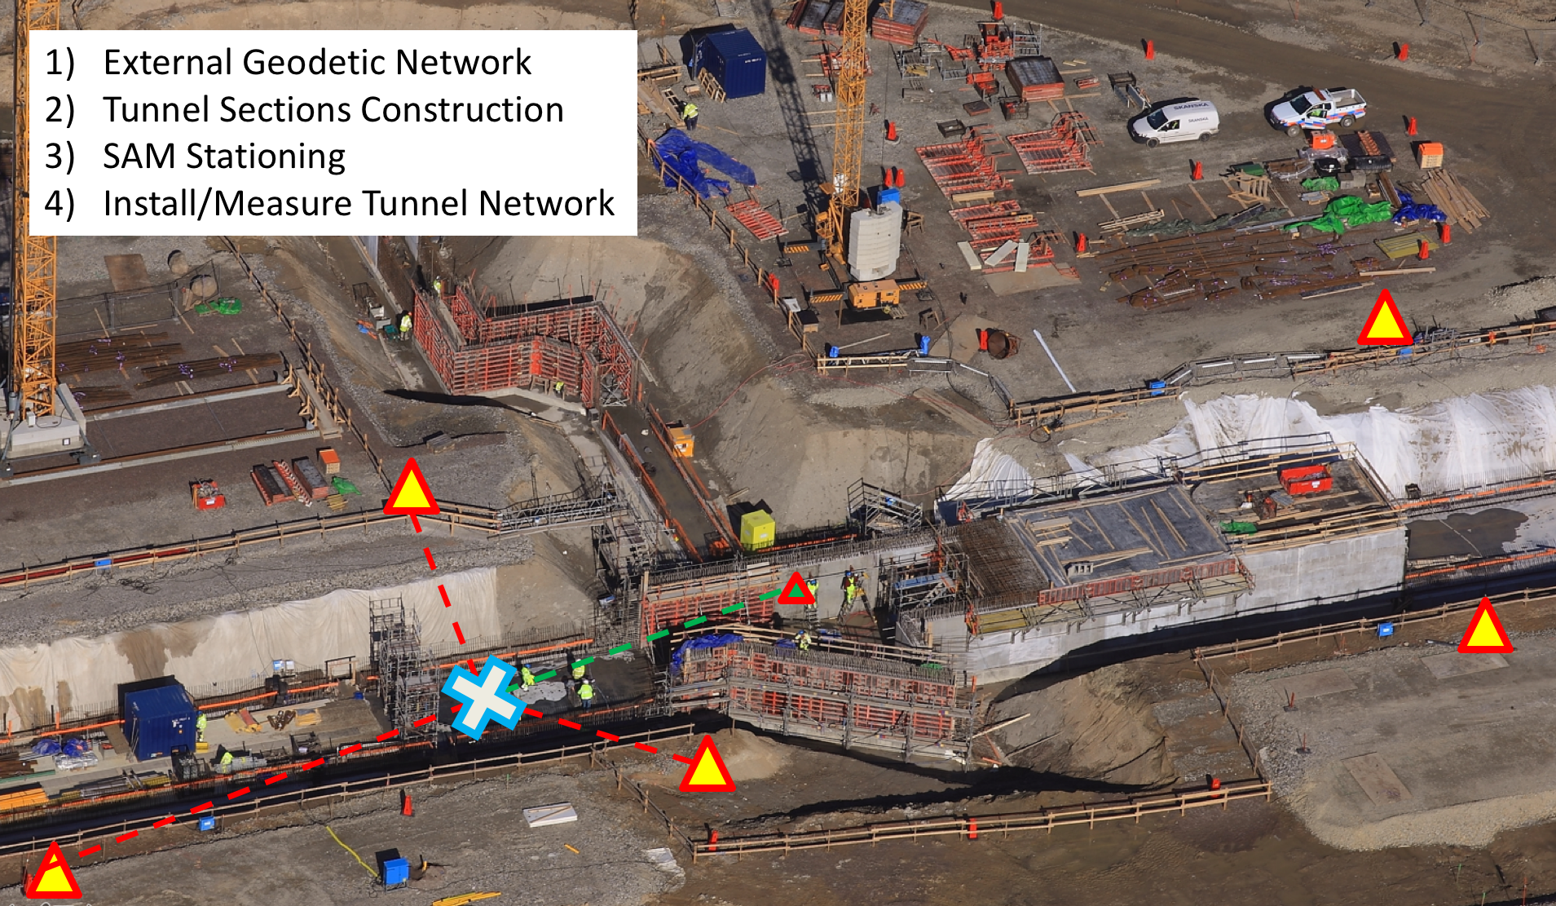
Network and Scanning

Slide 7
1st Space Claim
(A)
Reverse Engineering based on Scans. Models and space claims adjusted
CF
files
Integrate flow of models
Light Model – Integrate in ESS Plant Layout – Clash Analysis - Communication
Spatial Integration
Skanska
C
O
N
S
T
R
U
C
T
I
O
N
Network
Establishment
Scanning
-Concrete Works-
Survey Alignment Metrology

Slide 8
Illustration of previous slide

Slide 9
1st Space Claim
(A)
Reverse Engineering based on Scans. Models and space claims adjusted
CF
files
Integrate flow of models
Light Model – Integrate in ESS Plant Layout – Clash Analysis - Communication
Spatial Integration
Provide SAM strategy
Fiducialization
Installation/Alignment
Skanska
C
O
N
S
T
R
U
C
T
I
O
N
Network
Establishment
Recommendation on Adjustment Systems
Scanning
-Concrete Works-
Scanning
Skanska Utilities
Survey Alignment Metrology

Slide 10
Illustration of previous slide

Slide 11
1st Space Claim
(A)
Model and 3D interfaces for utilities (B)
Reverse Engineering based on Scans. Models and space claims adjusted
CF
files
Integrate flow of models
Light Model – Integrate in ESS Plant Layout – Clash Analysis - Communication
Automatic Exchange with Aveva (cables and pipes design tool)
VR
Spatial Integration
Provide SAM strategy
Fiducialization
Installation/Alignment
Skanska
C
O
N
S
T
R
U
C
T
I
O
N
Network
Establishment
Recommendation on Adjustment Systems
Scanning
-Concrete Works-
Scanning
Skanska Utilities
Survey Alignment Metrology

Slide 12
Illustration of previous slide

Slide 13
1st Space Claim
(A)
Model and 3D interfaces for utilities (B)
Model Issue for Construction (P)
Reverse Engineering based on Scans. Models and space claims adjusted
CF
files
Integrate flow of models
Light Model – Integrate in ESS Plant Layout – Clash Analysis - Communication
Automatic Exchange with Aveva (cables and pipes design tool)
VR
VR
Spatial Integration
Provide SAM strategy
Fiducialization
Installation/Alignment
Factory Acceptance Test
Skanska
Site Acceptance Test
C
O
N
S
T
R
U
C
T
I
O
N
Network
Establishment
Fiducialization- Metrology
Dimensional Control
Recommendation on Adjustment Systems
Marking
Scanning
-Concrete Works-
Scanning
Skanska Utilities
Scanning
ESS Utilities
Survey Alignment Metrology

Slide 14
Illustration of previous slide

Slide 15
1st Space Claim
(A)
Model and 3D interfaces for utilities (B)
Model Issue for Construction (P)
Model Issue for Installation (R)
As-built (Asb)
Reverse Engineering based on Scans. Models and space claims adjusted
CF
files
Integrate flow of models
Light Model – Integrate in ESS Plant Layout – Clash Analysis - Communication
Automatic Exchange with Aveva (cables and pipes design tool)
VR
VR
VR
Spatial Integration
Provide SAM strategy
Fiducialization
Installation/Alignment
Factory Acceptance Test
Skanska
Site Acceptance Test
ALIGNMENT
C
O
N
S
T
R
U
C
T
I
O
N
Network
Establishment
Fiducialization- Metrology
Dimensional Control
Recommendation on Adjustment Systems
Marking
Scanning
-Concrete Works-
Scanning
Skanska Utilities
Scanning
ESS Utilities
Scanning
After Installation
Survey Alignment Metrology

Slide 16
Illustration of previous slide

Slide 17
1st Space Claim
(A)
Model and 3D interfaces for utilities (B)
Model Issue for Construction (P)
Model Issue for Installation (R)
As-built (Asb)
As-Scanned (Asc)
Reverse Engineering based on Scans. Models and space claims adjusted
CF
files
Integrate flow of models
Light Model – Integrate in ESS Plant Layout – Clash Analysis - Communication
Automatic Exchange with Aveva (cables and pipes design tool)
VR
VR
VR
VR
Spatial Integration
Provide SAM strategy
Fiducialization
Installation/Alignment
Factory Acceptance Test
Skanska
Support to Commissioning
Beam Instrumentation
Network
Establishment
Site Acceptance Test
ALIGNMENT
C
O
N
S
T
R
U
C
T
I
O
N
Fiducialization- Metrology
Dimensional Control
Re-alignment
Recommendation on Adjustment Systems
Marking
Scanning
-Concrete Works-
Scanning
Skanska Utilities
Scanning
After Installation
Scanning
Operation
Scanning
ESS Utilities
Survey Alignment Metrology

Slide 18
Illustration of previous slide

Slide 19
Preliminary Results

Slide 20
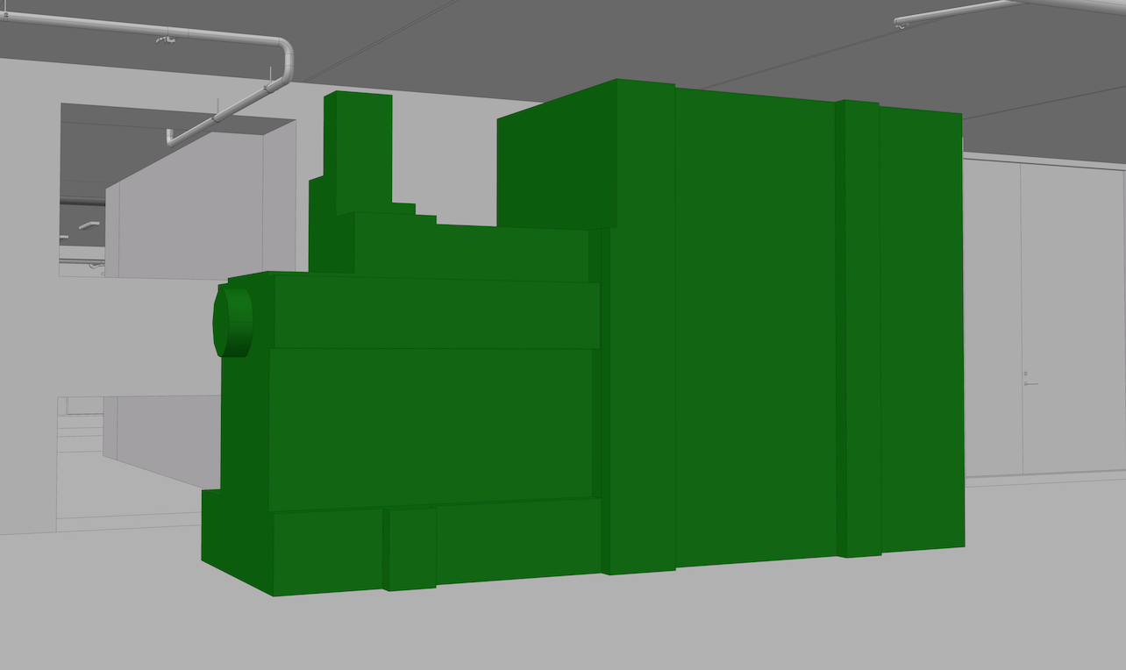
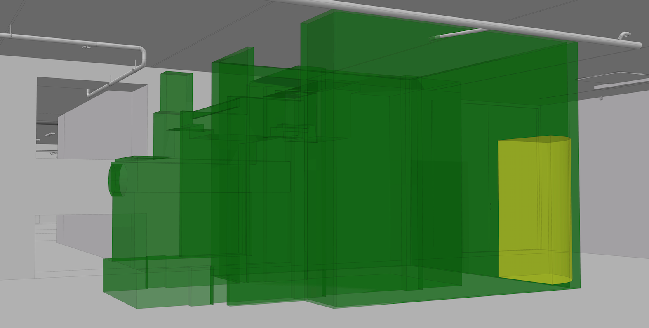
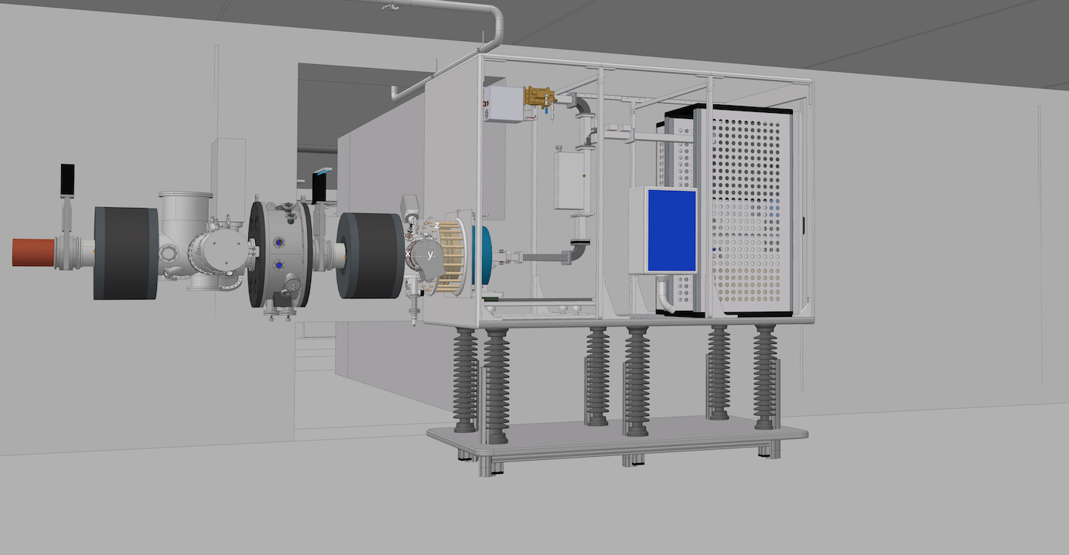
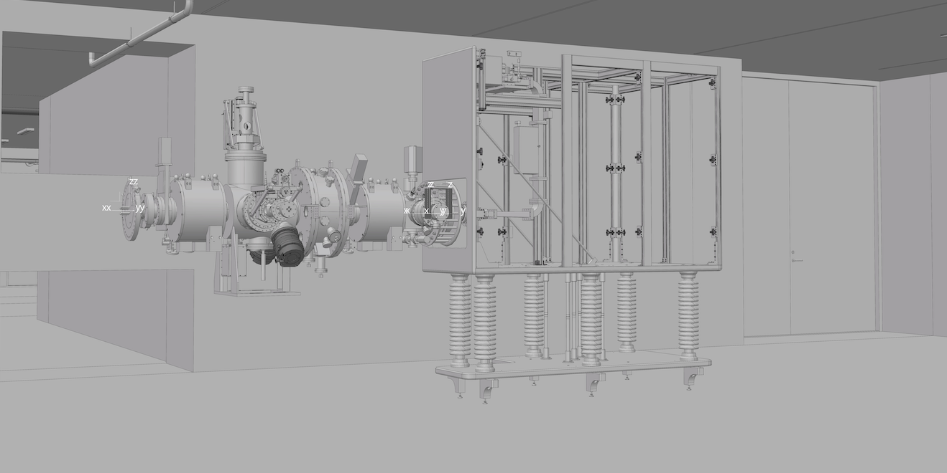
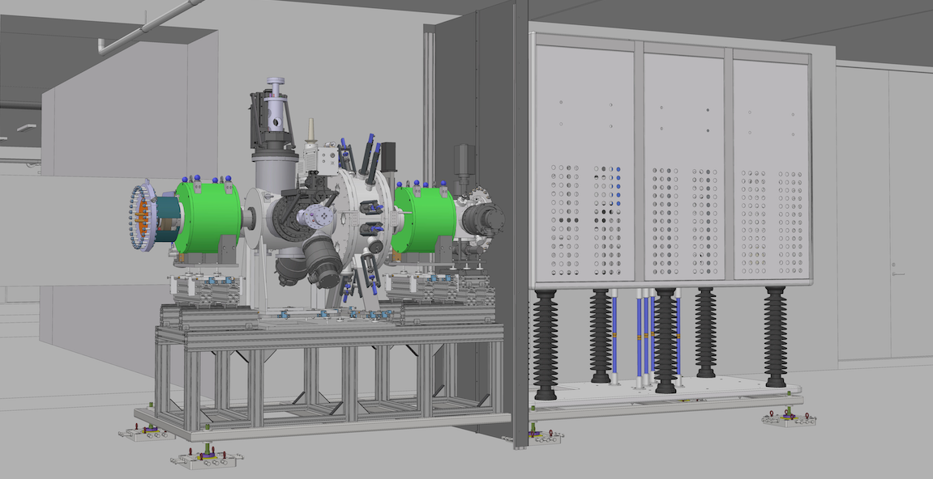
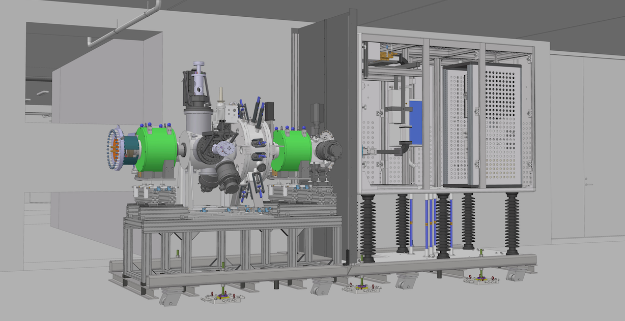
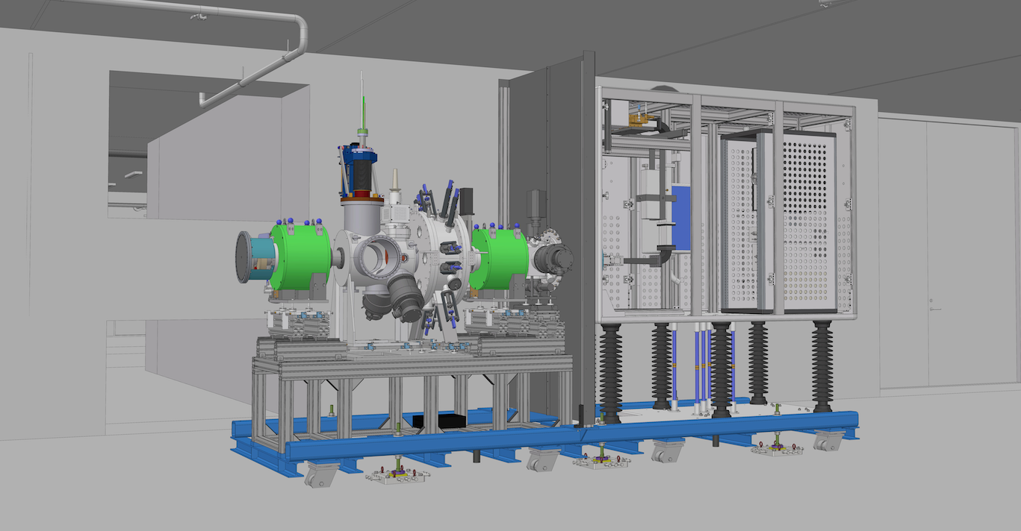
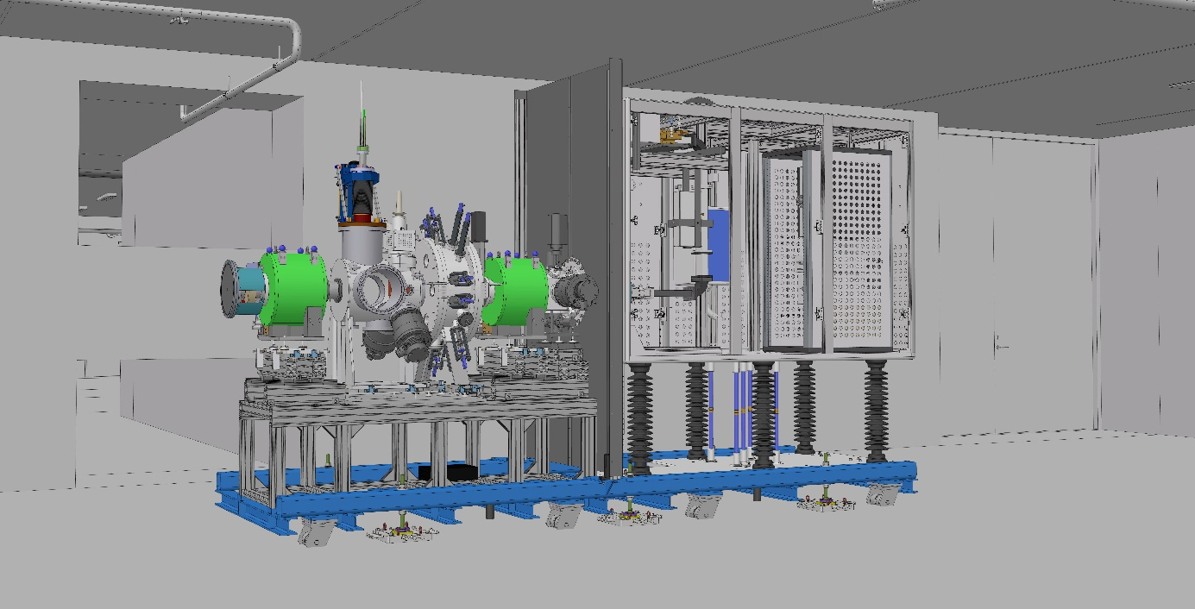
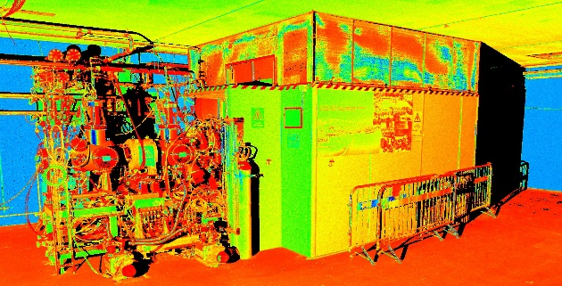
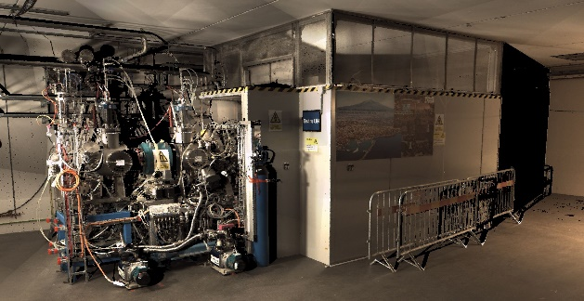
Spatial Integration
Lifecycle
Ion Source - LEBT
1- Initial Space Claim - Oct 2013
2- Functional Review - Sept 2014
3- Preliminary Design Review - Feb 2015
4- Detailed Design - Oct 2015
5- Issued for Quotation - Nov 2015
6- Critical Design Review - Feb 2016
7- Installation Readiness Review - Sept 2017
8 - As-built - Test Readiness Review- May 2018
9 – As-Scanned Intensity 3D Point Clouds - Jan 2019
10 – As-Scanned Coloured 3D Point Clouds - Jan 2019

Slide 21
Survey Alignment Metrology
Preliminary Results
Satisfaction of our customers
No one is waiting for Alignment
Smooth Installation/Alignment - No big worries
No safety issue
MAJOR SUCCES: Ion Source LEBT - Commissioning on going.

Slide 22
Conclusion
2 sections well established providing services to all ESS
Fully centralized in EIS Division- funding and staff secured
Synergies and Interactions demonstrated
Ready to face incoming challenges of Installation and Commisioning

Slide 23
BACK – UP Slides

Slide 24
Challenges around our 3D data
1.5 year ago….
ESS Plant Layout (EPL) ESS-0016885
Configuration Management
Missing clear Breakdown Structure
Very little data released
Very heavy models
3D data not connected to the PLM
CF models
Communication
Swedish Nuclear Authority (SSM)
What are we exporting/showing ?
Collaborators – Inkinds- Manufacturers
Facility Documentation Management

Slide 25
Actions
REBUILT THE ESS Plant Layout (EPL) ESS-0500000
Note: ESS-0016885 becomes ESS Conceptual Assembly
Following ESS Breakdown Structures
naming and connection to CHESS (PLM)
Based on Light Versions
Lighter to open and work on it
Possibility to load full detailed models
Showing only Released Data ( with level of maturity)
Reliable information understanding design maturity
Source for Exports
Other platforms - External users - Partners
Redefine central rules and interactions with sub projects
Implementation of Spatial Integration REQUEST
  in Confluence
Spatial Integration Configuration Management
New rules in order to enter in the EPL

Slide 26
Spatial Integration Configuration Management
V3: 23-10-2018
Sub Project
TG 1
TG 2
TG 3
TG 4
TG 5
TG 6
Mechanical Design
A
B
C
D
P
R
ASB
ASC
Electrical
Process Piping
Design
Issued for
System Design
Issued for
Detailled Design
Detailed design
Issued for Quotation
Issued for Construction
Issued for Installation
As-Built
As-Scanned
CHESS
Release
Development Phase
Production Phase
Release Models
with Level Of Maturity
Including Space Reservation for
Designer
Installation
Operation
Remote Handling
Maintenance
Work Package/ Project Leader
Central Support
Spatial Integration Request
Model Management
Integrate design in ESS Plant Layout: ESS-0500000 Produce light model Connect to CHESS: Facility Breakdown Structure Location Breakdown Structure
Communication
Confluence Page for each Work-Package Status Integration Report on Clash Analysis Single point of truth for Exported Models In-Kind Partner and other disciplines Navisworks Coordination Visualization Rendering and Captures Virtual Reality Room
Analysis
Integration with: Other Systems Conventional Facility Models Point clouds – Laser Scanning Model Quality Check Interface Simulation Clash Analysis

Slide 27
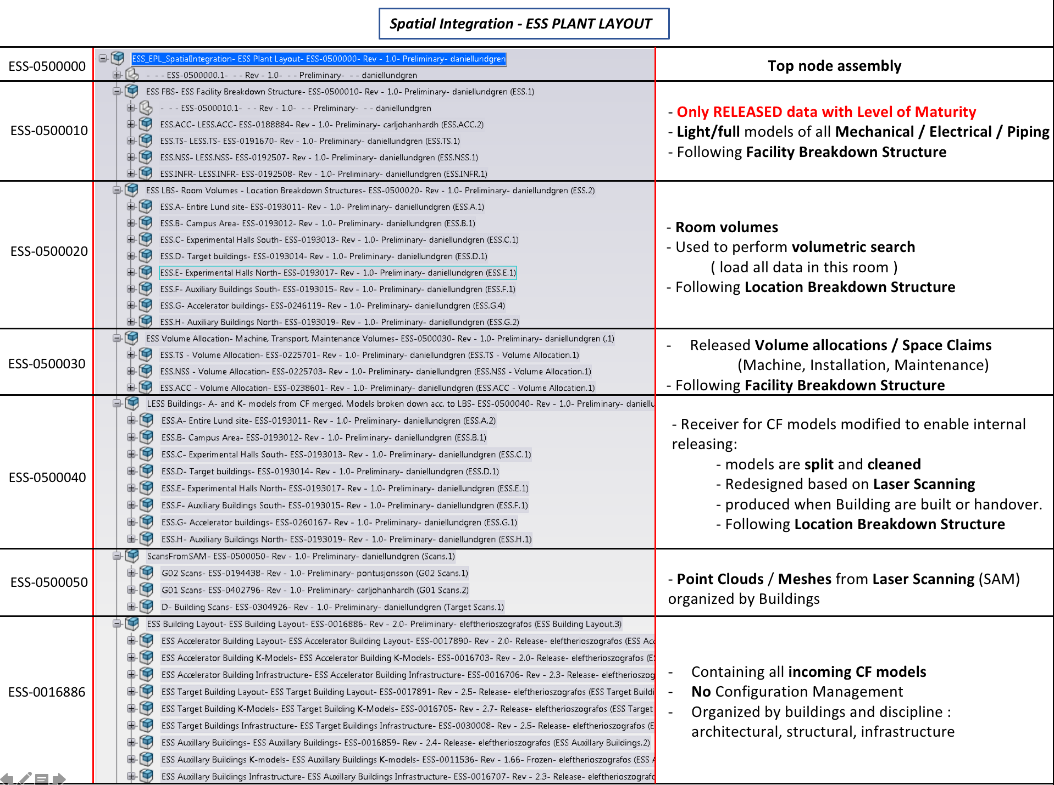

Slide 28
1st Space Claim
(A)
Model and 3D interfaces for utilities (B)
Model Issue for Construction (P)
Model Issue for Installation (R)
As-built (Asb)
As-Scanned (Asc)
Reverse Engineering based on Scans. Models and space claims adjusted
CF
files
Integrate flow of models
Light Model – Integrate in ESS Plant Layout – Clash Analysis - Communication
Automatic Exchange with Aveva (cables and pipes design tool)
VR
VR
VR
VR
Spatial Integration
Provide SAM strategy
Fiducialization
Installation/Alignment
Factory Acceptance Test
Skanska
Support to Commissioning
Beam Instrumentation
Network
Establishment
Site Acceptance Test
ALIGNMENT
C
O
N
S
T
R
U
C
T
I
O
N
Fiducialization- Metrology
Dimensional Control
Re-alignment
Recommendation on Adjustment Systems
Marking
Scanning
-Concrete Works-
Scanning
Skanska Utilities
Scanning
After Installation
Scanning
Operation
Scanning
ESS Utilities
Survey Alignment Metrology

