Slide 1


WP3 Kick Off Meeting
Tobias Richter
European Spallation Source DMSC, Copenhagen, May 2019
This project has received funding from the European Union’s Horizon 2020 research and innovation programme under grant agreement No. 823852

Slide 2
Welcome!

Slide 3
Why are we here?
We are getting paid – to do something quite specific as part of PaNOSC.
We are accountable to
EU/PaNOSC
Our home facilities
PaN user communities
Notes:
Preferences
Resource distribution

Slide 4
PaNOSC Objectives
Participate in the construction of the EOSC by linking with the e-infrastructures and other ESFRI clusters.
Make scientific data produced at Europe’s major Photon and Neutron sources fully compatible with the FAIR principles.
Generalise the adoption of open data policies, standard metadata and data stewardship from 15 photon and neutron RIs and physics institutes across Europe.
Provide innovative data services to the users of these facilities locally and the scientific community at large via the EOSC.
Increase the impact of RIs by ensuring data from user experiments can be used beyond the initial scope.
Share the outcomes with the national RIs who are observers in the proposal and the community at large to promote the adoption of FAIR data principles, data stewardship and the EOSC.

Slide 5

Making FAIR a reality for PaNOSC
How to make FAIR reality?
How to make the EOSC reality?
How to make Open Science reality?
PaNOSC will build on and help make FAIR, EOSC and Open Science become reality for the Photon and Neutron community
PaNOSC developments: new Data Policy framework, NeXus-compliant metadata, e-logbook, certified data catalogues, search API, data services, linking to EOSC, etc.

Slide 6
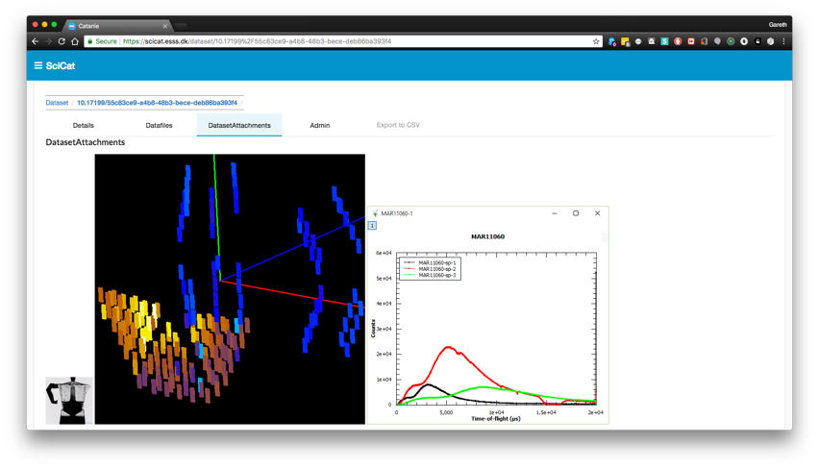



WP3 Data Catalogues – Basic Functions
Store reference to raw data and enough metadata
to identify the “right” dataset to work with
Proposal Information
Sample Information
Scientific Metadata
Previews
Provenance
Relationship to other data
(derived data)
Relationship to people
Facilitate Sharing and Publication

Slide 7
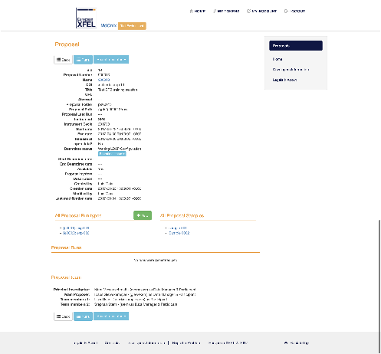
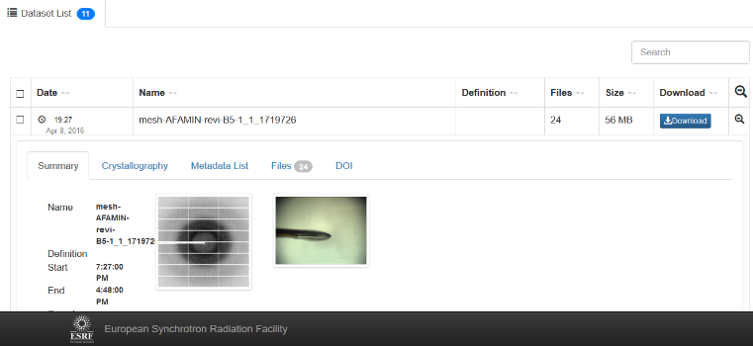
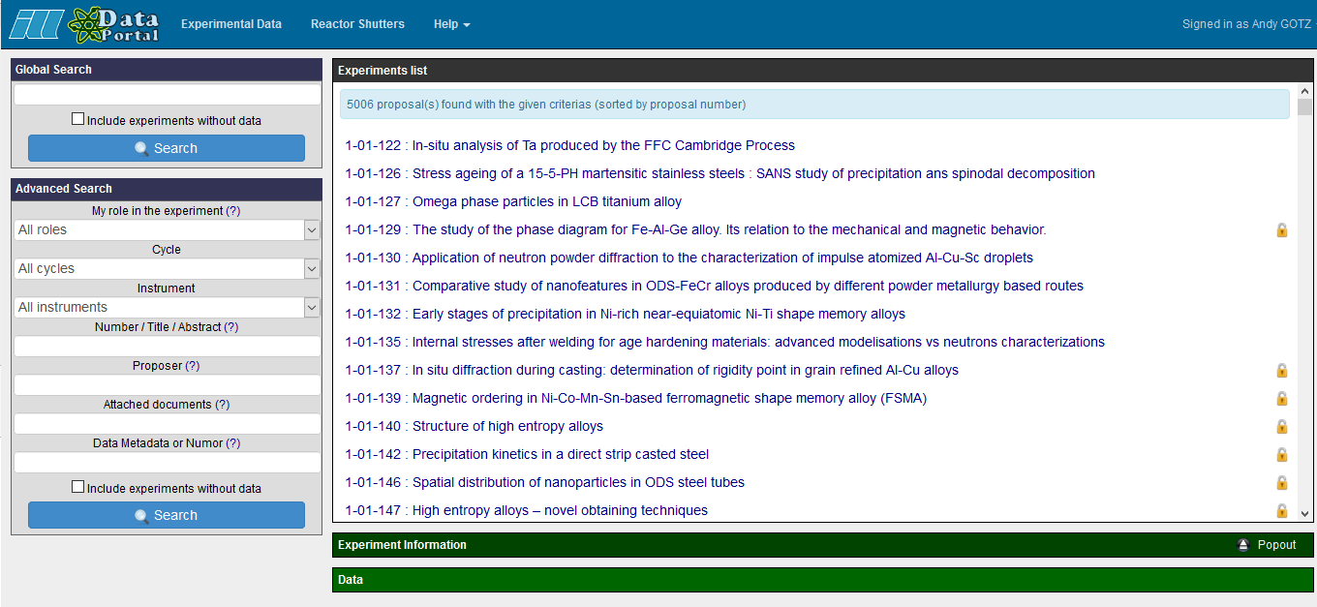
PaNOSC has 6 data catalogues with different APIs + UIs
ESRF
(Icat)
CERIC
(VUO)
ESS
(SciCat)
ILL
(local)
ELI
(tbd)
XFEL
(myMdc)

Slide 8
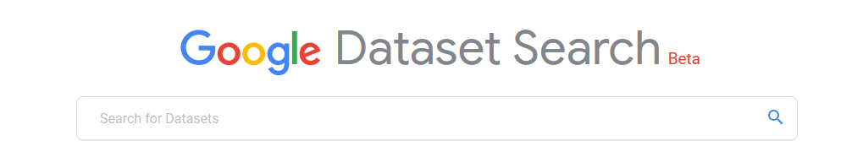
PaNOSC is implementing a common API searchable across sites
EOSC
Common API to search across all PaNOSC catalogues
ESRF
(icat)
CERIC
(icat)
ESS
(SciCat)
ILL
(local)
ELI
(tbd)
XFEL
(MyMdc)

Slide 9
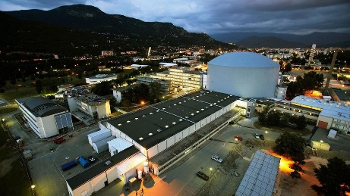
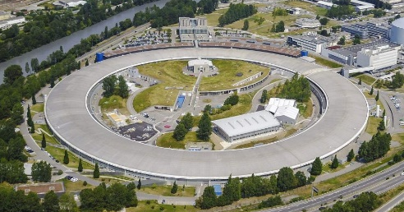
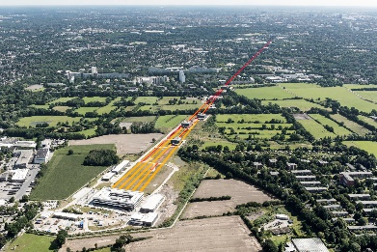





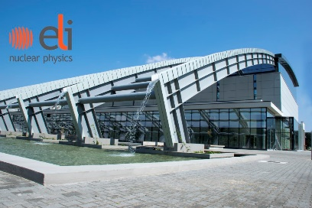




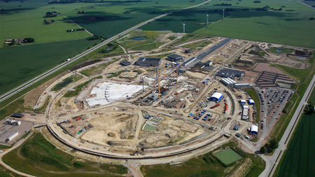

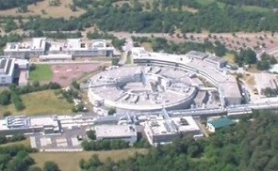


PaNOSC Partners – ESFRI projects
Photon and Neutron Open Science Cloud
Notes:
PEOPLE
Catalogues
Datasets
policies

Slide 10
Partner | CERIC | ESS | ELI | ESRF | ILL | XFEL
Catalogue | VUO (online storage NOT a catalogue) | SciCat | TBD | ICAT | ILL Own | myMdC
URL | https://vuo.elettra.trieste.it | https://scicat.esss.se | --- | https://datahub.esrf.fr | https://data.ill.eu | https://in.xfel.eu/metadata
Login required | Yes | Yes | --- | Yes | Yes | Yes
File formats | NeXus, HDF5, ASCII and many others | NeXus | --- | EDF, SPEC, MCA, CBF, CCD, MCCD, HDF5, NeXus | NeXus and ILL Ascii | HDF5
Database | Oracle | MongoDB | --- | Oracle and MongoDB | Oracle | MySQL and PostgreSQL
Language | Plsql, Python | Javascript | --- | JAVA and Javascript | PHP | App: Ruby(onRails), Client: Python
Main technologies | WebDAV, Guacamole | Angular | --- | React, NodeJS, EJB, JPA | Symfony, JQuery | Rails
Number of public datasets/files | 0/0 | 181/250,000 | --- | ~540K/157M | ~250K/4M | 0/0
Using OAI-PMH | No | Not yet installed | --- | No | No | No
Minting DOIs | Yes | Yes | --- | Yes | Yes | Yes
Data/embargo policy | Not defined | Embargoed for 3 years | --- | Embargoed for 3 years, ESRF Data Policy | Embargoed for 3 to 5 years, ILL Data Policy | Embargoed for 3 with possible extension to 5 years, XFEL Data Policy
Number of instruments connected to data catalogue | None | 1 | --- | 17 | 54 | 16

Slide 11
PaNOSC KPIs – from Andy Gotz
 | ILL | ESRF | CERIC | XFEL | ELI | ESS
Data/year 2018 | 0.2 PB | 8 PB | 1 PB | 3PB | < 1 PB | 0
Data/year 2023 | 0.6 PB | 50 PB | 15 PB | 100 PB | 10 PB | < 1 PB
Data Policy 2018 | 2011 | 2016 | 2014(3/8) | 2017 | in prog | 2017
Data Policy 2023 | 2011 | 2016 | 2019 | 2017 | 2019 | 2017
Metadata catalogue 2018 | Local | Icat | Local | myMdC | No | SciCat
Metadata catalogue 2023 | Local | Icat | Icat | myMdC | [TBD] | SciCat
Metadata definition 2018 | NeXus | NeXus | custom | myMdC | ? | NeXus
Metadata definition 2023 | NeXus | NeXus | NeXus | NeXus | [NeXus] | NeXus
DOI 2018 | yes | yes | no | yes | no | yes
DOI 2023 | yes | yes | yes | yes | yes | yes

Slide 12
PaNOSC KPIs – from Andy Gotz
 | ILL | ESRF | CERIC | XFEL | ELI | ESS
Open Data 2018 | 100s | 2 | 0 | 10s | 0 | 10s
Open Data 2023 | 1000s | 1000s | 100s | 1000s | 100s | 100s
Data Services 2018 | Pilot | In progress | Remote | In progress | ? | In progress
Data Services 2023 | Desktop Jupyter | Jupyter Desktop | Jupyter Desktop | Jupyter Desktop | Desktop Jupyter | Jupyter Desktop
Common data API 2018 | No | No | No | No | No | No
Common data API 2023 | Yes | Yes | Yes | Yes | Yes | Yes
User training 2018 | No | No | No | No | No | No
User training 2023 | Yes | Yes | Yes | Yes | Yes | Yes

Slide 13
Deliverables Tasks Milestones

Slide 14

Task 3.1: Develop API
M1-M28
Define an API to be used in the Photon and Neutron community that will allow for FAIR exposure of the data at the individual institutions through a catalogue service. The API will allow federation, and exposure of metadata relevant for the area, in a way that will enable search and facilitate access of researchers across scientific disciplines. The API will enable domain specific search extensions aware of the metadata definitions and usage at photon and neutron facilities.

Slide 15
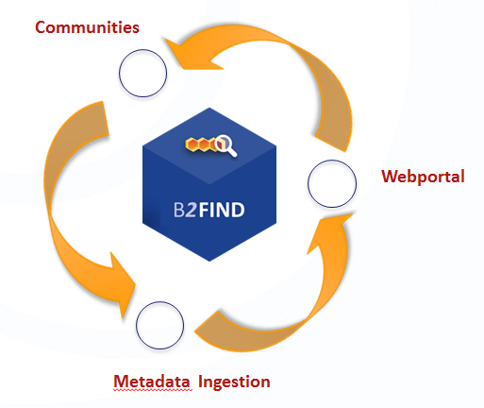
Task 3.2: Provisioning Federated Search
M8-M20
This task will link the PaNOSC beneficiaries’ data catalogues to the EOSC hub. The EOSC hub will provide the API needed to share and search metadata. In the absence of a definition following the OpenAIRE DOI equivalent scheme should yield sufficiently wide exposure. A web service demonstrator will be provided that allows searching all PaNOSC partner sites for available datasets using the common metadata API. The demonstrator will showcase how access to the catalogue will provide identifiers that will allow the found data to be accessed and used for analysis.

Slide 16
Task 3.3: Local Deployment
M20-M44
The participants will implement the mandatory part of the API for their local data repository. This includes effort required to ensure that all facilities metadata is compliant with the standards from WP2. The implementation is expected to happen through extending the existing catalogue services at the partner sites with the API or by an equivalent solution.

Slide 17
Task 3.4: Catalogue Integration
M12-M48
Integration of data production facilities with the data catalog which is especially important for heterogeneous and distributed facilities. This task will document best practices and support heterogenous and distributed facilities getting their workflow to support cataloging data.

Slide 18
Task 3.5: Meta Ontology for Catalogues
M1-M42
Extend NeXus metadata standards to enhance interoperability. For large parts of the PaN communities NeXus is the most commonly used file format. To explore relevant foreign datasets in the public domain, searches on the scientific metadata need to yield the correct results. Building search terms and keywords from the NeXus dictionary, would make use of the community buy in and expertise that went into this standard.
In this task we can add missing raw data definitions for raw data, as well as some for processed derived data. Working towards an Ontology will help harmonize processing codes between facilities.

Slide 19
Ways of working (from PaNOSC kick off in January)
Every partner and observer responsible for putting the correct people on the WP mailing list.
There is a monthly teleconference for the whole work package.
Task leaders to organise their own meetings in addition as needed.
Mayor development should be done collaboratively as much as possible. Especially the API can benefit from everyone’s expertise.
Github is accepted as the main collaborative platform.
For the NeXus ontology task it would be extremely useful for every facility to have a representative on the NeXus advisory committee.

Slide 20
Agenda
Agree what to do.
What have we promised in the grant?
What is needed to achieve this?
Clarify milestones and deliverables.
Identify any bonus tasks.
What improvements can we make on the way without sacrifices?
Agree how to do it.
Work distribution
Future meetings
Interactions with other WPs, projects and EOSC
Tools, Procedures, etc

Slide 21
Thank you.

Slide 22
Deliverables Tasks Milestones

Slide 23
Upcoming
Meeting in October close to the GA
At Elettra
Conflicts with RDA in Helsinki

Slide 24
Status Today
Most facilities have some sort of data catalogue.
Richness of the metadata represented varies.
Public data is often registered with DataCite (DOI),
with minimal metadata.
A person searching needs to know where data was collected
Dataset are not very findable or accessible.
Legacy formats put limit on the re-usability and interoperability.

Slide 25
Desired Outcome
All PANOSC facilities catalogue their data with
rich enough metadata to support clever searches.
Public data receives DOIs and is available for federated
searches in the EOSC with relevant metadata.
A person searching does not need to know where data was collected.
Datasets are easily findable or accessible.
Community driven formats enable re-usability and interoperability.

Slide 26
Challenges
  FAIR data – more difficult to implement than most believe
      Implementing an electronic logbook as part of the RICH metadata capture
      Promote use of Jupyter notebooks and workflows to capture data analysis
  Integration - services linked by a supported federated identity scheme covering the research life cycle where users access data, software, IT capacity and the expertise for performing analysis
      GEANT will help PaNOSC by hosting AAI, ESFRIs to provide expertise
  Hybrid model - should not compete with but rather profit from user friendliness and innovation of commercial service providers
      PaNOSC will procure and integrate commercial services
  Provenance, citation and use of data & software
      Train users to cite DOIs and provide Open Data
  Business model of how to provide services to all scientists and general public
      ESFRI Photon and Neutron RIs have funding for Users who come to the source, but no funding for providing services for using Open Data. Will EOSC provide resources?

Slide 27
PaNOSC Kick off Summary – WP3
All partners +
PSI, HZB, DLS, B2Find
Round the table – who was present in the room
* status of local metadata catalogues activities
* data policy (existing and planned)
* existing integration with external infrastructures (DataCite, OpenAIRE, etc)
* integration with data acquisition and downstream processing
* NeXus status
* status and plan of staffing for WP3
ExPaNDS has direct links to WP3 deliverables.
Go through Tasks, Deliverables, Milestones.
What is running now? Who leads? How do we start the work?
2 tasks have nominally started, both lead by ESS.

Slide 28
NeXus International Advisory Committee NIAC
Mark Basham,
Diamond Light Source, UK
(Executive Secretary)
Herbert Bernstein,
CIF (non-facility member)
Aaron Brewster,
Lawrence Berkeley Laboratory, USA
Stuart Campbell,
Brookhaven National Laboratory, USA
(Technical Manager)
Bjorn Clausen,
Los Alamos National Laboratory, USA
Stephen Cottrell,
Rutherford Appleton Laboratory, UK
Ricardo Ferraz-Leal,
SNS and HFIR at ORNL, USA
Jens-Uwe Hoffmann,
Helmholtz Zentrum Berlin, Germany
Pete Jemian,
Advanced Photon Source, USA
(Documentation Release Manager)
Mark Könnecke,
Paul Scherrer Institute, Switzerland
Raymond Osborn,
Argonne National Laboratory, USA
(non-facility member)
Tobias Richter,
European Spallation Source, Sweden
Armando Sole,
European Synchrotron Radiation Facility, France
Jiro Suzuki,
KEK, Japan
Benjamin Watts,
Swiss Light Source, Switzerland (Chair)

Slide 29
Capturing Experimental Metadata
Users are not much incentivised to disclose all metadata openly to third parties.
They will only add what they find it useful for their own purposes.
Users keep metadata in
Filenames (run1_vanadium_15V.csv)
Excel spreadsheets
Google docs / Evernote
Jupyter Notebooks
Paper logbook
Entering metadata in the catalogue needs to be easy and add value.
As much as possible capturing metadata needs to be automated.

Slide 30
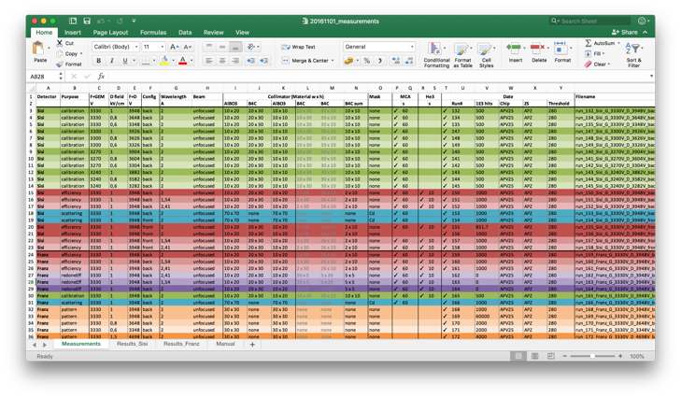
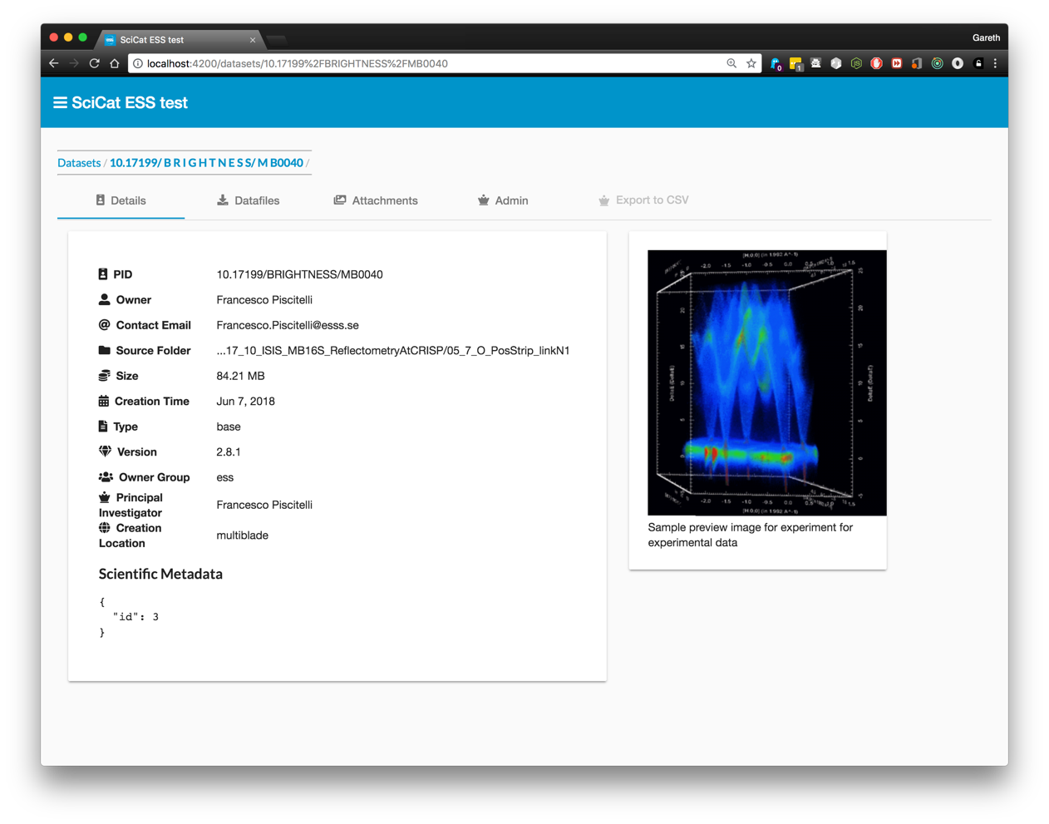

Capturing metadata at the source

Slide 31

Relationship to other WPs

Slide 32
Summary and Outlook
Data catalogues and repositories will often be the first entry point into an EOSC providing facilities to work with data.
Better capturing of experimental metadata supports the original experiment team in doing their research as well as it enables third party use once data becomes open.
Developing the NeXus data conventions can enable domain specific searching and be fruitful for more versatile processing code.

Slide 33
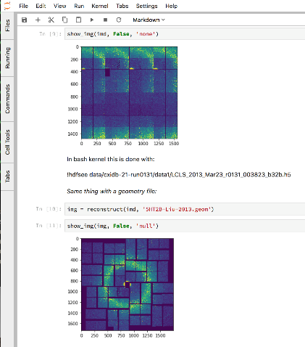
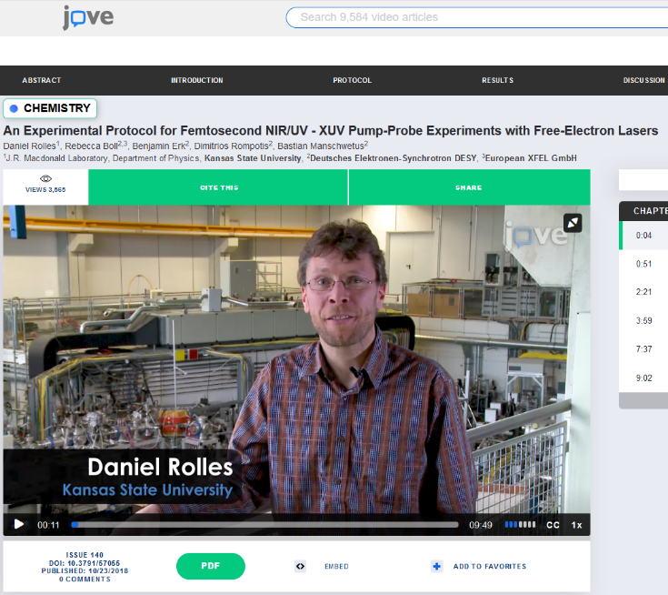
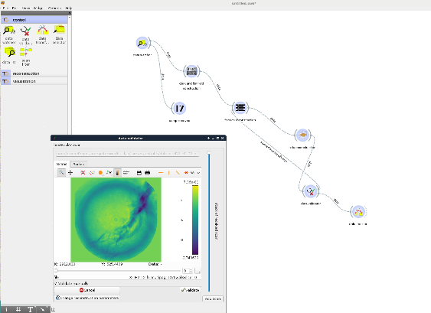
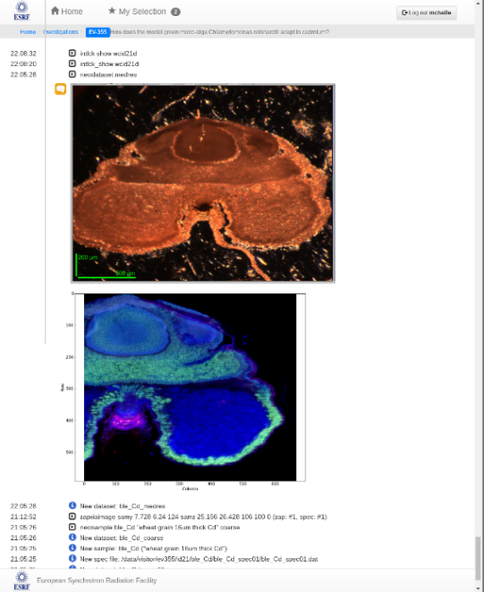
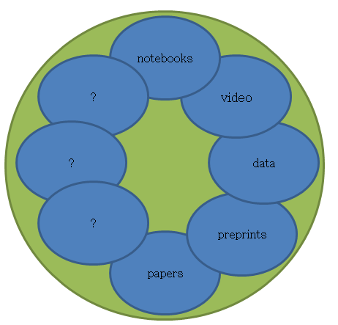
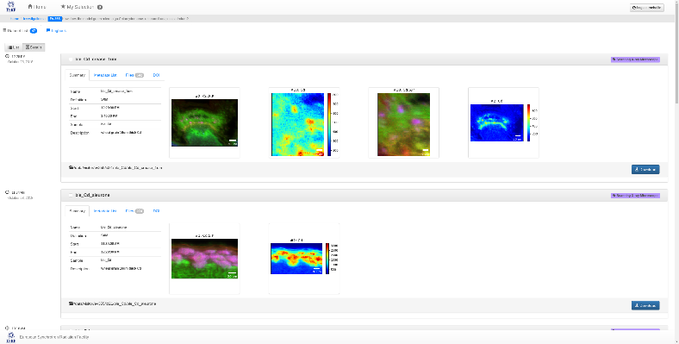
Why – to link all scientific data and output together
Image Source: http://michaelnielsen.org/blog/the-future-of-science-2/
Workflow
Logbook
Software

Slide 34
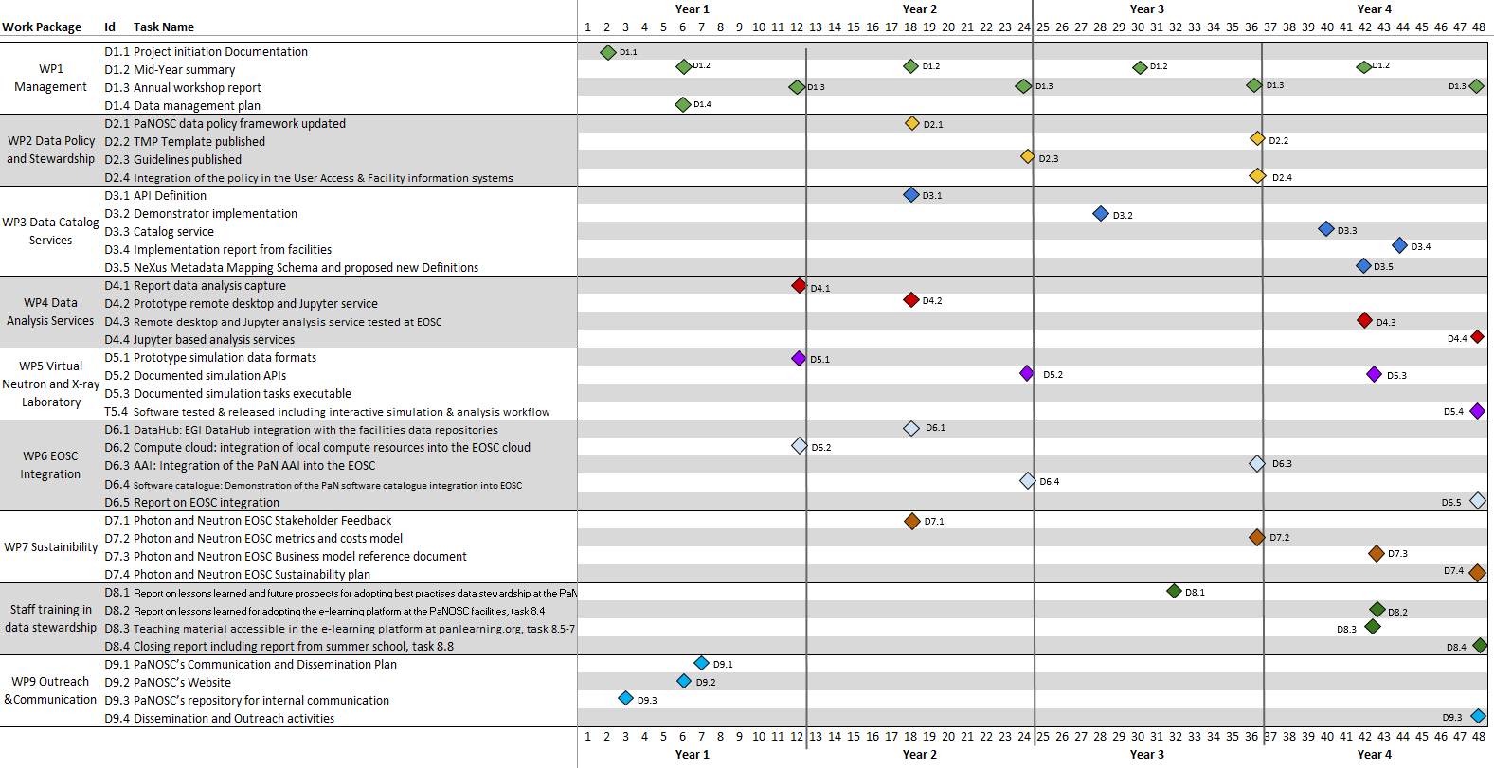
PaNOSC Deliverables
May 2019

Slide 35
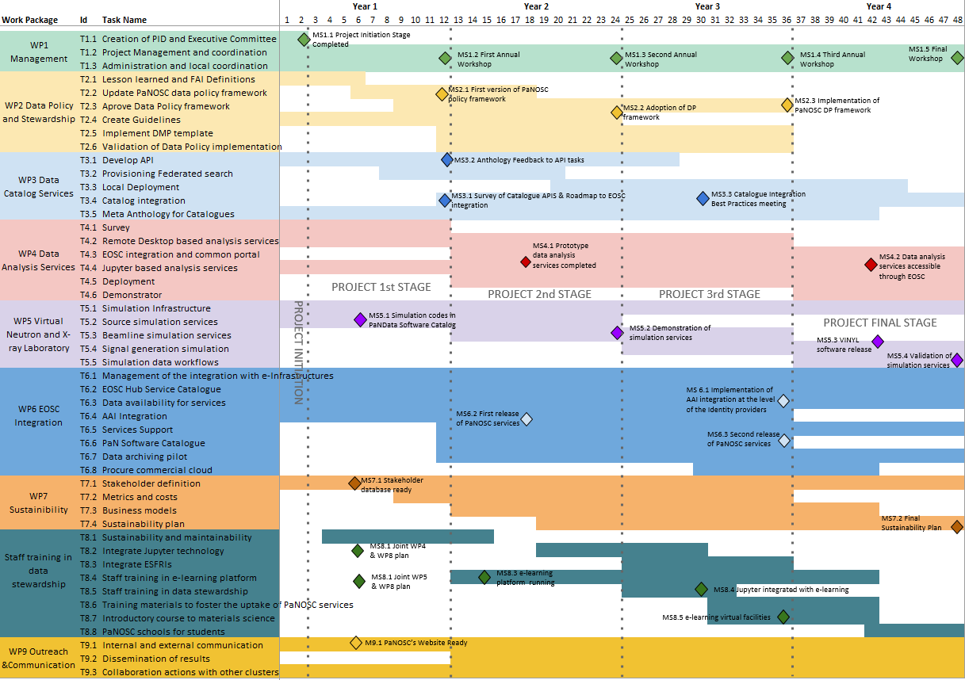
PaNOSC Milestones
May 2019

Slide 36
B2Find – EOSC Integration
Claudia Martens presented B2Find, explained what it does and doesn’t do and offered the service and expertise.
Fruitful discussion on the possible avenues to achieve the WP goals ensued.

