Slide 1
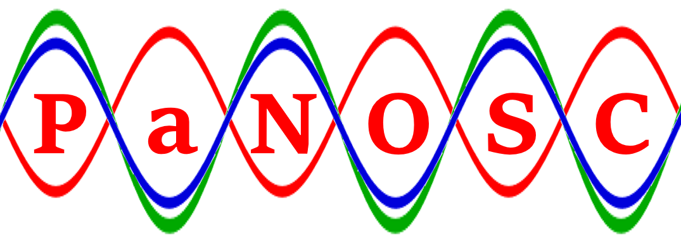
PaNOSC Kick-off Meeting
Photon and Neutron Open Science Cloud
Impact and Benefits from PaNOSC?
ELI’s Perspective and Expectations
Florian Gliksohn, ELI-DC Associate Director 15/01/2019
Florian Gliksohn – ELI’s Perspective and Expectations – 15/01/2019

Slide 2
ELI in Brief
ELI ERIC will be the world’s most advanced laser research infrastructure
First international research infrastructure built completely in Central Europe
Funded in synergy between ESIF, National and Framework funds, after EU approval and delivered through a community effort
This project has received funding from the European Union's Horizon 2020 research and innovation programme under grant agreement No 823852
Florian Gliksohn – ELI’s perspective and expectations – 15/01/2019

Slide 3
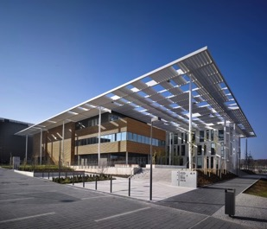
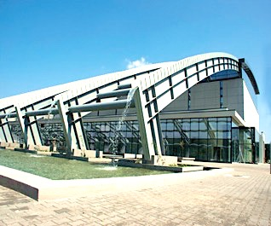
Current Implementation Status
Host Countries are completing the delivery of the ELI facilities with initial operations starting in 2019
Transitioning from Implementation (Construction) to Operations
The three facilities are coming together as a single ELI ERIC
Future access centrally managed by ELI ERIC with an ELI ERIC’s single data policy and integrated management approach
This project has received funding from the European Union's Horizon 2020 research and innovation programme under grant agreement No 823852
Florian Gliksohn – ELI’s perspective and expectations – 15/01/2019

Slide 4
Institutional Timeline
This project has received funding from the European Union's Horizon 2020 research and innovation programme under grant agreement No 823852
Florian Gliksohn – ELI’s perspective and expectations – 15/01/2019

Slide 5
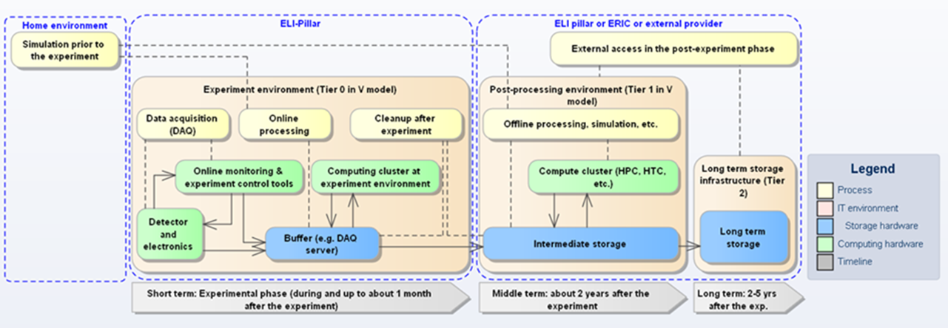
General Data Workflow at ELI
This project has received funding from the European Union's Horizon 2020 research and innovation programme under grant agreement No 823852
Florian Gliksohn – ELI’s perspective and expectations – 15/01/2019

Slide 6
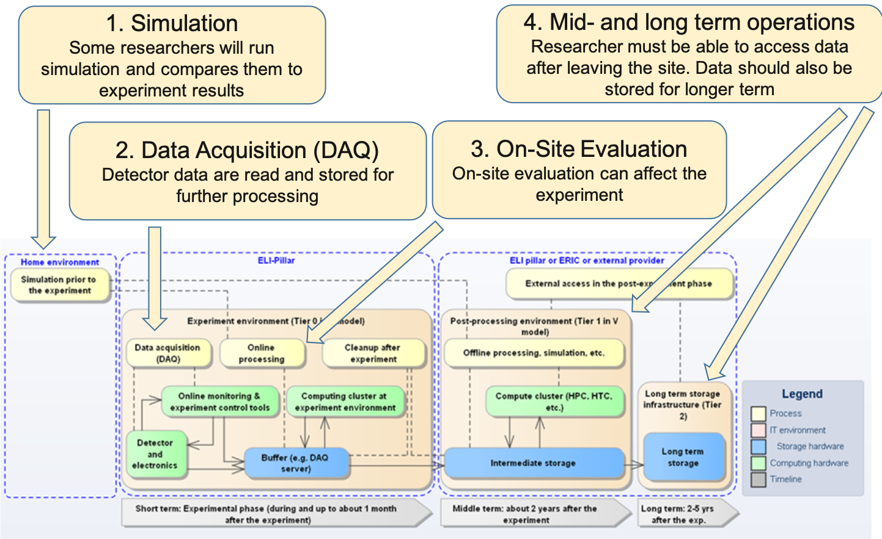
General Data Workflow at ELI
This project has received funding from the European Union's Horizon 2020 research and innovation programme under grant agreement No 823852
Florian Gliksohn – ELI’s perspective and expectations – 15/01/2019

Slide 7
Elements of a Data Policy
In the area of Data, the Charter invites RIs to:
Define a transparent data policy, which is accepted by the users upon submitting the proposal
Maintain a data management plan
Encourage the open access of the data after a certain embargo period (during which the experimenter has exclusive access to the data and can publish results based on them)
Envisaged approach at ELI:
ELI as custodian of the data (archiving obligation)
Catalogue of metadata to allowing search
Publication rights for the data belong to the experimenter
Publication by ELI after embargo period (still undefined) with copyright for the experimenter.
This project has received funding from the European Union's Horizon 2020 research and innovation programme under grant agreement No 823852
Florian Gliksohn – ELI’s perspective and expectations – 15/01/2019

Slide 8
Challenges
The amount of data will not be the main challenge (10+ PB of archived data per annum)
Fragmentation of staff involved in data-related activities within organization and only very few data scientists involved
Standardisation challenge (approach to metadata, diagnostics, etc.) not yet achieved
Need for cohesive vision and strategy going beyond the photon factory mission to that of a data provider
Cultural issue due to a “lab approach” to experimental data
Doubts from insiders that going online is possible and valuable
This project has received funding from the European Union's Horizon 2020 research and innovation programme under grant agreement No 823852
Florian Gliksohn – ELI’s perspective and expectations – 15/01/2019

Slide 9
PaNOSC as an opportunity
Very timely opportunity for ELI given the challenges ahead
Development of data policy, data management plan and data strategy along the project timescale
Support to online approach to data provision
EOSC-compatible design
Capacity building opportunity as ELI ERIC starts up activities in an integrated way
Strong networking benefits through involvement in the consortium
This project has received funding from the European Union's Horizon 2020 research and innovation programme under grant agreement No 823852
Florian Gliksohn – ELI’s perspective and expectations – 15/01/2019

