Slide 1
PaNOSC WP3 - introduction to myMdC the European XFEL metadata catalogue
Luís Maia,
On behalf of European XFEL ITDM group
23rd May 2019

Slide 2
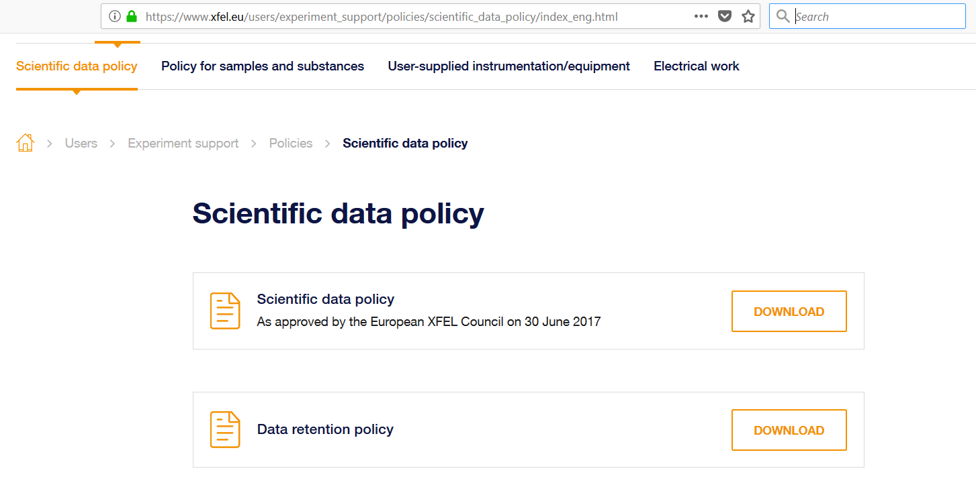
Scientific Data Management
Organize and manage data in a coherent way
Aggregate and record large volumes of data
Provide possibility of inspecting data during experiment
Enable users to efficiently analyse experiment data when back at home institute
Prepare for open access era
General principles
Open access
Long term data curation
Embargo period with restricted access

Slide 3
Data Management Activities
Storage | Quota | Safety | Lifetime | Comment
dcache.raw | None | Tape Archive | 6 months (t.b.c) | Raw data
raw | None | None | 2 months (t.b.c) | Fast accessible raw data, lifetime not guaranteed
usr | 5TB | Snapshots + Tape Backup | 24 months (t.b.c) | user data, results
proc | None | None | 6 months (t.b.c) | processed data e.g. calibrated
scratch | None | None | 6 months | Temporary data (lifetime not guaranteed)
dcache.cal | None | Tape Archive | 10 years | Calibration constants
cal | None | Tape archive | 6 months
user home | 20GB | Snapshots + Tape Backup | Lifetime of the account
archive.raw | None | - | Long-term | Long term means 5 years and XFEL will strive for 10 years
archive.cal | None | - | 10 years
Catalog and document the data generated at European XFEL
Data migration services
Keep track of data location
Allow data publishing, exportation and authorization management
Manage permissions and accesses to the data in an uniform manner and guarantee that only authorized people have access to the data
Data Retention Policies control and execution
Data Quality Assessment
Data Calibration
Data Archiving
Data Cleanup

Slide 4
Elog
Elog logbook config file generation
Integration with Elog replacement tool
SLURM
Priority queues reservation for beamtime*
Karabo - DAQ
Universal Run Management
Run tagging and basic details
Number of files and size
Data Source Groups definition
Calibration Pipeline
Trigger Processed data generation*
myCaL
Document used CCV on data calibration
Grid-FTP / Globus / Off-shore data exportation
Transfer Agent Off-shore data migration
DataCite / Tind.io
DOI generation and publish*
Public DOI end point
Data Policy enforcement Service
Notifications*
Statistics
myMdC Purpose
Glue together different systems and services
UPEX
Users and internal proposals
Proposals Experiment team & Samples sheet
Check and sync users accepted data policies
Trigger proposal team snapshot
Registry
Users accounts
Staff organizational group
Instrument support groups*
LDAP
Users Proposal groups*
GPFS
Repository location
Universal folders management
Proposal folders creation
Runs data migration
Folders removal*
Data Audit and reconciliation

Slide 5
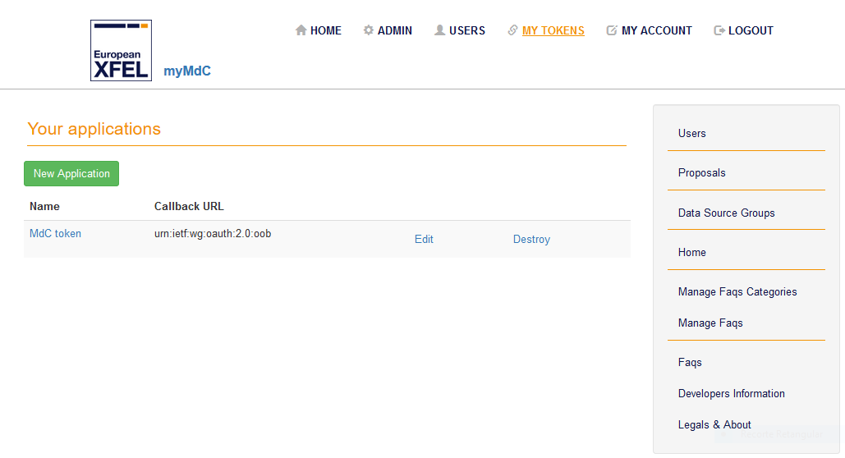
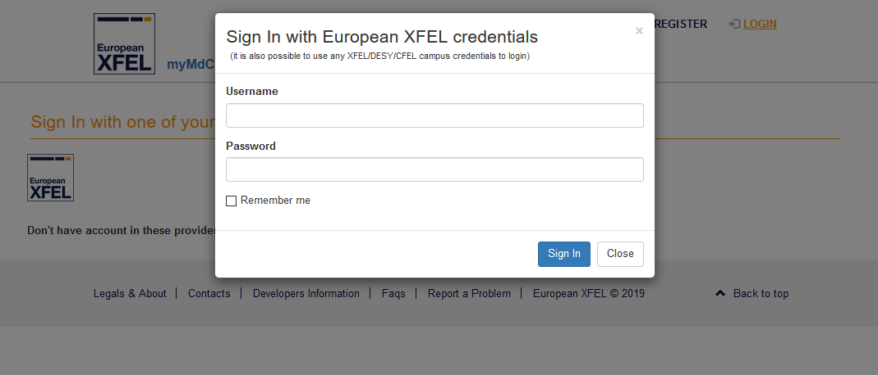
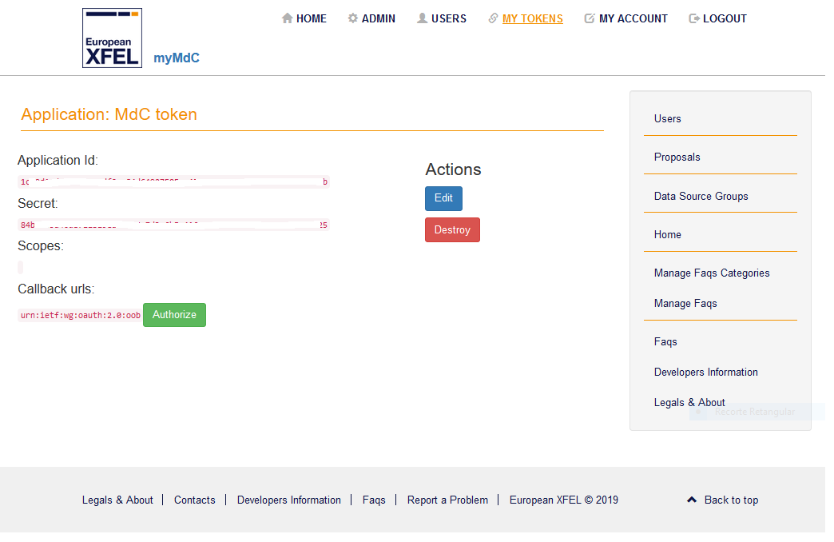
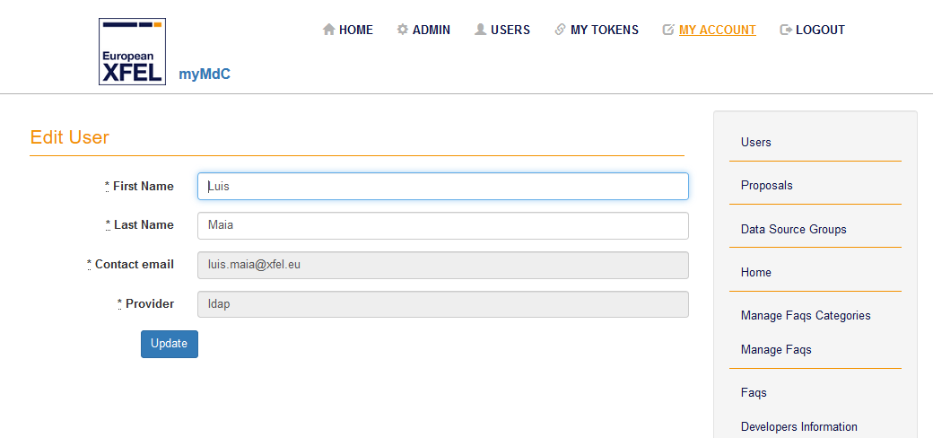
Key Features Authentication

Slide 6
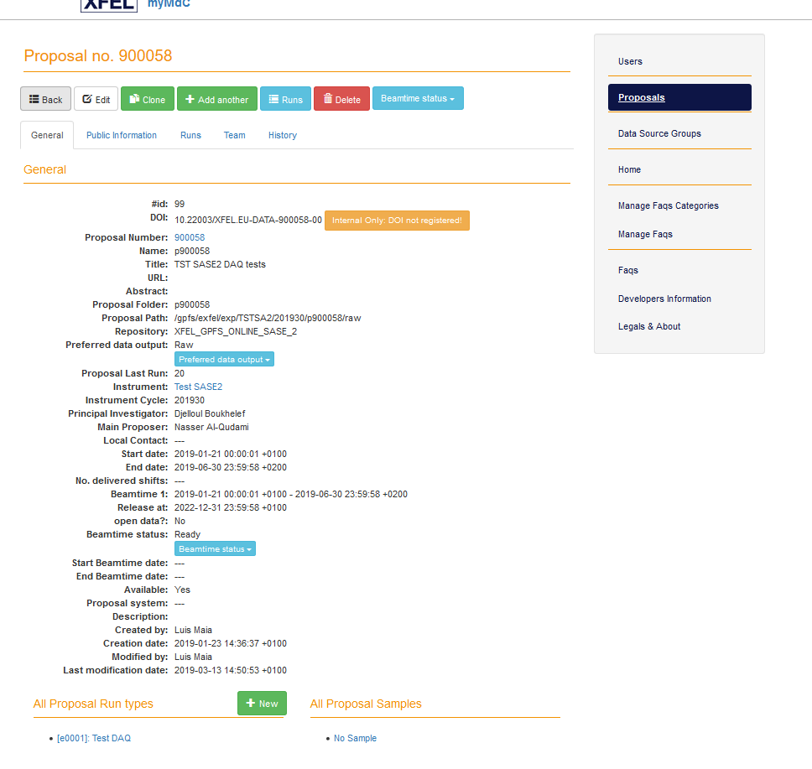
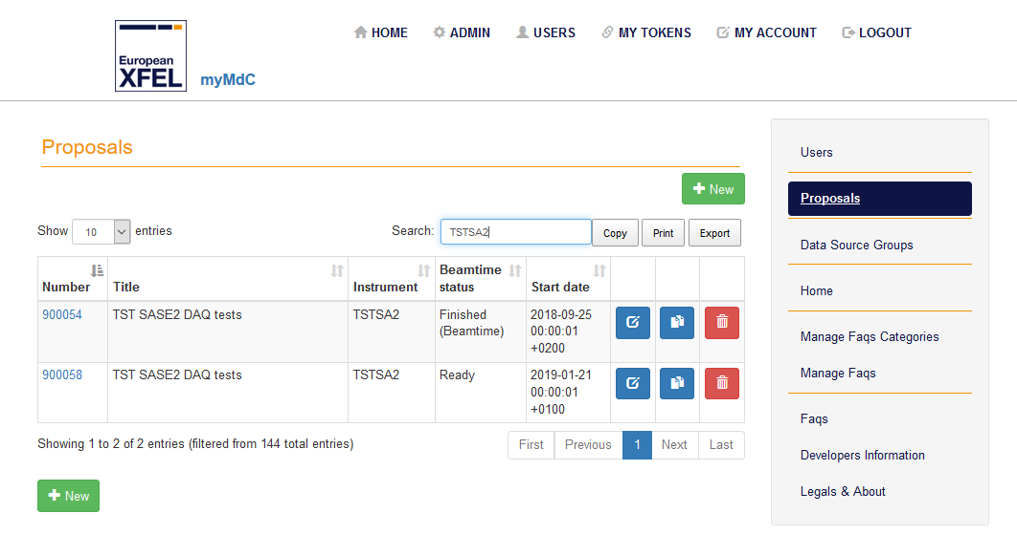
Key Features Proposal details

Slide 7
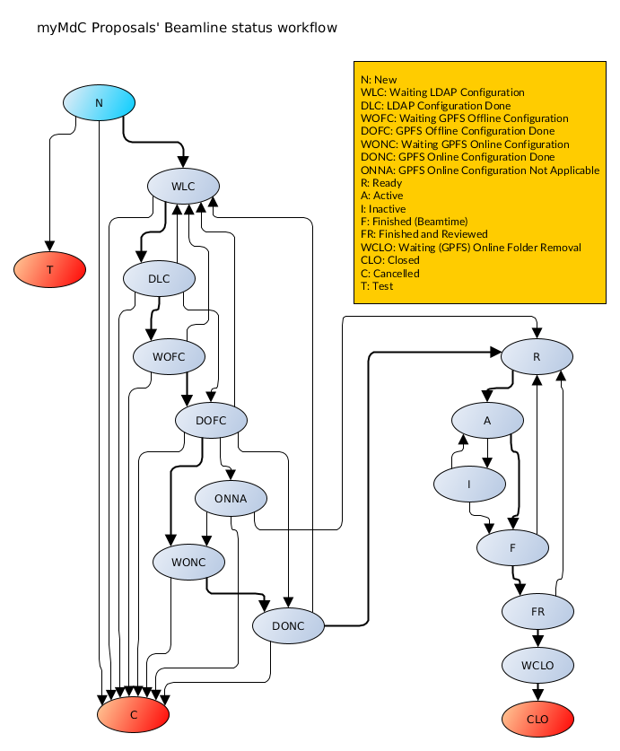
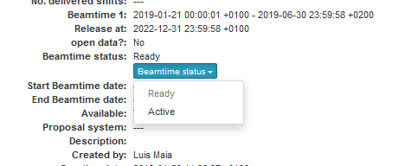
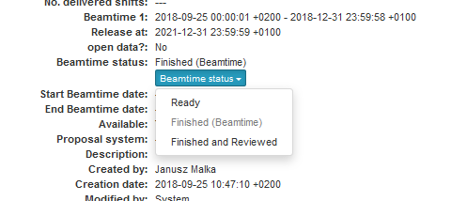
Key Features Proposal workflow and notifications

Slide 8
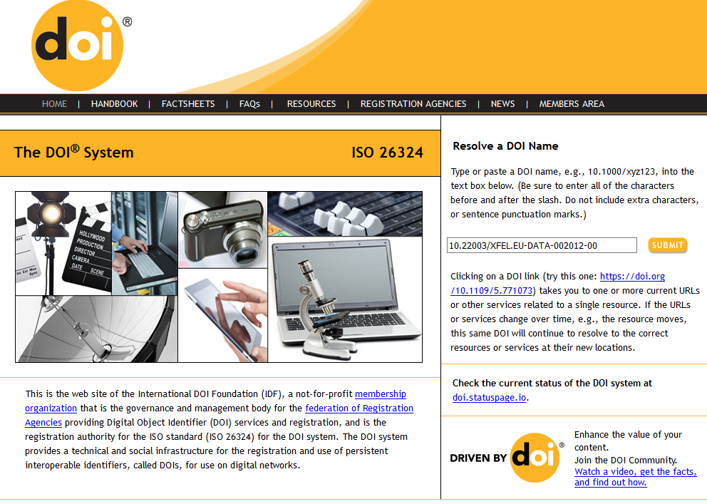
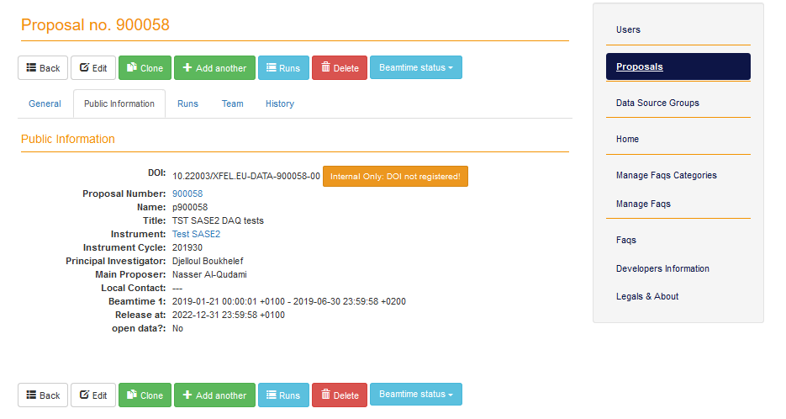
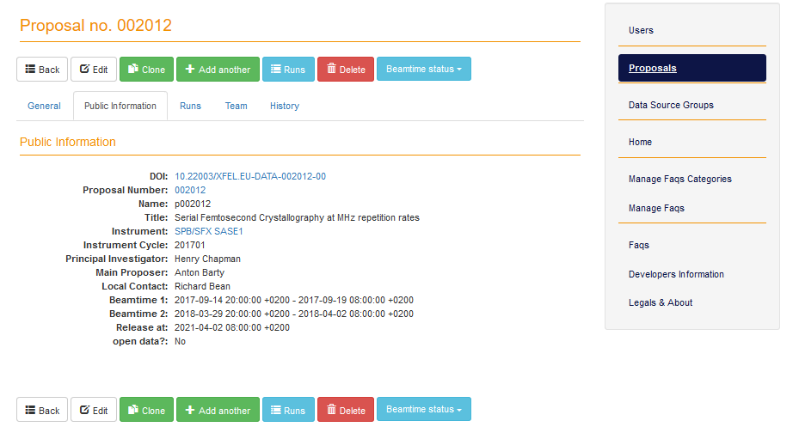
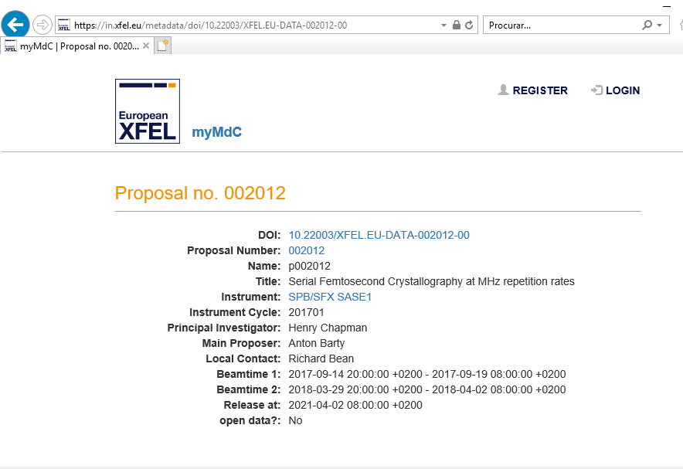
Key Features Proposal DOIs integration

Slide 9
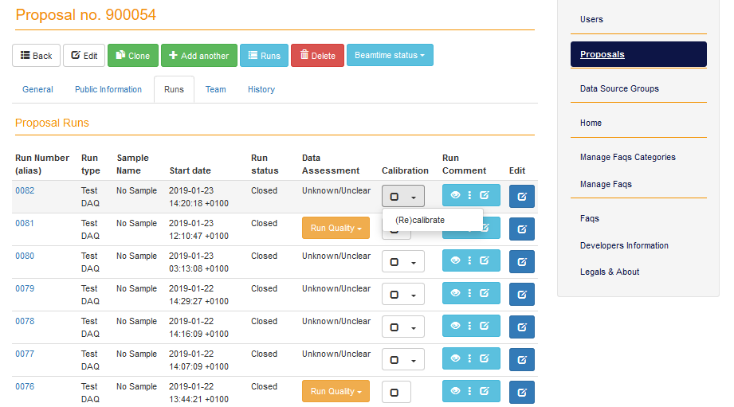
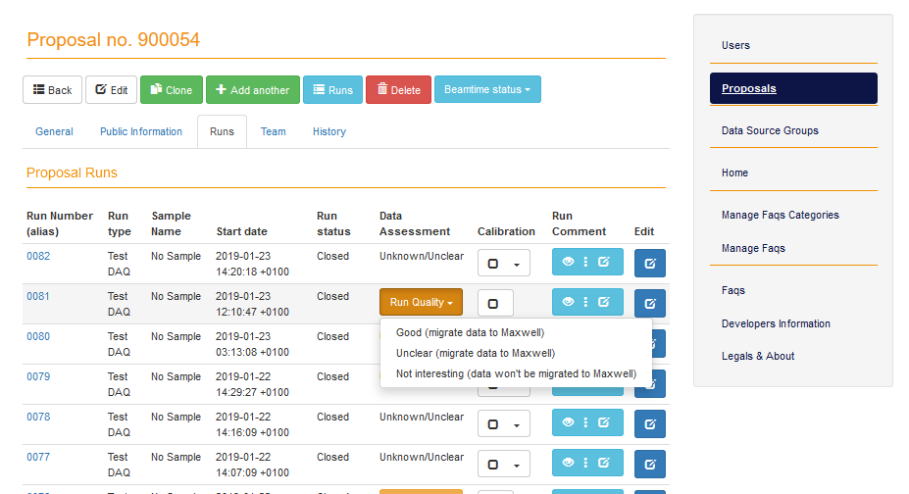
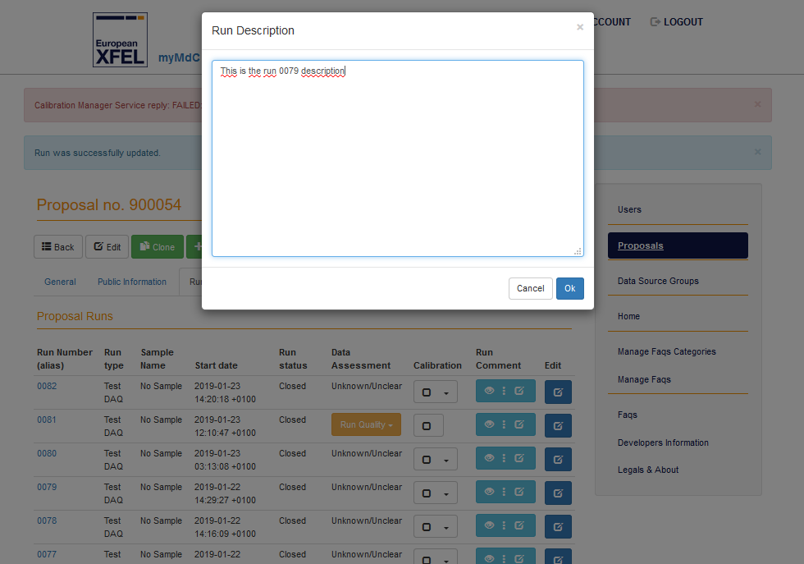
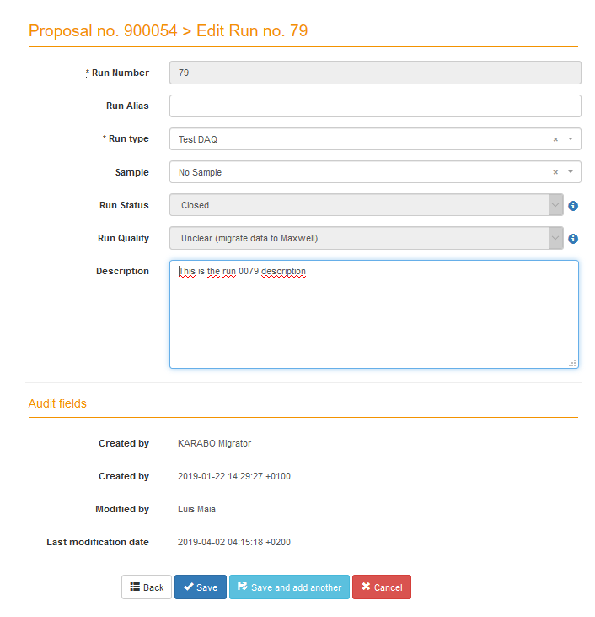
Key Features Proposal runs (data) management

Slide 10
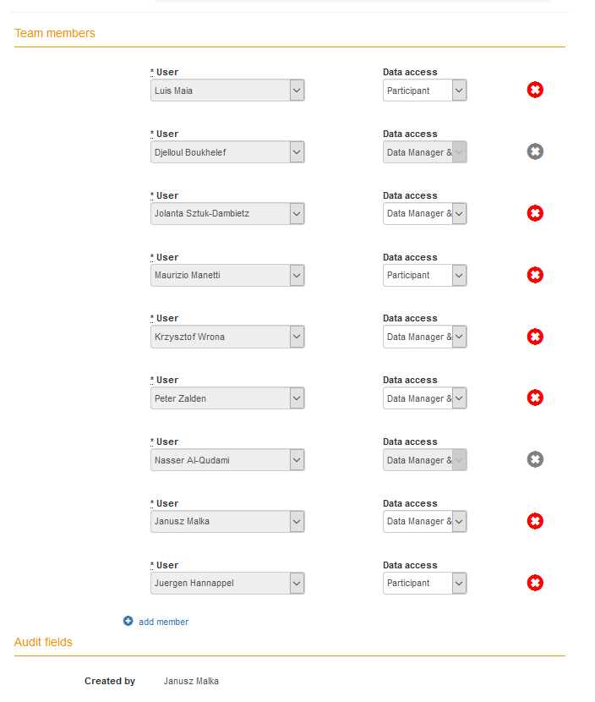
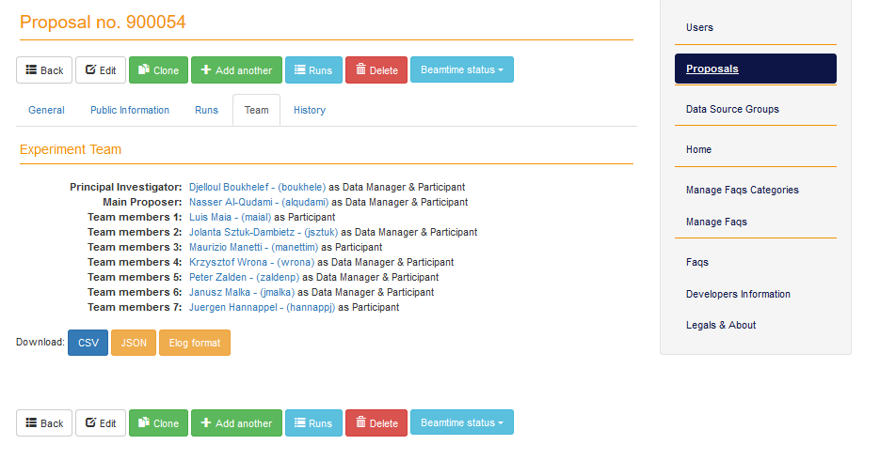
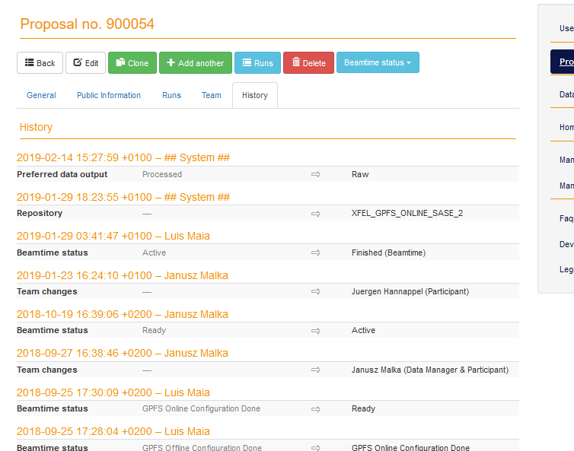
Key Features Proposal team and History

Slide 11
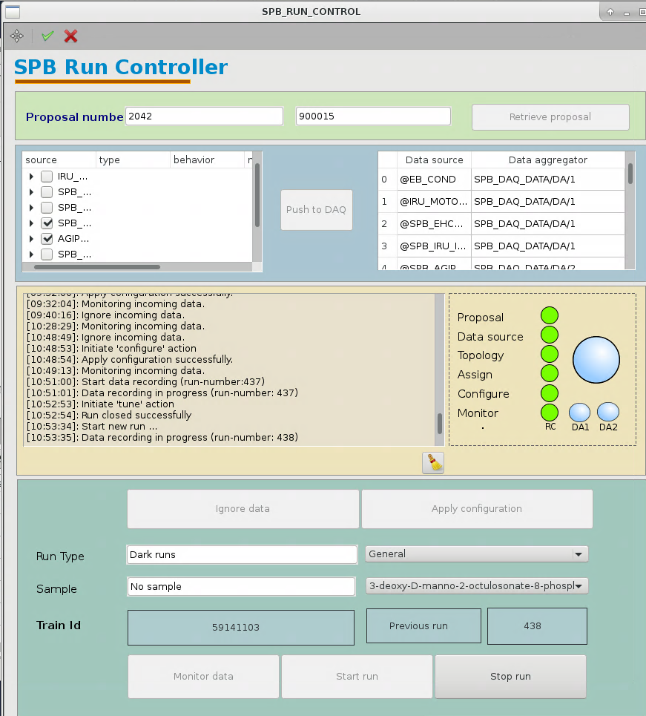
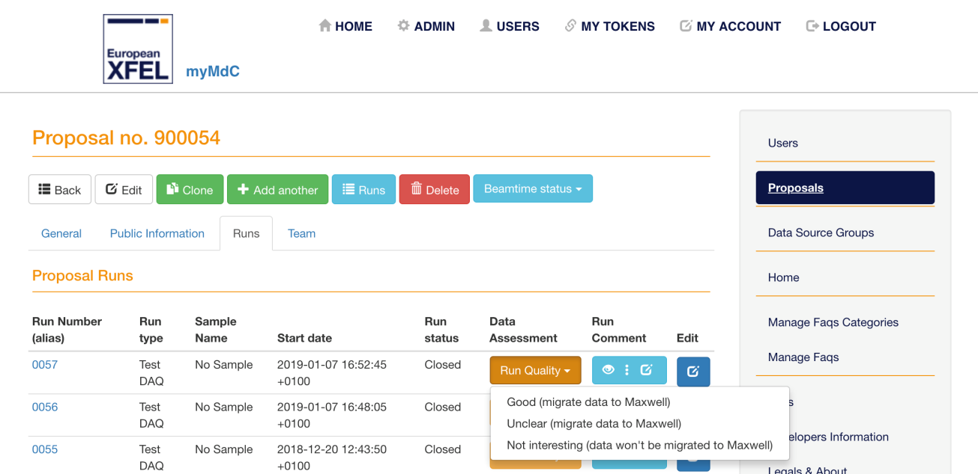
Key Features Integration with data acquisition

Slide 12
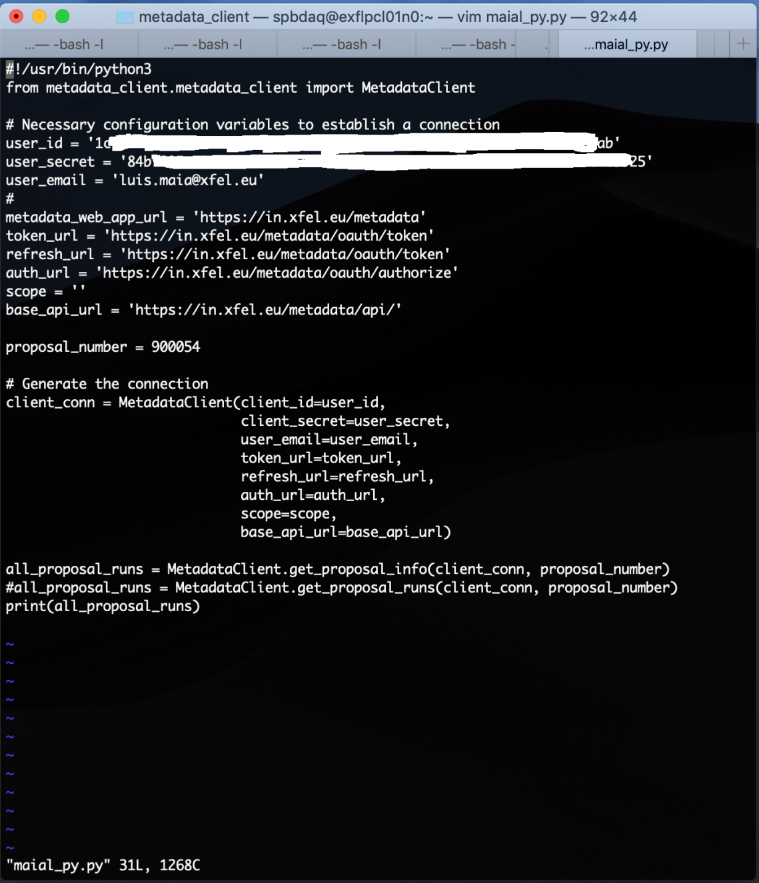
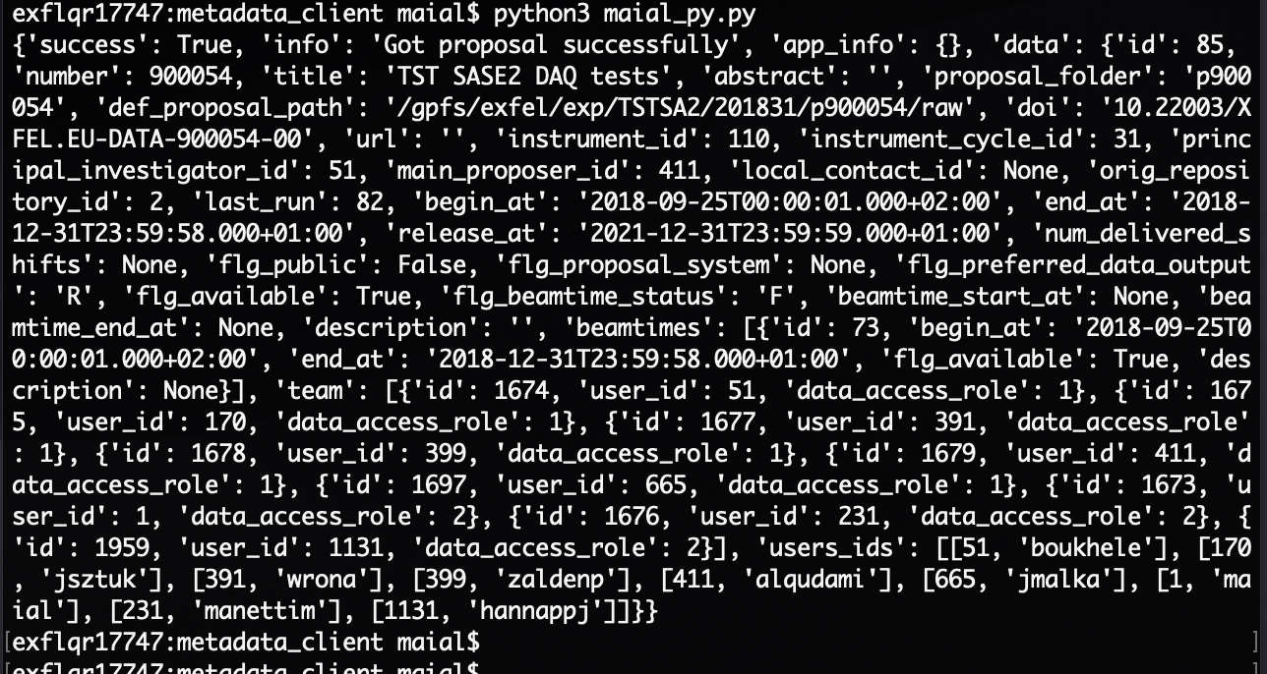
Key Features RESTful API’s
Python library: https://in.xfel.eu/gitlab/ITDM/metadata_client

Slide 13
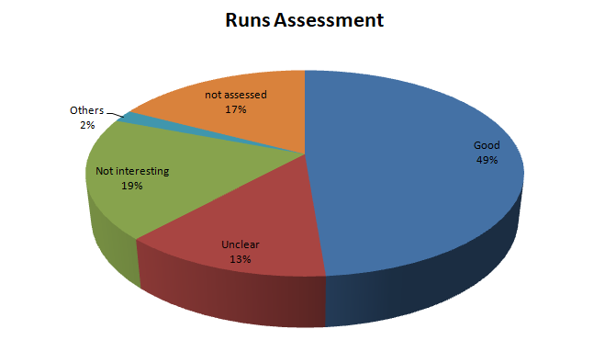
Key Features Statistics
Users | 1296
Groups | 346
Instruments | 15
Instrument Cycles | 59
Repositories | 11
Porposals | 144
Proposals with published DOI | 3
Samples in all proposals | 540
Run Types in all proposals | 488
Users in all proposals | 2833
Runs in all proposals | 29736
Runs migrated to Maxwell | 18304
Runs Calibrated (via myMdC) | 463

Slide 14
Links
myMdC: Metadata Catalog Web Server
https://in.xfel.eu/metadata/ (website, intro, FAQs)
https://in.xfel.eu/gitlab/ITDM/metadata_catalog (code)
https://in.xfel.eu/redmine/projects/metadata-catalogue (questions, suggestions, issue tracking & project planning)
Email it-support@xfel.eu (for urgent support)
Metadata_client: Metadata Client python RESTful APIs client
https://in.xfel.eu/gitlab/ITDM/metadata_client (code)
https://in.xfel.eu/redmine/projects/metadata-catalogue (questions, suggestions, issue tracking & project planning)
Email it-support@xfel.eu (for urgent support)

Slide 15
Thank you!
Special thank you to all the people that contributed to the project:
Krzysztof Wrona, Maurizio Manetti, Djelloul Boukhelef, Janusz Szuba, Janusz Malka, Varun Singh, Illia Derevianko, Siriyala Devi Kujala, Piotr Wasiuk, Henryk Giemza, Nasser Alqudami, Steffen Hauf, Hans Fangohr, Silvia Bertini

Slide 16
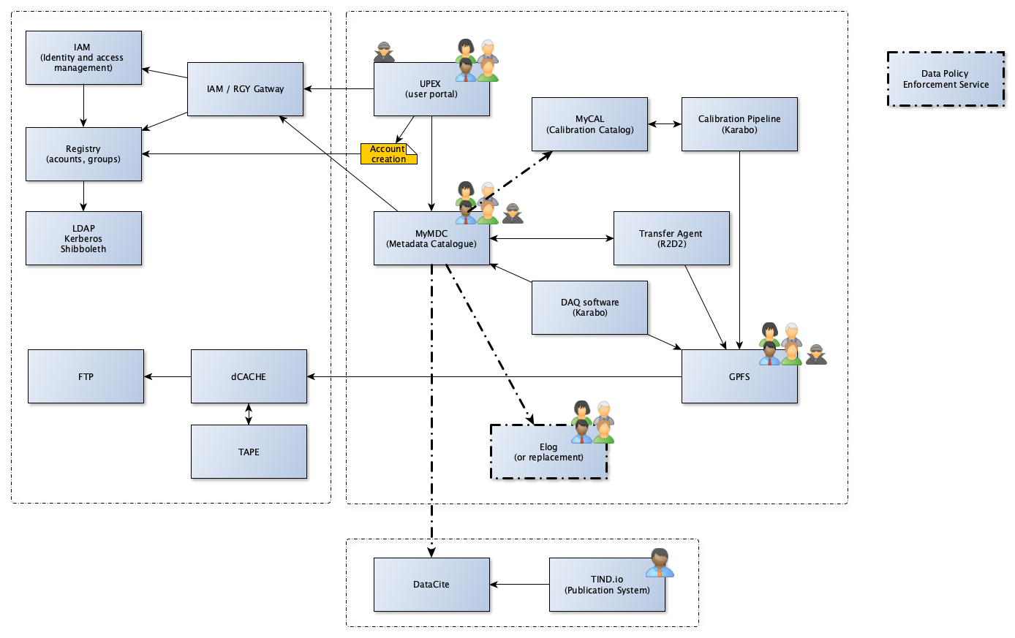
Landscape

Slide 17
Data Retention Policy – under review
Storage | Quota | Safety | Lifetime | Comment
dcache.raw | None | Tape Archive | 6 months (t.b.c) | Raw data
raw | None | None | 2 months (t.b.c) | Fast accessible raw data, lifetime not guaranteed
usr | 5TB | Snapshots + Tape Backup | 24 months (t.b.c) | user data, results
proc | None | None | 6 months (t.b.c) | processed data e.g. calibrated
scratch | None | None | 6 months | Temporary data (lifetime not guaranteed)
dcache.cal | None | Tape Archive | 10 years | Calibration constants
cal | None | Tape archive | 6 months
user home | 20GB | Snapshots + Tape Backup | Lifetime of the account
archive.raw | None | - | Long-term | Long term means 5 years and XFEL will strive for 10 years
archive.cal | None | - | 10 years

Slide 18
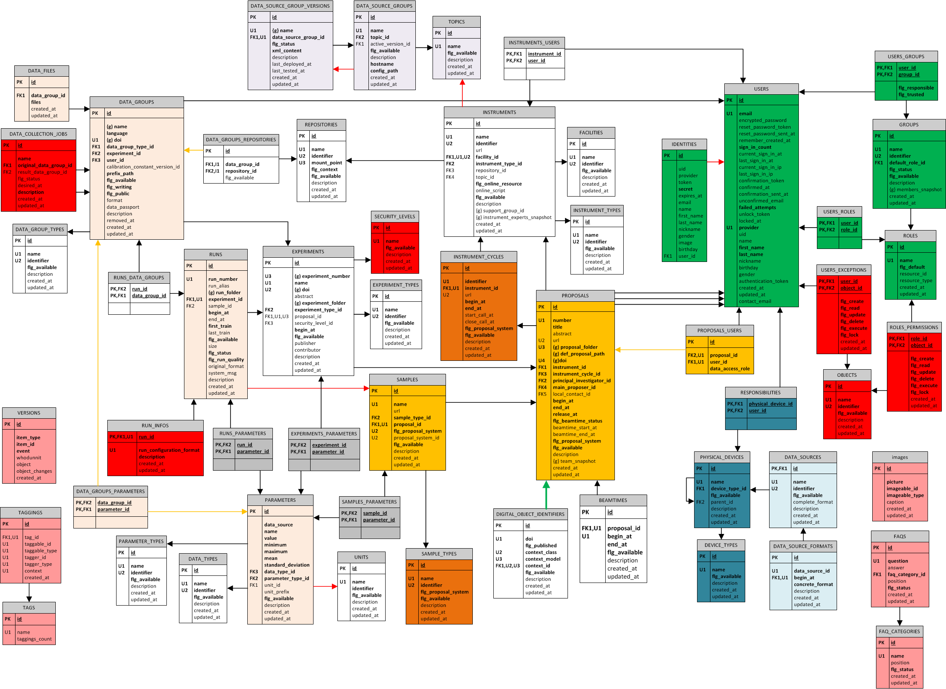
myMdC – DB model

