Slide 1


WP3 Kick Off Meeting – NeXus
Tobias Richter
European Spallation Source DMSC, Copenhagen, May 2019
This project has received funding from the European Union’s Horizon 2020 research and innovation programme under grant agreement No. 823852

Slide 2

NeXus
NeXus aims to provide a format that can hold:
raw experimental data
(with all information required for processing)
all data needed for diagnostics
metadata
processed data
All of the above are optional.
For all techniques at
  neutron
  muon
  X-ray
  soft X-ray
  VUV
research facilities.
Goal is to replace any formats that require implicit knowledge about the experiment.

Slide 3
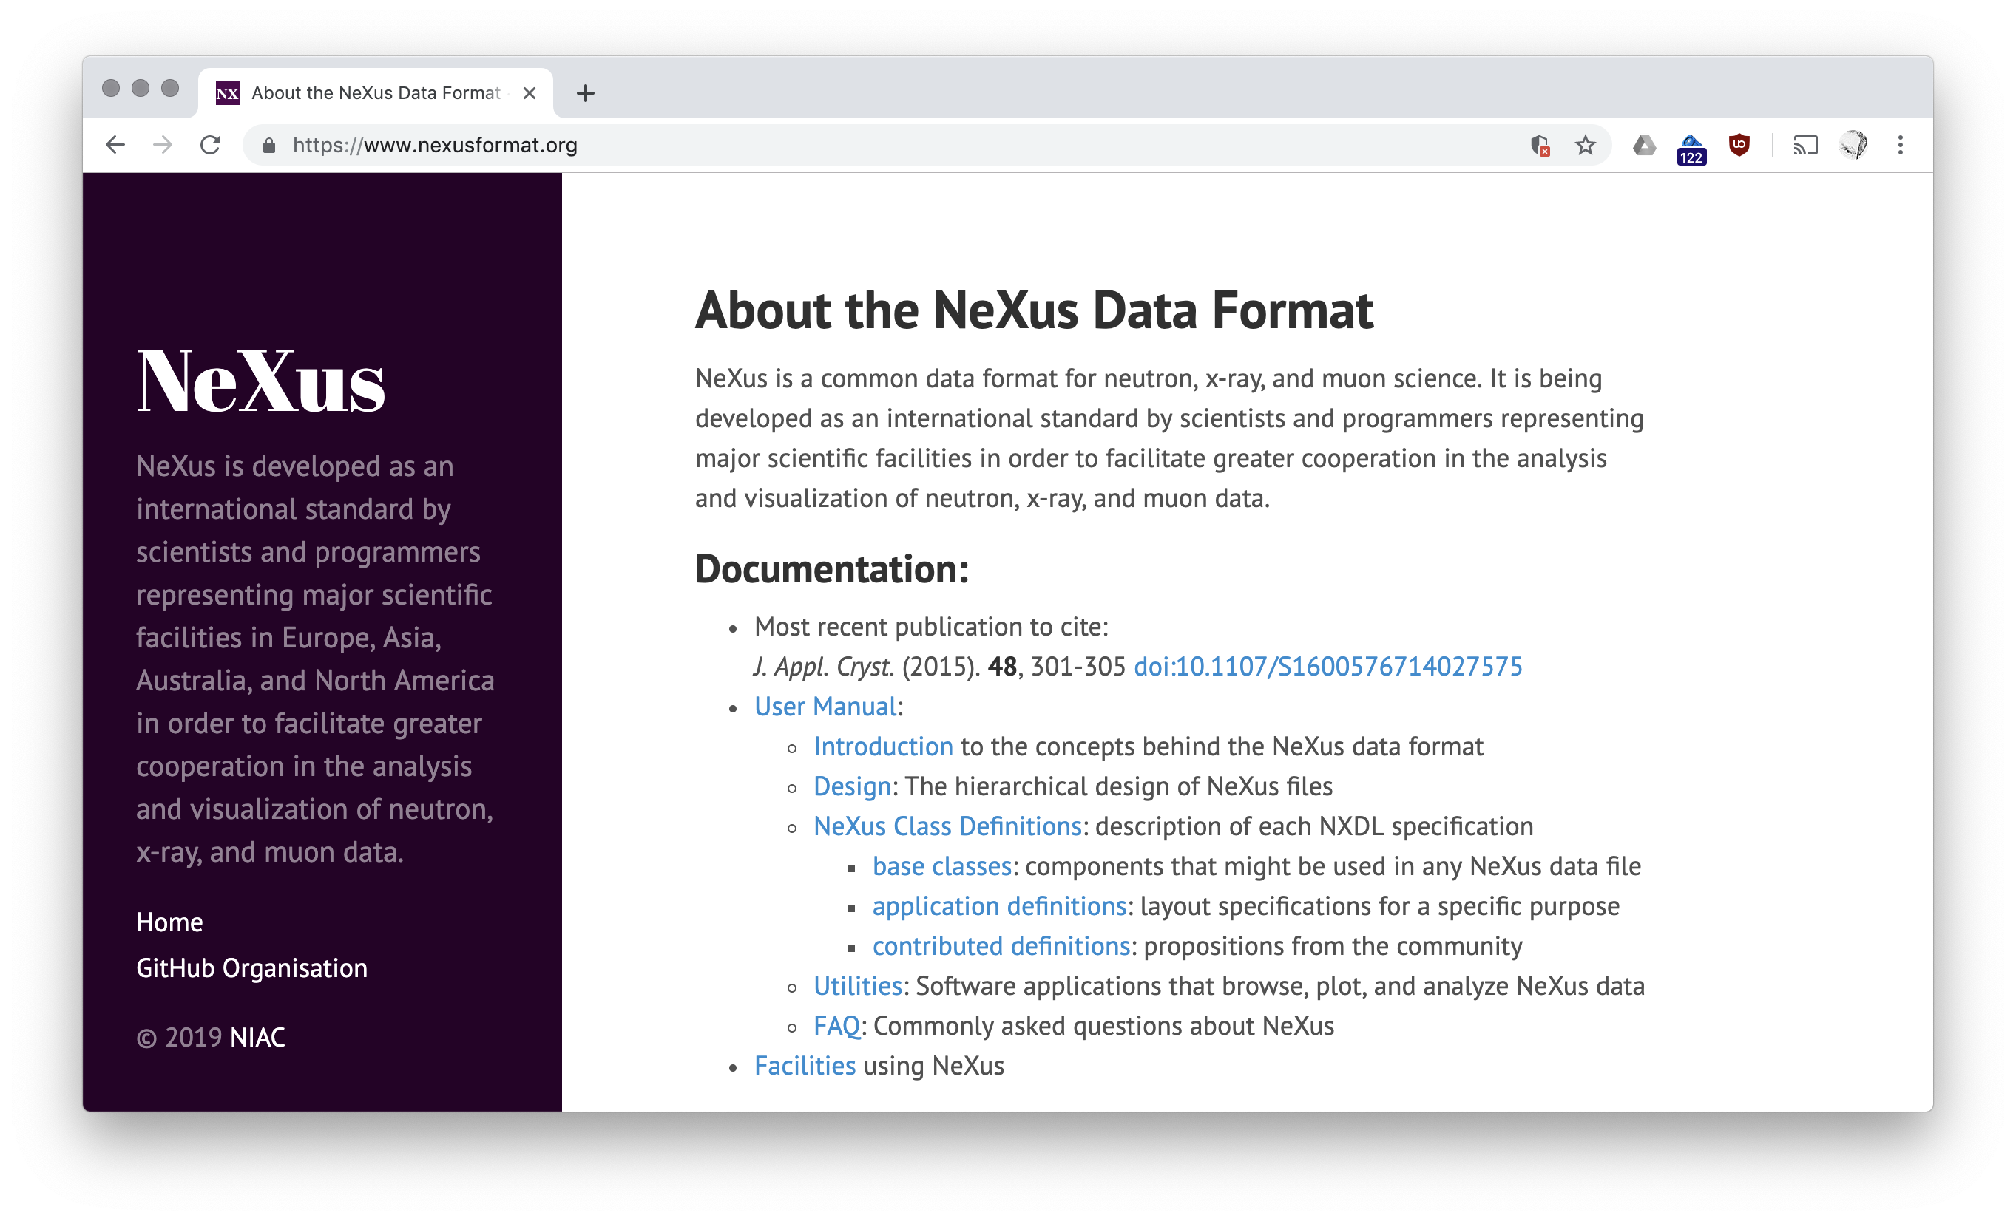

Slide 4
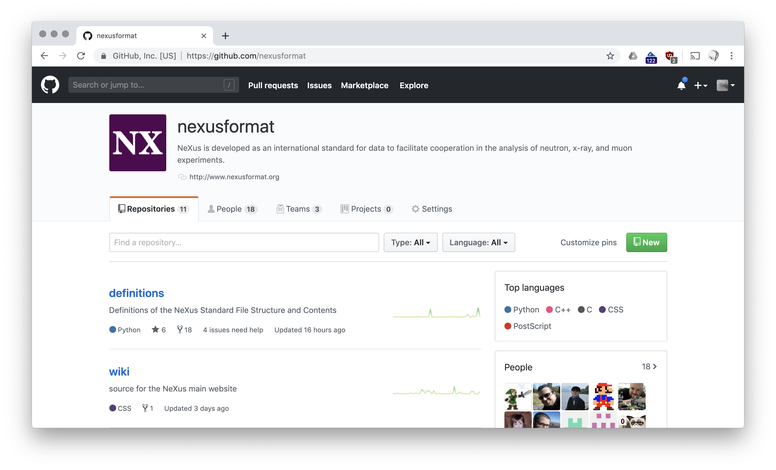

Slide 5
NeXus International Advisory Committee NIAC
Mark Basham,
Diamond Light Source, UK
(Executive Secretary)
Herbert Bernstein,
CIF (non-facility member)
Aaron Brewster,
Lawrence Berkeley Laboratory, USA
Stuart Campbell,
Brookhaven National Laboratory, USA
(Technical Manager)
Bjorn Clausen,
Los Alamos National Laboratory, USA
Stephen Cottrell,
Rutherford Appleton Laboratory, UK
Ricardo Ferraz-Leal,
SNS and HFIR at ORNL, USA
Jens-Uwe Hoffmann,
Helmholtz Zentrum Berlin, Germany
Pete Jemian,
Advanced Photon Source, USA
(Documentation Release Manager)
Mark Könnecke,
Paul Scherrer Institute, Switzerland
Raymond Osborn,
Argonne National Laboratory, USA
(non-facility member)
Tobias Richter,
European Spallation Source, Sweden
Armando Sole,
European Synchrotron Radiation Facility, France
Jiro Suzuki,
KEK, Japan
Benjamin Watts,
Swiss Light Source, Switzerland (Chair)

Slide 6
Levels of NeXus adoption
  At a formal level:
  Data stored in HDF5 container
  NeXus base classes followed (use of dictionary terms)
  Making guarantees about the file contents
  * Following application definitions
  * Advertising recipes for data extraction (“features”)
  In addition the amount and quality of the information that goes into the file is hard to measure sensibly.
Notes:
gold standard

Slide 7
What does HDF5 do for you?
Offers a useful structured (hierarchical) storage container supporting many datatypes.
Saves a lot of work accessing data randomly in many dimensions (less then 32)
Has lots of clever features that make organising and writing data fast, efficient and flexible.
  Custom compression filters
  SWMR
  Virtual Dataset
HDF5 is well and widely supported
(h5py, MATLAB, IgorPro, …)
As a rule:
Don’t solve problems that HDF5 has already solved for you.
Notes:
tools

Slide 8
What is/was NAPI?
Back in the day you could ”Download & Install NeXus”
That provided a common interface abstracting the backends HDF5, HDF4 and XML and some more or less useful tools.
  most modern HDF5 features are not available in NAPI
  yet using HDF4 and XML is deprecated
  not using a programming model popular in 2019
  relatively low adoption with facilities
  in maintenance mode
Recommendation now: Use your preferred HDF5 binding directly.

Slide 9
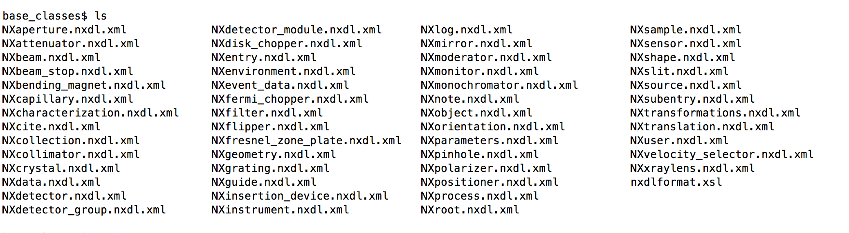
Base Classes
Contain parameters common for particulars type of equipment or sample, user, etc.
With those you can build up a hierarchy describing a fairly complete description of an experiment.
Notes:
NXdata, Mono, Detector

Slide 10
Application Definitions
Aim was to describe the file contents (mostly taken from base class definitions) required for the analysis of a particular “application”.
Like the base classes they are defined via XML/XSD schema files with custom documentation elements that produce part of the NeXus manual.
Concept has a few weaknesses and the adoption is low.

Slide 11
Modularise the contract about the file contents?
Every scheme puts a burden on developers of NeXus and consuming software.
Everything needs to be implemented and tested at every facility.
Would it not be nice if you could just steal the code required?
Unfortunately there is not enough critical mass in the photon and neutron
community for this to work via cut & paste from
Idea:
    Use readable Python code both to
      support the documentation and
      as reference implementation.
    Works like a unit test for data file and processing code.
    Also allows for finer granularity control of what information is kept in the file.
NeXus Features / Recipes

Slide 12
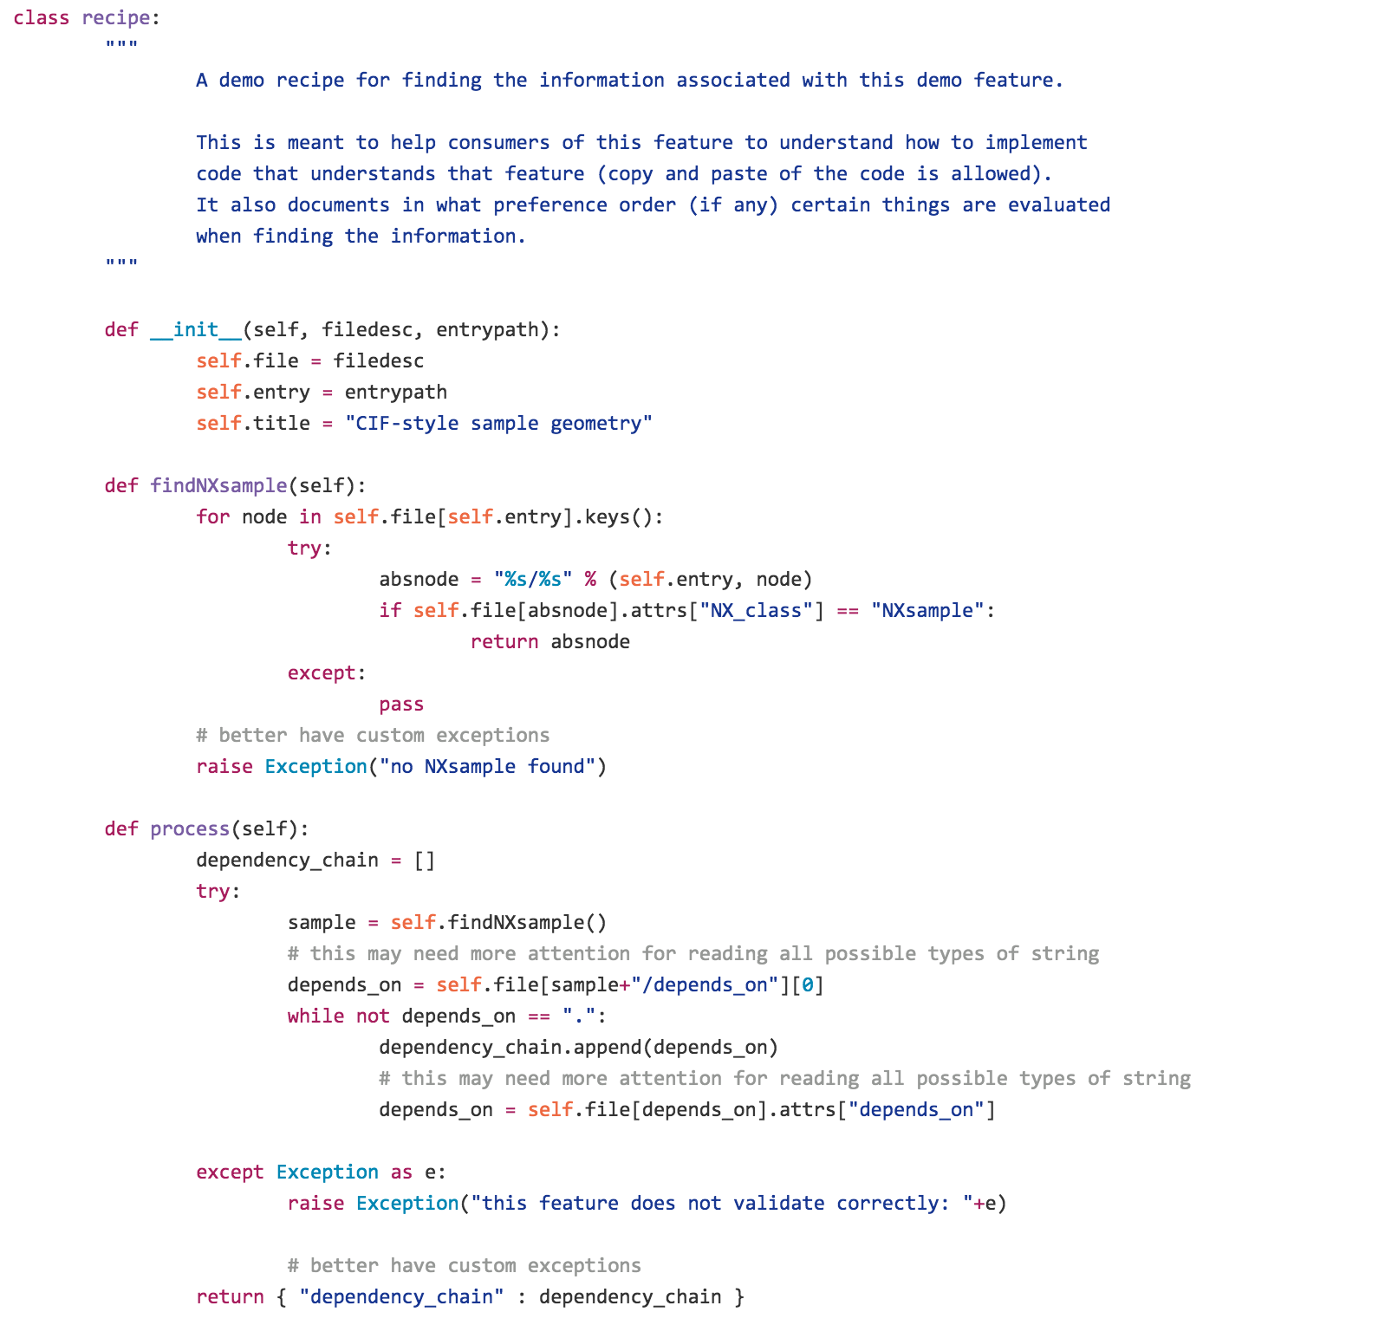
Example
Feature / Recipe
NeXus Features / Recipes
Example

Slide 13
Considerations
In an experiment there can be different ways of realising the same properties – consequently NeXus allows different ways of encoding what may be functionally equivalent
Readers of the file may not want to care about all options
Writers often do, because they want to write what is efficient and ”true” to the measurement conditions
Examples: Different ways of monochromatizing the beam, different ways of recording scan information, etc

Slide 14
Metadata for Scans
From simple to complex or
from old school to modern.
    Static Exposure
    NeXus Scan Rules
    Multiple Dimensions
    Time Stamp Everything
Caveat:
Not all required and helpful structure is shown in the examples on the slides!

Slide 15
Multi dimensional scan data
Not shown in the examples:
Scheme for describing the correct alignment of indices.
entry:NXentry data:NXdata data[11,1024,1024,512] x_scan[1024] y_scan[1024] energy[1024,1024,512] temperature[11]
y
temperature
Pros | Cons
Easy slicing and plotting, captures scan intend | Limited to rectangular geometries
x
Notes:
NXcansas poster

Slide 16
Asynchronous Scan Recording
polarisation
rotation_angle
temperature
NXlog Group for asynchronous time stamped data can replace any dataset in a base class or application definition.
Fits well with neutron event recording, data only updated on change.
time
entry:NXentry data:NXdata data:NXlog polarisation:NXlog temperature:NXlog rotation_angle:NXlog
Pros | Cons
very flexible, efficient storage, little DAQ hardware support needed | No default plot, requires post processing

Slide 17
In an ideal world…
In an ideal scenario the consumer would be able to use the data in functionally the same way, regardless in which of the officially ways the experiment was carried out:
Static Exposure
NeXus Scan Rules (1D)
Multiple Scan Dimensions
Time Stamp Everything
However: Trying to bury that functionality in a library and attempting to transform the data transparently will be prohibitive in most cases.
Notes:
EDIT

Slide 18
Locations and Orientations
entry:NXentry data:NXdata … instrument:NXinstrument detetctor:NXdetector … sample:NXsample depends_on=diffr/phi diffr:NXtransformations phi[…] @transformation_type=rotation @vector=0,1,0 @depends_on=chi chi[…] @transformation_type=rotation @vector=0,0,1 @depends_on=rotation_angle rotation_angle[…] @transformation_type=rotation @vector=0,1,0
depends_on
locates and orients components and is used to chain transformations corresponding to their physical setup
Transformations
describe the dynamic or static placement of components with @transformation_type, @vector, @depends_on, @units, @offset, etc
NXtransformations
used to group transformations, for example to have axes on one diffractometer together
Notes:
AIMGE?

Slide 19
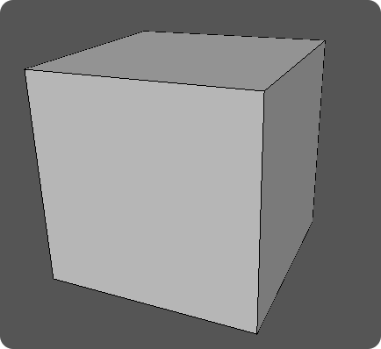

Shapes in NeXus
Based on Object File Format (OFF)
  Mesh based
  Supported by CAD software
  Supported by McStas
  Supported by Mantid
Location and Orientation are defined by existing NeXus descriptions
(stemming from the CIF conversion).

Slide 20
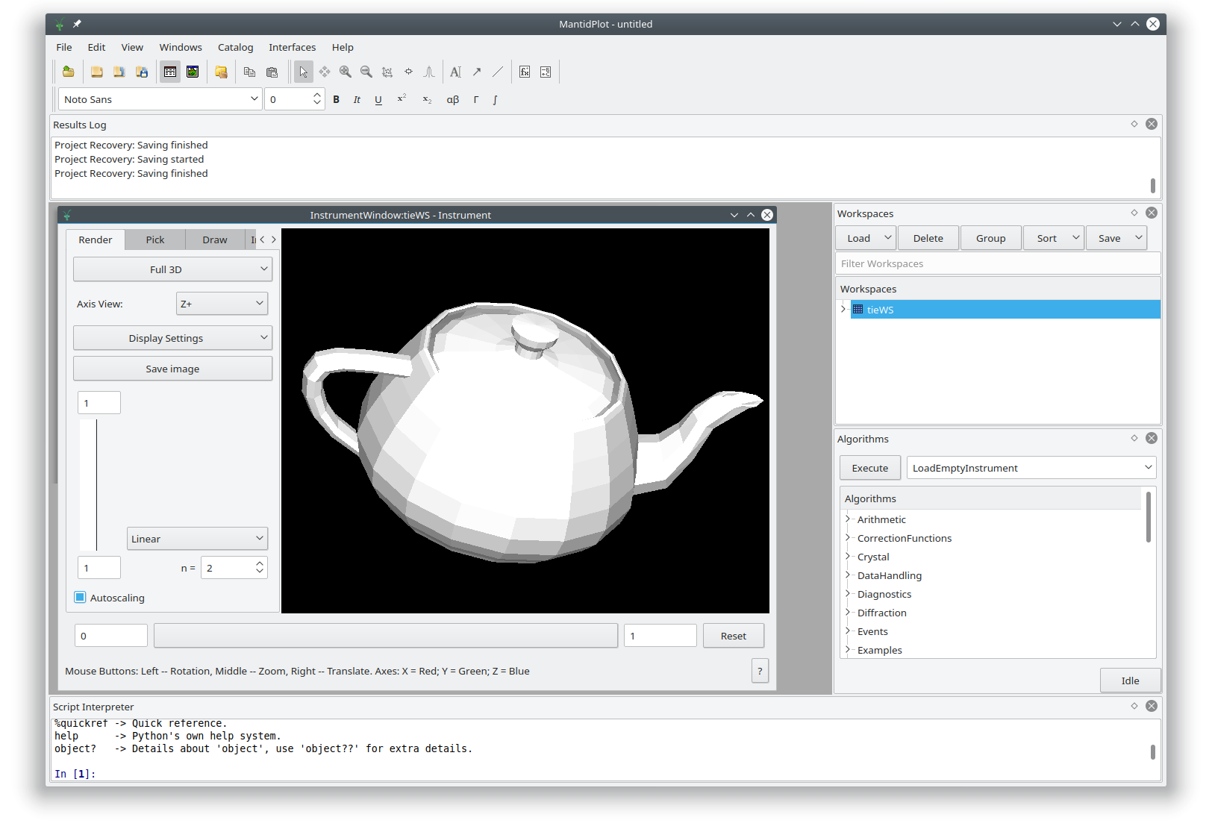

Display in Mantid

Slide 21
Life Cycle of NeXus
Techniques develop
Software becomes more specialised
Demands for storing a more accurate and complete experiment description increase
Hence:
  New Structures, Terms, or Rules get added to NeXus
  Others go out of fashion and may be removed
  Like software NeXus is not something that will be “finished”

Slide 22
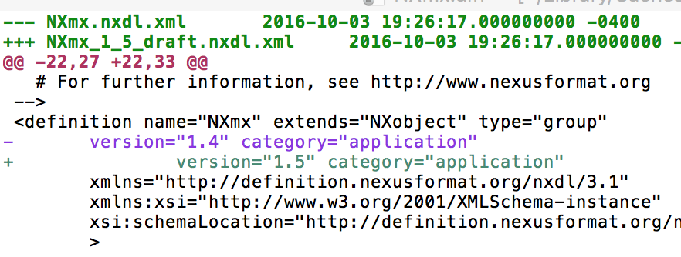
NeXus Versions and Validation
Version Control
  NeXus definitions always had that ✓
  Granularity has moved to
  repository-wide, not per definition,
  allows retrieving specific versions
  and the documentation for it ✓
Validation – cnxvalidate
  Better than just black/white, yes/no –
  provides helpful info messages and warnings ✓
  Still in progress:
  (soft) validation of base classes, support for versions

Slide 23
Get street creds with NeXus!
NXcite
NXcite informs the consumer of the file when using the data to cite the specified reference items like:
  instrument used
  detector
  special hardware
  DAQ application or readout chain
  processing algorithms
  calibration methods
  …
  Can be used for provenance and relationships.
NXcite should be found in every file.

Slide 24
Task 3.5: Meta Ontology for Catalogues
M1-M42
Extend NeXus metadata standards to enhance interoperability. For large parts of the PaN communities NeXus is the most commonly used file format. To explore relevant foreign datasets in the public domain, searches on the scientific metadata need to yield the correct results. Building search terms and keywords from the NeXus dictionary, would make use of the community buy in and expertise that went into this standard.
In this task we can add missing raw data definitions for raw data, as well as some for processed derived data. Working towards an Ontology will help harmonize processing codes between facilities.

Slide 25
Ontologies
What is an ontology?
How would we set one up?
What is it you would want to search for?

Slide 26




Get involved!
http://www.nexusformat.org
documentation - “wiki”
join the open Google Hangout
session twice a month
subscribe to the mailing list
https://github.com/nexusformat

Slide 27
NeXus
What is missing? For new facilities?
How can we make NeXus better?

Slide 28
NeXus example file collection
NeXus has one on Github.
It would help everyone to have a few more examples to look at.

Slide 29
Thank you.

Slide 30
Upcoming
Meeting in October close to the GA
At Elettra
Conflicts with RDA in Helsinki

Slide 31
Deliverables Tasks Milestones

Slide 32

No software needed?
There is need for a reference implementation and some generic tools, validation, …
NeXus has a ”new” validation tool based on libhdf5.
They main to maintain a repository for HDF5 compression filters.
https://github.com/nexusformat/HDF5-External-Filter-Plugins
Infrastructure for versioning of NeXus definitions and building documentation.

Slide 33
Project: Define Modular Content
Goal: finer granularity control for how information is stored in the file
Example: Incident wavelength spectrum on the sample could be encoded:
  as parameter of the source
  as parameter of the monochromator (if one exists)
  as property of incident beam on sample
This works a bit like a unit test for data.

