Slide 1
Recapture of CDR1 - TSS requirements - TSS CDR2
Mikael Olsson
Control Engineer
www.europeanspallationsource.se
8 April, 2019

Slide 2
TSS documentation map - CDR 2
Life-cycle process
Hazard analysis process
ESS-0041755
ESS classification
ESS-0016468
Categorization Monolith Events
ESS-0454232
ESS rules for I&C classification & design
ESS-0054158
Classification list ESS-0191808
KFM
TSS classification
ESS-0218018
Concept of operation ESS-0485264
P&ID
Installation plan
Concept
ESS-0037596
Hazard analysis overview
ESS-0050077
System requirements
ESS-0002776
Architecture ESS-0045067
System design ESS-0321310
Safety PLC function specification
ESS-0043617
Software test specification
Software test report
FAT specification
FAT report
Gateway PLC function specification
ESS-0464719
FIT specification
FIT report
Target Station
RSFs & DiD ESS-0050185
Accidents reports ESS-0040075
ESS-0044348
ESS-0050081
TSS trip limits ESS-0287373
ICD-R:s
ESS-0016380
ESS-0022915
ESS-0030063
ESS-0030068
ESS-0042356
ESS-0048755 ESS-0032009
ESS-0198545
ESS-0288103
FMEA
ESS-0047128
SAT specification
SAT report
SIT specification
SIT report
Prob. analysis
ESS-0052608
Electrical design (ePLAN)
V&V plan
ESS-0048372
Categorization Monolith Events
ESS-0454232
Instrumentation technical specification
Qualification report
Normal environmental conditions
ESS-0085658

Slide 3
From CDR1 - TSS functions
Radiation safety functions, identified in AAs | Class | Functions, not identified in AAs | Class
RSF-68: Target wheel rotational speed too slow | EICPA | Static permit beam (bypass) | EICPA
RSF-69: He pressure too low | EICPA | Manual operational (start/stop) | EIC0
RSF-70: Monolith vessel pressure too high | EICPA | Manual safety stop | EICPB
RSF-71: He inlet temperature too high | EICPA | Operational monitoring | EIC0
RSF-72: He mass flow too low | EICPA | Safety monitoring | EIC0

Slide 4
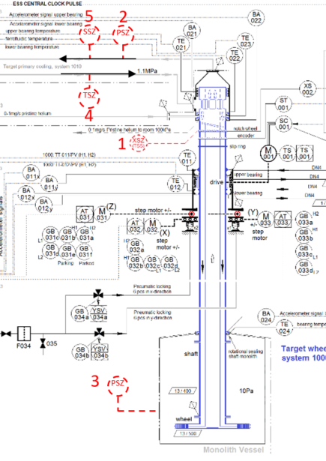
From CDR1 - TSS radiation safety functions
# | Function | Trip level | Trip time [s]
 | Prevent beam from hitting Target if…
1 | Target wheel rotational speed is … | < 9 rpm | 3
2 | He pressure is … | < 8 bar(a) | 25
3 | Monolith vessel pressure is … | > 0.5 bar(a) | 2.5
4 | He inlet temperature is … | > 70 $°$C | 25
5 | He mass flow is … | < 1.75 kg/s | 25

Slide 5
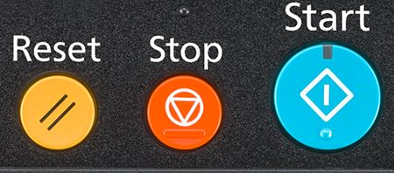
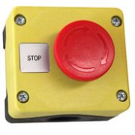
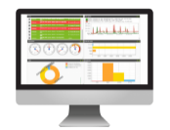
From CDR1 - TSS functions not identified in AAs
Static permit beam (bypass of Radiation safety functions)
static permit for beam production independent of the target mode, requires that beam is direct to dump
Accelerator Division requires beam production for maintenance purposes even when the target is not ready for beam
Manual operational start/stop
Start = intentional permit of beam production
Stop = set in safe state, for maintenance of TSS, periodic testing of TSS, planned downtime, etc
It is assumed that this function is used as part of a sequence of actions defined for operation of the facility
SSM condition C25 and 29
Manual safety stop
Emergency stop, in case of antagonistic event, loss of information in main control room, etc.
SSM deems that the operators shall be able to manually shut down with a safety system
Operational monitoring
provide TSS status and status history to the operator in the main control room
SSM condition C3 and C29
Safety monitoring
Provide critical TSS status to the operator in the main control room, during defense in depth L3
Monitored data may be a subset of “Operational monitoring”
May be used to initiate manual actions in the future (not yet credited)
SSM condition C3 and C29

Slide 6
From CDR1 - subset of constraint requirements
Redundancy, diversity, physical separation, functional separation
Passive solutions, fail-safe concept
Deterministic assessment of reliability
Probabilistic assessment of reliability (PFD 10⁻⁴)
IEC 61226, 61513: system design
IEC 61511: probabilistic assessment

Slide 7
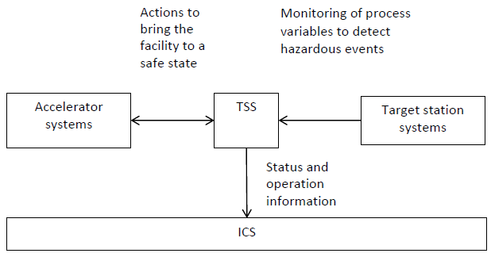
From CDR1 - Conceptual TSS architecture, basic interfaces
ESS-0037596, TSS concept
Critical process values are monitored and evaluated continuously, from the target station systems
Actuation at the Ion source and the RFQ in the Accelerator
Control and monitoring of beam direction to bypass TSS RSFs
Information of TSS status to operator in the Main control room
Benefit ICS infrastructure
Fail-safe concept
Loss of power or communication will lead to actuation
Securing beam to dump
, Main control room

