Slide 1
TSS System Architecture ESS-0045067 - TSS CDR2
Mikael Olsson
Control Engineer
www.europeanspallationsource.se
8 April, 2019

Slide 2
TSS System Architecture - agenda
Scope and purpose
Architecture
Layout and physical separation
Summary

Slide 3
Scope and purpose

Slide 4
TSS architecture - scope and purpose
Scope:
IEC 61513, 3.27: To define organisational structure of the system
main functions, class, subsystems, interconnections between subsystems, independence between subsystems, priority, voting, HMI
Purpose:
The purpose is to contribute to further detailed design, such as instrumentation, choice of components, electrical design, application software design, etc.

Slide 5
Architecture

Slide 6
TSS architecture - overall architecture
Other systems
Operation & monitoring - software based
Start
Operational system - class EIC0
Radiation safety system - class EICPA or EICPB
Safety logic - hardware based
Safety actuators
Safety sensors
Safety logic – software based

Slide 7
TSS architecture - radiation safety function
One radiation safety function
A
B
C
Sensors
– hardware based train
– software based train
Diverse equipment
Communication and 2oo3 voting
Actuation (trip)
A3 (RFQ)
A4 (RFQ)
A1 (ion)
A2 (ion)

Slide 8
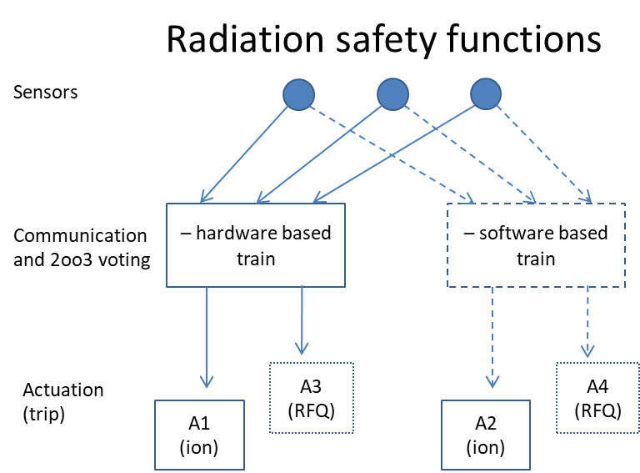
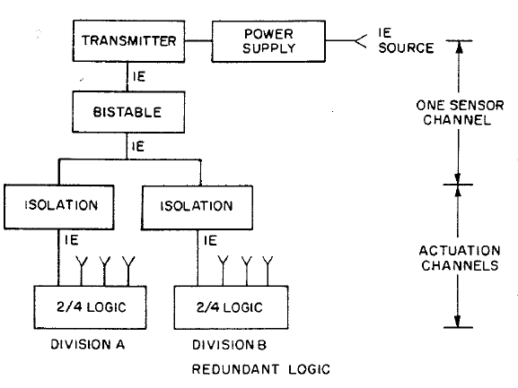
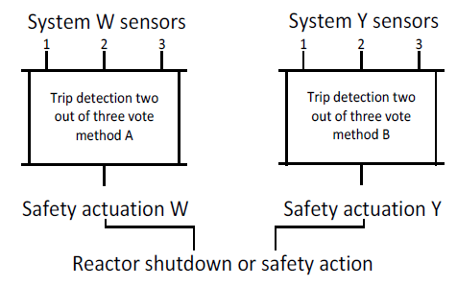
TSS architecture - radiation safety function
Sharing sensors
IEEE 384 ‘Independence of Class 1E’,
7.2.1: “Electrical isolation methods shall be used as required in instrumentation and control circuits to maintain the independence of redundant circuits”
7.2.2: “acceptable isolation devices … relays, fiber optic, circuit breakers…”
IEC 62340 ‘NPP coping with CCF’,
7.1: “I&C systems perform their safety functions independently if a postulated failure of one of these I&C systems does not prevent the other systems from performing their functions as intended”
2oo3 voting, two trains
IEC 61513 ‘NPP general requirements’, Annex C, Example 5
“typical situations” which has “low potential causes of CCF”.
“diverse protection functions”
“two different systems”
“Different (diverse) actuation systems”
IEC 62340 ‘NPP coping with CCF’, 5.2
“For I&C systems that perform category A functions the appropriate application of redundancy combined with voting mechanisms has been proven to meet the single failure criterion. This design ensures that the likelihood of a failure of such I&C systems is very low.”

Slide 9
TSS architecture - radiation safety function
Several radiation safety functions
A
B
C
Target wheel rotation
He pressure
Sensors
Monolith pressure
He temperature
Diverse equipment
He mass flow
5
5
5
Communication and 2oo3 voting
– hardware based train
– software based train
Actuation (trip)
A3 (RFQ)
A4 (RFQ)
A1 (ion)
A2 (ion)

Slide 10
TSS architecture - manual stop
Manual stop
Manual stop control
Monitoring and communication
– hardware based train
– software based train
Diverse equipment
A3 (RFQ)
A4 (RFQ)
Actuation (trip)
A1 (ion)
A2 (ion)
Note, both ‘manual safety stop’ and ‘manual operational stop’ are designed this way

Slide 11
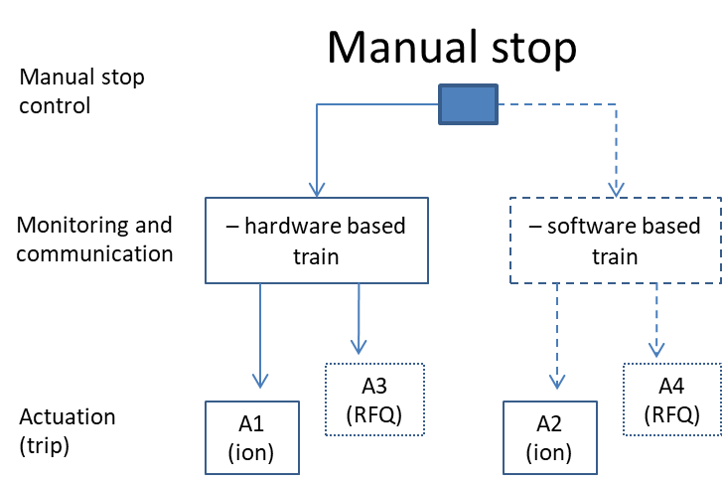
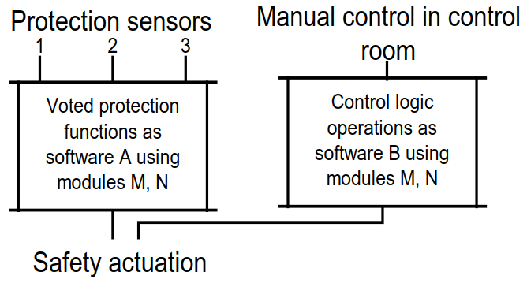
TSS architecture - manual stop
IEC 61513 ‘NPP general requirements’, Annex C, Example 3
“typical situations” which has “low potential causes of CCF”.
Manual control:
“manual control acting downstream of voter” as defence against “A failure in the two out of three voting”
“same protection action”

Slide 12
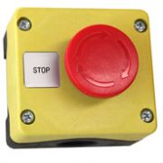
TSS architecture - bypass function
Bypassing five radiation safety functions that monitor target system parameters, and replacing them with a new radiation safety function that prevents the beam from going to the target.
- Disconnect dipole magnet electrical supply
- Disconnect dipole magnet electrical supply
- Switch at ion source
- Switch at RFQ
1
2
3
4
4
1
2
3
Position feedback
Redundant means to direct beam to dump
Diverse setting (confirmation)
All conditions fulfilled?
Helium massflow
Helium pressure
Helium temperature
Wheel speed
Monolith pressure
If YES: override with beam permit
A
A
A
A
A
2oo3
B
B
B
B
B
C
C
C
C
C

Slide 13
TSS architecture - bypass
Bypass
Diverse equipment
Bypass control
No real support in standards how to organise/arrange bypass elements
IEC 61226, 7.3.2.1
“Testing may require suppression of output signals, or the provision of bypass facilities”.
IEC 61511, 11.7.1.2
“… minimize … the need to bypass the system while the unit is running”.
“… facilities for protection against operator error”.
Monitoring, 4oo4 evaluation and communication
– hardware based train
– software based train
Actuation (bypass)
A3 (RFQ)
A4 (RFQ)
A1 (ion)
A2 (ion)

Slide 14
TSS architecture
RFQ power
Ion source power
TSS
Helium pressure
Wheel speed
Helium mass flow
Helium temperature
Monolith pressure
Manual safety stop
Manual operational stop
A
Relay PLC
Relay train
2oo3
Actuator 1
B
Relay PLC
Channel
Actuator 3
C
Relay PLC
Bypass
Manual operational stop
Safety PLC train
Actuator 4
Manual safety stop
5
2oo3
Manual operational stop
5
Bypass
Manual safety stop
Actuator 2
5
Target wheel
Dipole magnet
Beam dump
Proton beam
RFQ
Ion source
Machine protection
Basic process control system

Slide 15
TSS architecture - operational system
Monitors status of components in the radiation safety system
GUI, alarm handling, manual start, communication to other systems
Software based (PLC system with distributed I/O:s)
Separate cables and control components
Does not include redundancy or diversity
Electrically isolated from the radiation safety system
No impact on the radiation safety system
Cannot prevent radiation safety functions
Cannot prevent manual stop
Cannot affect bypass
Cannot generate a spurious trip
Note, ‘manual operational stop’ is performed by the radiation safety system, due to availability

Slide 16
TSS architecture - basic state machine
No beam
Beam allowed
Beam production prevented by TSS
Beam production allowed by TSS
Manual start
Bypass
Manual operational stop
Manual safety stop
Any bypass condition not fulfilled
All bypass conditions fulfilled
2oo3 channels trip
No Bypass

Slide 17
Layout and physical separation

Slide 18
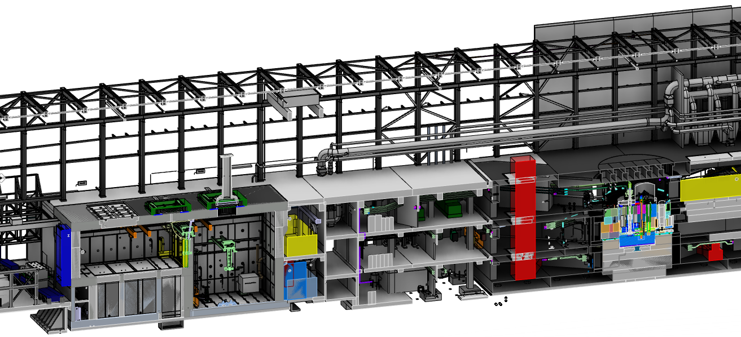
TSS layout - Target utility area
Relay 2oo3
Actuators
Ion source and RFQ
PLC 2oo3
TSS room #1

Slide 19
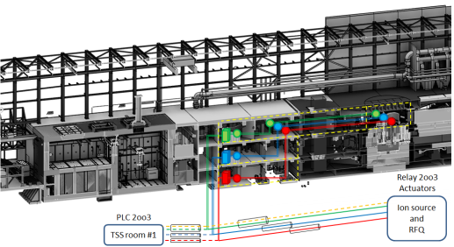
TSS layout - Target utility area – separation
TSS separation
IEC 60709, IEEE 384: “Hazard area”
Copper cables
Redundant cables in separate metallic pipes
Redundant control cabinets on separate levels (fire zones)
Functions/sensors in separate areas (fire zones)
IEC 60709:
“for plant failure and external failure events … greater physical separation [than 30 cm horizontal, 80 cm vertical] including barriers and/or safety structures shall be applied.”
“For lesser separation distances [than 30 cm horizontal, 80 cm vertical] in hazardous areas, the degree of hazards (such as size of the fire or pipe break) and mitigating measures (such as sprinklers) should be considered”.
IEEE 384:
“Hazard area”: “Protection … shall be accomplished by the use of barriers, restraints, separation distance, or appropriate combination thereof.”

Slide 20
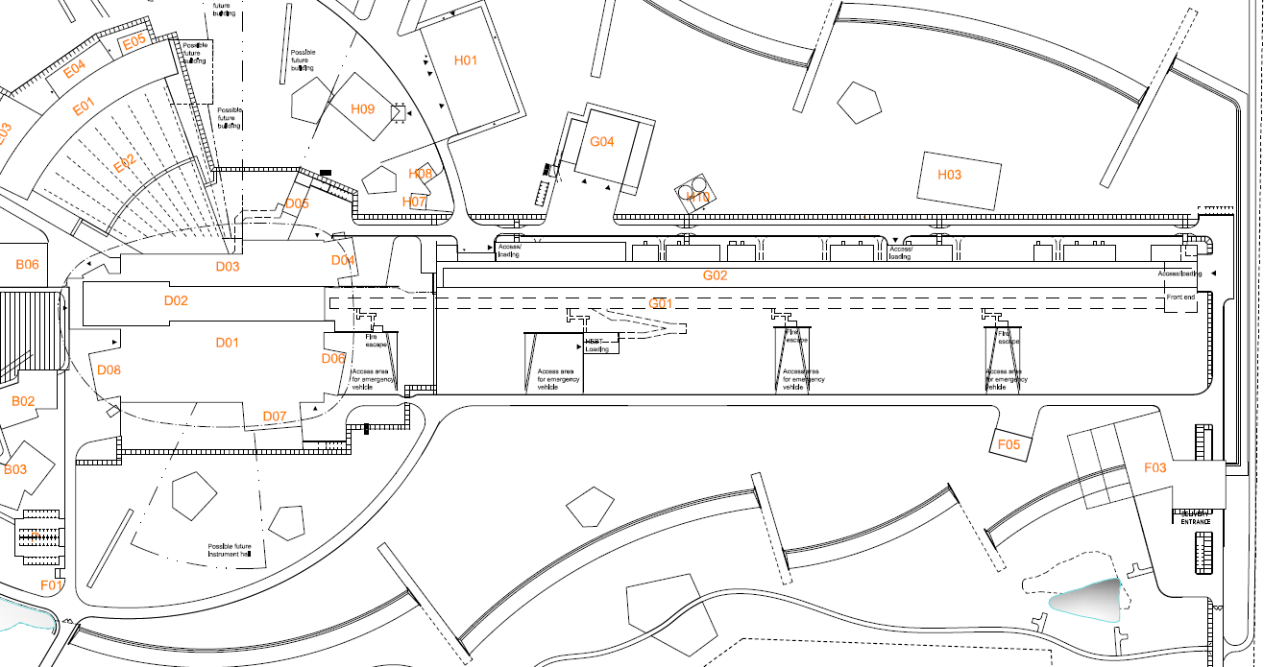
TSS layout - ESS facility
MCR - manual stop
Target buidling
Klystron gallery (G02)
Front end building
TSS #1 - PLC 2oo3
Target utility block
Dipole magnet
RFQ - Relay 2oo3
Ion source - Relay 2oo3
Relay system cables
Safety PLC system cables

Slide 21
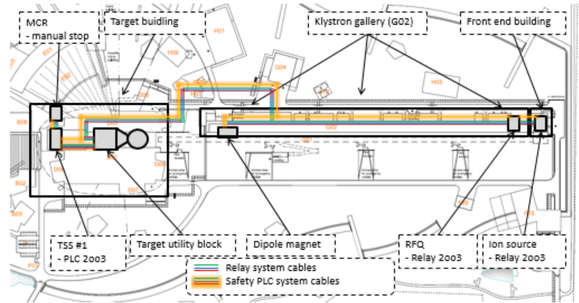
TSS layout - outside Target utility area - separation
TSS separation
IEC 60709, IEEE 384: “Nonhazard area”
Fiber cables
Redundant cables in separate metallic pipes
>0.1 m between metallic pipes
Routed in same area (fire zone)
IEC 60709:
“redundant groups … separate cable routes”
If less separation than 30 cm (horizontal) and 80 cm (vertical), then “enclosed raceways that qualify as barriers” shall be used
IEEE 384:

Slide 22
TSS layout - separation - conclusions
Target utility area is considered as a “Hazard area”
Possible events that cause accidents, or are consequences of accidents, that demand TSS to work
Strong physical separation
Areas outside Target utility area are considered as “Nonhazard areas”
No event that causes accidents, or is consequence of accidents, that demand TSS to work
Less physical separation
According to standards

Slide 23
Summary

Slide 24
TSS architecture - RFPD consideration
Redundancy
2oo3 of sensors, two communication and voting systems (trains), four actuators, two actuation locations (ion source and RFQ)
Diversity
Different functions (T_{He}, P_{He}, P_{M}, ṁ, ω), different types of communication, different voting systems (hardware and software based), different types of actuators
Functional separation
Electrical isolation between radiation safety system and operational system
Electrical isolation between the trains
Electrical isolation between the channels
Physical separation
Channels in separate cable paths, even at separate levels inside Target utility area
The level of RFPD to withstand independent failures and external events is assessed by the TSS FMEA.
We feel confident when entering the assessment phase…

Slide 25
TSS system architecture
Thank you!

