Slide 1
TSS Failure Mode Effects Analysis (FMEA) ESS-0275671 and ESS-0047128 - TSS CDR2
Mikael Olsson
Control Engineer
www.europeanspallationsource.se
8 April, 2019

Slide 2
TSS FMEA - agenda
Purpose
Independent single failure criteria
Fail-safe concept
Failure and Failure effect
Assumptions
Conclusions

Slide 3
TSS FMEA - purpose
Deterministic analysis of reliabilty (SSM, D1):
“Deterministic … methods shall be used to analyse and evaluate the … facility’s ability to fulfil the fundamental safety functions”.
Independent single failure (SSM, E10)
“… the most adverse single failure shall be applied in the safety group. A single failure in active structures, systems, and components shall be applied at the most adverse time.”
Independent common cause failure (SSM, E11)
“… common cause failures in a safety group shall be applied instead of a single failure, in the same way as in Condition E10 …”
IEC 61226 recommends FMEA to analyze Cat A systems
Independent failure in combination with external event

Slide 4
TSS FMEA - independent single failure criteria
SSM conditions (C22 ‘Intake state during failures’, guiding support doc)
“Absolute reliability of individual SSC important to safety can never be obtained” and “Failures will always be able to occur”
SSM conditions (C18 ‘Resistance to single failures’, guiding support doc)
“The key words here are ‘independent/unforeseen’, implying that the additional failure is not a direct result of the occurred event, or alternatively a failure that has not been possible to anticipate, or has been missed”
IEC 61513 (single failure criterion, 3.20, 3.21, 3.49, 3.50)
Criterion = “…must be capable of performing its safety task in the presence of any single failure”
Single failure = “…loss of capability of a component to perform its intended safety function”
IAEA NS-R-1 (‘Safety of NPP: design’)
“At no point in the single failure analysis is more than one random failure assumed to occur.”
“Spurious action shall be considered as one mode of failure when applying the concept [single failure criteria] to a safety group or system.”
IEEE 379 (‘IEEE Standard Application of the Single-Failure Criterion to Nuclear Power Generating Station Safety Systems’)
“The safety systems shall perform all required safety functions for a design basis event in the presence of the following: […] a) Any single detectable failure within the safety systems”
“detectable failures = Failures that can be identified through periodic testing or that can be revealed by alarm or anomalous indication”

Slide 5
TSS architecture - fail-safe concept
Each active component in the TSS has a predefined “acceptable mode for safety” in case of failure, that actuates a trip of a channel or the complete system.
Sensors
Predefined safe mode in case of loss of power
Indicate trip = safe mode
Hardware based train (relay)
Relays: predefined safe mode in case of loss of control signal.
Fiber communication modules: predefined safe mode of outputs to actuators in case of loss of power or loss of communication
Software based train (PLC)
Predefined safe mode of outputs to actuators in case of loss of power or loss of internal communication
Actuators
Predefined safe mode in case of loss of control signal
Must receive an active/continuous control signal in order to allow beam production

Slide 6
TSS FMEA - failure
Sensor (pressure) | Process status
Sensor reply | Pressure OK | Pressure NOK
Pressure OK |  | Most severe
Pressure NOK (safe mode) | Spurious trip
Actuator | Requested action
Performed action | Close power circuit | Open power circuit
Close |  | Most severe
Open (safe mode) | Spurious trip
2oo3 voting | Channel trip status (input)
Voting result (output) | 0oo3 | 1oo3 | 2oo3 | 3oo3
No trip
Trip (safe mode)

Slide 7
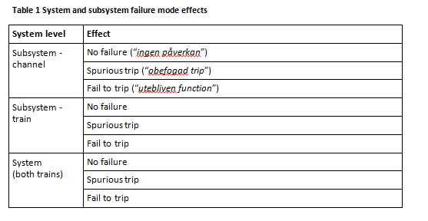
TSS FMEA - failure effect
Potential failure effects on the system

Slide 8
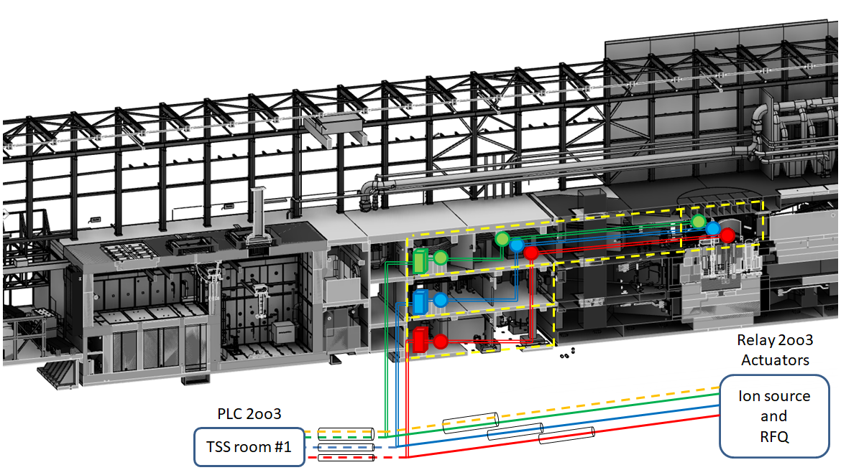
TSS FMEA - assumptions
The H3 fire is the facility internal event that demands the TSS.
It is assumed that other facility internal events (e.g. missiles, pipe failures, as exemplified in IEEE 384) are covered by the H3 fire.
The fire takes place in Target utility area, and leads to an accident that demands the TSS
or the H3 fire is a consequence of such accident
The fire affects only one area (fire zone).
The fire eliminates all TSS components in the area (fire zone)
i.e. they cannot perform their safety function.
The fire does not affect the TSS sensing lines in a negative way from safety point of view.
A fire in any other area (i.e. outside Target utility area) could affect TSS components in those areas, but does not demand the TSS.

Slide 9
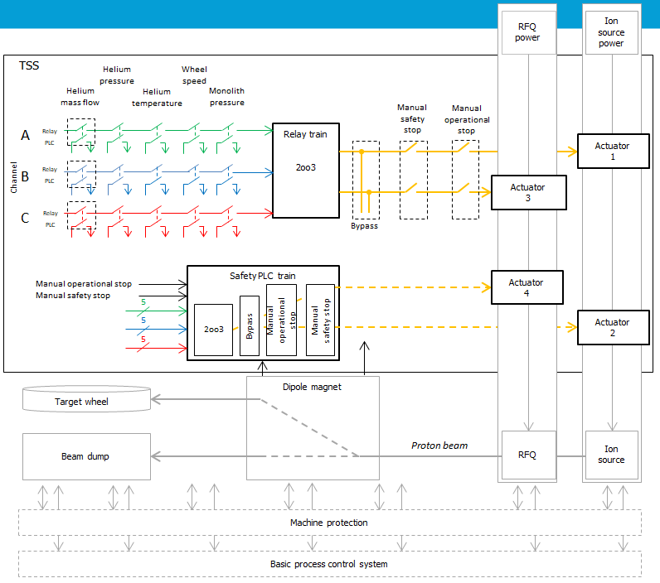
TSS FMEA - procedure
Identify critical components
Identify failures
Analyze effects of independent failures
Apply independent SF/CCF
Combine with H3 fire
Identify protection measure (if needed)
Analyze effects after protection measure
Conclude

Slide 10
TSS FMEA - details in Excel

Slide 11
TSS FMEA - conclusions (independent failure)
In general the design of the system includes both redundancy, functional separation between redundant parts, and diversity to prevent loss of function due to an independent failure.
Redundant sensors and cable paths for each safety function
Resistance to SF of the sensors
Diverse safety functions (primary and secondary function)
Resistance to CCF of the sensors
Diverse 2oo3 voting system (different technology)
Resistance to SF and CCF of the voting, and the associated communication equipment
Diverse actuators (different technology)
Resistance to SF and CCF of the actuators

Slide 12
TSS FMEA - conclusions (independent failure + fire)
Most severe
Fire zone: Connection cell or Utility area level 115
SF/CCF: Sensors
Demanded safety function due to the fire
‘Target rotational speed’ (connection cell)
All channels eliminated
One diverse function is needed to withstand fire + SF
Two diverse functions are needed to withstand fire + CCF
‘He inlet temperature’ (utility area)
All channels eliminated
Two diverse functions are needed to withstand fire + SF/CCF
‘He mass flow’ (utility area)
One channel eliminated
One diverse function is needed to withstand fire + SF/CCF
‘He inlet temperature’ must not be defined as the diverse function
‘He pressure’, ‘Monolith pressure’
Same as He mass flow

Slide 13
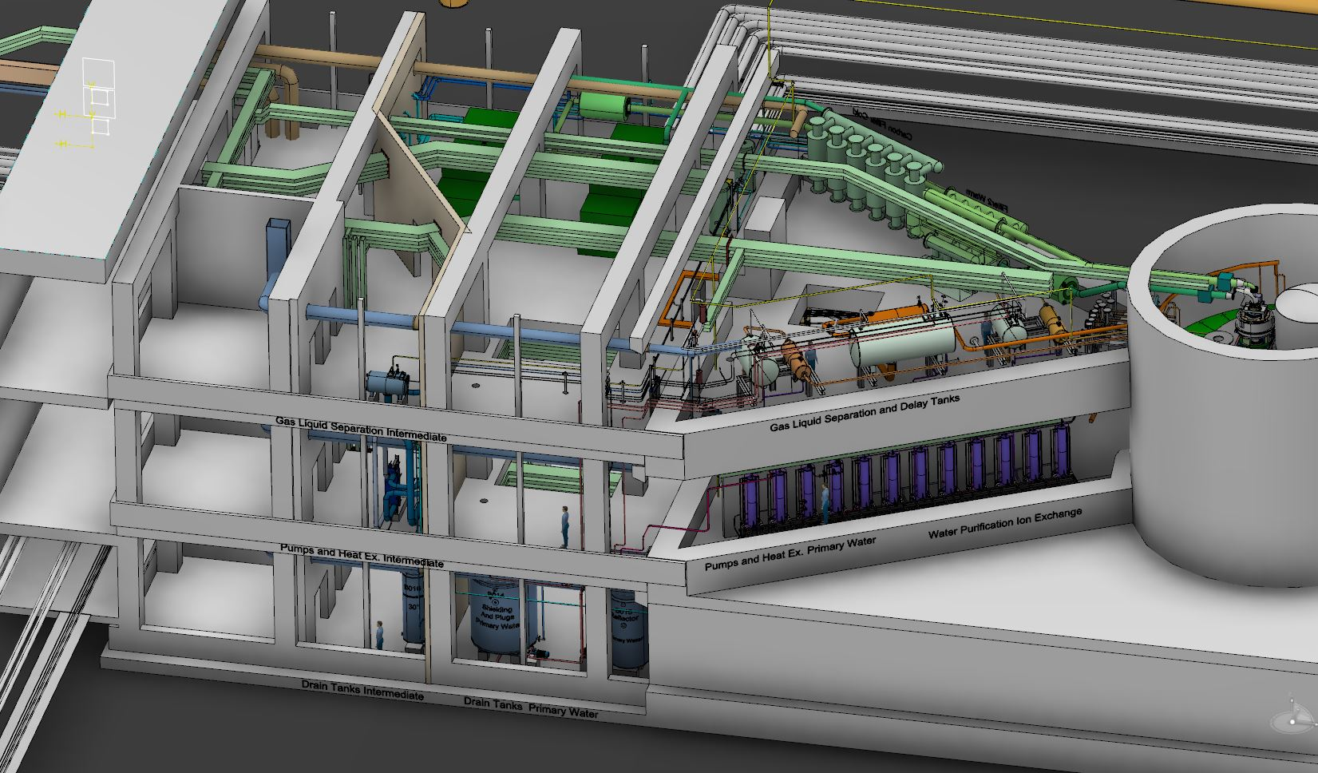
TSS FMEA - Diverse functions (draft)
Postulated Initiating Event | Detection Parameter (C.20)
Helium compressor stop | F_{He}⬇ P_{He} ⬇ P_{M} ⬆
Heat exchanger malfunction or loss of cooling by intermediate system | T_{He} ⬆ P_{He} ⬇ P_{M} ⬆
Helium pressure control malfunction, isolation of cooling system by valve closing | P_{He} ⬇ P_{M} ⬆
Power outage | F_{He}⬇ T_{He} ⬆ P_{He} ⬇ P_{M} ⬆
Large leakage – in monolith (AA4) | F_{He}⬇ P_{He} ⬇ P_{M} ⬆
Large leakage – utility room (AA8) | F_{He}⬇ P_{He} ⬇
Failure in process control system | F_{He}⬇ T_{He} ⬆ P_{He} ⬇ P_{M} ⬆
Operator error | F_{He}⬇ T_{He} ⬆ P_{He} ⬇ P_{M} ⬆
Leak between helium and intermediate water system (AA7) | F_{He}⬇ P_{He} ⬇
Large bypass in target wheel (AA5) | Target shroud remains intact – no release
Methods of detection are identified to cover all event initiators
He Temperature (T_{He})
He Pressure (P_{He})
He Flow (F_{He})
Monolith Pressure (P_{M})
13
13

Slide 14
TSS FMEA
Thank you!

